Slide 1
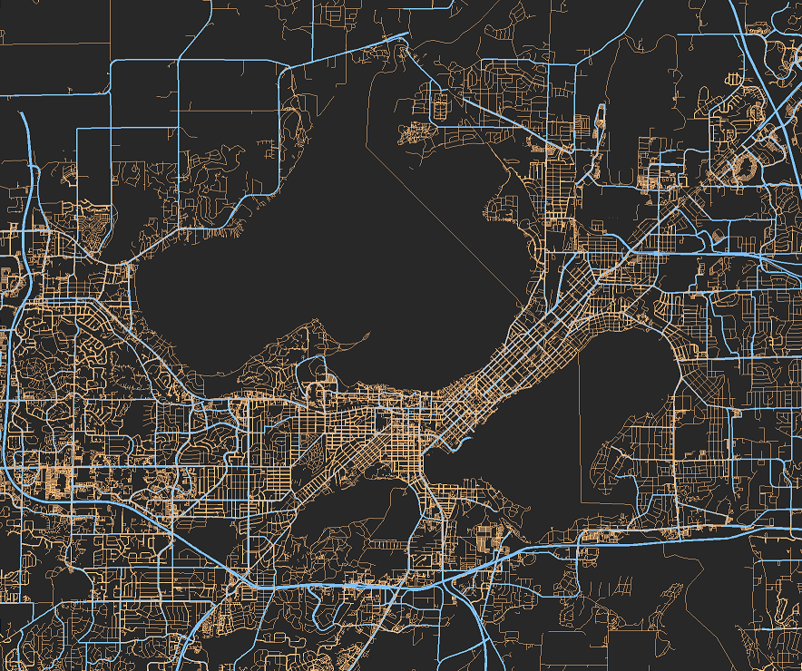
Madison, Wisconsin
43.015°N / 89.529°W

Slide 2
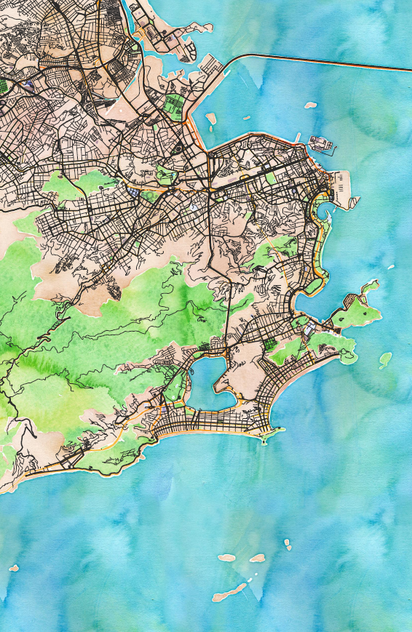
Rio de Janeiro, Brasil
23.051°S / 43.282°W

Slide 3
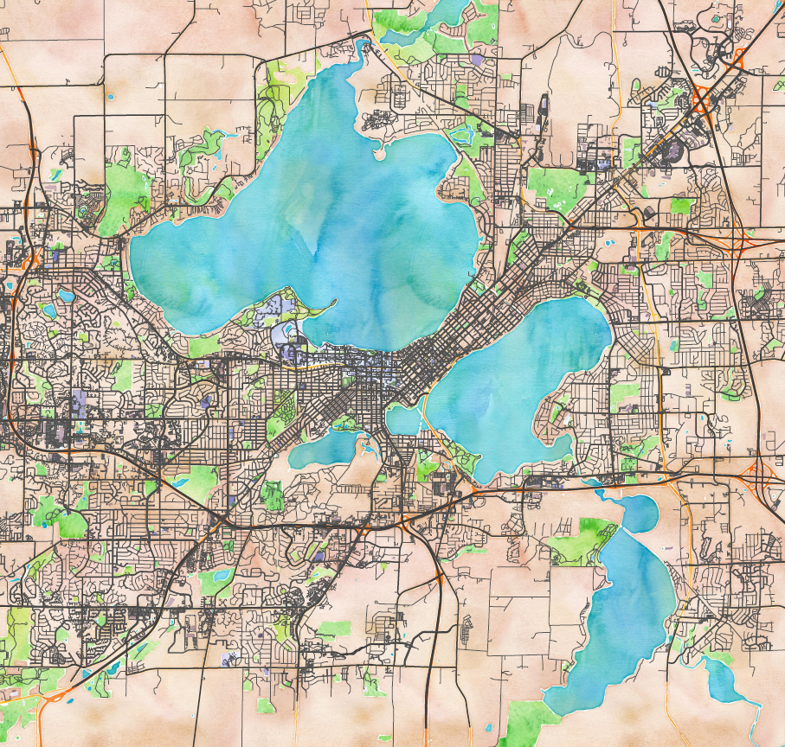
Madison, Wisconsin
43.015°N / 89.529°W

