Slide 1
Transformers and Attention
Eric Keilty

Slide 2
Natural Language Processing
High-Level Goal: get a computer to understand human language
Focused Goal for this presentation: Machine Translation
Get a computer program to convert English text to French text

Slide 3




Recurrent Neural Network
Idea: Give the model memory
Do this by maintaining a hidden state, which is passed into the next iteration of the model
naturel
langage
traitement
RNN
Cell
$${\vec{H}}_{1}$$
RNN
Cell
$${\vec{H}}_{2}$$
RNN
Cell
Initialized randomly
$${\vec{H}}_{0}$$
$${\vec{H}}_{3}$$
natural
language
processing

Slide 4
Bidirectional RNN
Idea: processes the entire sentence before giving any outputs
Do this by having a forward pass and then a backward pass
<SOS> traitement langage naturel <EOS>
Linear Layer
Forward-pass RNN
Backward-pass RNN
<SOS> natural language processing <EOS>
<EOS> processing language natural <SOS>

Slide 5
















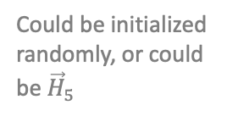




<SOS>
traitement
langage
naturel
<EOS>
Linear Layer
Linear Layer
Linear Layer
Linear Layer
Linear Layer
$${\vec{H}}_{1}$$
$${\overset{⃖}{H}}_{1}$$
$${\vec{H}}_{2}$$
$${\overset{⃖}{H}}_{2}$$
$${\vec{H}}_{3}$$
$${\overset{⃖}{H}}_{3}$$
$${\vec{H}}_{4}$$
$${\overset{⃖}{H}}_{4}$$
$${\vec{H}}_{4}$$
$${\overset{⃖}{H}}_{4}$$
B-RNN
Cell
B-RNN Cell
B-RNN
Cell
B-RNN
Cell
B-RNN
Cell
$${\overset{⃖}{H}}_{0}$$
$${\overset{⃖}{H}}_{2}$$
$${\overset{⃖}{H}}_{3}$$
$${\overset{⃖}{H}}_{4}$$
$${\overset{⃖}{H}}_{4}$$
$${\vec{H}}_{0}$$
B-RNN
Cell
B-RNN
Cell
B-RNN
Cell
B-RNN
Cell
B-RNN
Cell
$${\vec{H}}_{1}$$
$${\vec{H}}_{2}$$
$${\vec{H}}_{3}$$
$${\vec{H}}_{4}$$
Initialized
randomly
Could be initialized randomly, or could be ${\vec{H}}_{5}$
<SOS>
natural
language
processing
<EOS>

Slide 6
Seq2Seq RNN
Idea: use a generative model, i.e. encoder/decoder architecture, to allow for arbitrary output sequence lengths
<SOS> traitement langage naturel <EOS>
Code Vector
Encoder
Decoder
<SOS> natural language processing <EOS>

Slide 7







Seq2Seq RNN
The Hidden States are also called Context Vectors or Annotation
$${\vec{H}}_{0}$$
$${\vec{H}}_{1}$$
$${\vec{H}}_{2}$$
$${\vec{H}}_{3}$$
$${\vec{H}}_{4}$$
${\vec{H}}_{5}$ = Code Vector
Encoder
Cell
Encoder
Cell
Encoder
Cell
Encoder
Cell
Encoder
Cell
<SOS>
natural
language
processing
<EOS>
traitement
du
langage
naturel
<EOS>
${\vec{H}}_{5}$ = Code Vector
Decoder
Cell
Decoder
Cell
Decoder
Cell
Decoder
Cell
Decoder
Cell
<SOS>

Slide 8
Seq2Seq + Attention
The previous architecture had a context length of 1, since we only gave the decoder the final hidden state of the encoder
Instead, we can pass in a weighted sum of all encoder hidden states (annotations), called Attention
The attention weights, in principle, should correspond to how important each annotation is in deciding the next state
Attention weights are computed using an alignment model which scores how well the inputs and outputs match

Slide 9
Seq2Seq + Attention
traitement du langage naturel <EOS>
Decoder
Contexts
Attention
Annotations
Annotations
Encoder
<SOS> natural language processing <EOS>

Slide 10










Seq2Seq + Attention
$${\vec{H}}_{1}$$
$${\vec{H}}_{2}$$
$${\vec{H}}_{3}$$
$${\vec{H}}_{4}$$
$${\vec{H}}_{0}$$
Encoder
Cell
Encoder
Cell
Encoder
Cell
Encoder
Cell
Encoder
Cell
$${\vec{H}}_{5}$$
<SOS>
natural
language
processing
<EOS>
annotations
$${\vec{H}}_{0},{\vec{H}}_{1},…,{\vec{H}}_{5}$$
$$α_{0}, α_{1}, …,α_{5}$$
attention weights
output
Attention model
$$\vec{c}= \sum{α_{i}{\vec{H}}_{i}}$$
context vector
Decoder
Cell
$${\vec{H}}_{d}$$
Decoder
Cell
input
output

Slide 11
Problems with RNNs
Exploding / Vanishing Gradient Problems
This is solved with LSTMs and Residual Blocks
Performance decreases as sequences get larger due to long-term dependencies, since each RNN cell only has access to the previous hidden state
This is solved with Attention
Due to RNNs sequential nature, they cannot model dependencies among the inputs themselves or among the outputs themselves
“She is taller than me” vs “I have no choice other than to do this”. The meaning of the word ‘than’ is dependent on the entire sentence
This is solved with Multi-Head Attention

Slide 12
Problems with RNNs
There is a bottleneck of information. All information must be represented by the code vector between the encoder and decoder.
It was famously said at the ACL 2014 workshop: “You can’t cram the meaning of a whole %&!$# sentence into a single $&!#* vector!”
This is solved with Transformers
Due to the sequential nature of RNNs, backprop is not computationally efficient nor parallelizable, so they are slow on GPUs
This is solved with Transformers

Slide 13
What Exactly is a Transformer?
Idea: Instead of going left-to-right through a sentence, give the encoder/decoder the entire input sequence all at once
In essence, a transformer is a set of encoders and decoders stacked on top of each other, which utilize attention in some way (usually Multi-Head Attention)
Encoder
Decoder
inputs
outputs

Slide 14
Transformer Workflow: The Encoder
P1, P2, P3, P4, P5
Encoded Vectors
Positional Embeddings
E1, E2, E3, E4, E5
Word Embeddings
<SOS> natural language processing <EOS>

Slide 15
Transformer Workflow: The Decoder
traitement
Output:
traitement
Encoded Vectors
No input

Slide 16
Transformer Workflow: The Decoder
du
Output:
traitement du
Encoded Vectors
traitement

Slide 17
Transformer Workflow: The Decoder
langage
Output:
traitement du langage
Encoded Vectors
traitement du

Slide 18
Transformer Workflow: The Decoder
naturel
Output:
traitement du langage naturel
Encoded Vectors
traitement du langage

Slide 19
Transformer Workflow: The Decoder
<EOS>
Output:
traitement du langage naturel <EOS>
Encoded Vectors
traitement du langage naturel

Slide 20
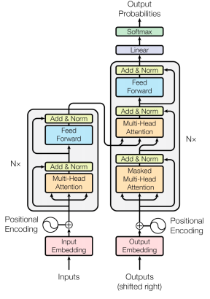
Attention Is All You Need
outputs
inputs
Right-shifted outputs

Slide 21
Multi-Head Attention
The attention mechanism is used as a way for the model to focus on relevant information based on what it is currently processing
Based on the query and the key, we calculate the attention weights compared to the values
Query: current state being processed
Keys/Values: input sequence
The Key/Value/Query terminology comes from retrieval systems (like a search engine). Here attention is being thought of as a retrieval process where we are searching through the input sentence to find the most relevant parts for the generation of the next word

Slide 22
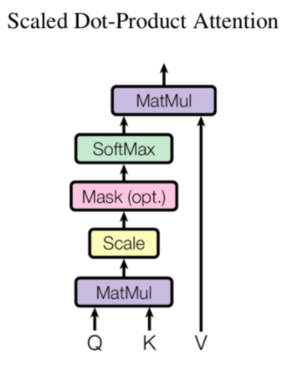
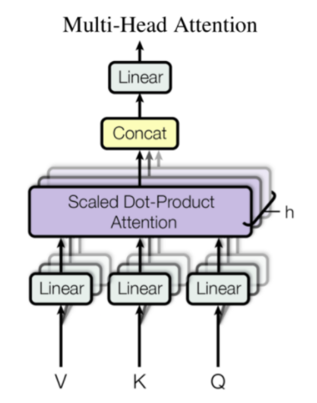
Multi-Head Attention
h = hidden size
(which is a hyper-parameter, and can be any value)

Slide 23
Attention: The Encoder
K = V = {<SOS>, natural, language, processing, <EOS>}
Attention(<SOS>, K, V) = C1
Attention(natural, K, V) = C2
Attention(language, K, V) = C3
Attention(processing, K, V) = C4
Attention(<EOS>, K, V) = C5
context vectors
<SOS> natural language processing <EOS>
This is called Self-Attention because the queries are from the same sequence as the keys/values

Slide 24
Attention: The Decoder
This is called Masked Attention because we do not give the decoder the entire target sequence, only what has been previously generated
K = V = {traitement, du, langage}
Encoded Vectors
Attention(traitement, K, V) = C1
Attention(du, K, V) = C2
Attention(langage, K, V) = C3
traitement du langage
This is called Self-Attention because the queries are from the same sequence as the keys/values

Slide 25
Attention: The Decoder
K = V = {Encoder Output}
Attention(traitement, K, V) = C1
Attention(du, K, V) = C2
Attention(langage, K, V) = C3
Encoder Output
traitement du langage

Slide 26
Appendix

Slide 27


The Positional Encodings
Goal is to provide information about where in the sentence the word vectors are located. This is to make up for the fact the model has no recurrence
The original paper “Attention Is All You Need” notes they also tried learned positional encodings, but they produced nearly identical results
p^{th} word embedding = input_embedding + positional_encoding(p)
PE(pos, 2i) = $\sin\left(\frac{pos}{{10,000}^{2i/d_{model}}}\right)$
pos = position in sentence
PE(pos, 2i+1) = $\cos\left(\frac{pos}{{10,000}^{2i/d_{model}}}\right)$
i = index in input_embedding

Slide 28
The Feed Forward Layer
Two Linear Layers with a ReLU activation between
One important thing to note is the skip connection, also called a Residual Block
This helps with the problem of vanishing gradients as the original input x skips the sublayer. This is done for every sublayer, thus acts as a giant skip connection directly to the output
y = Layer Norm( x + Sublayer(x) )

Slide 29
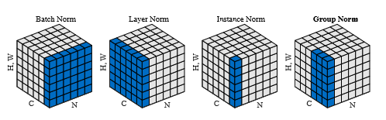
Layer Normalization
Layer Normalization is simply the transposition of Batch Normalization. Instead of normalizing across a batch, it normalizes within a batch
This type of normalization is much easier to theoretically analyze and has been empirically shown to stabilize hidden states
See the original paper here: https://arxiv.org/pdf/1607.06450.pdf

Slide 30

Additive Attention Formulas
c_{t}
Dot Product
$${\tilde{α}}_{i}^{(t)}=Linear( ReLU\left( Linear\left( concat\left(Q_{t}, K_{i}\right) \right) \right) )$$
$${ α}_{i}^{(t)}=Softmax({\tilde{α}}_{i}^{\left(t\right)})$$
$$c_{t}={\left(α_{i}^{(t)}\right)}^{T}V$$
Softmax
Linear
ReLU
Linear
Concat
Q
K
V

Slide 31

Scaled Dot Attention Formulas
$${\tilde{α}}_{i}^{(t)}=f\left(Q_{t}, K_{i}\right)=\frac{{Linear\left(Q_{t}\right)}^{T}Linear\left(K_{i}\right)}{\sqrt{d}}$$
$${ α}_{i}^{(t)}=Softmax({\tilde{α}}_{i}^{\left(t\right)})$$
$$c_{t}=\sum_{i=1}^{T}{{\left(α_{i}^{\left(t\right)}\right)}^{T}Linear(V)}$$
Including masks in a particular way gives Causal Dot Attention

