Slide 1
Project 1: Web server with orm backend
Evan K / Patricia M / Mohamed S / John D

Slide 2

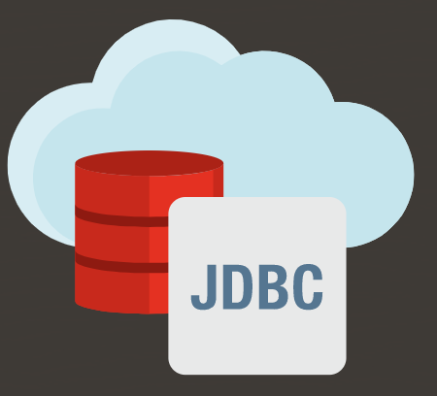
Our team created an HTML web server using the Java Servlet API that is persisted by AWS through an ORM.
Tomcat Server
HTTP Request
HTTP Response
Servlet
Query
Object (List)
ORM
Query
Query
ResultSet
Response

Slide 3
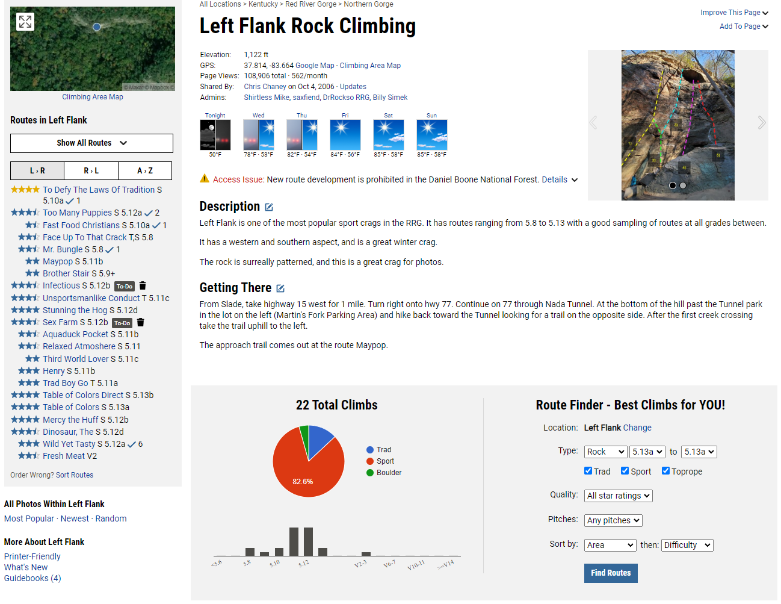
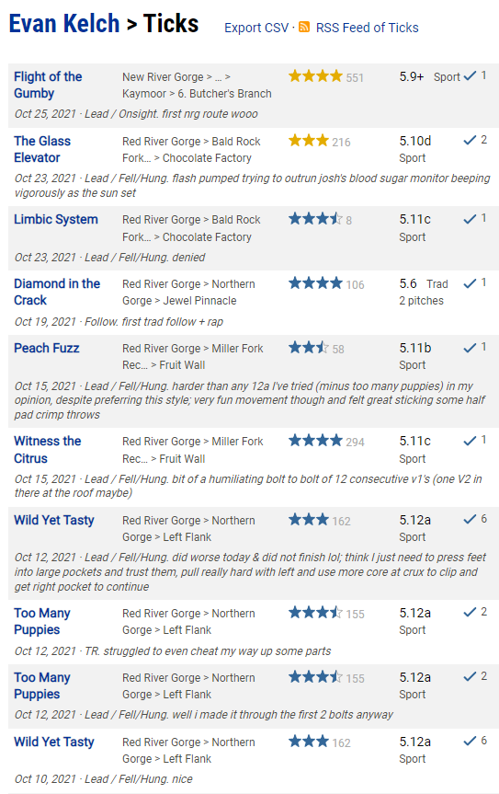
Our web server is a simple version of MountainProject and includes user-route interaction with a tick list.

Slide 4
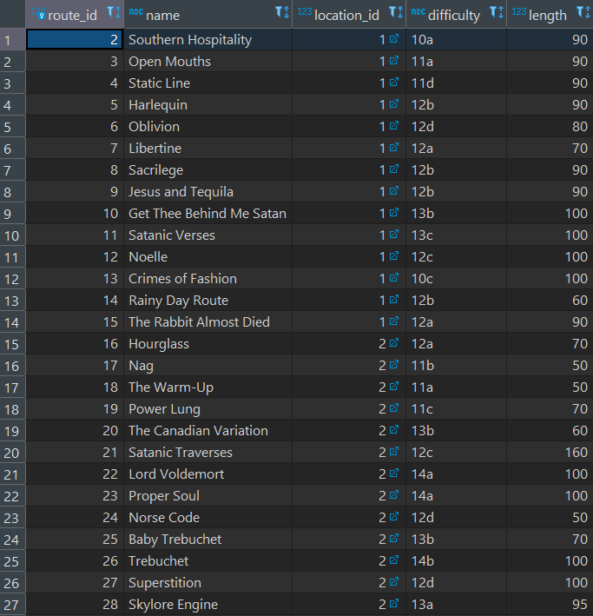
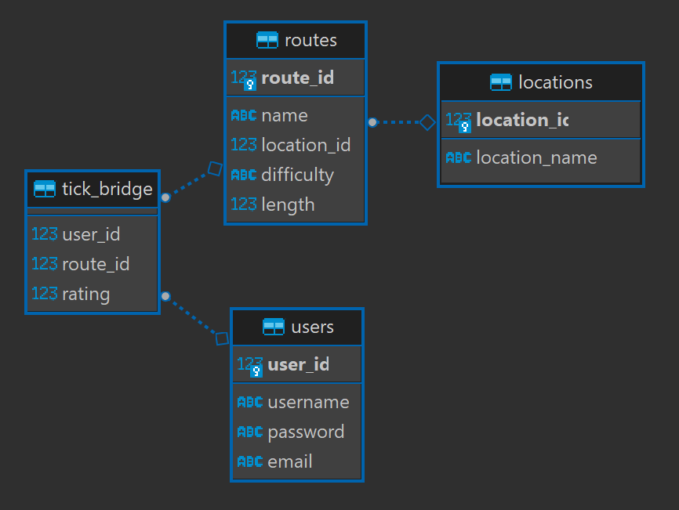
Our database stores tables for users, routes, locations, and a bridge table to store our tick list with ratings.

Slide 5
Patch slides here

Slide 6
Whoever’s slides here

Slide 7
END OF PRESENTATION
Next slides are bonus slides for Q/A

Slide 8

SQL Queries are performed with the QueryBuilder class with the builder design pattern.

Slide 9
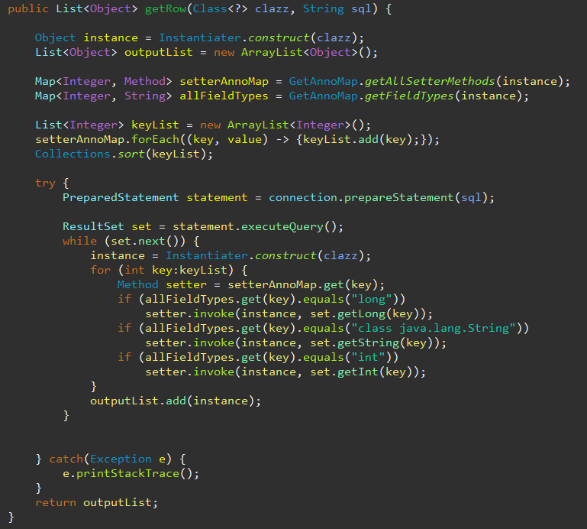
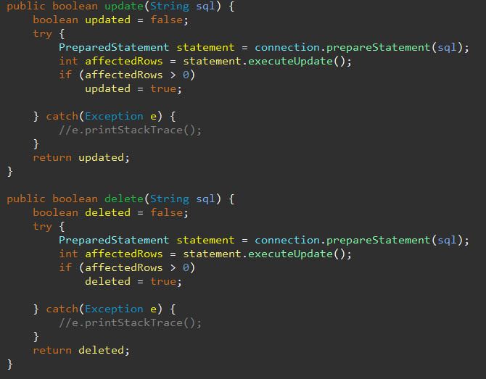
Insert() returns Object getColumn()/getRow() returns List<Object> update()/delete() return boolean

