Slide 1
ET AutoTech Hackathon 2026
Theme: AI for EV Retrofit & Conversion Ecosystem
Team Name: Ekemainai
Team Members: Ekemini Ini Stephen

Slide 2
Theme Chosen - Brief Summary & Proposed Solution/Idea
Theme: AI for EV Retrofit & Conversion Ecosystem
Problem: Independent EV retrofit workshops in India perform high-stakes engineering decisions on imperfect vehicles (damaged, modified, undocumented) using inconsistent manual workflows and tribal knowledge — leading to slow turnaround, uneven safety, and poor standardization.
Solution: RetroMind AI — an end-to-end AI-powered platform that ingests vehicle photos, detects structural deviations, and produces deviation-aware retrofit recommendations (battery placement, wiring routing, risk analysis, compliance reports).
Type: New solution — first-of-its-kind deviation-aware retrofit intelligence engine. Not an improvement on existing tools; retrofits currently have no AI-assisted engineering workflow.

Slide 3
Impact of Proposed Solution
Impact
Scalability
Single VM → Fleet: Currently deployed on 1 OCI Ampere VM (4 OCPU). Horizontally scalable via container orchestration (K8s).
Vehicle types: Currently 5 classes (3-wheeler, 4-wheeler, motorcycle, scooter, commercial). Extensible via OEM data layer + CLIP zero-shot classification.
Geography: India-first (Tier 1/2 workshops). Architecture is region-agnostic.
Feasibility
Running prototype: 401 tests passing, API healthy, frontend deployed.
Deployment: OCI Always Free Tier (₹0 infra cost for MVP).
Tech risk: All components have ARM64 Docker support. Production-ready.
Metric | Target
Assessment time | 60s (vs 4-6 hours manual)
Engineering effort reduction | ~70% per retrofit
Safety consistency | Standardized via AI, not tribal knowledge
Cost estimation accuracy | Deviation-aware, not generic

Slide 4
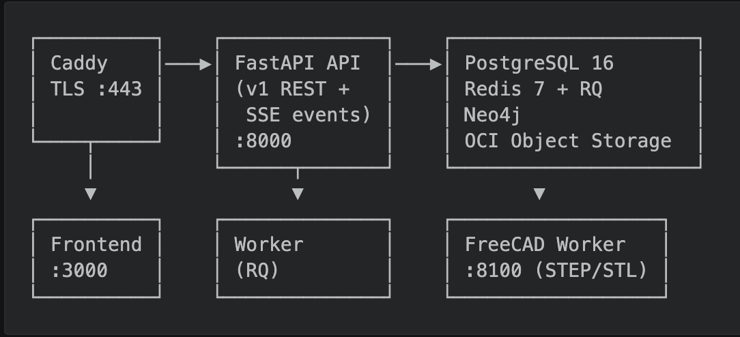
Tech Stack & Architecture
Layer | Technology | Role
Frontend | Next.js 16 + Tailwind CSS 4 + Three.js | Workshop UI, 3D twin, reports
API | FastAPI (Python 3.12) | REST endpoints, job orchestration
Worker | RQ + Redis | Background AI pipeline
Database | PostgreSQL 16 (SQLAlchemy + Alembic) | Jobs, assessments, compliance
Graph | Neo4j (AuraDB) | Retrofit DNA knowledge graph
AI | OpenCV + ONNX + CLIP + PyTorch | Classification, detection, optimization
CAD | FreeCAD (separate container) | STEP/STL export
Proxy | Caddy (auto Let's Encrypt) | TLS termination
Infra | OCI Ampere A1 Flex (4 OCPU, 24 GB) | Single VM deployment

Slide 5
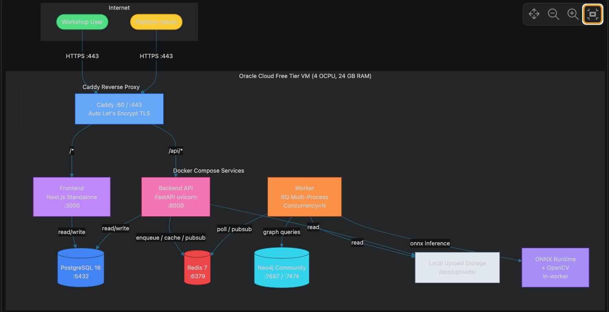
Architecture & Demo

Slide 6
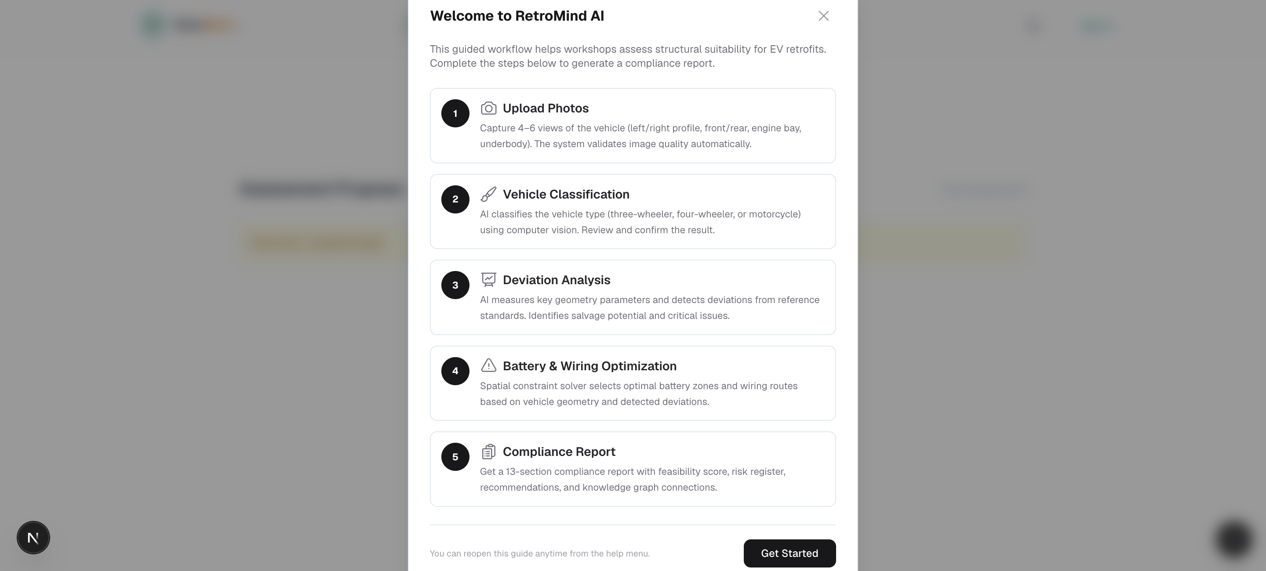
RetroMind AI – Landing Page Screenshots

Slide 7
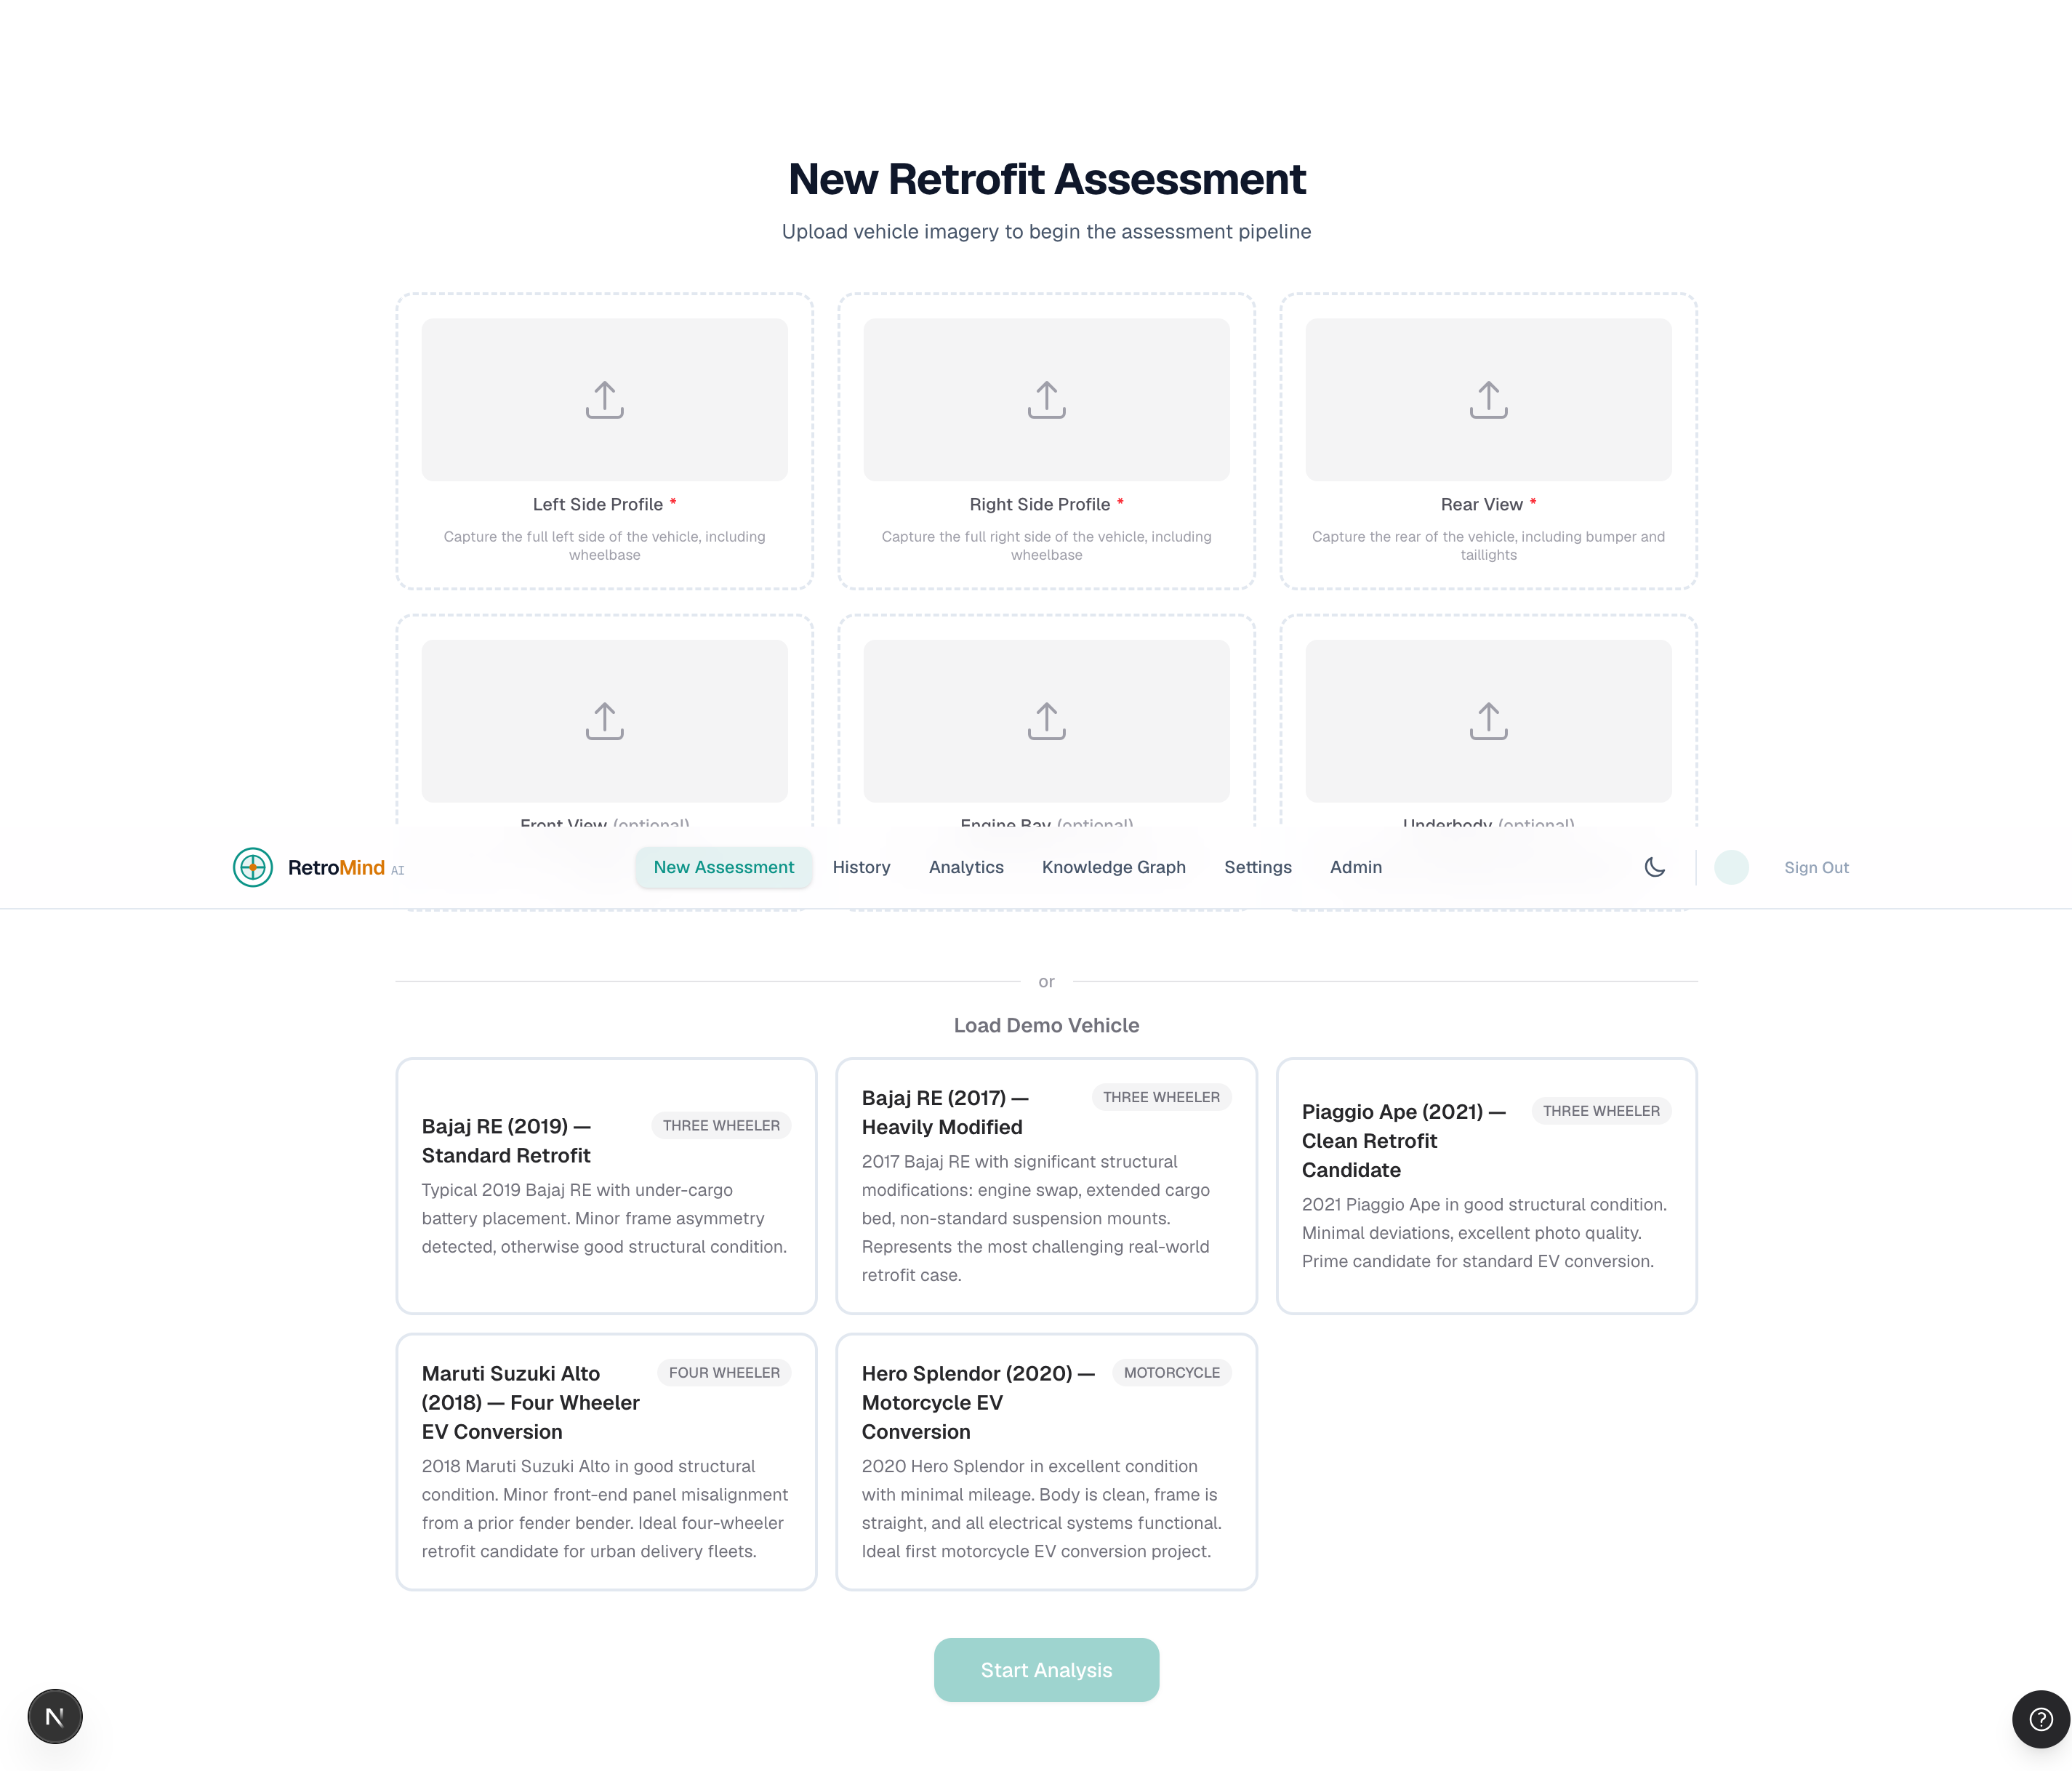
RetroMind AI – New Retrofit Assessment page Screenshot

Slide 8
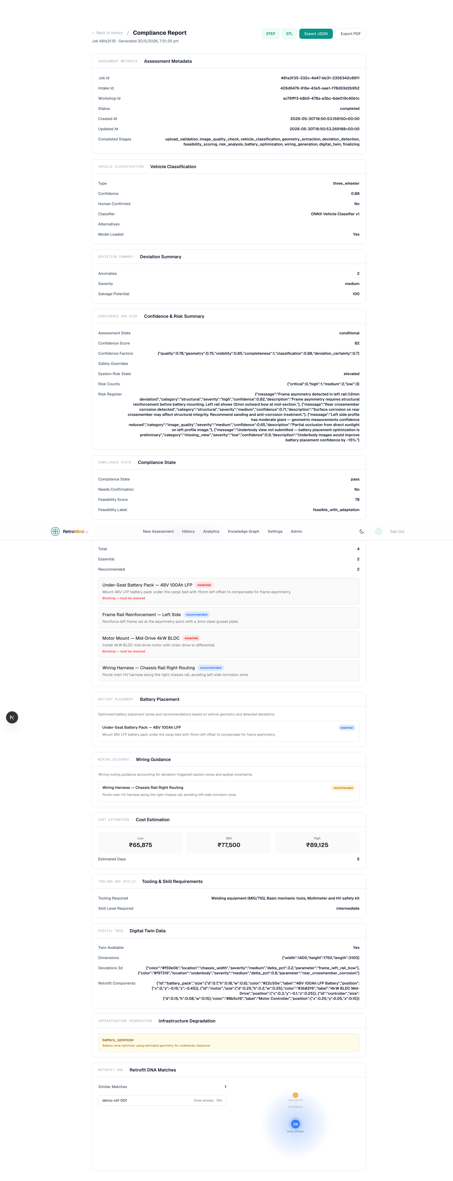
RetroMind AI – Compliance Report Page Screenshot

Slide 9
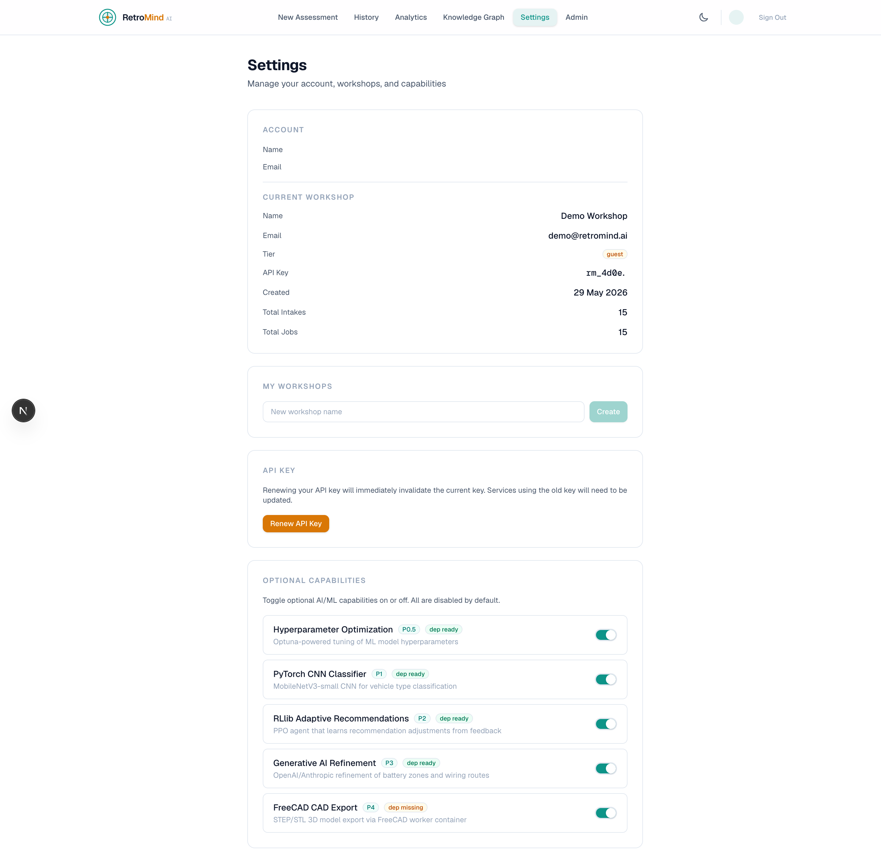
RetroMind AI – Settings Page Screenshot

Slide 10
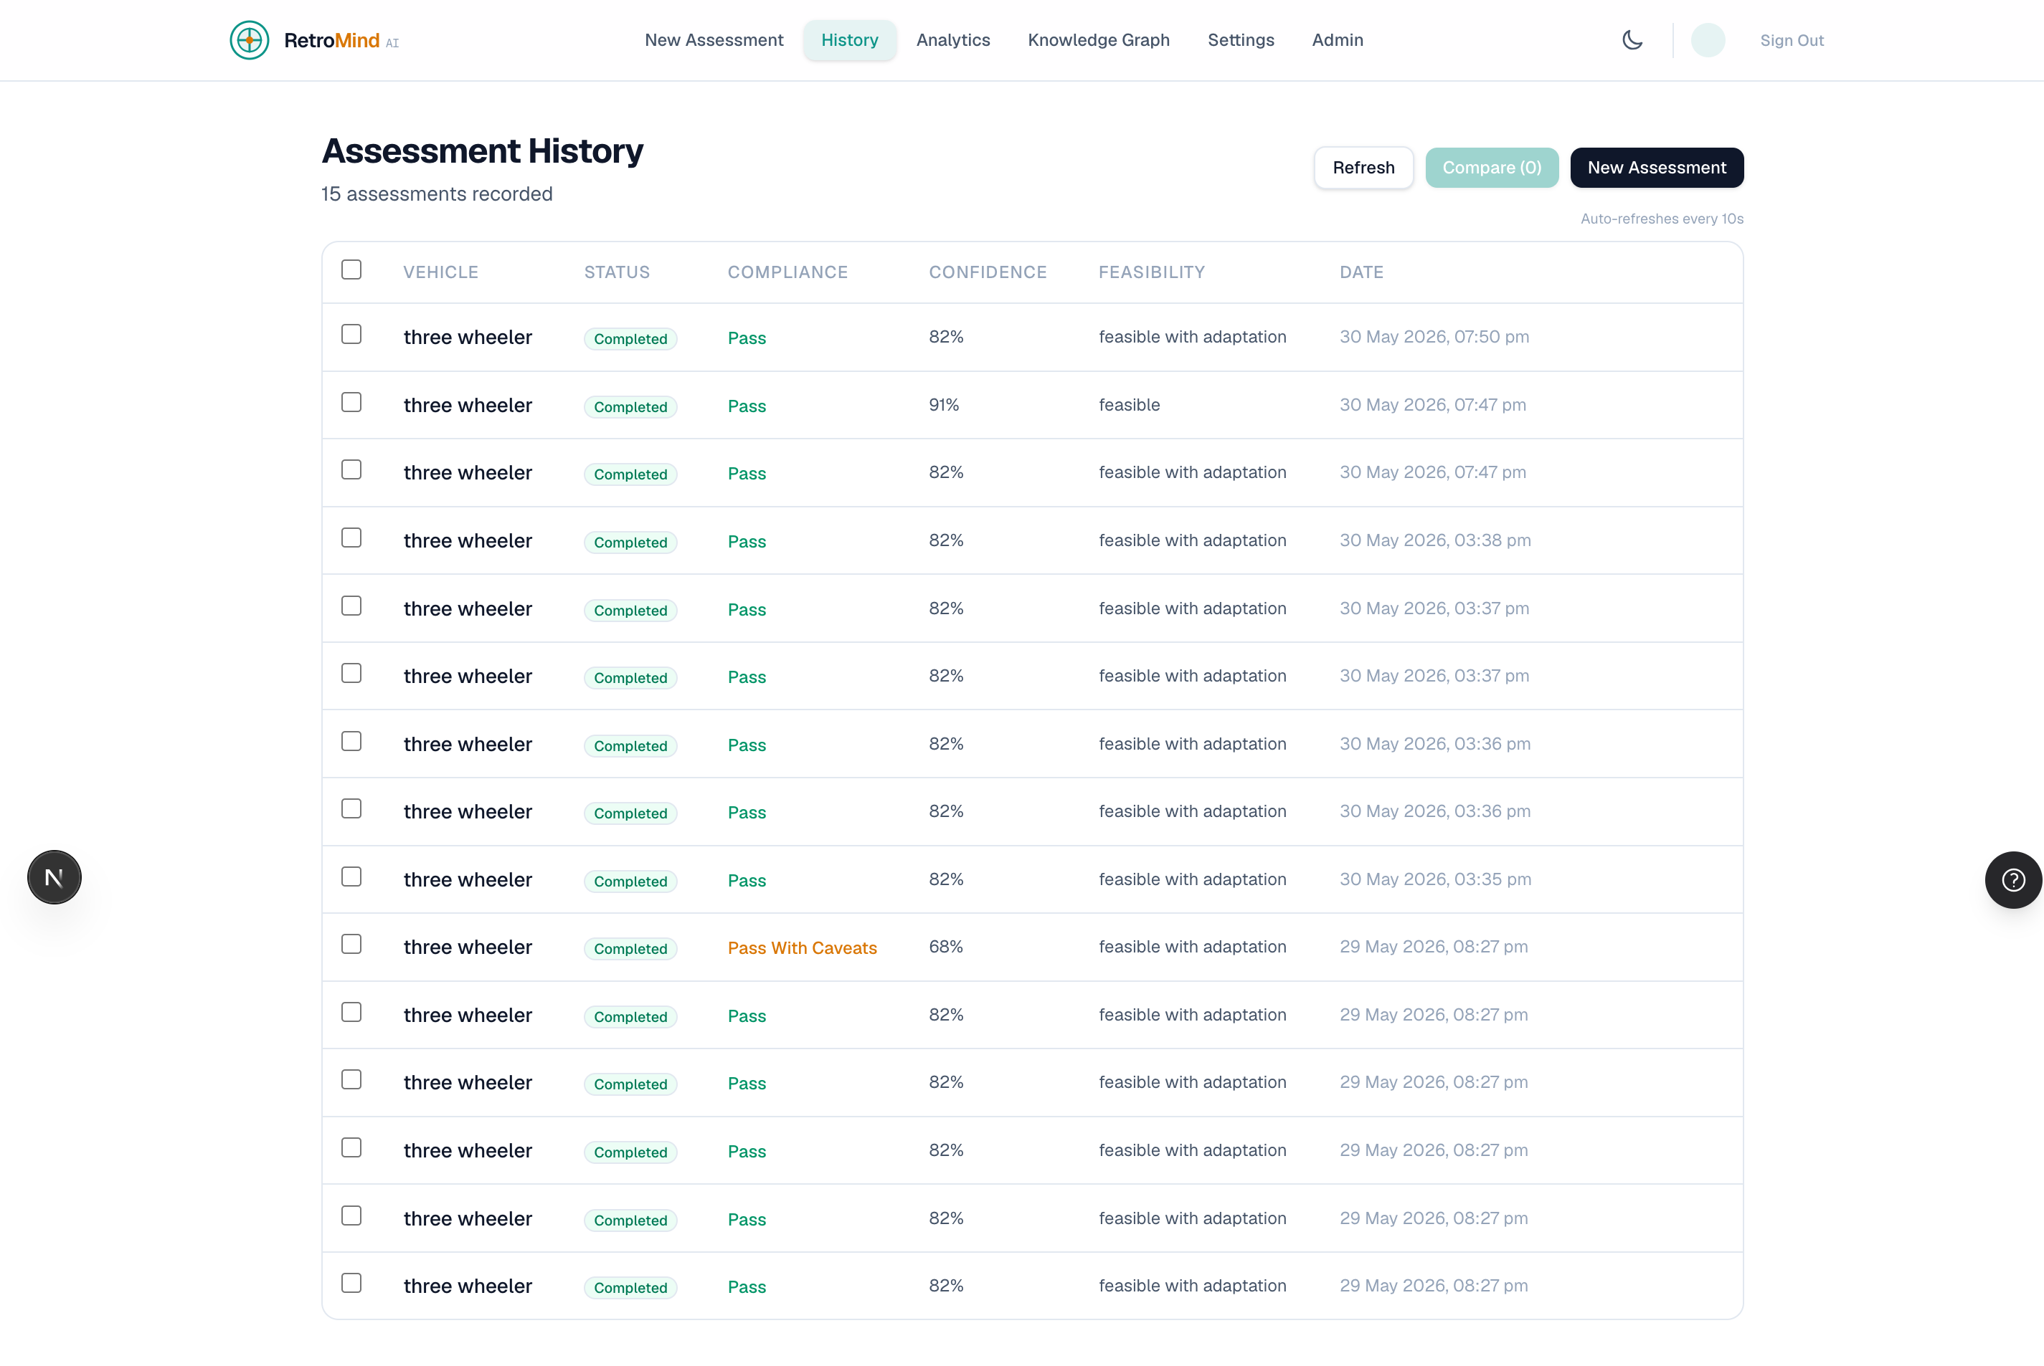
RetroMind AI – Assessment History Page Screenshot

Slide 11
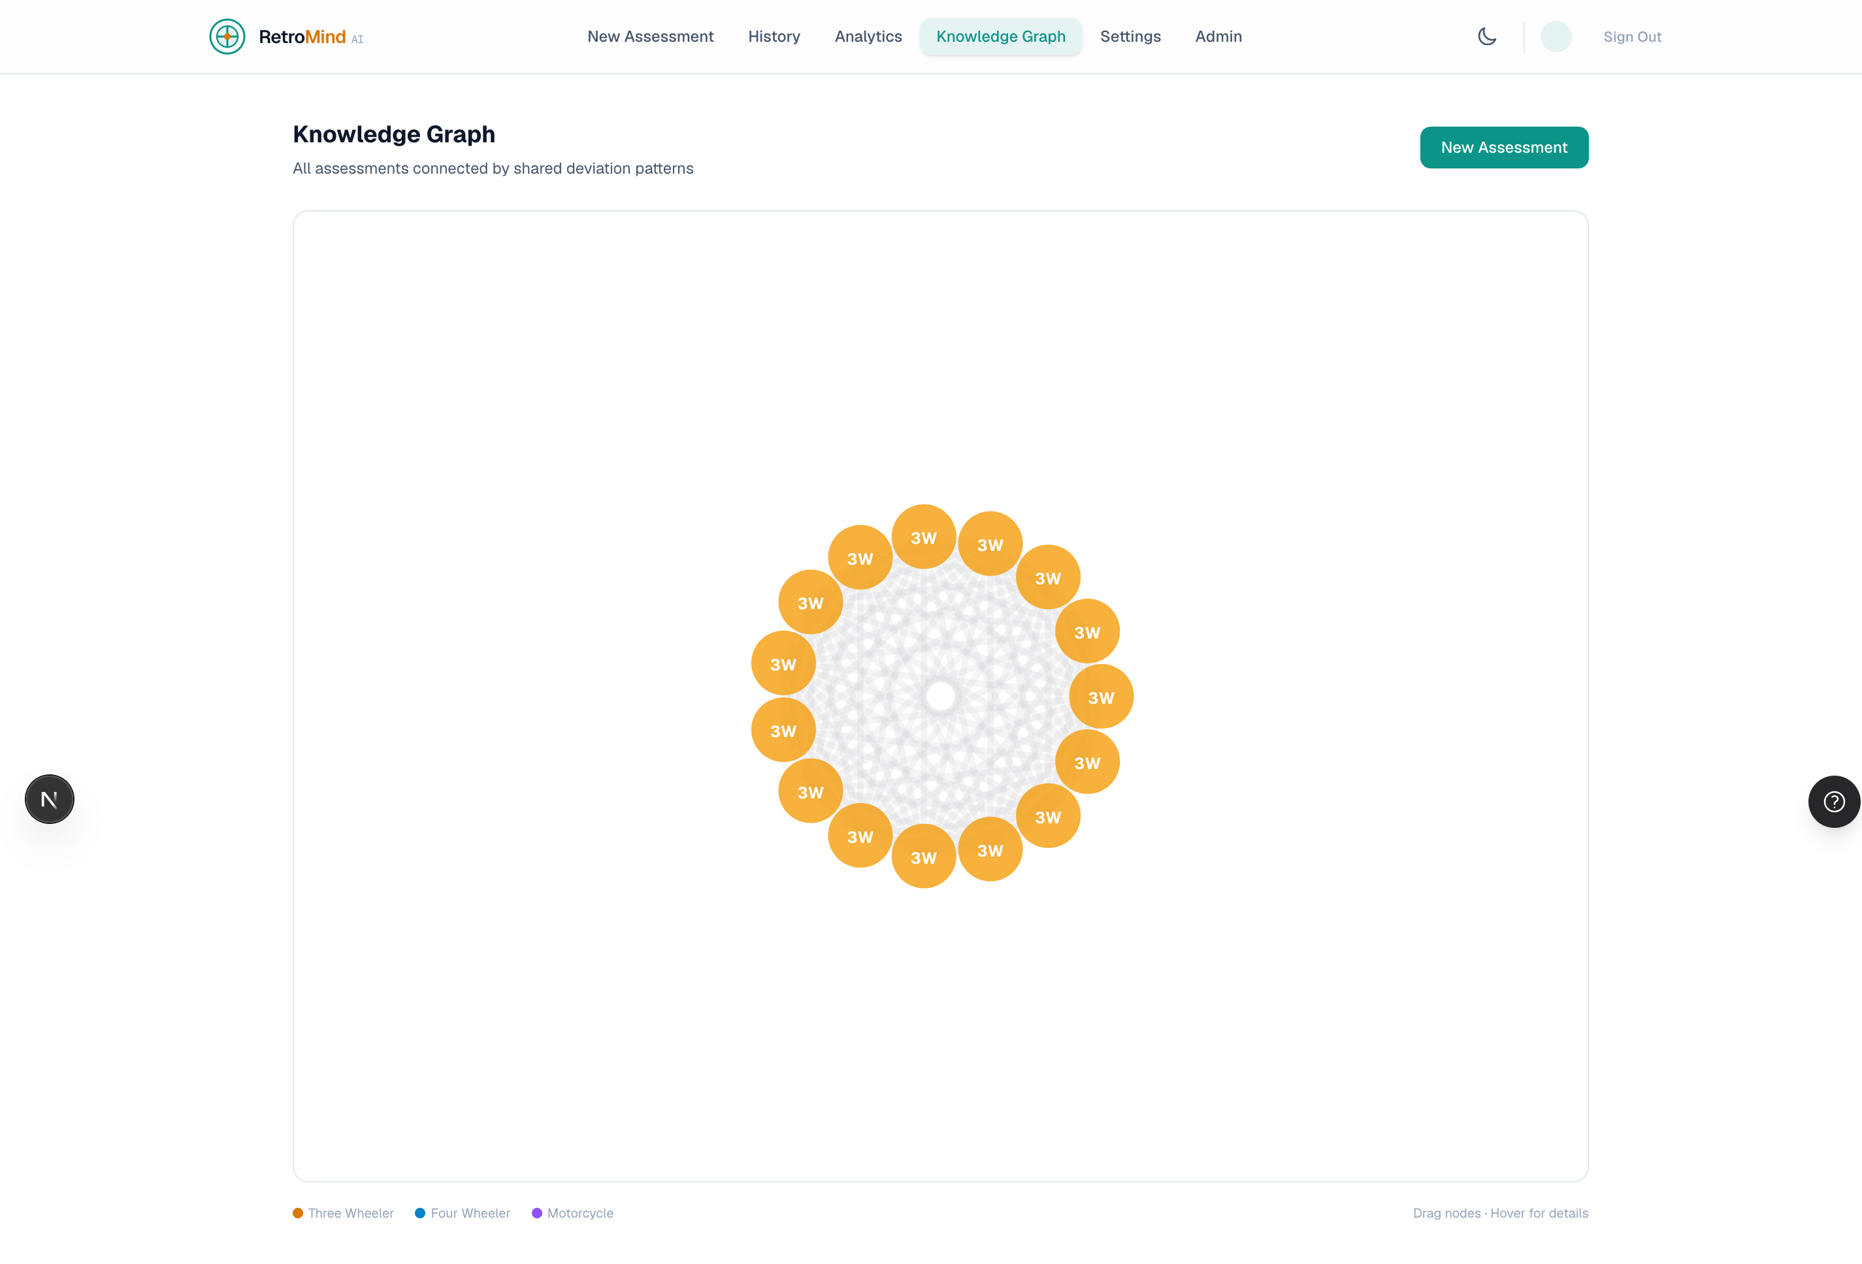
RetroMind AI – Knowledge Graph Page Screenshot

Slide 12
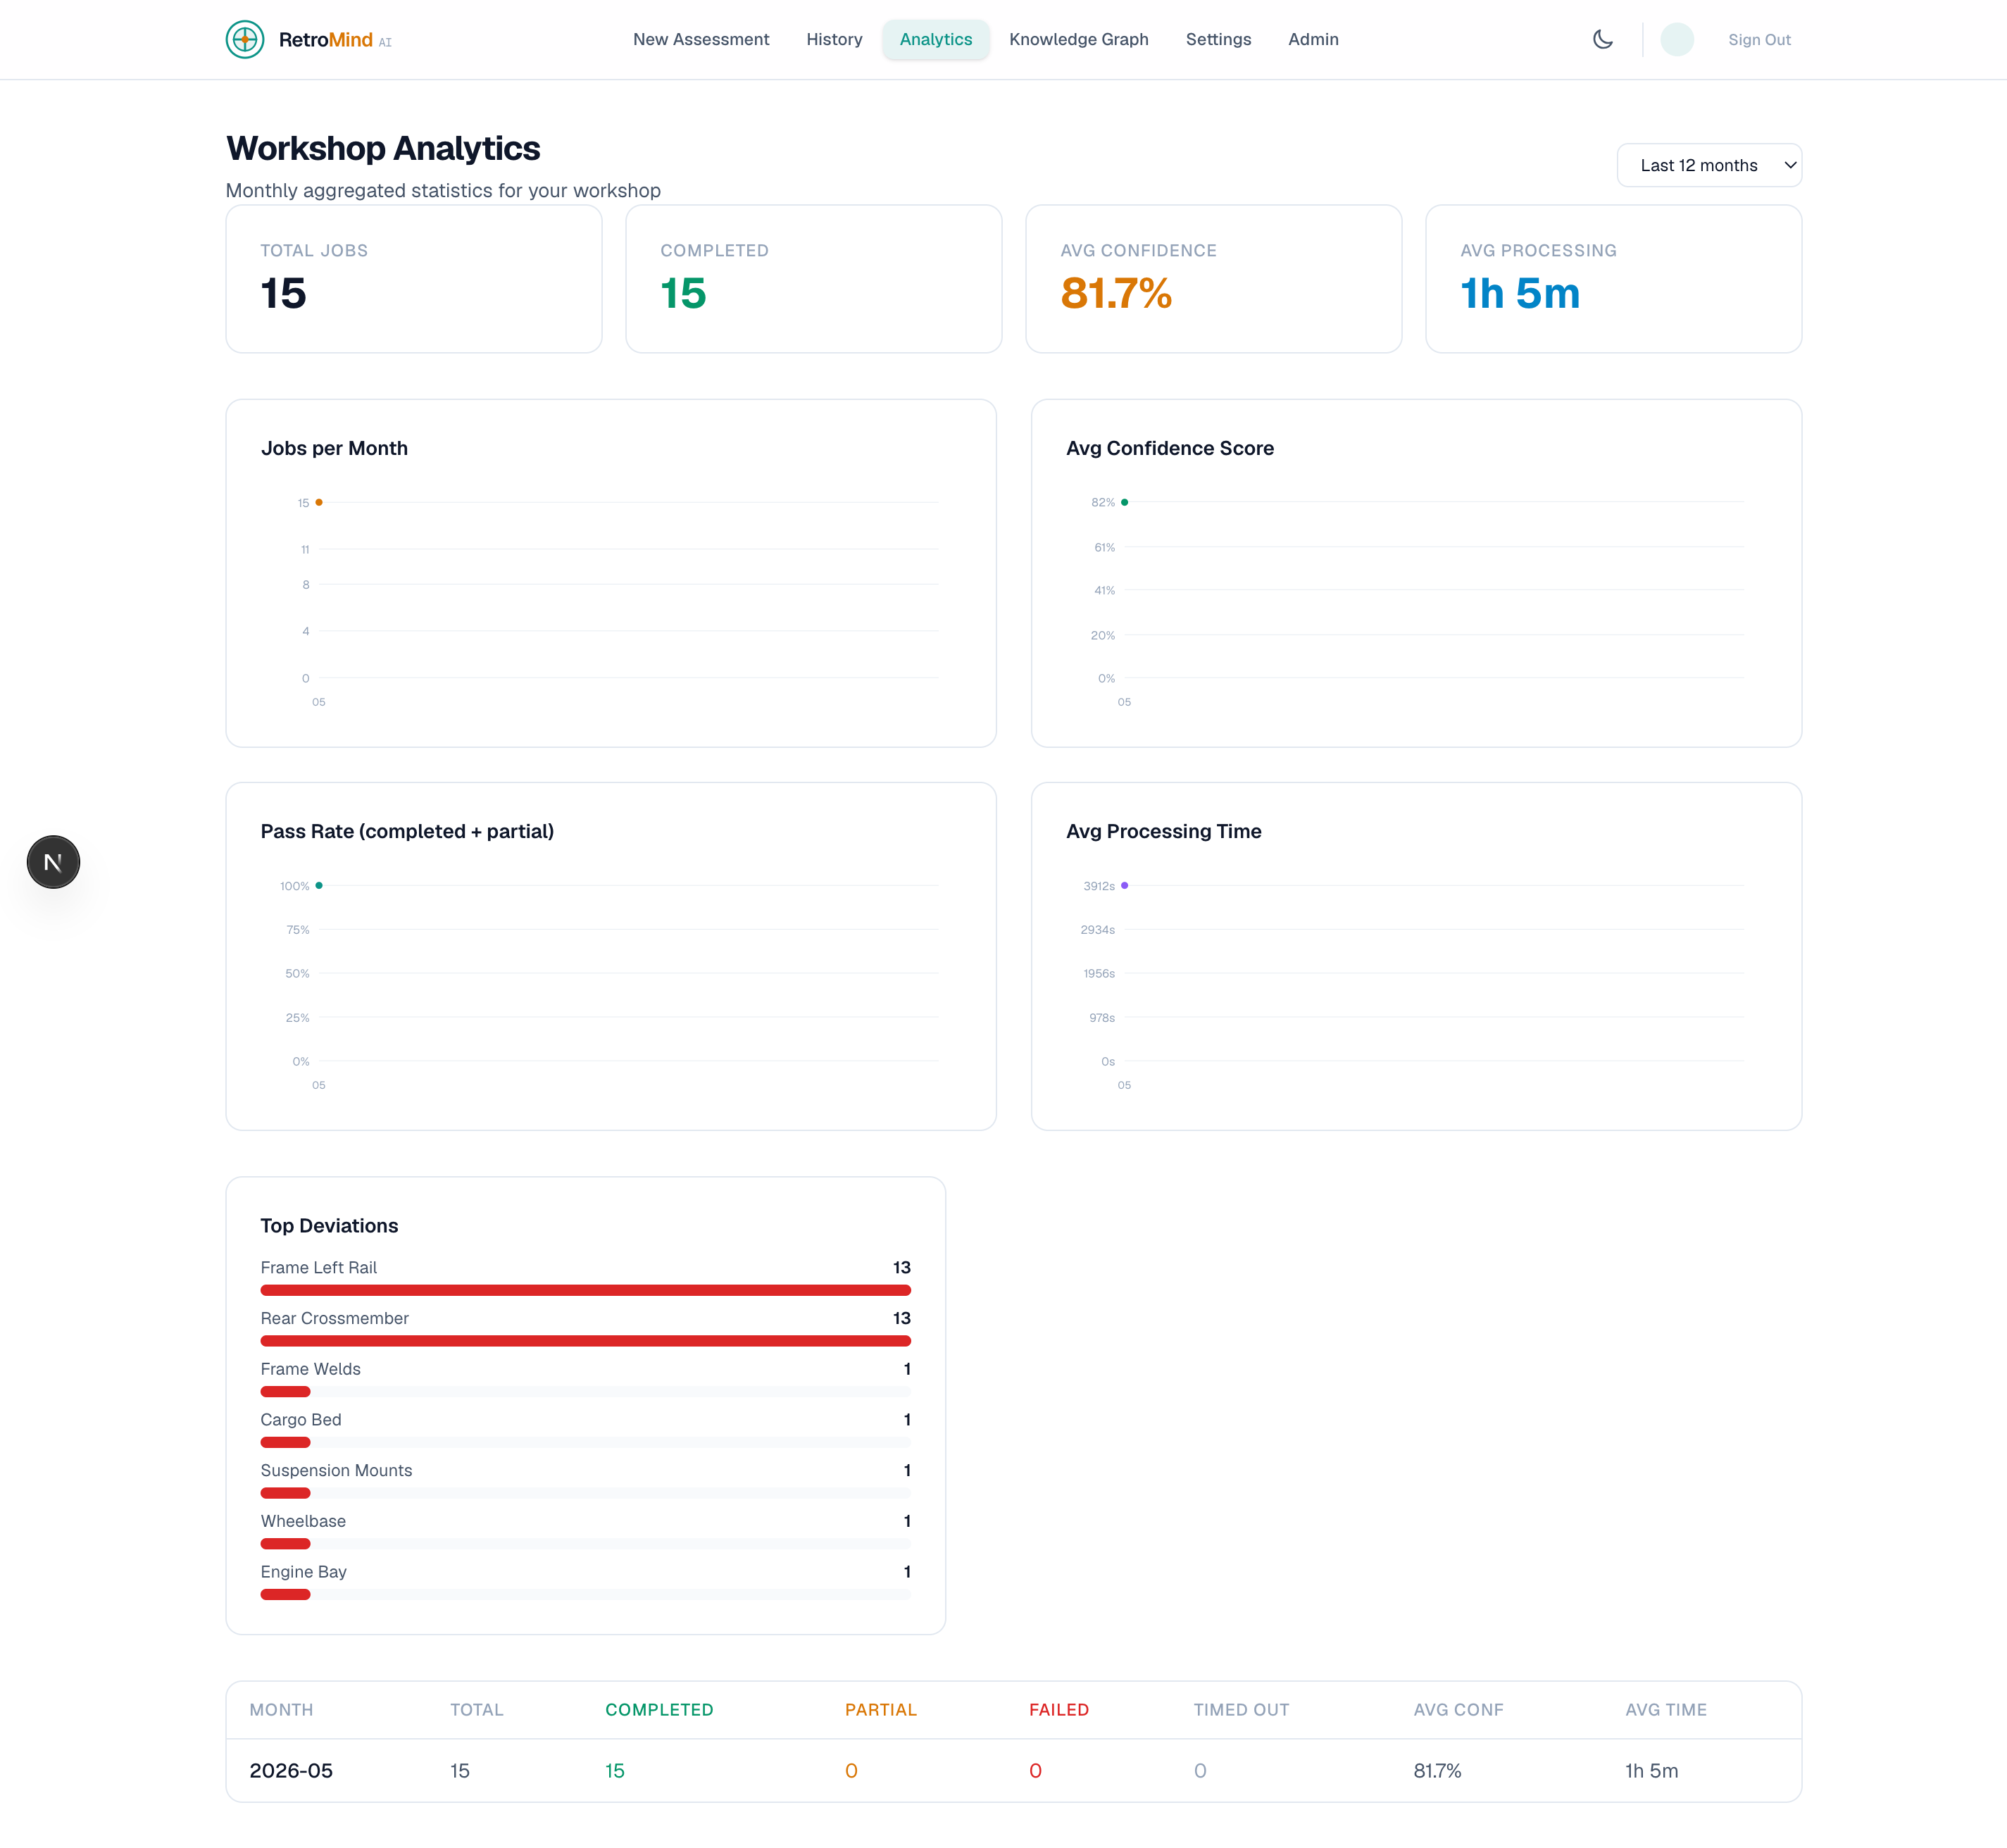
RetroMind AI – Workshop Analytics Page Screenshot

Slide 13
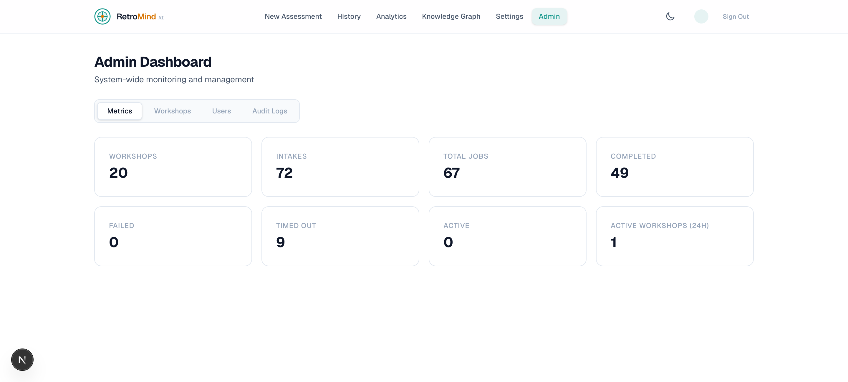
RetroMind AI – Admin Dashboard Page Screenshot
Git URL: https://github.com/ekemainaiML/RetroMindAI

Slide 14
Why Your Solution Must Be Considered
1. Real working prototype — 401 tests, all services healthy, end-to-end flow running
2. Technical depth across the stack
AI/ML: CLIP zero-shot, OpenCV heuristics, ONNX Runtime, PyTorch, Optuna
Engineering: Graceful degradation, confidence engine, deviation detection
DevOps: OCI Terraform provisioning, GitHub Actions CI/CD, Caddy TLS, Docker Compose
3. Production-grade architecture — Not a hackathon throwaway
Feature flags for all optional capabilities
8 Alembic DB migrations, 18 OEM REST routes
Infrastructure degradation telemetry
ARM64-native deployment (no QEMU emulation)
4. Clear real-world impact — Indian 3-wheeler retrofit workshops
60s assessment vs 4-6 hours manual engineering
Deviation-aware safety (catches frame damage, asymmetry, mods)
Self-learning via Neo4j Retrofit DNA graph
5. Innovation: Deviation-aware intelligence
Not "generic AI labels" — every recommendation adapts to detected vehicle imperfections
CLIP zero-shot: no training dataset needed for new vehicle types
Confidence engine with explicit reason codes (not black-box)

Slide 15
Any Additional Information
Optional Capabilities (Feature-Flagged)
Assessment Pipeline (11 stages, 60s target)
1. Upload Validation → 2. Image Quality → 3. Vehicle Classification → 4. Geometry Extraction → 5. Deviation Detection → 6. Feasibility Scoring → 7. Risk Analysis → 8. Battery Optimization → 9. Wiring Guidance → 10. Digital Twin → 11. Finalize
Phase | Capability | Status
P0.5 | Optuna hyperparameter tuning | ✅ Built
P1 | PyTorch MobileNetV3 CNN classifier | ✅ Built
P2 | RLlib adaptive recommendations (PPO) | ✅ Built
P3 | Generative AI refinement (OpenAI/Anthropic) | ✅ Built
P4 | FreeCAD STEP/STL CAD export | ✅ Built, ARM64
P5 | Continuous learning (hourly retrain) | ✅ Built

Slide 16
Any Additional Information
Key Metrics
401 tests (unit + integration)
18 OEM REST endpoints (makes, models, trims, specs)
8 Alembic migrations (001-008)
13-section compliance report
OCI Always Free Tier: ₹0/month infrastructure
Demo Flow
Visit app → Use Demo Key → Upload 3 vehicle photos
AI identifies vehicle type (CLIP zero-shot + OpenCV heuristic)
60s assessment runs: geometry, deviations, feasibility
Report generated: confidence, risks, battery placement, wiring
Download STEP/STL via FreeCAD worker
Knowledge graph shows related past retrofits

Slide 17
Thank You
RetroMind AI — Making Every Retrofit Safer, Faster, and Smarter
Team: Ekemainai
RetroMind AI GitHub: https://github.com/ekemainaiML/RetroMindAI
Tech Stack: Next.js 16 · FastAPI · PostgreSQL · Neo4j · Redis · OpenCV · CLIP · ONNX · FreeCAD · Caddy · OCI

