Slide 1
Smoothing
Misha Kazhdan

Slide 2
Outline
Motivation
Review
Signals on curves
Smoothing
Implementation

Slide 3

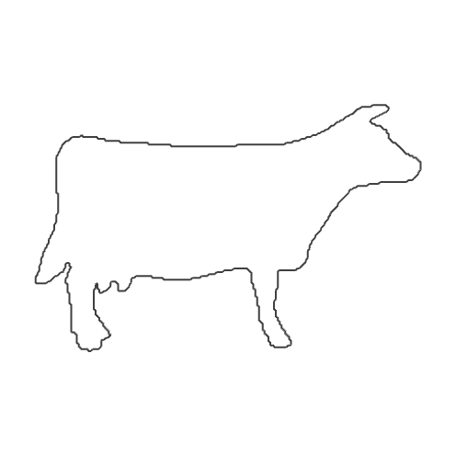

Motivation
Given a 2D grid, we can compute its $α$-level-set.

Slide 4
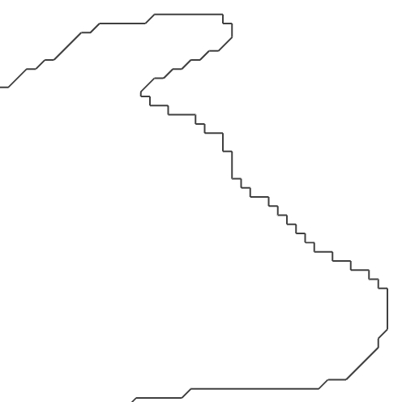

Motivation
Given a 2D grid, we can compute its $α$-level-set.
But if the signal is noisy (or quantized), the level-set may be noisy (or aliased)

Slide 5
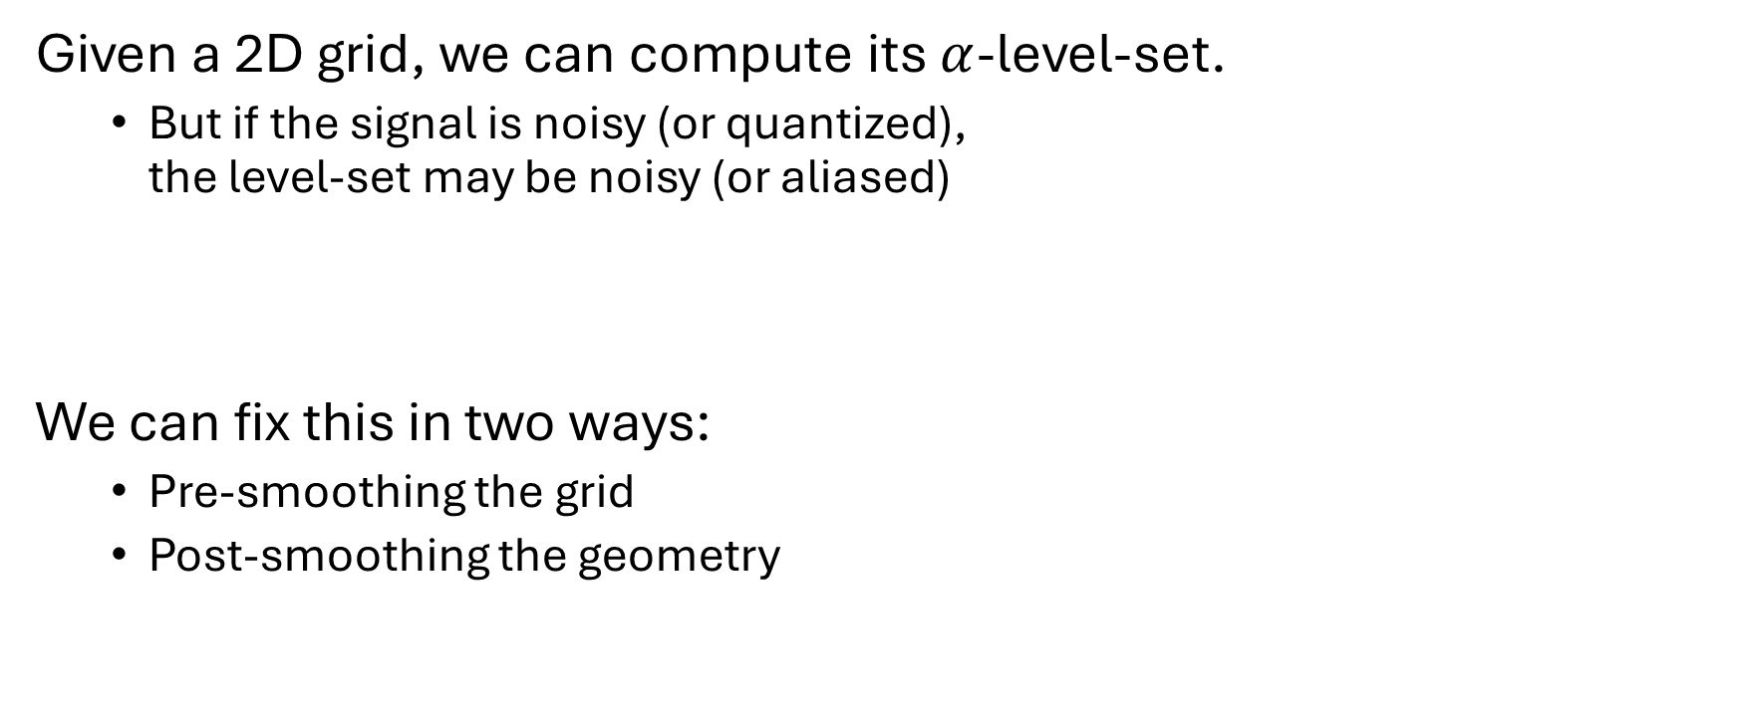
Motivation
Given a 2D grid, we can compute its $α$-level-set.
But if the signal is noisy (or quantized), the level-set may be noisy (or aliased)
We can fix this in two ways:
Pre-smoothing the grid
Post-smoothing the geometry

Slide 6

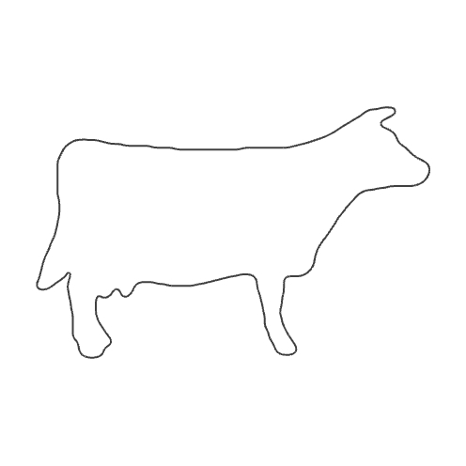
Motivation: Grid pre-smoothing
Given a 2D grid, we can smooth the grid of values by replacing each value by the weighted average of the values in the neighborhood.

Slide 7
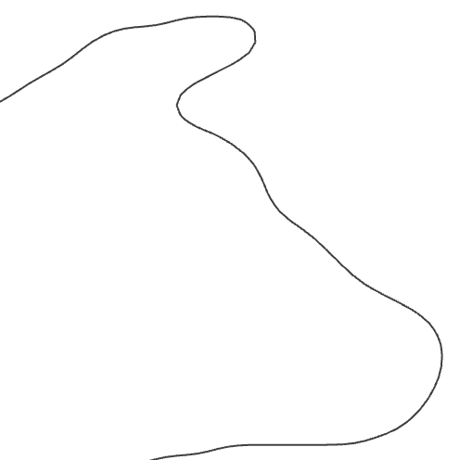
Motivation: Grid pre-smoothing
Given a 2D grid, we can smooth the grid of values by replacing each value by the weighted average of the values in the neighborhood.

Slide 8
Motivation: Curve post-smoothing
Independently, we can smooth the geometry of the level-set curve, after it has been extracted.

Slide 9

Review
Given a real value $a∈ℝ$, we can define the constant function:
$$C_{a}:ℝ^{d}→ℝ \\ v↦a$$
The gradient of the function $C_{a}$ at a point $v∈ℝ^{d}$ is: $$∇C_{a}{\left.​\right|}_{v}=0$$

Slide 10

Review
Given a vector $w∈ℝ^{n}$, we can define the linear function:
$$L_{w}:ℝ^{d}→ℝ \\ v↦\left\langle w,v\right\rangle ≡\sum_{j}{v_{j}⋅w_{j}}$$
The partial derivative with respect to $v_{i}$ is:
$$\frac{∂L_{w}}{∂v_{i}}=\frac{∂}{∂v_{i}}\sum_{j}{v_{j}⋅w_{j}}=w_{j}$$

Slide 11
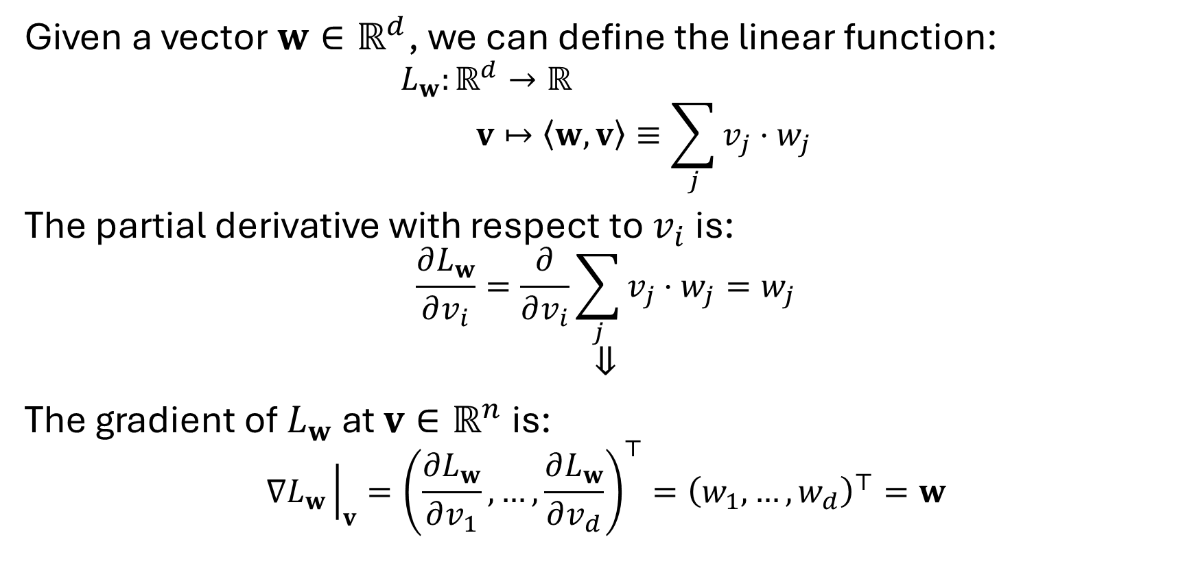
Review
Given a vector $w∈ℝ^{d}$, we can define the linear function:
$$L_{w}:ℝ^{d}→ℝ \\ v↦\left\langle w,v\right\rangle ≡\sum_{j}{v_{j}⋅w_{j}}$$
The partial derivative with respect to $v_{i}$ is:
$$\frac{∂L_{w}}{∂v_{i}}=\frac{∂}{∂v_{i}}\sum_{j}{v_{j}⋅w_{j}}=w_{j}$$
$$⇓$$
The gradient of $L_{w}$ at $v∈ℝ^{n}$ is: $$∇L_{w}{\left.​\right|}_{v}={\left(\frac{∂L_{w}}{∂v_{1}},…,\frac{∂L_{w}}{∂v_{d}}\right)}^{⊤}={\left(w_{1},…,w_{d}\right)}^{⊤}=w$$

Slide 12
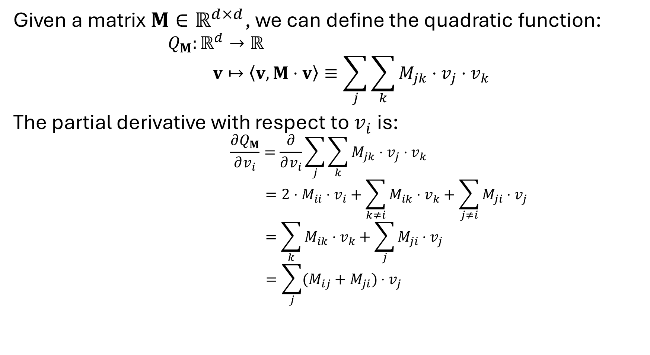
Review
Given a matrix $M∈ℝ^{d×d}$, we can define the quadratic function:
$$Q_{M}:ℝ^{d}→ℝ \\ v↦\left\langle v,M⋅v\right\rangle ≡\sum_{j}{\sum_{k}{M_{jk}⋅v_{j}⋅v_{k}}}$$
The partial derivative with respect to $v_{i}$ is:
$$\frac{∂Q_{M}}{∂v_{i}}=\frac{∂}{∂v_{i}}\sum_{j}{\sum_{k}{M_{jk}⋅v_{j}⋅v_{k}}}$$
$$=2⋅M_{ii}⋅v_{i}+\sum_{k≠i}{M_{ik}⋅v_{k}}+\sum_{j≠i}{M_{ji}⋅v_{j}}$$
$$=\sum_{k}{M_{ik}⋅v_{k}}+\sum_{j}{M_{ji}⋅v_{j}}$$
$$=\sum_{j}{(M_{ij}+M_{ji})⋅v_{j}}$$

Slide 13
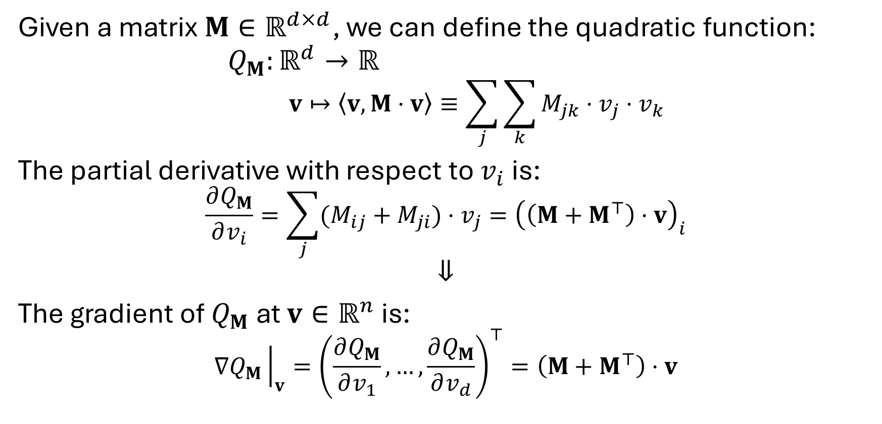
Review
Given a matrix $M∈ℝ^{d×d}$, we can define the quadratic function:
$$Q_{M}:ℝ^{d}→ℝ \\ v↦\left\langle v,M⋅v\right\rangle ≡\sum_{j}{\sum_{k}{M_{jk}⋅v_{j}⋅v_{k}}}$$
The partial derivative with respect to $v_{i}$ is:
$$\frac{∂Q_{M}}{∂v_{i}}=\sum_{j}{(M_{ij}+M_{ji})⋅v_{j}}={\left(\left(M+M^{⊤}\right)⋅v\right)}_{i}$$
$$⇓$$
The gradient of $Q_{M}$ at $v∈ℝ^{n}$ is: $$∇Q_{M}{\left.​\right|}_{v}={\left(\frac{∂Q_{M}}{∂v_{1}},…,\frac{∂Q_{M}}{∂v_{d}}\right)}^{⊤}=\left(M+M^{⊤}\right)⋅v$$

Slide 14
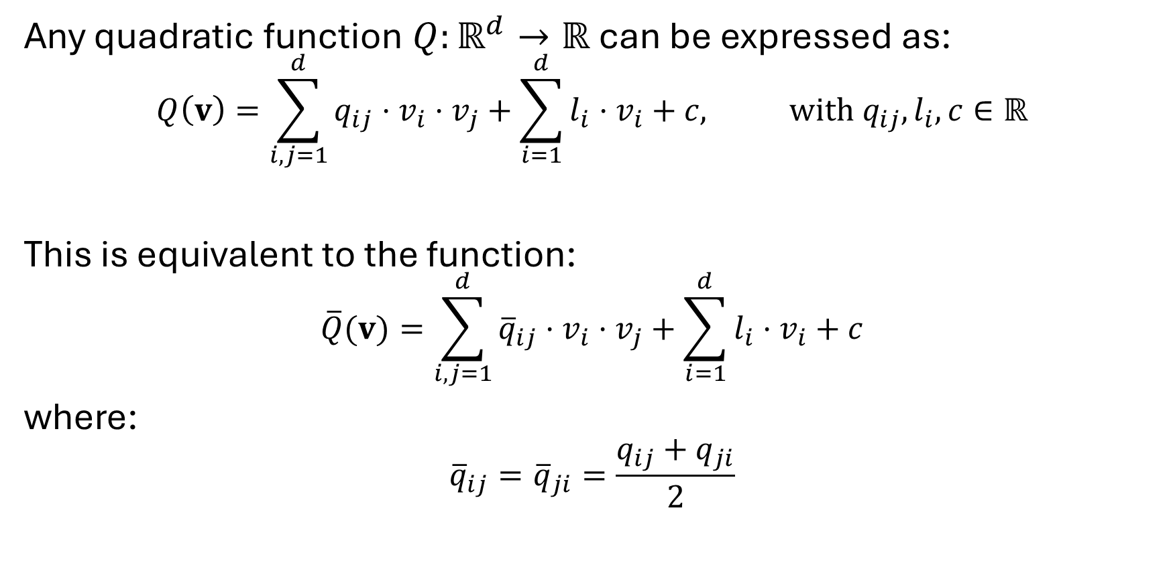
Review
Any quadratic function $Q:ℝ^{d}→ℝ$ can be expressed as:
$$Q\left(v\right)=\sum_{i,j=1}^{d}{q_{ij}⋅v_{i}}⋅v_{j}+\sum_{i=1}^{d}{l_{i}⋅v_{i}}+c, with q_{ij},l_{i},c∈ℝ$$
This is equivalent to the function: $$\overline{Q}(v)=\sum_{i,j=1}^{d}{{\overline{q}}_{ij}⋅v_{i}}⋅v_{j}+\sum_{i=1}^{d}{l_{i}⋅v_{i}}+c$$
where: $${\overline{q}}_{ij}={\overline{q}}_{ji}=\frac{q_{ij}+q_{ji}}{2}$$

Slide 15
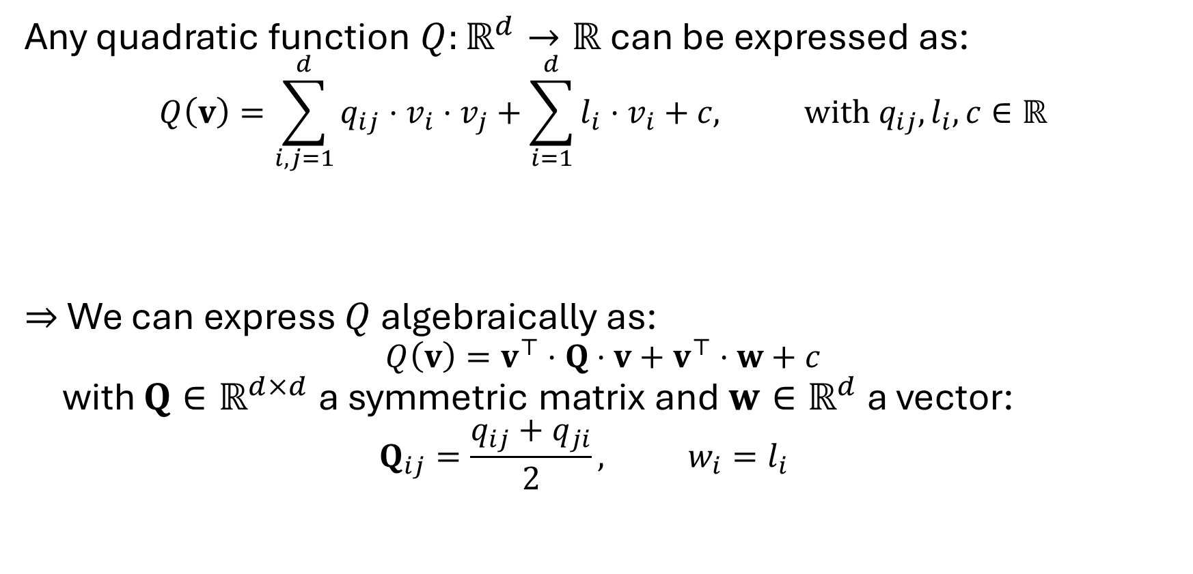
Review
Any quadratic function $Q:ℝ^{d}→ℝ$ can be expressed as:
$$Q\left(v\right)=\sum_{i,j=1}^{d}{q_{ij}⋅v_{i}}⋅v_{j}+\sum_{i=1}^{d}{l_{i}⋅v_{i}}+c, with q_{ij},l_{i},c∈ℝ$$
$⇒$ We can express $Q$ algebraically as: $$Q\left(v\right)=v^{⊤}⋅Q⋅v+v^{⊤}⋅w+c$$ with $Q∈ℝ^{d×d}$ a symmetric matrix and $w∈ℝ^{d}$ a vector: $$Q_{ij}=\frac{q_{ij}+q_{ji}}{2}, w_{i}=l_{i}$$

Slide 16
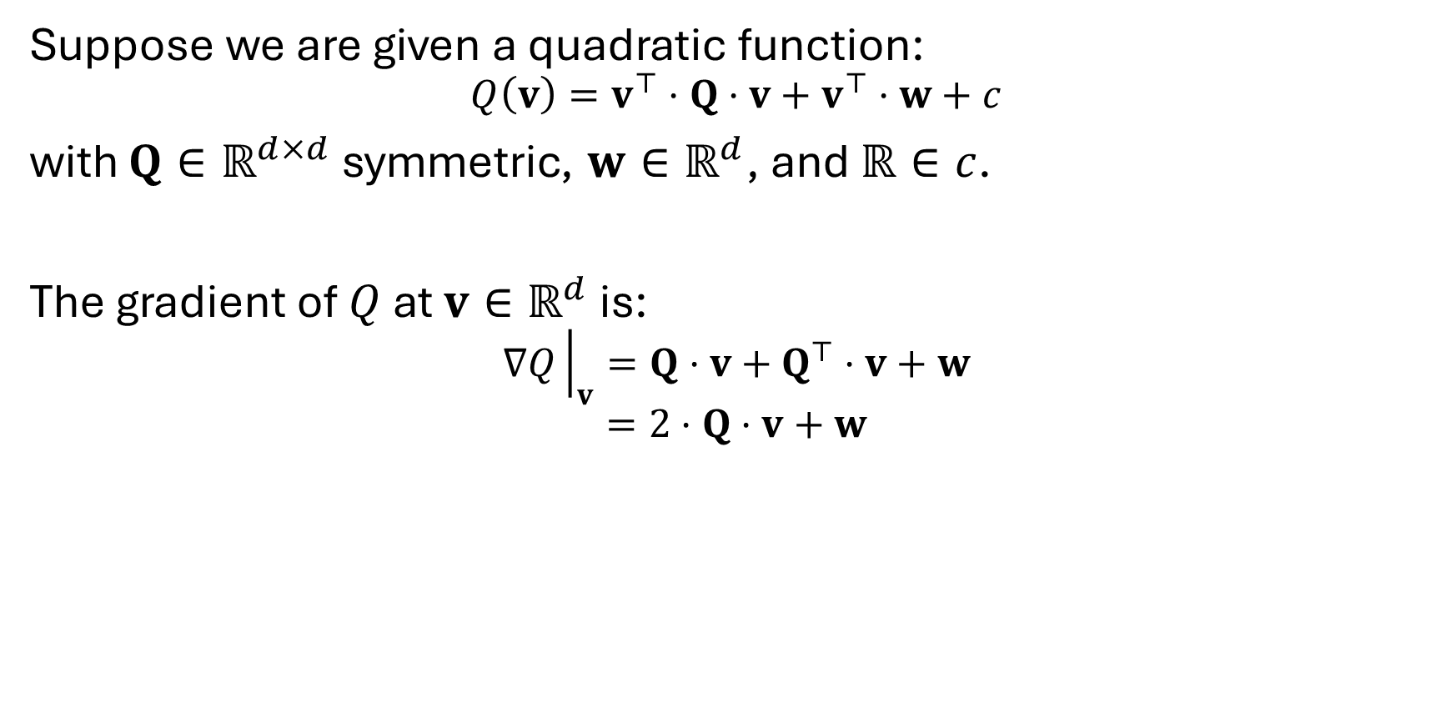
Review
Suppose we are given a quadratic function:
$$Q\left(v\right)=v^{⊤}⋅Q⋅v+v^{⊤}⋅w+c$$ with $Q∈ℝ^{d×d}$ symmetric, $w∈ℝ^{d}$, and $ℝ∈c$.
The gradient of $Q$ at $v∈ℝ^{d}$ is: $$∇Q{\left.​\right|}_{v}=Q⋅v+Q^{⊤}⋅v+w$$
$$=2⋅Q⋅v+w$$

Slide 17
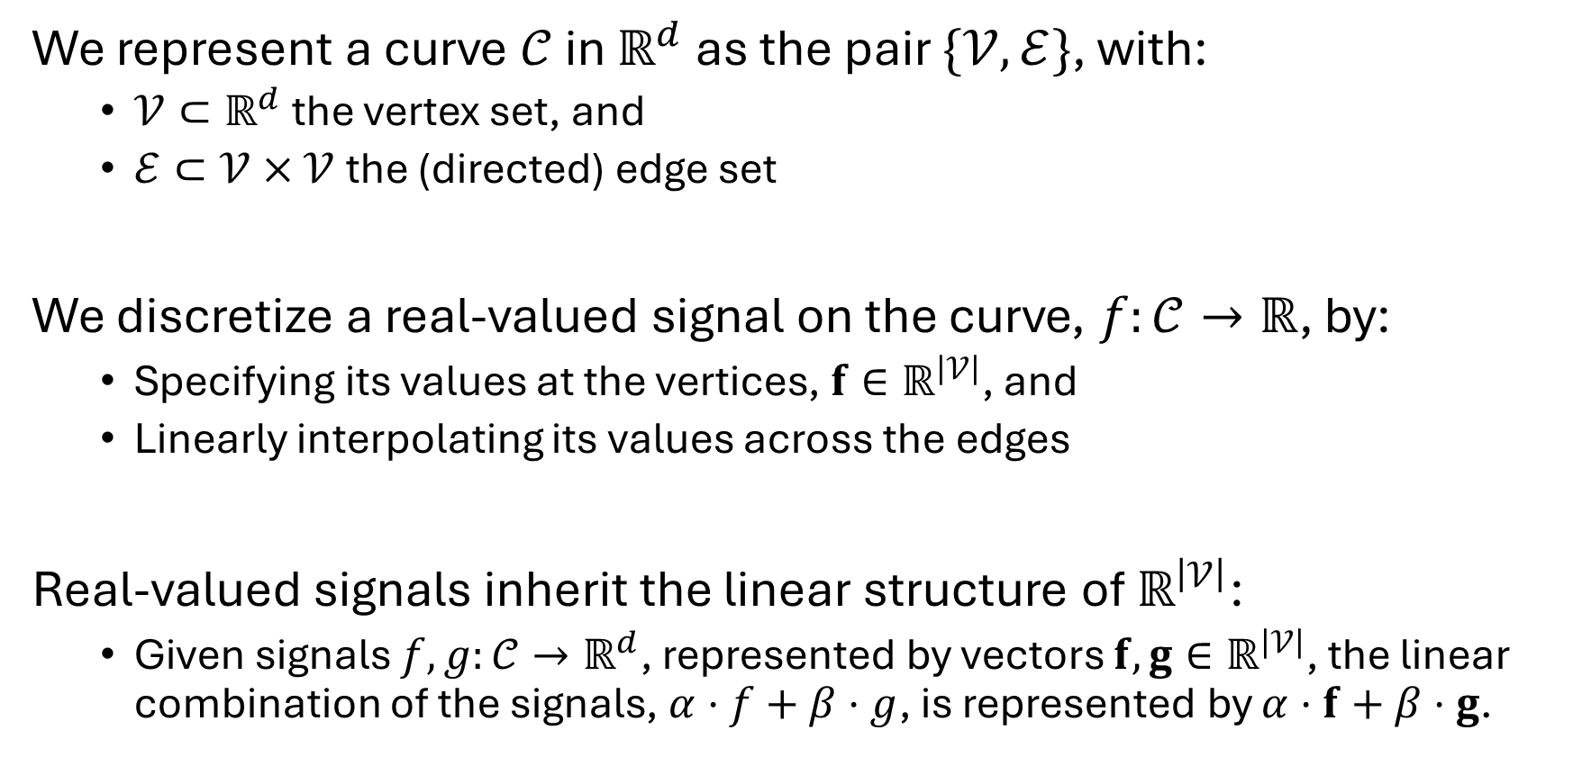
Signals on curves
We represent a curve $𝒞$ in $ℝ^{d}$ as the pair $\{𝒱,ℰ\}$, with:
$𝒱⊂ℝ^{d}$ the vertex set, and
$ℰ⊂𝒱×𝒱$ the (directed) edge set
We discretize a real-valued signal on the curve, $f:𝒞→ℝ$, by:
Specifying its values at the vertices, $f∈ℝ^{\left|𝒱\right|}$, and
Linearly interpolating its values across the edges
Real-valued signals inherit the linear structure of $ℝ^{\left|𝒱\right|}$:
Given signals $f,g:𝒞→ℝ^{d}$, represented by vectors $f,g∈ℝ^{\left|𝒱\right|}$, the linear combination of the signals, $α⋅f+β⋅g$, is represented by $α⋅f+β⋅g$.

Slide 18
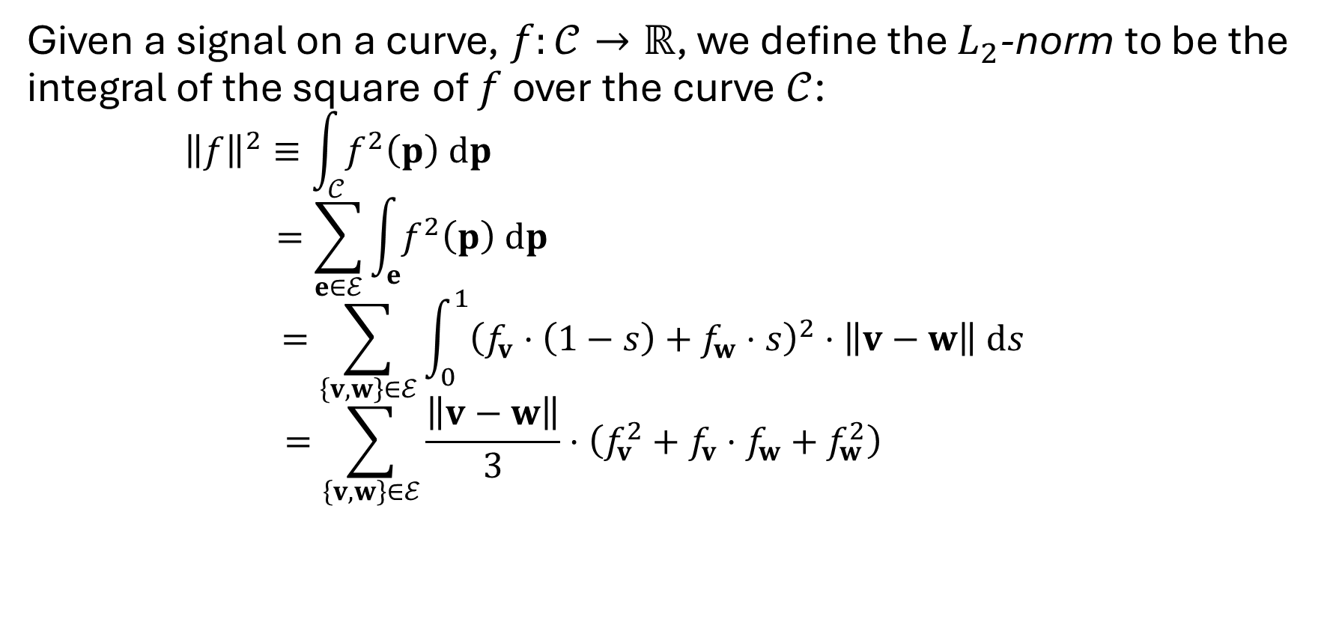
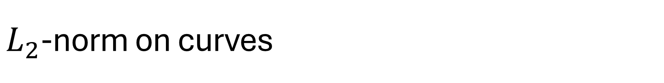
$L_{2}$-norm on curves
Given a signal on a curve, $f:𝒞→ℝ$, we define the $L_{2}$-norm to be the integral of the square of $f$ over the curve $𝒞$:
$${\left\|f\right\|}^{2}≡\int_{𝒞}{f^{2}\left(p\right) dp}$$
$$=\sum_{e∈ℰ}{\int_{e}{f^{2}\left(p\right) dp}}$$
$$=\sum_{\left\{v,w\right\}∈ℰ}{\int_{0}^{1}{{\left(f_{v}⋅\left(1−s\right)+f_{w}⋅s\right)}^{2}⋅\left\|v−w\right\| ds}}$$
$$=\sum_{\left\{v,w\right\}∈ℰ}{\frac{\left\|v−w\right\|}{3}⋅\left(f_{v}^{2}+f_{v}⋅f_{w}+f_{w}^{2}\right)}$$
With a slight abuse of notation, we use vertices to represent both positions in $ℝ^{2}$ and indices in the vector of values $f∈ℝ^{|𝒱|}$.

Slide 19
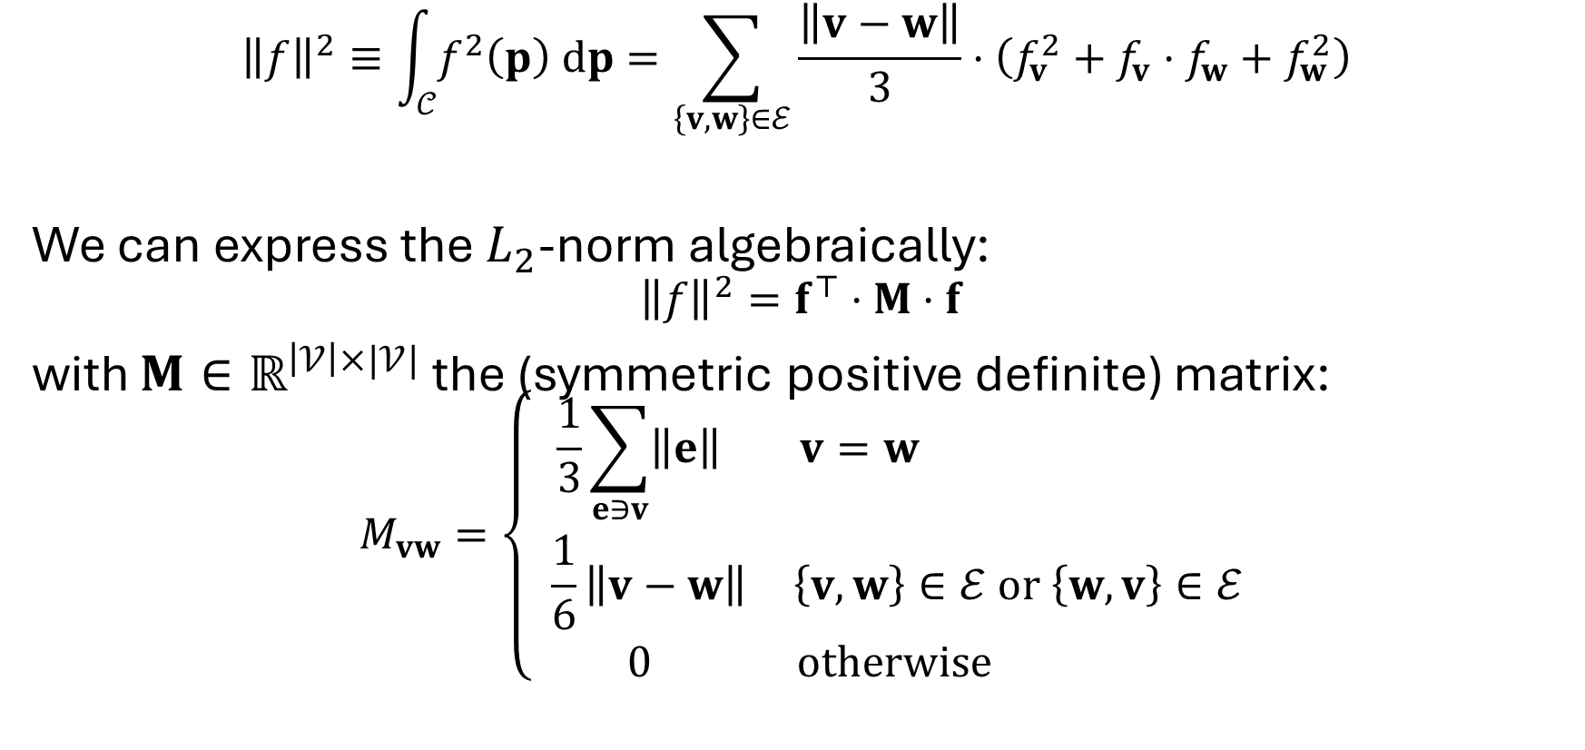
$L_{2}$-norm on curves
$${\left\|f\right\|}^{2}≡\int_{𝒞}{f^{2}\left(p\right) dp}=\sum_{\left\{v,w\right\}∈ℰ}{\frac{\left\|v−w\right\|}{3}⋅\left(f_{v}^{2}+f_{v}⋅f_{w}+f_{w}^{2}\right)}$$
We can express the $L_{2}$-norm algebraically:
$${\left\|f\right\|}^{2}=f^{⊤}⋅M⋅f$$
with $M∈ℝ^{\left|𝒱\right|×|𝒱|}$ the (symmetric positive definite) matrix:
$$M_{vw}=\left\{\begin{matrix}\frac{1}{3}\sum_{e∋v}{\left\|e\right\|} & v=w \\ \frac{1}{6}\left\|v−w\right\| & \left\{v,w\right\}∈ℰ or \left\{w,v\right\}∈ℰ \\ 0 & otherwise \end{matrix}\right.$$

Slide 20
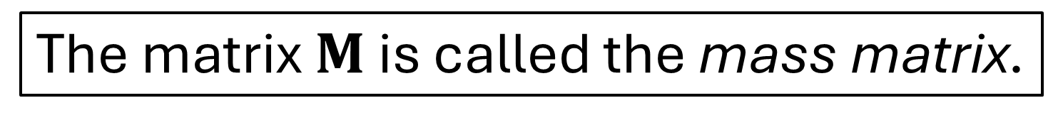
$L_{2}$-norm on curves
$${\left\|f\right\|}^{2}≡\int_{𝒞}{f^{2}\left(p\right) dp}=\sum_{\left\{v,w\right\}∈ℰ}{\frac{\left\|v−w\right\|}{3}⋅\left(f_{v}^{2}+f_{v}⋅f_{w}+f_{w}^{2}\right)}$$
We can express the $L_{2}$-norm algebraically:
$${\left\|f\right\|}^{2}=f^{⊤}⋅M⋅f$$
with $M∈ℝ^{\left|𝒱\right|×|𝒱|}$ the (symmetric positive definite) matrix:
$$M_{vw}=\left\{\begin{matrix}\frac{1}{3}\sum_{e∋v}{\left\|e\right\|} & v=w \\ \frac{1}{6}\left\|v−w\right\| & \left\{v,w\right\}∈ℰ or \left\{w,v\right\}∈ℰ \\ 0 & otherwise \end{matrix}\right.$$
The matrix $M$ is called the mass matrix.

Slide 21
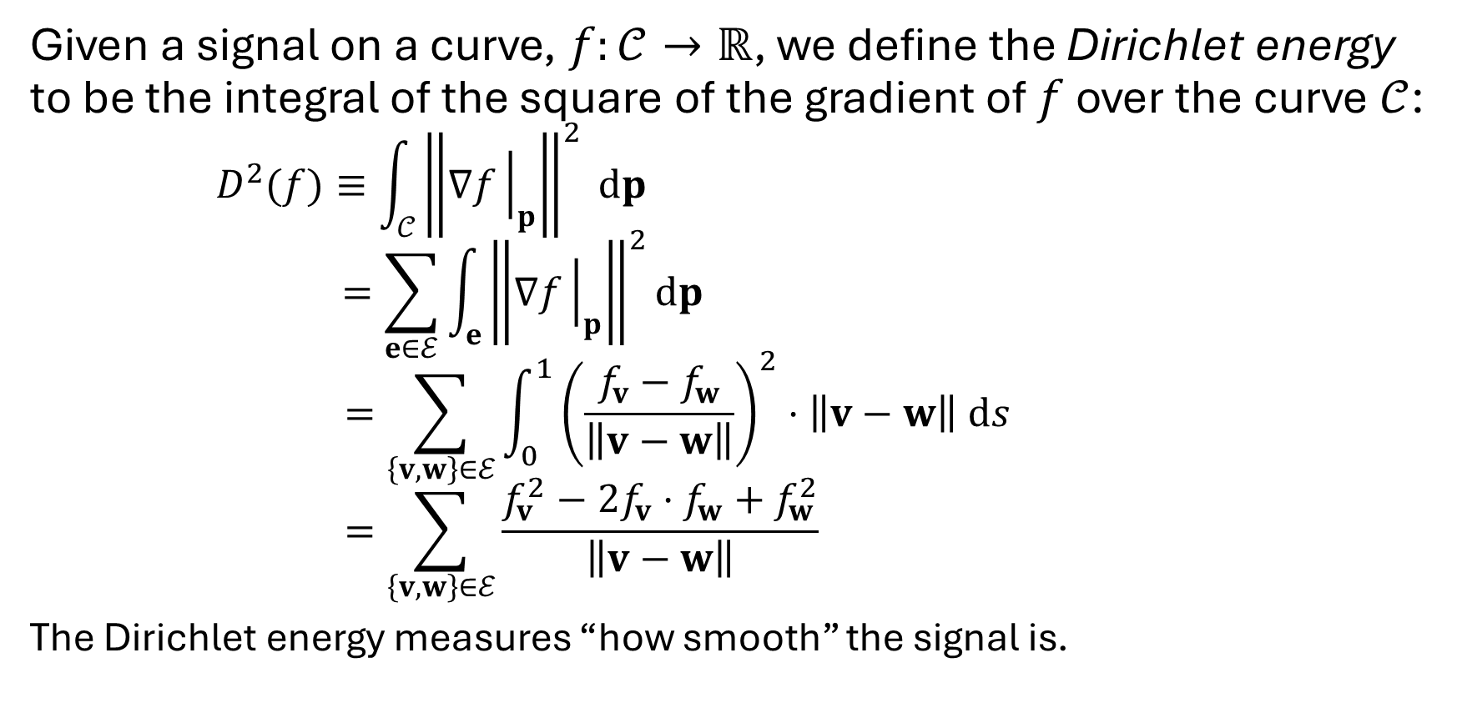
Dirichlet energy on curves
Given a signal on a curve, $f:𝒞→ℝ$, we define the Dirichlet energy to be the integral of the square of the gradient of $f$ over the curve $𝒞$:
$$D^{2}(f)≡\int_{𝒞}{{\left\|∇f{\left.​\right|}_{p}\right\|}^{2} dp}$$
$$=\sum_{e∈ℰ}{\int_{e}{{\left\|∇f{\left.​\right|}_{p}\right\|}^{2}dp}}$$
$$=\sum_{\left\{v,w\right\}∈ℰ}{\int_{0}^{1}{{\left(\frac{f_{v}−f_{w}}{\left\|v−w\right\|}\right)}^{2}⋅\left\|v−w\right\| ds}}$$
$$=\sum_{\left\{v,w\right\}∈ℰ}{\frac{f_{v}^{2}−2f_{v}⋅f_{w}+f_{w}^{2}}{\left\|v−w\right\|}}$$
The Dirichlet energy measures “how smooth” the signal is.

Slide 22
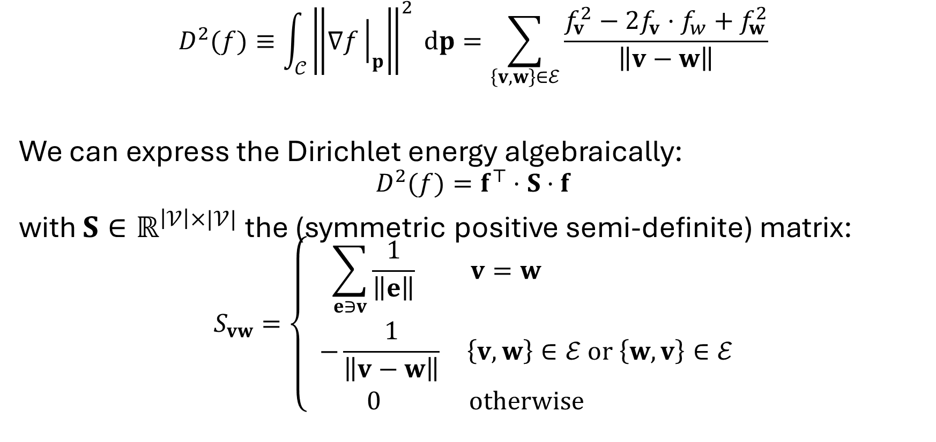
Dirichlet energy on curves
$$D^{2}(f)≡\int_{𝒞}{{\left\|∇f{\left.​\right|}_{p}\right\|}^{2} dp}=\sum_{\left\{v,w\right\}∈ℰ}{\frac{f_{v}^{2}−2f_{v}⋅f_{w}+f_{w}^{2}}{\left\|v−w\right\|}}$$
We can express the Dirichlet energy algebraically:
$$D^{2}(f)=f^{⊤}⋅S⋅f$$
with $S∈ℝ^{\left|𝒱\right|×|𝒱|}$ the (symmetric positive semi-definite) matrix:
$$S_{vw}=\left\{\begin{matrix}\sum_{e∋v}{\frac{1}{\left\|e\right\|}} & v=w \\ −\frac{1}{\left\|v−w\right\|} & \left\{v,w\right\}∈ℰ or \left\{w,v\right\}∈ℰ \\ 0 & otherwise \end{matrix}\right.$$

Slide 23
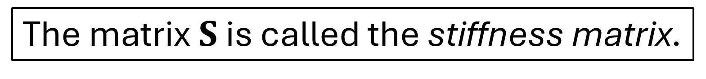
Dirichlet energy on curves
$$D^{2}(f)≡\int_{𝒞}{{\left\|∇f{\left.​\right|}_{p}\right\|}^{2} dp}=\sum_{\left\{v,w\right\}∈ℰ}{\frac{f_{v}^{2}−2f_{v}⋅f_{w}+f_{w}^{2}}{\left\|v−w\right\|}}$$
We can express the Dirichlet energy algebraically:
$$D^{2}(f)=f^{⊤}⋅S⋅f$$
with $S∈ℝ^{\left|𝒱\right|×|𝒱|}$ the (symmetric positive semi-definite) matrix:
$$S_{vw}=\left\{\begin{matrix}\sum_{e∋v}{\frac{1}{\left\|e\right\|}} & v=w \\ −\frac{1}{\left\|v−w\right\|} & \left\{v,w\right\}∈ℰ or \left\{w,v\right\}∈ℰ \\ 0 & otherwise \end{matrix}\right.$$
The matrix $S$ is called the stiffness matrix.

Slide 24
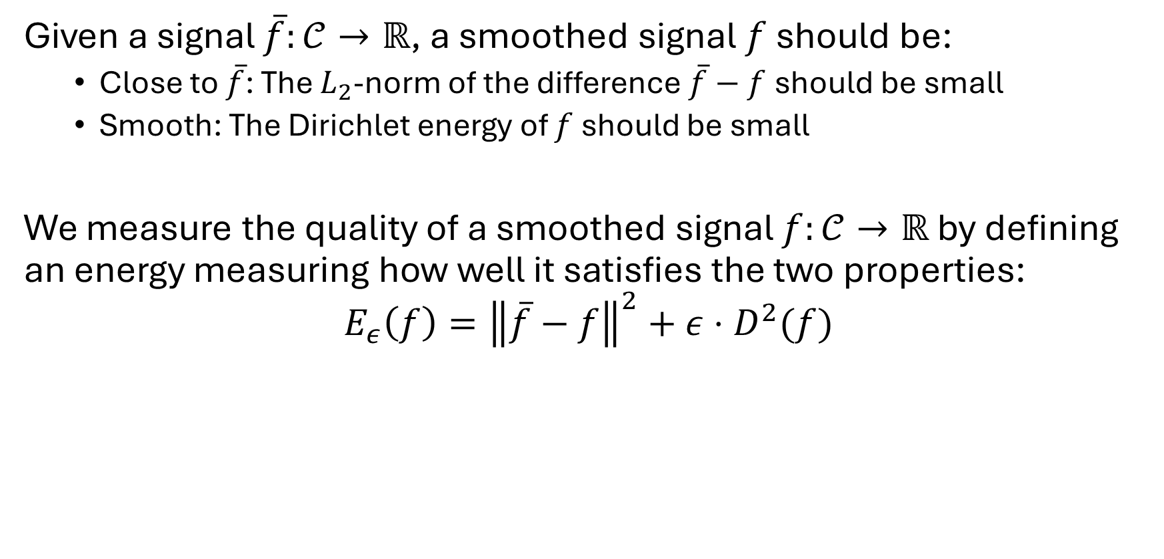
Smoothing signals on curves
Given a signal $\overline{f}:𝒞→ℝ$, a smoothed signal $f$ should be:
Close to $\overline{f}$: The $L_{2}$-norm of the difference $\overline{f}−f$should be small
Smooth: The Dirichlet energy of $f$ should be small
We measure the quality of a smoothed signal $f:𝒞→ℝ$ by defining an energy measuring how well it satisfies the two properties:
$$E_{ε}\left(f\right)={\left\|\overline{f}−f\right\|}^{2}+ε⋅D^{2}(f)$$

Slide 25
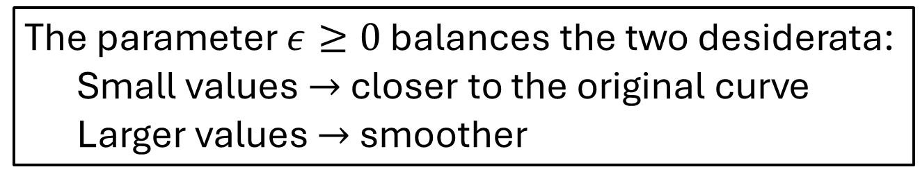
Smoothing signals on curves
Given a signal $\overline{f}:𝒞→ℝ$, a smoothed signal $f$ should be:
Close to $\overline{f}$: The $L_{2}$-norm of the difference $\overline{f}−f$should be small
Smooth: The Dirichlet energy of $f$ should be small
We measure the quality of a smoothed signal $f:𝒞→ℝ$ by defining an energy measuring how well it satisfies the two properties:
$$E_{ε}\left(f\right)={\left\|\overline{f}−f\right\|}^{2}+ε⋅D^{2}(f)$$
The parameter $ε≥0$ balances the two desiderata:
Small values $→$ closer to the original curve
Larger values $→$ smoother

Slide 26
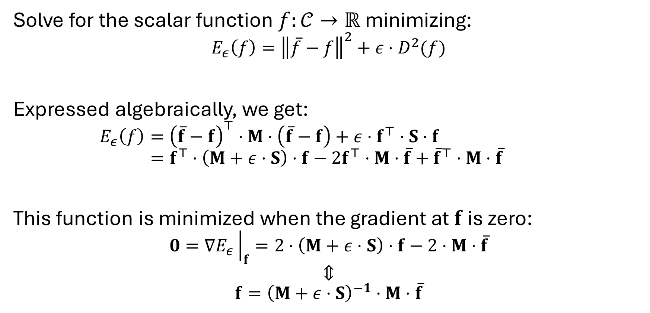
Smoothing signals on curves
Solve for the scalar function $f:𝒞→ℝ$ minimizing:
$$E_{ε}\left(f\right)={\left\|\overline{f}−f\right\|}^{2}+ε⋅D^{2}(f)$$
Expressed algebraically, we get: $$E_{ε}\left(f\right)={\left(\overline{f}−f\right)}^{⊤}⋅M⋅\left(\overline{f}−f\right)+ε⋅f^{⊤}⋅S⋅f$$
$$=f^{⊤}⋅\left(M+ε⋅S\right)⋅f−2f^{⊤}⋅M⋅\overline{f}+{\overline{f}}^{⊤}⋅M⋅\overline{f}$$
This function is minimized when the gradient at $f$ is zero: $$0=∇E_{ε}{\left.​\right|}_{f}=2⋅\left(M+ε⋅S\right)⋅f−2⋅M⋅\overline{f}$$
$$⇕$$
$$f={\left(M+ε⋅S\right)}^{−1}⋅M⋅\overline{f}$$

Slide 27
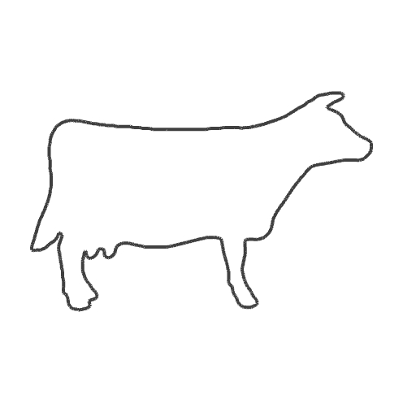
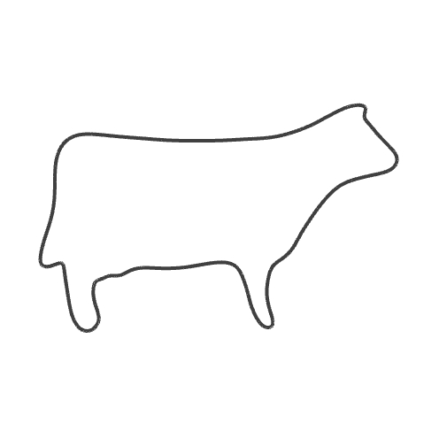

Curve post-smoothing
Given a curve $𝒞=\{𝒱,ℰ\}$, with $𝒱⊂ℝ^{d}$, we can smooth the curve by:
Treating the coordinates of the vertices as functions,
Smoothing the coordinate functions independently, and
Over-writing the vertex coordinates with the smoothed coordinates
Note:
Implicitly, we are treating edges between vertices as straight.

Slide 28
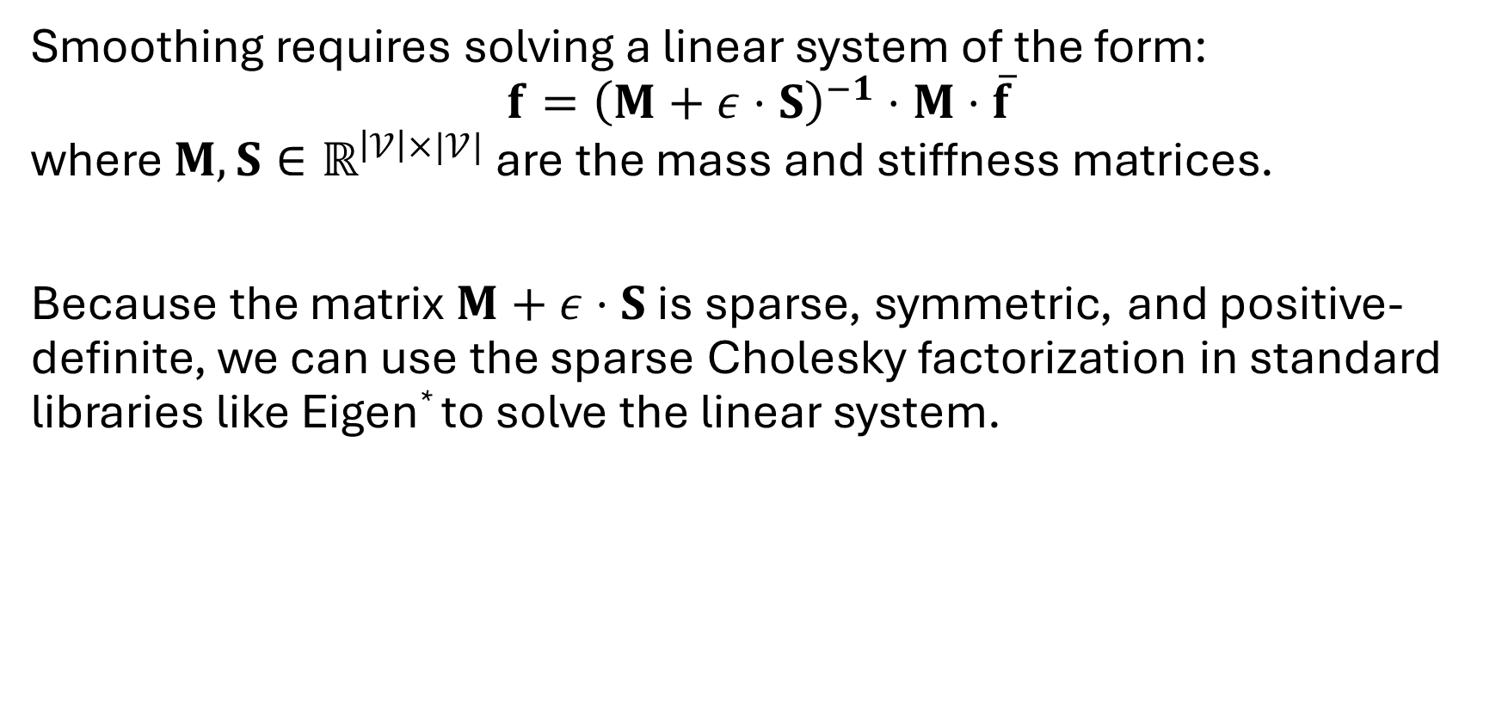
Implementation (solving)
Smoothing requires solving a linear system of the form: $$f={\left(M+ε⋅S\right)}^{−1}⋅M⋅\overline{f}$$ where $M,S∈ℝ^{\left|𝒱\right|×|𝒱|}$ are the mass and stiffness matrices.
Because the matrix $M+ε⋅S$ is sparse, symmetric, and positive-definite, we can use the sparse Cholesky factorization in standard libraries like Eigen* to solve the linear system.
* https://eigen.tuxfamily.org/

Slide 29
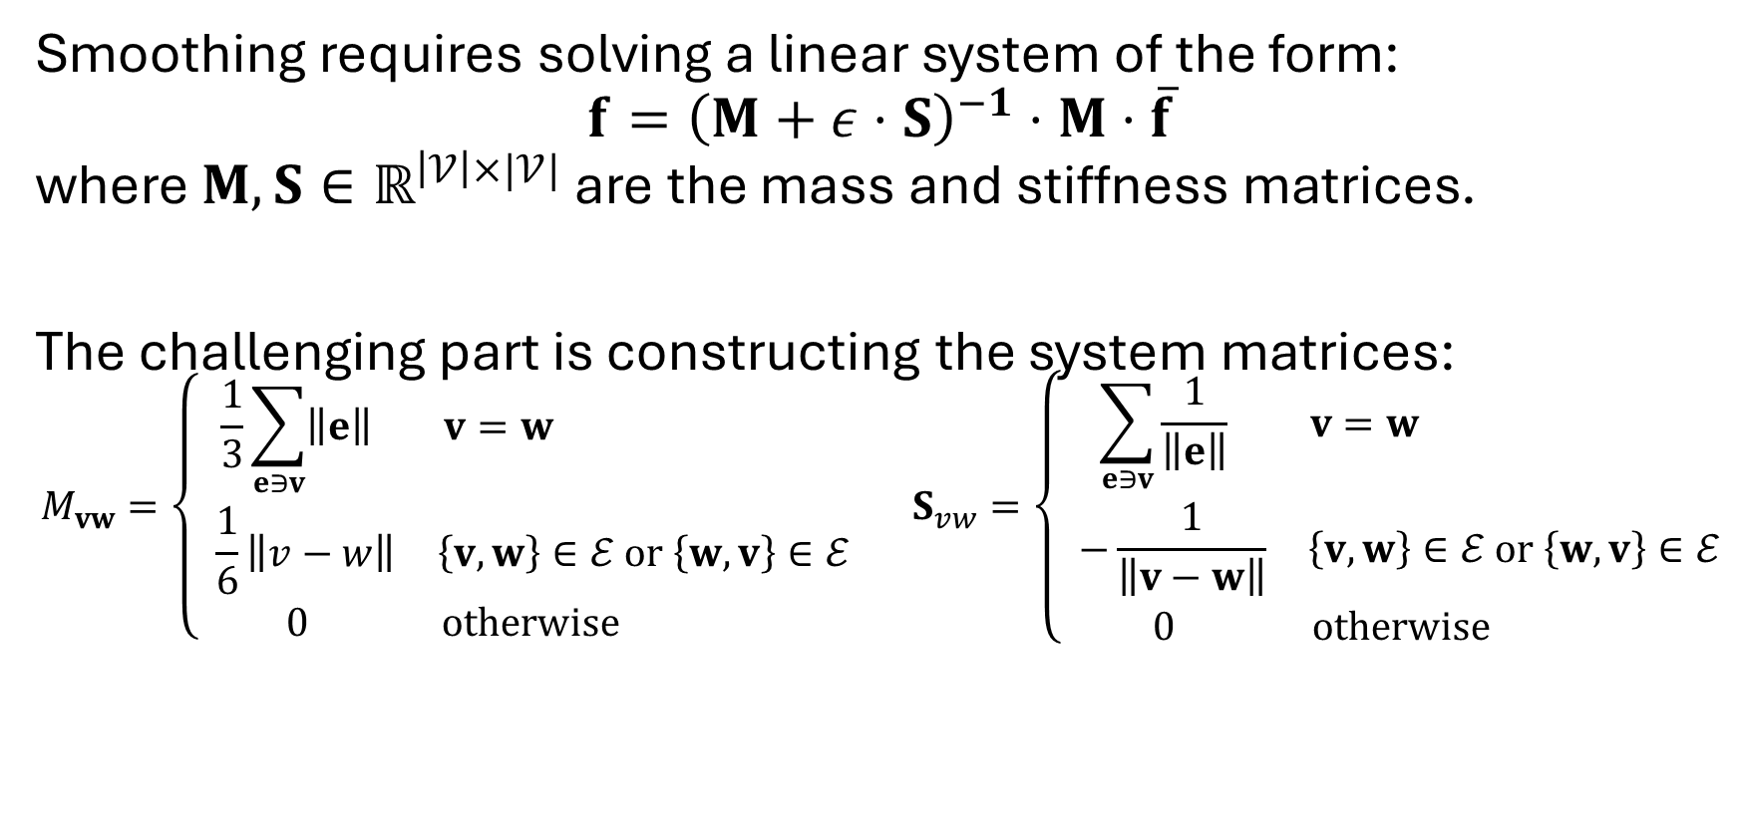
Implementation (constructing)
Smoothing requires solving a linear system of the form: $$f={\left(M+ε⋅S\right)}^{−1}⋅M⋅\overline{f}$$ where $M,S∈ℝ^{\left|𝒱\right|×|𝒱|}$ are the mass and stiffness matrices.
The challenging part is constructing the system matrices:
$$M_{vw}=\left\{\begin{matrix}\frac{1}{3}\sum_{e∋v}{\left\|e\right\|} & v=w \\ \frac{1}{6}\left\|v−w\right\| & \left\{v,w\right\}∈ℰ or \left\{w,v\right\}∈ℰ \\ 0 & otherwise \end{matrix}\right. S_{vw}=\left\{\begin{matrix}\sum_{e∋v}{\frac{1}{\left\|e\right\|}} & v=w \\ −\frac{1}{\left\|v−w\right\|} & \left\{v,w\right\}∈ℰ or \left\{w,v\right\}∈ℰ \\ 0 & otherwise \end{matrix}\right.$$

Slide 30
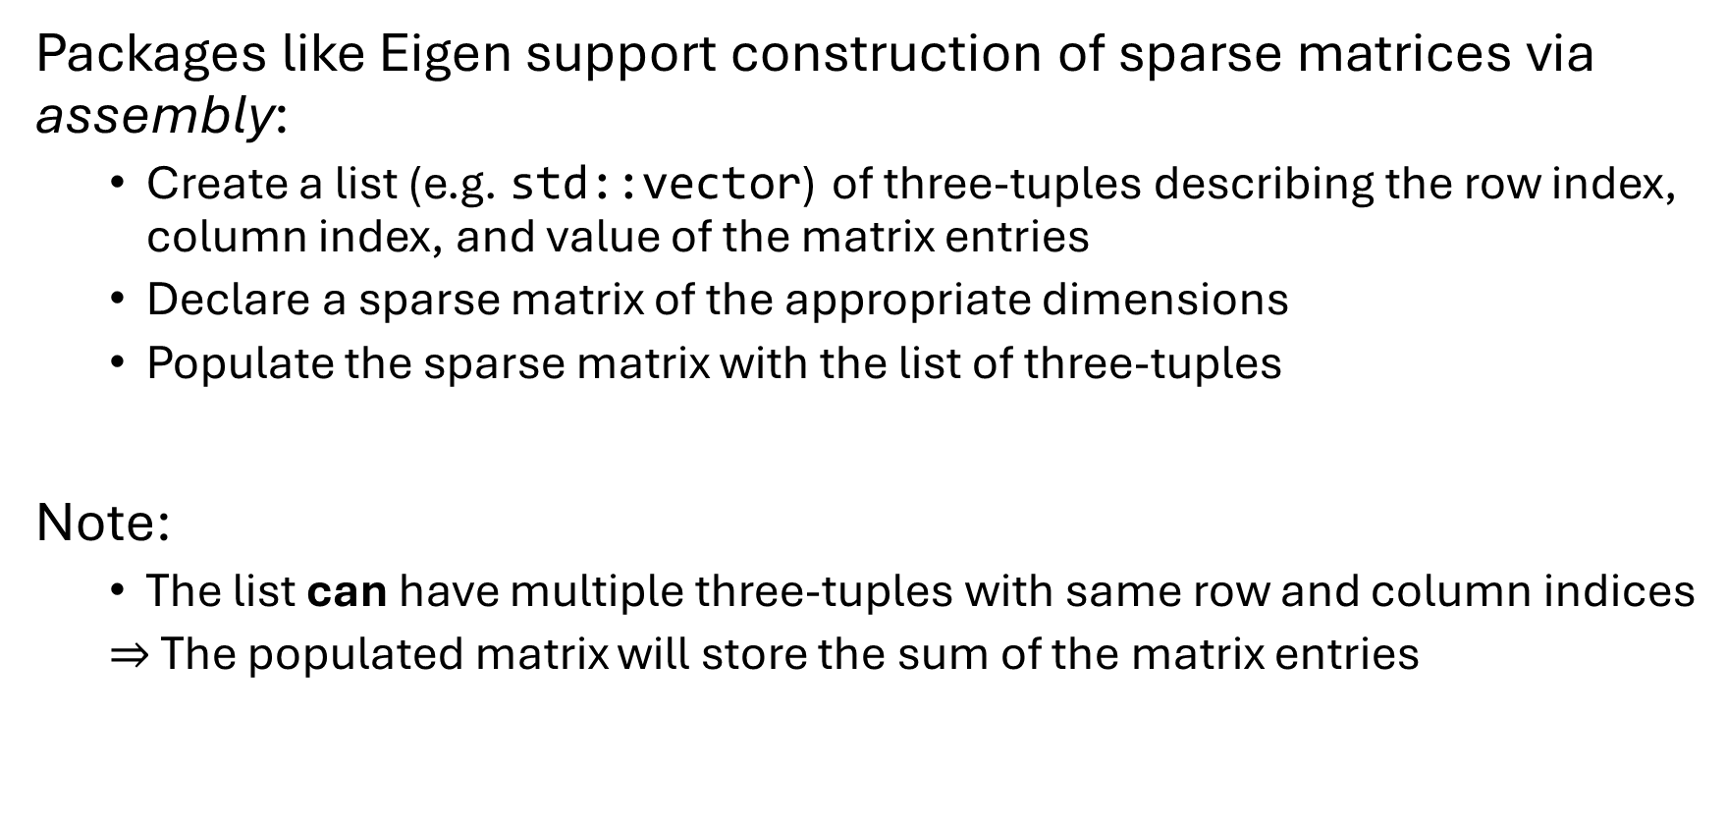
Implementation (constructing)
Packages like Eigen support construction of sparse matrices via assembly:
Create a list (e.g. std::vector) of three-tuples describing the row index, column index, and value of the matrix entries
Declare a sparse matrix of the appropriate dimensions
Populate the sparse matrix with the list of three-tuples
Note:
The list can have multiple three-tuples with same row and column indices
$⇒$ The populated matrix will store the sum of the matrix entries

Slide 31
Implementation (constructing)
#include <Eigen/Sparse>
unsigned int nV; // the number of vertices
...
std::vector< Eigen::Triplet< double > > triplets;
// set the triplets by iterating over the edges and
// adding matrix entry contributions from each edge
...
Eigen::SparseMatrix< double > M( nV , nV );
M.setFromTriplets( triplets.begin() , triplets.end() );

Slide 32
Smoothing: recap
Pre-smoothing:
Smooth the signal, extract the curve
The topology can change
Vertices cannot be tracked
Post-smoothing:
Extract the curve, smooth the geometry
Vertices can be tracked
Topology is fixed

Slide 33
Smoothing: recap
Pre-smoothing:
Smooth the signal, extract the curve
The topology can change
Vertices cannot be tracked
Post-smoothing:
Extract the curve, smooth the geometry
Vertices can be tracked
Topology/connectivity is fixed

