Slide 1
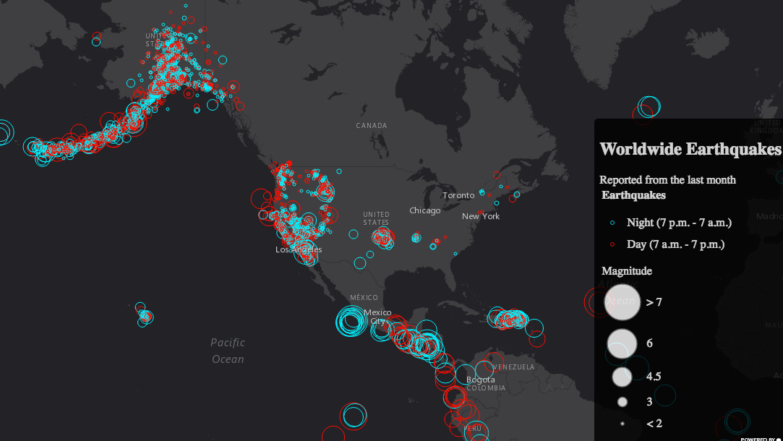

Arcade
Expression language that can be used and safely distributed in apps across the ArcGIS platform
var utcDate = toUTC(Date($feature.time));
var hour = Hour(DateAdd(utcDate, $feature.tz, 'minutes'));
if(hour >= 7 && hour < 19){ return 'day'; }
if(hour >= 19 || hour < 7){ return 'night'; }

