Slide 1
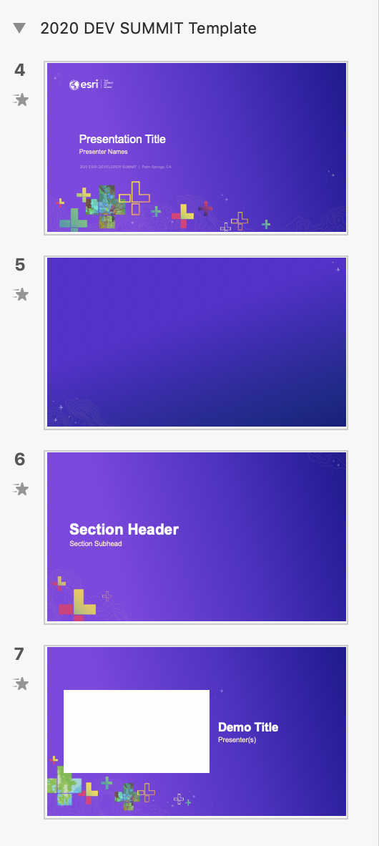
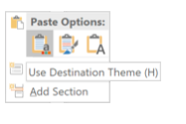
How to apply this template to existing slides
Which background to use?
Open your previous presentation.
Copy all relevant slides from previous presentation to this template. Paste using Destination Theme.
Going slide by slide, copy the Standard Background image.
Paste and send to back. Windows shortcut: Ctrl+Shift+[
Delete any remaining pieces left from the old background.
For other backgrounds (Title, Section Divider, Demo Intro) use the provided slides in this template.
Check your fonts. The default font is Arial to maintain consistency across the enterprise. If you used Avenir previously, consider switching to Arial to avoid unknown font substitution by other users. Instructions for changing font themes.
Why not use PowerPoint’s template features?
Title
Standard Background
Section Divider
Demo Intro
—
Use behind Images
Notes:
G456808 DEVELOPER SUMMIT 2020 Template for Esri staff

Slide 2
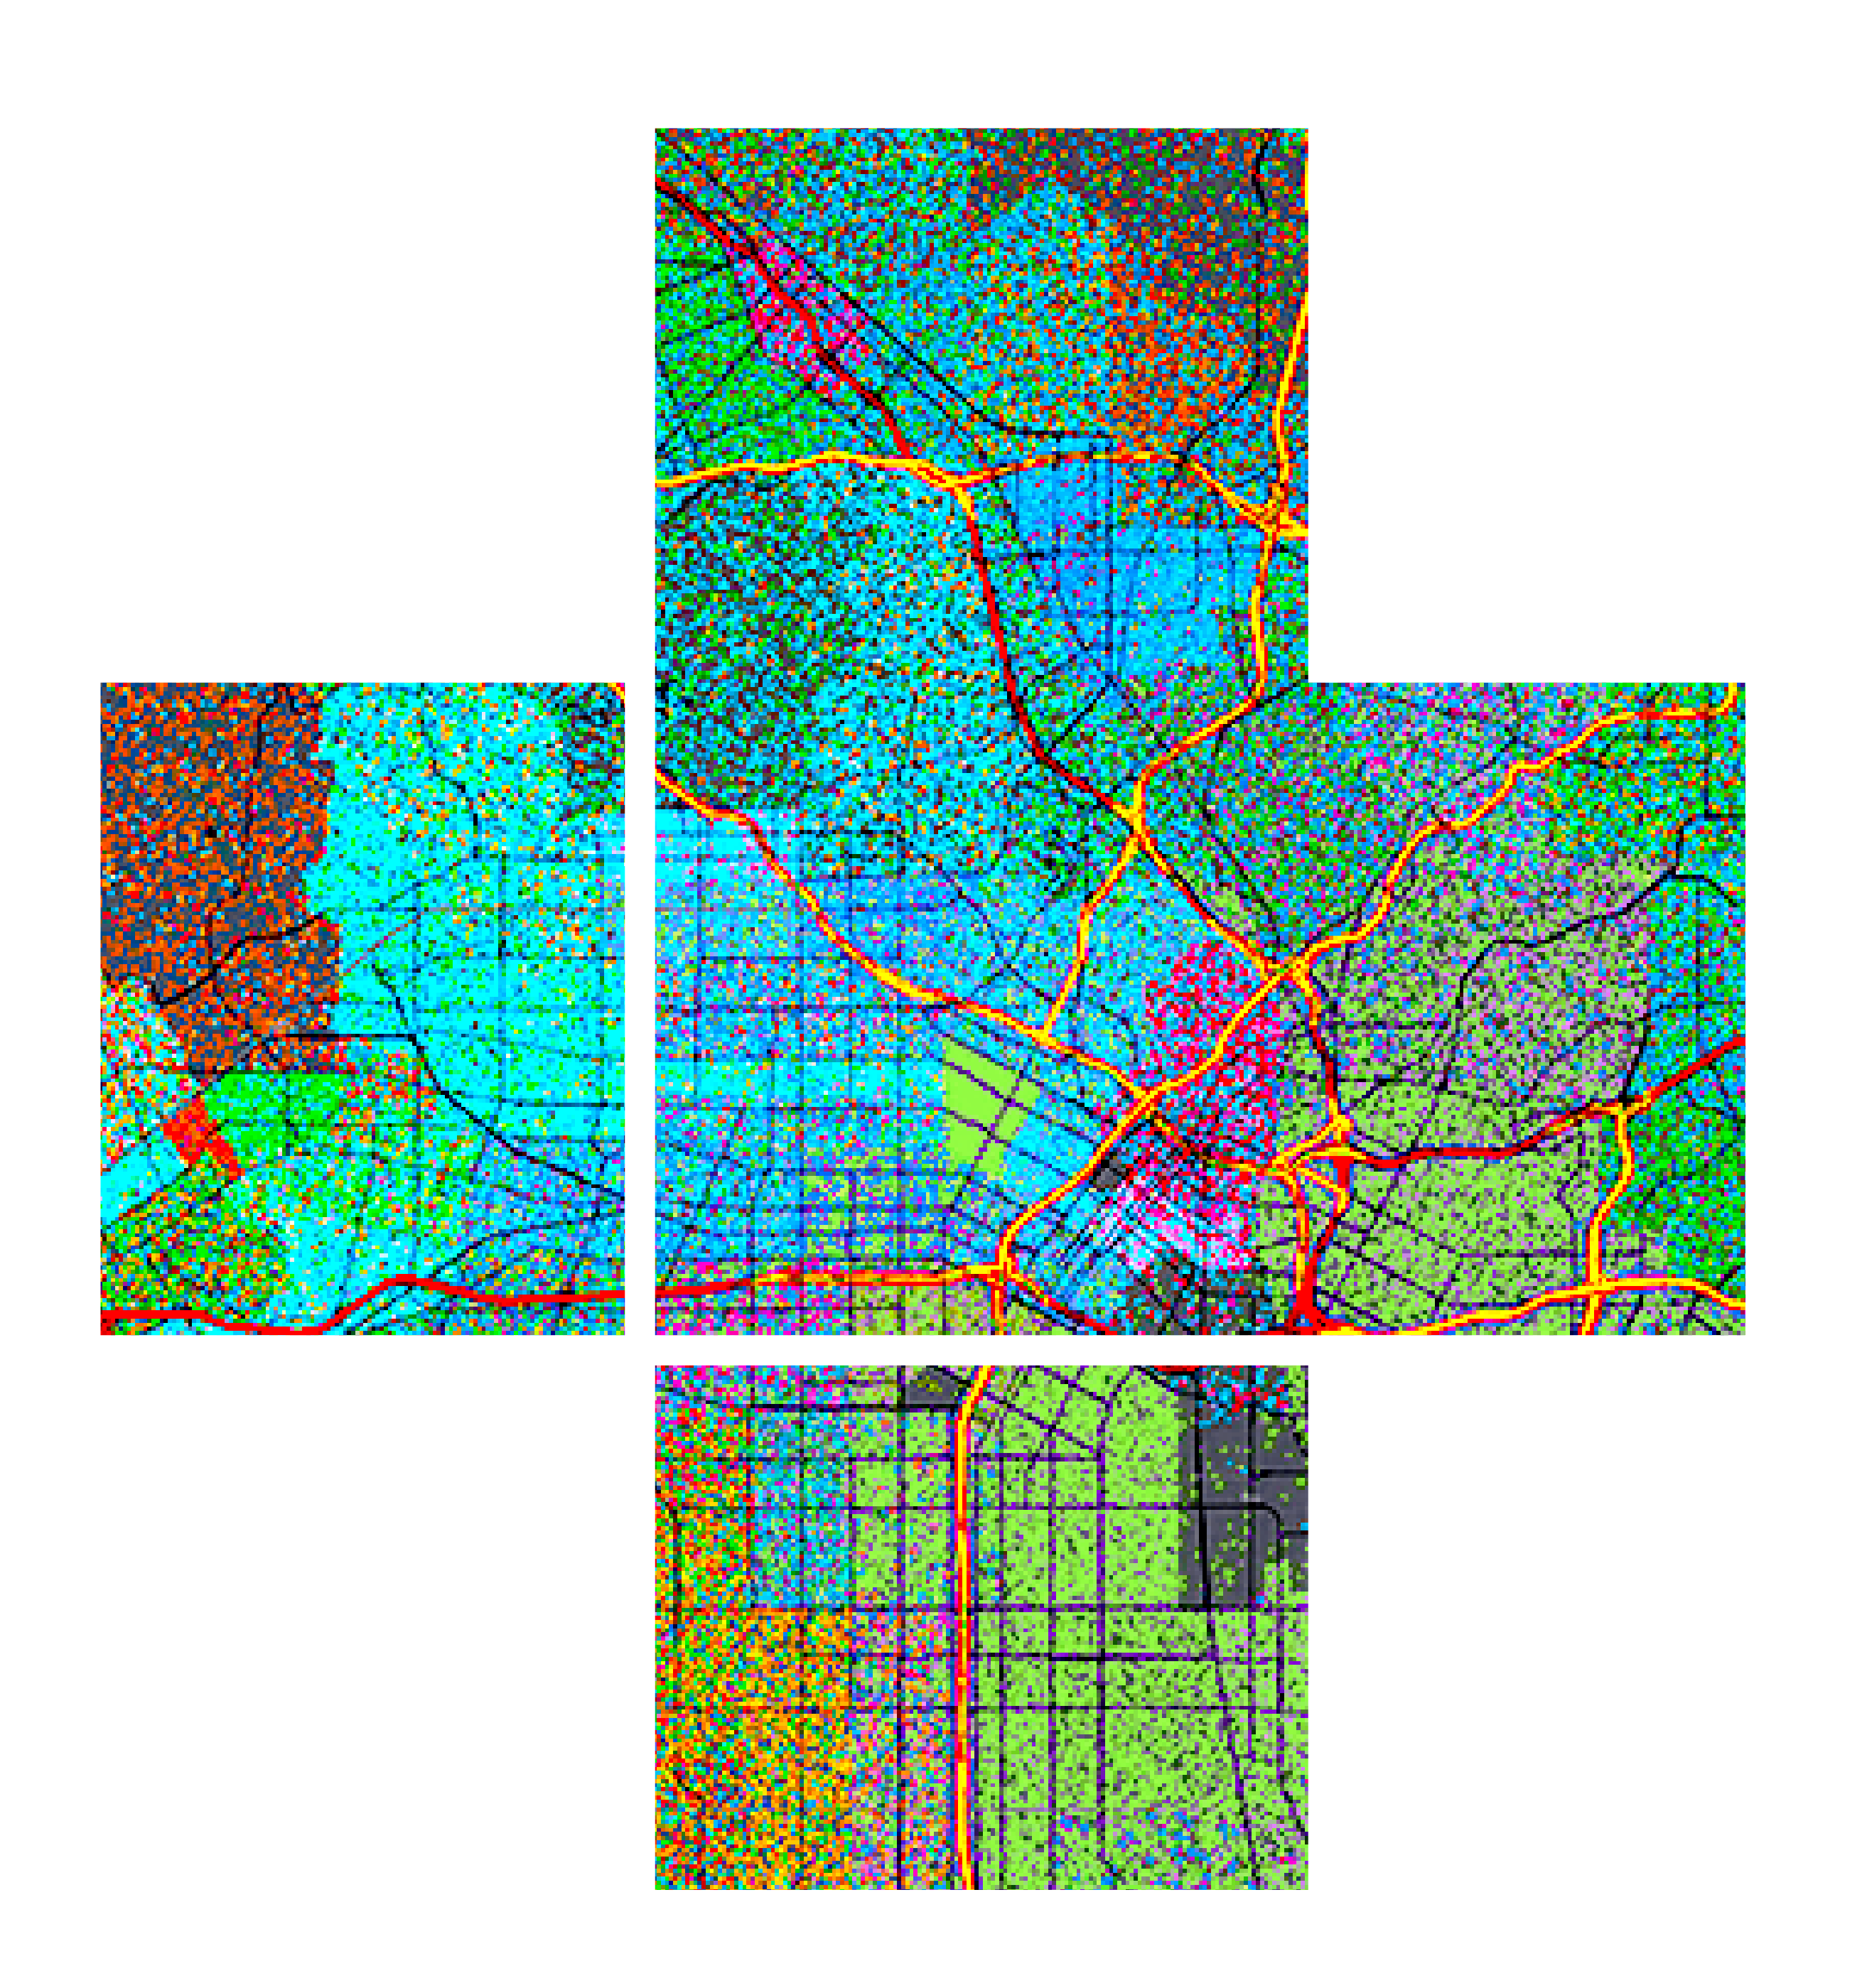








Presentation Title
Please leave artwork “+” clustered.
Do not use them alone, as bullet points, or as a “plus” concept. Thank you.
Presenter Names
2020 ESRI DEVELOPER SUMMIT | Palm Springs, CA

Slide 3


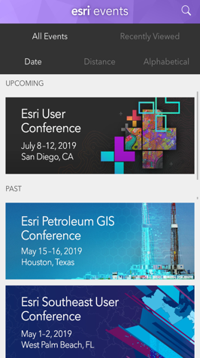
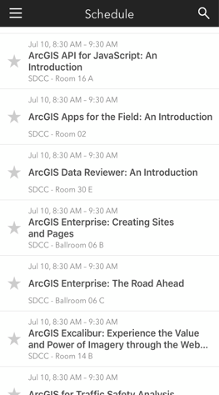
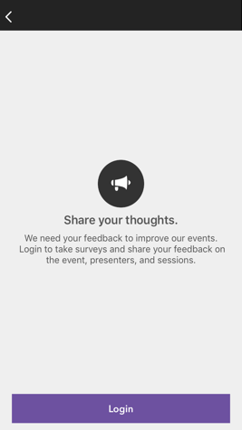
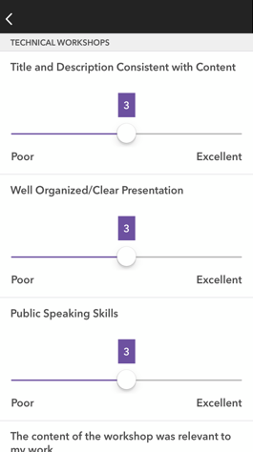




Please Share Your Feedback in the App
Download the Esri Events app and find your event
Select the session you attended
Scroll down to “Survey”
Log in to access the survey
Complete the survey and select “Submit”
Notes:
Guidance:
This is the survey slide. You can use the example as is or you can screenshot your session.

Slide 4
Presentation Title
Please leave artwork “+” clustered.
Do not use them alone, as bullet points, or as a “plus” concept. Thank you.
Presenter Names
2020 ESRI DEVELOPER SUMMIT | Palm Springs, CA

Slide 5



Slide 6


Section Header
Section Subhead

Slide 7

Demo Title
Presenter(s)

