Slide 1





Layers and Layer Views
Working with data already on the client

Slide 2


const layer = new FeatureLayer({ url: "https://services.arcgis.com/..." });

Slide 3
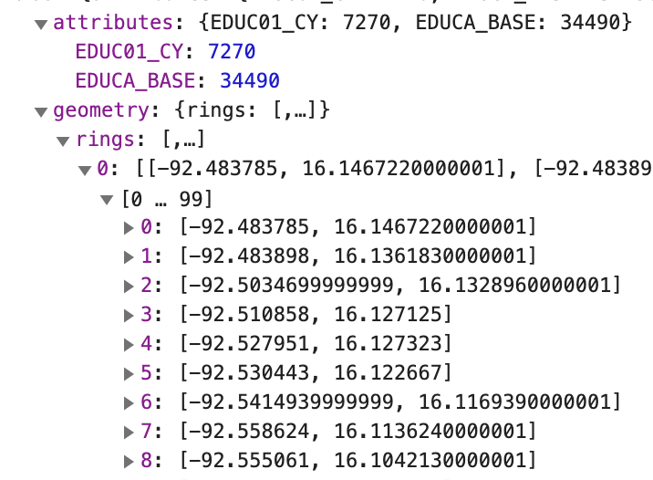
const layer = new FeatureLayer({ url: "https://services.arcgis.com/..." });
view.map.add(layer);

Slide 4
const layer = new FeatureLayer({ url: "https://services.arcgis.com/..." });
view.map.add(layer);
// features queried from server
const { features } = await layer.queryFeatures();

Slide 5
const layer = new FeatureLayer({ url: "https://services.arcgis.com/..." });
view.map.add(layer);
const layerView = await view.whenLayerView(layer); // features queried from client
const { features } = await layerView.queryFeatures();

