Slide 1


Building Interactive Web Apps Using the JavaScript API's Geometry Engine
Kristian Ekenes and David Bayer
Notes:
Esri Corporate Template-Dark v3.3
16:9 version – January 21, 2016
For more templates, sample files, and icons, see https://compass.esri.com/resources/presentations/Pages/Main.aspx
To add footer text in Windows
On the Home tab, under Insert, click Text, and then click Header and Footer.
Click the Slide tab, select the Footer check box, and then type the footer text that you want.
Click either Apply or Apply to All.
To add footer text on a Mac
On the View menu, select Header and Footer.
Select the Footer check box and then type the footer text that you want.
Click either Apply or Apply to All.
If footers don't appear on the slides
If footers don't appear on title slides, in the Header and Footer dialog box make sure the Don't show on title slide check box is not selected.
If the footers are missing from other slides, the placeholders for these items might have been removed from specific slide layouts or the slide master.

Slide 2


Session Goals
Overview of the Geometry Engine
What operations are available with the Geometry Engine?
Coding with the Geometry Engine
How to use the Geometry Engine
Geometry Engine Internals
Spatial Reference Tolerance
Async Architecture
When to use the Geometry Engine
Where will it make a difference to your app
Notes:
OK… Quick Question… who came to the talk yesterday, giving an overview of the Geometry Engine.
This talk is going to go through a lot of the same materials, but we are planning on showing a few more demos, and giving a bit more detail about to use the various methods.
In this talk, we are going to run through the ESRI Javascript APIs geometry Engine.
This engine was incorporated into the API last year, and provides a lot of scope for making certain types of applications much more interactive.
We are going to through the type of operations that exist in the Geometry Engine, then look at how to actually make calls to the geometry engine, before finally looking at why you may want to use it, and when not to use it.

Slide 3
Geometry
Points, Lines, Polygons, Multipoints, …
Notes:
Geometry…. Points, Lines, Polygons, Multi Points.
As we all know Geometry is fundamental to GIS. Features on the ground are represented as geometric shapes, with real world coordinates.
The relationships between these shapes is how spatial analysis works. Understanding whether geometries overlap, what the intersection between shapes are, the distance between features.
The geometry engine in the Javascript API, allows you to do these types of operations in your web apps, running in the browser.
So what kind of operations can you do.

Slide 4
Geometry Engine: what is it?
Touches
Geometry Relationships
Overlaps
Crosses
Equals
Within
Intersects
Orchards Demo
Notes:
There are lots of methods in the GeometryEngine. Possibly the most useful, are the relationship tests you can do with the Geometry Engine.
These relationship tests, will tell you whether geometries overlap each other, of they intersect each other, cross, touch, are equal.
All of these operations, work with the Spatial Tolerance of the data. So this means that functions such as equal, will tell you if two shapes are the same, even if they are have very slight mathematical differences in coordinates, which are below the tolerance of the coordinate system.
If we look at a quick demo of those operations…
It is also worth noting, that these operations work across the different geometry types, so you can test whether a line crosses a polygon, or whether a line crosses another line.

Slide 5
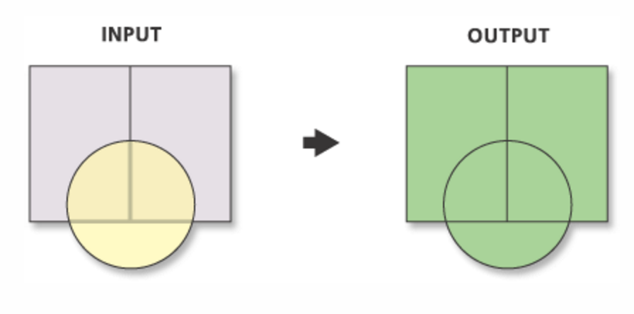
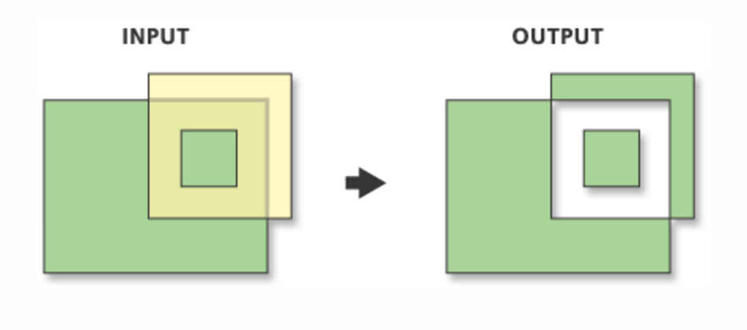
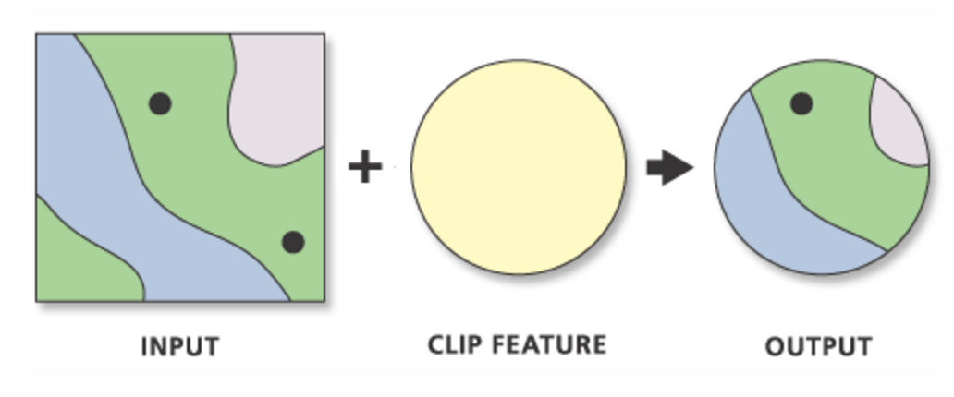
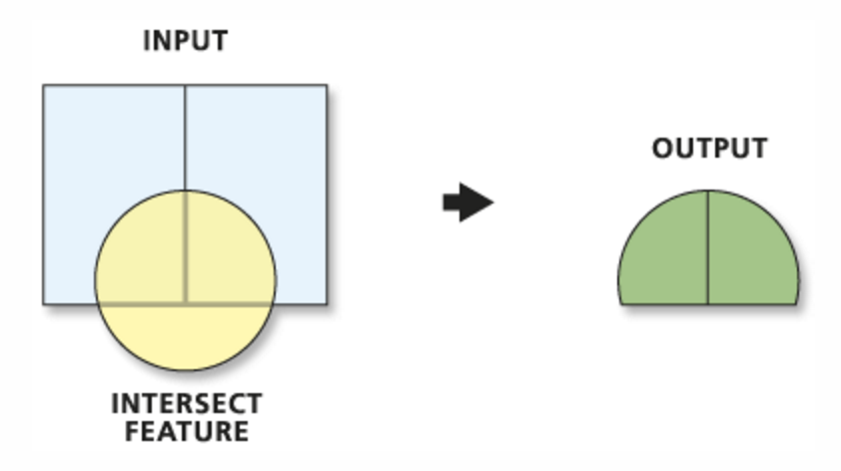
Geometry Engine: what is it?
Geometry Algebra/Overlay operations
Union
Symmetric Difference
Clip
Intersection
Utah land demo
Notes:
Understanding the relationships between geometries is useful, but very often in applications you need the actual intersection geometry between shapes, or you need to clip shapes, union shapes. These are typically used for overlay operations.
The geometry Engine allows you to do this kind of operation as well.

Slide 6
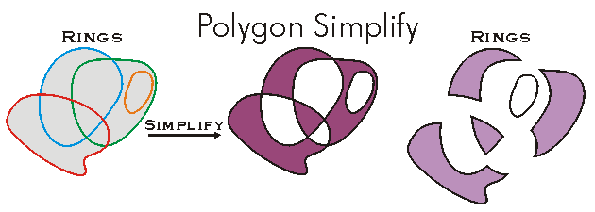
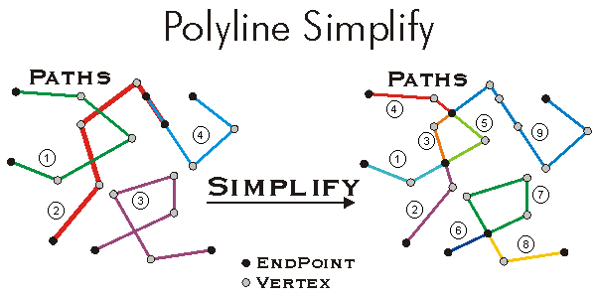
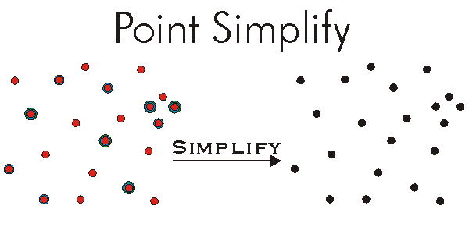
Geometry Engine: what is it?
Topological Correctness : Simplify, isSimple
Simplify polygon demo

Slide 7
Geometry Engine: what is it?
Nearest Vertices, Nearest Coordinates
Nearest Vertex Demo

Slide 8
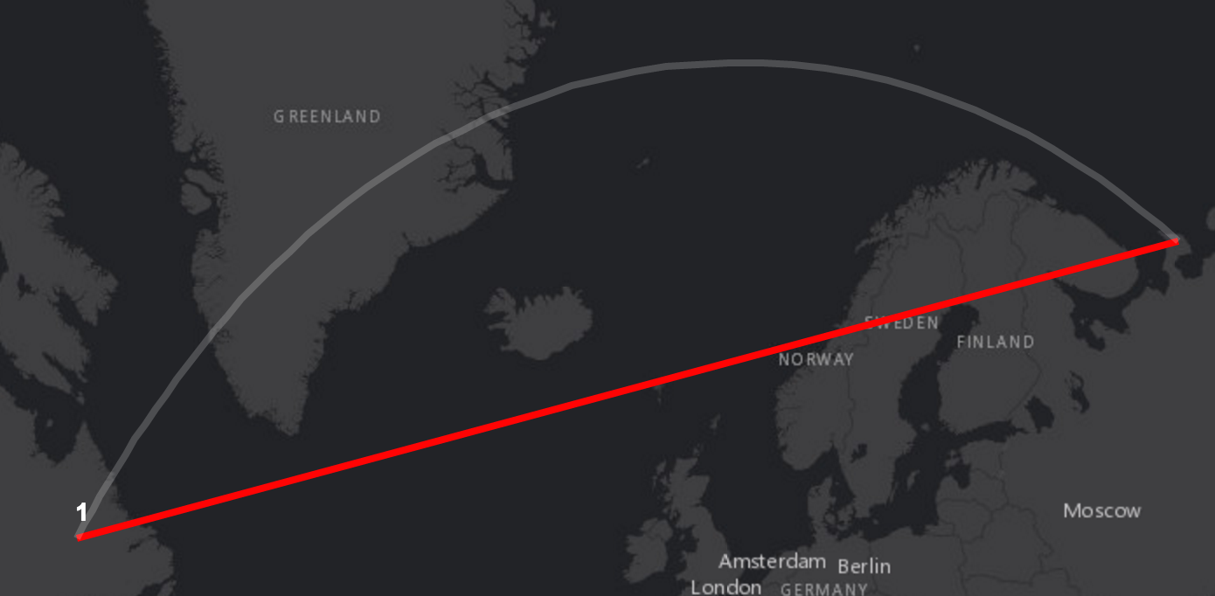
Geometry Engine: what is it?
Distances and Measurements
geodesicLength
planarLength
geodesicArea
planarArea
geodesic and planar measurement demo
Notes:
There are also other kinds of operations… distances and measurements.. What is the distance between two points, or the length or area of a line.
The geometry Engine gives you the ability to calculate planar lengths and areas for features.
Also importantly, it gives you the ability to do geodesicLengths and geodesic areas. [If you are in WebMercator].. It is worth pointing out, that the geometry engine does not have projection engine. If you need to do projection you will need to use server side calls.

Slide 9
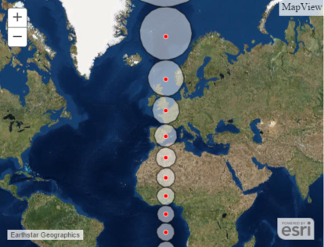
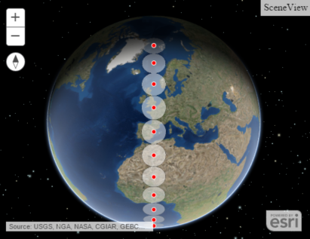
Geometry Engine: what is it?
Buffering and Geodesic Buffering
Missiles

Slide 10
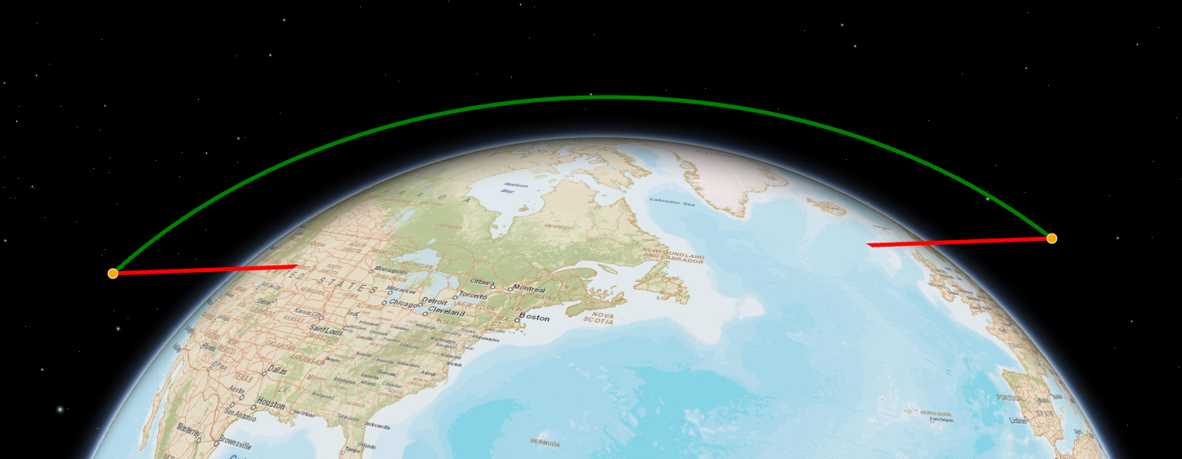
Geometry Engine: what is it?
Other Operations
Rotate
Flip
Generalize
Densify
ConvexHull
geodesicDensify
Notes:
There are many more methods in the geometry engine…
Buffering, and Geodesic Buffering allows you to grow and shrink geometries.
Generalize and Densify, allow you increase or reduce the number of vertices in your geometries.
IsSimple and Simplify allow you to fix issues with your geometry, and make them legal. This allows you to fix geometry that is not topologically correct, say if it has self intersecting lines

Slide 11
I can do this already….
It’s called the Geometry Service!
Notes:
[DAVID]
You will all have realised, that you have been able to do all of these operations for the past 10 years with the ESRI Javascript API.
You can just make a REST call to the Geometry Service, and voila… You have clipped, unioned, intersected

Slide 12
User Experience: Interactivity
Geometry Service REST Call
Encoding
Geometry
as JSON
5ms
Sending Request over Network
200+ ms
Running Geometry
Operation
100+ ms
Sending Response back
over Network
200+ ms
Decoding
Response
5ms
Notes:
The Geometry Service, requires you to make a REST Call
The geometry involved in the operation is converted to JSON, sent over the wire to the Geometry Service. The geometry service runs its logic, and sends the results back over the wire.
This is 500ms + for every operation… For poor networks, or large payloads even longer.
Interactive UX is measured in <300ms

Slide 13
User Experience: Interactivity
Geometry Engine API Call
Running Geometry Operation
200+ ms
Notes:
The Geometry Service, requires you to make a REST Call
The geometry involved in the operation is converted to JSON, sent over the wire to the Geometry Service. The geometry service runs its logic, and sends the results back over the wire.
This is 500ms + for every operation… For poor networks, or large payloads even longer.
Interactive UX is measured in <300ms

Slide 14
Demo
How many REST calls can I save?
Orchards demo: number of GS requests avoided
Notes:
Purpose of DEMO, is cool demo, showing on the fly, splitting, cutting, area etc

Slide 15
Writing Apps with the Geometry Engine
Notes:
You will all have realised, that you have been able to do all of these operations for the past 10 years with the ESRI Javascript API.
You can just make a REST call to the Geometry Service, and voila… You have clipped, unioned, intersected

Slide 16
Geometry Engine : Writing Code
Calling the methods
require( [ “esri/geometry/geometryEngine” ],
function( geometryEngine ) {
var buffer = geometryEngine.buffer(mapPoint, 10, “miles”);
});
Notes:
AMD the Module,
Call the Operation

Slide 17
Geometry Service : Code Comparison
require( [ “esri/tasks/GeometryService”, “esri/tasks/BufferParameters” ],
function( GeometryService, BufferParameters ) {
var geomService = new GeometryService("//.../GeometryServer");
var bufferParams = new BufferParameters();
bufferParams.geometries = [mapPoint]
bufferParams.distances = [10]
bufferParams.unit = GeometryService.UNIT_MILE;
bufferParams.outSpatialReference = map.spatialReference;
geomService.buffer( bufferParams, function(buffer) {
});
});
Notes:
AMD the Module,
Call the Operation

Slide 18
Building an Editing App
Notes:
Quick Practical Example… Lets Build an Editing App with the Geometry Engine

Slide 19
Building Analysis Apps
Notes:
[KRISTIAN]

Slide 20
Synchronous versus Asynchronous
You can use GeometryEngine Async
Notes:
Purpose of DEMO, is cool demo, showing on the fly, splitting, cutting, area etc

Slide 21
Geometry Engine Async
Asynchronous Geometry Engine
Uses Web Workers to perform Geometry Engine
Operations return Promises.
Benefits
Browser is not blocked whilst operations run
Greater throughput. Operations can run in parallel
Easier substitution of existing GeometryService code
Drawbacks
Older Browsers do not support WebWorkers

Slide 22
Asynchronous Patterns
Uses Deferred Pattern
require( [ “esri/geometry/geometryEngineAsync” ],
function( geometryEngineAsync ) {
geometryEngineAsync.buffer(mapPoint, 10, “miles”).then( function(buffer) {
},
function(erre) {
});
});
Buffer 500 points: GeometryEngine vs GeometryService
Notes:
AMD the Module,
Call the Operation

Slide 23
Geometry Engine Internals
What is the geometry engine doing for me!
Notes:
[DAVID]

Slide 24
Spatial Tolerance
Spatial References have different Tolerances.
GeometryEngine uses X/Y Tolerance
in its calculations
XY Tolerance = 0.001

Slide 25
Spatial Tolerance
Inside the Geometry Methods
require( [ “esri/geometry/geometryEngine” ],
function( geometryEngine ) {
var mapPointA = new esriPoint(1.22, 2.0, map.spatialReference)
var mapPointB = new esriPoint(1.22000000001, 2.0, map.spatialReference)
var areequal = geometryEngine.equals(mapPointA, mapPointB);
// Returns True
});
Notes:
AMD the Module,
Call the Operation

Slide 26

Geometry Engine Async
Architecture and Throughput
buffer
Queued Geometry Operations
Busy
Busy
Busy
Busy
Free
Deferred
Resovle
WebWorker
SendMessage
Web
Worker
Web
Worker
Web
Worker
Web
Worker
Web
Worker
geometryEngine
Async

Slide 27
Coordinate Systems
Projected and Geographic
No Project Operation
Certain methods will only work in WebMercator or Geographic Coordinate Systems
GeodesicArea
GeodesicLength
GeodesicBuffer

Slide 28
When to Use the GeometryEngine
When will it make a difference to my App
Notes:
[KRISTIAN]

Slide 29
Geometry Engine: Trade-offs
Trade-off between Geometry Service and Geometry Engine
Large AMD download for Geometry Engine
versus
Network latency and round trip cost of Geometry Service
Other Considerations: Apps Requirements
Unsupported operations : projections
Frequency of calls : user interactivity
Offline or poor network connection
Ease of coding

Slide 30
Geometry Engine Resources
Documentation, Blogs, Samples

Slide 31
Resources
Documentation
https://developers.arcgis.com/javascript/jsapi/esri.geometry.geometryengine-amd.html
https://developers.arcgis.com/javascript/jsapi/esri.geometry.geometryengineasync-amd.html
Blogs
Testing spatial relationships and editing
Measurement
Overlay analysis
Demos/samples
https://github.com/ekenes/conferences/tree/master/ds-2016/ge-deep-dive
https://github.com/ekenes/esri-js-samples

