Slide 1
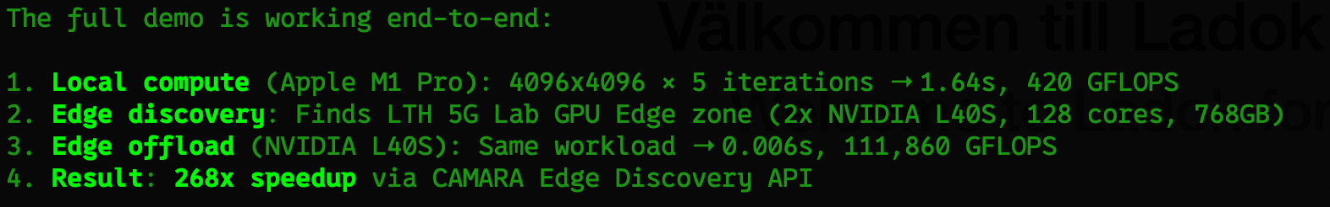
EdgeVision
- A real-world offloading demo in the LTH 5G Lab
Johan Eker, Ericsson
Work is part of the NextG2Com Competence Center, Vinnova projects AORTA & 6G-FOX
and the WASP research arena WARA-Ops
Notes:
KEY MESSAGE: EdgeVision demonstrates real-time AI inference offloaded to a 5G edge GPU using standardized CAMARA APIs.
Talking points:
- This is a working demo built on Ericsson's 5G SA lab at LTH
- Shows CAMARA Edge Cloud APIs orchestrating GPU workloads
- Demonstrates sub-20ms edge inference vs 500ms+ local CPU
REFERENCE: CAMARA project (Linux Foundation + GSMA, Dec 2022). GSMA Open Gateway announced MWC Feb 2023. Ericsson is a founding contributor.

Slide 2

6G is a network platform
Network APIs for differentiated communication services
Network APIs for information, compute & AI services
Transport data for anything, anywhere
Process & store data
Be a source of data
Notes:
6G should bring the use cases that are emerging with 5G to a larger scale. For instance, mixed reality and AI assistant glasses are emerging now/soon, and future networks will have to cope with massive use of those. Large impact on e.g. UL capacity, and compute offload capabilities
Our industry needs to adopt Network APIs that can help application developers to easily access and make use of network capabilities. Focus now with 5G is on APIs related to communication services, such as QoD for different needs of applications. But also on things like fraud detection etc…
With 6G we can take this to another level and also provide “beyond-connectivity” services and information, such as spatial data generated from Integrated Sensing and Communication (ISAC), but also AI and compute services.

Slide 3




Why offload to 6G compute services?
Notes:
Reasons too off-load
Save energy/battery
Reduce heat dissipation
More compute power
Multi-agent collaborations

Slide 4






Compute offloading
UE
Module A
Dynamic scheduling of the offloaded modules is triggered by situational changes, during application runtime
B
Application
C
D
UE
Module A
?
B
Application
C
Deploy anywhere, anytime
Adapt dynamically
UE
Remote Compute
D
Module A
B
Application
C
D
Bring your own code
Notes:
[click] After reaching a certain threshold,
[click] this device can dynamically offload one of the computational heavy tasks - for instance some AI inference, or object detection as we will show later in the demo. This happens during application runtime, potentially even transparent to the user.
[click] As a result, the device will now have a reduced energy consumption, produce less heat, and in some cases the application might even experience a speed up, depending on the HW use in the device and the network location, respectively.

Slide 5



Compute offloading
Computational heavy functions can be offloaded to reduce device heat, battery consumption, or computation times
Tradeoffs
UE
Module A
B
Application
C
UE
Module A
B
Application
C
UE
Remote Compute
Module A
B
D
Application
C
A common coordination task can be offloaded, e.g., to realize collaborative perception or to save overall bandwidth
Collaboration
Notes:
[click] After reaching a certain threshold,
[click] this device can dynamically offload one of the computational heavy tasks - for instance some AI inference, or object detection as we will show later in the demo. This happens during application runtime, potentially even transparent to the user.
[click] As a result, the device will now have a reduced energy consumption, produce less heat, and in some cases the application might even experience a speed up, depending on the HW use in the device and the network location, respectively.

Slide 6
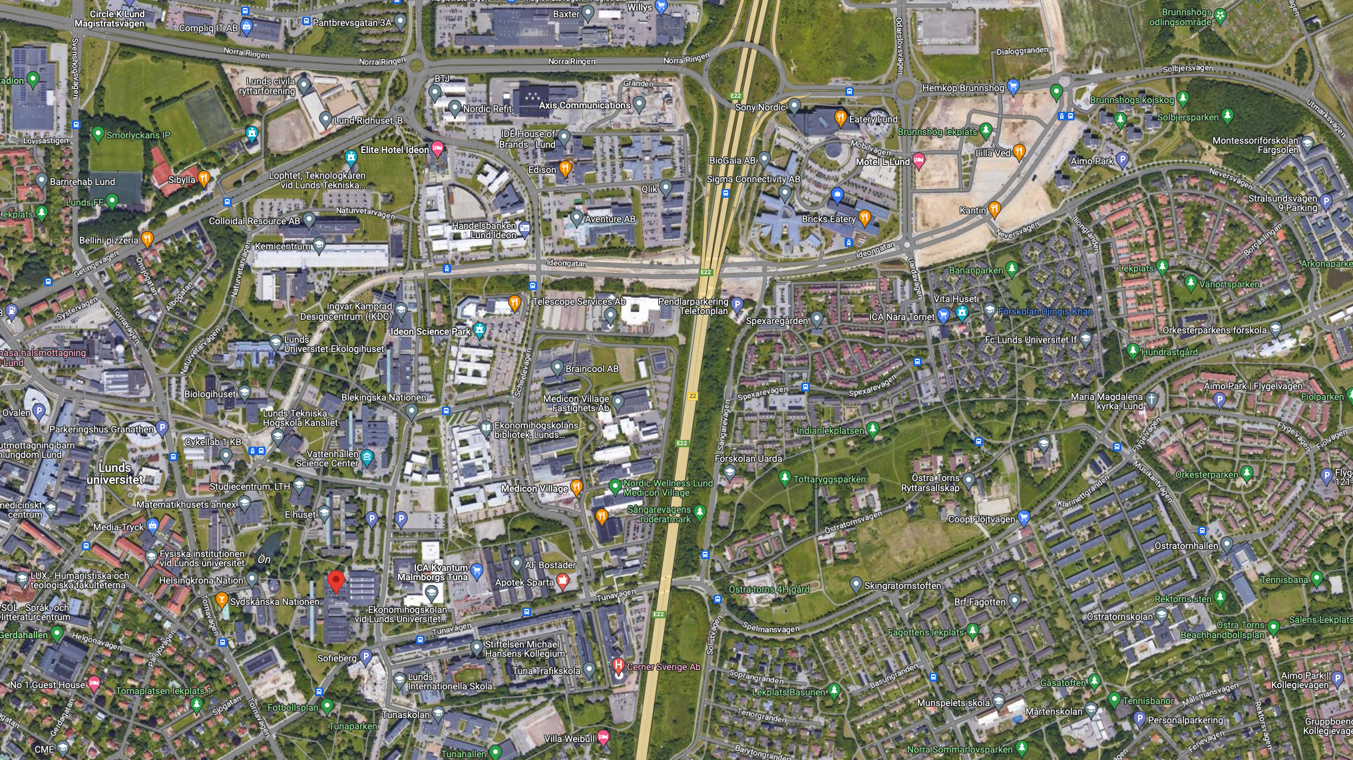







The Setup
ERDC
E-huset
M-huset

Slide 7
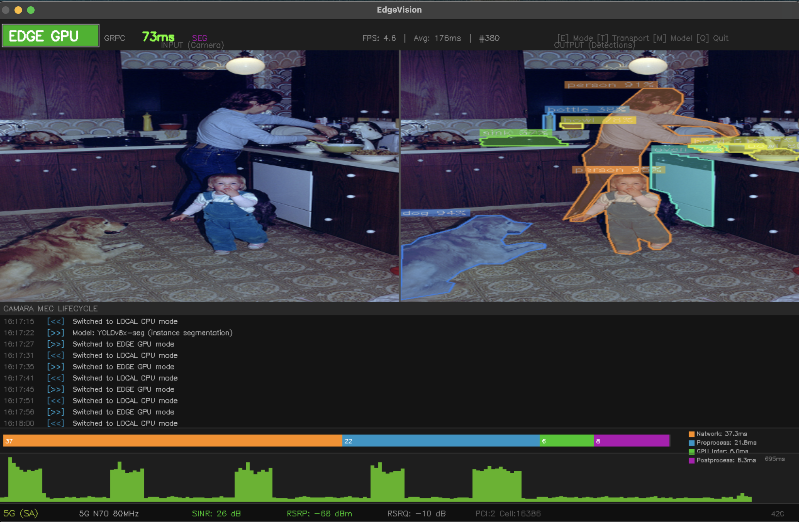

Slide 8
System Architecture
Client Device
5G SA Network
Edge Cloud (K8s)
GUI (Tkinter)
NGINX Ingress (HTTP proxy)
gNB (BB6651 + AIR6419)
Local Detector (CPU)
NodePort (gRPC direct)
5G Core (AMF/SMF/UPF)
Remote Detector (gRPC/HTTP)
Triton Inference Server
gRPC / HTTP inference
CAMARA Client
CAMARA
NEF-Shim (CAMARA API)
Sidecar (JPEG→Tensor→JSON)
Camera Feed (MJPEG)
NVIDIA L40S GPU + TensorRT
Notes:
KEY MESSAGE: Three-tier architecture — client device, 5G SA network with CAMARA NEF-shim, and GPU-accelerated edge cloud.
Talking points:
- Client runs on any device connected via 5G (laptop, phone, embedded)
- NEF-shim is the CAMARA-compliant orchestrator: it translates standardized API calls into k8s operations
- Edge cloud runs Triton with TensorRT FP16 on NVIDIA L40S
- Two transport paths: gRPC direct (NodePort, 5G only) and HTTP via NGINX (works over VPN too)
- Sidecar pattern: JPEG in, JSON out — avoids sending 4.8MB raw tensors over the network
Color meaning: Blue = client/CAMARA path, Teal = edge compute, Grey = 5G transport

Slide 9
Our CAMARA-inspired API Lifecycle
Done using a NEF-Shim (Open5Gs lacks NEF)
1. Edge Discovery
2. App Management
3. Endpoint Discovery
GET /edge-cloud-zones
POST /app-instances
GET /endpoints
Find available GPU zones
near the UE
Deploy containerized
inference workload
Get gRPC/HTTP target
for inference
4. Teardown
DELETE /app-instances/{id}
Remove all edge resources
on quit
Notes:
KEY MESSAGE: CAMARA defines a clean 4-step lifecycle for edge applications — discover, deploy, connect, teardown.
Talking points:
- Step 1: Edge Discovery returns available zones with GPU capabilities and location
- Step 2: App Management creates a containerized instance (our Triton+sidecar image)
- Step 3: Endpoint Discovery returns the gRPC/HTTP target once the instance is ready
- Step 4: Teardown deletes all k8s resources when the client quits
- All APIs are tenant-isolated (source IP hashing)
REFERENCE: CAMARA Edge Cloud API sub-project: github.com/camaraproject/EdgeCloud. API specs follow OpenAPI 3.0.

Slide 10
CAMARA Edge Cloud — Specification State
Sub-project
Repo
Version
Maturity
Simple Edge Discovery
camaraproject/SimpleEdgeDiscovery
v2.0.1
Stable (r2.3)
Traffic Influence
camaraproject/TrafficInfluence
v0.10.0
Active
Edge App Management
camaraproject/EdgeApplicationManagement
v0.1.0-alpha
Early draft
Optimal Edge Discovery
camaraproject/OptimalEdgeDiscovery
v0.1.0
Early draft
App Endpoint Discovery
camaraproject/ApplicationEndpointDiscovery
v0.1.0
Early draft
App Endpoint Registration
camaraproject/ApplicationEndpointRegistration
v0.1.0
Early draft
The original EdgeCloud umbrella repo is now maintenance-only.
All active development split into 6 sub-repos (April 2024).
Only SimpleEdgeDiscovery has reached a stable release.
Notes:
KEY MESSAGE: CAMARA Edge Cloud is still maturing — only Edge Discovery is stable; App Management is alpha.
Talking points:
- The EdgeCloud umbrella repo (github.com/camaraproject/EdgeCloud) is empty now
- Work was split into 6 focused repositories
- SimpleEdgeDiscovery is the most mature (v2.0.1, released with CAMARA r2.3)
- EdgeApplicationManagement is v0.1.0-alpha — the manifest schema is not yet finalized
- This means our NEF-shim can't be 'fully compliant' — the target spec doesn't exist yet
- We follow the lifecycle semantics (discover → deploy → connect → teardown) even if the exact schemas differ
REFERENCE: github.com/camaraproject — all repos are OpenAPI 3.0.3 under code/API_definitions/

Slide 11
Our NEF-Shim vs the Actual CAMARA Spec
CAMARA Specification (target)
Our NEF-Shim (implementation)
Edge Discovery
Aligned
Edge Discovery
GET /edge-cloud-zones → zones[]
GET /edge-cloud-zones → GPU node info
App Package
Differs
App Manifest
Abstract appPackageSource, pre-onboarded
Inline containerSpec + requiredResources
Instantiation
Differs
Instantiation
References package by ID only
Direct image pull + k8s Deployment
Endpoint Discovery
Aligned
Endpoint Discovery
GET /endpoints → connectionInfo
GET /endpoints → grpc + http URLs
Lifecycle
Aligned
Lifecycle
discover → deploy → connect → teardown
Same 4-step: discover → deploy → connect → teardown
Pragmatic approach: lifecycle semantics aligned, manifest schema diverges
because the CAMARA App Management spec is still alpha (v0.1.0).
When the spec stabilizes, the shim manifest can be updated without changing the client.
Notes:
KEY MESSAGE: Our shim follows CAMARA lifecycle semantics but uses a pragmatic manifest format because the spec is still alpha.
Talking points:
- Green badges = aligned with CAMARA spec (Edge Discovery, Endpoint Discovery, overall lifecycle)
- Orange badges = differs (App Package/Instantiation — we use inline container specs instead of pre-onboarded packages)
- CAMARA assumes apps are 'onboarded' through a separate channel; we collapse this into the API call for demo simplicity
- The important point: the 4-step lifecycle IS standard CAMARA — discover, deploy, connect, teardown
- When EdgeApplicationManagement reaches v1.0, we can update the manifest schema without touching the client
- The client only knows: 'call CAMARA, get endpoint, send frames'
Color meaning: Teal badge = aligned with spec, Coral badge = diverges from spec

Slide 12
NEF-Shim: CAMARA → Kubernetes
Incoming CAMARA Calls
Kubernetes Operations
GET /edge-cloud-zones/v0/zones
kubectl get nodes --gpu
POST /app-instances/v0/instances
kubectl apply -f deployment.yaml
GET /app-instances/v0/{id}/status
NEF-Shim
(FastAPI)
kubectl get pod -l tenant=...
GET /endpoints/v0/endpoints
kubectl get svc nodePort
DELETE /app-instances/v0/{id}
kubectl delete deploy,svc
Tenant isolation:
t-{md5(source_ip)[:8]}
Notes:
KEY MESSAGE: The NEF-shim translates every CAMARA API call into corresponding Kubernetes operations, providing tenant isolation.
Talking points:
- FastAPI service running as a Deployment in the same cluster
- Each tenant gets isolated resources namespaced by IP hash (t-{md5[:8]})
- Creates Deployment + Service + ConfigMap per tenant instance
- Monitors pod readiness and reports status (building_models, waiting_ready, ready)
- Handles TRT build time gracefully (liveness probe: 600s initial delay)
Color meaning: Blue = CAMARA/external API layer, Teal = internal Kubernetes operations

Slide 13
NVIDIA Triton Inference Server
— a model serving runtime
Loads multiple models simultaneously (TensorRT, ONNX, PyTorch, TensorFlow)
Handles scheduling, batching, and GPU memory management
Exposes gRPC + HTTP inference APIs
Supports shared memory IPC (zero-copy between co-located processes)
Model hot-swap without restart
Open source
Notes:
KEY MESSAGE: Triton handles GPU model serving while the sidecar handles network I/O — zero-copy shared memory between them.
Talking points:
- Sidecar pattern avoids sending 4.8MB raw tensors over the network
- Client sends JPEG (~50KB), gets back JSON detections (<1KB)
- Shared memory IPC between sidecar and Triton = zero network overhead
- TensorRT FP16 engines are built on first boot from ONNX models
- Build takes ~4 min on L40S (one-time cost per fresh deployment)
- Both models loaded simultaneously, switchable via request header
Color meaning: Teal = edge compute components (all same system, one color)

Slide 14
Triton Inference Server + Sidecar
Kubernetes Pod
Triton Inference Server
Sidecar (gRPC + HTTP server)
yolov8n_trt
yolov8xseg_trt
SHM
1. JPEG decode + resize 640×640
2. Shared mem write → Triton infer
Shared Memory IPC (zero-copy)
3. Post-process: NMS / mask decode
4. Return JSON detections
NVIDIA L40S — TensorRT FP16 — 48GB VRAM
First boot: TRT engine build (~4 min on L40S)
Subsequent: engines cached, ready in seconds
Models: YOLOv8n (detection, 6.3M params)
YOLOv8x-seg (segmentation, 71.8M params)
Triton manages two TensorRT FP16 engines (yolov8n, yolov8x-seg) on the L40S. The sidecar talks to it via shared memory, writes input tensor, triggers inference, reads output tensor. No serialization, no network hop between them.
Notes:
KEY MESSAGE: Triton handles GPU model serving while the sidecar handles network I/O — zero-copy shared memory between them.
Talking points:
- Sidecar pattern avoids sending 4.8MB raw tensors over the network
- Client sends JPEG (~50KB), gets back JSON detections (<1KB)
- Shared memory IPC between sidecar and Triton = zero network overhead
- TensorRT FP16 engines are built on first boot from ONNX models
- Build takes ~4 min on L40S (one-time cost per fresh deployment)
- Both models loaded simultaneously, switchable via request header
Color meaning: Teal = edge compute components (all same system, one color)

Slide 15
Deployment Sequence
Client
NEF-Shim
K8s API
Pod
GET /edge-cloud-zones
zone: LTH 5G Lab (L40S)
POST /apps (manifest)
appId: d8ecc4bc...
POST /app-instances
kubectl apply deploy+svc
create pod
build TRT engines (~4min)
GET /status (poll)
kubectl get pod (polling)
readiness probe OK
status: ready
GET /endpoints
grpc: host:31xxx, http: .../proxy
9
Notes:
KEY MESSAGE: The deployment sequence shows how a single 'edge offload' button press triggers a cascade of API calls and k8s operations.
Talking points:
- Total time from button press to inference-ready: ~4 minutes (dominated by TRT engine build)
- Subsequent toggles are instant — instance stays alive until quit
- NEF-shim polls pod status and reports progress to client (building_models → waiting_ready → ready)
- Client can display status updates in real-time during wait
- gRPC endpoint is a NodePort — only works on 5G (kube-proxy won't forward to unready pods)

Slide 16
Application Manifest
APP_MANIFEST = {
"appName": "edgevision-yolov8",
"appProvider": "lth-frtn90",
"appSoftwareVersion": "1.0.0",
"packageType": "CONTAINER",
"containerSpec": {
"imageRegistry": "ghcr.io/ekeroid/5glab",
"imageName": "edgevision-infer",
"imageTag": "latest",
},
"requiredResources": {
"cpu": 4,
"memory": 8192,
"gpu": 1,
},
"componentSpec": [
{
"componentName": "triton",
"networkInterfaces": [
{"port": 8000, "protocol": "TCP",
"name": "http-inference"},
{"port": 8002, "protocol": "TCP",
"name": "metrics"},
],
}
],
}
This is what gets POSTed to
POST /edge-app-management/v0/apps
during the edge offload flow. The NEF-shim receives it
and translates it into a Kubernetes Deployment + Service.
Notes:
KEY MESSAGE: The deployment sequence shows how a single 'edge offload' button press triggers a cascade of API calls and k8s operations.
Talking points:
- Total time from button press to inference-ready: ~4 minutes (dominated by TRT engine build)
- Subsequent toggles are instant — instance stays alive until quit
- NEF-shim polls pod status and reports progress to client (building_models → waiting_ready → ready)
- Client can display status updates in real-time during wait
- gRPC endpoint is a NodePort — only works on 5G (kube-proxy won't forward to unready pods)

Slide 17
Inference Sequence (Runtime)
Client
Sidecar
Triton
GPU
gRPC: InferRequest(jpeg, model)
decode + resize 640×640
SHM write + infer()
TensorRT FP16 forward
output tensors
SHM read results
NMS + mask decode
InferResponse(detections[])
End-to-end: ~18ms (gRPC) | ~25ms (HTTP) — Local CPU: ~120ms (detect) / ~530ms (segmentation)
Notes:
KEY MESSAGE: Edge inference round-trip is 18-25ms end-to-end — 7-30x faster than local CPU.
Talking points:
- gRPC path: binary protobuf, single TCP connection, ~18ms total
- HTTP path: JPEG POST to /infer, JSON response, ~25ms (7ms overhead from encode/decode)
- Local CPU comparison: YOLOv8n=120ms, YOLOv8x-seg=530ms
- Sidecar does all pre/post-processing — client just sends JPEG and gets JSON
- Shared memory between sidecar and Triton eliminates internal serialization
Color meaning: Blue = external data path, Teal = internal pod processing

Slide 18
Latency Breakdown (Placeholder)
Component
Time (ms)
Comparison:
Edge GPU (gRPC): ~18ms — YOLOv8n detect
Edge GPU (HTTP): ~25m — YOLOv8n detect
Edge GPU (gRPC): ~22ms — YOLOv8x-seg
Local CPU (M1 Pro): ~120ms — YOLOv8n detect
Local CPU (M1 Pro): ~530ms — YOLOv8x-seg
5G UL (JPEG upload, ~50KB)
3.2
Sidecar: decode + preprocess
1.5
Triton: TensorRT inference
4.8
Sidecar: NMS + postprocess
2.1
5G DL (JSON response, <1KB)
1.2
Total round-trip (gRPC, YOLOv8n)
~13 ms
Notes:
KEY MESSAGE: The 5G air interface contributes ~35% of total latency; GPU inference is only ~5ms of the 18ms total.
Talking points:
- UL latency dominated by TDD pattern (DDDSU = 80% DL, 20% UL slots)
- With JPEG compression, upload is only ~50KB — still 3.2ms due to scheduling
- DL is faster (more slots available) and response is tiny (<1KB JSON)
- Triton inference itself is 4-5ms — the rest is transport and pre/post-processing
- Segmentation (YOLOv8x-seg) adds only ~4ms on GPU vs 400ms on CPU
Color meaning: Blue = network transport, Teal = compute processing

Slide 19
Transport: gRPC vs HTTP Fallback (placeholder)
gRPC (Primary — 5G only)
HTTP (Fallback — any network)
• NodePort exposed on 5G network
• Binary protobuf (smaller payload)
• Single persistent TCP connection
• ~18ms round-trip
• Requires pod readiness (kube-proxy)
• Blocked when on VPN
• NGINX Ingress reverse proxy
• JPEG POST, JSON response
• New connection per request
• ~25ms round-trip
• Works over VPN and WiFi
• Auto-fallback on gRPC failure
fallback
Notes:
KEY MESSAGE: gRPC is primary (faster, binary) but HTTP fallback ensures the demo works in any network condition.
Talking points:
- gRPC only works when directly on 5G — NodePort is exposed on the cluster's external IP
- VPN routes traffic through a different path, NodePort becomes unreachable
- Client auto-detects gRPC failure (RuntimeError) and falls back to HTTP
- HTTP path goes through NGINX ingress which is always accessible
- 7ms penalty for HTTP vs gRPC is the JPEG encode + JSON parse overhead
Color meaning: Blue = primary/preferred path, Grey = fallback/alternative

Slide 20
Development & Deployment Workflow
Git Push
Container Build
Registry
K8s Deploy
Code changes
pushed to repo
Docker build
(triton + sidecar)
ghcr.io/
edgevision-triton
NEF-shim pulls
image on demand
Container Contents:
First Boot Sequence:
• Triton Inference Server (NVIDIA base image)
• Sidecar gRPC/HTTP server (Python)
• YOLOv8n.pt + YOLOv8x-seg.pt (weights)
• export_model.py (ONNX → TRT on first boot)
• Model configs (config.pbtxt)
• entrypoint.sh (orchestrates build + start)
1. Export .pt → ONNX (if not cached)
2. Build TRT FP16 engine (~4 min)
3. Start Triton (load both models)
4. Start sidecar (gRPC:50051, HTTP:8080)
5. Readiness probe passes → NodePort live
Notes:
KEY MESSAGE: Development is a standard container workflow — git push, Docker build, registry push, then NEF-shim pulls on demand.
Talking points:
- No special deployment pipeline — standard Docker + k8s
- Container includes model weights but NOT TRT engines (built on-device for hardware compatibility)
- First boot takes ~4 min due to TRT engine compilation — subsequent starts are instant
- Liveness probe set to 600s initial delay to accommodate TRT build
- NEF-shim creates a fresh Deployment on each POST /app-instances
REFERENCE: GitHub Container Registry (ghcr.io). NVIDIA Triton base image: nvcr.io/nvidia/tritonserver:24.01-py3

Slide 21
Client can select two modes: Detection or Segmentation
Two AI models that can run either locally or be offloaded
YOLOv8n — Object Detection
YOLOv8x-seg — Instance Segmentation
Parameters: 6.3M
Input: 640×640×3 (FP16)
Output: [1, 84, 8400] (boxes + 80 classes)
Edge inference: ~5ms
Local CPU (M1): ~120ms
Speedup: 24x
Use case: Real-time object counting,
tracking, presence detection
Parameters: 71.8M
Input: 640×640×3 (FP16)
Output 0: [1, 116, 8400] (boxes + masks)
Output 1: [1, 32, 160, 160] (prototypes)
Edge inference: ~9ms
Local CPU (M1): ~530ms
Speedup: 59x
Use case: Pixel-level object boundaries,
scene understanding, AR overlays
Notes:
KEY MESSAGE: The edge GPU makes heavy models practical in real-time — 59x speedup for segmentation.
Talking points:
- YOLOv8n is the 'nano' model — fast even on CPU, but edge makes it instant
- YOLOv8x-seg is the 'extra-large' segmentation model — impossible in real-time on CPU
- Segmentation output requires mask coefficient decoding: coeffs @ prototypes → sigmoid → threshold → contour
- This is where edge offloading truly shines — tasks that are infeasible locally become trivial on GPU
- Both models use same input size (640×640) — switchable at runtime via M key
REFERENCE: Ultralytics YOLOv8 (Jan 2023). Architecture: CSPDarknet backbone + C2f modules + detection/segmentation heads.

Slide 22
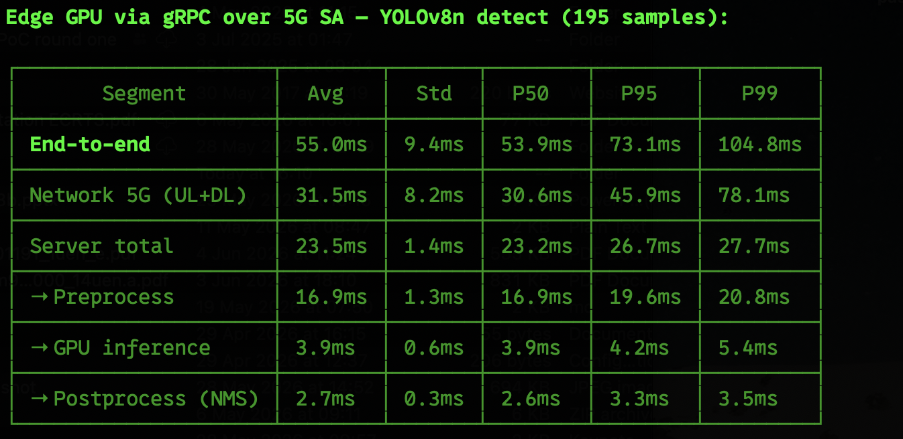
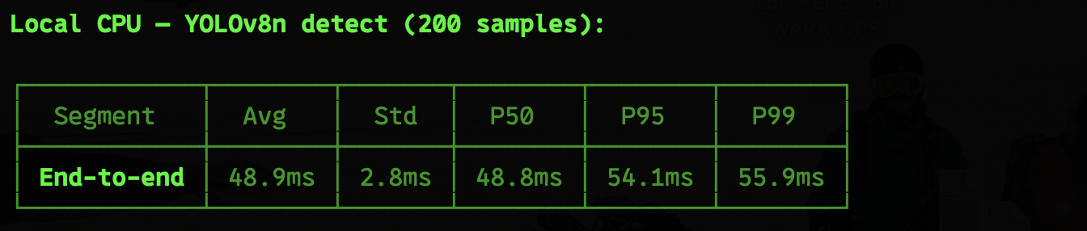
Runtime Properties - Detection
Notes:
KEY MESSAGE: The system is efficient enough for multi-tenant deployment — each tenant uses only 2.5GB of GPU memory.
Talking points:
- L40S with 48GB VRAM could theoretically serve ~19 concurrent tenants
- TDD pattern (DDDSU) means UL has fewer time slots — this is the main source of UL latency
- FP16 inference gives near-identical accuracy to FP32 but 2x throughput
- Tenant isolation is lightweight — just k8s label selectors and service routing
- HTTP response is slightly larger due to JSON encoding vs binary protobuf
Color meaning: Blue header = data table styling (single color for uniformity)

Slide 23
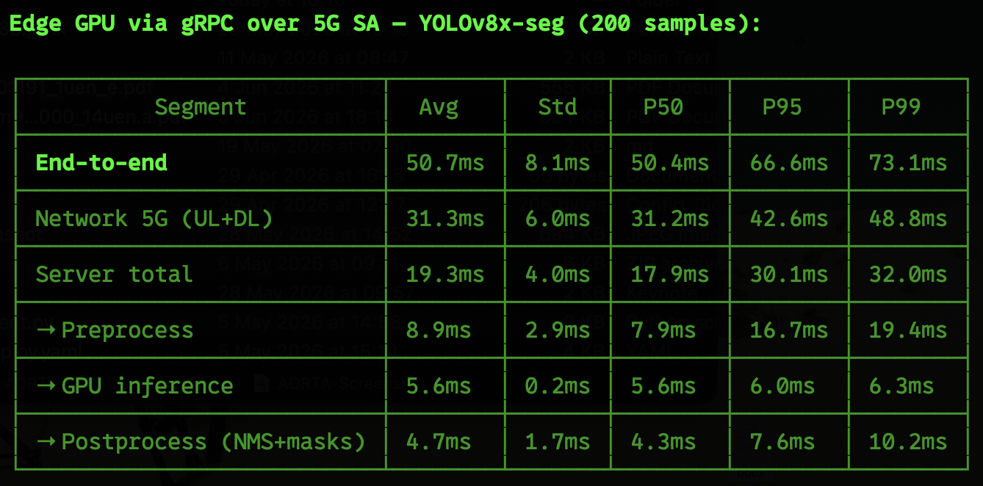
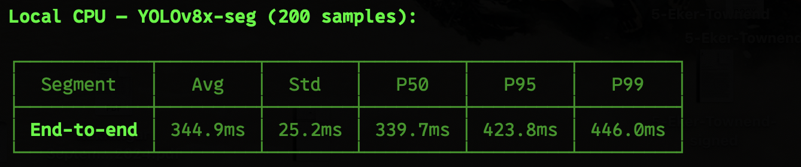
Runtime Properties - Segmentation
Notes:
KEY MESSAGE: The system is efficient enough for multi-tenant deployment — each tenant uses only 2.5GB of GPU memory.
Talking points:
- L40S with 48GB VRAM could theoretically serve ~19 concurrent tenants
- TDD pattern (DDDSU) means UL has fewer time slots — this is the main source of UL latency
- FP16 inference gives near-identical accuracy to FP32 but 2x throughput
- Tenant isolation is lightweight — just k8s label selectors and service routing
- HTTP response is slightly larger due to JSON encoding vs binary protobuf
Color meaning: Blue header = data table styling (single color for uniformity)

Slide 24
Notes:
KEY MESSAGE: Thank you — questions welcome.
Talking points:
- Demo is live and can be shown on request
- Code is on GitHub (tag: beta-1)
- Next steps: multi-tenant benchmarking, QoS-on-demand integration, model hot-swap
REFERENCE: github.com (edgevision repo, beta-1 tag). CAMARA project: camaraproject.org. Ericsson edge computing: ericsson.com/edge-computing

