Slide 1
Advanced Programming Lab
Python programming

Slide 2
Pattern
We get 4 labs (4hrs+4hrs+2hrs+2hr)
There will be 2 evaluations (2nd and 3rd lab) for 20 marks each.
40 marks scaled up to 60
Each evaluation :
6 marks for record
4 marks execution
10 marks quiz / give some code to execute
Last lab Final exam (1.5hrs including write up + execution)

Slide 3
What are Scripting Languages ??
A high-level programming language that is interpreted by another program at runtime rather than compiled by the computer's processor as other programming languages.
Scripting languages, which can be embedded within HTML, commonly are used to add functionality to a Web page, such as different menu styles or graphic displays.

Slide 4
Python
Python is a general-purpose, interpreted, interactive, object-oriented and high-level programming language.
Python was created by Guido van Rossum in the late eighties and early nineties.
It’s a true cross-platform language, running equally well on Windows, Linux/UNIX, and Macintosh platforms, as well as others, ranging from supercomputers to cell phones.
It can be used to develop small applications and rapid prototypes, but it scales well to permit development of large programs.
It comes with a powerful and easy-to-use graphical user interface (GUI) toolkit, web programming libraries, and more. And it’s free.

Slide 5
Python is expressive
Python is a very expressive language.
Expressive in this context means that a single line of Python code can do more than a single line of code in most other languages.
The fewer lines of code you have to write, the faster you can complete the project.
For example, let’s consider swapping the values of two variables, var1 and var2.
In Java, this requires three lines of code and an extra variable:
int temp = var1;
var1 = var2;
var2 = temp;
Using Python, var2, var1 = var1, var2

Slide 6
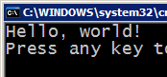



Compiling and interpreting
Many languages require you to compile (translate) your program into a form that the machine understands.
Python is instead directly interpreted into machine instructions.
compile
execute
source code
Hello.java
byte code
Hello.class
output
interpret
source code
Hello.py
output

Slide 7
Variables, Expressions, and Statements
Fixed values such as numbers, letters, and strings are called “constants” because their value does not change.
Numeric constants are as you expect .
String constants use single quotes (') or double quotes (")
>>> print (123)
123
>>> print (98.6)
98.6
>>> print ('Hello world‘)
Hello world

Slide 8
Variables
A variable is a named place in the memory where a programmer can store data and later retrieve the data using the variable “name”
Programmers get to choose the names of the variables .
You can change the contents of a variable in a later statement
X=11.2
Y=19

Slide 9
Python Variable Name Rules
Must start with a letter or underscore _
can consist of letters and numbers and underscores
Case Sensitive
Good: spam eggs spam23 _speed
Bad: 23spam #sign var.12
Different: spam Spam SPAM

Slide 10
Reserved Words
You cannot use reserved words as variable names / identifiers.
Ex:
[and del for is raise assert elif from lambda return break else global not try class except if or while continue exec import pass yield def finally in print as with]

Slide 11
Assignment Statements
We assign a value to a variable using the assignment statement (=)
An assignment statement consists of an expression on the right-hand side and a variable to store the result

Slide 12
Numeric Expressions
You can manipulate them using the arithmetic operators:
+ (addition), – (subtraction), *(multiplication), / (division), ** (exponentiation)
and % (modulus).

Slide 13
Operator Precedence Rules
Highest precedence rule to lowest precedence rule:
Parenthesis are always respected
Exponentiation (raise to a power)
Multiplication, Division, and Remainder
Addition and Subtraction
Left to right

Slide 14
Math commands
Python has useful commands for performing calculations.
To use many of these commands, you must write the following at the top of your Python program:
from math import *
Command name | Description
abs(value) | absolute value
ceil(value) | rounds up
cos(value) | cosine, in radians
floor(value) | rounds down
log(value) | logarithm, base e
log10(value) | logarithm, base 10
max(value1, value2) | larger of two values
min(value1, value2) | smaller of two values
round(value) | nearest whole number
sin(value) | sine, in radians
sqrt(value) | square root
Constant | Description
e | 2.7182818...
pi | 3.1415926...

Slide 15
Python Integer Division
Integer division can produce decimal numbers
Floating point division produces floating point numbers (put brackets for parameters in print in python 3.x)
Eg. >>> print (9/2)
4.5

Slide 16
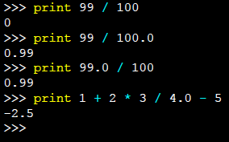
Mixing Integer and Floating
When you perform an operation where one operand is an integer and the other operand is a floating point, the result is a floating point
The integer is converted to a floating point before the operation (put brackets for parameters in print in python 3.x)

Slide 17
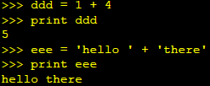
What does “Type” Mean?
In Python variables, literals and constants have a “type”
Python knows the difference between an integer number and a string
For example “ + ” means “addition” if something is a number and “concatenate” if something is a string

Slide 18
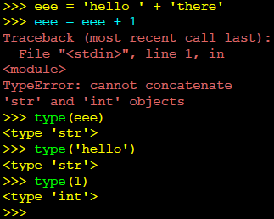
Type Matters
Python knows what “type” everything is
Some operations are prohibited
You cannot “add 1” to a string
We can ask Python what type something is by using the type() function

Slide 19
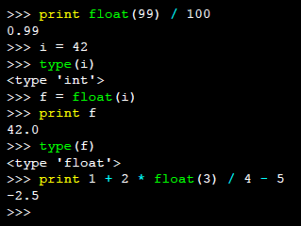
Type Conversions
When you put an integer and floating point in an expression, the integer is implicitly converted to a float
You can control this with the built-in functions int() and float()

Slide 20
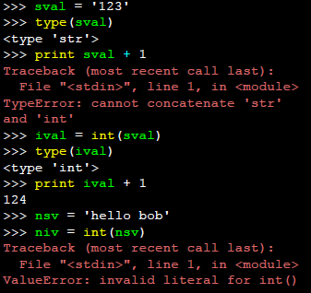
String Conversions
You can also use int() and float() to convert between strings and integers
You will get an error if the string does not contain numeric characters

Slide 21
User Input
We can instruct Python to pause and read data from the user using the input() function
The input() function returns a string
Eg. nam = input(‘Enter name’)
print(‘Welcome ’, nam)

Slide 22
Converting User Input
If we want to read a number from the user, we must convert it from a string to a number using a type conversion function
Later we will deal with bad input data
inp = input(‘Europe floor?’)
usf = int(inp)+1
print (‘US floor’, usf)
Anything after a # is ignored by Python(comments)

Slide 23
input
input : Reads a number from user input.
You can assign (store) the result of input into a variable.
Example:
age = input("How old are you? ")
print ("Your age is", age)
print ("You have", 65 – int(age), "years)
until retirement"
Output:
How old are you? 53
Your age is 53
You have 12 years until retirement

Slide 24
list
You can create a list as well as assign it.
a list automatically grows or shrinks in size as needed.
It can have any number of items and they may be of different types (integer, float, string etc.).

Slide 25
# empty
my_list = []
# list of integers
my_list = [1, 2, 3]
# list with mixed datatypes
my_list = [1, "Hello", 3.4]

Slide 26
# nested list
my_list = ["mouse", [8, 4, 6], ['a']]

Slide 27
my_list = ['p','r','o','b','e']
# Output: p
print(my_list[0])
# Output: o
print(my_list[2])
# Output: e
print(my_list[4])
# my_list[4.0]
# Error! Only integer can be used for indexing
# Nested List
n_list = ["Happy", [2,0,1,5]]
# Nested indexing
# Output: a
print(n_list[0][1])
# Output: 5
print(n_list[1][3]) <!-- -->

Slide 28
my_list = ['p','r','o','b','e']
# Output: e
print(my_list[-1])
# Output: p
print(my_list[-5])

Slide 29
# mistake odd = [2, 4, 6, 8]
# change the 1st item
odd[0] = 1
# Output: [1, 4, 6, 8]
print(odd)
# change 2nd to 4th items
odd[1:4] = [3, 5, 7]
# Output: [1, 3, 5, 7]
print(odd)

Slide 30
my_list = ['p','r','o','g','r','a','m','i','z']
# elements 3rd to 5th
print(my_list[2:5])
# elements beginning to 4th
print(my_list[:-5])
# elements 6th to end
print(my_list[5:])
# elements beginning to end
print(my_list[:])

Slide 31
odd = [1, 3, 5] odd.append(7)
# Output: [1, 3, 5, 7]
print(odd)
odd.extend([9, 11, 13])
# Output: [1, 3, 5, 7, 9, 11, 13]
print(odd)

Slide 32
odd = [1, 3, 5]
# Output: [1, 3, 5, 9, 7, 5]
print(odd + [9, 7, 5])

Slide 33
my_list = ['p','r','o','b','l','e','m']
# delete one item
del my_list[2]
# Output: ['p', 'r', 'b', 'l', 'e', 'm'] print(my_list)
# delete multiple items
del my_list[1:5]
# Output: ['p', 'm']
print(my_list)
# delete entire list
del my_list
# Error: List not defined
print(my_list)

Slide 34
my_list = [3, 8, 1, 6, 0, 8, 4]
# Output: 1
print(my_list.index(8))
# Output: 2
print(my_list.count(8))
my_list.sort()
# Output: [0, 1, 3, 4, 6, 8, 8]
print(my_list)
my_list.reverse()
# Output: [8, 8, 6, 4, 3, 1, 0]
print(my_list)

Slide 35
Tuple
The difference between the two is that we cannot change the elements of a tuple once it is assigned whereas in a list, elements can be changed.
A tuple is created by placing all the items (elements) inside a parentheses (), separated by comma. The parentheses are optional but is a good practice to write it.
A tuple can have any number of items and they may be of different types (integer, float, list, string etc.).

Slide 36
String
Strings can be delimited by single (' '), double (" "), triple single (''' '''), or triple double (""" """) quotations and can contain tab (\t) and newline (\n) characters.
The operators (in, +, and *) and built-in functions (len, max, and min) operate on strings as they do on lists and tuples.
“hello” in “hello world” returns True
“Hello ” + “world” returns “Hello world”
“Hello”*3 returns “HelloHelloHello”
len(“something”) returns 9
max(“Returns the character with greatest ascii value in this string”) which is ‘w’
min(“Returns the character with least ascii value in this string”) which is space

Slide 37
String
The print function outputs strings. Other Python data types can be easily converted to strings and formatted:
>>> e = 2.718
>>> x = [1, "two", 3, 4.0, ["a", "b"], (5, 6)]
>>> print("The constant e is:", e, "and the list x is:", x)
The constant e is: 2.718 and the list x is: [1, 'two', 3, 4.0, ['a', 'b'], (5, 6)]
Objects are automatically converted to string representations for printing.

Slide 38
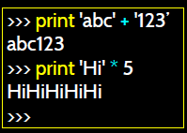
String Operations
Some operators apply to strings
+ implies “concatenation”
* implies “multiple concatenation”
Python knows when it is dealing with a string or a number and behaves appropriately. Put paranthesis for print in python 3.x.

