Slide 1

A study on the impact of Servant Leadership on the success of IT Projects in the Indian IT sector
for the award of
Master of Business Administration
Name | Ekessh, Thorali Kuppusamy Sarathi
LJMU Student Number | PN1035932
Under Supervision of | Dr. M.R. Jhansi Rani

Slide 2
Table of Content
Introduction
Aim & Research Question
Literature Review
Research Gap
Research Methodology
Conceptual Model
Analysis & Results
Discussions
Conclusion
Research Reflection

Slide 3
Introduction
Due to COVID, 82% IT industry employees prefer working from home (SCIKEY: Tech Talent Outlook 2022)
Project delivery involves technical aspects, and equally important are human aspects
Pandemic has compelled leaders to adapt new leadership style
The Leader should know to tap into the power centre to brings out an incredible performance
In the Servant leadership style, the leader will serve the people
Many organisations are adopting servant leadership to foster a more collaborative and empowering work environment.
The success of IT project delivery is essential to the Indian IT industry as it has major contribution to its GDP growth
Source:International Brand Equity Foundation Industry

Slide 4
Aim & Research Question
The aim of this study is:
To create awareness of the Servant Leadership style for IT project delivery in the Indian IT sector.
To encourage Indian IT project leaders to incorporate the Servant Leadership style in IT project delivery.
To contribute to the increase in the Indian IT project delivery success rate.
The research questions for the study are:
Is the Servant Leadership style followed in the Indian IT sector for IT project delivery?
If the Servant Leadership style is followed, then what is the level of attributes followed?
Will there be an increase in the success rate of IT project delivery if the Servant Leadership style is followed?

Slide 5
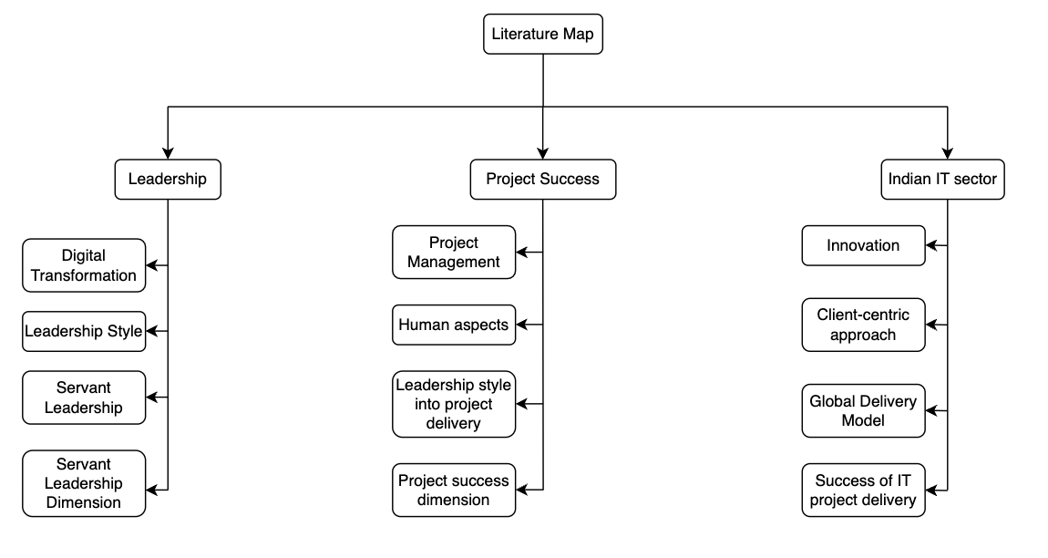
Literature Review

Slide 6
Research Gap
Demography for this study is India
Harwardt, M. (2018)
Model of Servant Leadership
Impact of Servant Leadership in the IT Project Success
Model of IT Project Success
Germany, Austria, Switzerland
Van Dierendonck and Nuijten's (2011)
Harwardt, M. (2020)

Slide 7
Research Methodology
Research Design
Research based on Survey Technique (5-point Likert scale)
Scope of study
The scope of the study is limited to the Indian IT companies
Sampling
Primary data collection with convenience sampling
(Harwardt, 2020)
Sample Frame
Leaders, Project Managers and Project delivery Managers or similar designations involving decision-making in the project delivery in their role
Technique
Structural Equation Modelling (Harwardt, 2020), bootstrapped to 5000 subsamples

Slide 8
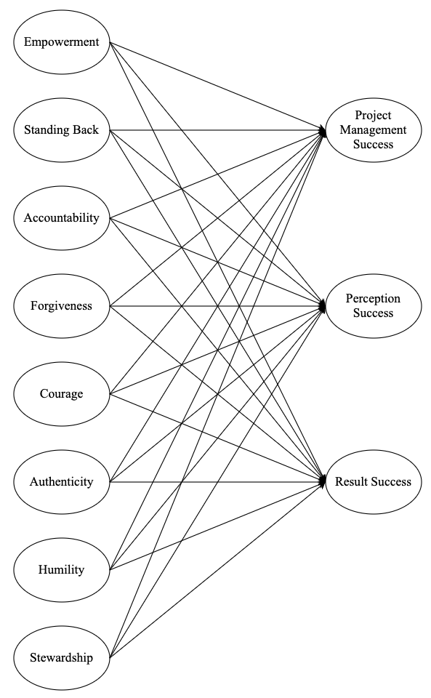
Conceptual Model
Servant Leadership model Constructs derived from Van Dierendonck and Nuijten (2011)
IT Project Success model Constructs derived from Harwardt (2018)
Conceptual Model derived from Harwardt (2020)

Slide 9
Analysis & Results
Level of Servant Leadership attributes followed by Indian IT leaders
0
1
2
3
4
5
Strongly Disagree | Disagree | Neutral | Agree | Strongly Agree
11 items
0
1
2
3
4
5
Strongly Disagree | Disagree | Neutral | Agree | Strongly Agree
All the attributes of the data are within +/- 2 Standard Deviation (Altman et. al. 2005)
15 items
All the attributes median and mode of the data is 4 or more than 4, for negated statement 2 or less than 2
0
1
2
3
4
5
Strongly Disagree | Disagree | Neutral | Agree | Strongly Agree
Tested Reliability, Validity and Multicollinearity (Hair, 2009)
3 negated items

Slide 10
Analysis & Results
Construct | Cronbach's alpha | Composite reliability (rho_a) | Composite reliability (rho_c) | Average variance extracted (AVE)
ACC | 0.82 | 0.854 | 0.892 | 0.735
AU | 0.778 | 1.012 | 0.891 | 0.805
CR | 0.737 | 0.82 | 0.88 | 0.786
EMP | 0.773 | 0.785 | 0.869 | 0.689
FG | 0.843 | 0.969 | 0.901 | 0.754
HUM | 0.884 | 0.94 | 0.915 | 0.731
SB | 0.795 | 0.858 | 0.876 | 0.703
STW | 0.757 | 1.12 | 0.878 | 0.784
PMS | 0.862 | 0.878 | 0.935 | 0.878
PS | 0.822 | 0.827 | 0.918 | 0.848
RS | 0.709 | 0.714 | 0.873 | 0.774

Slide 11
Analysis & Results
Construct | ACC | AU | CR | EMP | FG | HUM | PMS | PS | RS | SB | STW
ACC
AU | 0.539
CR | 0.435 | 0.58
EMP | 0.301 | 0.231 | 0.176
FG | 0.154 | 0.135 | 0.201 | 0.302
HUM | 0.186 | 0.399 | 0.197 | 0.104 | 0.144
PMS | 0.502 | 0.206 | 0.131 | 0.387 | 0.479 | 0.353
PS | 0.266 | 0.31 | 0.311 | 0.548 | 0.554 | 0.229 | 0.624
RS | 0.404 | 0.278 | 0.329 | 0.382 | 0.498 | 0.441 | 0.805 | 0.886
SB | 0.474 | 0.416 | 0.202 | 0.226 | 0.243 | 0.416 | 0.427 | 0.488 | 0.623
STW | 0.259 | 0.146 | 0.197 | 0.556 | 0.389 | 0.148 | 0.587 | 0.332 | 0.467 | 0.254

Slide 12
Analysis & Results
Item | VIF
ACC1 | 1.569
ACC2 | 2.079
ACC3 | 2.276
AU1 | 1.679
AU3 | 1.679
CR1 | 1.516
CR2 | 1.516
EMP3 | 1.912
EMP4 | 1.839
EMP5 | 1.363
FG1 | 1.927
FG2 | 2.273
FG3 | 1.938
HUM1 | 3.082
HUM2 | 4.581
HUM3 | 1.469
HUM5 | 3.744
SB1 | 1.743
SB2 | 1.55
SB3 | 2.072
STW2 | 1.588
STW3 | 1.588
PMS1 | 2.346
PMS2 | 2.346
PS1 | 1.946
PS2 | 1.946
RS1 | 1.432
RS2 | 1.432

Slide 13
Analysis & Results
Independent Variable | Dependent Variable | Significance
Accountability | Project Management success | 0.019
 | Perception success | 0.665
 | Result Success | 0.789
Authenticity | Project Management success | 0.461
 | Perception success | 0.086
 | Result Success | 0.561
Courage | Project Management success | 0.77
 | Perception success | 0.001
 | Result Success | 0.022
Empowerment | Project Management success | 0.876
 | Perception success | 0.008
 | Result Success | 0.592
Forgiveness | Project Management success | 0.011
 | Perception success | 0
 | Result Success | 0
Humility | Project Management success | 0.001
 | Perception success | 0.092
 | Result Success | 0.003
Standing Back | Project Management success | 0.443
 | Perception success | 0.098
 | Result Success | 0.038
Stewardship | Project Management success | 0
 | Perception success | 0.948
 | Result Success | 0.059

Slide 14
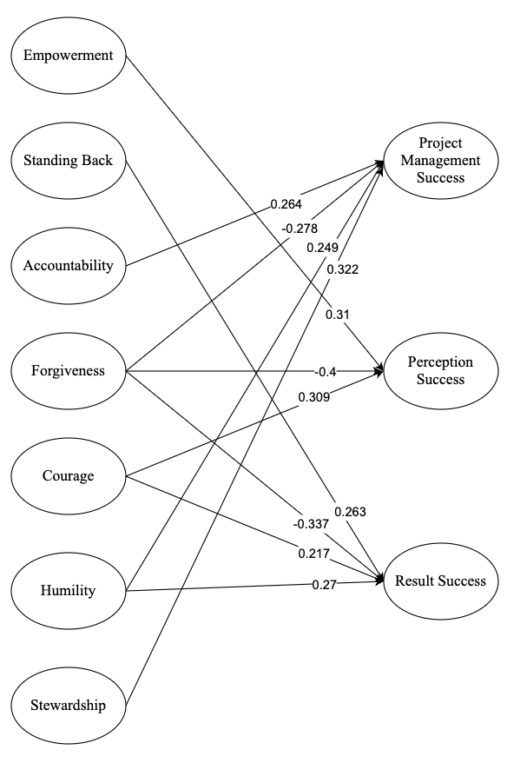
Discussions

Slide 15
Conclusion
Most leaders or managers in the Indian IT sector follow the Servant Leadership style in IT project delivery
All the attributes of the Van Dierendonck & Nuijten model is followed but the extent to which they follow differs
Based on the result, leaders in Indian IT sector can now comprehend the activities and behaviours that can contribute to the practical completion of projects
An additional study could be undertaken to investigate factors which could reveal the causal links of the impact of Servant Leadership on the IT Project success dimensions
Since this research has only been conducted in India, a global study is desirable

Slide 16
Research Reflection
Throughout the research process, interacting with my mentor has been illuminating, as she has offered direction, comments, and unique insights that have enabled me to strengthen my research abilities
While collecting data from the leaders was difficult, it was also important to note that they did not wish to reveal their identities, so many participants provided dummy email addresses. So, privacy comes first compared to any other factor
My communication ability improved, allowing me to intelligibly articulate the study questions, methods, results, and conclusions to the target audience and facilitating the dissemination of information
From the professional development perspective, the research has trained me to start correlating the influence of leadership style by associating it with other factors like employee retention, job satisfaction, etc.
The research report enhanced my critical thinking, analytical, and problem-solving abilities and my comprehension and knowledge of the subject. I was very relieved when the results of the validity and reliability tests were all GREEN. This is when a great deal of my research made sense.

Slide 17
Thank you

Slide 18
References
Altman, D.G. and Bland, J.M., 2005. Standard deviations and standard errors. Bmj, 331(7521), p.903.
Hair, J.F., 2009. Multivariate data analysis.
Harwardt, M., 2018. IT project success from the management perspective-A quantitative evaluation. Open Journal of Information Systems (OJIS), 5(1), pp.24-52.
Harwardt, M., 2020. Servant leadership and its effects on IT project success. Journal of Project Management, 5(1), pp.59-78.
Information Technology India, Top IT Companies in India – IBEF. Available at: https://www.ibef.org/industry/information-technology-india. [Accessed 23rd Sep 2022]
SCIKEY: Tech Talent Outlook 2022, Scikey.ai. Available at: https://www.scikey.ai/read-blog/1531_scikey-tech-talent-outlook-2022.html [Accessed: January 15, 2023].
Van Dierendonck, D. and Nuijten, I., 2011. The servant leadership survey: Development and validation of a multidimensional measure. Journal of business and psychology, 26(3), pp.249-267.

