Slide 1
Playing Football with Couchbase
Eran Keydar - INPLAY

Slide 2
Agenda
About INPLAY & me
NoSQL What and Why?
Couchbase Overview
Coding examples
Conclusions

Slide 3
Agenda
About INPLAY & me
NoSQL What and Why?
Couchbase Overview
Coding examples
Conclusions

Slide 4
INPLAY
“Whatsapp” for football fans
Chat application with unique tools for football fans:
predictions
special stickers
social media stream
Successful campaign with ONE

Slide 5
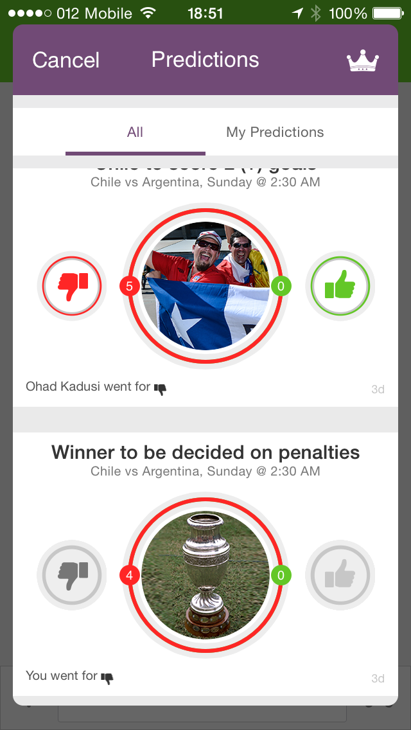
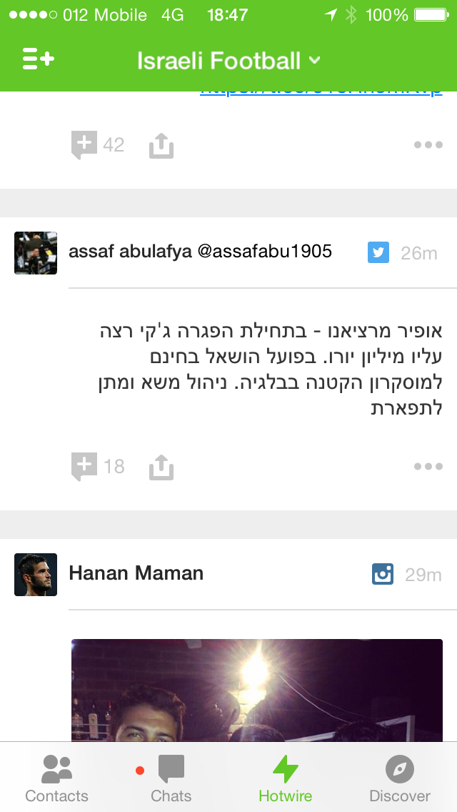
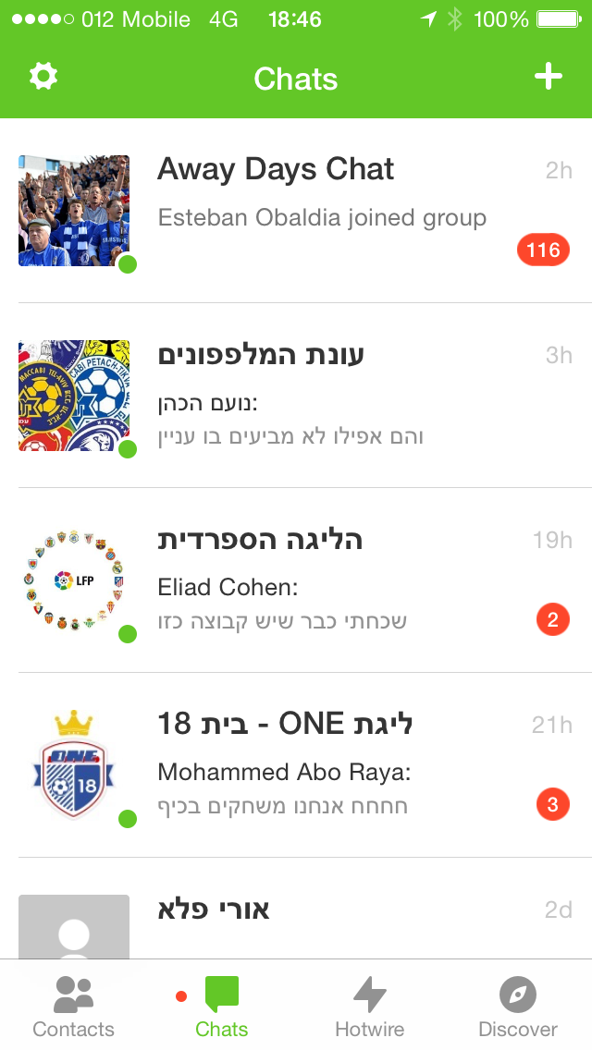

Slide 6
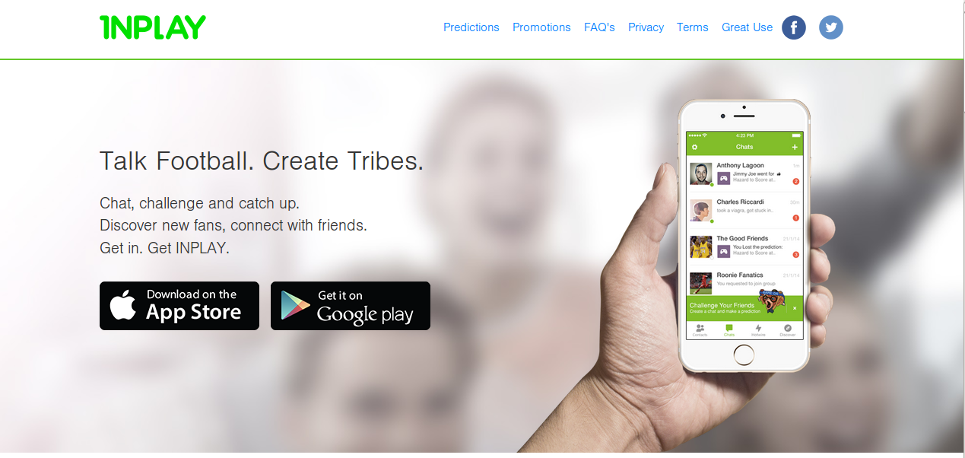



Slide 7


About me
Eran Keydar
Worked 10 years in Verisity/Cadence
Moved to server side developing and worked in INPLAY
Active in Public Knowledge Workshop

Slide 8
Agenda
About INPLAY & me
NoSQL What and Why?
Couchbase Overview
Coding examples
Conclusions

Slide 9
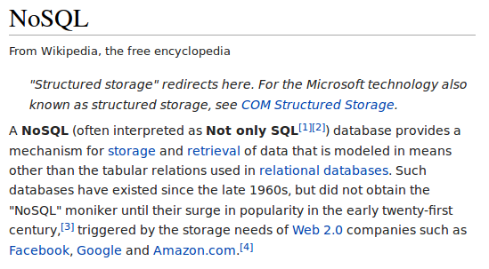

Slide 10






NoSQL Examples
Document Store
Key/Value Store
Document Store
Graph DB
& more….
Column-Based

Slide 11
NoSQL
RDBMS is hard to scale
Flexible data model (semi-structured or not-structured) - no migrations
Built to be distributed, horizontal scaling on commodity HW
Built for web
Big Data

Slide 12
Should I use NoSQL
Let’s discuss….

Slide 13
Agenda
About INPLAY & me
NoSQL What and Why?
Couchbase Overview
Coding examples
Conclusions

Slide 14


Couchbase
Membase + Couchdb = Couchbase
Key/Value Store + Document Store

Slide 15
Membase: persistent version of memcache, e.g. caching with disk durability
CocuhDB: document store, which uses json as query language, through map reduce

Slide 16
High Level Architecture
Couchbase Cluster is a set of nodes.
Bucket is the container of the data.
Data is composed of documents, each document has user defined key
Each key is hashed and assigned to one of 1024 vBucket-s
hash: key space => 1..1024 vBuckets

Slide 17
For each vBucket, there is active copy one one node and replicate-s on 1-3 other nodes.
All nodes are “equal”, each node holds active copies of vBucket-s and replicates of some vBuckets

Slide 18

Bucket with 1G docs
replicate = 2
cluster of 4 nodes
Cluster Map
VB | A | R1 | R2
1 | n1 | n2 | n3
2 | n2 | n3 | n4
3 | n3 | n1 | n4
...
1024 | n1 | n3 | n4
n1
1024 vBuckets
1G docs
vb1
hash
vb2
n2
vb1024
n3
internal impl.
1024 vBuckets => Each node 256 active copies of vBuckets
2048 replicas => Each node 512 replicas.
n4
Notes:
1024 vb => 4 nodes. Each node will hold 1024 / 4 = 256 vbuckets active copies and 1024*2/4=512 replicates.
table is build with mapping
Each client connects directly to the active node

Slide 19
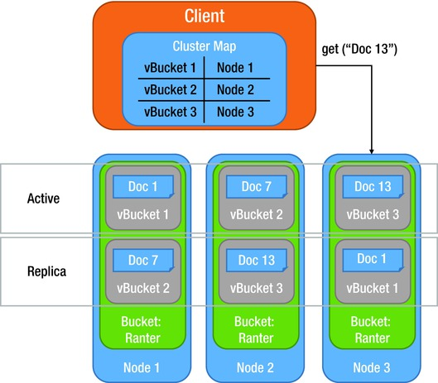
vBuckets

Slide 20
Why Couchbase (IMHO)
Very Very fast
Strong Consistency
Cache & DB
TTL
“Hard” to do slow Operations
Easy to use and deploy

Slide 21
Pitfalls...
Objects has to fully read in order to modify
to add item to list, you need to read the full list
Since everything in memory, better to delete what you don’t use
Use TTL, whenever you can
Enterprise Edition vs. Community Edition

Slide 22
Couchbase Mobile -
Not covered here…
Couchbase mobile is DB for mobile clients (instead of sqlite).
You can also sync it with the cloud.
We did not use it, and it is not covered here, but just to mention…

Slide 23
Let’s code

Slide 24
How Can We:
count users per country
count users per join year/join month/join day
e.g. 2015?
e.g March 2015?
e.g. 14 March 2014?
Send messages to all IL Users?
Sort the users by name? Find users whose name start with B?

Slide 25
We can do some manually, like the phone, but:
big lists
need to maintain sorted
need to update every time user change name or country
Need to transfer the full list in one chunk
List can be too big for one couchbase doc (20 MB)

Slide 26
Solution: Views
Views are a way to define secondary indexes using Javascript and map-reduce
Views are eventual consistent
Prior to couchbase 3.0, there was big latency, but in couchbase 3.0 latency is very small

Slide 27
Views are defined/edited and checked in development mode, and then moved to production

Slide 28
Agenda
About INPLAY & me
NoSQL What and Why?
Couchbase Overview
Coding examples
Conclusions

Slide 29
What’s more?
N1QL - Query language for the data
Integration with search engines and other 3rd party?
Couchbase 4.0 - now in beta

