Slide 1
Learning Value Chain
Learning
Needs
Diagnosis
Learning
Design &
Development
Learning
Deliver &
Deployment
Learning
Impact
Measurement
Meningkatkan Relevansi
antara Learning Solution
dengan Stretegy Business
Meningkatkan kualitas
Learning Solution sesuai
Dengan ISD dan DACUM
Meningkatkan kualitas
penyelenggaraan Learning agar dapat diaplikasikan di lapangan
Memperbaiki sistem pengukuran
Agar dapat mengukur efektifitas
learning solution dalam mendukung
Business Strategy

Slide 2
The Learning Value Chain
Learning
Needs
Diagnosis
Learning
Design &
Development
Learning
Delivery &
Deployment
Learning
Impact
Measurement
Understanding
the needs,
causes
& requirements
to provide the
required
“Learning Solutions
& Services”
BNA
PNA
TNA
CNA
INA
DACUM
Acquire the
required
Learning Solutions
through
sourcing, buying,
Developing
internally,
customizing
or reusing
ISD
Systems Design
Customization
Courses
Tool Kits
Instruments
Pilot studies
TTT
Transfer the required “
Competencies” & Learning
Solutions to the Individuals,
Teams & Business. Provide
follow-thru assistance to ensure Application of Learning takes place
Classroom Training
Adventure Learning
Delivery Partners
e-Learning
Coaching Skills
OJL
Application Consultancy
Follow-thru engines
Training Systems Audits
On Job Coaching
Action Learning Systems
Competency Assessment
On Job Certifications
Measure the Process
& Outcome of the
Learning System,
Service & Solutions
to enable the
achievement
of targeted results.
CFL monitor
Knowledge & Skills Test
Behavioral Change
Studies
Job Impact Analysis
Results Collection
ROI Studies
PBT Approach

Slide 3
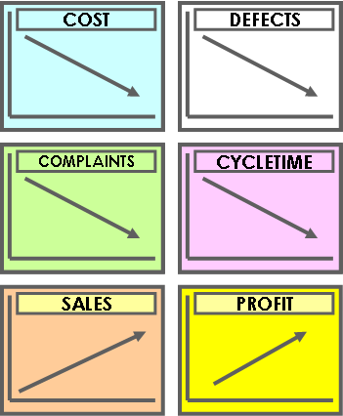
WHY
PERFORM
A TNA?

Slide 4









LINKING LEARNING TO BUSINESS
Actual Business
Performance
BUSINESS NEEDS ANALYSIS
( by Business Units)
Expected Business
Performance
TNA
BUSINESS GAPS
Expected Job Performance
Actual Job
Performance
PERFORMANCE NEEDS
ANALYSIS
( by Depts, Functions etc)
PERFORMANCE GAPS
Expected
Competency
Actual
Competency
COMPETENCY GAPS
COMPETENCY NEEDS ANALYSIS
( by Job Groups)
LEARNING PLANS

Slide 5


PROCESSES IN TNA
4 PROCESSES IN TNA
THE APPROACH
BNA
PNA
CNA
INA

Slide 6





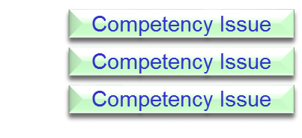






TNA OVERVIEW
Business
Needs
Analysis
Performance
Needs
Analysis
Competency
Needs
Analysis
Instructional
Needs
Analysis
Performance
Issue
Knowledge
Skills
Performance
Issue
Business
Issues
Attitudes/Beliefs
Performance
Issue
Performance
Issue
Competency Issue
Competency Issue
Competency Issue

Slide 7
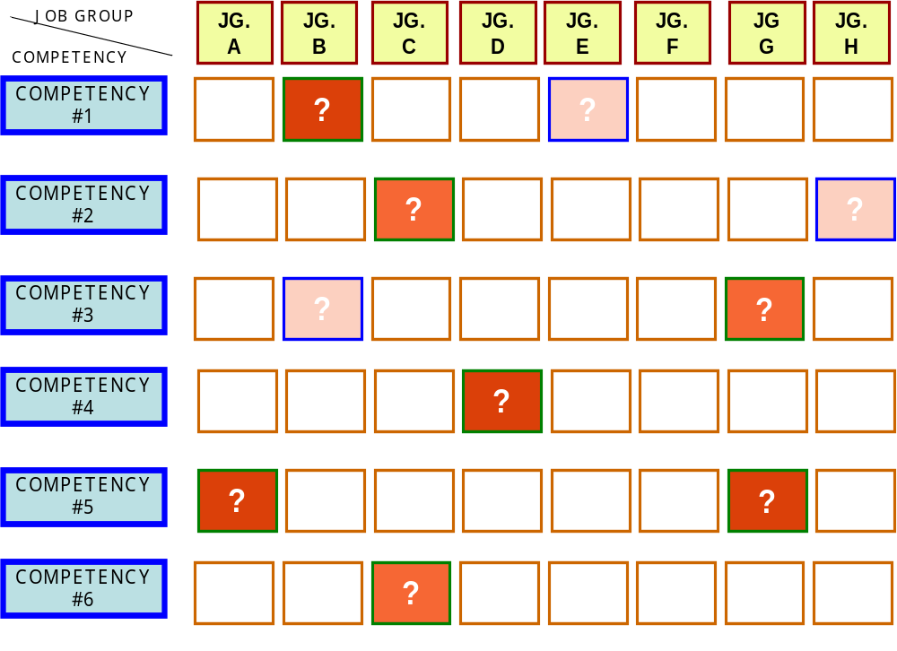
P3 - PERFORMING
WHAT ARE THE “HOT AREAS”? - HEAT CHART

Slide 8



























P3 - PERFORMING
TNA “Findings” Analysis Map
Competency
Issue C
Competency
Issue B
Competency
Issue
Competency
Issue
Performance
Issue
Performance
Issue 1
Competency
Issue A
Competency
Issue
Performance
Issue 2
Job
Group B
Performance
Issue
Job
Group A
BUSINESS
UNIT
Competency
Issue
Competency
Issue
Competency
Issue
Job
Group C
Job
Group D
Performance
Issue
Competency
Issue
Performance
Issue
Competency
Issue
Performance
Issue
CRITICAL
Competency
Issue
Competency
Issue
URGENT
Competency
Issue

Slide 9
IDENTIFICATION LEARNING PROGRAM TABLE
WHO ISSUE | ORGANIZATION/ DEPARTMENT | TEAM | INDIVIDUAL
ANNUAL | To plan for the year’s training calendar/ budget |  | To establish the staff’s Individual Dev. Plan for the year
PERFORMANCE PROBLEM (Reactive) | When the Org./ Dept. faces a non- performance situation | When a Team/ Unit faces a non- performance situation | When a staff faces is not meeting his/her performance goals
PROJECT IMPLEMENTATION (Proactive) | When the Org./ Dept. Is planning for a project | When the Team Is planning for a project | When a individual staff Is planning for a project

Slide 10


Performance-Based Training
A Way to Develop Organizational Competency
DACUM by PBT

Slide 11



Outline
Challenge
The Thinking Behind
Lesson From BSC
Performance-Based Training
(PBT)
PBT Flow Chart & Example
Key Success Factors
PBT Step by Step

Slide 12

Challenges
Good training does not mean useful training.
Useful training is not participated by the right participants.
Right participants may receive not useful training materials.
Useful training materials may be not delivered correctly.
Correct training materials may be delivered in the wrong time.
Useful training does not necessary mean improving business performance
How to deliver the right training to the right person
at the right time in the right way to ensure the right result?

Slide 13
The Thinking Behind
Resources such as money and time are limited and the use of them in a more effective and efficient ways are demanded in facing the wild competition.
The company’s capability to fight its competitors is not built on single individu but on all employees reside in the organization.
The ultimate goal of training is not merely to develop individual competency but most importantly to achieve organizational competency and performance in the most effective and efficient way.

Slide 14


Development Process
Design Approach (6E)
  Effective
  Efficient
  Easy to understand
  Easy to use
  Embedded into formal procedure
  Executable
KISS: Keep It Smart and Simple
Simplicity is Innovation…!!!

Slide 15
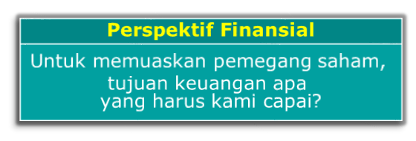

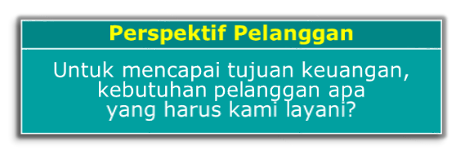






Development Process
Lesson Learn From BSC
From Competency to Performance
We can’t develop what we don’t define.
If we know what to achieve,
then we can trace back to answer what to prepare.
If we know
the business
targets

Slide 16
PBT Flow
From Performance to Organizational Competency
Menentukan Unit yang berperan → Peserta Pelatihan
Target kinerja
Apa yang harus
dicapai periode ini?
Unit mana yang
memimpin pencapaian
Target kinerja tsb?
Siapa yg memimpin
pencapaian kinerja
di unit tersebut?
Siapa anggota tim inti
yang mengawal
pencapaian kinerja?
Job position
Unit mana yang
mendukung
pencapaian
Target kinerja tsb?
Siapa yg paling
bertanggung jawab
dlm memberikan
dukungan tersebut?
Siapa yg ikut
berperan dlm
memberikan
dukungan tersebut?

Slide 17




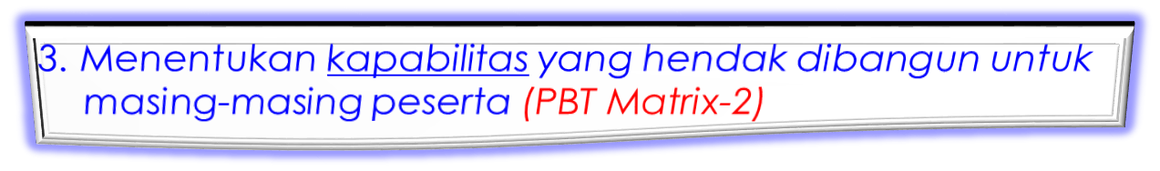

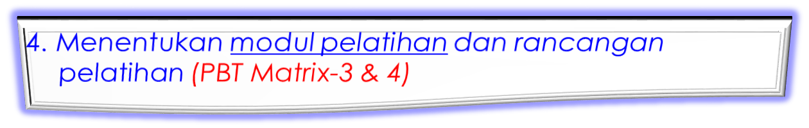


PBT Step by Step
PBT menggunakan lima tahap yaitu:

Slide 18
PBT Matrix-1
PBT Matrix-1: Mengidentifikasi peserta pelatihan
  Kinerja yang hendak dicapai:
  Unit yang berperan :
Capability Functions
1
Performance
Achievement
Direct
Support
Infrastructure
Support
Multimedia
Support
HR/Finance
Support
Coordination
Support
Pemimpin
Kinerja Unit
..........
..........
..........
..........
..........
..........
Anggota
tim inti
……….
……….
……….
……….
……….
……….
Peran
Pemimpin
Pendukung
……….
……….
……….
……….
……….
……….
Anggota
Pendukung
……….
……….
……….
……….
……….
……….
Keterangan: Tabel ini Diisi oleh Pimpinan Kinerja Unit dan Atasannya

Slide 19
PBT Matrix-2
PBT Matrix-2: Menentukan kapabilitas yang hendak dibangun untuk masing-masing peserta
  Kinerja yang hendak dicapai:
  Kapabilitas yang diperlukan:
2
Pemahaman/
Concept/
Awareness
Technical
Skills
Managerial
Skills
Supervisory
Skills
Personal
Quality
Skills
People
Skills
Pemimpin
Kinerja Unit
..........
..........
..........
..........
..........
..........
..........
Anggota
tim inti
……….
……….
……….
……….
……….
……….
……….
Pemimpin
Pendukung
……….
……….
……….
……….
……….
……….
……….
Anggota
Pendukung
……….
……….
……….
……….
……….
……….
……….
Keterangan: Tabel ini Diisi oleh Pimpinan Kinerja Unit dan Atasannya

Slide 20
PBT Matrix-3
PBT Matrix-3: Menentukan modul pelatihan
  Kompetensi yang sama/mirip (termasuk proficiency level yang dibutuhkan) digabungkan ke dalam modul pelatihan yang sama agar penyelenggaraan pelatihan lebih efisien.
3
Pemahaman/
Concept/
Awareness
Technical
Skills
Managerial
Skills
Supervisory
Skills
Personal
Quality
Skills
People
Skills
Modul
Pelatihan *)
Metoda
(JP)
Pemimpin
Kinerja Unit
..........
Kompetensi A
Kompetensi C
Kompetensi E
..........
Kompetensi G
Kompetensi I
Modul A
Modul B
Modul C
Modul D
Modul E
Modul F
Modul G
Modul H
Modul I
Teori
Teori
Praktek
Praktek
Case
IFT
Praktek
Praktek
Praktek
Anggota
tim inti
……….
Kompetensi A
Kompetensi C
……….
Kompetensi F
Kompetensi H
……….
Pemimpin
Pendukung
……….
Kompetensi B
Kompetensi D
Kompetensi E
……….
……….
……….
Anggota
Pendukung
……….
Kompetensi B
Kompetensi D
……….
……….
……….
……….
Keterangan: Matrix ini diisi oleh HR berkonsultasi dengan Bagian Pelatihan

Slide 21
PBT Matrix-4
PBT Matrix-4: Menentukan rancangan pelatihan
  Modul-modul pelatihan yang terbentuk dikelompokkan ke dalam pelatihan-pelatihan dengan menggunakan berbagai pendekatan yaitu:
    Kemiripan modul
    Posisi Jabatan
    Kebutuhan Unit
4
Pemahaman/
Concept/
Awareness
Technical
Skills
Managerial
Skills
Supervisory
Skills
Personal
Quality
Skills
People
Skills
Pemimpin
Kinerja Unit
..........
Modul A
Modul C
Modul E
..........
Modul G
Modul I
Pelatihan dibentuk berdasarkan posisi jabatan
Anggota
tim inti
……….
Modul A
Modul C
……….
Modul F
Modul H
……….
Pemimpin
Pendukung
……….
Modul B
Modul D
Modul E
……….
……….
……….
Anggota
Pendukung
……….
Modul B
Modul D
……….
……….
……….
……….
Pelatihan dibentuk berdasarkan Kebutuhan Unit
Pelatihan dibentuk berdasarkan kemiripan modul
Keterangan: Matrix ini diisi oleh HR berkonsultasi dengan Bagian pelatihan

Slide 22
PBT Matrix-5
PBT Matrix-5: Melakukan konfirmasi dengan peserta
  Untuk meningkatkan keakuratan pelatihan dengan target kinerja dan pengembangan kompetensi yang bersangkutan maka perlu dilakukan konfirmasi dengan data HRIS dan peserta yang bersangkutan
5
Nama
Jabatan
Target
PBT
HRIS
Konfirmasi
Prioritas
..…
Manager
…..
Mencapai …..
di …..
…..
…..
…..
…..
…..
…..
…..
…..
…..
…..
…..
…..
…..
…..
…..
…..
…..
…..
…..
…..
…..
…..
…..
…..
…..
…..
…..
…..
Mencapai …..
di …..
…..
…..
…..
…..
…..
…..
…..
…..
…..
….
…..
…..
…..
…..
…..
…..
Keterangan: Matrix ini diisi oleh Karyawan ybs/ berkonsultasi dengan HR/ Sistem

Slide 23
PBT Matrix-5
PBT Matrix-5: Melakukan konfirmasi dengan peserta
  Untuk meningkatkan keakuratan pelatihan dengan target kinerja dan pengembangan kompetensi yang bersangkutan maka perlu dilakukan konfirmasi dengan data HRIS dan peserta yang bersangkutan
5
Nama
Jabatan
Target
PBT
HRIS
Konfirmasi
Prioritas
..…
Manager
…..
Mencapai …..
di …..
…..
…..
…..
…..
…..
…..
…..
…..
…..
…..
…..
…..
…..
…..
…..
…..
…..
…..
…..
…..
…..
…..
…..
…..
…..
…..
…..
…..
Mencapai …..
di …..
…..
…..
…..
…..
…..
…..
…..
…..
…..
….
…..
…..
…..
…..
…..
…..
Keterangan: Matrix ini diisi oleh Karyawan ybs/ berkonsultasi dengan HR/ Sistem

Slide 24
Terima Kasih
Coming together is a beginning.
Keeping together is progress.
Working together is success. "
(Henry Ford)

