Slide 1
Text Management Tool
By: Khurram Saleem

Slide 2
Requirements
Challenges
Step 1: Hello world wide web
Create a ‘hello world’ web page that runs on a local application server.
Helpful tutorials are available here: http://www.w3schools.com /
Step 2: Build the back-end
Create a REST web service with a method that returns the text that is passed to it.
Create a few unit tests to verify your application. You may use any unit test framework.
Step 3: Connect your front and back ends
Create a web form that has a text box, and a ‘Done’ button. When ‘Done’ is clicked make AJAX call, passing the entered text to the web service you created in the previous step. Display the response from the web service call below the text box on the form.
Extend your tests to verify new components.
Step 4: Bring in the database
Extend your web service to add a method to store text passed from the form into the database using design patterns where appropriate. In addition to saving the text, store the date and time when the data was saved .
Step 5: Include the user info
Extend the form to capture the user name and a list of all the submissions by user. Add another method to the service to return all text submissions and display them at the bottom of the page.

Slide 3
Requirements Continued
Step 6: Replying to text
Extend your solution from previous challenge to allow “responding” to already posted texts and display responses, indented, below the related text entry.
As always, extend your tests.
Step 7: Capture more data
Capture user’s location (user enters the city) on the form. For every post, include city, city’s latitude and longitude and current temperature. Display this information on the form, next to each post.
Step 8: Secure your application with https
This should be easy!

Slide 4
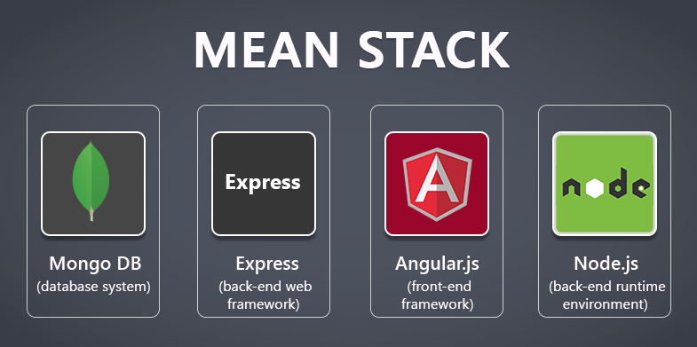



Technologies Used

Slide 5
Strategy for Back-End
Implement a API to POST a Text for Step 2.
Implement a API to GET all the Texts for Step 5.
Implement a API to GET all the Texts in a Forum View where text can contain texts recursively to support “Replying to a Text” for Step 6. (More Info in Upcoming Slides).

Slide 6
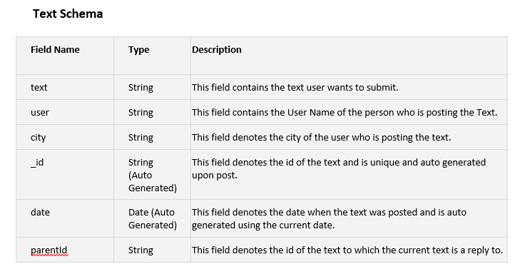
Database Design
Create a Schema in Database with the following fields:

Slide 7
POST a Text
Request
{
"text": "Welcome to Text Management Tool",
"city": "cityText",
"user": "admin"
}
Response
{
"text": "Welcome to Text Management Tool",
"city": "cityText",
"user": "admin",
"_id": "57b9fccc0013be442f00174d",
"date": "2016-08-21T19:11:08.951Z"
}
In the Request, we just specify the text, city and user field.
In the Response, you can see that the date, _id fields are auto generated.

Slide 8
Reply to a Text
Request
{
"text": "Welcome to Text Management Tool",
"city": "cityText",
"user": "admin“
“parentId”: “23b8fdfe0013bef42f0317fd”
}
Response
{
"text": "Welcome to Text Management Tool",
"city": "cityText",
"user": "admin",
"_id": "57b9fccc0013be442f00174d",
"date": "2016-08-21T19:11:08.951Z“
“parentId”: “23b8fdfe0013bef42f0317fd”
}
This is not a new service, we are using “Post a Text” service with an additional field in the request called parentId. This field contains the id of the text you are replying to.

Slide 9
Get All Texts
Response
[
{
"text": "Welcome to Text Management Tool",
"city": “How are you today?",
"user": "admin",
"_id": "57b9fccc0013be442f00174d",
"date": "2016-08-21T19:11:08.951Z",
},
{
"text": "Welcome to Text Management Tool",
"city": “I am great, how are you?",
"user": "admin2",
"_id": "55f5fdfh0013be442f20146d",
"date": "2016-08-21T19:11:08.951Z",
“parentId": " 57b9fccc0013be442f00174d"
}
]
This will retrieve all the texts from the database, and display them in a array of texts in Json format.

Slide 10
Get All Texts in Forum View
Response
[
{
"_id": "57bc3dbcec97671022e57e8f",
"city": "Toronto",
"text": "How are you doing today",
"user": "Admin1",
"date": "2016-08-23T12:12:44.084Z",
"children": [
{
"_id": "57bc3de0ec97671022e57e90",
"city": "Mississauga",
"text": "I am doing good, how about you?",
"user": "Admin2",
"parentId": "57bc3dbcec97671022e57e8f",
"children": [],
"date": "2016-08-23T12:13:20.719Z"
}
],
}
]
This will retrieve all the texts from the database, and based on parentId, it will put the replies to a text underneath the parent Text in a array of texts called children using a recursive method.
This will help us to display the replies better on the front end.
This is like a tree, children and can have their own children and so on…

Slide 11
Please refer to REST API Doc for more details.
REST API Doc will help other developers to consume these services.

Slide 12
Backend Demo using Postman !!!

Slide 13
Front End Strategy : General Solution
Create a input text field where user can enter the text.
Create a input text field where user can enter the User Name.
Create a Button Submit, when click make REST Call to backend to “Post a Text”.
Have a message log text area where all the responses and errors are displaced.

Slide 14

Front End Strategy : City’s Information
Create a input text field where user can enter the city.
Create three text areas for temperature, longitude and latitude.
When user clicks on Submit, make a REST call to Open Weather Map to retrieve the information and display in the respective fields.

Slide 15
Front End Strategy : All Texts by User
Create a text area at the bottom of the page where all the texts by user will be shown.
Create a new button called “Get All Texts By User”, upon click it will make a REST Call to get all texts and then it will filter with the user name entered on the UI.

Slide 16
Front End Strategy : Forum View and Replying to a Text
On the left panel of the page, show all the texts in forum view where the replies are indented. This is where “Get all texts in forum view” comes in handy, you can easily indent the replies.
To reply to a Text, user clicks on a existing text, types a new text and click Submit, behind the scenes we will store the id of the text as parentId in the request.

Slide 17
Front End Demo !!!

Slide 18
Test Scenarios
POST a Text, response code should be 200
POST a Text, Verify fields text, city, user, date, textId are present in response
POST a Text, Verify values of fields text, city, user, date, textId in response
Reply to a Text, Replying to an existing text using POST
Verifying Reply is shown properly in Forum View

Slide 19
Test Scenarios Continued
GET all Texts, Response Code should be 200, response should be an Array
GET all Texts in Forum View, response code should be 200
POST a Text, response time should be less than 20 ms
GET all Texts, response time should be less than 30 ms
GET all Texts in Forum View, response time should be less than 50 ms
Post 100 Texts, response time should be less than 200 ms.

Slide 20
The Way Forward
Add a service to delete texts. When a text is deleted, find its children recursively and delete all the children.

