Slide 1
Programación Cuadrática con el Método de Mehrota
Mónica Alba González
Miguel González Borja
Jorge Rotter Vallejo

Slide 2
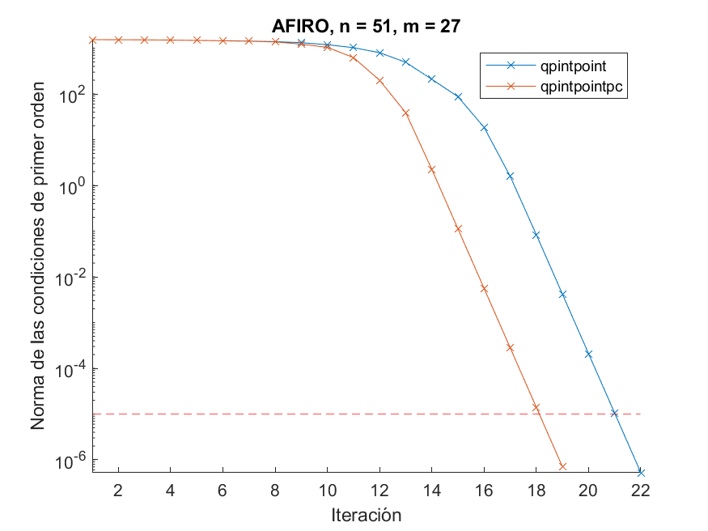
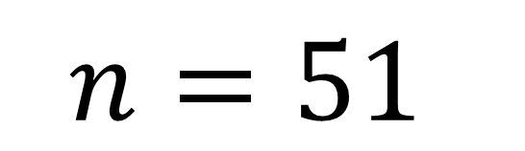
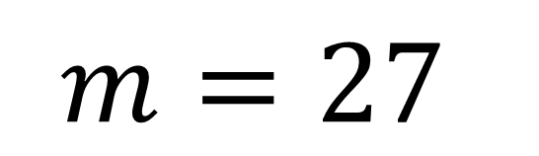
AFIRO
$$n=51$$
$$m=27$$
 | qpintpoint_full | qpintpoint | qpintpointpc_full | qpintpointpc | quadprog
Iteraciones | 29 | 21 | 18 | 18 | 7
Tiempo (s) | 0.021026 | 0.016536 | 0.028907 | 0.036616 | 0.058853
Valor de la función | 2.0082E+05 | 2.0082E+05 | 2.0082E+05 | 2.0082E+05 | 2.0082E+05
Sistema completo | - | 1 | - | 0 | -
Convergencia | ✅ | ✅ | ✅ | ✅ | ✅

Slide 3
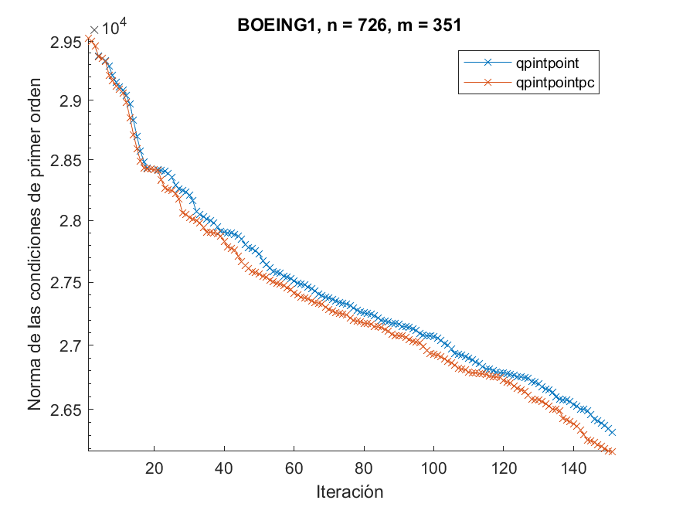
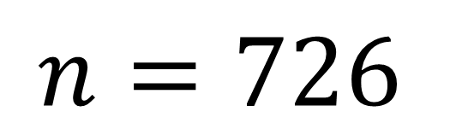
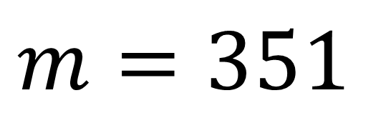
BOEING1
$$n=726$$
$$m=351$$
 | qpintpoint_full | qpintpoint | qpintpointpc_full | qpintpointpc | quadprog
Iteraciones | 150 | 150 | 150 | 150 | 150
Tiempo (s) | 30.539 | 20.984 | 60.288 | 21.684 | 2.5559
Valor de la función | 1.7284E+08 | 1.763E+08 | 1.7182E+08 | 1.7182E+08 | 4.158E+06
Sistema completo | - | 60 | - | 23 | -
Convergencia | ❌ | ❌ | ❌ | ❌ | ❌

Slide 4
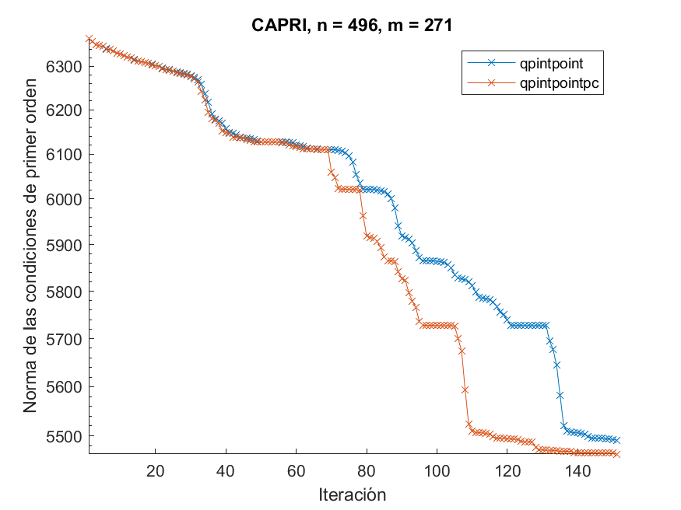
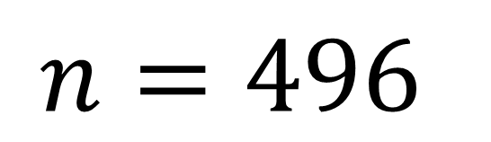
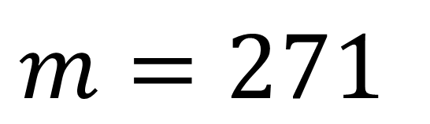
CAPRI
$$n=496$$
$$m=271$$
 | qpintpoint_full | qpintpoint | qpintpointpc_full | qpintpointpc | quadprog
Iteraciones | 150 | 150 | 150 | 150 | 41
Tiempo (s) | 12.779 | 7. En 7676 | 24.713 | 12.554 | 0.27425
Valor de la función | 1.035+e07 | 1.0297+e07 | 1.0354+e07 | 1.0354+e07 | 9.3979+e07
Sistema completo | - | 52 | - | 49 | -
Convergencia | ❌ | ❌ | ❌ | ❌ | ✅

Slide 5
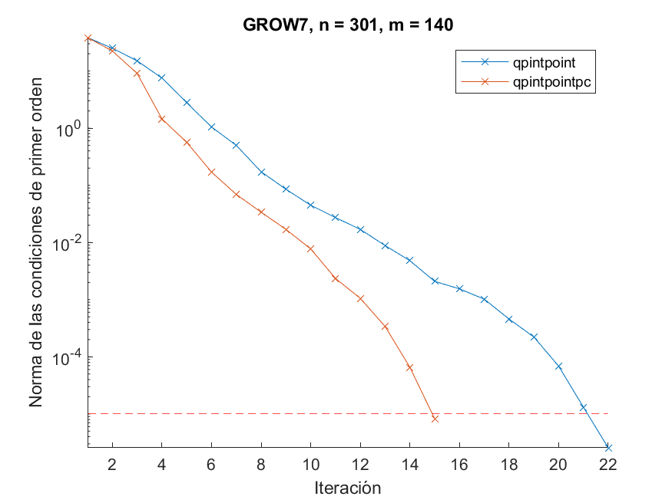
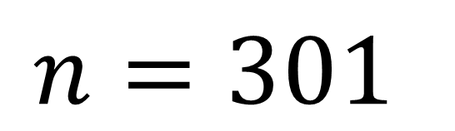
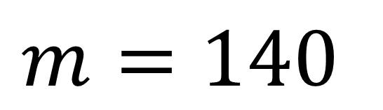
GROW7
$$n=301$$
$$m=140$$
 | qpintpoint_full | qpintpoint | qpintpointpc_full | qpintpointpc | quadprog
Iteraciones | 25 | 21 | 14 | 14 | 11
Tiempo (s) | 0.69438 | 0.15178 | 0.71385 | 0.16869 | 0.039308
Valor de la función | -88.36 | -88.36 | -88.36 | -88.36 | -88.36
Sistema completo | - | 0 | - | 0 | -
Convergencia | ✅ | ✅ | ✅ | ✅ | ✅

Slide 6
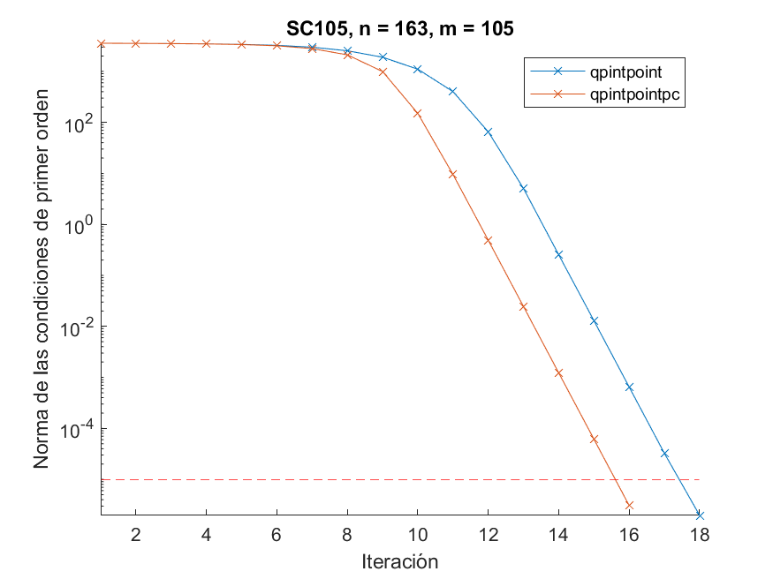
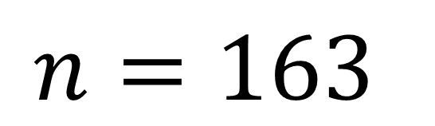
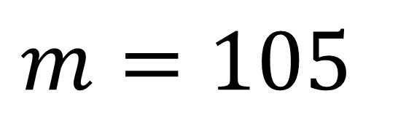
SC105
$$n=163$$
Matriz mal condicionada
$$m=105$$
 | qpintpoint_full | qpintpoint | qpintpointpc_full | qpintpointpc | quadprog
Iteraciones | 27 | 17 | 15 | 15 | 8
Tiempo (s) | 0.16364 | 0.045007 | 0.15601 | 0.074281 | 0.0088308
Valor de la función | 1.772E+05 | 1.772E+05 | 1.772E+05 | 1.772E+05 | 1.772E+05
Sistema completo | - | 3 | - | 3 | -
Convergencia | ✅ | ✅ | ✅ | ✅ | ✅

Slide 7
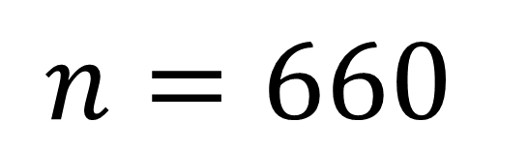
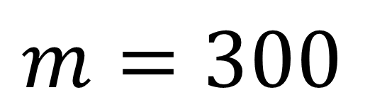
GROW7
$$n=660$$
$$m=300$$
 | qpintpoint_full | qpintpoint | qpintpointpc_full | qpintpointpc | quadprog
Iteraciones | 56 | 87 | 37 | 37 | 17
Tiempo (s) | 8.7194 | 5.8812 | 11.029 | 3.5177 | 0.20946
Valor de la función | 14453 | 14453 | 14453 | 14453 | 14453
Sistema completo | - | 12 | - | 4 | -
Convergencia | ✅ | ✅ | ✅ | ✅ | ✅

