Slide 1
Evaluating Topic, Source and Viewpoint Diversity in Corona News
A Computational Analysis of Covid-19 News Coverage in the Netherlands
Elif Kılık

Slide 2
In a nutshell…
Leveraging generative large language models to extract information from news articles, which can be used to evaluate the diversity of the news content.

Slide 3
Background of this study
“…although we witness a period of news abundance characterized by a proliferation of communication channels and outlets, the content of news is increasingly similar” (Beckers et al., 2017, p.1666)
Concerns about the impact on the quality of news (Saltzis, K., & Dickinson, 2008) and findings about decrease in diversity of news content (Hendrickx, & Van Remoortere, 2022)
In the Netherlands → motion Peter Kwint (NL House of Representatives) – CvDM (Dutch Media Authority)

Slide 4
Definition of News (Content) Diversity
”… the heterogeneity of news content in terms of the plurality of actors, issues, and viewpoints (or frames) represented in the news." (Beckers et al., 2017, p.1668)
Subdimensions of diversity in news content (Loecherbach et al., 2020):
Topic (or issue) diversity: the degree of variation in reporting on different topics issues
Actor (or source/entity) diversity: the representation of (status positions of) sources used to create a news product
Diversity of viewpoints (perspectives): the representation of ideas, perspectives, opinions

Slide 5
The Case Study – News about the Covid-19 Pandemic
National and international extensive reporting over a limited period
Enough data for testing purposes
Viewpoints on corona measures → allows more straightforward definition & measurement

Slide 6
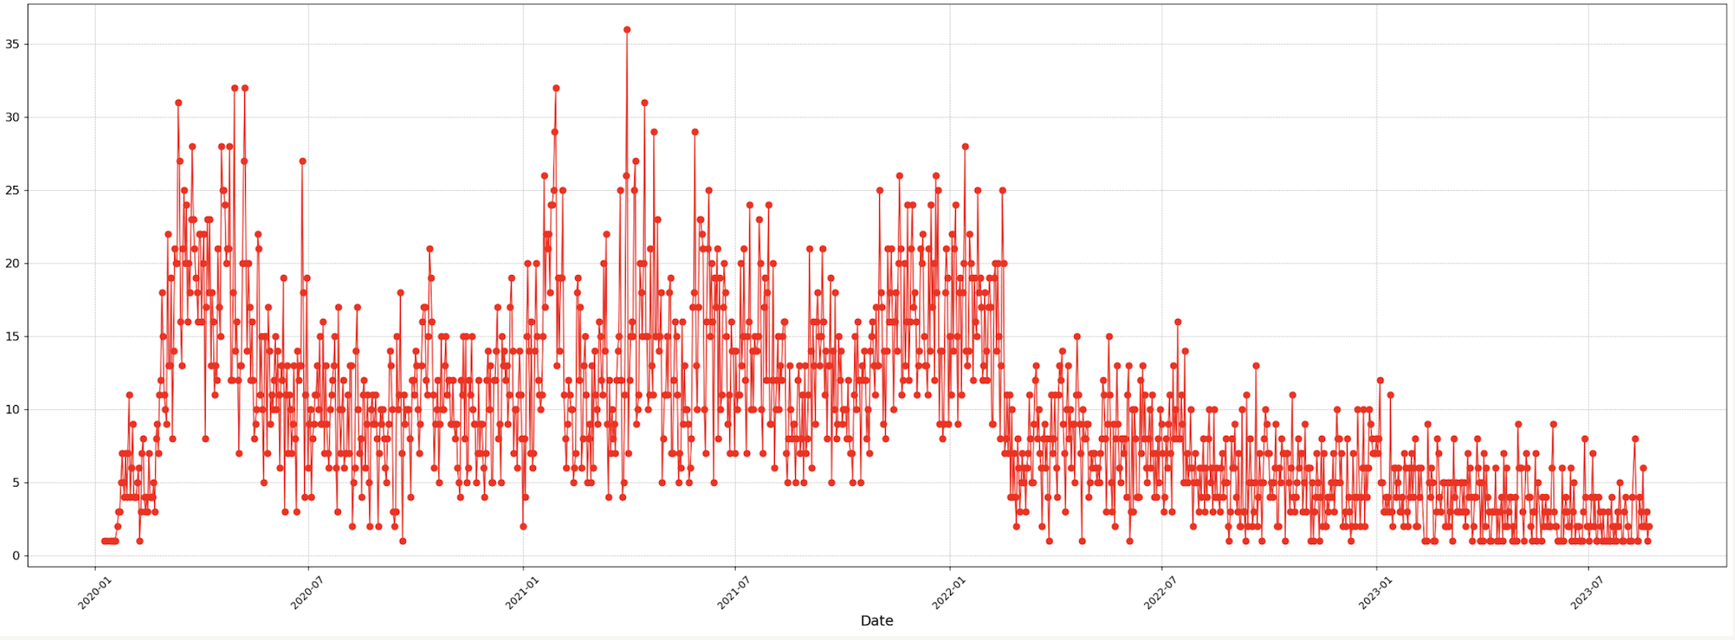
Data
13586 news items retrieved from NOS.nl (Query: corona*, covid*, sars-cov-2*)

Slide 7
Methodology
Manual annotation
1000 randomly sampled articles, stratified based on date.
472 already annotated by a trained student coder
This data is used as validation data for annotation with LLM’s.
Annotation with Generative LLM’s
Tests (so far) with 3 Generative LLM’s using 472 manually annotated articles:
meta-llama/Llama-2-7b-chat-hf
meta-llama/Llama-2-13b-chat-hf
berkeley-nest/Starling-LM-7B-alpha

Slide 8
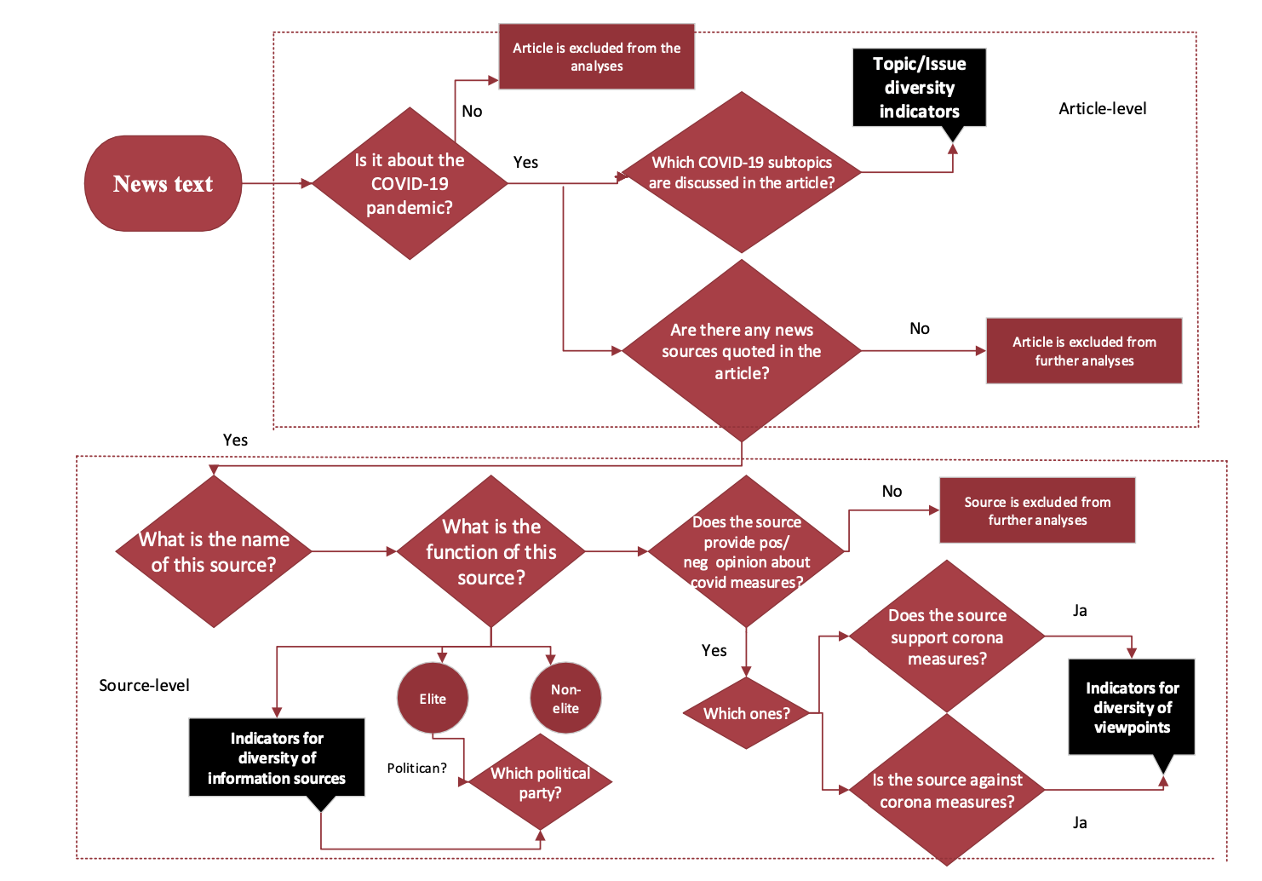
Annotation Flow

Slide 9
Findings
(Work in progress…)

Slide 10
Finding 1: LLM’s are able to detect main topic COVID-19
Classification of articles covid/non-covid
Manual coding:
Variable 0: Is the article mainly about the corona pandemic?
This is a question to filter out articles that are not about the corona pandemic. The article can only be considered mainly about the corona pandemic if the majority of the article is about the pandemic or its (sub)topics (see V1 below). To be sure, you can check the word count of the parts dealing with the pandemic. If that is the majority, the article is mainly about the pandemic.

Slide 11
Finding 1: LLM’s are able to detect main topic COVID-19
Input → article text, keywords and categories
Model Name | Examples in prompt | Kappa | Accuracy | Macro-averaged f1- score | N | Duration in mins
Starling 7b Alpha | Zero-shot | 0.82 | 0.91 | 0.91 | 472 | 24
 | One-shot | 0.83 | 0.92 | 0.91 | 472 | 17
 | Few-shot | 0.84 | 0.92 | 0.92 | 472 | 29
Llama-2 7b Chat | Zero-shot | 0.73 | 0.86 | 0.86 | 472 | 15
 | One-shot | 0.47 | 0.75 | 0.72 | 472 | 16
 | Few-shot | 0.71 | 0.86 | 0.85 | 419 | 41
Llama-2 13b Chat | Zero-shot | 0.74 | 0.87 | 0.87 | 472 | 36
 | One-shot | 0.80 | 0.90 | 0.90 | 472 | 23
 | Few-shot | 0.78 | 0.89 | 0.89 | 426 | 59

Slide 12
Finding 2: Extracting subtopics is not straightforward
Pre-defined 14 topics (based on qualitative analysis of the news texts and previous studies):
Statistics (spread of the pandemic, number of positive cases, patients, fatalities
Measures taken against the spread of the coronavirus pandemic
COVID-19 tests and test procedures
COVID-19 vaccines and vaccination procedures and campaigns
Long COVID and long term effects of the coronavirus on health
Impact of the COVID-19 and coronavirus pandemic on the healthcare system and medical response
Scientific and medical knowledge on the coronavirus and COVID-19
Economic impact of the coronavirus pandemic and recovery (industry & market, work culture, recovery packages)
Social impact of the coronavirus pandemic (education, social gatherings, cultural events, sports)
Impact of the COVID-19 and coronavirus pandemic on mental health
Impact of the COVID-19 and coronavirus pandemic on individual rights and freedoms
Misinformation and disinformation about the coronavirus, COVID-19 and/or the coronavirus pandemic
Impact of the COVID-19 and coronavirus pandemic on politics and government (discussions in the Tweede Kamer, discussions on government’s responsibility and ability)
International discussions, cooperation and responses related to the coronavirus pandemic

Slide 13
Finding 2: Extracting subtopics is not straightforward
Some of these topics are not coded in the sample sufficient enough for the tests → 6 left
Statistics (spread of the pandemic, number of positive cases, patients, fatalities
Measures taken against the spread of the coronavirus pandemic
COVID-19 tests and test procedures
COVID-19 vaccines and vaccination procedures and campaigns
Long COVID and long term effects of the coronavirus on health
Impact of the COVID-19 and coronavirus pandemic on the healthcare system and medical response
Scientific and medical knowledge on the coronavirus and COVID-19
Economic impact of the coronavirus pandemic and recovery (industry & market, work culture, recovery packages)
Social impact of the coronavirus pandemic (education, social gatherings, cultural events, sports)
Impact of the COVID-19 and coronavirus pandemic on mental health
Impact of the COVID-19 and coronavirus pandemic on individual rights and freedoms
Misinformation and disinformation about the coronavirus, COVID-19 and/or the coronavirus pandemic
Impact of the COVID-19 and coronavirus pandemic on politics and government (discussions in the Tweede Kamer, discussions on government’s responsibility and ability)
International discussions, cooperation and responses related to the coronavirus pandemic

Slide 14
Finding 2: Extracting subtopics is not as straightforward
Binary classification of each label separately – so far the best working approach
You are a reliable assistant tasked with determining whether the news article below about the COVID-19 pandemic substantially discusses the subtopic: ”[insert subtopic name here]"
Substantial discussion of a subtopic means that the article discusses one or more aspects of this subtopic in at least two sentences.
The subtopic: ”[insert subtopic name here]" entails the following aspects:
- .. List of what the subtopic discussions may contain
Based on the information provided, determine if the article substantially discusses the subtopic: ”[insert subtopic name here]"
Assign a value of 1 if the article substantially discusses the subtopic, and a value of 0 if the article does not substantially discuss the subtopic.

Slide 15
Finding 2: Model performances differ per subtopic
Statistics (spread of the pandemic, number of positive cases, patients, fatalities
→ Good results, but there are differences between models
Model Name | Examples in prompt | Kappa | Accuracy | Macro-averaged f1- score | N | Duration in mins
Starling 7b Alpha | Zero-shot | 0.73 | 0.89 | 0.87 | 216 | 10
 | One-shot | 0.81 | 0.92 | 0.90 | 216 | 10
 | Few-shot | 0.78 | 0.90 | 0.89 | 216 | 11
Llama-2 7b Chat | Zero-shot | 0.28 | 0.62 | 0.61 | 216 | 7
 | One-shot | 0.49 | 0.81 | 0.74 | 216 | 9
 | Few-shot | 0.58 | 0.83 | 0.79 | 216 | 11
Llama-2 13b Chat | Zero-shot | 0.50 | 0.78 | 0.75 | 216 | 12
 | One-shot | 0.47 | 0.81 | 0.72 | 216 | 13
 | Few-shot | 0.50 | 0.81 | 0.74 | 216 | 16

Slide 16
Finding 2: Model performances differ per subtopic
Measures taken against the spread of the coronavirus pandemic
→ Has to be improved (models annotate too many cases of 1)
Model Name | Examples in prompt | Kappa | Accuracy | Macro-averaged f1- score | N | Duration in mins
Starling 7b Alpha | Zero-shot | 0.38 | 0.73 | 0.69 | 216 | 11
 | One-shot | 0.43 | 0.75 | 0.71 | 216 | 10
 | Few-shot | 0.37 | 0.77 | 0.68 | 216 | 12
Llama-2 7b Chat | Zero-shot | 0.05 | 0.38 | 0.36 | 216 | 7
 | One-shot | 0.28 | 0.69 | 0.64 | 216 | 9
 | Few-shot | 0.24 | 0.72 | 0.62 | 212 | 13
Llama-2 13b Chat | Zero-shot | 0.28 | 0.62 | 0.61 | 216 | 12
 | One-shot | 0.24 | 0.67 | 0.62 | 216 | 13
 | Few-shot | 0.18 | 0.70 | 0.59 | 211 | 19

Slide 17
Finding 2: Model performances differ per subtopic
COVID-19 tests and test procedures
→ Has to be improved (models are not able to detect all relevant cases – low recall)
Model Name | Examples in prompt | Kappa | Accuracy | Macro-averaged f1- score | N | Duration in mins
Starling 7b Alpha | Zero-shot | 0.34 | 0.89 | 0.66 | 216 | 10
 | One-shot | 0.46 | 0.89 | 0.73 | 216 | 10
 | Few-shot | 0.47 | 0.89 | 0.74 | 216 | 11
Llama-2 7b Chat | Zero-shot | 0.10 | 0.40 | 0.39 | 216 | 7
 | One-shot | 0.48 | 0.89 | 0.74 | 216 | 9
 | Few-shot | 0.28 | 0.84 | 0.64 | 215 | 11
Llama-2 13b Chat | Zero-shot | 0.27 | 0.67 | 0.59 | 216 | 14
 | One-shot | 0.21 | 0.88 | 0.59 | 216 | 13
 | Few-shot | 0.12 | 0.88 | 0.53 | 216 | 16

Slide 18
Finding 2: Model performances differ per subtopic
COVID-19 vaccines, vaccination procedures and campaigns
→ Good reliability for all the models
Model Name | Examples in prompt | Kappa | Accuracy | Macro-averaged f1- score | N | Duration in mins
Starling 7b Alpha | Zero-shot | 0.73 | 0.92 | 0.86 | 216 | 10
 | One-shot | 0.76 | 0.93 | 0.88 | 216 | 10
 | Few-shot | 0.73 | 0.92 | 0.86 | 216 | 12
Llama-2 7b Chat | Zero-shot | 0.58 | 0.83 | 0.78 | 216 | 7
 | One-shot | 0.66 | 0.91 | 0.83 | 215 | 9
 | Few-shot | 0.43 | 0.86 | 0.70 | 214 | 11
Llama-2 13b Chat | Zero-shot | 0.64 | 0.87 | 0.82 | 216 | 14
 | One-shot | 0.52 | 0.87 | 0.76 | 216 | 13
 | Few-shot | 0.47 | 0.86 | 0.72 | 215 | 16

Slide 19
Finding 2: Model performances differ per subtopic
Economic impact of the COVID-19 pandemic and recovery
→ Easier to detect for all models
Model Name | Examples in prompt | Kappa | Accuracy | Macro-averaged f1- score | N | Duration in mins
Starling 7b Alpha | Zero-shot | 0.76 | 0.96 | 0.88 | 216 | 10
 | One-shot | 0.73 | 0.95 | 0.86 | 216 | 9
 | Few-shot | 0.76 | 0.95 | 0.88 | 216 | 11
Llama-2 7b Chat | Zero-shot | 0.12 | 0.48 | 0.43 | 216 | 7
 | One-shot | 0.62 | 0.94 | 0.81 | 216 | 8
 | Few-shot | 0.66 | 0.95 | 0.83 | 216 | 10
Llama-2 13b Chat | Zero-shot | 0.27 | 0.71 | 0.59 | 216 | 17
 | One-shot | 0.65 | 0.94 | 0.83 | 216 | 12
 | Few-shot | 0.82 | 0.97 | 0.91 | 216 | 13

Slide 20
Finding 2: Model performances differ per subtopic
Social impact of the coronavirus pandemic
→ Anything and everything is social?
Model Name | Examples in prompt | Kappa | Accuracy | Macro-averaged f1- score | N | Duration in mins
Starling 7b Alpha | Zero-shot | 0.26 | 0.75 | 0.62 | 216 | 11
 | One-shot | 0.16 | 0.54 | 0.50 | 216 | 10
 | Few-shot | 0.08 | 0.45 | 0.43 | 216 | 12
Llama-2 7b Chat | Zero-shot | 0.03 | 0.46 | 0.41 | 214 | 7
 | One-shot | 0.10 | 0.78 | 0.55 | 216 | 10
 | Few-shot | 0.18 | 0.72 | 0.58 | 212 | 13
Llama-2 13b Chat | Zero-shot | 0.07 | 0.54 | 0.47 | 216 | 14
 | One-shot | 0.00 | 0.68 | 0.49 | 216 | 14
 | Few-shot | 0.00 | 0.68 | 0.49 | 213 | 19

Slide 21
Next Steps
Analysis of topics: where do we not agree? What kind of articles are difficult to label?
Manual annotation of more articles → couldn’t test everything
Testing methods for extracting actors/sources from text (Named Entity Recognition)
Matching actors to their functions and political parties
Testing methods for viewpoint detection
And for all these steps: all tips and suggestions are welcome ☺

Slide 22
Some info on testing with LLM’s
Refining prompts are very important but very tricky
Getting the output format right takes a lot of trying (and failing)
What works for one model may not work for another
Giving examples to the model does not always improve the model’s ability to detect information in the text
Always validate, to make sure you have the right model for the task at hand, and the right prompt
But, all in all the results are promising.

Slide 23
Questions?

Slide 24

Thank you for your attention!
Contact: elif.kilik@uantwerpen.be

