Slide 1
Collisions Data Analysis IBM Data Science Capstone Project
E Kim
August 18, 2020

Slide 2
Introduction
Background
Each year around 20-30 Million people get into a road accident in which around 10% of those lose their lives. Road accidents are a serious shame for our society and still we are not in a state to reduce it. Most of the innocent casualties are of the pedestrians , cyclists and the bikers and between the age of 20-35 yrs, the future of any country and the solo earners of a family.
Problem Description
We have to gather old accident record and its severity for a place with other informations like location of accident, number of people involved, number of pedestrians, number of vehicles time and date of accident, way of accident, road condition, lighting and whether at place of accident and create a machine learning model with this data so that later if we pass the following details , the model can predict the severity to us.

Slide 3
Data requirement
According to the problem description We need a dataset which has a large combination of the data related to a particular place which can be used to create a best suitable model and predict the severity of accident by using the required data. The dimensions of the dataset should be large and should have a high number of entries for better accuracy of model.
The quality we need in our data are -
It should have a large amount of data for better model training
The data should have a column which shows the severity level of the accident.
Other necessary traits are -
Condition of road, weather, light at place of accident
Driver’s behaviour and consciousness
Detailed description of collision with date and time and location
Number of people and vehicles involved.

Slide 4
Project objective
Creating a prediction system using the old data from a particular place that can predict the severity of a road collision with maximum accuracy.

Slide 5
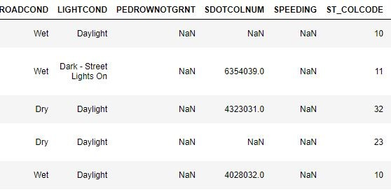
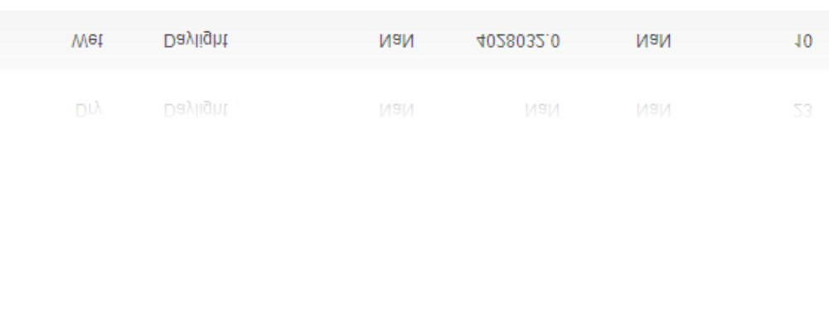
Data description
The data we will be using for the project is from Seattle, Washington, US named as
“Data-Collisions.csv” provided by-"SDOT GIS Analyst”. It has stored data from the year
2004-Present. It is a large dataset with dimension 193673 x 38 to work on. It has a special column showing the Severity of the collision which can be used for training and predicting the model.

Slide 6
Data importing and Cleaning
Firstly useful attributes are selected and transferred to a new dataframe.
The null values were ﬁlled with the most abundant unit of the columns and some were ﬁlled with a zero(0) values.
The categorical data in most of the column is converted to numeric data
The data type of most of the columns were converted from object →
int64 or the date time data was converted to date time format.
The columns that cannot be converted to easy binary numeric data are passed through one hot encoding which splits them up each unique value to a new column with a binary values (0 or 1).
Data is again ﬁltered for best attributes and sent to features
The data is normalised for a better model.

Slide 7
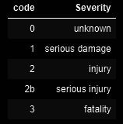
Target
The column named ‘SEVERITYCODE’ is our target cell which we have to predict. It contain the severity of the collision in form of code. Each increment in the code means an increase in severity of collison.

Slide 8
Date-time data analysis
Date time or the timestamp is one of the best column in a dataset. As with that it can be splitted into various form the way we like it.
So, that's what we did and splitted the data into 3 new columns and tried to form a pattern 3 parts were,
From date part we added 2 new columns
The day of week column which shows the each day of week with a number range 0-6 , monday-sunday respectively
The month column which shows the month of year with each number from 1-12.
From Time part we added 1 new column
The hour column which shows he hour in 24hr format , 0-23.
Graphs were plotted to ﬁnd a pattern.

Slide 9
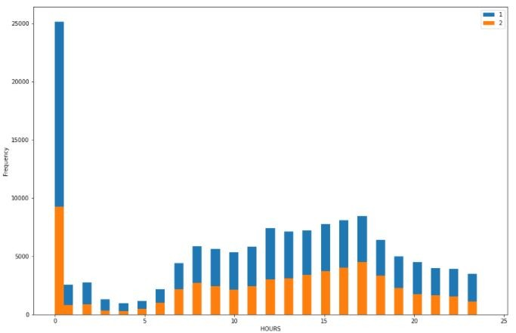
Date-time data analysis
Day of week and month did not show any pattern.
The hour plot clearly showed the sudden peak in collision at 0000 hrs time.
So the hour data converted to new column hour_gp
Hour_gp had a binary output,
1 for collison more than 5000
0 for collison less than 5000

Slide 10

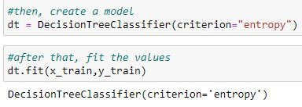
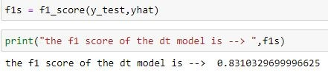
Machine learning and model evaluation
The data was splitted into training and testing data to give out of sample testng to our model, it also prevent biasing.
A decision tree machine learning model was created as it is fast and accurate at the same time. Other models were slow and were crashing the kernel and hanging the machine
Our model have a out of sample f1 score of 0.831 which is acceptable for a good model.

Slide 11
Conclusion and future directions
Finally the model is re trained with whole data so no data is left wasted.
Built useful model to predict the severity of the collision.
The model f1 scored 0.8636
But still there is a room for the improvement.
Could be increased with more different type of data
Otherwise the model will train on itself as the time goes on and it is used, it will have new data.

