Slide 1
INTRODUCTION TO LOGISTIC REGRESSION

Slide 2
TODAY’S LEARNING OBJECTIVES
INTRODUCTION TO LOGISTIC REGRESSION
Describe a sigmoid function, odds, and the odds ratio and how they relate to logistic regression
Build a Logistic regression classification model using the statsmodels and sklearn libraries library
Evaluate a model using metrics such as classification accuracy/error, confusion matrix, ROC/AUC curves, and loss functions

Slide 3
COURSE
PRE-WORK

Slide 4
PRE-WORK REVIEW
Implement a linear model with the sklearn and statsmodels libraries
Understand what a regression coefficient is
Recall metrics such as accuracy and misclassification
Recall the differences between lasso/L1 and ridge/L2 regularization

Slide 5
OPENING
MODEL DIFFERENCES

Slide 6

MODEL DIFFERENCES
ANSWER THE FOLLOWING QUESTIONS (10 minutes)
EXERCISE
Read through the following questions and brainstorm answers for each:
What are the main differences between linear regression and KNN? What is different about how they approach predicting the outcome variable?
For example, what is interpretable about linear regression compared to what's interpretable in KNN?
What would be the advantage of using a linear regression to solve a classification problem instead of KNN?
What might some of the challenges be when using a linear regression to solve a classification problem?
DELIVERABLE
Answers to the above questions

Slide 7

WHERE ARE WE IN THE DATA SCIENCE WORKFLOW?
Data has been acquired and parsed.
Today we’ll refine the data and build models (We’ll also use plots to represent the results).

Slide 8

WHERE ARE WE IN THE MACHINE LEARNING UNIVERSE?

Slide 9
DEMO
WHY NOT
LINEAR REGRESSION?

Slide 10
WHY NOT LINEAR REGRESSION?
Open up the starter-code-9 notebook and let’s see what happens when we apply a linear regression model to a classification problem.

Slide 11
INTRODUCTION
LOGISTIC REGRESSION

Slide 12
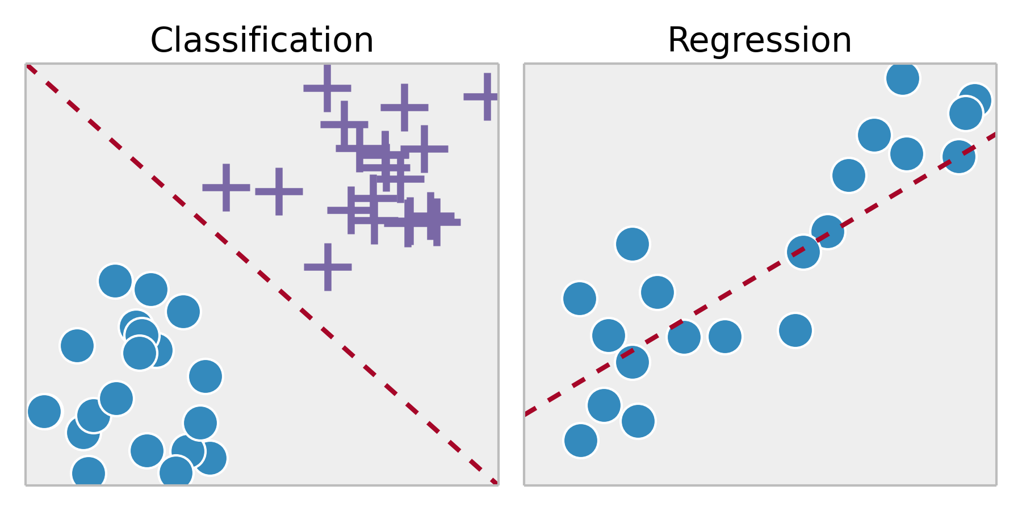
LOGISTIC REGRESSION
Logistic regression is a linear approach to solving a classification problem. It will use a linear regression style approach to predict the class of an item, but retain the interpretability of linear regression model.

Slide 13
THE FAILURES OF LINEAR REGRESSION
This all sounds great, but we’re going to need to solve two major problems with our linear regression model.
First, we’re predicting continuous values for a categorical outcome variable. While we could use some sort of decision rule to transform our continuous outcome into a categorical variable (e.g. values >= 0.5 become Yes), is there another way to interpret this output?
That decision rule is often referred to as a classification threshold.

Slide 14

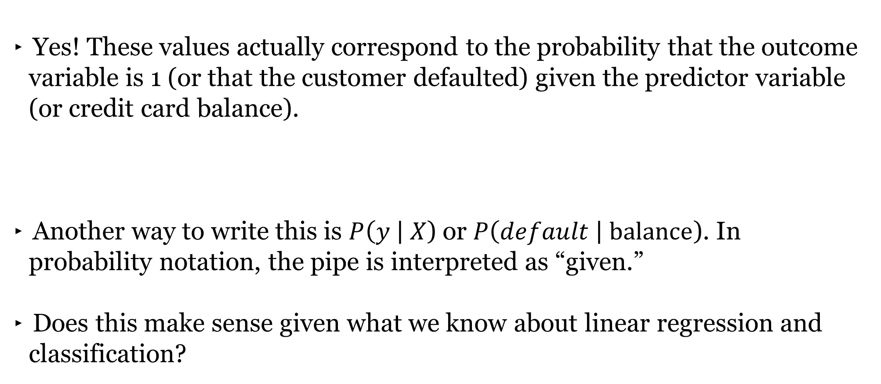
THE FAILURES OF LINEAR REGRESSION
Yes! These values actually correspond to the probability that the outcome variable is 1 (or that the customer defaulted) given the predictor variable (or credit card balance).
Another way to write this is $P\left(y \right| X$) or $P\left(default \right| balance$). In probability notation, the pipe is interpreted as “given.”
Does this make sense given what we know about linear regression and classification?
PROBABILITY ALERT!

Slide 15
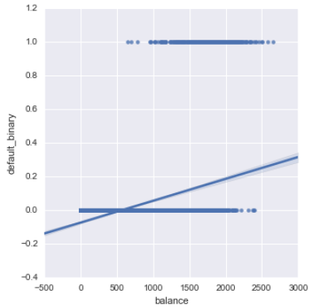
THE FAILURES OF LINEAR REGRESSION
Second, we’ve got to solve this shape problem. Even if we interpret the results as probabilities, it clearly does not fit the data well.
We need a way to transform our regression model so that its range changes from [-∞, ∞] to [0, 1].

Slide 16
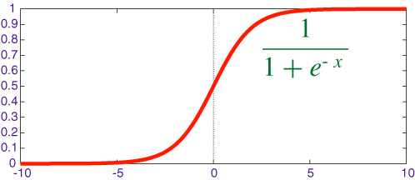
TRANSFORMING LINEAR REGRESSION
To do this, we’ll use a log-based transformation called the sigmoid function.
It will limit our range to [0,1] and create the right shape for our regression line to match the categorical outcome variable.

Slide 17
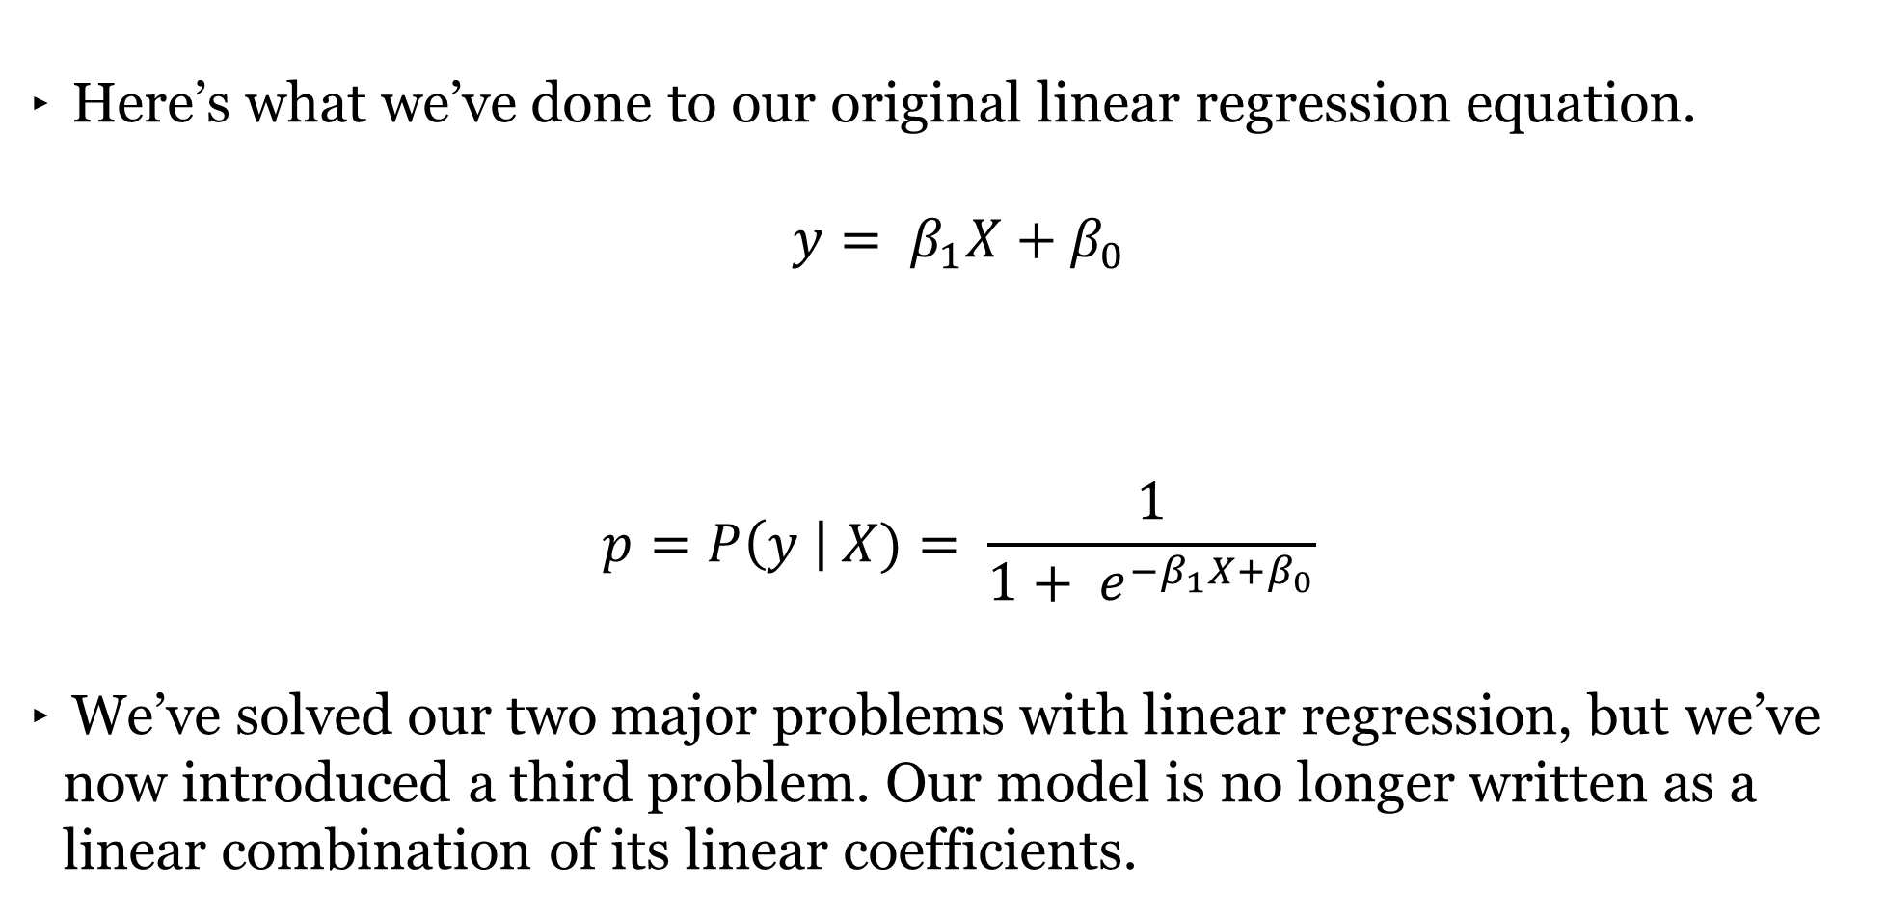
TRANSFORMING LINEAR REGRESSION
Here’s what we’ve done to our original linear regression equation.
$$y= β_{1}X+β_{0}$$
$$p=P\left(y \right| X)= \frac{1}{{1+ e}_{}^{−β_{1}X+β_{0}}}$$
We’ve solved our two major problems with linear regression, but we’ve now introduced a third problem. Our model is no longer written as a linear combination of its linear coefficients.
PROBABILITY ALERT!

Slide 18
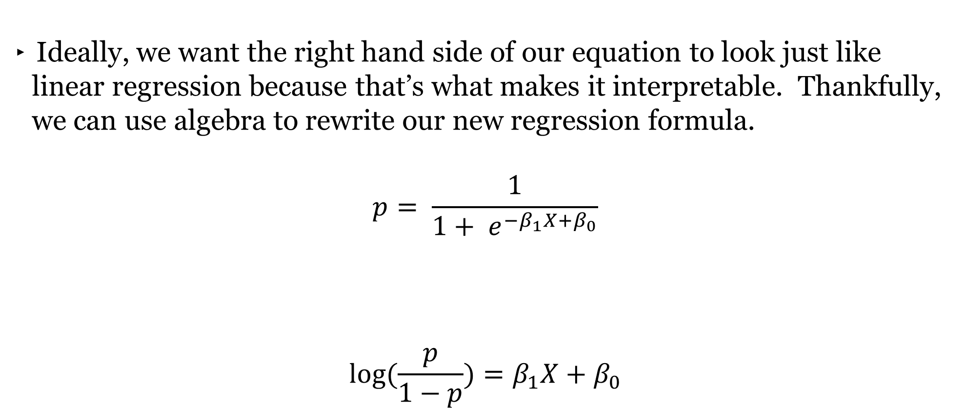
TRANSFORMING LINEAR REGRESSION
Ideally, we want the right hand side of our equation to look just like linear regression because that’s what makes it interpretable. Thankfully, we can use algebra to rewrite our new regression formula.
$$p= \frac{1}{{1+ e}_{}^{−β_{1}X+β_{0}}}$$
$$log⁡(\frac{p}{1−p})=β_{1}X+β_{0}$$
PROBABILITY ALERT!

Slide 19
TRANSFORMING LINEAR REGRESSION
This new formula allow us to express our regression using the inverse of the sigmoid function or the logistic function and preserves the interpretability of linear regression.
This often referred to as a link function since it links our traditional regression equation with a new type of outcome variable.
However, our outcome variable has changed. It is no longer the probability of outcome variable being 1, but the log ratio of probabilities. This ratio of probabilities is referred to as the odds ratio (and the log ratio is referred to as the log odds ratio).

Slide 20
GUIDED PRACTICE
NEVER
TELL ME THE ODDS

Slide 21
ACTIVITY: NEVER TELL ME THE ODDS
ANSWER THE FOLLOWING QUESTIONS (15 minutes)
EXERCISE
Given a standard deck of cards, calculate the probability, odds, and log odds of the obtaining the following cards. (Hint : You may want to use the log function from NumPy)
The 2 of clubs
Any diamond card
A face card (any J, Q, K)
What do each of these measures tell you about how likelihood of each scenario?
DELIVERABLE
Answers to the above questions

Slide 22
DESCRIBING THE ODDS
The probability of a scenario can be interpreted as…
The odds ratio can be interpreted as…
The log odds ration can be interpreted as…

Slide 23
DEMO
BUILDING A
LOGISTIC REGRESSION

Slide 24
BUILDING A LOGISTIC REGRESSION
Open up the starter-code-9 notebook and let’s see how we’ll build a logistic regression model with both statsmodels and sklearn.

Slide 25
INDEPENDENT PRACTICE
MULTIVARIATE LOGISTIC REGRESSION

Slide 26
ACTIVITY: MULTIVARIATE LOGISTIC REGRESSION
DIRECTIONS (15 minutes)
EXERCISE
Use the default data set and build a logistic regression model in statsmodels using all of the available predictor variables (balance, student, and income).
Score your model using sklearn’s MSE function.
Which features have the most impact on default? Which features have the least?
DELIVERABLE
Answers to the above questions

Slide 27
INTRODUCTION
ADVANCED CLASSIFICATION METRICS

Slide 28
ADVANCED CLASSIFICATION METRICS
While we’ve already discussed three different metrics to measure the effectiveness of a classification model, they’ve only given us an overall picture of how a model is performing.
What if we wanted to know exactly how a classifier was performing (e.g. what is predicting correctly vs incorrectly)?

Slide 29
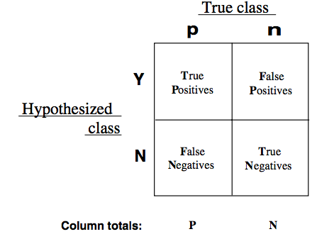
ADVANCED CLASSIFICATION METRICS
We can use a confusion matrix to obtain more granular accuracy ratings for of each class by using the true positive rate and the false positive rate.

Slide 30
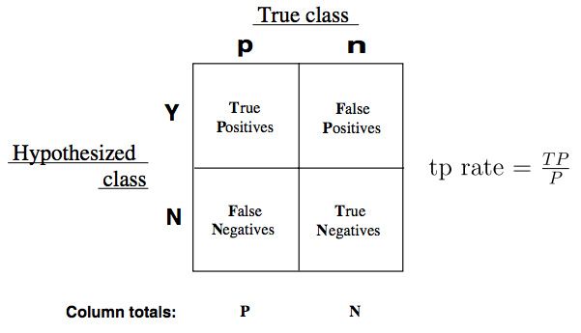
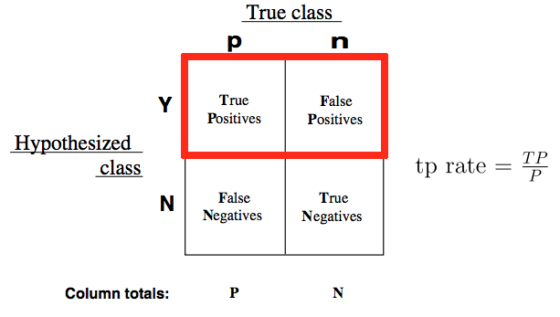
ADVANCED CLASSIFICATION METRICS
The true positive rate (TPR) asks, “Out of all of the target classes, how many were accurately predicted to belong to that class?”
Using our example, the TPR would be how often does our model correctly identify customer who will default on their credit card debt.

Slide 31
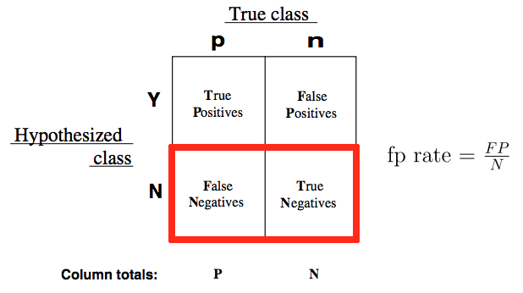
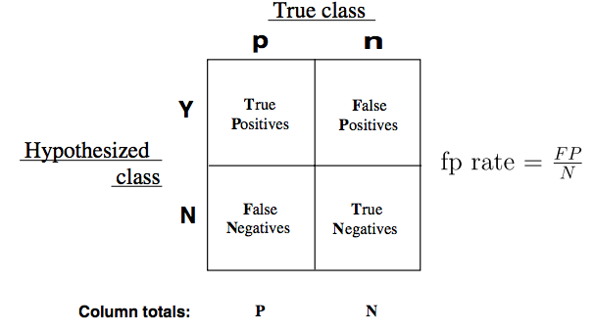
ADVANCED CLASSIFICATION METRICS
The false positive rate (FPR) asks, “Out of all items not belonging to a class, how many were predicted as belonging to that target class label?”
Using our example, the FPR would be how often the model predict that a customer will default when they end up not doing so.

Slide 32
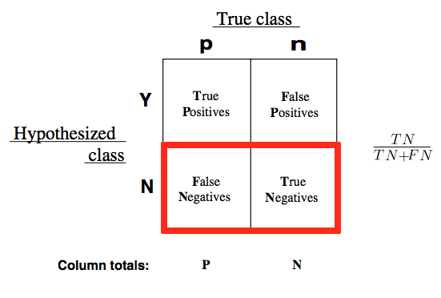
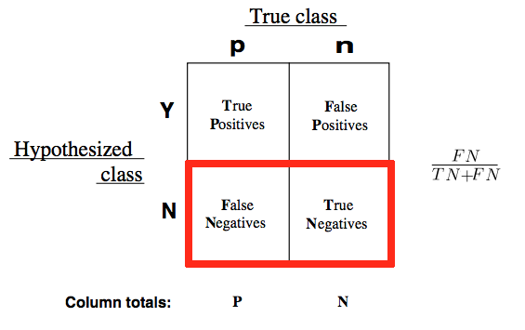
ADVANCED CLASSIFICATION METRICS
We can also measure the inverse of TPR/FPR or the false negative rate and the false negative rate (TNR).

Slide 33
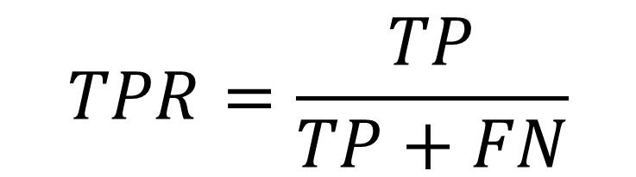
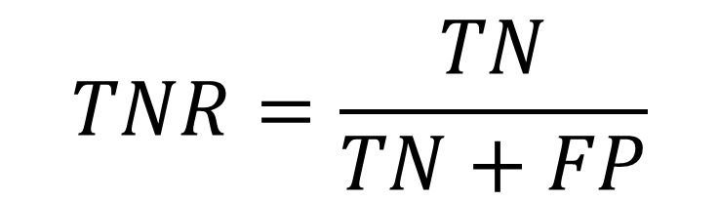


ADVANCED CLASSIFICATION METRICS
These rates gives us a much clearer pictures of where model predictions begin to fall apart and exactly what business cases are being mishandled.
This allows us to adjust our models accordingly and use metrics that best align to our business needs.
$$TPR=\frac{TP}{TP+FN}$$
$$FPR=\frac{FP}{TN+FP}=1−TPR$$
$$TNR=\frac{TN}{TN+FP}$$
$$FNR=\frac{FN}{TP+FN}=1−TNR$$

Slide 34
ADVANCED CLASSIFICATION METRICS
Ideally, our classifier would have a TPR approaching 1 and a FPR approaching 0. This would mean that our model is correctly predicting all customers who defaulted and not mistakenly predict that they wouldn’t default.
We can vary the classification threshold for our model to get different predictions, but how do we know if a model is better overall than other model?
We can compare the FPR and TPR of the models, but it can often be difficult to optimize two numbers at once. Can you think of any ways to combine our two metrics?

Slide 35
THE ROC CURVE
This is where the Receiver Operation Characteristic (ROC) curve comes in handy.
The curve is created by plotting the TPR against the FPR at various model classification settings.
Area Under the Curve (AUC) summarizes the impact of TPR and FPR in a single value.

Slide 36
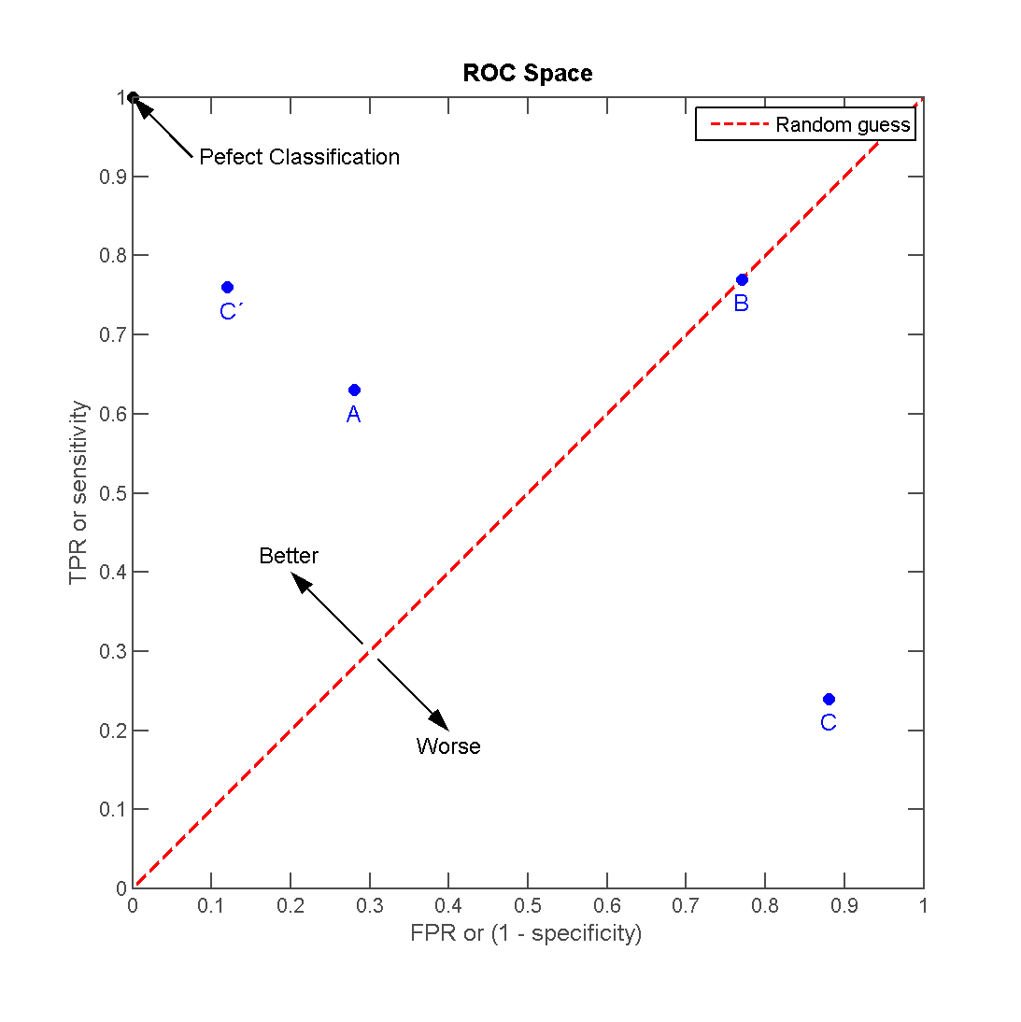
THE ROC CURVE
There can be a variety of points on an ROC curve.

Slide 37
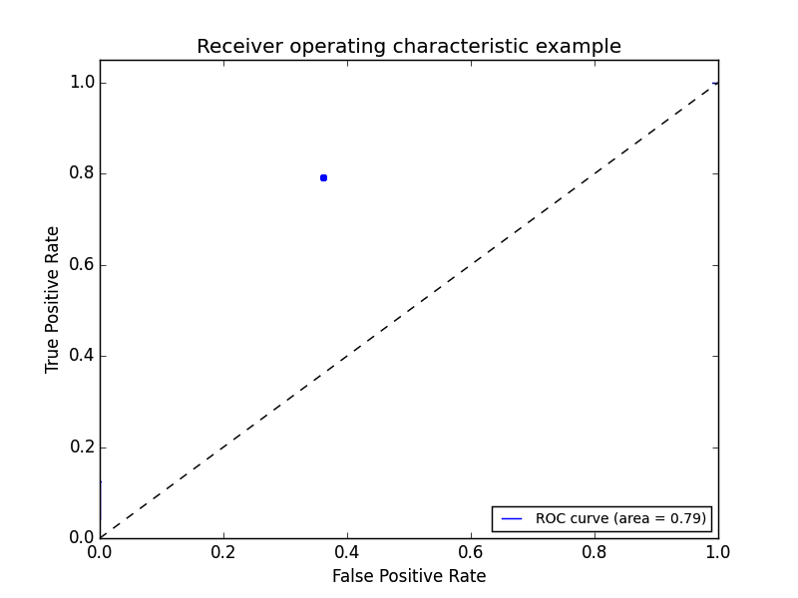
THE ROC CURVE
We can begin by plotting an individual TPR/FPR pair for one threshold.

Slide 38
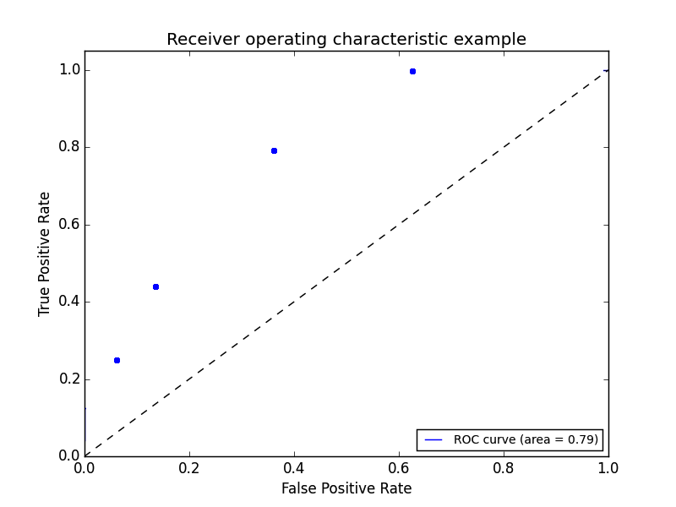
THE ROC CURVE
We can continue adding pairs for different thresholds.

Slide 39
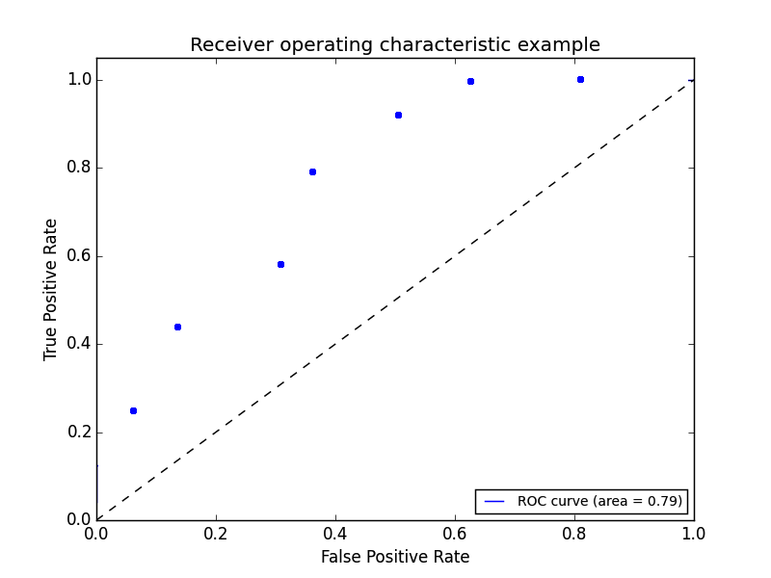
THE ROC CURVE
We can continue adding pairs for even more thresholds.

Slide 40
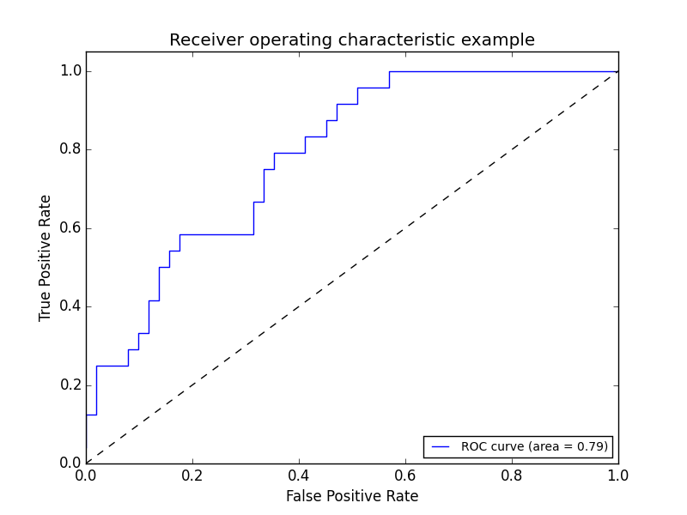
THE ROC CURVE
Finally, we create a full “curve” that is described by both TPR and FPR.

Slide 41
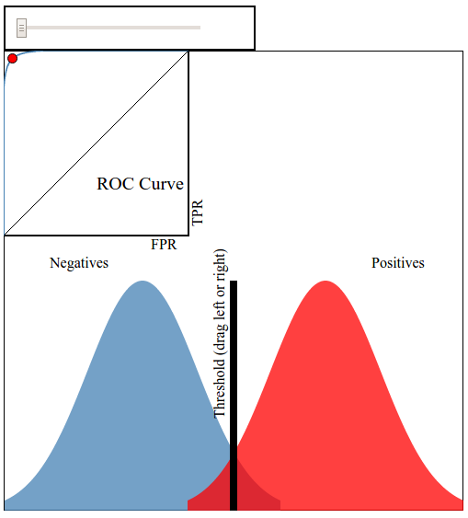
THE ROC CURVE
This interactive visualization can help practice visualizing ROC curves.

Slide 42
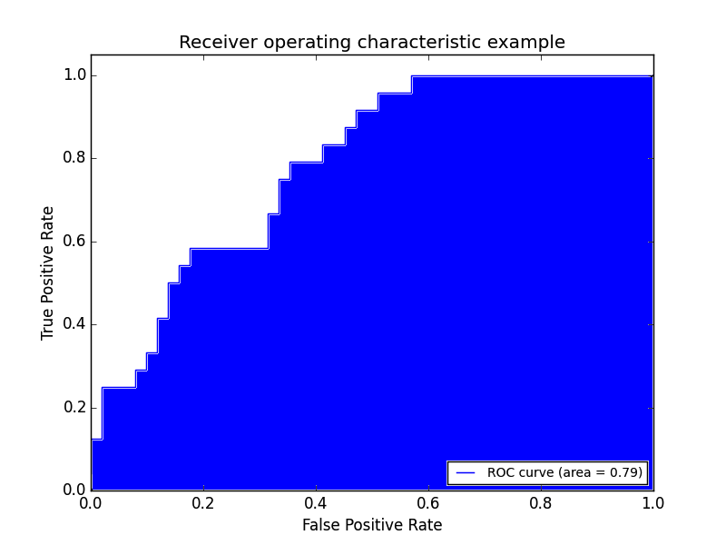
AREA UNDER THE CURVE
With this curve, we can find the Area Under the Curve (AUC).

Slide 43
AREA UNDER THE CURVE
If we have a TPR of 1 (all positives are marked positive) and FPR of 0 (all negatives are not marked positive), we’d have an AUC of 1. This means everything was accurately predicted.
If we have a TPR of 0 (all positives are not marked positive) and an FPR of 1 (all negatives are marked positive), we’d have an AUC of 0. This means nothing was predicted accurately.
An AUC of 0.5 would suggest a model no better than random is an excellent benchmark to use for comparing predictions (e.g. is my AUC above 0.5?).

Slide 44
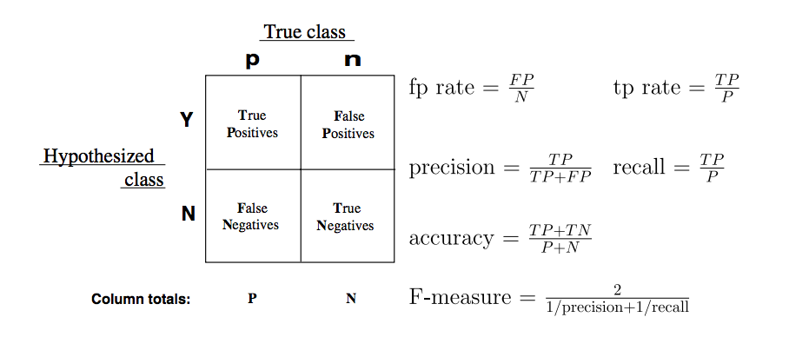
MORE CLASSIFICATION METRICS!
There are several other common metrics that are similar to TPR and FPR that can also be useful.
Sklearn has all of these metrics located on one convenient page.

Slide 45
GUIDED PRACTICE
WHICH METRIC MATTERS?

Slide 46
ACTIVITY: WHICH METRIC MATTERS?
DIRECTIONS (15 minutes)
EXERCISE
While AUC seems like a “golden standard”, it could be further improved depending upon your problem. There will be instances where error in positive or negative matches will be very important. For each of the example on the next slide:
Write a confusion matrix: true positive, false positive, true negative, false negative. Then decide what each square represents for that specific example.
Define the benefit of a true positive and true negative and the cost of a false positive and false negative.
DELIVERABLE
Answers for each example

Slide 47
ACTIVITY: WHICH METRIC MATTERS?
DIRECTIONS (15 minutes)
EXERCISE
Examples:
A test is developed for determining if a patient has cancer or not.
A newspaper company is targeting a marketing campaign for "at risk" users that may stop paying for the product soon.
You build a spam classifier for your email system.
DELIVERABLE
Answers for each example

Slide 48
DEMO
ROC CURVES AND AUC

Slide 49
BUILDING A LOGISTIC REGRESSION
Open up the starter-code-9 notebook and let’s see how to use sklearn to calculate (and visualize) ROC curves and AUC.

Slide 50
INDEPENDENT PRACTICE
TUNING A
LOGISTIC REGRESSION

Slide 51
ACTIVITY: TUNING A LOGISTIC REGRESSION
DIRECTIONS (30 minutes)
EXERCISE
Use the sklearn library to fit and tune the multivariate logistic model we’ve built for the default dataset. Your tuning parameter here will be C or the cost parameter that governs the effect of regularization.
Make sure to incorporate K-fold cross-validation and experiment with fitting a model across a variety of C values.
Measure the effectiveness of these models using one (or more) of our new classification metrics.
DELIVERABLE
A tuned logistic model

Slide 52
CONCLUSION
TOPIC REVIEW

Slide 53
REVIEW QUESTIONS
What’s the link function used in logistic regression?
What kind of machine learning problems does logistic regression address?
What do the coefficients in a logistic regression represent? How does the interpretation differ from ordinary least squares? How is it similar?
How does True Positive Rate and False Positive Rate help explain accuracy?
What would an AUC of 0.5 represent for a model? What about an AUC of 0.9?

Slide 54
COURSE
BEFORE NEXT CLASS

Slide 55
DUE DATE
BEFORE NEXT CLASS
Unit Project 3

Slide 56
LESSON
Q & A

Slide 57
LESSON
EXIT TICKET
DON’T FORGET TO FILL OUT YOUR EXIT TICKET
LESSON 9
INTRO TO LOGISTIC REGRESSION

Slide 58
CITATIONS
THANKS FOR THE FOLLOWING
An Introduction to Statistical Learning, James, G et al (2013): http://www-bcf.usc.edu/~gareth/ISL/getbook.html

