Slide 1
TIME SERIES MODELING
Doug Friedman

Slide 2
TODAY’S LEARNING OBJECTIVES
TIME SERIES MODELING
Identify and decompose time series data into seasonality and trend components
Model and predict from time series data using AR, ARMA, and ARIMA models using the statsmodels library

Slide 3
COURSE
PRE-WORK

Slide 4
PRE-WORK REVIEW
Familiarity with time series data and analysis (e.g. moving averages and autocorrelation)
Prior exposure to linear regression with discussion of coefficients and residuals

Slide 5
OPENING
TIME SERIES MODELING

Slide 6
TIME SERIES MODELING
So far, we’ve focused on formatting and exploring time series data with some new summary statistics (e.g. autocorrelation).
In this lesson, we will advance those techniques to
Identify trends and seasonality
Predict/forecast forward in time (given those trends and seasonality)

Slide 7
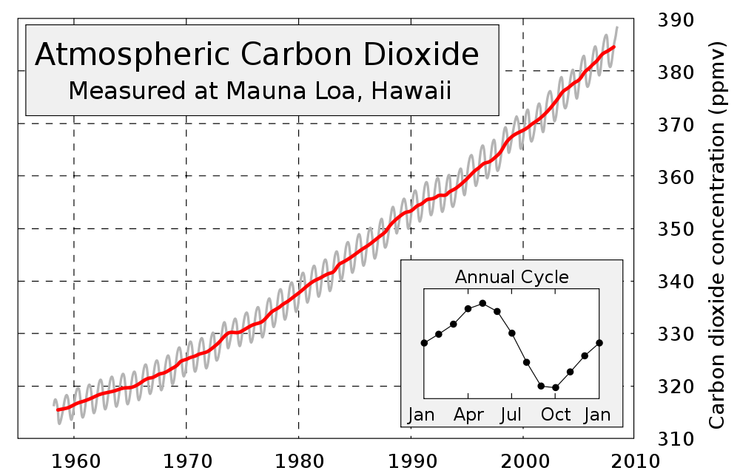
TIME SERIES MODELING
The big picture idea will be that we can use information about the overall trend and seasonality of our data to predict the future.

Slide 8
INTRODUCTION
IDENTIFYING TRENDS AND SEASONALITY

Slide 9
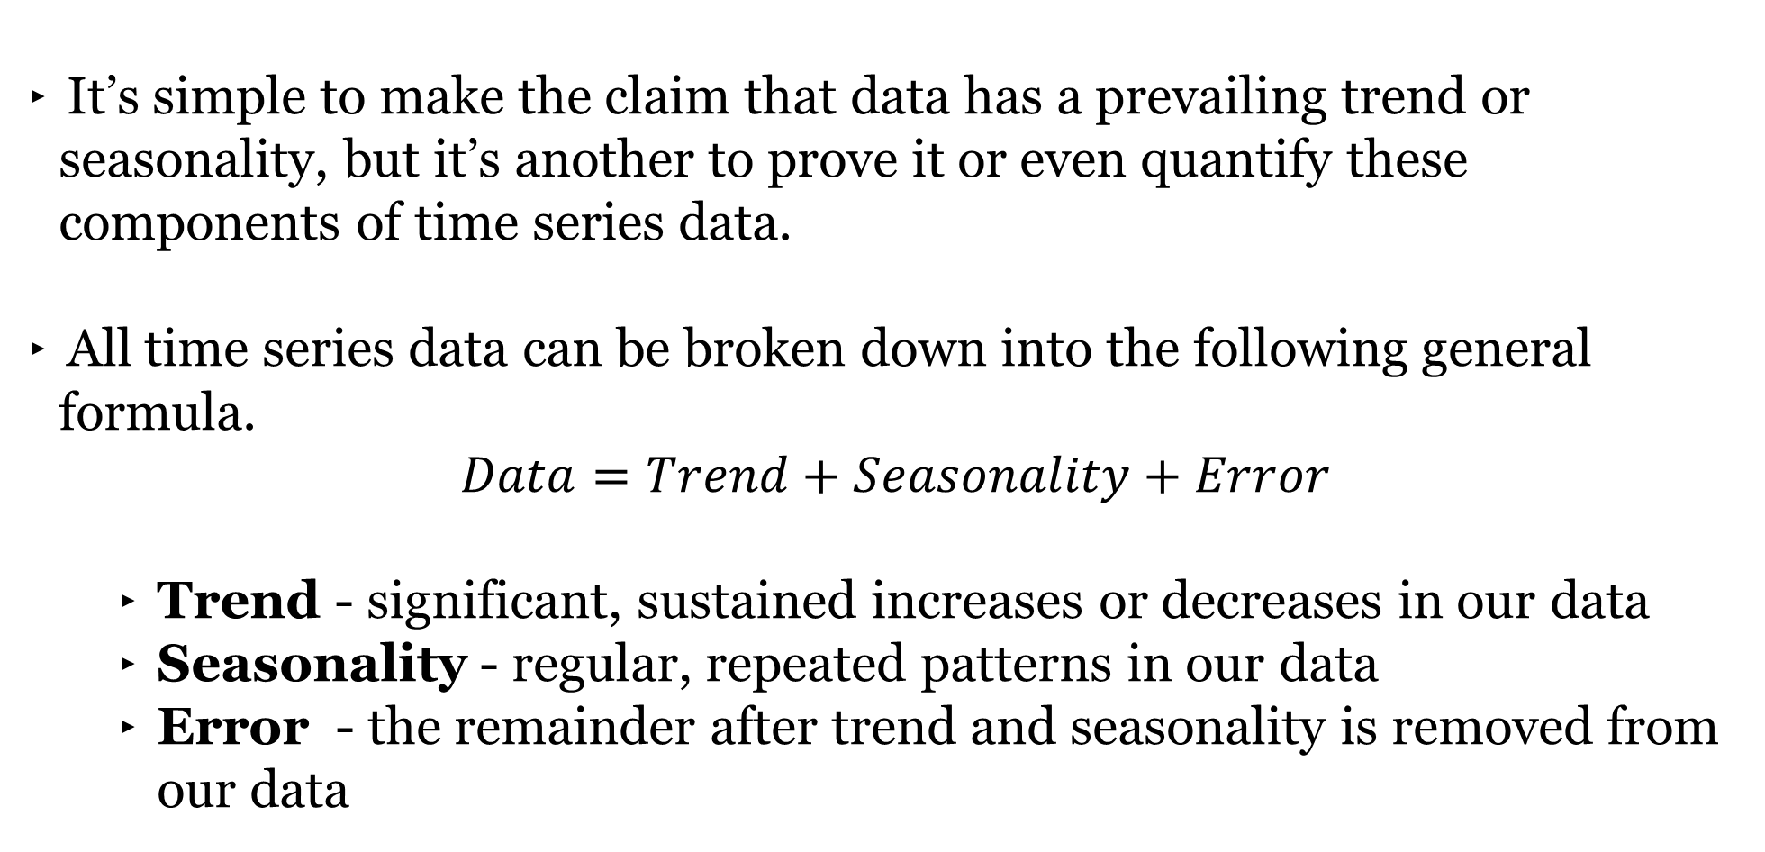
IDENTIFYING TRENDS AND SEASONALITY
It’s simple to make the claim that data has a prevailing trend or seasonality, but it’s another to prove it or even quantify these components of time series data.
All time series data can be broken down into the following general formula.
$$Data=Trend+Seasonality+Error$$
Trend - significant, sustained increases or decreases in our data
Seasonality - regular, repeated patterns in our data
Error - the remainder after trend and seasonality is removed from our data

Slide 10
IDENTIFYING TRENDS AND SEASONALITY
Of these components, the trend is the easiest to identify and there are many, many methods for identifying trends in the data. Each has a slightly different definition of trend.
One of the more popular hypothesis tests for identifying the presence of a trend in data is known as the Mann-Kendall Test. It tests for the presence of a monotonic (consistently increasing or decreasing) trend in the overall data.
It serves as a good high-level test to confirm what we may have already identified through visual inspection.

Slide 11
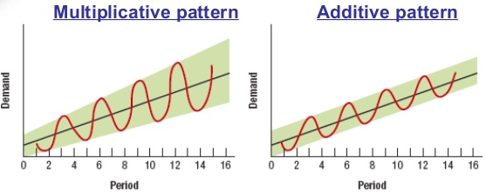
IDENTIFYING TRENDS AND SEASONALITY
Additionally, it is possible to use a linear regression model to determine the strength and direction of a trend in time series data. However, this assumes that the trend is both linear and constant.
Seasonality is relatively harder to identify with a hypothesis test, but is normally categorized as being additive or multiplicative.

Slide 12
IDENTIFYING TRENDS AND SEASONALITY
However, we can use a moving average to identify both trends and seasonality at the same time since it dampens the seasonal component of our data and heightens the trend component.
If we were to identify the ideal window for a moving average and apply it to our data...
The window would be the seasonal period associated with our data
The resulting dataset would be our trend

Slide 13
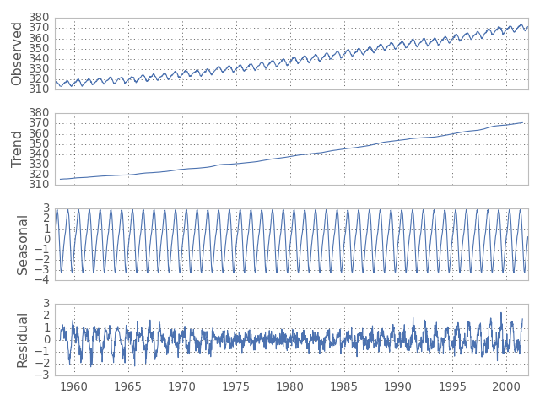
IDENTIFYING TRENDS AND SEASONALITY
This process is known as seasonal-trend decomposition.

Slide 14
DEMO
IDENTIFYING TRENDS AND SEASONALITY

Slide 15
IDENTIFYING TRENDS AND SEASONALITY
Open up starter-code-16 and we can take a look at how to implement these methods in Python with our DC Sea Level data.

Slide 16
GUIDED PRACTICE
IDENTIFYING TRENDS AND SEASONALITY

Slide 17

ACTIVITY: IDENTIFYING TRENDS AND SEASONALITY
ANSWER THE FOLLOWING QUESTIONS (15 minutes):
EXERCISE
Perform the same two analyses (Mann-Kendall testing and Trend-Seasonality Composition) on the Chesapeake Bay sea level data.
Is the a trend present in the Chesapeake Bay data? If so, what direction?
Plot the seasonality components of the Chesapeake Bay and DC sea level data on the same plot. Do they have similar seasonality?
Hint: Limiting your plot to just a few years with matplotlib/pyplot’s plt.xlim may prove useful.
DELIVERABLE
Answers to the above questions

Slide 18
INTRODUCTION
MODELING
TIME SERIES DATA

Slide 19
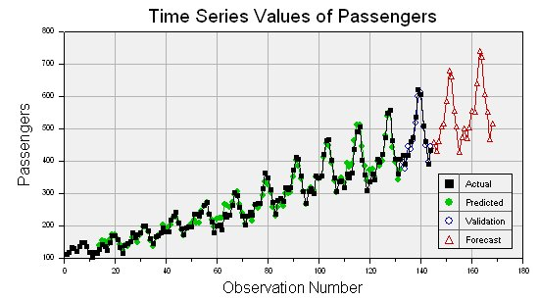
MODELING TIME SERIES DATA
Time series models are models that will be used to predict a future value in the time series given the trend and seasonality of the data.
Similar to other types of models, we’ll need to split our data into training and test data sets.

Slide 20
MODELING TIME SERIES DATA
As before, this will allows us to evaluate how our model performs well on unseen data. However, we won’t be able to use standard cross-validation for evaluation.
Since there is a time component to our data, we cannot choose training and test examples at random.
Suppose we did select a random 80% sample of data points for training and a random 20% for testing. What could go wrong?

Slide 21
MODELING TIME SERIES DATA
The training dataset would likely contain data from before and after the test dataset.
This would not be possible in real life (you can’t use future, unseen data when building your model). Therefore, it’s not a valid test of how our model would perform in practice.
Instead, we will exclusively train on values earlier (in time) in our data and test our model on values at the end of the data period.

Slide 22
STATIONARITY
Many time series models make an assumption of stationarity or that the mean and variance of our values is constant.
While the data may shift up or down over time, the mean and variance of our data must remain constant in order to be stationary.
These assumptions may not (and often will not) represent real data so you need to be aware of when we are breaking the assumptions of our model.

Slide 23
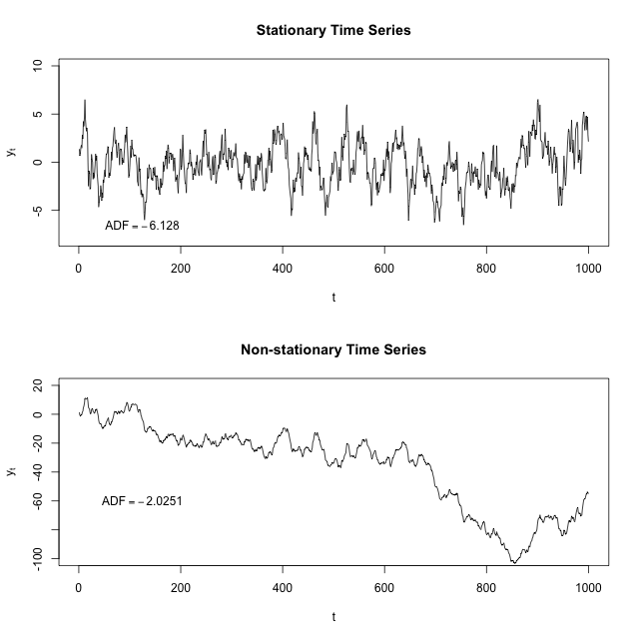
STATIONARITY

Slide 24
STATIONARITY
If our data does not meet the assumption of stationarity, then we’ll need to transform our data in order to meet it before applying a time series model.
Two common transformations for meeting the assumption of stationarity are detrending and differencing.
Detrending would mean removing the trend component from our data using an of the previously discussed trend identification methods (e.g. linear regression).

Slide 25
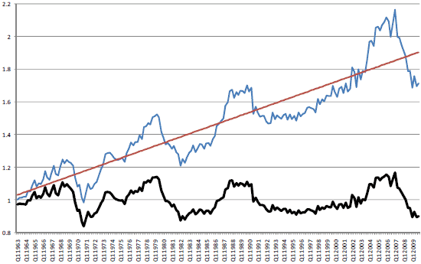
STATIONARITY
In order to make US housing prices stationary, the trend is identified using linear regression and then removed from the data.

Slide 26
STATIONARITY
While detrending can be effective, it is much easier to use differencing. This is very closely related to the moving differences that we worked with previously.
Instead of predicting the original nonstationary time series data, we can instead predict the stationary differences between two consecutive data points.

Slide 27
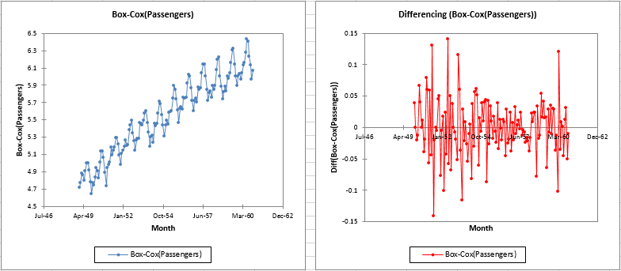
STATIONARITY

Slide 28
GUIDED PRACTICE
STATIONARITY

Slide 29
ACTIVITY: STATIONARITY
ANSWER THE FOLLOWING QUESTIONS (5 minutes):
EXERCISE
Identify one real/actual time series dataset that is stationary.
Identify one real/actual time series dataset that is nonstationary.
DELIVERABLE
Answers to the above questions

Slide 30
INTRODUCTION
AR, ARMA, AND ARIMA

Slide 31
AR, ARMA, AND ARIMA
For the rest of this lesson, we are going to build up towards the ARIMA time series model which combines two common time series models with differencing which allows it to model nonstationary time series data.
This model combines differencing with AR (autoregressive) and MA (moving average) models which build on the previous concepts of autocorrelation and moving averages.

Slide 32
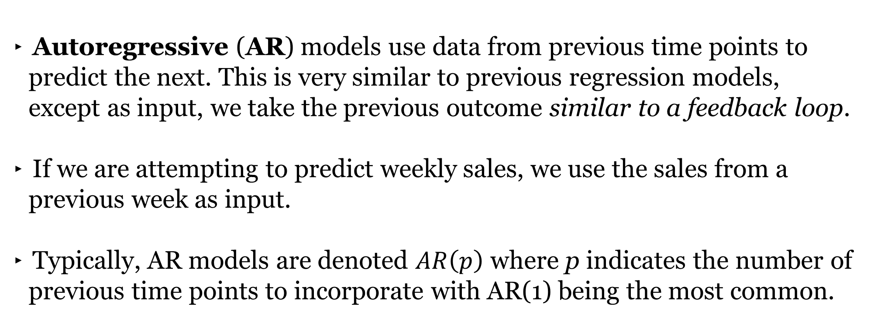
AR MODELS
Autoregressive (AR) models use data from previous time points to predict the next. This is very similar to previous regression models, except as input, we take the previous outcome similar to a feedback loop.
If we are attempting to predict weekly sales, we use the sales from a previous week as input.
Typically, AR models are denoted $AR\left(p\right)$ where p indicates the number of previous time points to incorporate with AR(1) being the most common.

Slide 33
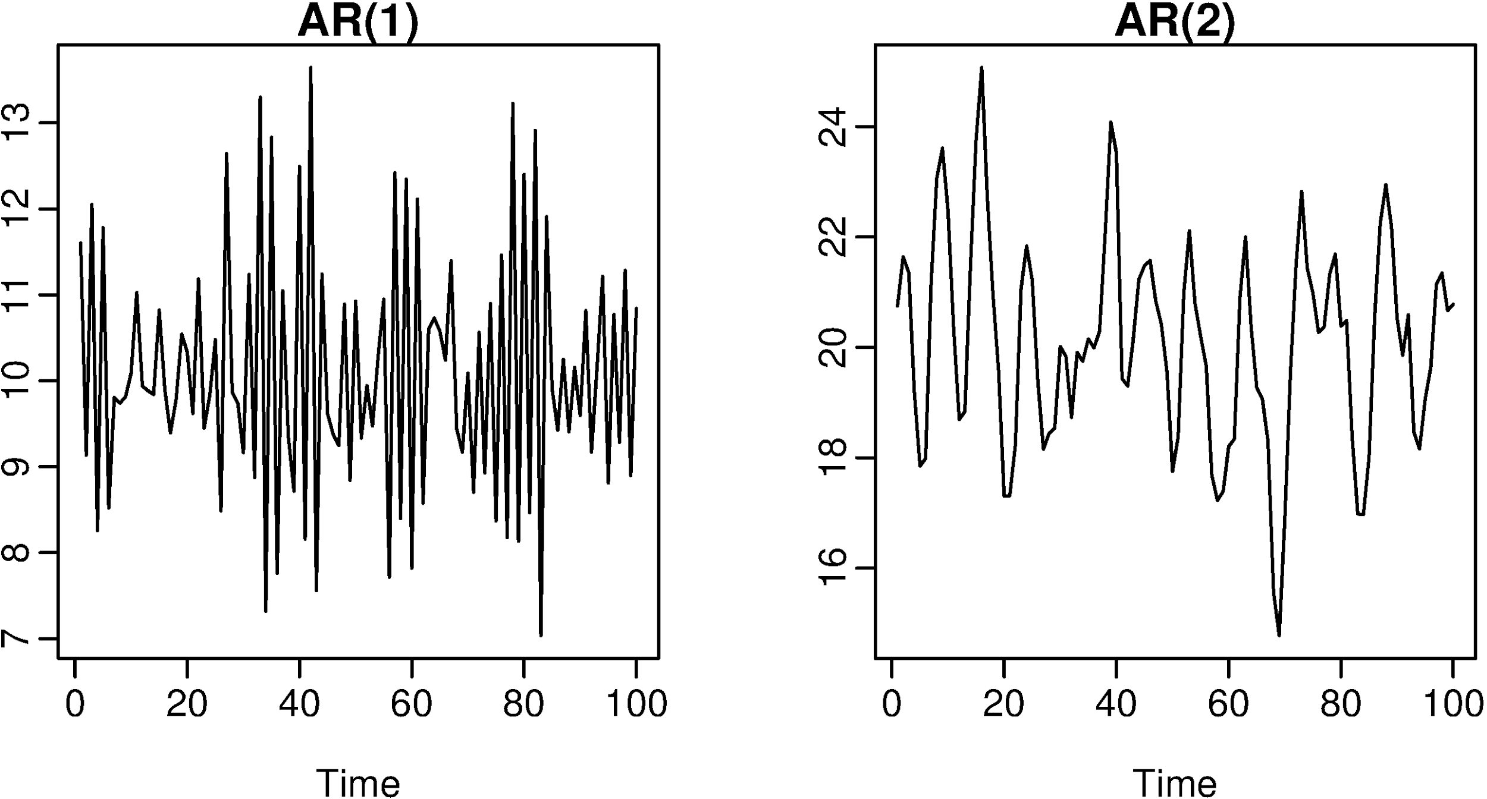
AR MODELS

Slide 34
AR MODELS
In an autoregressive model, similar to standard regression, we are learning regression coefficients for each of the p previous values. Therefore, we will determine p regression coefficients (or 𝛃 values).
If we have a time series of sales per week, y_{i}, we can regress each yi from the last p values.
y_{i} = 𝛃₀ + 𝛃₁y_{i-1} + 𝛃₂y_{i-2} + … + 𝛃_{p}y_{i-p} + 𝜺
As with standard regression, our model assumes that each outcome variable is a linear combination of the inputs and a random error term.

Slide 35
AR MODELS
For an AR(1) model, we will determine a single coefficient.
This coefficient, 𝛃, will tell us the relationship between the previous value, Y_{t - 1}, and the next value, Y_{t}.
Y_{t} = 𝛃·Y_{t - 1}

Slide 36
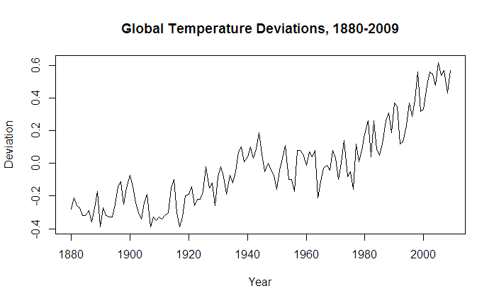
AR MODELS
A coefficient with value > 1 would indicate growth over previous values. This would typically represent nonstationary data, since if we compound the increases, the values are continually increasing.

Slide 37
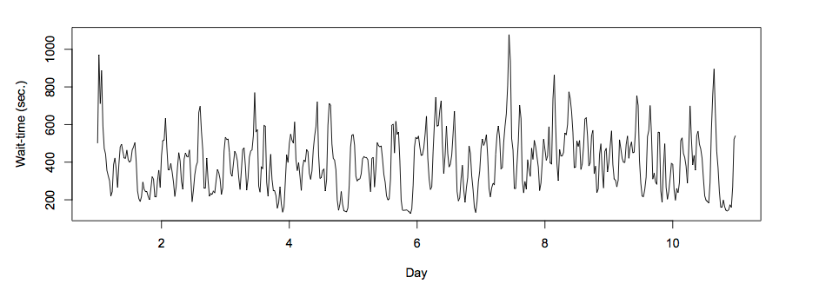
AR MODELS
A coefficient with value between -1 and 1 represent increasing and decreasing patterns from previous patterns.

Slide 38
AR MODELS
As with other models, interpretation of the model becomes more complex as we add more factors (e.g. going from AR(1) to AR(2) can add significant multi-collinearity).
Recall that autocorrelation is the correlation of a value with its previous p values.
A model with high autocorrelation implies that the data is highly dependent on previous values and an autoregressive model would perform well.

Slide 39
AR MODELS
Autoregressive models are useful for learning falls or rises in our series and will weight together the last few values to make a future prediction.
Typically, this model type is useful for small-scale trends such as an increase in demand or change that will gradually increase or decrease the time series overall.

Slide 40
MA MODELS
Moving average (MA) models do not take the previous outputs or values as inputs. Instead, they take the previous error terms.
We will attempt to predict the next value based on the overall average and how off our previous predictions were. This is useful for handling abrupt changes in a system.
Where AR models slowly incorporate changes in the system by combining previous values, MA models use prior errors to quickly incorporate changes.

Slide 41
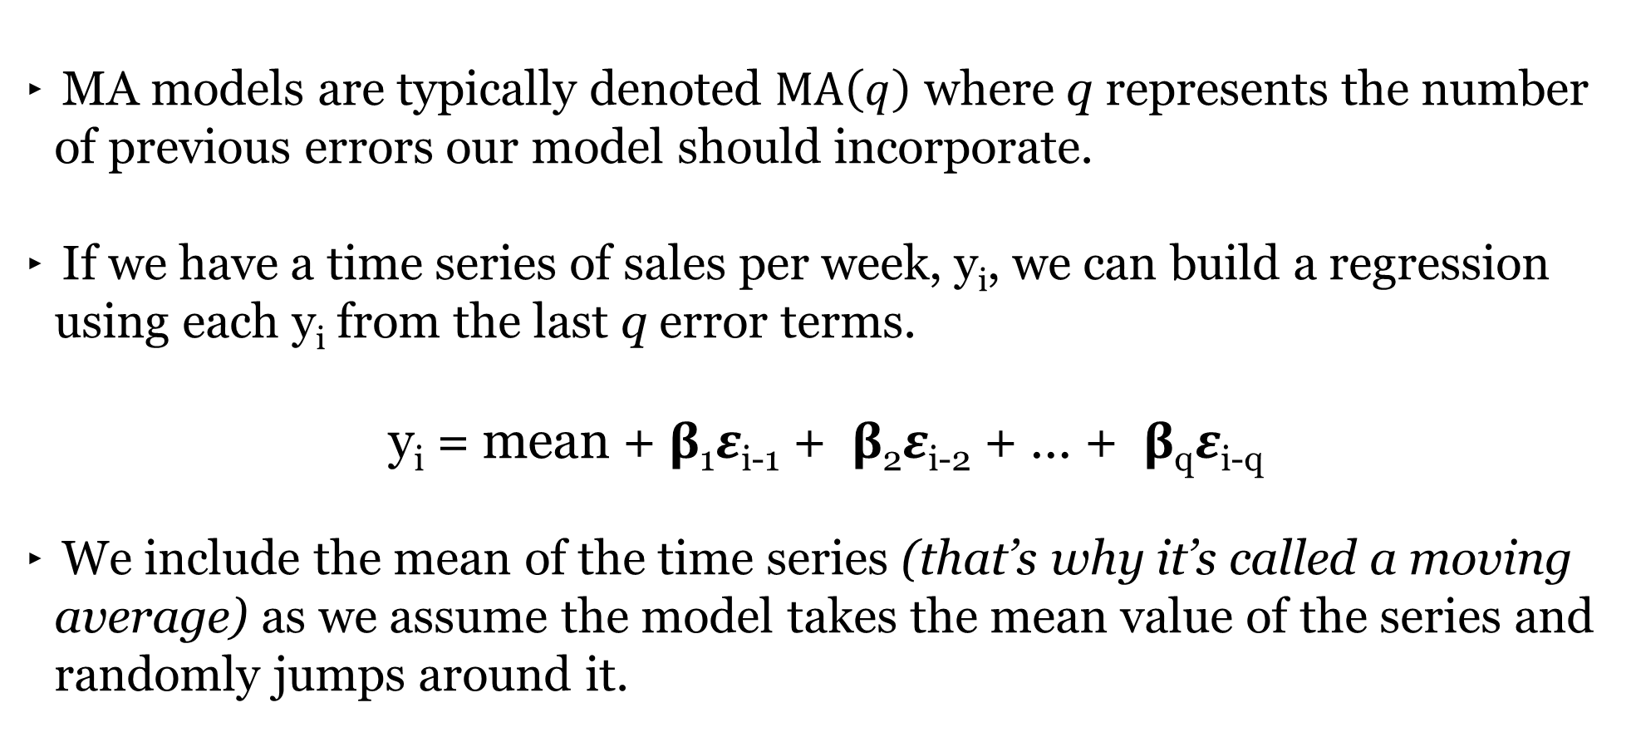
MA MODELS
MA models are typically denoted $MA\left(q\right)$ where q represents the number of previous errors our model should incorporate.
If we have a time series of sales per week, y_{i}, we can build a regression using each y_{i} from the last q error terms.
y_{i} = mean + 𝛃₁𝜺_{i-1} + 𝛃₂𝜺_{i-2} + … + 𝛃_{q}𝜺_{i-q}
We include the mean of the time series (that’s why it’s called a moving average) as we assume the model takes the mean value of the series and randomly jumps around it.

Slide 42
MA MODELS
This would be easy, but we don’t have error terms when we start modeling – so where do they come from?
This requires a more complex fitting procedure than with our models. Here, we need to iteratively fit a model, compute the errors and then refit, again and again.
In this model, we learn q coefficients. For example, in an MA(1) model, we learn one coefficient and this value indicates the impact of how our previous error term on the next prediction.

Slide 43
GUIDED PRACTICE
AR & MA

Slide 44
ACTIVITY: AR & MA
ANSWER THE FOLLOWING QUESTIONS (10 minutes):
EXERCISE
What is the difference between an AR(1) and an MA(1) model?
DELIVERABLE
Answers to the above questions

Slide 45
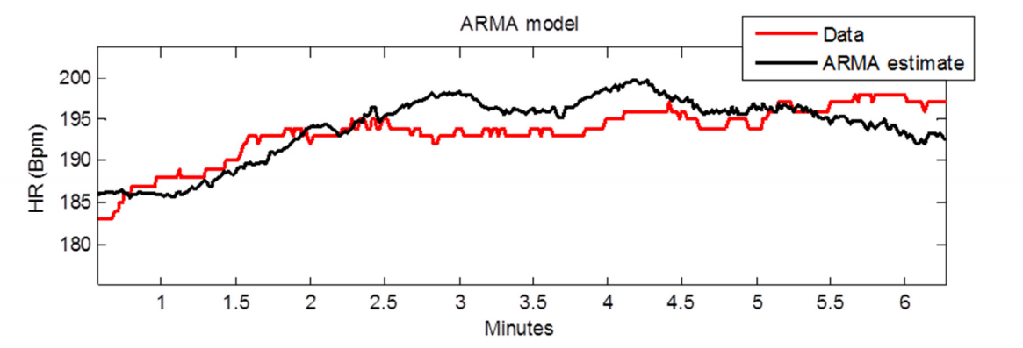
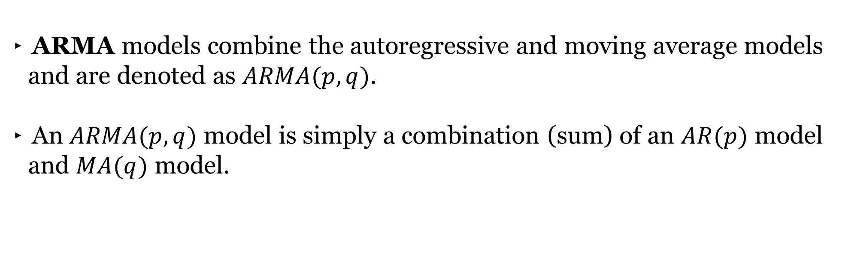
ARMA MODELS
ARMA models combine the autoregressive and moving average models and are denoted as $ARMA(p, q)$.
An $ARMA(p, q)$ model is simply a combination (sum) of an $AR(p)$ model and $MA(q)$ model.

Slide 46
ARMA MODELS
We specify two model settings, p and q, which correspond to combining an AR(p) model with an MA(q) model.
Incorporating both models allows us to mix these two types of effects. AR models slowly incorporate long-term changes while MA models allow us to correct sudden changes based on random events.

Slide 47
ARIMA MODELS
Finally, ARIMA (or AutoRegressive Integrated Moving Average) models combine ARMA models with differencing to allow an ARMA model to be fit to a nonstationary time series dataset.
An ARIMA model actually fits an ARMA model to the differenced data and uses the results to predict our original nonstationary time series dataset.
It handles the stationarity assumption for us so we do not need to perform detrending or differencing manually.

Slide 48
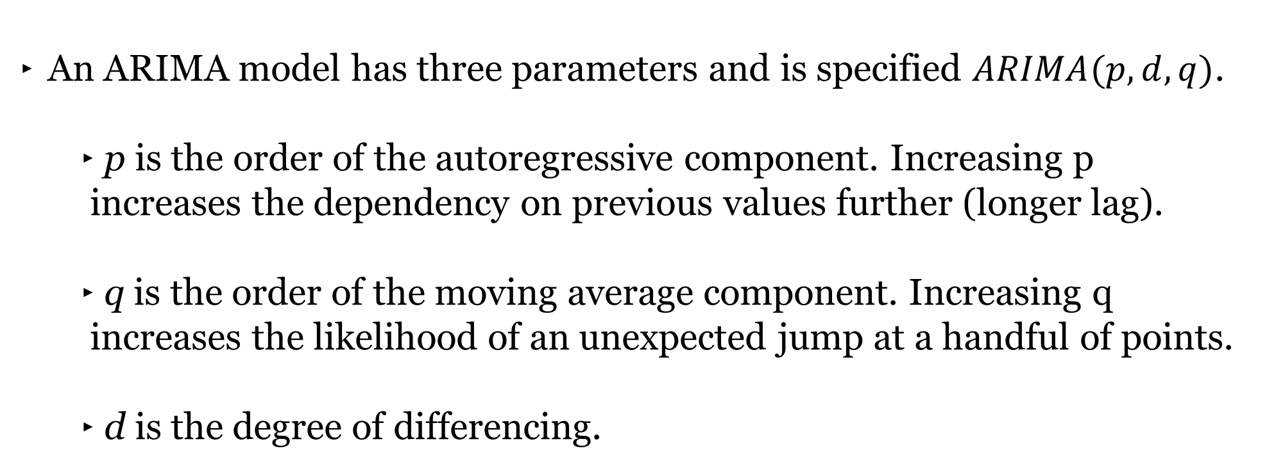
ARIMA MODELS
An ARIMA model has three parameters and is specified $ARIMA(p, d, q)$.
p is the order of the autoregressive component. Increasing p increases the dependency on previous values further (longer lag).
q is the order of the moving average component. Increasing q increases the likelihood of an unexpected jump at a handful of points.
d is the degree of differencing.

Slide 49
ARIMA MODELS
Compared to an ARMA model, ARIMA models do not rely on the underlying series being stationary.
The differencing operation can convert the series to one that is stationary.
Instead of attempting to predict values over time, our new series is the difference in values over time.

Slide 50
DEMO
AR, ARMA, AND ARIMA

Slide 51
AR, ARMA, AND ARIMA
Open up starter-code-16 and let’s take a look how we’d fit an ARMA and ARIMA model to the DC sea level data.

Slide 52
DEMO RECAP
To put it all together, here’s the steps we took to fit an ARIMA model
Establish a training and test dataset.
Evaluate stationarity with visuals or the ADF Test.
If stationary, use an ARIMA model with d=0
If nonstationary, identify a difference that makes the data stationary and use that as d.
Identify potential values of p and q by plotting the ACF and PACF functions. If original data was nonstationary, use the differenced data.

Slide 53
DEMO RECAP (CONT’D)
To put it all together, here’s the steps we took to fit an ARIMA model
Fit an ARIMA model with our identified p, d, and q.
Plot the residuals and confirm that there is no significant trend of pattern present.
Plot the model forecast against the training and test datasets.
Calculate the Mean Squared Error of the model forecast.
(Optional) Consider an ARMA grid search of the differenced data.

Slide 54
INDEPENDENT PRACTICE
MIND YOUR
P’s, D’s, and Q’s

Slide 55
ACTIVITY: MIND YOUR P’s, D’s, and Q’s
ANSWER THE FOLLOWING QUESTIONS (30 minutes):
EXERCISE
Fit an ARIMA model on the Chesapeake Bay sea level data. Use the steps on the previous slides and the code earlier in the notebook as a guide.
Additionally, use the same training and test dataset timeframes as with the DC sea level data.
What values of p, d, and q did your final model have? Did it match our results for the DC sea level?
DELIVERABLE
Answers to the above questions

Slide 56
CONCLUSION
TOPIC REVIEW

Slide 57
CONCLUSION
Time-series models use previous values to predict future values, also known as forecasting.
AR and MA model are simple models on previous values or previous errors respectively.
ARMA combines these two types of models to account for both gradual shifts (due to AR models) and abrupt changes (MA models).
ARIMA models train ARMA models on differenced data to account for non-stationary data.

Slide 58
COURSE
BEFORE NEXT CLASS

Slide 59
DUE DATE
BEFORE NEXT CLASS
Project: Final Project, Part 4

Slide 60
LESSON
Q & A

Slide 61
LESSON
EXIT TICKET
DON’T FORGET TO FILL OUT YOUR EXIT TICKET
LESSON 16
TIME SERIES MODELING

Slide 62
CITATIONS
THANKS FOR THE FOLLOWING
Manua Loa CO2 Graphic: https://gailtheactuary.files.wordpress.com/2012/01/1000px-mauna_loa_carbon_dioxide-en-svg.png
Additive vs Multiplicative Seasonality: https://image.slidesharecdn.com/gaxm9an4tzcsjh0ht6no-140511182034-phpapp02/95/chapter-13-2-42-638.jpg?cb=1399832624

