Slide 1
DATA SCIENCE TOOLS
Aleks Ontman & Alex Sherman

Slide 2
LEARNING OBJECTIVES
DATA SCIENCE TOOLS
Identify the data science toolkit
Navigate Git and the Command Line

Slide 3
COURSE
PRE-WORK

Slide 4
PRE-WORK REVIEW
Complete the General Assembly Command Line Tutorial
Set up GitHub account

Slide 5
OPENING
DATA SCIENCE TOOLS

Slide 6
LET’S DISCUSS THE CURRENT LESSON OBEJCTIVES
Identify the data science toolkit
Navigate Git and the Command Line

Slide 7
INTRODUCTION
TOOLS OF THE TRADE

Slide 8
TOOLS OF THE TRADE
Today we are going to review some of the tools we use in data science.
We’ll see how they fit into the wider programming environment.
We’ll start with the command line. This is your portal to your computer and the outside world.

Slide 9
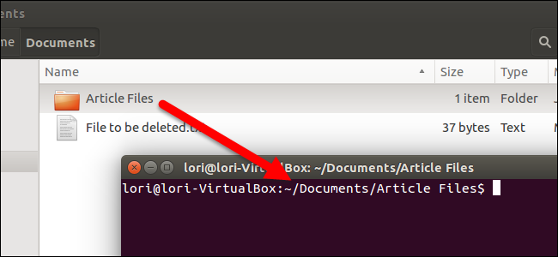
LOCAL MACHINE
On your local computer, you have a variety of tools at your disposal.
Text editor
Programs/tools
Your files
All of these can be accessed through the terminal or through a GUI (Graphical User Interface).
You can navigate your files through the terminal or through Finder.

Slide 10
DATA SCIENCE TOOLS
Terminal/ Command Line
Outside World
Local Machine

Slide 11
DEMO
COMMAND LINE

Slide 12
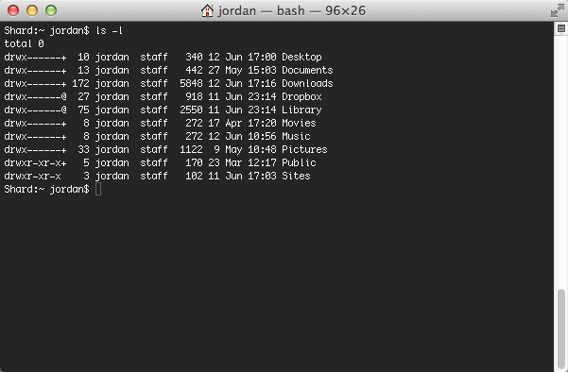
COMMAND LINE
Let’s walk through a few commands.
cd
pwd
$home
mkdir
open
We can access many tools with the terminal. Let’s walk through a few.

Slide 13
DATA SCIENCE TOOLS
Terminal/ Command Line
Outside World
Local Machine
open, mkdir, cd, rm
Your Files

Slide 14
INTRODUCTION
TEXT EDITORS

Slide 15



TEXT EDITORS
So far, we’ve used iPython Notebooks in place of a text editor.
However, there are many options available
eMacs
Vim
Sublime Text
Let’s see what Sublime Text look like with Python.

Slide 16
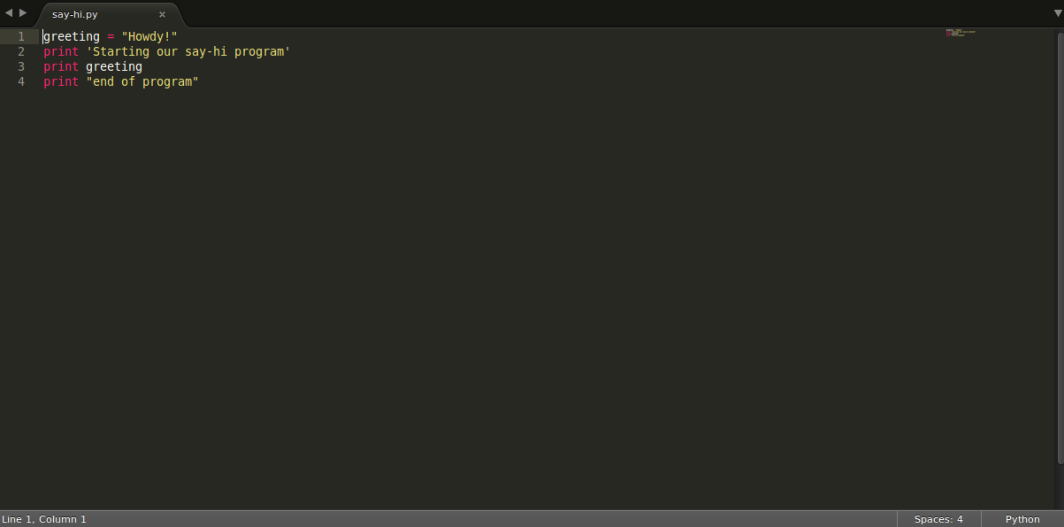
TEXT EDITORS
Open “say-hi.py”, found in the lesson-02 folder of the class repo, in Sublime Text to see it for yourself.

Slide 17
DATA SCIENCE TOOLS
Terminal/ Command Line
Outside World
Local Machine
open, mkdir, cd, rm
Your Files
Text Editor, e.g. Sublime Text
Edit

Slide 18

ACTIVITY: KNOWLEDGE CHECK
ANSWER THE FOLLOWING QUESTIONS
EXERCISE
What is a text editor?
Can you name any other examples?
DELIVERABLE
Answers to the above questions

Slide 19
INTRODUCTION
IPYTHON NOTEBOOK

Slide 20
INTRODUCTION
PYTHON PACKAGES

Slide 21
PYTHON PACKAGES
The terminal allows us to run programs and reach out to the outside world.
We can add programs and packages as needed.
To add Python packages, we use a tool called pip.
Let’s pip install a package with the command line. We’ll install Beautiful Soup, a HTML/XML parsing package.
pip install beautifulsoup4

Slide 22
DATA SCIENCE TOOLS
Terminal/ Command Line
Outside World
Local Machine
open, mkdir, cd, rm
pip install
Your Files
Text Editor, e.g. Sublime Text
Python and Packages
Edit

Slide 23
INTRODUCTION
THE OUTSIDE WORLD

Slide 24
THE OUTSIDE WORLD
The command line also allows you to download and use other tools and packages.
There are many tools for different purposes available in the outside world.

Slide 25
DATA SCIENCE TOOLS
Tools and Packages
Terminal/ Command Line
Outside World
Local Machine
open, mkdir, cd, rm
pip install
Your Files
Text Editor, e.g. Sublime Text
Python and Packages
Edit

Slide 26
THE OUTSIDE WORLD
As we saw with pip, the command line can connect us to the outside world. This becomes more important for data.
We may have Health Insurance Portability and Accountability Act (HIPAA) protected data. This means we can’t leave this sensitive data on our local machine (i.e. laptop).
We need to communicate with a remote machine (i.e. server) to access the data via command line.
Let’s see a demonstration of this.

Slide 27
DATA SCIENCE TOOLS
Tools and Packages
Remote Computers, e.g. AWS
SSH/tunnel
Terminal/ Command Line
Outside World
Local Machine
open, mkdir, cd, rm
pip install
Your Files
Text Editor, e.g. Sublime Text
Python and Packages
Edit

Slide 28
INTRODUCTION
GIT

Slide 29
GIT
Version control is necessary when working on complex projects.
Git is a way of tracking changes we’ve made to our programs that allows us to go back in time to fix errors.
Combined with Github, Git is a powerful tool for collaborating with colleagues. You can work on different aspects of projects simultaneously and merge the changes together seamlessly.
There are many different ways to use these tools.

Slide 30
GIT
Let’s see an example of using Git and Github.
There are three primary commands we’ll use.
git add
git commit
git push
When a colleague wants to implement our change, we may use the command git pull.

Slide 31
DATA SCIENCE TOOLS
Github
Tools and Packages
Remote Computers, e.g. AWS
SSH/tunnel
git push
Terminal/ Command Line/
Git Bash
git pull
Outside World
Local Machine
Local Machine
git commit,
cd, rm
pip install
Your Files
Text Editor, e.g. Sublime Text
Python and Packages
git
Edit

Slide 32
ACTIVITY: KNOWLEDGE CHECK
ANSWER THE FOLLOWING QUESTIONS
EXERCISE
What is a GUI?
What is the command line?
What are the big advantages of using the command line over a GUI?
DELIVERABLE
Answers to the above questions

Slide 33
GUIDED PRACTICE
GIT AND COMMAND LINE

Slide 34
ACTIVITY: GIT AND COMMAND LINE
DIRECTIONS (20 minutes)
EXERCISE
Let’s review the exercises from Codecademy Python.
Let’s review the exercises from the GA command line tutorial.
Are there any questions?
DELIVERABLE
Questions

Slide 35
CONCLUSION
TOPIC REVIEW

Slide 36
REVIEW
What are some common data science tools?
Why are these tools useful?
Any other questions?

Slide 37
COURSE
BEFORE NEXT CLASS

Slide 38
DUE DATE
BEFORE NEXT CLASS
Project:

Slide 39
LESSON
CREDITS

Slide 40
CITATIONS
THANKS FOR THE FOLLOWING
Title, Author: link
Title, Author: link
Title, Author: link

Slide 41
LESSON
Q & A

Slide 42
LESSON
EXIT TICKET
DON’T FORGET TO FILL OUT YOUR EXIT TICKET

Slide 43
THANKS!
NAME
Body Level One
Body Level Two
Body Level Three
Body Level Four
Body Level Five
Body Level One
Body Level Two
Body Level Three
Body Level Four
Body Level Five
Optional Information:
Email?
Website?
Twitter?

