Slide 1
STATISTICS FUNDAMENTALS, PART 2

Slide 2
TODAY’S LEARNING OBJECTIVES
STATISTICS FUNDAMENTALS, PART 2
Explain the difference between causation and correlation
Test a hypothesis with a sample case study
Validate your findings using statistical analysis

Slide 3
INTRODUCTION
CORRELATION AND CAUSATION

Slide 4
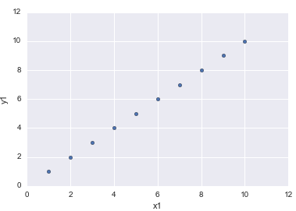
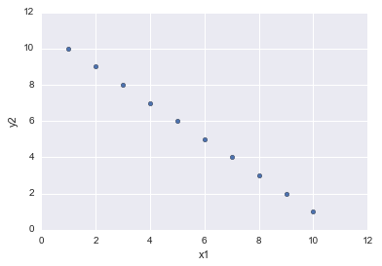
CORRELATION
Correlation is the measure of interdependence or association between two variables. It is measured on a scale of -1 (negatively associated) to 1 (positively associated).
Correlation of 1
Correlation of -1

Slide 5
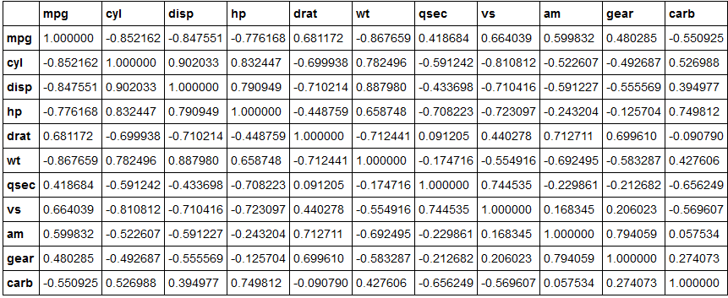
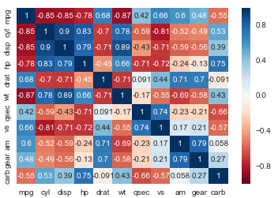
CORRELATION MATRICES AND COLINEARITY
Correlation is particularly useful for quickly determining the association between several variables in a large dataset. Most often, this is represented as a correlation matrix.
This is also useful for identifying collinearity or a lack of independence between variables in a dataset which is key to avoid for many types of statistical models.

Slide 6
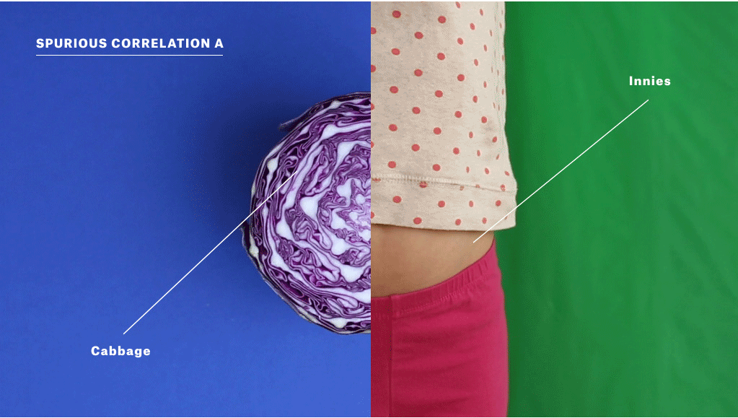
CORRELATION AND CAUSATION
Correlation does not equal causation. It is simply a measure of association.

Slide 7
CAUSATION AND CORRELATION
There is also often a lack of understanding of the difference between causation and correlation.
Understanding this difference is critical in the data science workflow, especially when Identifying and Acquiring data.
Additionally, this comes up when we Present our results to stakeholders as we don’t want to overstate what our model measures.
Be careful not to say “caused” when you really mean “associated” or “coincided with.”

Slide 8
LECTURE
WHAT IS CAUSATION?

Slide 9
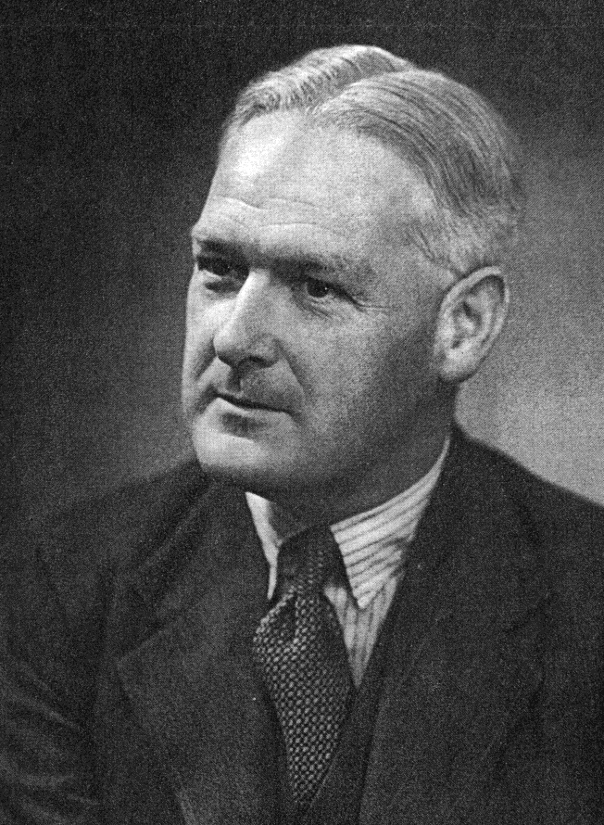
CAUSAL CRITERIA
Causal criteria is one approach to assessing causal relationships. However, it’s very hard to define universal causal criteria.
One attempt that is commonly used in the medical field is based on work by Bradford Hill.

Slide 10
CAUSAL CRITERIA
Criteria | Description
Strength of association | Is there a strong association between the predictor and outcome variables?
Consistency | Does the association remain under different or varying circumstances?
Specificity | Is the predictor variable the causing the observed effect? Could there potentially be other variables involved?
Temporality | Does the predictor variable precede (or come before) the outcome variable?
Dose Response Relationship | Does an increase in the predictor variable increase the effect on the outcome variable?
Plausibility | Does this relationship make sense? Would someone else believe it?
Coherence | Is this result consistent with similar studies of the predictor and outcome variables?
Experiment | Was the evidence obtained from a properly designed experiment?
Analogy | Is there a similar association found in an adjacent subject area?
Notes:
Source: http://www.southalabama.edu/coe/bset/johnson/bonus/Ch11/Causality%20criteria.pdf

Slide 11
CAUSAL CRITERIA EXAMPLE
Criteria | Example Description
Strength of association | The lung cancer rate for smokers was quite a bit higher than for nonsmokers (e.g., one study estimated that smokers are about 35% more likely than nonsmokers to get lung cancer).
Consistency | Different methods (e.g., prospective and retrospective studies) produced the same result. The relationship also appeared for different kinds of people (e.g., males and females)
Specificity | Lung cancer is best predicted from the incidence of smoking.
Temporality | Smoking in the vast majority of cases preceded the onset of lung cancer.
Dose Response Relationship | Data showed a positive, linear relationship between the amount smoked and the incidence of lung cancer.
Notes:
Source: http://www.southalabama.edu/coe/bset/johnson/bonus/Ch11/Causality%20criteria.pdf

Slide 12
CAUSAL CRITERIA EXAMPLE
Criteria | Example Description
Plausibility | Biological theory of smoking causing tissue damage which over time results in cancer in the cells was a highly plausible explanation.
Coherence | The conclusion (that smoking causes lung cancer) “made sense” given the current knowledge about the biology and history of the disease.
Experiment | Tar painted on laboratory rabbits’ ears was shown to produce cancer in the ear tissue over time. Hence, it was clear that carcinogens were present in tobacco tar.
Analogy | Induced smoking with laboratory rats showed a causal relationship. It, therefore, was not a great jump for scientists to apply this to humans.
Notes:
Source: http://www.southalabama.edu/coe/bset/johnson/bonus/Ch11/Causality%20criteria.pdf

Slide 13
CAUSAL CRITERIA
Establishing causality is hard. As a result, most analyses find an association instead.
Hill’s Criteria are a great starting point, they aren’t necessarily exhaustive and elements may not be particularly relevant for non-medical fields.

Slide 14

ACTIVITY: AN ICE COLD CASE
ANSWER THE FOLLOWING QUESTIONS
EXERCISE
A recent paper is published in the Journal of Dairy Products and Policing claiming that ice cream consumption causes homicides. It cites several studies showing that when ice cream sales increase that the homicide rate also increases.
Could this paper be right about this causal relationship? Why or why not?
Which of Hill’s criteria does the paper meet (or not meet)?
DELIVERABLE
Answers to the above questions

Slide 15
INTRODUCTION
CONFOUNDING AND DAGs

Slide 16
CONFOUNDING
Often times, associations may be influenced by another confounding factor.
In the example of ice cream and homicides, you might find that an increase in ice cream sales corresponds to an increase in the homicide rate. However, we know that doesn’t make logical sense.
This normally points to the presence of a confounding factor which would explain both ice cream and homicides (e.g., summer weather).

Slide 17


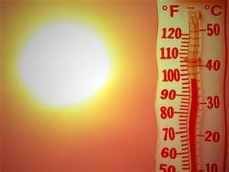
CONFOUNDING

Slide 18
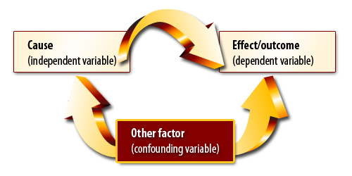
CONFOUNDING
Confounding variables often hide the true association between causes and outcomes.

Slide 19
DIRECTED ACYCLIC GRAPH
These types of graphics are called Directed Acyclic Graph (or DAGs) and can help determine which variables are most important for your model.
It also provides a nice way to visually demonstrate the logic of your models especially if they become more complex than ice cream and homicides.
A DAG always includes at least one predictor variable and one outcome variable.

Slide 20
THINK, PAIR, SHARE
DAGs

Slide 21
ACTIVITY: DAGS
DIRECTIONS
EXERCISE
Suppose we were building a model for a sales team to estimate the amount of sales with TV ads as our only predictor variable.
If this model demonstrated an association, would it be enough to determine causation?
What are some potential confounding variables?
Draw a basic DAG on your table or on the board. This DAG should show the relationship between ads and higher sales.
Discuss your DAGs in small groups and be ready to share one or two examples with the class.
DELIVERABLE
Answers

Slide 22
BIAS (AND CONFOUNDING)
What if the TV ads were run in November/December (peak buying season) while internet ads were run during February/March (low buying season)?
If we compare the two, we’re likely to reach the wrong conclusion! Seasonal trends are affecting our associations.
This is an example of bias and confounding. It isn’t that TV ads are better than Google ads, but that November/December is a better buying season than February/March.

Slide 23
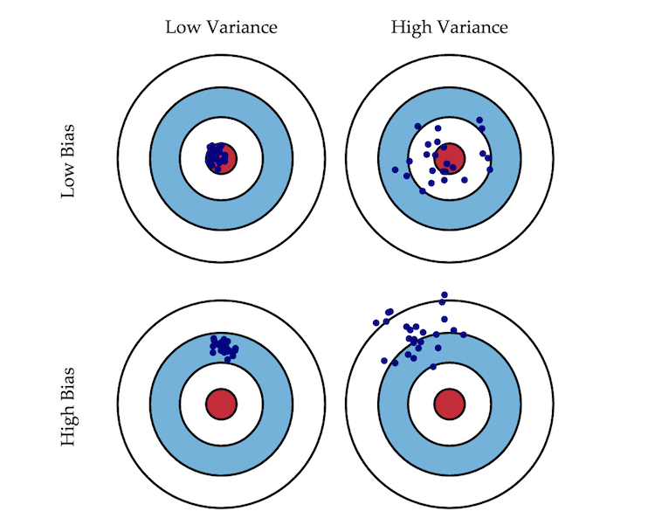
BIAS (AND VARIANCE)
In statistics, bias is defined as estimating an association or measure in a way that is systematically different from its true value.

Slide 24
A FEW KEY TAKEAWAYS
Subject matter expertise is key in identifying potential biases in your analysis. There is no amount of statistics that can replace subject matter expertise.
A DAG can be a useful tool for thinking through the logic of your model.
There is a difference between causation and correlation. Statistics usually show correlation/association, not causation.
The “right” data is important. Your analysis is only as good as your understanding of the problem and the data you have to work with. Garbage in garbage out.

Slide 25
LECTURE
HYPOTHESIS TESTING,
P-VALUES,
AND
CONFIDENCE INTERVALS

Slide 26
HYPOTHESIS TESTING
How can we prove a statistically significant difference between two groups of observations?
Imagine we are testing the health of smokers vs. non-smokers. At a cursory glance, our results may show that smokers are marginally healthier than non-smokers.
Are they healthier due to random chance or is there a statistically significant difference? Maybe we happened to assemble a strange group of smoking triathletes and a group of non-smoking couch potatoes.

Slide 27
HYPOTHESIS TESTING STEPS
First, you need a define your hypothesis or specific question to test.
This is referred to as the null hypothesis and is usually worded as a lack of association (e.g., there is no difference in health between smokers and non-smokers).
The opposite of the null hypothesis is the alternative hypothesis and is usually worded as the presence of an association (e.g., there is a difference in health between the smokers and non-smokers).
Notes:
Draw H0 and Ha

Slide 28
HYPOTHESIS TESTING STEPS
Then, you would identify the proper statistical procedure/test to evaluate the chosen hypothesis.
The result of the test is some evidence that the null hypothesis is true. If that evidence is small, you would reasonably reject the null hypothesis and accept the alternate hypothesis.
If that evidence is large, then you can’t reject the null hypothesis and accept the alternate hypothesis. However, this doesn’t mean we accept the null hypothesis. It just simply means that a verdict of “not null” was rendered.

Slide 29
HYPOTHESIS TESTING AND P-VALUES
To be more specific, the result of a hypothesis test is called a p-value (or probability value) and it represents the probability that the our data could have reasonably occurred (or been generated) if the null hypothesis was true.
A small p-value would indicate the it’s not very likely that this data would have occurred under the null hypothesis while a large p-value would indicate that it is likely that this data would have occurred.
Notes:
Generally, 5% (or .05) is the standard cutoff for a p-value. This means that p-values below .05 can be interpreted as enough statistical evidence to reject the null hypothesis.
This cutoff value is sometimes referred to as α (alpha) or a sensitivity level for our statistical experiment.

Slide 30
CHOOSING A HYPOTHESIS TEST
There are a lot of hypothesis tests to choose from and many of them allow you to test similar hypotheses using your data so how do you choose one?
Assumptions – Every hypothesis test comes with its own set of assumptions that need to be met in order to use it. If your data does not meet these assumptions, your results will be nonsensical.
Specifics – Pick the hypothesis test that best aligns to the question you have about your data. Choosing a more general hypothesis test means you can only make a general claim about your data.

Slide 31

CHOOSING A HYPOTHESIS TEST
Subject Matter – Don’t be afraid to ask subject matter experts (or statisticians) in your field or read up on what hypothesis tests are commonly used.
Hypothesis tests are like criminal trials where statistics are the evidence, so think like a prosecutor and choose the charge that you know will hold up in court.

Slide 32
HANDY HYPOTHESIS TESTS
Test | Description | Assumptions
T-test | 1 Sample – A test to see if the mean of a random sample of data is significantly different from the true mean. 2 Sample - A test to se e if there is significant difference in the means from two random samples of different data. | Data is normally distributed (or is large enough for CLT to apply). The standard deviation of the true/larger population is unknown. (2 Sample) – The two data sets are independent.
Z-test | 1 Sample – A test to see if a proportion from a random sample of data is significantly different from the true proportion. 2 Sample - A test to se e if there is significant difference in the proportion from two random samples of different data. | Data is normally distributed (or is large enough for CLT to apply). The standard deviation of the true/larger population is unknown.

Slide 33
HANDY HYPOTHESIS TESTS
Test | Description | Assumptions
Bartlett Test | 2 Sample – A test to see if there is a significant difference in the variances between two random samples of different data. | Data is normally distributed (or is large enough for CLT to apply).
Mann-Whitney U Test | 2 Sample – A test to see if there is a significant difference in the medians between two random samples of different data.
Levene Test | 2 Sample – A test to see if there is a significant difference in the variances between two random samples of different data.
Kolmogorov-Smirnov Test | 1 Sample – A test to see if there is a significant difference between the distribution of a random sample of data and a selected distribution. 2 Sample – A test to see if there is a significant difference between the distributions of two random samples of different data.

Slide 34
ACTIVITY: KNOWLEDGE CHECK
DIRECTIONS
EXERCISE
A colleague asks for your advice with measuring the effect of their marketing campaign and hands you a report showing the average number of sales doubled from last year.
Is this result statistically significant?
What hypothesis test would you use to test for statistical significance?
If the test result was not statistically significant, what does that mean about the effectiveness about the ad campaign?
DELIVERABLE
Answers

Slide 35
CONFIDENCE INTERVALS
All of the statistical measures (e.g., mean) we’ve discussed so far are point estimates or single values that represent characteristics of the data.
To describe how sensitive or robust these point estimates are to variation in the data, we could randomly sample our data 100 times and then take the same measure each time.
If we wanted to describe the results of these trials, we could give the range of values that the measure took during these 100 trials. This range is known as a confidence interval. The size of that range (e.g., 95) would represent our level of confidence (95%).

Slide 36
CONFIDENCE INTERVALS
There are a number of pre-existing formulas for the confidence intervals for data that align to major statistical distributions (e.g., Normal, t-distribution).
For those data that do not align to major statistical distributions, obtaining a confidence interval requires conducting a large number of random trials and describing the range in the results.
Thankfully, Python will make this process relatively painless.

Slide 37
CODEALONG
HYPOTHESIS TESTING,
P-VALUES,
AND
CONFIDENCE INTERVALS

Slide 38
HYPOTHESIS TESTING CASE STUDY
We’re going to walk through Part 1 of the hypothesis-test notebook in the class repo for lesson 4.

Slide 39
INDEPENDENT PRACTICE
HYPOTHESIS TESTING,
P-VALUES,
AND
CONFIDENCE INTERVALS

Slide 40
ACTIVITY: INTERPRETING RESULTS
DIRECTIONS (35 minutes)
EXERCISE
Using the lab-start-code-4, you will look through a variety of analyses and interpret the findings.
You will be presented with a series of outputs and tables from a published analysis.
Read the outputs and determine if the findings are statistically significant or not.
DELIVERABLE
Answers to the questions in the notebook

Slide 41
CONCLUSION
LAB REVIEW

Slide 42
LAB REVIEW
Let’s review the answers to the questions in the labs.
Any other questions?

Slide 43
COURSE
BEFORE NEXT CLASS

Slide 44
DUE DATE
BEFORE NEXT CLASS
Finish Unit Project 1 and Unit Project 2

Slide 45
LESSON
Q & A

Slide 46
LESSON
EXIT TICKET
DON’T FORGET TO FILL OUT YOUR EXIT TICKET
LESSON 3
STATISTICS FUNDAMENTALS

