Slide 1
Electrooptic Matched Filter Controlled by Independent Voltages Applied to Multiple Sets of Electrodes

Slide 2
Contents
Introduction
Mode Coupling in Optical Waveguide
    TE and TM Modes in Slab Dielectric Waveguide
    TE/TM Polarization Converter
Design of Electrooptic Matched Filter
    The Principal Characteristics of EMF
    The EMF Structure for Two Sidebands
    The EMF Structure for Single Sideband
    Matrix Formulation and Simulation Results
Electronic Driving Circuit for EMF
    Digital-to-Analog Converter Driving Driving Circuit
    Loading DAC Channels
Experimental Results
    Experimental Configuration
    Test Results
Conclusions
Recommendations

Slide 3
I. Introduction
Optical filters - essential components in a wavelength-division multiplexed (WDM) optical networks
Electrooptic tunable filters (EOTFs) - a good solution for sub-microsecond tunability through TE-TM mode coupling
Conventional EOTF - a Mach-Zehnder interferometer structure, phase-matched polarization conversion, and polarization beam splitter
Electrooptic matched filter (EMF) is a new type of EOTF providing wide spectral tuning range and rapid tuning
EMF - designed for operation in the 1550 nm wavelength regime for 100 GHz (0.8 nm) channel spacing corresponding to the ITU–T grid

Slide 4
II. Mode Coupling in Optical Waveguide
A. TE and TM Modes in Slab Dielectric Waveguide
Optical waveguide
The step-index planar waveguide is the simplest structure for discussing fundamental properties of guided modes
(a)
(b)
(c)
x
0
-t
Region I n₁
z
Region II n₂
Region III n₃

Slide 5



Wave Equation in Slab Waveguide
The allowed modes of this waveguide are obtained from the wave equation given by
The solutions are subject to the boundary conditions: tangential components of E and H are continuous at the interfaces x = 0 and –t
Assuming an isotropic and lossless medium in the waveguide, Maxwell’s equations written by
  and
  yields two orthogonal modes
$$∇^{2}E(r)+k_{0}^{2}n^{2}(r)E(r)=0$$
$$∇×H=−ε_{0}n^{2}\frac{∂E}{∂t}$$
$$∇×E=−μ_{0}\frac{∂H}{∂t}$$

Slide 6



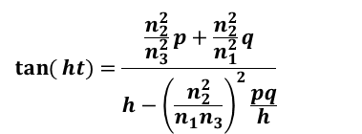
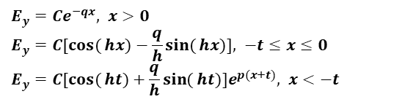
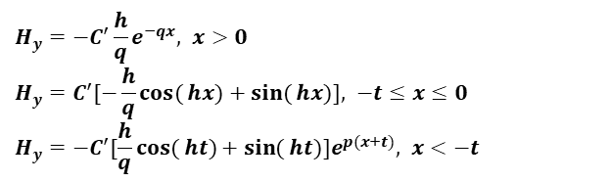





TE and TM Modes
Transverse electric (TE) mode
Transverse magnetic (TM) mode
$$\frac{∂^{2}}{∂x^{2}}E_{y}+(k_{0}^{2}n^{2}−β^{2})E_{y}=0$$
$$\frac{∂^{2}}{∂x^{2}}H_{y}+(k_{0}^{2}n^{2}−β^{2})H_{y}=0$$
Wave equation
Maxwell’s equations
TE/TM Mode field solution in each layer
Eigenvalue
equation
$$H_{y}=−\frac{β}{ωμ_{0}}E_{y}$$
$$E_{x}=\frac{β}{ωε_{0}n^{2}}H_{y}$$
$$H_{z}=−\frac{1}{jωμ_{0}}\frac{∂E_{y}}{∂x}$$
$$E_{z}=\frac{1}{jωε_{0}n^{2}}\frac{∂H_{y}}{∂x}$$
$$E_{y}=Ce^{−qx}, x>0 \\ E_{y}=C[\cos{(}hx)−\frac{q}{h}\sin{(}hx)], −t≤x≤0 \\ E_{y}=C[\cos{(}ht)+\frac{q}{h}\sin{(}ht)]e^{p(x+t)}, x<−t$$
$$H_{y}=−C^{′}\frac{h}{q}e^{−qx}, x>0 \\ H_{y}=C^{′}[−\frac{h}{q}\cos{(}hx)+\sin{(}hx)], −t≤x≤0 \\ H_{y}=−C^{′}[\frac{h}{q}\cos{(}ht)+\sin{(}ht)]e^{p(x+t)}, x<−t$$
$$\tan{(}ht)=\frac{\frac{n_{2}^{2}}{n_{3}^{2}}p+\frac{n_{2}^{2}}{n_{1}^{2}}q}{h−{\left(\frac{n_{2}^{2}}{n_{1}n_{3}}\right)}^{2}\frac{pq}{h}}$$
$$\tan{(}ht)=\frac{p+q}{h−\frac{pq}{h}}$$
$$q=\sqrt{β^{2}−k_{0}^{2}n_{1}^{2}}, h=\sqrt{k_{0}^{2}n_{2}^{2}−β^{2}}, p=\sqrt{β^{2}−k_{0}^{2}n_{3}^{2}}$$
where
and
$$k_{0}n_{3}<β<k_{0}n_{2}$$

Slide 7





II. Mode Coupling in Optical Waveguide
B. TE/TM Polarization Converter
Coupled Mode Theory in Optical Waveguide
In an isotropic charge-free medium, eigen modes satisfy the wave equation in the form
$$∇^{2}E(r,t)=με(r)\frac{∂^{2}E(r,t)}{∂t^{2}}$$
$$∇⋅(εE)=0$$
using
$$∇×∇×E≡∇(∇⋅E)−∇^{2}E$$
$$∇×H=−ε_{0}n^{2}\frac{∂E}{∂t}$$
Curl and substitute
$$∇×E=−μ_{0}\frac{∂H}{∂t}$$

Slide 8







Coupled Mode Theory Continued…
With the electric polarization of the medium $P(r,t)$
$$∇^{2}E(r,t)=με_{0}\frac{∂^{2}E(r,t)}{∂t^{2}}+μ\frac{∂^{2}}{∂t^{2}}P(r,t)$$
where , :Medium dielectric constant
$$P(r,t)=[ε(r)−ε_{0}]E(r,t)$$
$$ε(r)$$
If the deformation in the waveguide is taken into account, the induced perturbation in the polarization results in
$$∇^{2}E(r,t)=μ\frac{∂^{2}}{∂t^{2}}[ε(r)E(r,t)+P_{pert}(r,t)]$$
Assuming only the TE mode
$$∇^{2}E_{y}(r,t)−μ\frac{∂^{2}}{∂t^{2}}ε(r)E_{y}(r,t)=μ\frac{∂^{2}}{∂t^{2}}[P_{pert}(r,t)]_{y}$$
The following equation is derived after some calculation and used to consider TE and TM mode interaction.
$$\frac{dA_{s}^{−}}{dz}e^{j(ωt+β_{s}z)}−\frac{dA_{s}^{+}}{dz}e^{j(ωt−β_{s}z)}−c.c.=−\frac{j}{2ω}\frac{∂^{2}}{∂t^{2}}\int_{−∞}^{∞}{[P_{pert}(r,t)]_{y}}E_{y}^{s}(x)dx$$

Slide 9
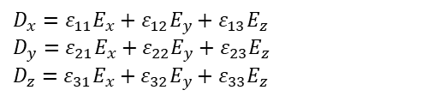

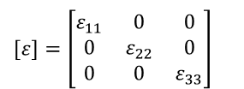
Electrooptic Effect in a Uniaxial Crystal
An electrooptic material undergoes the change in the refractive index induced by applied electric field linearly (Pockels effect) or quadratically (Kerr effect) and this phenomenon is called the electrooptic effect
The electric flux density $D$ in an anisotropic dielectric media is written by with dielectric constants and electric fields
$$D_{x}=ε_{11}E_{x}+ε_{12}E_{y}+ε_{13}E_{z} \\ D_{y}=ε_{21}E_{x}+ε_{22}E_{y}+ε_{23}E_{z} \\ D_{z}=ε_{31}E_{x}+ε_{32}E_{y}+ε_{33}E_{z}$$
If the coordinate system in a crystal structure is chosen to vanish off-diagonal elements, the axes in this coordinate system are defined as principal axes and a 3×3 electric permeability tensor can be expressed as
$$[ε]=\left[\begin{matrix}ε_{11} & 0 & 0 \\ 0 & ε_{22} & 0 \\ 0 & 0 & ε_{33}\end{matrix}\right]$$

Slide 10
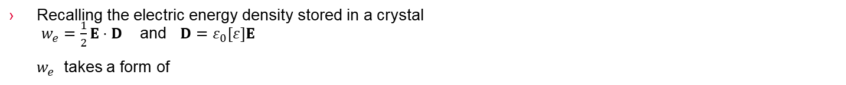

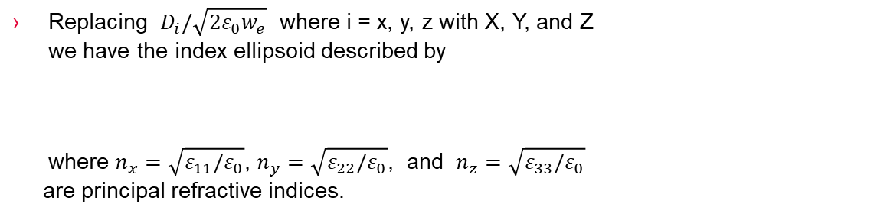
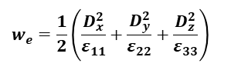
Index Ellipsoid
Recalling the electric energy density stored in a crystal
$w_{e}=\frac{1}{2}E⋅D$ and $D=ε_{0}[ε]E$
  $w_{e}$ takes a form of
$$w_{e}=\frac{1}{2}\left(\frac{D_{x}^{2}}{ε_{11}}+\frac{D_{y}^{2}}{ε_{22}}+\frac{D_{z}^{2}}{ε_{33}}\right)$$
Replacing $D_{i}/\sqrt{2ε_{0}w_{e}}$ where i = x, y, z with X, Y, and Z
we have the index ellipsoid described by
where $n_{x}=\sqrt{ε_{11}/ε_{0}}$, $n_{y}=\sqrt{ε_{22}/ε_{0}}$, and $n_{z}=\sqrt{ε_{33}/ε_{0}}$
are principal refractive indices.
$$\frac{X^{2}}{n_{x}^{2}}+\frac{Y^{2}}{n_{y}^{2}}+\frac{Z^{2}}{n_{z}^{2}}=1$$

Slide 11
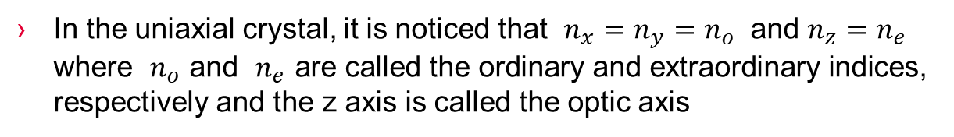
Index Ellipsoid of Uniaxial Crystal
In the uniaxial crystal, it is noticed that $n_{x}=n_{y}=n_{o}$ and $n_{z}=n_{e}$ where $n_{o}$ and $n_{e}$ are called the ordinary and extraordinary indices, respectively and the z axis is called the optic axis
z
n_{e}
n_{o}
y
x
n_{o}

Slide 12
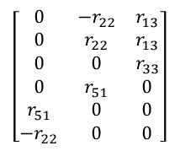
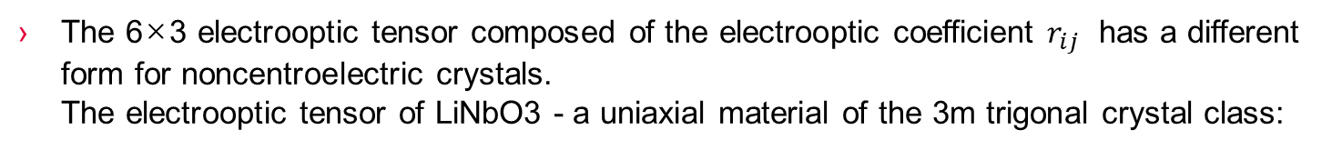
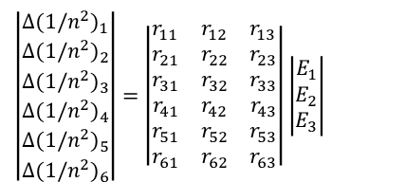
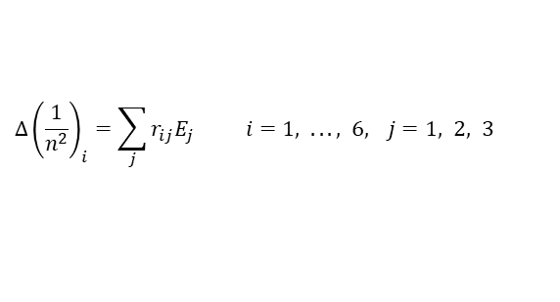
Electrooptic Tensor
The presence of electric field applied in an arbitrary direction to a crystal leads to a linear change in the coefficient $1/n_{i}^{2}$ according to
$$Δ{\left(\frac{1}{n^{2}}\right)}_{i}=\sum_{j}{r_{ij}E_{j} i=1, ..., 6, j=1, 2, 3}$$
$$\left|\begin{matrix}Δ(1/n^{2})_{1} \\ Δ(1/n^{2})_{2} \\ Δ(1/n^{2})_{3} \\ Δ(1/n^{2})_{4} \\ Δ(1/n^{2})_{5} \\ Δ(1/n^{2})_{6}\end{matrix}\right|=\left|\begin{matrix}r_{11} & r_{12} & r_{13} \\ r_{21} & r_{22} & r_{23} \\ r_{31} & r_{32} & r_{33} \\ r_{41} & r_{42} & r_{43} \\ r_{51} & r_{52} & r_{53} \\ r_{61} & r_{62} & r_{63}\end{matrix}\right|\left|\begin{matrix}E_{1} \\ E_{2} \\ E_{3}\end{matrix}\right|$$
In a matrix form
The 6×3 electrooptic tensor composed of the electrooptic coefficient $r_{ij}$ has a different form for noncentroelectric crystals.
The electrooptic tensor of LiNbO3 - a uniaxial material of the 3m trigonal crystal class:
$$\left[\begin{matrix}0 & −r_{22} & r_{13} \\ 0 & r_{22} & r_{13} \\ 0 & 0 & r_{33} \\ 0 & r_{51} & 0 \\ r_{51} & 0 & 0 \\ −r_{22} & 0 & 0\end{matrix}\right]$$

Slide 13
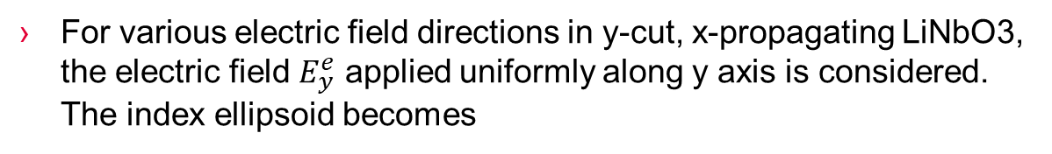



Axis transformation
The new index ellipsoid in the applied electric field is described by
$${\left(\frac{1}{n^{2}}\right)}_{1}^{′}x^{2}+{\left(\frac{1}{n^{2}}\right)}_{2}^{′}y^{2}+{\left(\frac{1}{n^{2}}\right)}_{3}^{′}z^{2}+2{\left(\frac{1}{n^{2}}\right)}_{4}^{′}yz+2{\left(\frac{1}{n^{2}}\right)}_{5}^{′}xz+2{\left(\frac{1}{n^{2}}\right)}_{6}^{′}xy=1$$
For various electric field directions in y-cut, x-propagating LiNbO3, the electric field $E_{y}^{e}$ applied uniformly along y axis is considered.
The index ellipsoid becomes
$$\left(\frac{1}{n_{o}^{2}}+r_{22}E_{y}^{e}\right)y^{2}+\left(\frac{1}{n_{e}^{2}}\right)z^{2}+2r_{51}E_{y}^{e}yz=1$$
y y ′
θ
$$E_{y}^{e}$$
x
Electrooptic grating
TM
TE
z ′
LiNbO₃
z

Slide 14

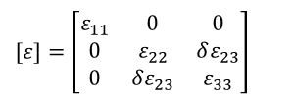

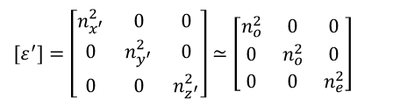
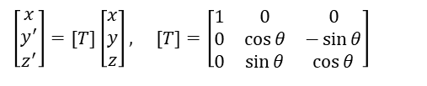
Axis transformation Continued…
The existence of the mixed yz term implies the index ellipsoid is rotated about x axis and x, y, and z are no longer the principal axes. The perturbed index ellipsoid in new x′y′ plane is expressed by
where
$$\frac{y^{′2}}{n_{y^{′}}^{2}}+\frac{z^{′2}}{n_{z^{′}}^{2}}=1$$
$$\left[\begin{matrix}x \\ y^{′} \\ z^{′}\end{matrix}\right]=[T]\left[\begin{matrix}x \\ y \\ z\end{matrix}\right], [T]=\left[\begin{matrix}1 & 0 & 0 \\ 0 & \cos{θ} & −\sin{θ} \\ 0 & \sin{θ} & \cos{θ}\end{matrix}\right]$$
Since practically $n_{x^{′}}≃n_{o}$, $n_{y^{′}}≃n_{o}$, and $n_{z^{′}}≃n_{e}$ for LiNbO3
$$[ε^{′}]=\left[\begin{matrix}n_{x^{′}}^{2} & 0 & 0 \\ 0 & n_{y^{′}}^{2} & 0 \\ 0 & 0 & n_{z^{′}}^{2}\end{matrix}\right]≃\left[\begin{matrix}n_{o}^{2} & 0 & 0 \\ 0 & n_{o}^{2} & 0 \\ 0 & 0 & n_{e}^{2}\end{matrix}\right]$$
$$[ε]=\left[\begin{matrix}ε_{11} & 0 & 0 \\ 0 & ε_{22} & δε_{23} \\ 0 & δε_{23} & ε_{33}\end{matrix}\right]$$
$$[ε]=[T]^{T}[ε^{′}][T]$$

Slide 15
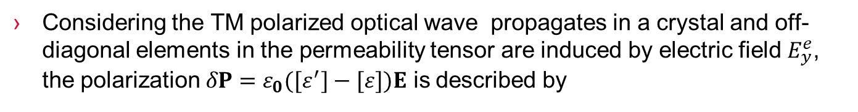

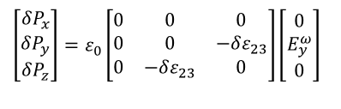
Axis transformation Continued…
Considering the TM polarized optical wave propagates in a crystal and off-diagonal elements in the permeability tensor are induced by electric field $E_{y}^{e}$, the polarization $δP=ε_{0}([ε^{′}]−[ε])E$ is described by
$$\left[\begin{matrix}δP_{x} \\ δP_{y} \\ δP_{z}\end{matrix}\right]=ε_{0}\left[\begin{matrix}0 & 0 & 0 \\ 0 & 0 & −δε_{23} \\ 0 & −δε_{23} & 0\end{matrix}\right]\left[\begin{matrix}0 \\ E_{y}^{ω} \\ 0\end{matrix}\right]$$
Perturbation in the permeability tensor induced by electric field $E_{y}^{e}$ gives rise to the perturbation in the optical wave $E_{y}^{ω}$ written by .
$$δP_{z}=−ε_{0}δε_{23}E_{y}^{ω}$$

Slide 16
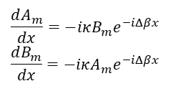


TE↔TM Mode Converter
The TE↔TM mode conversion between two codirectional and orthogonal modes is described by the coupled mode equations
$$\frac{dA_{m}}{dx}=−iκB_{m}e^{−iΔβx} \\ \frac{dB_{m}}{dx}=−iκA_{m}e^{−iΔβx}$$
where $A_{m}$ and $B_{m}$ are complex amplitudes of the two coupled optical waves
$$Δβ≡β_{TM}−β_{TE}$$
$$κ=\frac{1}{2}(n_{e}n_{o})^{3/2}k_{0}r_{51}E_{y}^{e}$$

Slide 17

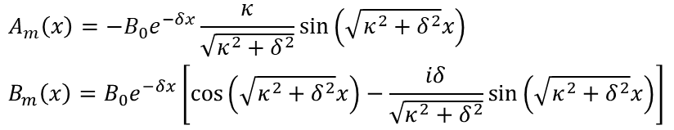


Solution of Coupled Mode Equations
Assuming the boundary conditions
the solutions are obtained as
$$A_{m}(x=0)=0 \\ B_{m}(x=0)=B_{0}$$
$$A_{m}\left(x\right)=−B_{0}e^{−δx}\frac{κ}{\sqrt{κ^{2}+δ^{2}}}\sin\left(\sqrt{κ^{2}+δ^{2}}x\right)$$
$$B_{m}\left(x\right)=B_{0}e^{−δx}\left[\cos\left(\sqrt{κ^{2}+δ^{2}}x\right)−\frac{iδ}{\sqrt{κ^{2}+δ^{2}}}\sin\left(\sqrt{κ^{2}+δ^{2}}x\right)\right]$$
where
$$δ≡\frac{1}{2}(β_{TM}−β_{TE})$$
When the two modes are phase matched, we have the simpler solution
$$A_{m}=−B_{0}\sin{(}κx) \\ B_{m}=B_{0}\cos{(}κx)$$

Slide 18








Power conversion over coupling length
The plot of the normalized powers ${\left|A_{m}(x)/B_{0}\right|}^{2}$ and ${\left|B_{m}(x)/B_{0}\right|}^{2}$
$${\left|\frac{A_{m}(x)}{B_{0}}\right|}^{2}$$
$${\left|\frac{B_{m}(x)}{B_{0}}\right|}^{2}$$
1
1
$${\left|\frac{A_{m}(x)}{B_{0}}\right|}^{2}$$
$${\left|\frac{B_{m}(x)}{B_{0}}\right|}^{2}$$
$$\frac{π}{2}$$
$$π$$
$$κx$$
$$κx$$
(a)
(b)
The shortest coupling length L for full power transfer is denoted by
$$L=\frac{π}{2κ}$$

Slide 19
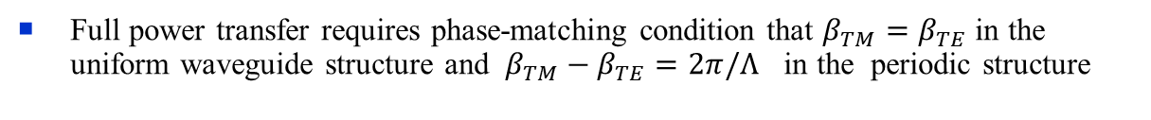

Power conversion over coupling length Continued…
Full power transfer requires phase-matching condition that $β_{TM}=β_{TE}$ in the uniform waveguide structure and $β_{TM}−β_{TE}=2π/Λ$ in the periodic structure
y
V_{c}
z
x
Λ
P_{i}
P_{o}
TM
TE
The periodicity of the structure compensates the difference between two propagation constants
Assuming the phase-matching condition at a certain wavelength, the polarization converter behaves as a wavelength filter and the optical bandwidth of TE↔TM conversion becomes
$$Δλ_{FWHM}≈0.8\left(\frac{Λ}{L}\right)λ$$

Slide 20



III. Design of Electrooptic Matched Filter
A. The Principal Characteristics of EMF
The x component of electric field provides TE↔TM mode conversion induced by $δε_{23}$ perturbation in the permeability tensor via the electrooptic coefficient $r_{51}$
Λ
+V Ground +V Ground +V
Electrode
Insulating film
Waveguide
x
Substrate
z
y
The mode conversion is a wavelength selective process. The most efficient wavelength $λ_{0}$ is found by the phase-matching condition as
$$λ_{0}=Λ\left|n_{TM}−n_{TE}\right|$$
$Λ$ : the period of interdigital electrodes
$n_{TM}$, $n_{TE}$: the effective refractive indices of the TM and TE modes

Slide 21
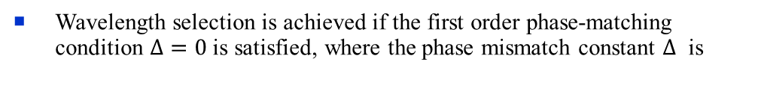

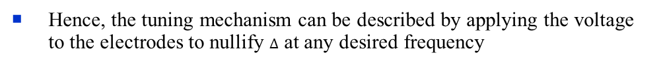

Principal Characteristics of EMF Continued…
Wavelength selection is achieved if the first order phase-matching condition $Δ=0$ is satisfied, where the phase mismatch constant $Δ$ is
$$Δ=\frac{2πν(n_{TM}−n_{TE})}{c}±\frac{2π}{Λ}$$
Hence, the tuning mechanism can be described by applying the voltage to the electrodes to nullify $Δ$ at any desired frequency
The sidelobe levels are suppressed to below –10 dB by applying a raised cosine apodizing function
$$κ(y)=κ_{0}+0.5κ_{0}\cos\left[2π\left(\frac{y}{L}−0.5\right)\right]$$

Slide 22
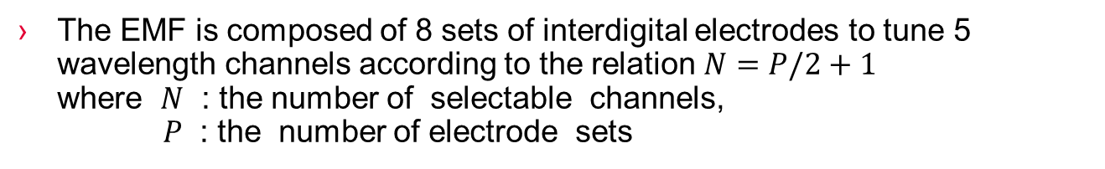
III. Design of Electrooptic Matched Filter
B. The EMF Structure for Two Sidebands
The array of electrode sets is formed on the waveguide which is fabricated on an x-cut y-propagating LiNbO3 substrate by Ti diffusion
The EMF is composed of 8 sets of interdigital electrodes to tune 5 wavelength channels according to the relation $N=P/2+1$
where $N$ : the number of selectable channels,
$P$ : the number of electrode sets

Slide 23



EMF Structure for Two Sidebands Continued…
V₁ V₂ V₃ V₄ V₅ V₆ V₇ V₈
Ti:LiNbO₃
Π Π Π
P_{i}
P_{o}
TE/TM
TM/TE
z
Λ
l_{c} l_{p}
x
y
LiNbO₃
$$Λ=21 μm$$
: spatial period of interdigital electrodes
: period of electrode sets
: length of single mode conversion region
$$Π=200⋅Λ$$
$$l_{c}=(179+3/4)⋅Λ$$

Slide 24

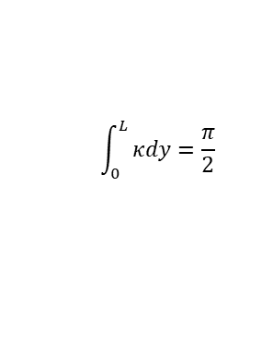
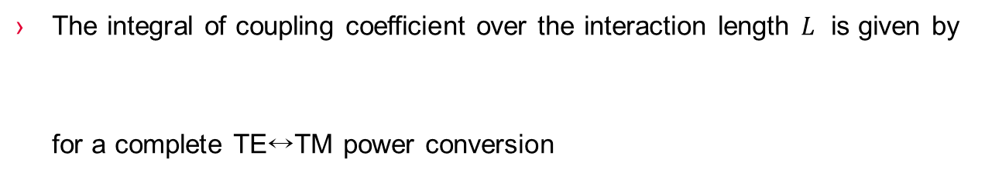


Coupling Strength Distribution
The ideal coupling strength distribution along the length of the electrode sets in the structure for two sidebands is
$$κ_{j}(y)=S(y)\cos{(}Δ_{j}y), j=1, 2, 3,⋯, N$$
$$S(y)$$
: the apodization function
$$Δ_{j}=\frac{2π\left|n_{1g}−n_{3g}\right|(ν_{j}−ν_{0})}{c}$$
The integral of coupling coefficient over the interaction length $L$ is given by
for a complete TE↔TM power conversion
$$\int_{0}^{L}{κdy=\frac{π}{2}}$$

Slide 25













Applied Voltages to Eight Sets of Electrodes
In this research, $V_{0}$ is obtained experimentally to optimize the polarization conversion
$$V/V_{0}$$
$$V_{j1}$$
$$V_{j2}$$
$$V_{j3}$$
$$V_{j4}$$
$$V_{j5}$$
$$V_{j6}$$
$$V_{j7}$$
$$V_{j8}$$
2
1
(a)
$$y/L$$
$$V/V_{0}$$
2
1
(b)
$$y/L$$
$$V/V_{0}$$
2
1
(c)
$$y/L$$

Slide 26

The Ratio of V_{jp} to V₀ – Two Sidebands
The voltages for the raised cosine apodization are obtained by using equation
$$κ_{j}(y)=S(y)\cos{(}Δ_{j}y)(1+0.5\cos\left[2π\left(\frac{y}{L}−0.5\right)\right])$$

Slide 27




III. Design of Electrooptic Matched Filter
C. The EMF Structure for Single Sideband
V₁ V₂ V₃ V₄ V₅ V₆ V₇ V₈
Ti:LiNbO₃
Π_{α} Π_{β} Π_{α} Π_{β} Π_{α}
P_{i}
P_{o}
TE/TM
TM/TE
z
Λ
l_{c} l_{pα} l_{c} l_{pβ}
x
y
LiNbO₃
$$Λ=21 μm$$
: spatial period of interdigital electrodes
,
: length of single mode conversion region
$$Π_{α}=(200−1/4)Λ$$
$$Π_{β}=(200+1/4)Λ$$
$$l_{c}=(179+3/4)⋅Λ$$

Slide 28
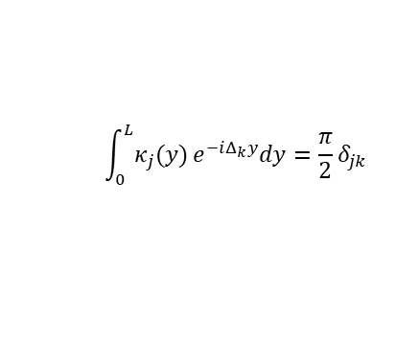

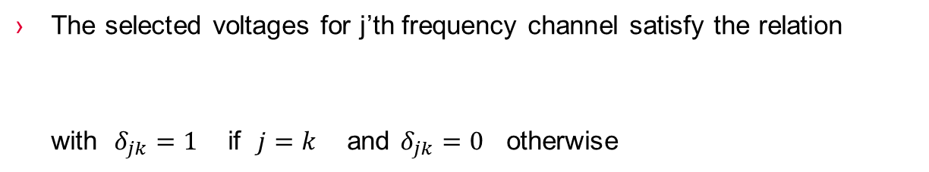



Coupling Strength Distribution
The regions of $Π_{α}$ and $Π_{β}$ cause in-phase and quadrature coupling, respectively. The coupling coefficient is complex and is written by
$$κ_{j}(y)=S(y)e^{iΔ_{j}y}$$
For the in-phase and quadrature coupling, the coupling coefficient $κ_{j}$ is written by
$$κ_{j}(y)=S(y)\cos{(}Δ_{j}y), j=±(2n−1) \\ κ_{j}(y)=iS(y)\sin{(}Δ_{j}y), j=±2n$$
The selected voltages for j’th frequency channel satisfy the relation
with $δ_{jk}=1$ if $j=k$ and $δ_{jk}=0$ otherwise
$$\int_{0}^{L}{κ_{j}(y)}e^{−iΔ_{k}y}dy=\frac{π}{2}δ_{jk}$$

Slide 29













Applied Voltages to Eight Sets of Electrodes
Selection of voltages in the structure of a single sideband: (a) for $j=0$ sideband, (b) for $j=1$ sideband, (c) for $j=2$ sideband.
$$V/V_{0}$$
$$V_{j1}$$
$$V_{j2}$$
$$V_{j3}$$
$$V_{j4}$$
$$V_{j5}$$
$$V_{j6}$$
$$V_{j7}$$
$$V_{j8}$$
2
1
(a)
$$y/L$$
$$V/V_{0}$$
2
1
(b)
$$y/L$$
$$V/V_{0}$$
2
1
(c)
$$y/L$$

Slide 30
The ratio of V_{jp} to V₀ – Single Sideband

Slide 31




III. Design of Electrooptic Matched Filter
D. Matrix Formulation and Simulation Results
The effect of polarization conversion in the j’th coupling region and of phase shift in the spacing between electrodes is written by
where
, : electric field amplitudes of two polarization modes just prior to the j’th coupling region
$$E_{j+1}=M_{j}E_{j}$$
$$E_{j}=\left(\begin{matrix}E_{j}^{TE} \\ E_{j}^{TM}\end{matrix}\right), j=1, 2, 3,⋯, P$$
$$E_{j}^{TM}$$
$$E_{j}^{TE}$$

Slide 32


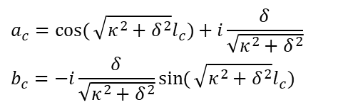

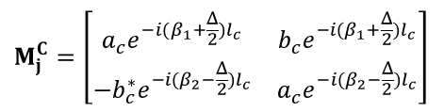

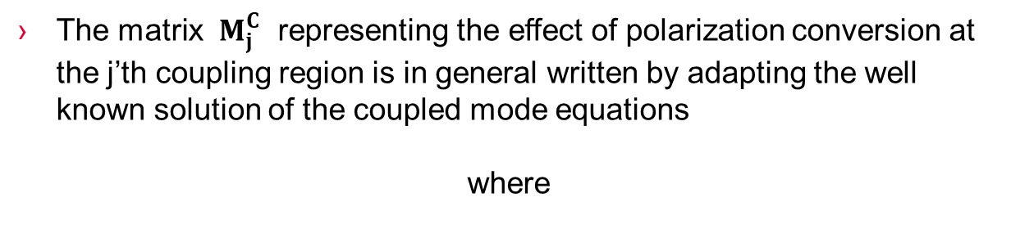
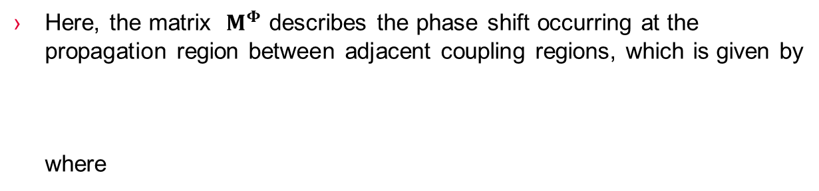

Matrix Formulation Continued…
The 2×2 transfer matrix $M_{j}$ is given by $M_{j}^{C}M^{Φ}$
Here, the matrix $M^{Φ}$ describes the phase shift occurring at the propagation region between adjacent coupling regions, which is given by
where
$$M^{Φ}=\left[\begin{matrix}e^{−i\frac{φ}{2}} & 0 \\ 0 & e^{i\frac{φ}{2}}\end{matrix}\right]$$
$$φ=(β_{1}−β_{2})l_{p}$$
$$β_{1}=2πνn_{TE}/c$$
$$β_{2}=2πνn_{TM}/c$$
$$l_{p}=Π−l_{c}$$
The matrix $M_{j}^{C}$ representing the effect of polarization conversion at the j’th coupling region is in general written by adapting the well known solution of the coupled mode equations
where
$$a_{c}=\cos{(}\sqrt{κ^{2}+δ^{2}}l_{c})+i\frac{δ}{\sqrt{κ^{2}+δ^{2}}} \\ b_{c}=−i\frac{δ}{\sqrt{κ^{2}+δ^{2}}}\sin{(}\sqrt{κ^{2}+δ^{2}}l_{c})$$
$$M_{j}^{C}=\left[\begin{matrix}a_{c}e^{−i(β_{1}+\frac{Δ}{2})l_{c}} & b_{c}e^{−i(β_{1}+\frac{Δ}{2})l_{c}} \\ −b_{c}^{∗}e^{−i(β_{2}−\frac{Δ}{2})l_{c}} & a_{c}e^{−i(β_{2}−\frac{Δ}{2})l_{c}}\end{matrix}\right]$$

Slide 33
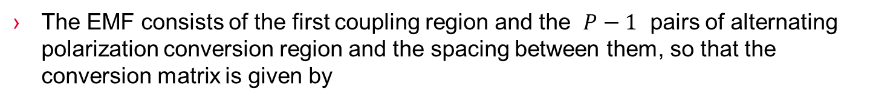

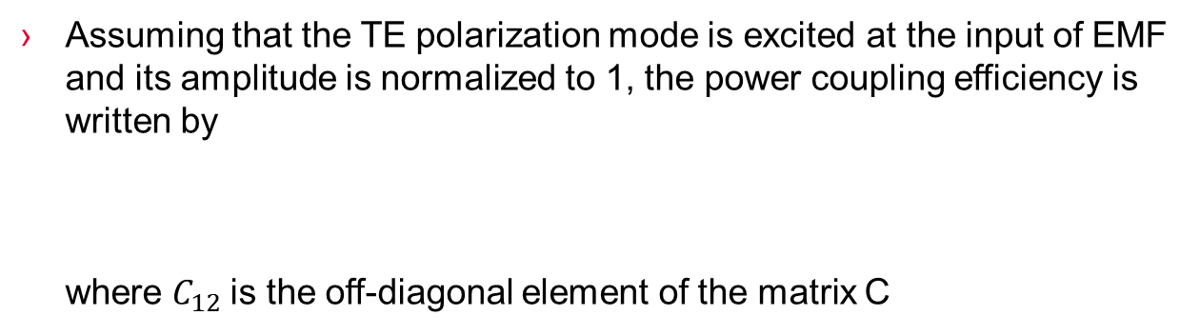
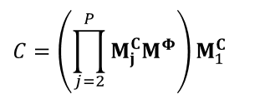
Conversion Matrix
The EMF consists of the first coupling region and the $P−1$ pairs of alternating polarization conversion region and the spacing between them, so that the conversion matrix is given by
$$C=\left(\prod_{j=2}^{P}{M_{j}^{C}M^{Φ}}\right)M_{1}^{C}$$
Assuming that the TE polarization mode is excited at the input of EMF and its amplitude is normalized to 1, the power coupling efficiency is written by
where $C_{12}$is the off-diagonal element of the matrix C
$$PCE={\left|C_{12}\right|}^{2}$$

Slide 34
Simulation Result – Two Sidebands
(a)
(b)
Simulated performances
in the structure of two sidebands:
(a) for channel 0,
(b) for channel ±1,
(c) for channel ±2.
(c)

Slide 35

Matrix Formulation for Single Sideband
The transfer matrix for single sideband configuration can be described except that the matrix $M^{Φβ}$ is replaced with $M^{Φ}$ if j is the even number and $M^{Φα}$ otherwise.
$φ_{α}$ and $φ_{β}$ are used instead of $φ$, respectively where
$$φ_{α}=(β_{1}−β_{2})l_{pα} \\ φ_{β}=(β_{1}−β_{2})l_{pβ}$$
Simulated performance in the single sideband configuration for channel –2

Slide 36
IV. Electronic Driving Circuit for EMF
A. Digital-to-Analog Converter Driving Circuit
The EMF is controlled by applying different voltages to each electrode set independently
The AD5379 contains 40 DACs in one package and provides the maximum output voltages span of 17.5 V
Power Supply Inputs
5V +12V –12V
V_{CC} V_{DD} V_{SS}
AD5379
40-channel
DAC
5V
V_{REF(+)}
V_{REF(-)}
V0
–3.5V



Serial Interface 36 Pin Connector
Analog Outputs
Serial Data
Input
V39

Slide 37
Electronic Driving Circuit Configuration
In this research, programmable data inputs are loaded from a personal computer memory into the AD5379 input registers by serial interface
The DAC output voltages are insufficient to directly drive the EMF, so an external op-amp array is utilized to obtain higher voltages
Serial Interface
AD5379
Board
Op-amp
array
Electrooptic
matched filter
× 8
× 8

Slide 38
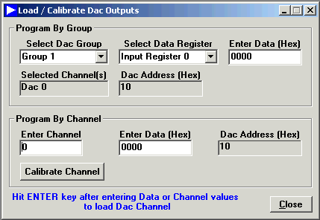
IV. Electronic Driving Circuit for EMF
B. Loading DAC Channels
All channels or each channel can be loaded manually with the entered DAC code
The AD5379 accepts 14-bit data word format for the serial interface
14-bit data word | Hexidecimal | Offset
11 1111 1111 1111 | 3FFF | +8191
11 1111 1111 1110 | 3FFE | +8190
10 0000 0000 0001 | 2001 | +1
10 0000 0000 0000 | 2000 | 0
01 1111 1111 1111 | 1FFF | -1
00 0000 0000 0001 | 0001 | -8191
00 0000 0000 0000 | 0000 | -8192
The hexadecimal code can be decoded as follows:

Slide 39
V. Experimental Results
A. Experimental Configuration
Optical testing was carried out using the amplified spontaneous emission (ASE) from a broadband light source of an erbium-doped fiber pumped by a 980 nm laser diode
Electronic
driving circuits
Polarizing
fiber
×8
Analyzer
Erbium doped fiber
Optical
spectrum
analyzer
2×2 coupler
EMF
980 nm
pump laser
Lens
External electronic circuits drive 8 independent sets of electrodes by using a DAC array
The transmitted beam, after it passes through the EMF and the optical polarizer, is monitored with an optical spectrum analyzer

Slide 40
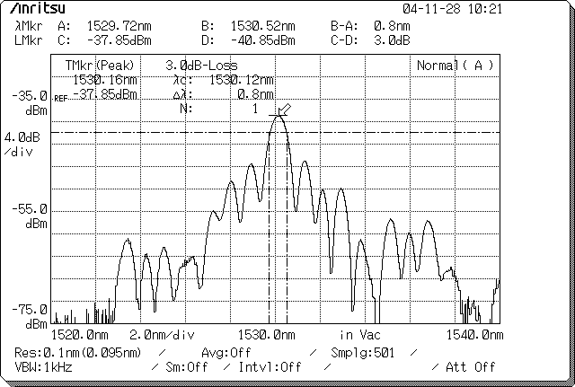
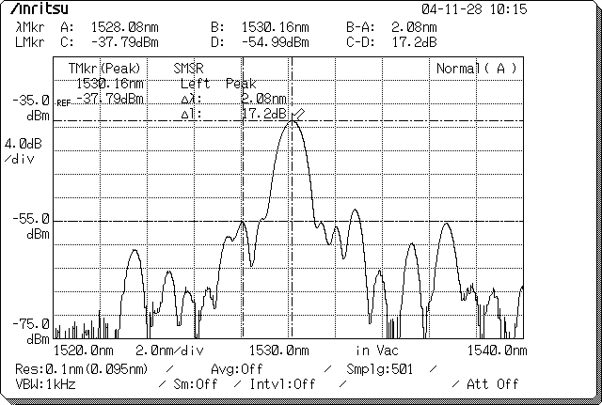
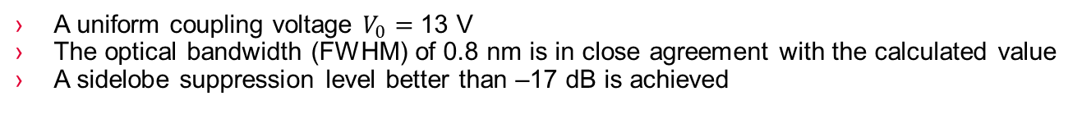
V. Experimental Results
B. Test Results
The optical output power spectra of EMF for TE→TM polarization conversion in the structure for two sidebands: (a) unapodized and (b) apodized filter responses of TM mode at channel 0
(a)
(b)
A uniform coupling voltage $V_{0}=$ 13 V
The optical bandwidth (FWHM) of 0.8 nm is in close agreement with the calculated value
A sidelobe suppression level better than –17 dB is achieved

Slide 41
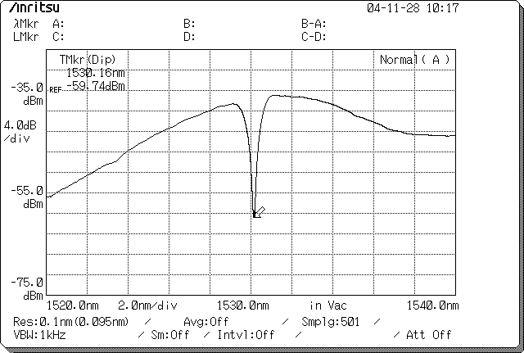
Test Result at Channel 0 Continued…
The optical output power spectra of EMF for TE→TM polarization conversion in the structure for two sidebands: (c) apodized filter response of TE mode at channel 0
(c)

Slide 42
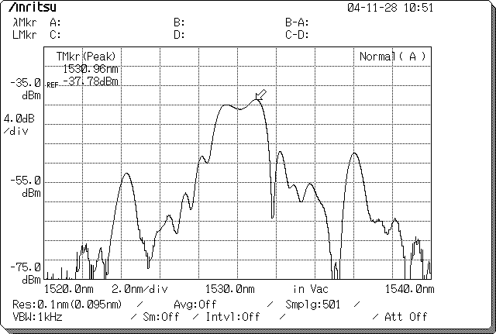
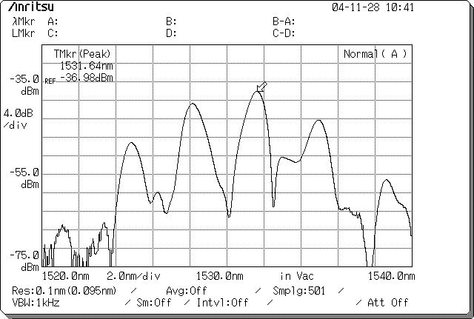
Test Results at Channel ±1 and ±2
The optical output power spectra of EMF for TE→TM polarization conversion in the structure for two sidebands:
(d) apodized output power responses of TM mode at channel ±1 and (e) channel ±2
(d)
(e)
The filter performance of TM→TE polarization conversion is similar to that of TE→TM conversion

Slide 43
Theoretical and Experimental Curves
(a)
(b)
Theoretical and experimental curves for apodized EMF
filter characteristic :
(a) at channel 0,
(b) at channel ±1,
(c) at channel ±2.
(c)

Slide 44
VI. Conclusions
The EMF is designed for operation in the 1530 nm spectral regime
The device utilizes TE↔TM polarization conversion in a single mode waveguide fabricated in LiNbO₃ by Ti diffusion
The performance of EMF - inherently independent of the input polarization because of the reciprocal characteristic between TE and TM mode polarization conversion
The spectral tuning range of 3.2 nm for 5 channels is demonstrated. More channels can be accommodated by increasing the number of electrode sets (e.g., if P = 198, then N = 100 ) with the length of the device unchanged
A tuning speed of less than 50 ns was achieved previously in a LiNbO3 tunable filter, and similar fast tuning is expected in the EMF
Apodization improves the sidelobe suppression from –8.6 dB to –17.2 dB

Slide 45
VII. Recommendations
The structure for single sideband with more than 8 electrode sets can realize good filter characteristics showing close agreement with prediction
New electronic components to provide higher voltage supply can facilitate the experiments
The EMF can be configured for a 4 port add-drop multiplexer and a two port bandpass filter of a Mach-Zehnder interferometer structure
The spectral tuning range of the EMF for coarse WDM application can be improved by using a LiTaO3 substrate because the birefringence of LiTaO₃ is much less than that of LiNbO₃

