Slide 1
Mind the Gap
Exploring Gaps in Medicaid Coverage in the United States
Michael Shaffer, DA-14, Nashville Software School

Slide 2

Project overview
Background
Enrollment Criteria
Objective
State-Level Enrollment Gaps
Age/Income
County-Level Enrollment Gaps
Age/Income
Digging Deeper

Slide 3

Background
While Medicaid enrollment varies across years, the overall trend shows increase in program utilization since February 2020*
New budgetary proposals have potential to reduce access
Reduced funding
New enrollment criteria
*kff.org, Medicaid Enrollment and Unwinding Tracker

Slide 4

Enrollment Criteria
Age
Income
All children are eligible if no other insurance is available
Up to age 19
U.S. Citizen
Seniors age 65+
Assets below $2,000
U.S. Citizen
Threshold varies by state
Range:
$967 per month ($11,640/year) to
$1,801 per month ($21,612/year)
Special Cases: Kentucky & Maryland
Supplemental Security Income (SSI)
Auto-enrolled in Medicaid
SSI Eligibility: $2,019/month ($24,228/year)
U.S. Citizen

Slide 5
Enrollment Criteria
Disability
Physical
Paralysis, brain injury
Neurological
Epilepsy, Alzheimer’s
Mental Health
Schizophrenia, bipolar disorder
Intellectual
Cerebral palsy, Down syndrome

Slide 6

Objective
Identify counties where gaps in coverage vs. eligibility are largest
Broken down by category
Age
Income
Dive deeper into regions identified as having large enrollment gaps
Investigate possible explanations

Slide 7
State-Level Coverage Gaps

Slide 8
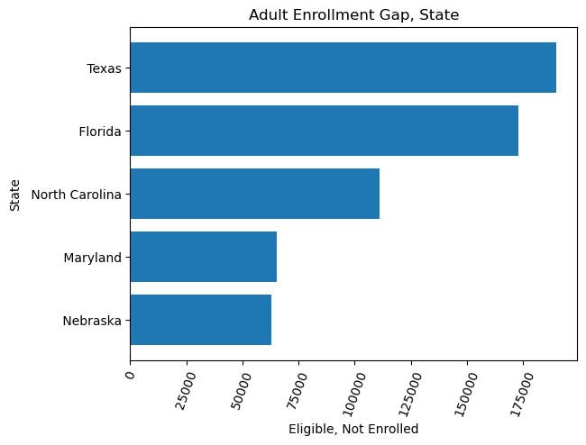
Adult Coverage
Fix mee!!!

Slide 9
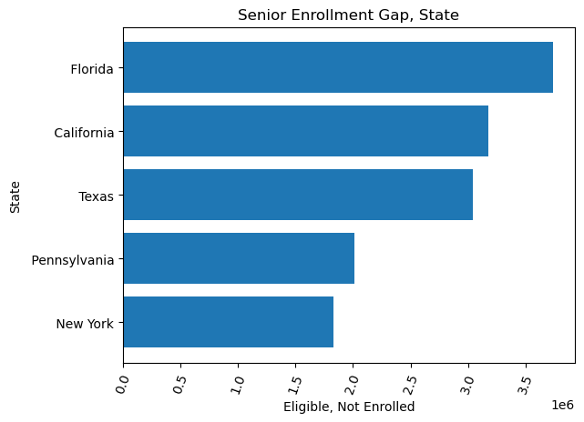
Senior Coverage
Fix Mee!!

Slide 10
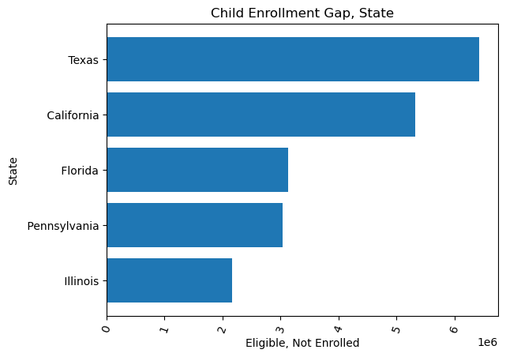
Child Coverage
Fix meeee!!!

Slide 11
County-Level Coverage Gaps

Slide 12
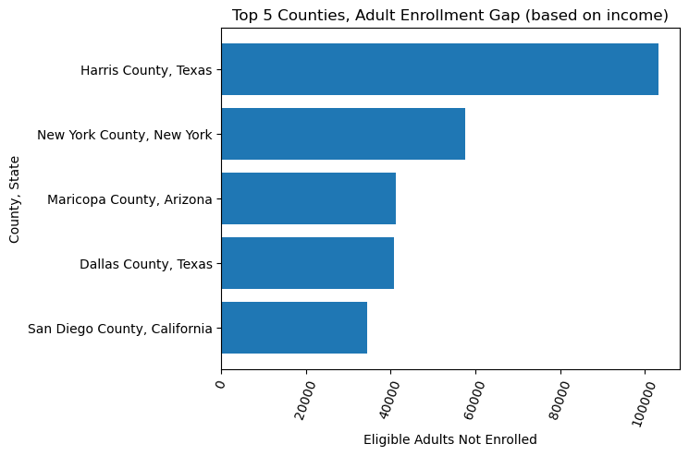
Adult Coverage
Harris County Stands out
Relatively large Adult population
2,847,531 adult-age residents
New York County
High Median Income
$207,389/year

Slide 13
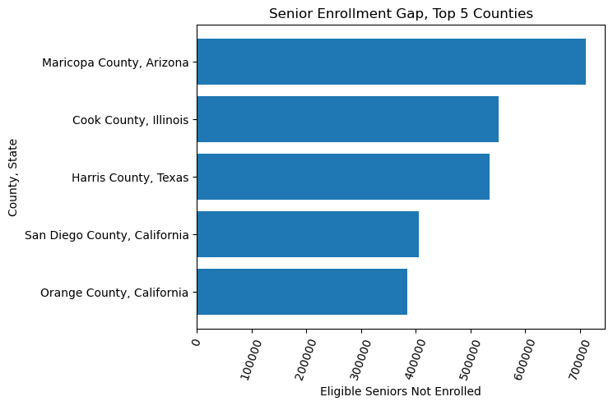
Senior Coverage
Cook County
Second Highest Senior Population
Maricopa County
Third Highest Senior Population

Slide 14
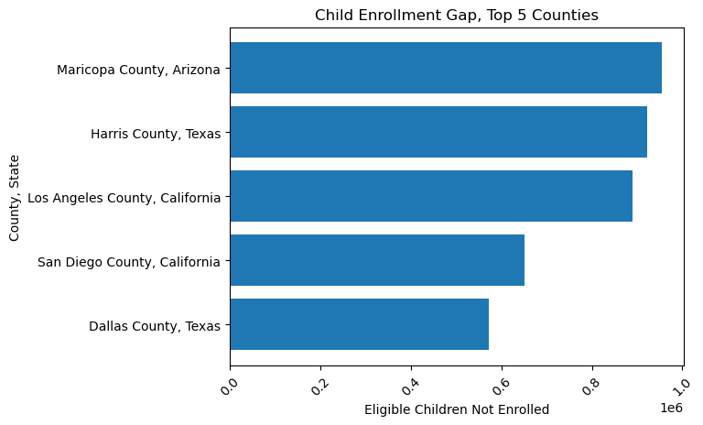
Child Coverage
Top 5 Largest Child Population
Los Angeles (1st)
Harris County (2nd)
San Diego County (4th)
Orange County (5th)

Slide 15
Digging Deeper
Falling into the gap

Slide 16
“Frequent Fliers”
Counties that appear most frequently all house large cities.
Harris County, TX
City: Houston
Pop: 4,758,579
Maricopa County, AZ
City: Phoenix
Pop: 4,491,987
San Diego County, CA
City: San Diego
Pop: 3,282,782

Slide 17
“Frequent Fliers”
Counties that appear most frequently all house large cities.
Citizenship Status
Non-Citizens not eligible for Medicaid
Non-Citizens are counted in the Census
Higher concentrations of non-citizens equal higher coverage gaps
Harris County, TX
City: Houston
Pop: 4,758,579
Maricopa County, AZ
City: Phoenix
Pop: 4,491,987
San Diego County, CA
City: San Diego
Pop: 3,282,782

Slide 18
“Frequent Fliers”
Counties that appear most frequently all house large cities.
Citizenship Status
Non-Citizens not eligible for Medicaid
Non-Citizens are counted in the Census
Higher concentrations of non-citizens equal higher coverage gaps
Higher mean income
More residents with private insurance
Harris County, TX
City: Houston
Mean Income: $108,284/year
Maricopa County, AZ
City: Phoenix
Mean Income: $115,430/year
San Diego County, CA
City: San Diego
Mean Income: $134,080/year

Slide 19
Demographic Variance
Population as a Confound
Senor Population Concentration
Harris County, Maricopa County
In Top 5 Highest Senior Population
Children and Medicaid Enrollment
Generally Healthier
Less likely to need long-term care
Less likely to enroll in Medicaid

Slide 20

Areas of Highest Utilization
*** Figure Coming Soon***
Los Angeles County
High Adult utilization
Over 1.25 million adults beyond income eligibility
40% of total population enrolled
Bronx County
1st highest Child/Senior utilization
2nd highest Adult utilization
48% of total population enrolled
Wayne County , MI
3rd highest Adult utilization
34% of total population enrolled

Slide 21
Highest Percentage of Total Population Enrolled
*** Figure Coming Soon***
Apache County, AZ
53% of total population
McKinley County, NM
51% of total population
Geographically Adjacent
Between Flagstaff and Albuquerque

Slide 22
Discussion
“… I’ll give you a topic.”
-Linda Richman

Slide 23
…. discuss….
Population is a big factor in predicting enrollment gap
Higher enrollment
equals higher utilization
Higher Enrollment % vs. Total Population usually indicative of a rural area (<50K)
76% of counties in Top 25 for enrollment percentages had fewer than 50K residents
100% in Top 25 had negative gap scores, indicating utilization beyond income criteria
Potentially disabled enrollees

