Slide 1
Python 3 Programming
Fundamental Variables

Slide 2
Fundamental variables
Contents
Python objects
Python variables
Type specific methods
Augmented assignments
Python types
Python lists
Python tuples
Python dictionaries
Summary
Python operators
Python reserved words
Notes:
This chapter discusses the basic building blocks of a Python program - its object types and variables.

Slide 3
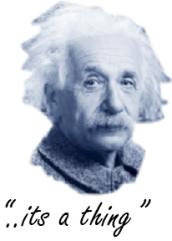
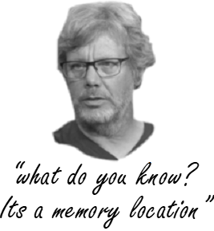
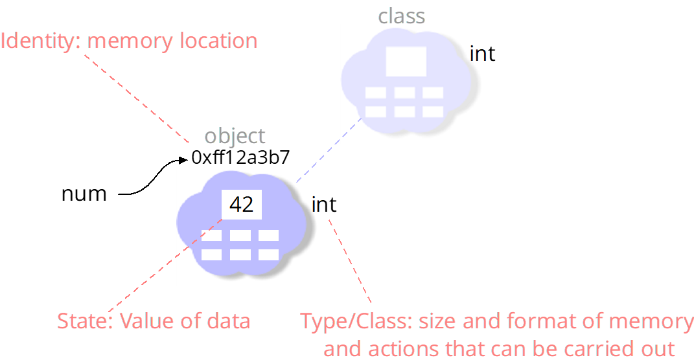
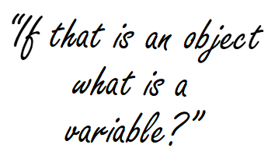
Python is object oriented
So what is an object?
To a mathematician the term describes a "thing"
To a programmer the term describes a specific area of memory
Objects have type, state, and identity
Notes:
Object orientation is inescapable if you wish to understand Python. You do not need to write OO code, but it is important to understand the principles, which are actually not that complicated. Many programming languages have the concept of variable types, which is roughly analogous to a class - it describes the object to which the variable is referring. How that object is laid out in memory is not particularly important to us, but it is important to Python - it has to know the size and format of memory required, and it is up to us to describe it. Fortunately, the common object types (classes), like strings, files, and exceptions, are already defined.
In Python, an object's identity can be obtained using the id built-in function, although this is rarely needed.
* Are classes types? Not really, we shall discuss this later (hint: duck-typing).

Slide 4
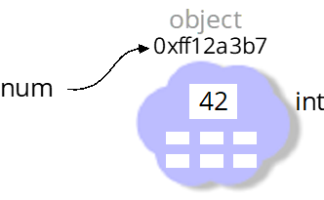
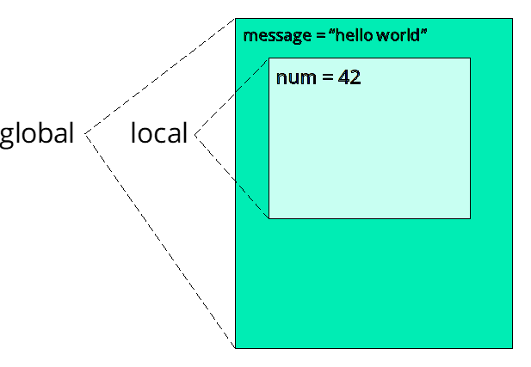
Python variables
Python variables are references to objects
Variables are defined automatically
An undefined variable refers to a special object called None
Variables can be deleted with del
An object's memory can be reused when it is no longer referenced
Variables are local by default
If created within a user written function
More on global variables and scope later…
Display local variables with print(locals())
references
variable
a
=
42
object
Notes:
Like most scripting languages, Python variables are defined automatically, and are untyped until assigned. Variables are actually references to objects, so the assignment of a string to a variable makes that variable reference a string object. Uninitialised variables reference an object called None (NULL or undef in other languages).
Being objects, class specific functions, like altering the case of a string, are implemented as methods calls on the object. If you are not familiar with this terminology, a method call is like a conventional function call, with a reference to the variable passed automatically. We shall see examples shortly.
Where the objects themselves are immutable (cannot be altered), then several variables may reference the same physical value.
Unlike most scripting languages, variables defined in a function are local by default - and must be specifically marked as global if required.
When you delete a variable then that removes the name. That will decrement the object's reference count, and when the count reaches zero then the memory can be reused.

Slide 5
Variable names
Naming rules
CaSe sensitive
Must start with an underscore or a letter
Followed by any number of letters, digits, or underscores
Conventions with underscores
Names beginning with one underscore are private to a module/class
Names beginning with two underscores are mangled
Names beginning and ending with two underscores are special
The character _ represents the result of the previous command
_private_to_module
__private_to_class
__itsakindamagic__
Notes:
The names given to variables, and also to other symbols like functions, follow the usual rules common to many programming languages. For example, names are case sensitive. Variable names must not clash with Python keywords: these may be listed with help ('keywords'), or consult the list at the end of this chapter.
In addition to the rules, we have a number of conventions which are followed by the interpreter and programmers concerning underscores.
A name (variable, function, method) prefixed by a single underscore indicates the name is meant for internal use only in a module or class. It’s not really private like other languages (Java) but merely a hint to programmers to not access the names. Additionally, the interpreter will not import the names when using a wildcard import (from moduleA import *) but this should be avoided in PEP008 compliant code.
A name prefixed with a double leading underscore (dunders) has its name mangled (changed) by the Python interpreter in order to avoid naming conflicts in subclasses. By default, all variables and methods are virtual in that they are inheritable and can be overridden by a subclass. Using the dunders makes it private to the specific class in which they are used and not accessible to its inherited child classes.
The upshot of these is that you should never have names of your own with both leading and trailing underscores - these should be reserved for system use. A single underscore prefix means that the name is not imported from a module, and names with two leading underscores are mangled, and so localised.
We shall be seeing examples of these conventions later.

Slide 6
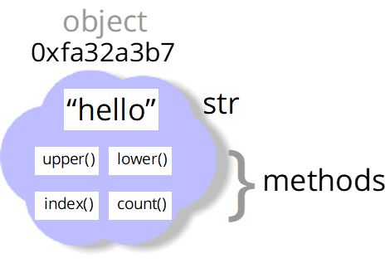
Type specific methods
Actions on objects are done by calling methods
A method is implemented as a function - a named code block
object need not be a variable
Which methods may be used?
Depends on the Class (type) of the object
dir(object) lists the methods available
help(object) often gives help text
Examples:
object.method ([arg1[,arg2…]])
name.upper() names.pop()
name.isupper() mydict.keys()
names.count() myfile.flush()
Notes:
Just about everything in Python is an object, and carrying out an operation on an object, or querying an attribute, is often done by calling a function, more correctly termed a method, from the object itself. There are several advantages to this system compared to just calling a general function. For example, you know that you are operating on the correct type - there is no other way.
In the examples, we have made up some variables:
name is a string object
names is a list object
mydict is a dictionary object
myfile is a file object
The method names shown are mostly self-explanatory, but full documentation for them (and all the others) is available in the online help. The help() function prints help text (docstrings) for the class and all the methods in that class. An alternative is print (object._doc_) which displays the docstring for the class only.

Slide 7
Operators and type
An operator carries out an operation on an object
Produces a result which does not (usually) alter the object
The operation depends on the Class (type) of the object
List the Class using the type built-in function
A list of Python operators is given after the chapter summary
a = 42
b = 9
print(a + b)
print(type(a))
a = 'Hello '
b = 'World!'
print(a + b)
print(type(a))
a and b refer to integers
51
<class 'int'>
a and b now refer to strings
Hello World!
<class 'str'>
Notes:
An operator is usually a symbol (see the slide after the summary) which carries out an operation on a single object (unary operator) or between two operators (binary operator). The result has a value, which may be passed to a function (like print) or used on the right-hand side of an assignment.
Arithmetic operators like + (plus), - (minus), * (multiply), /(divide), and % (modulus) have familiar meanings when used with numbers, but what do they mean when used with strings? Operators have different meanings depending on the type of object they are operating on, some of which are not at all obvious. For example, % does string formatting - something that you would not have guessed!
It is therefore, imperative that we know what type (class) of object we are dealing with, and the type function will tell us that.

Slide 8
Augmented assignments
A convenient shorthand for some assignments
Use any arithmetic operator
stein = 1
pint = 1
stein = stein + pint
stein += pint
lhs = lhs + rhs lhs = lhs - rhs lhs = lhs * rhs lhs = lhs / rhs lhs = lhs % rhs
lhs += rhs lhs -= rhs lhs *= rhs lhs /= rhs lhs %= rhs
Augmented assignment is an assignment! It has a result, which is usually ignored.
Notes:
Augmented assignments are called Compound assignments in some languages and come from an ancient language now lost in the mists of the distant past (C).
The expression a += b can be read as "a is incremented by the value of b". Therefore, in the code above, the variable stein, initially at 1 is incremented by the value of pint, which is 1. After the assignment, the value of stein becomes 2 and the value of pint remains 1.
Augmented assignment operators are more succinct than the long hand approach, so programmers tend to write expressions like this:
total += subtotal
geometric *= progression
Rather than like this:
total = total + subtotal
geometric = geometric * progression
Usually, the resulting code generated will be the same. Like other operators, their meaning depends on the class of the object, for example += on a string means append.
a = 'Hello '
b = 'World!'
a += b
print(a) gives Hello World! and a new string object is created. This operation is optimised on CPython.

Slide 9

Python 3 types
Numbers (int, float, complex)
3.142, 42, 0x3f, 0o664, (20+3j)
Bytes
b'Norwegian Blue', b"Mr. Khan's bike"
Strings
'Norwegian Blue', "Mr. Khan's bike", r'C:\Numbers'
Tuples
(47, 'Spam', 'Major', 683, 'Ovine Aviation')
Lists
['Cheddar', ['Camembert', 'Brie'], 'Stilton']
Bytearrays
bytearray(b'abc')
Dictionaries
{'Sword':'Excalibur', 'Bird':'Unladen Swallow'}
Sets
{'Chapman', 'Cleese', 'Idle', 'Jones', 'Palin'}
Sequences
Immutable
Mutable
Notes:
Some of these types are obvious, but some require an explanation. Note the notation for octal (base 8) numbers. In old releases of Python, any number starting with a 0 (zero) would be an octal value, in Python 2.6 the prefix 0o (zero, lowercase oh) was introduced, and at Python 3 the leading zero no longer means octal. Old Python also used a trailing L to mean 'long' and a trailing 'U' to mean 'unsigned' - both are now removed.
Strings of text are objects, and once a variable of this type has been created, a method (function) can be called on it.
Numbers, strings, and Tuples are immutable, that is they cannot be altered. References to them can change to refer to different values, but the values themselves cannot. This enables Python to save space by storing just one instance of literals used in a program, regardless of how many references there are to it.
Strings, Lists and Tuples are ordered collections of objects, also known as sequences. We have a chapter on string handling later, and also discuss lists and tuples further.
Dictionaries are collections of objects accessed by key, and are similar to associative arrays in awk and PHP, and hashes in Perl and Ruby.
Sets were introduced into Python 2.4 and are described in a later chapter. There is also an immutable set: frozenset.
Lists, Tuples, Dictionaries, and Sets are known as collections, and are discussed in more detail in the Collections chapter.
A byte object is an immutable array of 8-bit values, whereas a bytearray is a mutable array of 8-bit values.

Slide 10
Switching types
Sometimes Python switches types automatically
Sometimes you have to encourage it
This avoids unexpected changes of type
Use the str() function to return an object as a string
Use int() or float() to return an object as a number
Other functions available to return lists and tuples from strings
num = 42
pi = 3.142
num = 42/pi
print(num)
num gets automatic promotion
13.367281986
port = 80
print("Unused port: " + port)
TypeError: Can't convert 'int' object to str implicitly
print("Unused port: " + str(port))
Notes:
Like most modern languages, Python converts between numeric types automatically, generally from the narrow to the wider if there is a choice. If you actually want an integer division (so the result is truncated), then use the // operator. However, with other types things are not so clear-cut.
One form of (almost invisible) conversion is that given by the print built-in in the first example. In IDLE, if we look at the variable value by typing num, then the result is 13.367281985996181, but this is rounded by print to 13.367281986.
A common error when beginning Python is the type error shown. Python does not know if the + means string concatenation or arithmetic, anyway mixing objects of a different type is bad coding. We must explicitly tell Python what to convert and when - there is no hidden magic here.
One aid to typing is to use a naming system for your variables, for example a modified Hungarian notation which prefixes a string variable with 's', an integer with an 'i', a List with an 'l', and so on. For example: iCount, sName, lNames. This is, effectively, inventing your own sigil system.
Where we appear to call functions like str, int, and float (and tuple, list and dict which we will see latter) they are really the name of the class, so what we are really doing is constructing an object.
You can find out the memory size of an object by using the sys.getsizeof() call, for example:
import sys
print("Size of count", sys.getsizeof(count), "bytes")
print("Size of str(count)",
sys.getsizeof(str(count)),"bytes")

Slide 11
Python lists introduced
Python lists are similar to arrays in other languages
Items may be accessed from the left by an index starting at 0
Items may be accessed from the right by an index starting at -1
Specified as a comma-separated list of objects inside [ ]
Multi-dimensional lists are just lists containing others
cheese = ['Cheddar', 'Stilton', 'Cornish Yarg']
print(cheese[1])
cheese[-1] = 'Red Leicester'
print(cheese)
Stilton
['Cheddar', 'Stilton', 'Red Leicester']
cheese = ['Cheddar', ['Camembert', 'Brie'], 'Stilton']
print(cheese[1][0])
Camembert
Notes:
Lists are objects containing a sequential collection of other objects, commonly called elements. Elements may be accessed by a position (counting from zero) specified within [ ] which is probably familiar from other languages.
Lists are Mutable, that is they may be changed, so they are similar to arrays in some languages. They are dynamic in that they may be extended or shrunk. New items may be added anywhere with the list, and also removed.
We discuss lists in more detail in the Collections chapter.

Slide 12
Python tuples introduced
Tuples are immutable (read-only) objects
Specified as a comma-separated list of objects, often inside ( )
Can be specified inside ( ) sometimes required for precedence
The comma makes a tuple, not the ( )
Can be indexed in the same way as lists
Starting from 0 on the left or -1 on the right
Can be reassigned, but not altered
mytuple = 'eggs', 'bacon', 'spam', 'tea'
print(mytuple)
print(mytuple[1])
print(mytuple[-1])
('eggs', 'bacon', 'spam', 'tea')
bacon
tea
mytuple[2] = 'John'
TypeError: 'tuple' object does not support item assignment
Notes:
Tuples are Immutable (read only), for example if you attempt to append:
TupleVar.append('Vikings')
Traceback (most recent call last):
File "liststuples.py", line 6, in ?
TupleVar.append('Vikings')
AttributeError: 'tuple' object has no attribute 'append'
Tuples elements can be assigned, provided they are other variables. It may seem strange that Python has two seemingly similar types, tuples and lists. While lists are more flexible than tuples, there is a penalty to pay in performance overhead. In most cases, where either could be used, tuples are most efficient than lists.
Although parentheses are often associated with tuples, these are usually optional. So in the example on the slide:
mytuple = ('eggs', 'bacon', 'spam', 'tea')
is equally valid, and will produce the same result.
We discuss tuples further in the Collections chapter.

Slide 13
Python dictionaries introduced
A Dictionary object is an "ordered" collection of objects [see notes about ordering]
Constructed from { } or dict()
A key is a text string, or anything that yields a text string
Example
mydict = {'key1':object1, 'key2':object2, 'key3':object3}
mydict['key4'] = object4
mydict = {'Australia':'Canberra', 'Eire':'Dublin',
'France':'Paris', 'Finland':'Helsinki',
'UK':'London', 'US':'Washington’
}
print(mydict['UK'])
country = 'Iceland'
mydict[country] = 'Reykjavik'
London
Notes:
Dictionaries are just like associative arrays in awk and PHP, or hashes in Perl and Ruby. They are constructed from lists of key:object pairs, inside braces (curly brackets), although you may also assign them from the dict() function, for example:
mydict = dict(Sweden = 'Stockholm', Norway = 'Oslo')
The key is a text string, while the value is an object of any valid class, including a list, tuple, or dictionary. No special syntax is required to access them.
Traditionally in computing, this type of structure is considered an unordered collection, but becomes an ordered collection in CPython 3.6 and a language feature across all Python platforms from Python 3.7. It is ordered in "insertion order".
A list of the keys may be extracted using the keys() method, and values with the values() method.
We discuss dictionaries, and their related type sets, in the Collections chapter.

Slide 14
Summary
A Python variable is a reference to an object
Python variable names are case-sensitive
Watch out for leading underscores
Variables are accessed using operators and methods
dir(object) lists the methods available
Lists are like arrays in other languages
Tuples are "immutable"
But can contain variables
Dictionaries store objects accessed by key
Keys are unique
Not ordered

Slide 15
Python operators
or logical OR
and logical AND
not logical NOT
< <= > >= comparison operators
== != equality operators
is object identity test
in object membership test
| ^ binary OR, XOR
& binary AND
<< >> binary shift
- + subtract, add
* / // % multiply, divide, integer-divide, modulo
@ matrix multiplication (3.5)
~ ** complement, exponentiation
await await expression (3.5)
Notes:
The operators listed in reverse order of precedence (or is the lowest precedence).
Difference between / and // is best shown as an example:
x = 2
y = x/3 gives 0.666666666667
y = x//3 gives 0
Await is used with coroutines and becomes a keyword in 3.7, along with async. Both were introduced at 3.5 and require the asyncio module. This module is current provisional and may include changes that are not backward compatible.
The @ operator (matmul) is intended for matrix multiplication and has the same precedence as multiplication. No built-in types currently support this operator, it is intended for third-party modules.

Slide 16
Python reserved words
THE FOLLOWING ARE ILLEGAL AS VARIABLE OR FUNCTION NAMES IN PYTHON
False None True and as assert
async await break class continue def
del elif else except finally for
form global if import in is lambda nonlocal not or pass raise return try while with yield
Notes:
Briefly, the meanings of these reserved words are:
and, not, or logical operators
assert, raise trigger an exception
async, await used with async coroutines (from 3.5, reserved at 3.7)
break exit the current loop
class create a class object
continue do the next iteration of the current loop
def create a function object
del delete an item from a list
except indicates an exception handler for a try block
exec execute code
finally statements always executed after a try block
for sequence iteration loops
from used with 'import' to specify imported names
global declare variable as global
if, else, elif conditional clauses
import find and load a module
in tests sequence membership
is identity test
lambda create an anonymous function
pass empty statement (no-op)
print write to stdout, appending a "\n"
return return a value from a function
try catches exceptions
while conditional loop statement
yield is an extension, with and as are reserved words in 2.6, nonlocal in 3.0

