Slide 1
LONG TERM RECURRENT CONVOLUTIONAL NETWORKS
Ekin Akyurek
Electrical & Electronics Engineering

Slide 2
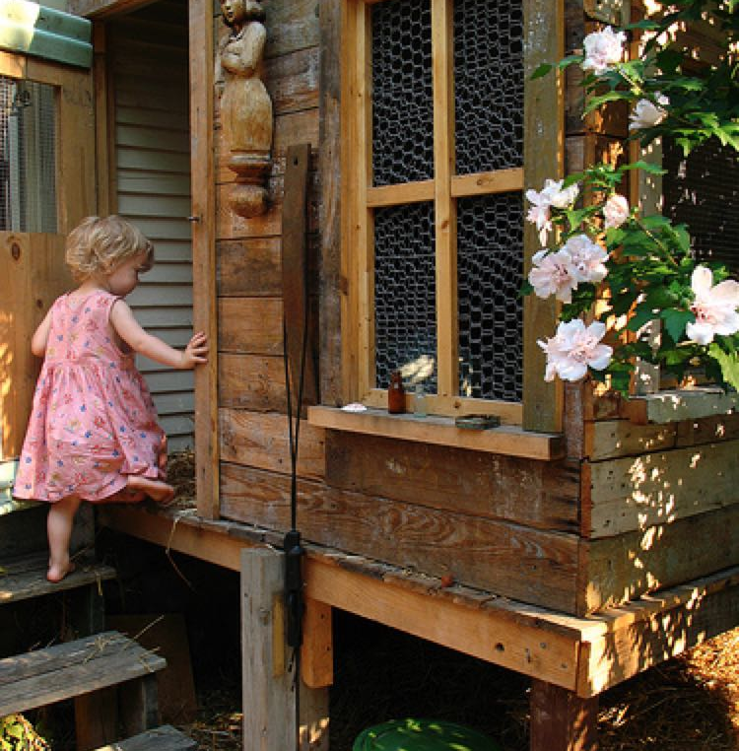
Image Captioning
Task:
Creating descriptions for images automatically.
Motivation:
Visually impaired people
Analyzing large datasets of images
Basis for video translation
Input-Output:
Image – sentence (a word array)
Pixel values – vocabulary indices of words (one hot vectors)
little girl climbing into a wooden playhouse

Slide 3
Related Works
Before Deep Learning:
Retrieval of keywords by matching images
Pan, Jia-Yu, et al. "Automatic image captioning." Multimedia and Expo, 2004. ICME'04. 2004 IEEE International Conference on. Vol. 3. IEEE, 2004.
Google – Show and Tell:
RNN networks can already generate sentences in machine translation
CNN networks can produce good feature vectors for images
Vinyals, Oriol, et al. "Show and tell: A neural image caption generator." Proceedings of the IEEE Conference on Computer Vision and Pattern Recognition. 2015.
m-RNN:
CNN- multimodal layer- RNN
Mao, Junhua, et al. "Deep captioning with multimodal recurrent neural networks (m-rnn)." arXiv preprint arXiv:1412.6632 (2014).

Slide 4
Data
Flickr-30k
31k images
5 caption for each image
id#caption_number: word1 word2 word3 ….
20k vocabulary size
7k >5 times used words
MS COCO 2014
80k training & 40k validation & 40k test images
5 caption for each image
JSON
10k >5 times used words

Slide 5
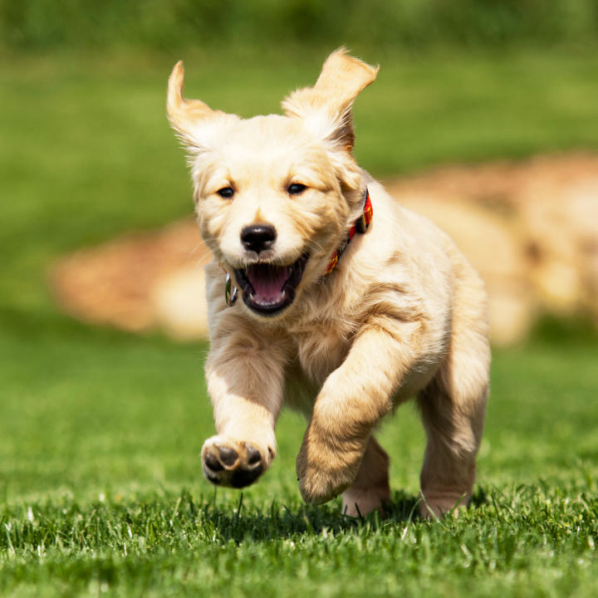
LRCN_{1f}
VggNet-fc7
4096
W_{CNN}
512
<dog>
<a>
<bos>
`
W_{E}
LSTM
LSTM
LSTM
runs
dog
a

Slide 6
LRCN
LRCN_{2f}
VggNet-fc7
4096
Wcnn
512
<runs>
<dog>
<bos>
LSTM
LSTM
LSTM
We
LSTM
LSTM
LSTM
runs
dog
a

Slide 7
Training
Extracted VggNet-fc7 features
Normalizing features
80 sentences in parallel
1 minutes ~ 100k words
Adam optimizer
Dropout ~0.7
5 epoch

Slide 8
Flickr30k

Slide 9
MS COCO

Slide 10
Generation: Beam Search
0.1
0.1
0.1
0.2
0.1
0.2
0.2
Beam Width:2
0.06
0.3
0.1
0.1
0.1
0.1
0.2
0.1
0.3
p1
Pick the path with maximum probability
..…
0.1
0.1
0.1
0.4
0.1
0.1
0.1
p2
0.2
0.08

Slide 11
BLEU Scores
Model* | Dataset | Beam Width | Sample (N/T) | LSTM | CNN | BLEU-1 | BLEU-2 | BLEU-3 | BLEU-4
M-LRCN_{1f} | COCO 14’ | 4 | - | 1-layer | Vgg | 0.692 | 0.490 | 0.353 | 0.258
P-LRCN_{1f} | COCO 14’ | - | 100/1.5 | 1-layer | Caffe | 0.679 | 0.507 | 0.370 | 0.268
P-LRCN_{2f} | COCO 14’ | - | 100/2.0 | 2-layer | Vgg | 0.714 | 0.543 | 0.402 | 0.297
M-LRCN_{1f} | Flickr30k | 10 | - | 1-layer | Vgg | 0.610 | 0.393 | 0.257 | 0.173
*M -> my models
P -> paper’s results

Slide 12
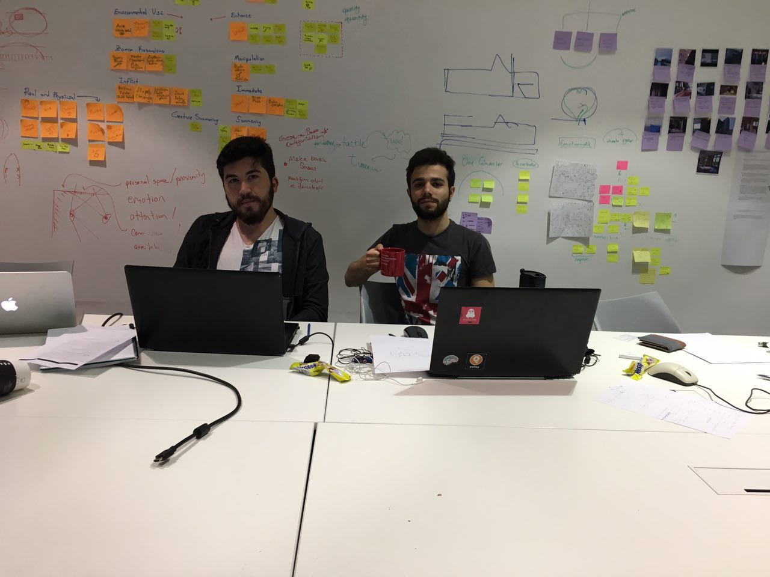
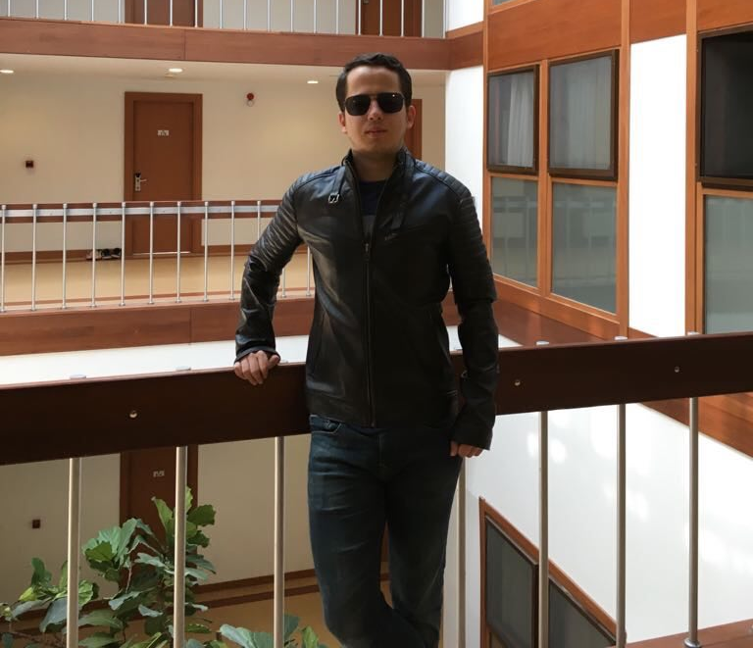
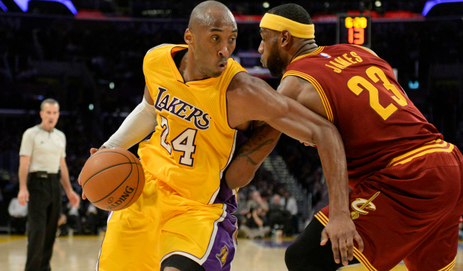
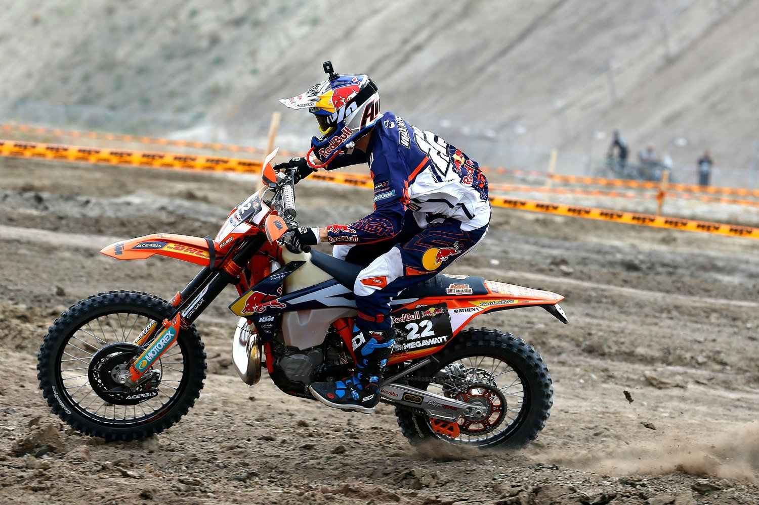
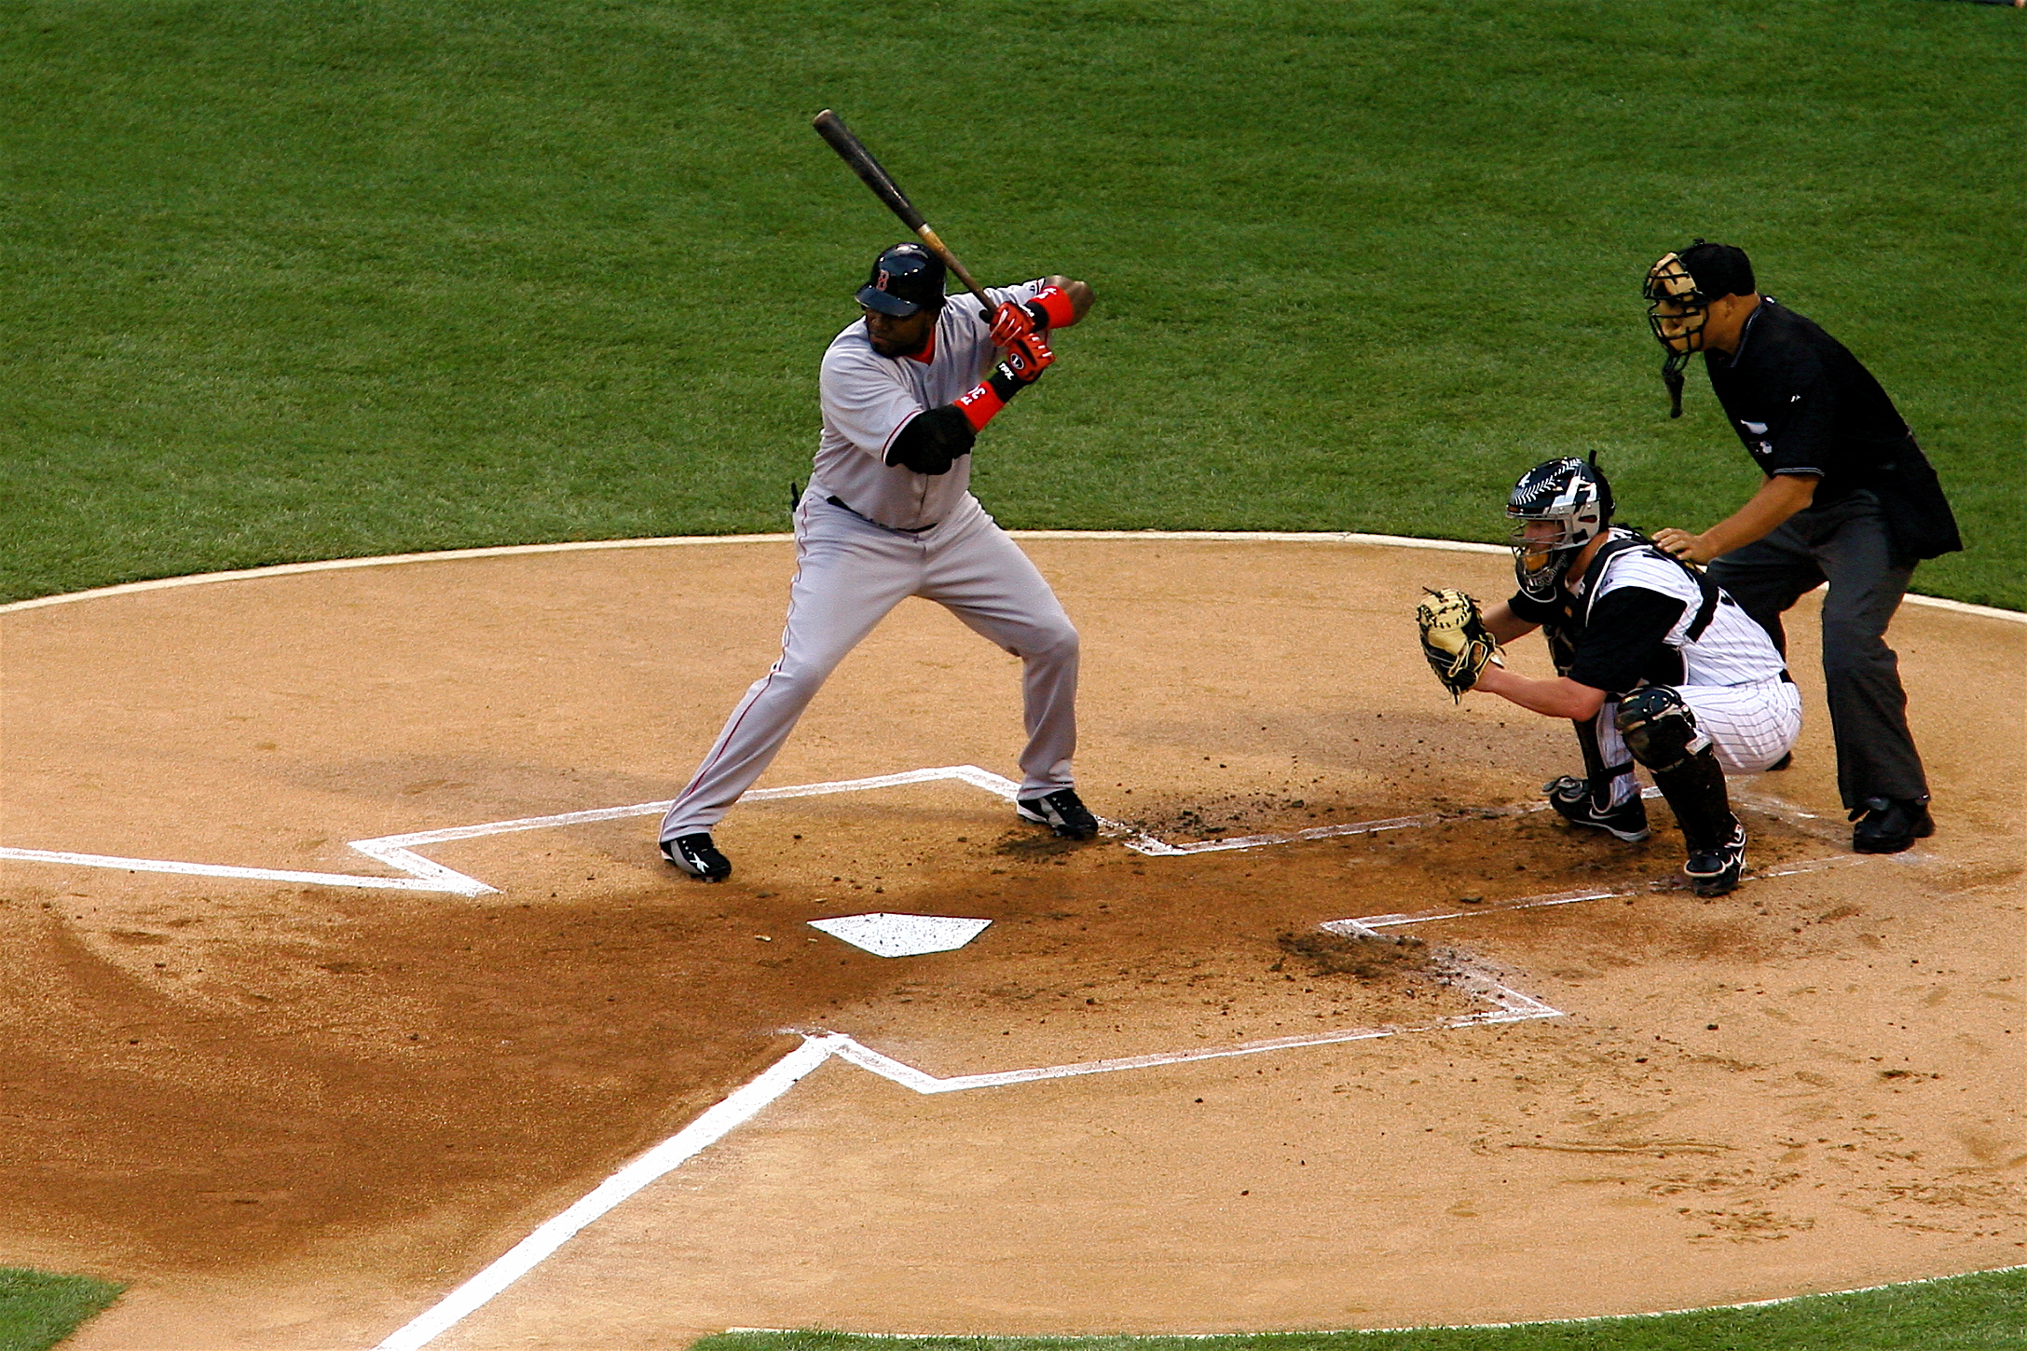
Examples
a group of people sitting at a table with laptops
a brown and white dog is running through a field of grass
a man in a blue shirt and black pants is standing on a scaffold
a man in a red and white uniform is running with a basketball
a baseball player swinging a bat at a baseball
a person on a dirt bike riding down a dirt road

Slide 13
References
Donahue, Jeffrey, et al. "Long-term recurrent convolutional networks for visual recognition and description." Proceedings of the IEEE conference on computer vision and pattern recognition. 2015.
Vinyals, Oriol, et al. "Show and tell: A neural image caption generator." Proceedings of the IEEE Conference on Computer Vision and Pattern Recognition. 2015.
https://github.com/denizyuret/Knet.jl
https://github.com/ekinakyurek/LRCN

Slide 14
Q&A
Thank you for listening ☺

