Slide 1
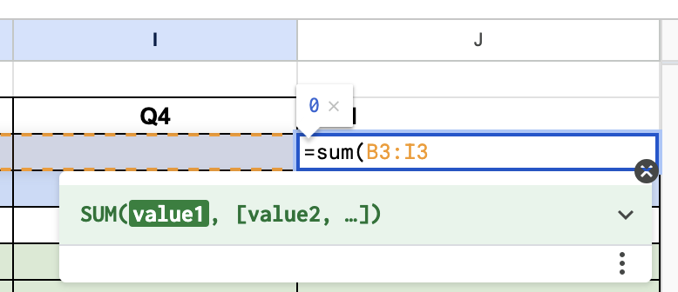
How to use Google Sheets to take over the world
Click on an empty cell and type =SUM and select the cells you want to add.
For multiplication, type =PRODUCT
You can use these functions to easily do all the addition and multiplication you need in your spreadsheet, without using an external calculator.
Google sheets

Slide 2
What you need to do for this assignment
Figure out how much money it will take you to develop the initial app
Use the article you read as a guideline
Put all of this information into the “Up Front Costs” section.
Figure out how much you need to make to pay off this debt in a year.
How many users / subscribers / other income do you need?
What are your ongoing costs?
Server costs
Marketing (to grow the site)
Any research that you do (“how much are server costs for an app with 10,000 users?”), put the link into the “Links” tab.
The “Calculating unit cost” tab is to help you convert from how many subscribers you have to your total revenue from subscribers.
Put all this information into your spreadsheet and see if you’ll break even in a year!

