Slide 1
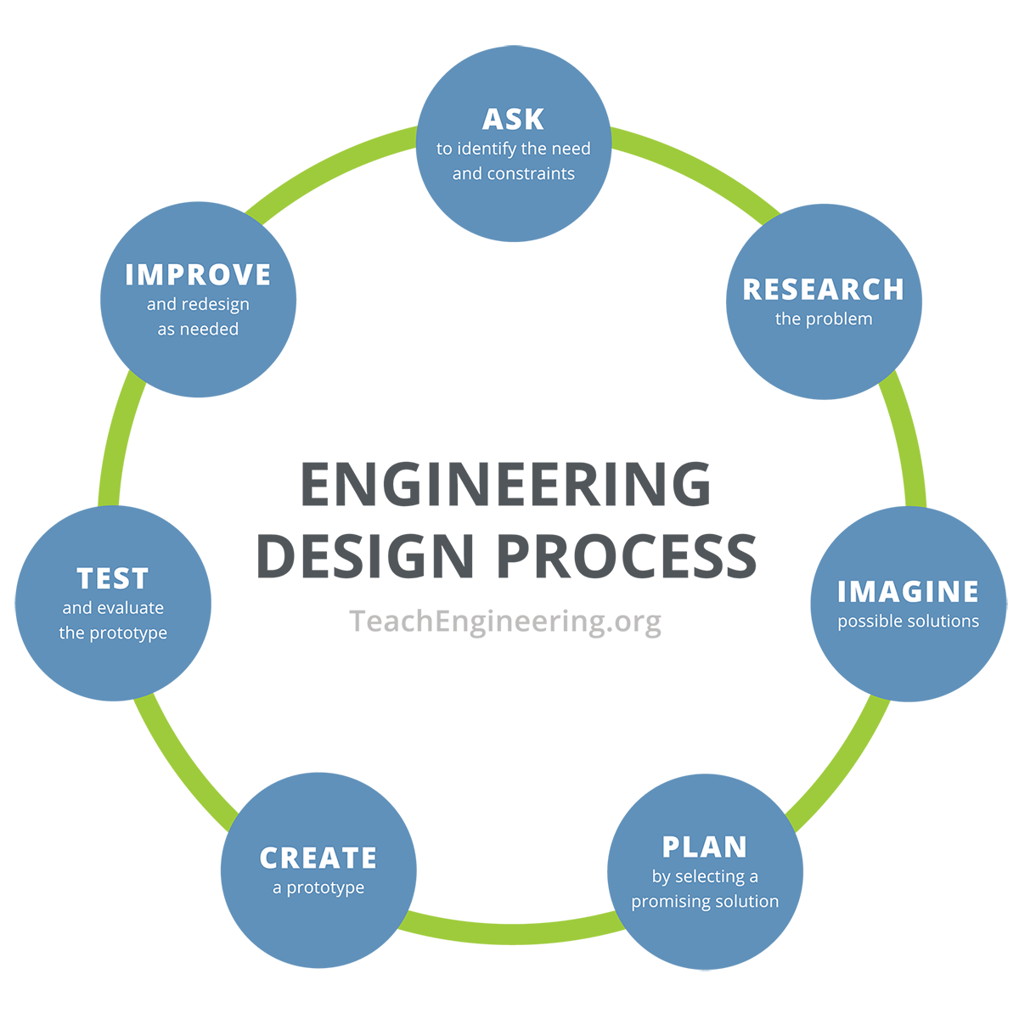
Day 1
Paper airplane lab?
Syllabus etc
Repeat kids?
Introduce engineering cycle in an authentic way
What do you do if something doesn’t work?
Solution for notebooks? Consequences for not turning in
Engineering cycle

Slide 2
Notes on voltage
Voltage is current times resistance

