Slide 1
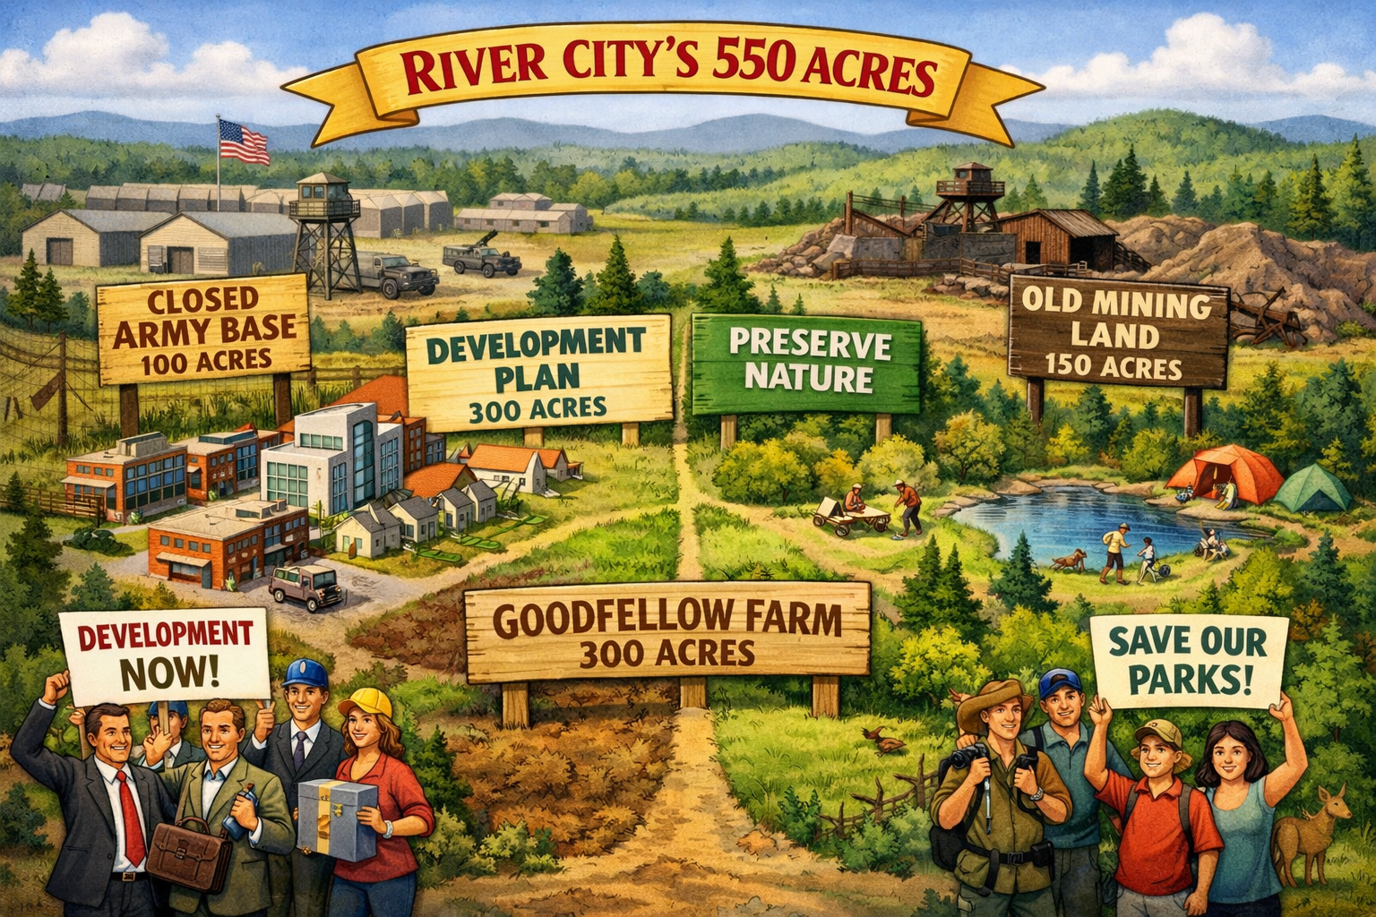
malls and meadows

Slide 2
Land
300 acre Mr. Goodfellow
100 acre Army
150 acres mining

Slide 3
Use
Recreation/development
300 acres for development
Army base and mine more “attractive”

Slide 4
Compromise
At most, 200 acres of the army base and mining land will be used for recreation.
The amount of army base land used for recreation and the amount of farmland used for development together must total exactly 100 acres.

