Slide 1
CIFAR-10
Ekin Öcal

Slide 2
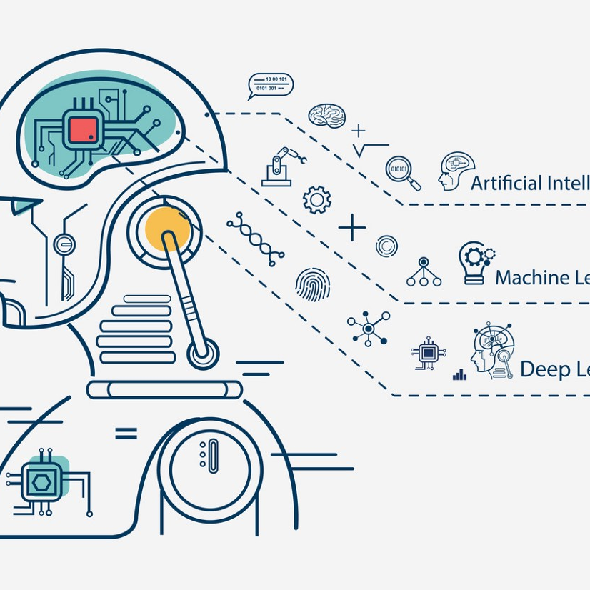
What was my purpose:
In this presentation, I present a Deep Learning Model using CIFAR-10 dataset. The dataset is commonly used in Deep Learning for testing models of Image Classification. It has 60,000 color images comprising of 10 different classes. The image size is 32x32 and the dataset has 50,000 training images and 10,000 test images.

Slide 3
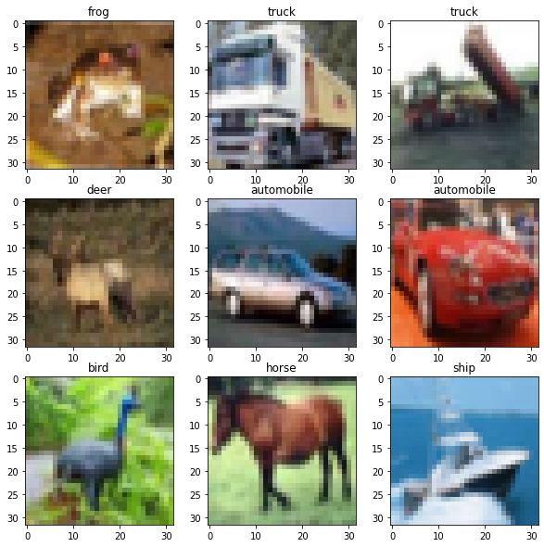
Airplanes, autos, birds, cats, deers, dogs, frogs, horses, ships, and trucks are among the ten item classifications represented in this dataset. These are all mutually exclusive classes. It's worth noting that there's no overlap between cars and trucks.

Slide 4
Qa about my dataset analysis
1)What is Cıfar-10 dataset in ?
This is a dataset of 50,000 32x32 color training images and 10,000 test images, labeled over 10 categories.
2)How to do use Cifar-10 dataset?
Next, we can load the CIFAR-10 data set. Print figure with 9 random images from the CIFAR-10 dataset. Running the code create a 3x3 plot of images and show examples from each class. The pixel values are in the range of 0 to 255 for each of the red, green and blue channels.
3)Was the whole dataset regular?
No it was not. For orgaize the dataset I did not use delimiter, skiprows, dtype parameters as defaults. I changed these parameters in order of ‘,’, 1, np.uint8. Skiprows 1 for get rid of first row, dtype uint8 is for
4) What was my difference from similar studies?
I have differences from other studies. I will explain that in future.
5) Which method did I use for Prediction. Why?
I used CNN. Because it is more powerful and common in image recognition than other methods.

Slide 5
My Code review

Slide 6
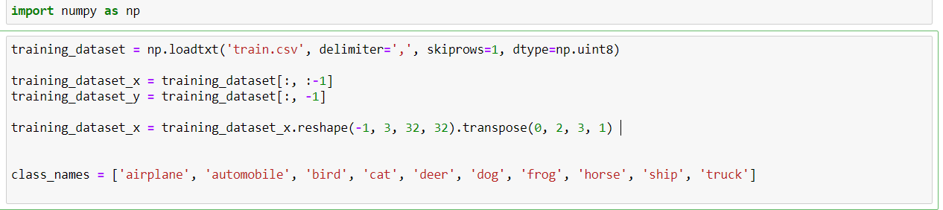
Reading Dataset

Slide 7
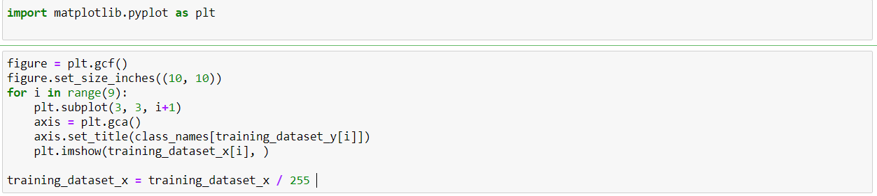
Plotting and Normalizing

Slide 8
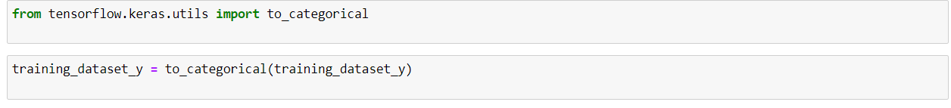
One- Hot Encoding

Slide 9
Creating the Image Classification Model
All the layers required for my convolutional neural network.
Conv2D stands for a 2-dimensional convolutional layer.
Here, 32and 64 are the numbers of filters needed. A filter is an array of numeric values. (3,3) is the size of the filter, which means 3 rows and 3 columns. The input image is 32*32*3 size, that is, 32 height, 32 widths, and 3 refer to RGB values. Each of the numbers in this array (32,32,3) is given values from 0 to 255, which describes the pixel intensity at that point.
MaxPooling layer is used for pooling. Pooling reduces the dimensionality of each feature map but retains the most important information. This helps to decrease the computational complexity of our network.
Flatten is used to convert the feature map to 1-dimension. We use the Dense function to initialize a fully connected network.
I need to compile the CNN model before I train it. We can use the compile() method for this. Also, let’s define the learning rate for training.
used the fit() method of keras to train the CNN.
I chose epoch as 5 however I don want it takes long time. It can be more than 5.

Slide 10
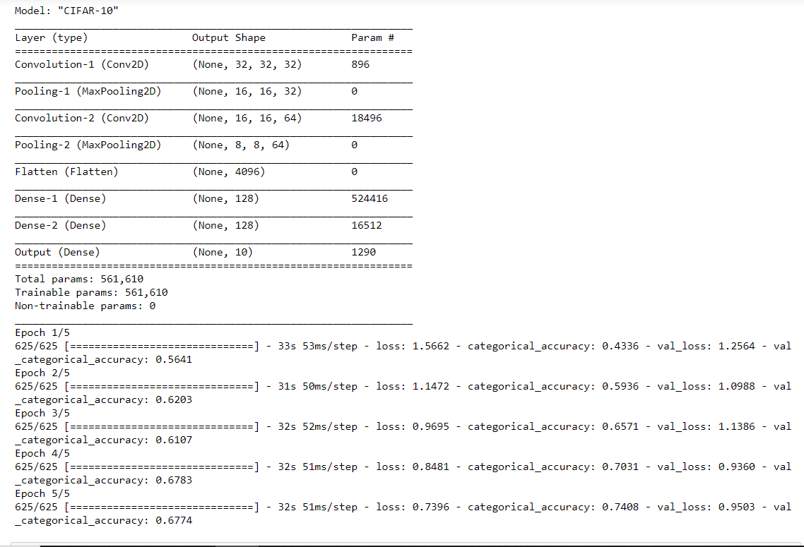
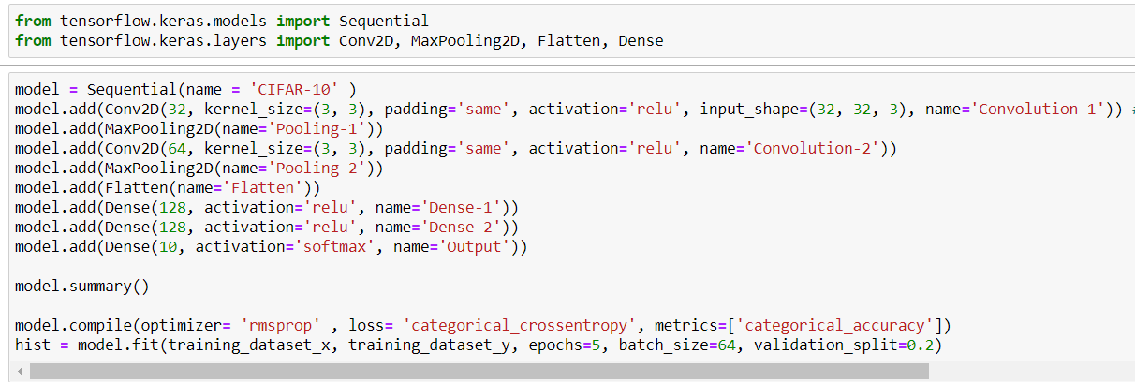
Walt Disney

Slide 11
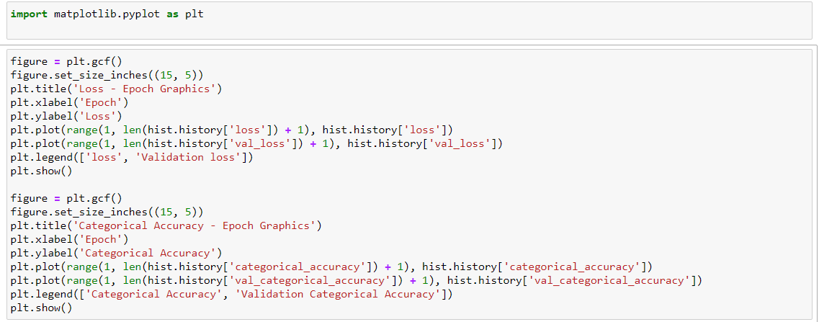
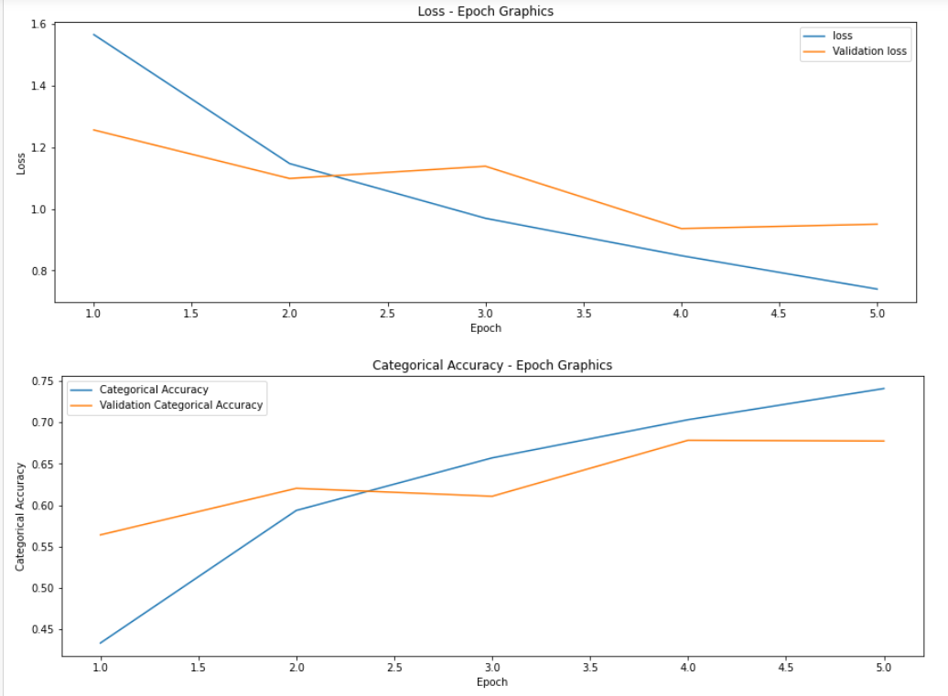
Plotting Results

Slide 12
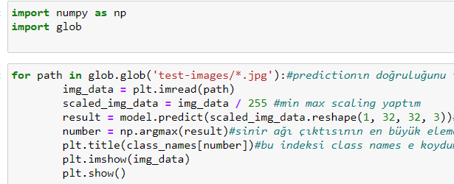
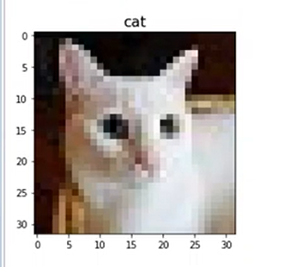
Predıctıon testıng part

Slide 13
My dıfferences
While the ready library was used in studies similar to my work, I carried out my work by downloading, reading and editing my own dataset.
While I was create an algorithm to test my prediction work and testing the data I found on the internet, I could not see this in similar studies.
I set the epoch parameter as a 5.

Slide 14
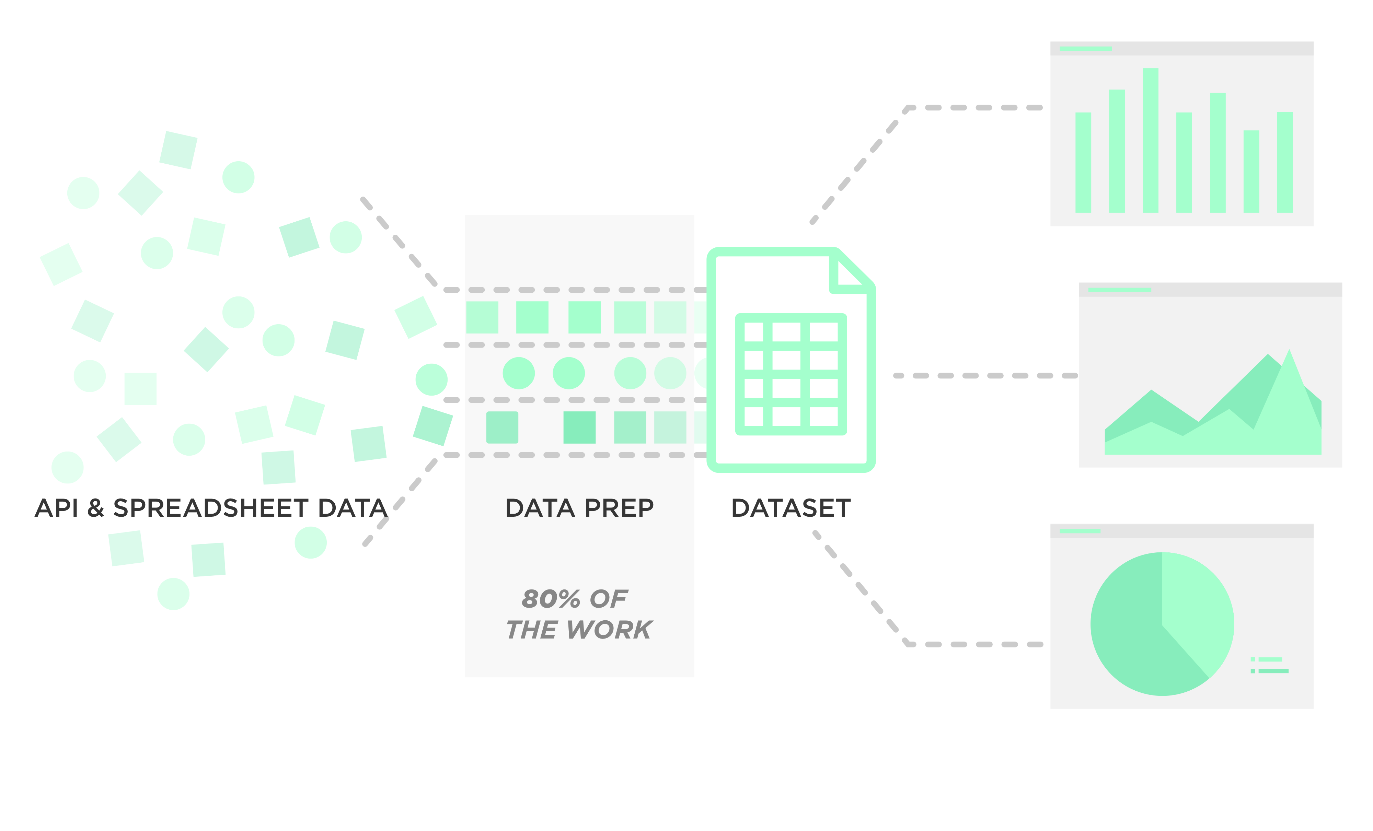
The aspects I struggle with
Reading and correcting the dataset
CNN Algorithm
Testing

Slide 15

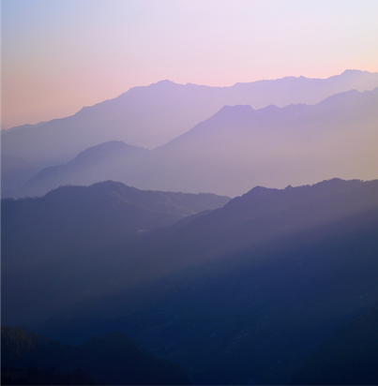
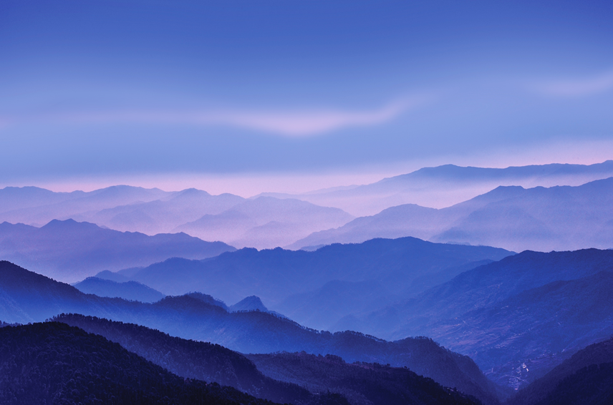
Summary
I would like to say that I am very happy that I have done this work. Even working with a dataset has added new things to me and allowed me to improve. CNN prediction was not a model that I used a lot, but now I feel strong in this area as well.

Slide 16



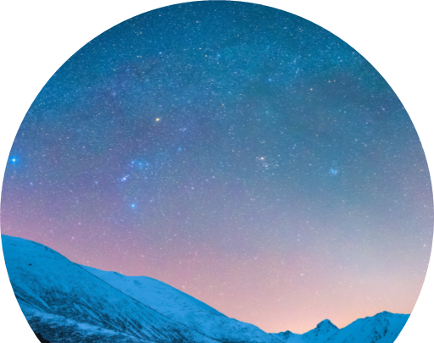
Thank you
Ekin Öcal

