Slide 1
EEE 475/575 Medical Image Reconstruction and Processing
ReconFormer for Accelerated MRI Reconstruction
Evaluation on the fastMRI single-coil knee dataset
Burcu Köprülü
Muhammet Talat Yavuz
Özgür Ekin Sönmez
Eylül Naz Berçin

Slide 2
BACKGROUND AND METHOD
Why accelerated MRI reconstruction matters
MRI scanners acquire frequency-domain measurements, not direct image pixels.
These measurements live in k-space and are collected sequentially.
k-space acquisition
>
fewer samples
>
image reconstruction
Under-sampling k-space shortens acquisition time but removes information.
The reconstruction task is to recover a high-quality image from incomplete data.
AF=4
AF=8
moderate acceleration
more aggressive under-sampling
Higher acceleration means fewer acquired measurements for the same image.

Slide 3
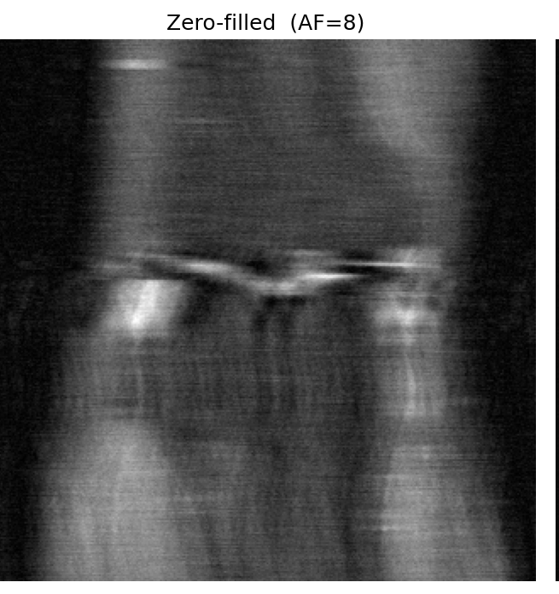
BACKGROUND AND METHOD
Under-sampling makes the inverse problem ill-posed
y = P F x + n
x: desired MR image
F: Fourier transform
P: under-sampling mask
y: measured k-space data
Zero-filled reconstruction: artifacts from missing k-space
Because only part of k-space is measured, multiple images can be consistent with the same acquired data.

Slide 4
BACKGROUND AND METHOD
Reconstruction combines measurement fidelity with prior information
x* = arg min || P F x - y ||² + λ R(x)
Data fidelity
Image prior
Keeps the reconstruction consistent with the k-space samples that were actually acquired.
Classical methods encode assumptions such as sparsity; learned methods estimate this prior from data.
ReconFormer follows this learned reconstruction framework.
The model estimates missing information while data consistency protects measured samples.

Slide 5
BACKGROUND AND METHOD
Data consistency grounds the neural reconstruction
network prediction
>
Fourier transform
>
replace measured samples
>
inverse transform
kDC(i) = y(i) at measured locations
A visually plausible output is not enough in medical reconstruction.
Measured k-space values should remain unchanged after the network update.
This links the deep model back to the inverse-problem formulation.

Slide 6
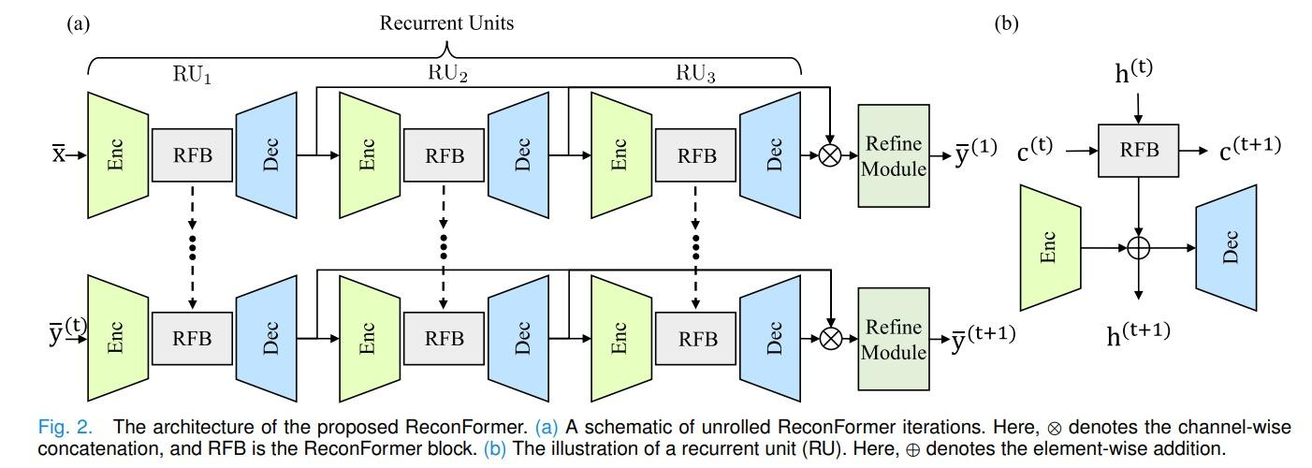
BACKGROUND AND METHOD
ReconFormer uses recurrent Transformer blocks for MRI reconstruction
Core idea
Recurrent Pyramid Transformer Layers process features across spatial scales.
Recurrent Scale-wise Attention helps combine information from different resolutions.
Local detail supports tissue boundaries; global context helps suppress aliasing artifacts.
Data-consistency layers keep the output compatible with measured k-space.

Slide 7
PROJECT OBJECTIVE AND IMPLEMENTATION
Why we selected ReconFormer
Recent reconstruction method published in IEEE Transactions on Medical Imaging.
Our objective
Official implementation and pre-trained weights are publicly available.
Understand the reconstruction framework.
Suitable for evaluating a recent method without training a model from scratch.
Run the official evaluation pipeline.
Evaluate AF=4 and AF=8 on fastMRI single-coil knee data.

Slide 8
PROJECT OBJECTIVE AND IMPLEMENTATION
Evaluation plan
AF=4
AF=8
3
4
center fraction 0.08
center fraction 0.04
quantitative metrics
qualitative panels
Quantitative evaluation: PSNR, SSIM, and NMSE.
Qualitative evaluation: ground truth, zero-filled image, ReconFormer output, and absolute error map.
Baselines: zero-filled reconstruction and D5C5 values reported by the original paper.
AF=8 is expected to be harder because more k-space samples are missing.

Slide 9
PROJECT OBJECTIVE AND IMPLEMENTATION
Implementation workflow
select acceleration
>
load checkpoint
>
run evaluation
>
export metrics and figures
main_recon_test.py -- acceleration AF=4 / AF=8 -- checkpoint corresponding to the selected AF
The model architecture and learned weights were kept unchanged.
The same pipeline produced both metric values and qualitative comparison figures.
The demo can show the command, checkpoint path, acceleration factor, and generated outputs.

Slide 10
DATASET AND EVALUATION
Computational setup and implementation adjustments
Environment
Compatibility changes
Google Colab
NVIDIA Tesla T4 GPU
Single-GPU execution
Updated deprecated Fourier transform calls to torch.fft.
Reduced test batch size from 8 to 1 due to GPU memory limits.
Added visualization export for qualitative comparison figures.
These adjustments affected execution compatibility, not the reconstruction algorithm.

Slide 11
DATASET AND EVALUATION
fastMRI single-coil knee validation subset
30
1059
2
validation scans
total slices
acceleration factors
The subset is smaller than the full validation protocol, but it is sufficient to check that the implementation runs correctly and that quality degrades from AF=4 to AF=8 as expected.
Same representative central knee slice was used for the qualitative AF=4 and AF=8 comparison.

Slide 12
DATASET AND EVALUATION
Quantitative image quality metrics
NMSE = ||x - x̂||² / ||x||²
NMSE: normalized reconstruction error, so lower is better.
PSNR: pixel-wise fidelity, so higher is better.
PSNR = 20 log10(xmax / sqrt(MSE))
SSIM: structural similarity, so higher is better.
Together, these metrics capture error magnitude, intensity fidelity, and structural quality.
SSIM compares luminance, contrast, and structure

Slide 13
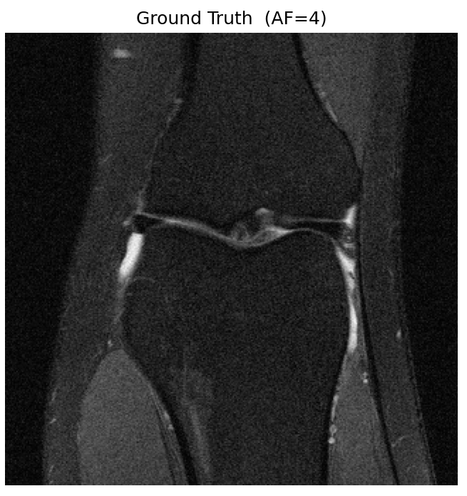
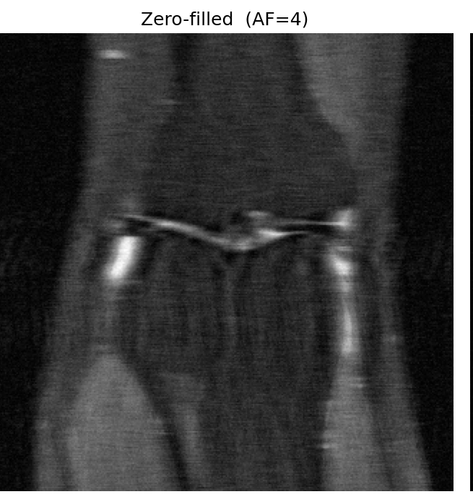
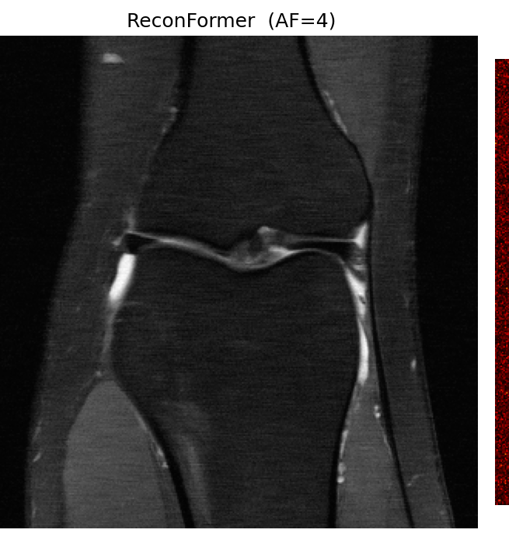
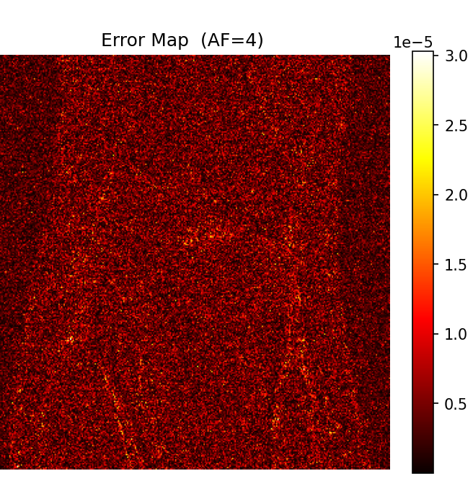
DATASET AND EVALUATION
Qualitative evaluation panels
Ground truth
Zero-filled
ReconFormer
Absolute error
The same four-panel structure is used for AF=4 and AF=8, making the visual effect of stronger under-sampling easier to compare.

Slide 14
RESULTS AND CONCLUSION
Quantitative results show the expected AF=4 to AF=8 degradation
31.69 dB
0.797
0.0345
AF=4 PSNR
AF=4 SSIM
AF=4 NMSE
-1.81 dB
PSNR decrease
from AF=4 to AF=8
29.88 dB
0.738
0.0477
AF=8 PSNR
AF=8 SSIM
AF=8 NMSE
As acceleration increases, fewer measurements are available and reconstruction quality decreases.

Slide 15
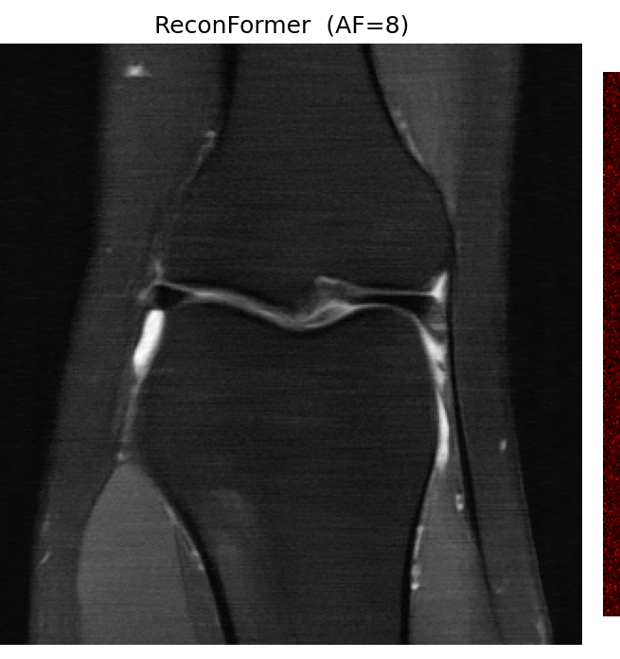
RESULTS AND CONCLUSION
Qualitative results: ReconFormer suppresses most zero-filled artifacts
AF=4 zero-filled
AF=4 ReconFormer
AF=8 zero-filled
AF=8 ReconFormer
Zero-filled reconstructions show stronger aliasing and blur at AF=8. ReconFormer recovers the main anatomical structures at both acceleration factors, with remaining errors mainly near fine boundaries.

Slide 16
RESULTS AND CONCLUSION
CNN comparison and project limitations
D5C5 reference baseline
Limitations
+0.48 dB
+1.24 dB
Used pre-trained weights rather than training from scratch.
ReconFormer PSNR advantage at AF=4
ReconFormer PSNR advantage at AF=8
Evaluated a 30-scan subset instead of the full validation set.
Did not independently reproduce all CNN baselines.
Experiments were limited to single-coil knee MRI.
The comparison suggests that the Transformer-based architecture is especially useful when under-sampling is more severe.

Slide 17
Conclusion
ReconFormer substantially improves image quality compared with zero-filled reconstruction.
AF=8 is more challenging than AF=4, and the quantitative metrics reflect this expected trend.
The method combines a learned image prior with explicit k-space data consistency.
Our evaluation supports the main idea that recurrent Transformer-based reconstruction is effective for accelerated MRI.
Thank you

