Slide 1
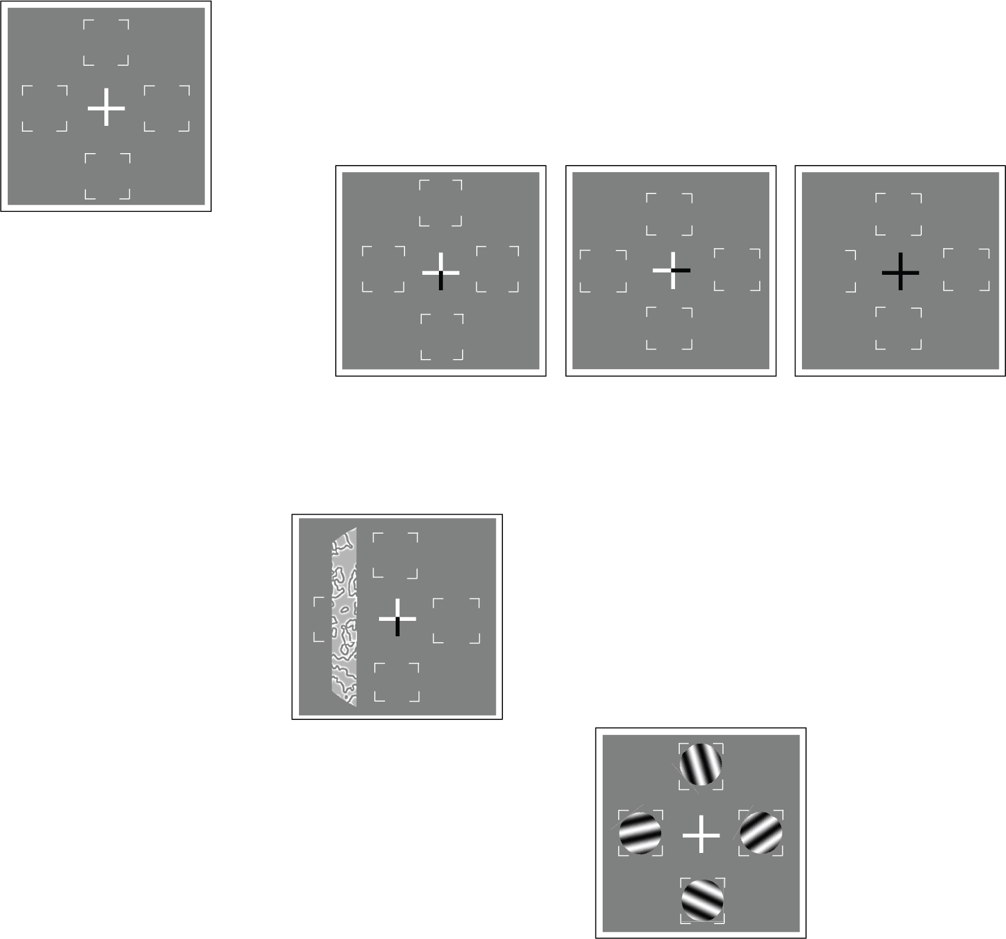
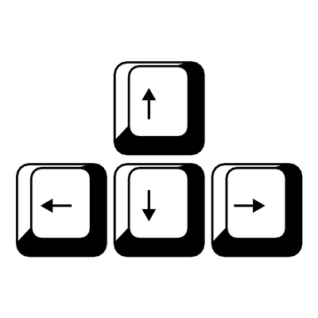

Thank you for participating in the experiment!
Press SPACE to start a new block after the break, and make sure to rest your eyes ☺
+
+
+
DISTRACTOR
TARGET
Fixate
Target is a vertical Gabor moving in LEFT or RIGHT direction
Distractors are diagonal Gabors moving diagonally
Report target movement direction

