Slide 1
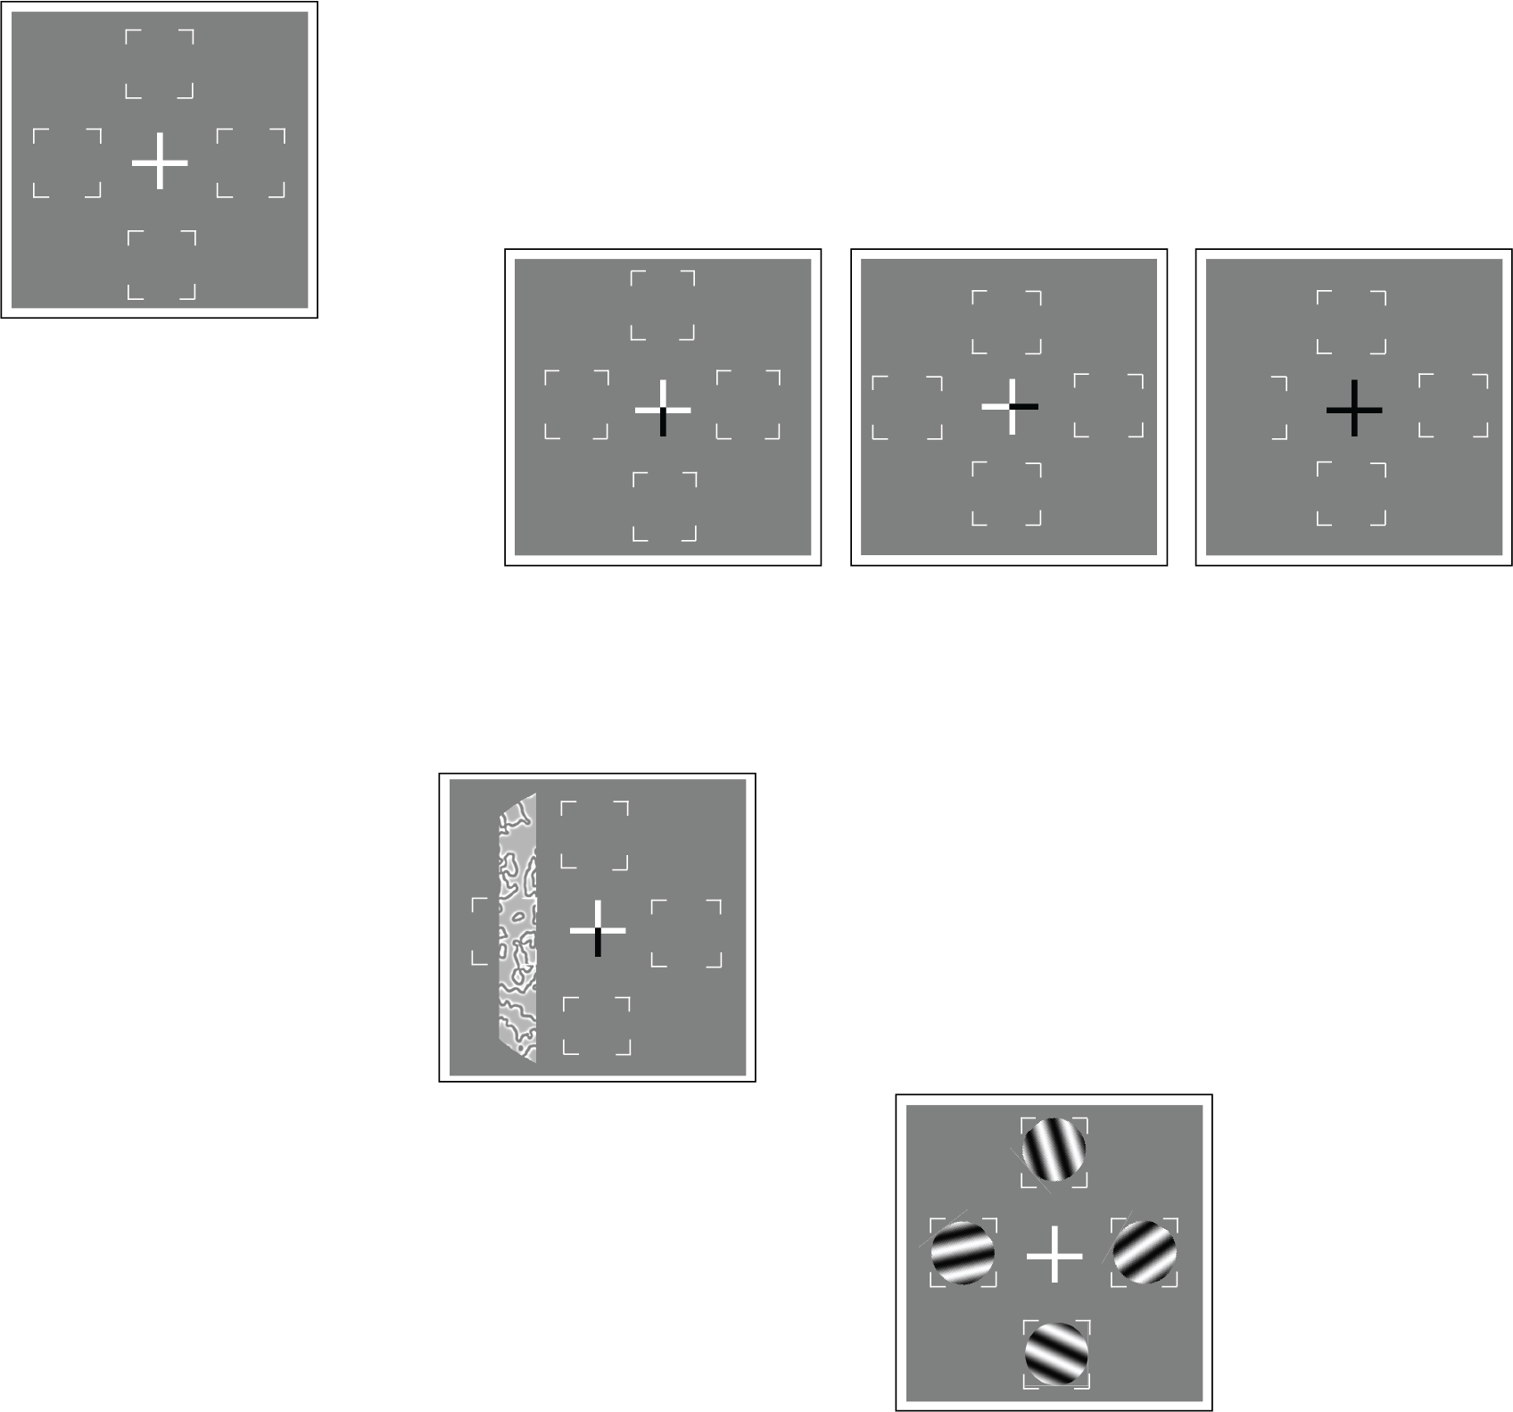
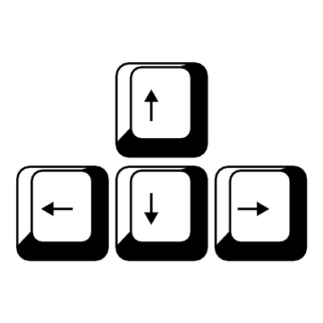

Thank you for participating in the experiment!
Press SPACE to start a new block after the break, and make sure to rest your eyes ☺
+
+
+
+
DISTRACTOR
+
+
Fixate
Attentional cue
Stimuli
Response cue
Report target tilt direction
+
Response cue

