Slide 1
Data Mining and Scraping
and general discussion on datasets you can use for research

Slide 2
Table of Contents
U.S. Census Data / ACS 5-year survey
Longitudinal Origin-Destination Employment Statistics (LODES)
WSDOT Traffic Loop Detector Data
You can also find not-as-processed, more recent traffic count data from WSDOT’s data portal
SafeGraph Data
City of Seattle Data Portal
GTFS Data

Slide 3
Definitions
Data Mining = extraction of actionable information from (usually) very large datasets; is the subject of extreme hype, fear, and interest
Data Scraping = automated extraction of structured or unstructured data from web pages or other digital interfaces, typically not provided in a conveniently downloadable format; often involves parsing HTML or APIs to collect information for analysis, aggregation, or integration into other systems.

Slide 4
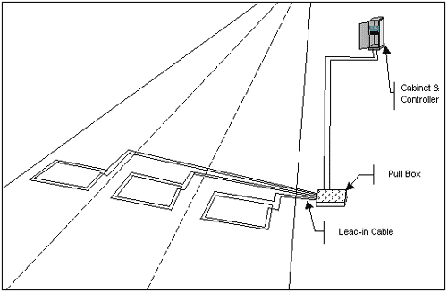
Detection Techniques
Inductance loop detectors, probably 85-90% of the market
In-road detector is 1 or 2 strands of 14-16 gauge copper wire
Any desired size or shape

Slide 5
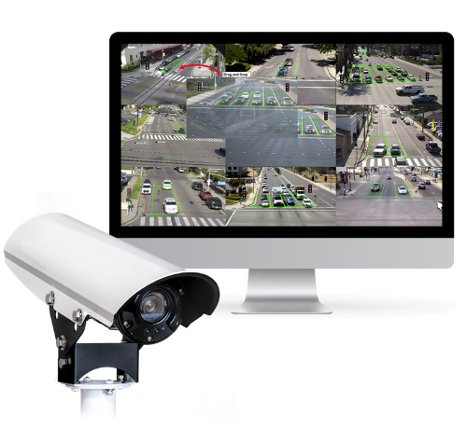
Detection Techniques
Video detection, likely to grow in market share
Video camera
Image recognition software

Slide 6
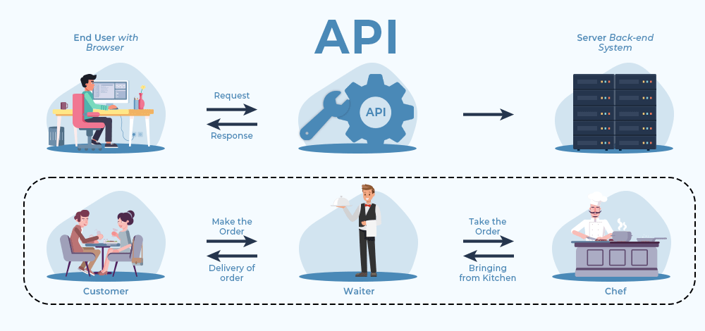
Application Programming Interface (API)

Slide 7
Other datasets I haven’t yet looked at
Twitter data [not available post-Musk]
Airport data
Airport 1, Airport 2, number of seats across the entire year that were available
Yelp data
Google Maps business reviews/metadata
COVID-19 Community Mobility Reports
Waymo data
AirBnB listing details + reviews
Seattle Police 911 calls data

