Slide 1
Data Mining and Scraping
and general discussion on datasets you can use for research

Slide 2
Notices
This is not a tutorial lecture on Python/GitHub/Terminal/Conda/Git etc.
I will assume some level of familiarity with the above;
If you do not have an IDE set up on your computer, you can simply follow along/ask about what is shown on my computer;
If you think what is shown may be helpful to you in the future, it is totally fine to save the Jupyter notebooks and refer to them later as needed.

Slide 3
Definitions
Data Mining = extraction of actionable information from (usually) very large datasets; is the subject of extreme hype, fear, and interest
Data Scraping = automated extraction of structured or unstructured data from web pages or other digital interfaces, typically not provided in a conveniently downloadable format; often involves parsing HTML or APIs to collect information for analysis, aggregation, or integration into other systems.

Slide 4
Datasets for Transportation Studies
U.S. Census Data / ACS 5-year survey
Longitudinal Origin-Destination Employment Statistics (LODES)
WSDOT Traffic Loop Detector Data
You can also find not-as-processed, more recent traffic count data from WSDOT’s data portal
SafeGraph Data
City of Seattle Data Portal
GTFS Data
PSRC Household Travel Survey Data

Slide 5
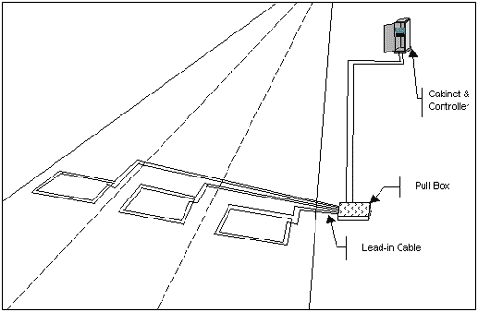
Detection Techniques
Inductance loop detectors, probably 85-90% of the market
In-road detector is 1 or 2 strands of 14-16 gauge copper wire
Any desired size or shape

Slide 6
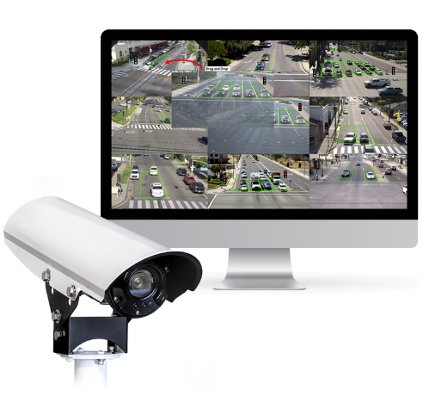
Detection Techniques
Video detection, likely to grow in market share
Video camera
Image recognition software

Slide 7
Application Programming Interface (API)

Slide 8
Data Scraping with Selenium
Allows developers to programmatically interact with a web browser, simulating user actions like clicking, typing, and navigating through web pages
Demonstration on scraping AV crashes from a graphical front-end

Slide 9
Other datasets I haven’t yet looked at
Twitter data [not available post-Musk]
Airport data
Airport 1, Airport 2, number of seats across the entire year that were available
Yelp data
Google Maps business reviews/metadata
COVID-19 Community Mobility Reports
Waymo data
AirBnB listing details + reviews
Seattle Police 911 calls data

Slide 10
Classes I recommend
CSE 547: Machine Learning for Big Data (Professor Tim Althoff)
Hard and math-heavy (more theoretical)
Teaches foundational concepts in working with large-scale datasets
CEWA 567: Geospatial Data Analysis with Python (Professor David Shean)
Accessible and useful even if you do not want to do snow research
Fully taught using Jupyter Notebooks (very practical!)
CS&SS 564: Bayesian Statistics for the Social Sciences (Professor Carlos Cinelli)
More R-focused if that’s your jam
Good mix of theory and practice
ME 574: Intro to Applied Parallel Computing for Engineers
Using CUDA in Python to parallelize operations

