Slide 1
Python Programming and Pizza
By Evan Kivolowitz – UPL Coordinator

Slide 2
Prerequisites
Assumes basic programming knowledge
C
C++
Java
CS200-300 or 302-367 knowledge

Slide 3
Why Python
Easy
Semantics over Syntax
Flexibility
Popularity
Portable

Slide 4
Uses
Scripting
Scientific Computing
Prototyping
Web Dev
GUI
Education

Slide 5
Cons
Slow
Lazy programming practices

Slide 6
About Python
Interpreted
Object Oriented (and more)
Dynamically Typed
Passed by Object Reference
Python 2.X and 3.X

Slide 7
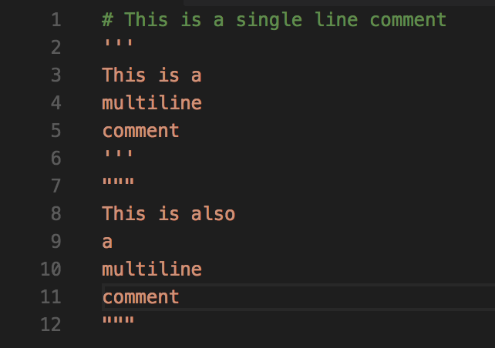
Comments

Slide 8
Built in Types
Numbers
Strings (and unicode strings)
Lists
Dictionaries
Tuples
Files
Sets

Slide 9
Numbers
Integers (unlimited precision in 3.x)
Floating Point
Immutability

Slide 10
Numeric Operations
Mathematical
+ - / % // ** abs()
Bitwise
| & ^ << >> ~
Comparative
< <= > >= == != ’is’ ‘is not’ ‘not’ ‘or’ ‘and’
And many, many more

Slide 11
Numeric Operations Examples
File available at

Slide 12
Strings
No char
Immutable
‘’ or “” or “”” “””
‘\’ escape character

Slide 13
String Formatting
”%s likes Python!” % “Evan”
”Evan likes Python!”
“{0}, {1}, {2:.2f}”.format(100, ‘Sports’, 1/ 5.0}
“100, Sports, 0.20”

Slide 14
String Operations
S.capitalize(..)
S.endswith(..)
S.Find(..)
S.Format(..)
S.isAlpha(..)
S.isDigit(..)
S.split(..)
S.replace(..)
And many many more

Slide 15
Lists
Mutable
Can contain anything
0 based indexing

Slide 16
List Creation
x = []
x = [1, 2, [3,4], “Apples and Bananas”]
y = [x *2 for x in range(5)]

Slide 17
List Operations
L.append(..)
L.extend(..)
L.sort(..)
L.index(..)
L.insert(..)
And many, many more

Slide 18
List Comprehension
[ expression for target1 in iterable [ if condition 1] …]
y = [x ** 2 for x in range(5)]
y = [0, 1, 4, 9, 16]
y = [x for x in range(5) if x % 2 == 0]
y = [ 0, 2, 4]

Slide 19
Dictionaries
Hashmap of Python
Key : Value storage
Mutable

Slide 20
Dictionary Creation
d = {}
c = dict(zip([’Evan, ’Randy’, ’Ben’], [1,2,3])

Slide 21
Dictionary Insertion and Accessing
d = {}
d[‘Evan’] = 10
print(d[‘Evan’]) # outputs 10

