Slide 1
Python Programming and Pizza
By Evan Kivolowitz – UPL Coordinator

Slide 2
Prerequisites
Assumes basic programming knowledge
C
C++
Java
CS200-300 or 302-367 knowledge

Slide 3
Why Python
Easy
Semantics over Syntax
Flexibility
Popularity
Portable

Slide 4
Uses
Scripting
Scientific Computing
Prototyping
Web Dev
GUI
Education

Slide 5
Cons
Slow
Lazy programming practices

Slide 6
About Python
Interpreted
Object Oriented (and more)
Dynamically Typed
Passed by Object Reference
Python 2.X and 3.X

Slide 7
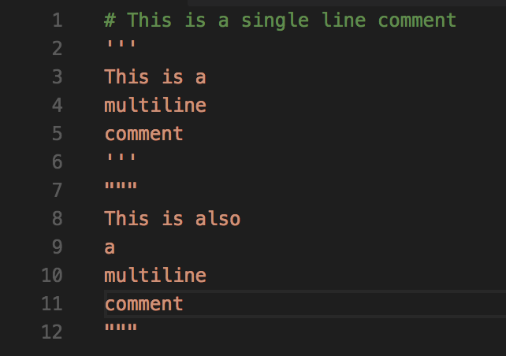
Comments

Slide 8
Built in Types
Numbers
Strings (and unicode strings)
Lists
Dictionaries
Tuples
Files
Sets

Slide 9
Numbers
Integers (unlimited precision in 3.x)
Floating Point
Immutability

Slide 10
Numeric Operations
Mathematical
+ - / % // ** abs()
Bitwise
| & ^ << >> ~
Comparative
< <= > >= == != ’is’ ‘is not’ ‘not’ ‘or’ ‘and’
And many, many more

Slide 11
Numeric Operations Examples
File available at https://github.com/ekivolowitz/PythonTalk/examples/numbers.py https://github.com/ekivolowitz/PythonTalk/examples/is.py

Slide 12
Strings
No char
Immutable
‘’ or “” or “”” “””
‘\’ escape character

Slide 13
String Operations
S.capitalize(..)
S.endswith(..)
S.Find(..)
S.Format(..)
S.isAlpha(..)
S.isDigit(..)
S.split(..)
S.replace(..)
And many many more

Slide 14
String Examples
File available at https://github.com/ekivolowitz/PythonTalk/examples/strings.py

Slide 15
Lists
Mutable
Can contain anything
0 based indexing

Slide 16
List Creation
x = []
x = [1, 2, [3,4], “Apples and Bananas”]
y = [x *2 for x in range(5)]

Slide 17
List Operations
L.append(..)
L.extend(..)
L.sort(..)
L.index(..)
L.insert(..)
And many, many more

Slide 18
List Comprehension
File available at https://github.com/ekivolowitz/PythonTalk/examples/lists.py

Slide 19
Dictionaries
Hashmap of Python
Key : Value storage
Mutable

Slide 20
Dictionary Creation
d = {}
c = dict(zip([’Evan, ’Randy’, ’Ben’], [1,2,3])

Slide 21
Dictionary Insertion and Accessing
d = {}
d[‘Evan’] = 10
print(d[‘Evan’]) # outputs 10

Slide 22
Dictionary Example
https://github.com/ekivolowitz/PythonTalk/examples/dictionaries.py

Slide 23
Tuples
Immutable list
Index and count
Returns index of an element (like list)
Returns number of instances of object in tuple (like list)
Created with ()

Slide 24
Files
Reading and writing to and from files
with
Files are iterable!!!

Slide 25
File functions
F.read()
F.readline()
F.readlines()

Slide 26
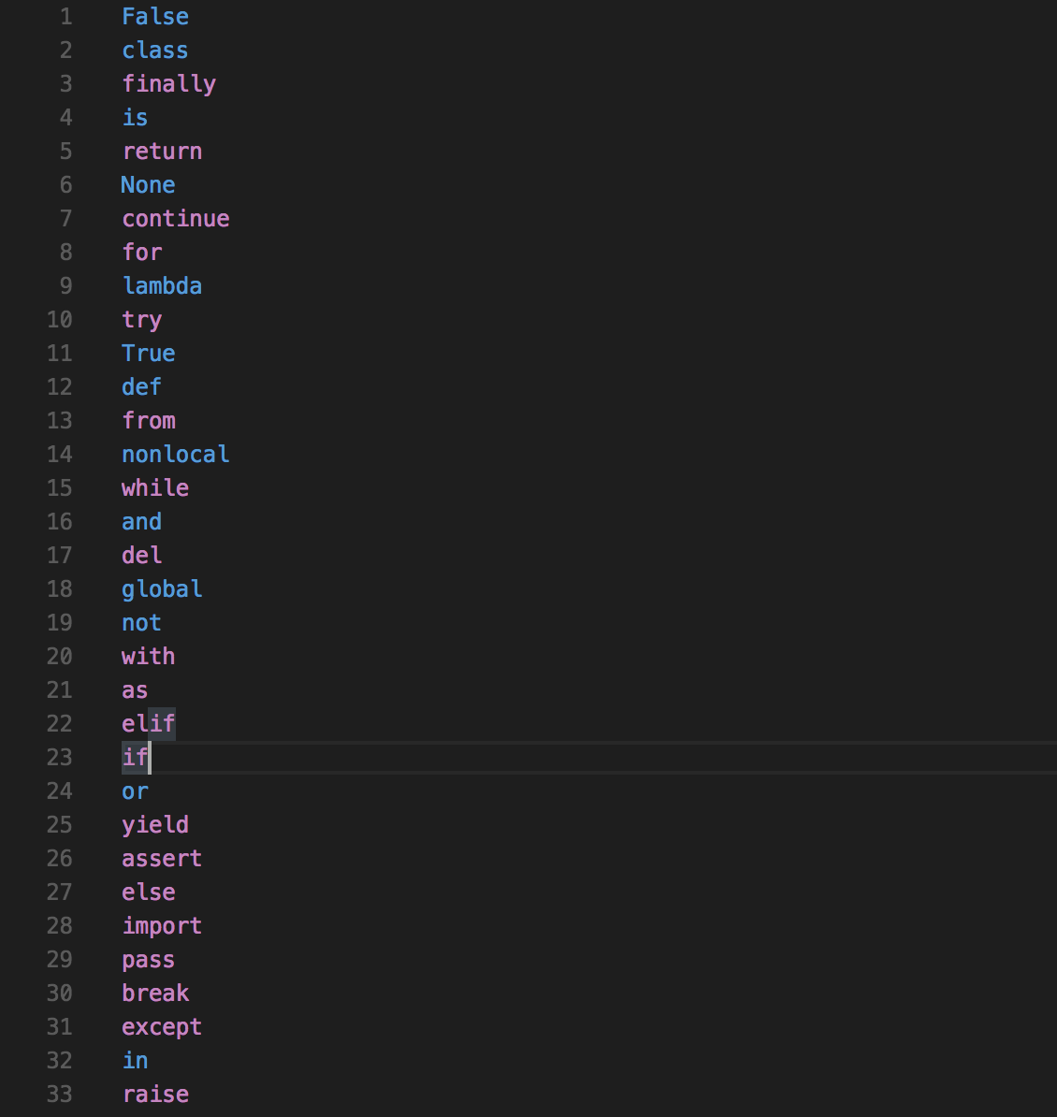
Reserved Words

Slide 27
Specific Statements
if / elif
while
for
pass
break
continue
def

Slide 28
Classes
Must have an __init__ method
Every method must have reference to self
Can declare members in any method or at any time
No private members*
_ vs __
_x remains as is
__ gets replaced by _classname_x (this is called name mangling)

Slide 29
Import statements
import module_name
from module_name import class, function, variable
as

