Slide 1
Grey Box Fuzzing the IoT
Program Monitoring for Memory
and Power Constraint Embedded Devices
Kevin Läufer <laeufer@berkeley.edu>

Slide 2
Problems in Embedded Programming and Testing
No memory protection:
all processes can access all memory
hard to detect and contain failures
Still predominantly programmed in C
No logging, no automatic stack traces
Lacks tools for automated testing

Slide 3
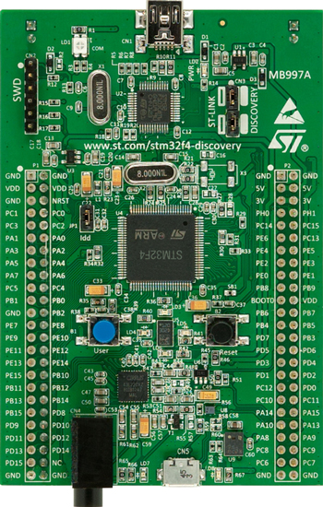
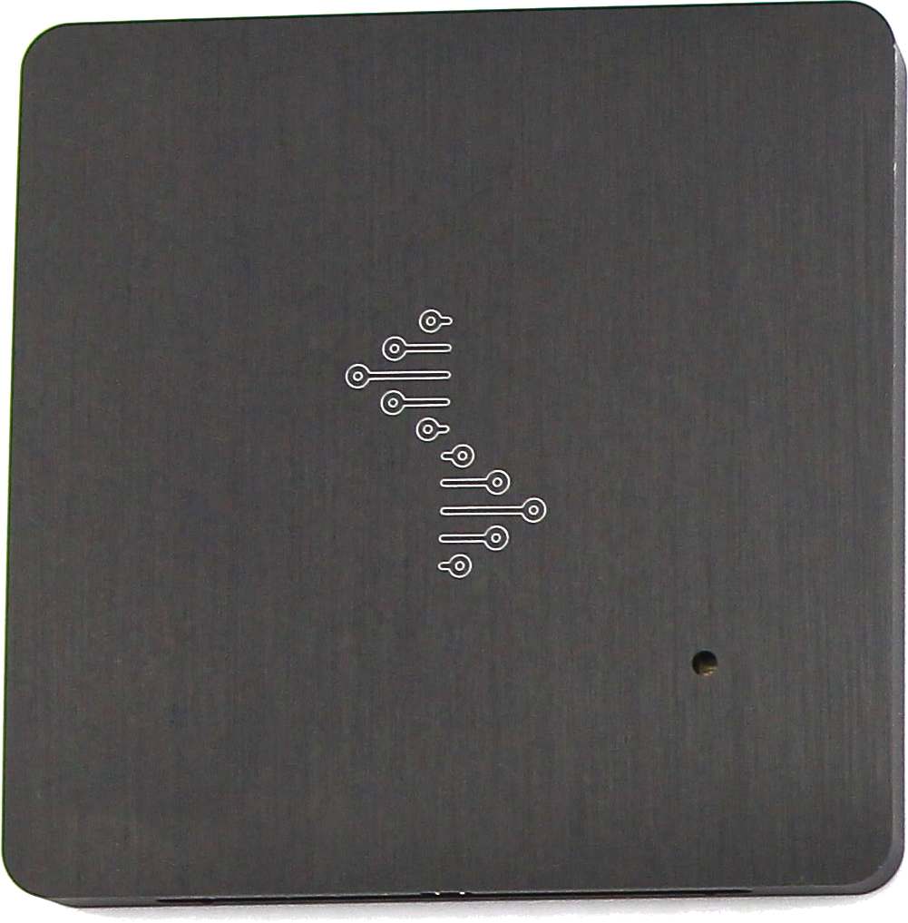
Fuzzing Embedded Devices
Fuzzer
USB
???
Fuzz inputs
Execution Control
Image Source: STMicroelectronics
USB
???
Execution Trace
Image Source: seeedstudio.com

Slide 4
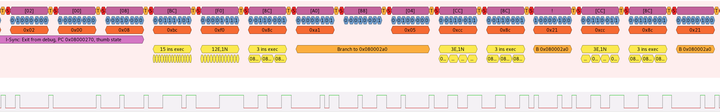
Fuzzing Embedded Devices

Slide 5
Trace Analysis Goals
Memcheck: V(alid) bits
find use of uninitialized value
find double free, use after free
Dynamic points to analysis:
detect buffer overflows

Slide 6
What’s new?
Execution Engine based on radare2 intermediate language: ESIL
Standardized Analysis Tool interface
Meta data storage

Slide 7
Micro Controller Trace Analysis (UCTA)
Simulated
Memory
(RAM, Registers)
Custom Analysis Tools
Program
Facts
(Instructions,
ROM, DWARF)
Execution
Engine

Slide 8
ESIL
Stack based intermediate language
Emitted by radare2
radare2 emits wrong code for some ARM instructions
Makes some analysis steps harder because intermediate values are saved to the stack
Better separation of concerns

Slide 9
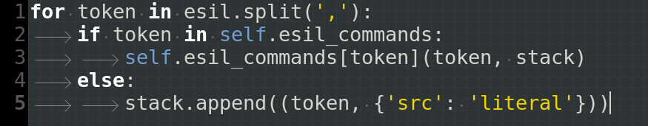
ESIL execution

Slide 10
ESIL example
strb r4, [r3, 1]
r4,r3,1,+,=[1]
*(char*)(r3 + 1) = r4

Slide 11
ESIL bug
strb r4, [r3, 1]!
r4,r3,1,+,=[1],1,r3,+=

Slide 12
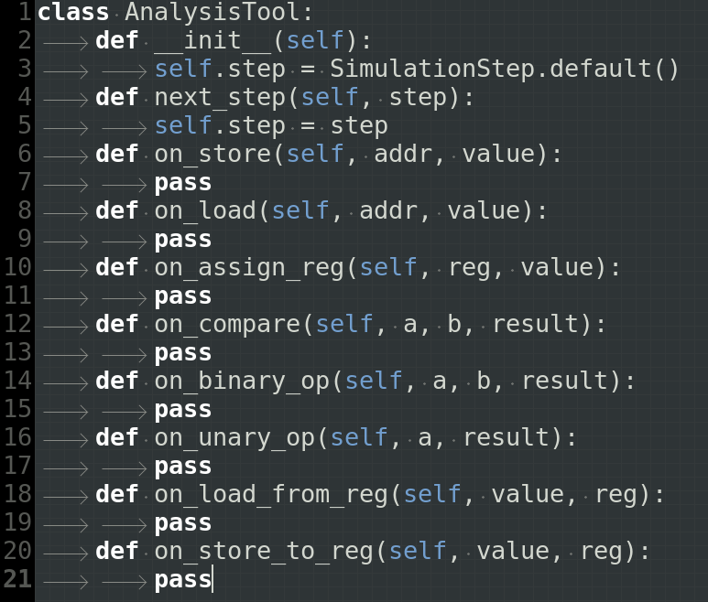
Analysis Tools Interface

Slide 13
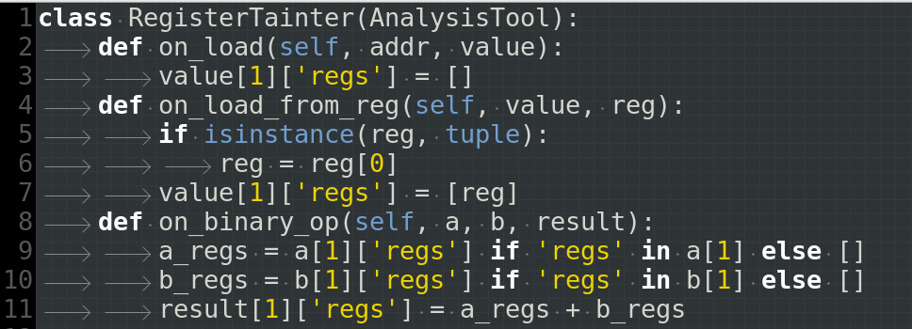
Register Taint Analysis

Slide 14
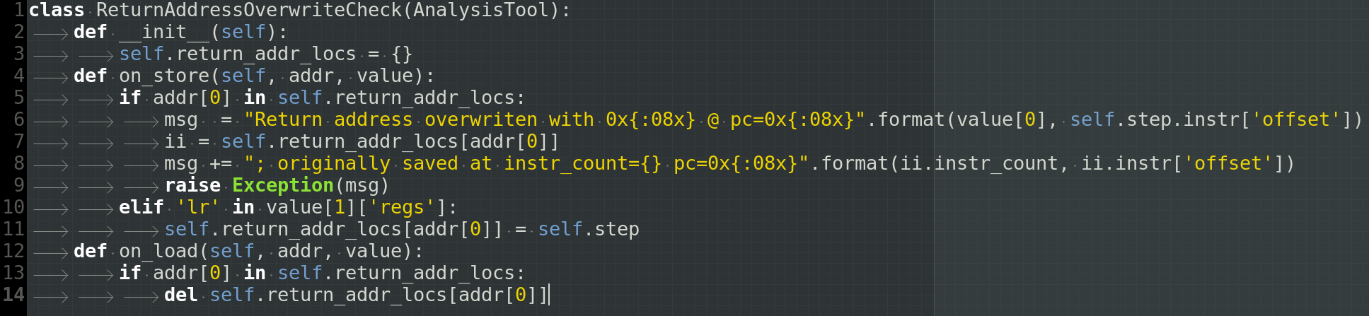
Return Address Overwrite Analysis
Exception: Return address overwritten with 0x000000a4 @ pc=0x08000616; originally saved at instr_count=11372 pc=0x080001a0

Slide 15
Dynamic Points to Analysis for Arrays on Stack: Idea Sketch
Use debug information to determine location of arrays on stack frame
Address always originates from Stack Pointer
Tag address with array name and bounds once it is derived from the Stack pointer
Throw exception if address is used to access memory outside array bounds

Slide 16
Buggy Function
void buggy_function(const uint8_t* packet) {
char buffer[8];
const uint8_t length = packet[0];
std::memcpy(buffer, packet + 1, length);
}

Slide 17
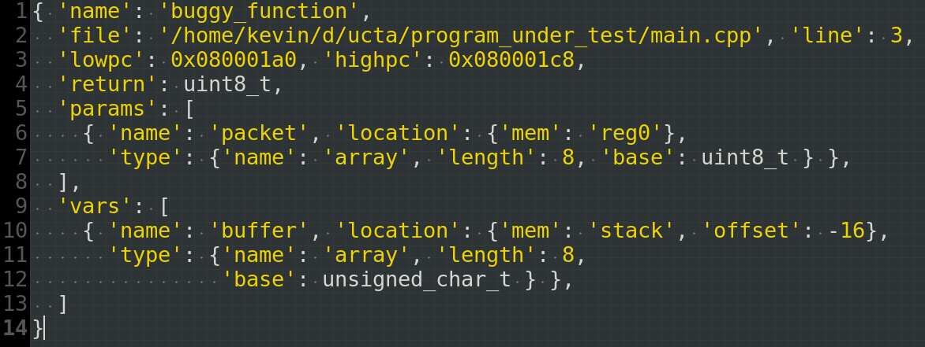
DWARF Debug Information

Slide 18
Address Loaded to Stack Pointer
0x080001a8 mov r0, sp
r0 <= ('buffer', 268438432, 268438440)
@ pc=0x080001a8

Slide 19
Address Decrement and Moved to r3
0x0800060a subs r3, r0, 1

Slide 20
Load from address and pre increment
0x08000616 strb r4, [r3, 1]!
r3 points to ('buffer', 268438432, 268438440)
→ check if r3 >= 268438432 and r3 < 268438440
When performing the store

Slide 21
Working
Simulation engine based on ESIL
Simulation can store meta data
Flexible and composable analysis passes
Return address overwrite analysis provides more information

Slide 22
Still Missing
Load DWARF debug information from file
Interrupt handling
Implement dynamic points to analysis
V(alid) bits for memcheck implementation
Test with larger code base

