Slide 1
Grey Box Fuzzing the IoT
Program Monitoring for Memory
and Power Constraint Embedded Devices
Kevin Läufer <laeufer@berkeley.edu>

Slide 2
Problems in Embedded Programming and Testing
No memory protection:
all processes can access all memory
hard to detect and contain failures
Still predominantly programmed in C
No logging, no automatic stack traces
Lacks tools for automated testing

Slide 3
Goal: Enable Fuzzing on Low Power Embedded Devices
How?

Slide 4
Fuzzing
Fuzzer
Program
Under Test
inputs
branch metric, error?

Slide 5
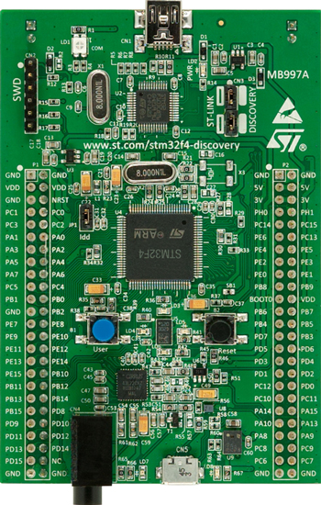
Fuzzing Embedded Devices
Fuzzer
???
Image Source: STMicroelectronics
???

Slide 6
Fuzzing Embedded Devices
Fuzzer
USB
???
Fuzz inputs
Execution Control
Image Source: STMicroelectronics
???
Execution Trace

Slide 7
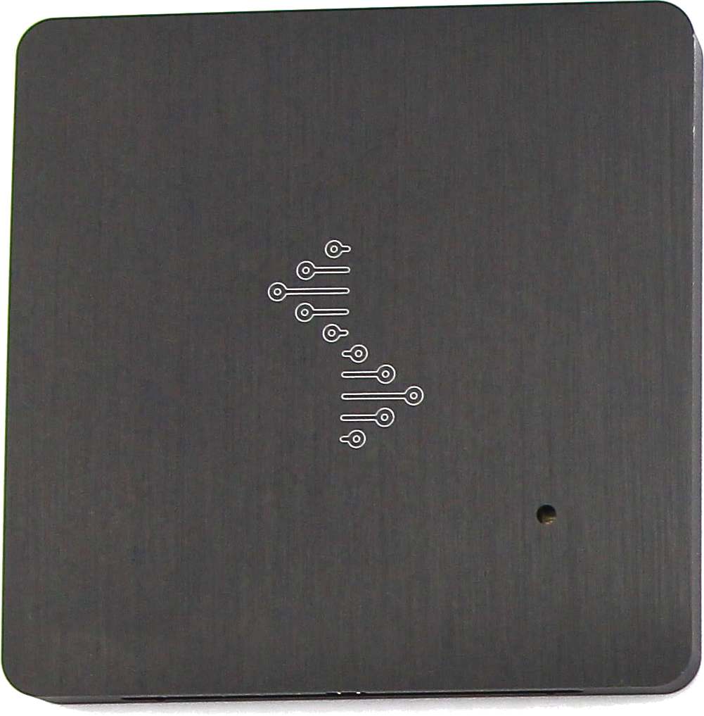
Fuzzing Embedded Devices
Fuzzer
USB
???
Fuzz inputs
Execution Control
Image Source: STMicroelectronics
USB
???
Execution Trace
Image Source: seeedstudio.com

Slide 8
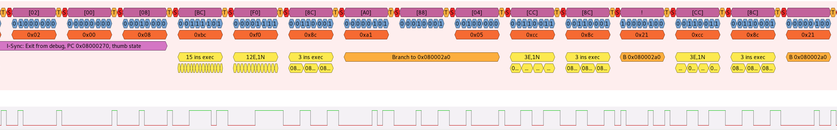
Fuzzing Embedded Devices
Instruction trace provides us with all program counter values, but no information about the memory state

Slide 9
Micro Controller Trace Analysis (UCTA)
UCTA
sim
Program Counter
Trace
radare2
.elf

Slide 10
Example: Stack Overflow
void buggy_function(const uint8_t* packet) {
char buffer[8];
const uint8_t length = packet[0];
std::memcpy(buffer, packet + 1, length);
}

Slide 11
Example: Stack Overflow
void buggy_function(const uint8_t* packet) {
char buffer[8];
const uint8_t length = packet[0];
std::memcpy(buffer, packet + 1, length);
}

Slide 12
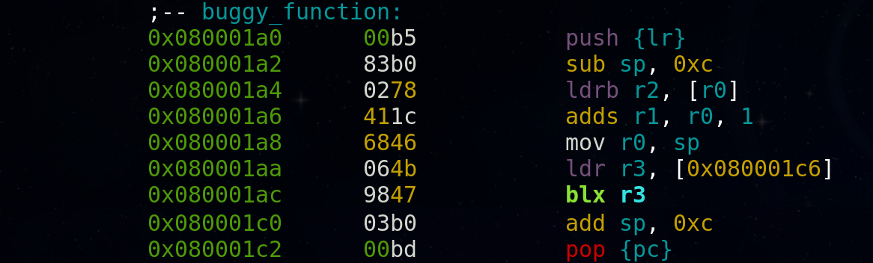
Example: Stack Overflow
void buggy_function(const uint8_t* packet) {
char buffer[8];
const uint8_t length = packet[0];
std::memcpy(buffer, packet + 1, length);
}

Slide 13
Example: Stack Overflow
return addr
[0x0c]
stack ptr
[0x0b]
….
[0x00]
void buggy_function(const uint8_t* packet) {
char buffer[8];
const uint8_t length = packet[0];
std::memcpy(buffer, packet + 1, length);
}

Slide 14
Example: Stack Overflow
return addr
[0x0c]
[0x0b]
….
[0x00]
stack ptr
void buggy_function(const uint8_t* packet) {
char buffer[8];
const uint8_t length = packet[0];
std::memcpy(buffer, packet + 1, length);
}

Slide 15
Example: Stack Overflow
return addr
[0x0c]
[0x0b]
….
[0x00]
stack ptr
void buggy_function(const uint8_t* packet) {
char buffer[8];
const uint8_t length = packet[0];
std::memcpy(buffer, packet + 1, length);
}

Slide 16
Example: Stack Overflow
return addr
[0x0c]
[0x0b]
….
[0x00]
stack ptr
void buggy_function(const uint8_t* packet) {
char buffer[8];
const uint8_t length = packet[0];
std::memcpy(buffer, packet + 1, length);
}

Slide 17
Example: Stack Overflow
return addr
[0x0c]
[0x0b]
….
[0x00]
stack ptr
void buggy_function(const uint8_t* packet) {
char buffer[8];
const uint8_t length = packet[0];
std::memcpy(buffer, packet + 1, length);
}
std::memcpy

Slide 18
Example: Stack Overflow
return addr
[0x0c]
stack ptr
[0x0b]
….
[0x00]
void buggy_function(const uint8_t* packet) {
char buffer[8];
const uint8_t length = packet[0];
std::memcpy(buffer, packet + 1, length);
}

Slide 19
Example: Stack Overflow
return addr
stack ptr
[0x0c]
[0x0b]
….
[0x00]
void buggy_function(const uint8_t* packet) {
char buffer[8];
const uint8_t length = packet[0];
std::memcpy(buffer, packet + 1, length);
}

Slide 20
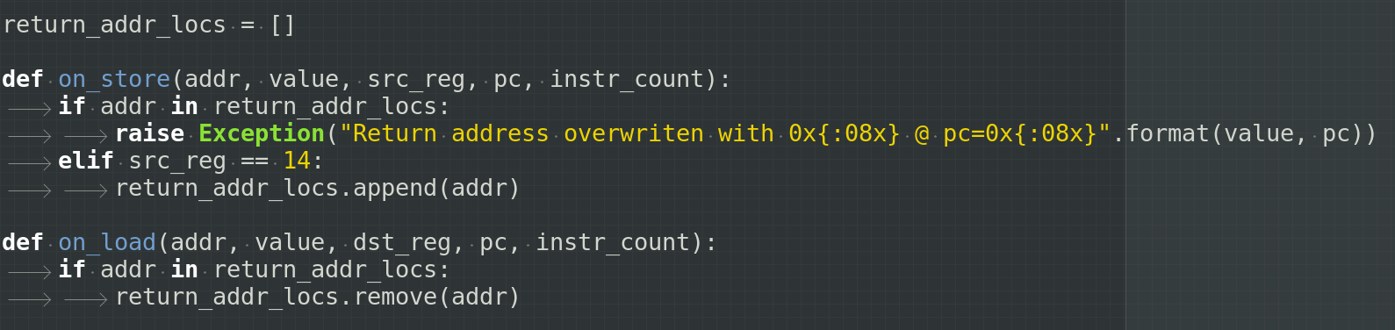
Example: Stack Overflow
write lr
unknown
valid
return
addr
error
write
read

Slide 21
Demo Time:
$ wc -l pc
$ ./sim.sh

Slide 22
Outlook
Scale up: add support for more instructions, interrupts and fix bugs
Automate trace analysis: this is required for automated fuzzing
Collect branch metrics
Implement more error detectors: stack overflow detector, detect out of bounds accesses, etc.

