Slide 1

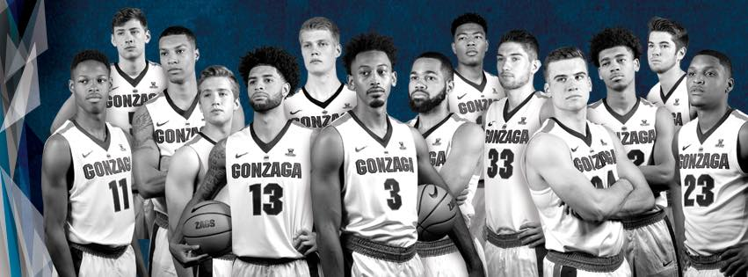

Gonzaga Men's Basketball Yahtzee
For fans ages 5 and up
Play
Leaderboard
Instructions

Slide 2
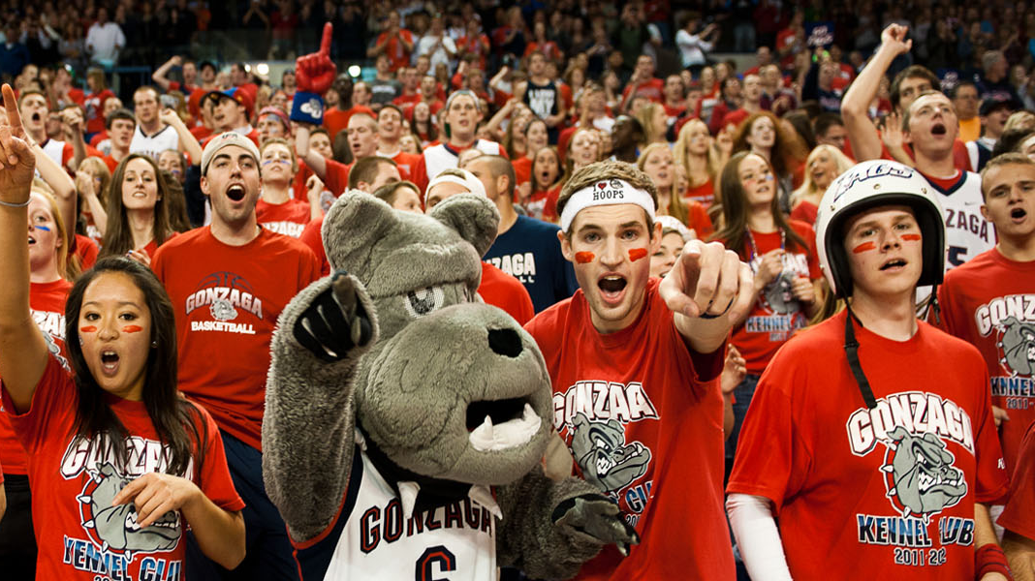
Leaderboard
#1 | Mark Few | 1,056 points
#2 | Adam Morrison | 894 points
#3 | Gary Bell Jr. | 741 points
Main Menu

Slide 3
Gonzaga Men's Basketball Yahtzee
For fans ages 5 and up
Play
Leaderboard
Instructions

Slide 4
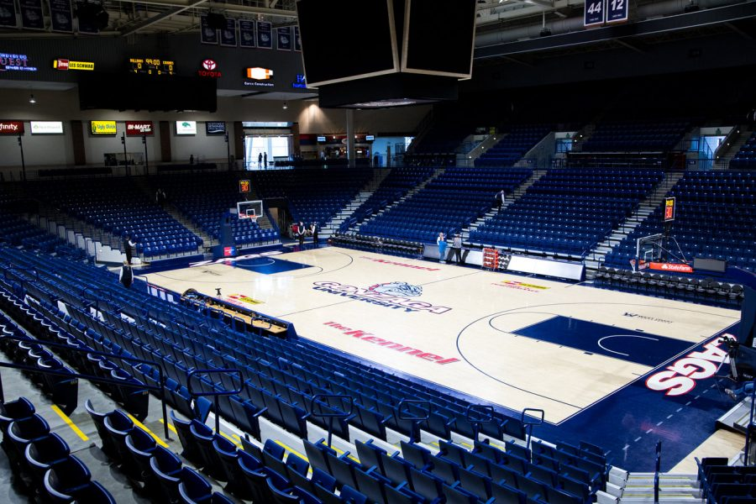
Instructions
Next
Main Menu

Slide 5
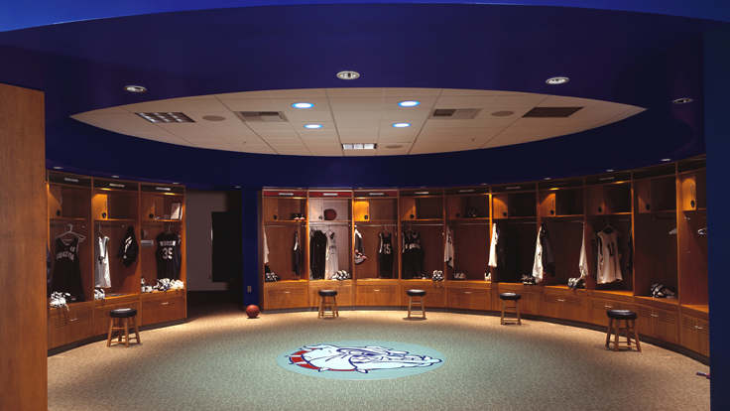
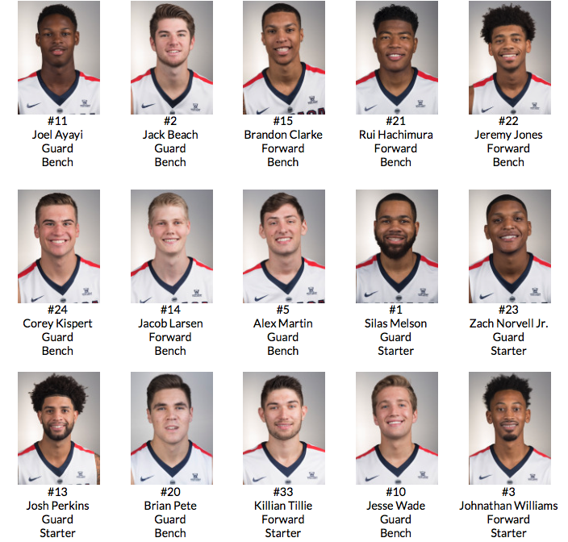
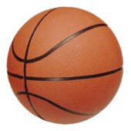
Dice
The game uses five, fifteen-sided dice.
The sides of each die represent the GU Men’s Basketball 2017-2018 Roster:
Next
Main Menu

Slide 6
How To Win
Roll dice 5 times to get the highest score after all 22 rounds.
Next
Main Menu

Slide 7
How To Play
To start, you will roll the dice by clicking Roll. After rolling you can either score the current roll on the scorecard or re-roll any or all of the dice*. You may only roll the dice a total of five times. After the fifth roll you must choose a category on the scorecard to score your hand in. You must choose a different category each time i.e., you can NOT score your hand in a category you have already scored.
To keep a die value enter ‘y’ in the same order that the die appeared. Enter ‘n’ to re-roll. For example, if the roll is Jones, Hachimura, Norvell, Tillie, Perkins to keep Jones, Norvell, and Tillie and re-roll the others you would enter: ‘ynyyn’.
*Note: For example, after the first roll you can keep 4 dice and re-roll the fifth die. Then you can choose to keep all of the die and end that round or keep the first 2 die and roll the next 3 and continue…
Next
Main Menu

Slide 8
Scoring
The scorecard is split into upper and lower sections.
Next
Main Menu

Slide 9
Upper Section
The upper section scores only the player used during that turn. Their score is based off their player number, for example, getting Johnathan Williams 3 times, and Jesse Wade 2 times, will score 9 points for the Williams section, and 20 for the Wade section.
Next
Main Menu

Slide 10
Lower Section
3 of a Zag
A player must have 3 of the same player in the hand.
The score is the value of all 5-dice added up.
4 of a Zag
A player must have 4 of the same player in the hand.
The score is the value of all 5-dice added up.
Full Team
A player must have 3 Guards and 2 Forwards to accomplish this score.
The score will be 25 points, regardless of the players number values.
The Bench Brigade
A player must have 5 players from the Bench to accomplish this score.
The score will be 30 points, regardless of players number values.
The Starters
A player must have all 5 Starters to accomplish this score.
The score will be 40 points, regardless of players’ number values.
The Kennel
No combos necessary. The score of this roll will be all the players’ \
numbers totaled together.
Zombie Nation
A player must have 5 of the same player to accomplish this score,
The score will be 100 points, regardless of players number values.
Next
Main Menu

Slide 11
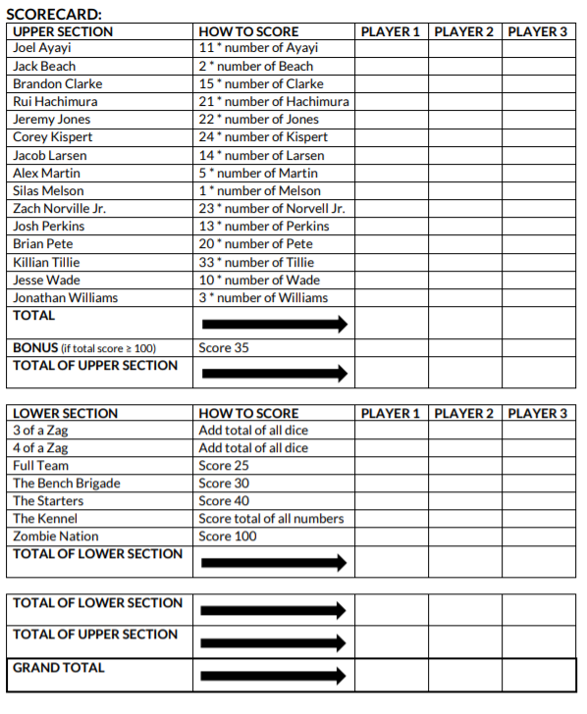
Scorecard
Main Menu

Slide 12
Gonzaga Men's Basketball Yahtzee
For fans ages 5 and up
Play
Leaderboard
Instructions

Slide 13
How many players?
1
2
3
4

Slide 14

Click the ball to roll

Slide 15
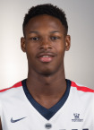
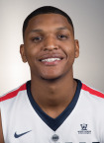
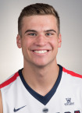
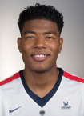
Select the players you wish to keep from the first roll:
Main Menu
Roll Again?
Finish turn

Slide 16
Select the players you wish to keep from the second roll:
Main Menu
Roll Again?
Finish turn

Slide 17
Select the players you wish to keep from the third roll:
Main Menu
Roll Again?
Finish turn

Slide 18
Select the players you wish to keep from the fourth roll:
Main Menu
Roll Again?
Finish turn

Slide 19
This is your final hand:
Main Menu
Finish turn

Slide 20
Player's Scorecard
Where would you like to score your hand?
User Input
84
23
107
107
107
End Game
Next Turn

