Slide 1
Concept learning
Maria Simi, 2011/2012
Machine Learning, Tom Mitchell
Mc Graw-Hill International Editions, 1997
(Cap 1, 2).
Notes:
1

Slide 2
Concept Learning
The problem of inducing general functions from specific training examples is central to learning.
Concept learning: Acquiring the definition of a general category given a sample of positive and negative training examples of the category.
This can be formulated as a problem of searching through a predefined space of potential hypotheses for the hypothesis that best fits the training examples.
This search can be done by general -to-specific ordering of hypotheses.

Slide 3
Concept Learning
Each concept can be thought of as a boolean-valued function defined over this larger set.
Concept learning. Inferring a boolean-valued function from training examples of its input and output.

Slide 4
A CONCEPT LEARNING TASK
Consider the example task of learning the target concept "days on which my friend Aldo enjoys his favorite water sport."
Table 2.1 describes a set of example days, each represented by a set of attributes.
The attribute EnjoySport indicates whether or not Aldo enjoys his favorite water sport on this day.
The task is to learn to predict the value of EnjoySport for an arbitrary day, based on the values of its other attributes.

Slide 5
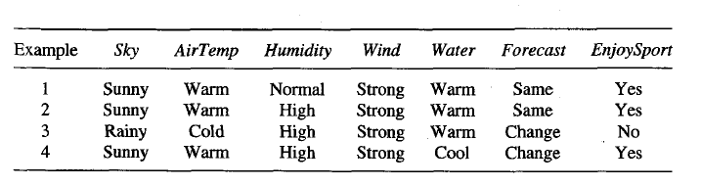

Slide 6
A CONCEPT LEARNING TASK
A simple representation is in which each hypothesis consists of a conjunction of constraints on the instance attributes.
For our example hypothesis be a vector of six constraints.
For each attribute, the hypothesis will either
indicate by a "?' that any value is acceptable for this attribute,
specify a single required value (e.g., Warm) for the attribute, or
indicate by a "Ø" that no value is acceptable.

Slide 7
Example hypothesis is Aldo enjoys his favorite sport only on cold days with high humidity (?, Cold, High, ?, ?, ?).
some instance x satisfies an hypothesis h iff all the constraints expressed by h are satisfied by the attribute values in x.
The most general Hypothesis—That every day is a positive example is represented as
Most general hypothesis: 〈?, ?, ?, ?, ?, ?〉
Most specific hypothesis: That no day is a positive example is represented as
〈Ø, Ø, Ø, Ø, Ø, Ø〉

Slide 8
Notation
The set of items over which the concept is defined
is called the set of instances, which we denote by X.
In the current example, X is the set of all possible days, each represented by the attributes Sky, AirTemp,Humidity, Wind, Water, and Forecast.
The concept or function to be learned is called the target concept, which we denote by c.
In general, c can be any boolean valued function defined over the instances X; that is,
c : X -> {O, 1).
Ex: c(x) = 1 if EnjoySport = Yes,
and c(x) = 0 if EnjoySport = No

Slide 9
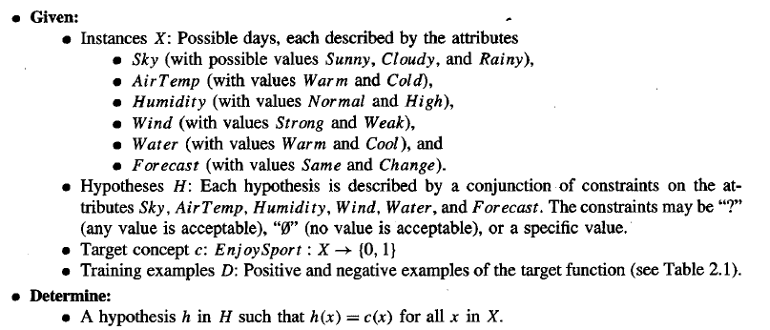
H denote the set of all possible Hypotheses: The goal of the learner is to find a hypothesis h in H such that h(x)=c(x) for all x in X

Slide 10
The Inductive Learning Hypothesis
Inductive learning algorithms can at best guarantee that the output hypothesis fits the target concept over the training data.
The inductive learning hypothesis. Any hypothesis found to approximate the target function well over a sufficiently large set of training examples will also approximate the target function well over other unobserved examples
i.e. given a significant training set, the output hypothesis is able to make predictions

Slide 11
Concept learning as search
Concept learning can be viewed as the task of searching through a large space of hypotheses with a goal to find the hypothesis that best fits the training examples.
The representation chosen for hypotheses determines the search space.
By selecting a hypothesis representation, the designer of the learning algorithm implicitly defines the space of all hypotheses that the program can ever represent and therefore can ever learn
Notes:
11
|H| sono tutte le possibile ennuple senza il valore 0 (escludiamo ennuple che non sono mai soddisfatte) più la ennupla con tutti 0

Slide 12
In the EnjoySport game consider the instances X and Hypotheses H
In the enjoy sport example we have:
3 x 2⁵ = 96 possible instances (6 attributes)
5 x 4⁵= 5120 syntactically distinct hypotheses
1 + 4 x 3⁵= 973 semantically distinct hypotheses considering that all the hypothesis with some ∅ are semantically equivalent hypotheses.
Structuring the search space may help in searching more efficiently.
Most practical learning tasks involve much larger, sometimes
infinite, hypothesis spaces.

Slide 13
General to specific ordering
Many algorithms for concept learning organize the search through the hypothesis space by relying on a very useful structure that exists for any concept learning problem: a general-to-specific ordering of hypotheses.
By taking this structure we can design learning algorithms that exhaustively search even infinite hypothesis spaces without explicitly enumerating every hypothesis
Consider:
h₁ = 〈Sunny, ?, ?, Strong, ?, ?〉
h₂ = 〈Sunny, ?, ?, ?, ?, ?〉
Now consider the sets of instances that are classified positive by h1 and by h2.

Slide 14
General to specific ordering
Any instance classified positive by h₁ will also be classified positive by h₂
h₂ is more general than h₁
Given hypotheses hj and hk, hj is more_general_than_or_equal_to hk if and only if any instance that satisfies hk also satisfies hj.
Definition: h_{j} ≥_{g} h_{k} iff (∀x ∈ X ) [(h_{k} (x)= 1) → (h_{j} (x)= 1)]
≥_{g} more general or equal; >_{g} strictly more general
Most general hypothesis: 〈?, ?, ?, ?, ?, ?〉
Most specific hypothesis: 〈Ø, Ø, Ø, Ø, Ø, Ø〉
Notes:
14

Slide 15

consider cases where one hypothesis is strictly more
general than the other.
Therefore, we will say that hj is (strictly) more_general_than hk (written hj >g hk) if and only
We will sometimes find the inverse useful and will say that hj is more_specific_than hk when hk is more_general_than hj.
Example:consider the three hypotheses hl, h2, and
h3 from our Enjoysport example
How are these three hypotheses related by the >=g relation

Slide 16
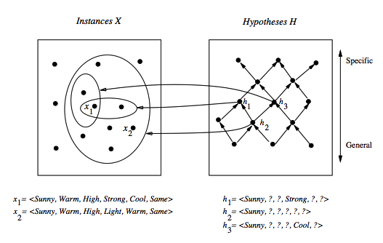
General to specific ordering: induced structure
Notes:
16
Partial order: reflexive, anti--symmetric, transitive.

Slide 17
As noted earlier, hypothesis h2 is more general than h1 because every instance that satisfies h1 also satisfies h2. Similarly, h2 is more general than h3.
Note that neither h1 nor h3 is more general than the other; although the instances satisfied by these two hypotheses intersect.
Formally, the >=g, relation defines a partial order over the hypothesis space H
The >=g relation is important because it provides a useful structure over the hypothesis space H for any concept learning problem

Slide 18
Find-S: finding the maximally specific hypothesis
Exploiting the structure we have alternatives to enumeration …
Initialize h to the most specific hypothesis in H
For each positive training instance:
for each attribute constraint a in h:
If the constraint a is satisfied by x then do nothing
else replace a in h by the next more general constraint satsified by x (move towards a more general hp)
Output hypothesis h
Notes:
18

Slide 19

Begin with the most specific possible hypothesis in H, then generalize this hypothesis each time it fails to cover an observed positive training example.
The learner is given the sequence of training examples from Table 2.1 for the EnjoySport task
The first step of FINDS is to initialize h to the most specific hypothesis in H
Upon observing the first training examplewhich happens to be a positive example, it becomes clear that our hypothesis is too specific

Slide 20


So each is replaced by the next more general constraint that fits the example.
Next, the second training example (also positive in this case) forces the algorithm to further generalize h.
This time substituting a "?' in place of any attribute value in h that is not satisfied by the new example.
Upon encountering the third training example-in this case a negative example- the algorithm makes no change to h

Slide 21

The fourth (positive) example leads to a
further generalization of h
The FIND-S algorithm illustrates one way in which the more-general_than partial ordering can be used to organize the search for an acceptable hypothesis.
The search moves from hypothesis to hypothesis, searching from the most specific to progressively more general hypotheses along one chain of the partial ordering.

Slide 22
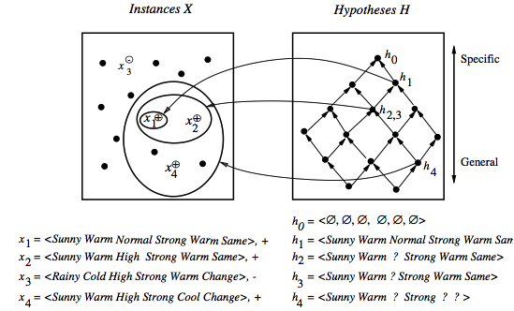
Find-S in action
Notes:
22

Slide 23
Properties of Find-S
Find-S is guaranteed to output the most specific hypothesis within H that is consistent with the positive training examples
The final hypothesis will also be consistent with the negative examples
Problems:
There can be more than one “most specific hypotheses”
We cannot say if the learner converged to the correct target
Why choose the most specific?
If the training examples are inconsistent, the algorithm can be mislead: no tolerance to rumor.
Negative example are not considered
Notes:
23

Slide 24
Candidate elimination algorithm: the idea
The idea: output a description of the set of all hypotheses consistent with the training examples (correctly classify training examples).
Version space: a representation of the set of hypotheses which are consistent with D
an explicit list of hypotheses (List-Then-Eliminate)
a compact representation of hypotheses which exploits the more_general_than partial ordering (Candidate-Elimination)
Notes:
24

Slide 25
Version space
The version space VS_{H,D} is the subset of the hypothesis from H consistent with the training example in D
VS_{H,D} ≡{h ∈ H | Consistent(h, D)}
An hypothesis h is consistent with a set of training examples D iff h(x) = c(x) for each example in D
Consistent(h, D) ≡ (∀ 〈x, c(x)〉 ∈ D) h(x) = c(x))
Note: "x satisfies h" (h(x)=1) different from “h consistent with x"
In particular when an hypothesis h is consistent with a negative example d =〈x, c(x)=No〉, then x must not satisfy h
Notes:
25
Consistente significa essere in accordo con la funzione target (un ipotesi è consistente ocn un esempio di apprendimento quando h(x) = c(x)
Un esempio soddisfa una ipotesi quando è un esempio positivo secondo l’ ipotesi (h(x) = 1).

Slide 26
The List-Then-Eliminate algorithm
Version space as list of hypotheses
VersionSpace ← a list containing every hypothesis in H
For each training example, 〈x, c(x)〉
Remove from VersionSpace any hypothesis h for which h(x) ≠ c(x)
Output the list of hypotheses in VersionSpace
Problems
The hypothesis space must be finite
Enumeration of all the hypothesis, rather inefficient
Notes:
26

Slide 27
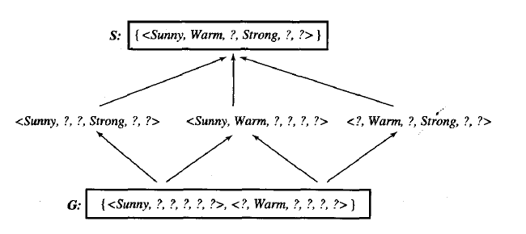
A compact representation for Version Space
Note: The output of Find-S is just 〈Sunny, Warm, ?, Strong, ?, ?〉
Version space represented by its most general members G and its most specific members S (boundaries)
Notes:
27

Slide 28

A compact representation for Version Space
The version space is represented by its most general and least general members.
These members form general and specific boundary sets that delimit the version space within the partially ordered hypothesis space.
To illustrate this representation for version spaces, consider again the Enjoysport concept learning problem
given the four training examples FIND-S outputs the hypothesis
This is just one of six different hypotheses from H that are consistent with these training examples

Slide 29
A compact representation for Version Space
They constitute the version space relative to this set of data and this hypothesis representation.
The arrows among these six hypotheses indicate instances of the more-general_than relation.
The CANDIDATE-ELIMINATlON algorithm represents the version space by storing only its most general members G and its most specific S.
Given S,G it is possible to enumerate all members of the version space as needed by generating the hypotheses.

Slide 30
General and specific boundaries
The Specific boundary, S, of version space VS_{H,D} is the set of its minimally general (most specific) members
S ≡{s ∈ H | Consistent(s, D)∧(¬∃s' ∈ H)[(s >_{g}s') ∧ Consistent(s', D)]}
Note: any member of S is satisfied by all positive examples, but more specific hypotheses fail to capture some
The General boundary, G, of version space VS_{H,D} is the set of its maximally general members
G ≡{g ∈ H | Consistent(g, D)∧(¬∃g' ∈ H)[(g' >_{g} g) ∧ Consistent(g', D)]}
Note: any member of G is satisfied by no negative example but more general hypothesis cover some negative example
Notes:
30
In S troviamo le ipotesi più specifiche che coprono tutti gli esempi positivi; se specializzassimo ulteriormente qualche esempi positivo non sarebbe coperto.
In G troviamo il massimo della generalizzazione possibile che non copre alcun esempio negativo.

Slide 31
Version Space representation theorem
G and S completely define the Version Space
Theorem: Every member of the version space (h consistent with D) is in S or G or lies between these boundaries
VS_{H,D}={h ∈ H |(∃s ∈ S) (∃g ∈ G) (g ≥_{g} h ≥_{g} s)}
where x ≥_{g} y means x is more general or equal to y
Sketch of proof:
⇐ If g ≥_{g} h ≥_{g} s, since s is in S and h ≥_{g} s, h is satisfied by all positive examples in D; g is in G and g ≥_{g} h, then h is satisfied by no negative examples in D; therefore h belongs to VS_{H,D}
⇒ It can be proved by assuming a consistent h that does not satisfy the right-hand side and by showing that this would lead to a contradiction
Notes:
31
Supponiamo che h sia consistente con tutti gli esempi in D (+ e -) ma non sia g >= h >= s, con s in S e g in G.
h dovrebbe cadere al di fuori del reticolo e quindi essere
più specifico di qualche s in S, contro l’ ipotesi che non si possano restringere ulteriormente le ipotesi senza escludere qualche esempio positivo
più generale di qualche ipotesi in g, contro l’ ipotesi che non si possano generalizzare ipotesi senza coprire qualche esempio negativo.
o più generale qualche g in G

Slide 32


Candidate elimination Learning algorithm
The CANDIDATE-ELIMINATiON algorithm computes the version space containing all hypotheses from H that are consistent with an observed sequence of training
examples.
initializing the version space to the set of all hypotheses in H
Each training example is considered, the S and G boundary sets are generalized and specialized, respectively.
After all examples have been processed, the computed version space contains all the hypotheses consistent with these examples and only these hypotheses

Slide 33
Candidate elimination algorithm-1
S ← minimally general hypotheses in H,
G ← maximally general hypotheses in H
Initially any hypothesis is still possible
S₀ = 〈∅, ∅, ∅, ∅, ∅, ∅〉 G₀ = 〈?, ?, ?, ?, ?, ?〉
For each training example d, do:
If d is a positive example:
Remove from G any h inconsistent with d
Generalize(S, d)
If d is a negative example:
Remove from S any h inconsistent with d
Specialize(G, d)
Note: when d =〈x, No〉 is a negative example, an hypothesis h is inconsistent with d iff h satisfies x
Notes:
33

Slide 34
Candidate elimination algorithm-2
Generalize(S, d): d is positive
For each hypothesis s in S not consistent with d:
Remove s from S
Add to S all minimal generalizations of s consistent with d and having a generalization in G
Remove from S any hypothesis with a more specific h in S
Specialize(G, d): d is negative
For each hypothesis g in G not consistent with d: i.e. g satisfies d, but d is negative
Remove g from G
Add to G all minimal specializations of g consistent with d and having a specialization in S
Remove from G any hypothesis having a more general hypothesis in G
Notes:
34

Slide 35
Example: initially
S₀:
〈∅, ∅, ∅, ∅, ∅. ∅〉
G₀
〈?, ?, ?, ?, ?, ?〉
Notes:
35

Slide 36
Example: after seeing 〈Sunny,Warm, Normal, Strong, Warm, Same 〉 +
S₀:
〈∅, ∅, ∅, ∅, ∅. ∅〉
S₁:
〈Sunny,Warm, Normal, Strong, Warm, Same〉
G₀, G₁
〈?, ?, ?, ?, ?, ?〉
Notes:
36

Slide 37
Example: after seeing <Sunny,Warm, High, Strong, Warm, Same〉+
S₁:
〈Sunny,Warm, Normal, Strong, Warm, Same〉
S₂:
〈Sunny,Warm, ?, Strong, Warm, Same〉
G₁, G₂
〈?, ?, ?, ?, ?, ?〉
Notes:
37

Slide 38
Example: after seeing 〈Rainy, Cold, High, Strong, Warm, Change 〉−
S_{2,} S₃:
〈Sunny, Warm, ?, Strong, Warm, Same〉
G₃:
〈Sunny, ?, ?, ?, ?, ?〉 〈?, Warm, ?, ?, ?, ?〉 〈?, ?, ?, ?, ?, Same〉
G₂:
〈?, ?, ?, ?, ?, ?〉
Notes:
38

Slide 39
Example
This negative example reveals that the G boundary of the version space is overly general
The hypothesis in the G boundary must therefore
be specialized until it correctly classifies this new negative example
Given that there are six attributes that could be specified to specialize G2, why are there only three new hypotheses in G3?
The hypothesis h = (?, ?, Normal, ?, ?, ?) is a minimal specialization of G2 that correctly labels the new example as a negative example.

Slide 40
Example
It is not included in G3 as it is inconsistent with the previously
encountered positive examples.
The S boundary of the version space forms a summary of the previously encountered positive examples
The G boundary summarizes the information from previously encountered negative examples

Slide 41
Example: after seeing 〈Sunny, Warm, High, Strong, Cool, Change 〉 +
S₃
〈Sunny, Warm, ?, Strong, Warm, Same〉
S₄
〈Sunny, Warm, ?, Strong, ?, ?〉
G₄:
〈Sunny, ?, ?, ?, ?, ?〉 〈?, Warm, ?, ?, ?, ?〉
G₃:
〈Sunny, ?, ?, ?, ?, ?〉 〈?, Warm, ?, ?, ?, ?〉 〈?, ?, ?, ?, ?, Same〉
Notes:
41

Slide 42
Example
The fourth training example further generalizes the
S boundary of the version space
It also results in removing one member of the G
boundary, because this member fails to cover the new positive example.
This learned version space is independent of the sequence in which the training examples are presented
As further training data is encountered, the S and G boundaries will move monotonically closer to each other, delimiting a smaller and smaller version space of candidate hypotheses.

Slide 43
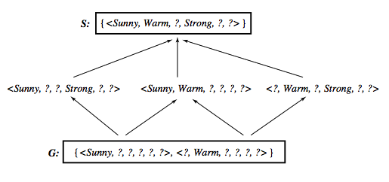
Learned Version Space
Notes:
43

Slide 44
Observations
The learned Version Space correctly describes the target concept, provided:
There are no errors in the training examples
There is some hypothesis that correctly describes the target concept
If S and G converge to a single hypothesis the concept is exactly learned
In case of errors in the training, useful hypothesis are discarded, no recovery possible
An empty version space means no hypothesis in H is consistent with training examples
Notes:
44

Slide 45
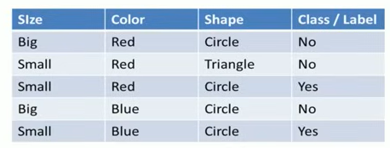

Slide 46
Ordering on training examples
The learned version space does not change with different orderings of training examples
Efficiency does
Learner is allowed to choose the next instance :
Generate instances that satisfy half the hypotheses in the current version space. For example:
〈Sunny, Warm, Normal, Light, Warm, Same〉 satisfies 3/6 hyp.
If the trainer classifies this as positive then S can be generalized otherwise G can be specialized.
Notes:
46

Slide 47
Ideally the VS can be reduced by half at each experiment
Correct target found in ⎡log₂|VS|⎤ experiments.
In general it may not be possible to construct an instance that matches precisely half the hypotheses.
In such cases, a larger number of queries may be required than ⎡log₂|VS|⎤ .

Slide 48
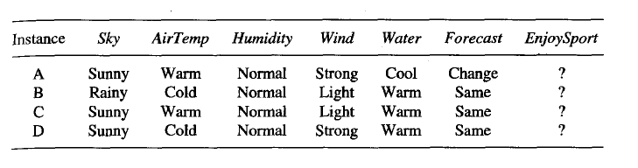
Use of partially learned concepts

Slide 49
Use of partially learned concepts
Classified as positive by all hypothesis, since satisfies any hypothesis in S
Notes:
49

Slide 50
Classifying new examples
Classified as negative by all hypothesis, since does not satisfy any hypothesis in G
Notes:
50

Slide 51
Classifying new examples
Uncertain classification: half hypothesis are consistent, half are not consistent
Notes:
51

Slide 52
Classifying new examples
〈Sunny, Cold, Normal, Strong, Warm, Same〉
4 hypothesis not satisfied; 2 satisfied
Probably a negative instance. Majority vote?
Notes:
52

Slide 53
Hypothesis space and bias
What if H does not contain the target concept?
Can we improve the situation by extending the hypothesis space?
Will this influence the ability to generalize?
These are general questions for inductive inference, addressed in the context of Candidate-Elimination
Suppose we include in H every possible hypothesis … including the ability to represent disjunctive concepts

Slide 54
Extending the hypothesis space
 | Sky | AirTemp | Humidity | Wind | Water | Forecast | EnjoyS
1 | Sunny | Warm | Normal | Strong | Cool | Change | YES
2 | Cloudy | Warm | Normal | Strong | Cool | Change | YES
3 | Rainy | Warm | Normal | Strong | Cool | Change | NO
No hypothesis consistent with the three examples with the assumption that the target is a conjunction of constraints
〈?, Warm, Normal, Strong, Cool, Change〉 is too general
Target concept exists in a different space H', including disjunction and in particular the hypothesis
Sky=Sunny or Sky=Cloudy
Notes:
54

Slide 55
An unbiased learner
The obvious solution is is to provide a hypothesis space capable of representing every teachable concept; that is, it is capable of representing every possible subset of the instances X.
In the EnjoySport learning task, for example, the size of the instance space X of days described by the six available attributes is 96
The number of distinct subsets that can be defined
over a set X containing 2 to the power of 1x1 element

Slide 56
An unbiased learner
Every possible subset of X is a possible target
|H'| = 2^{|X|}, or 2⁹⁶ (vs |H| = 973, a strong bias)
This amounts to allowing conjunction, disjunction and negation
〈Sunny, ?, ?, ?, ?, ?〉 V <Cloudy, ?, ?, ?, ?, ?〉
Sunny(Sky) V Cloudy(Sky)
We are guaranteed that the target concept exists
No generalization beyond the training examples is however possible!!!
Let's see why …
Notes:
56

Slide 57
No generalization without bias!
VS after presenting three positive instances x₁, x₂, x₃, and two negative instances x₄, x₅
S = {(x₁ v x₂ v x₃)}
G = {¬(x₄ v x₅)}
… all subsets including x₁ x₂ x₃ and not including x₄ x₅
We can only classify precisely examples already seen!
In order to converge to a single final target concept we have to present every instance of X.
We can avoid this difficulty by using using the partially learned version space and by taking a vote
Notes:
57

Slide 58
An unbiased learner
Take a majority vote?
Unseen instances, e.g. x, are classified positive (and negative) by half of the hypothesis
This is because for any hypothesis h that classifies x as positive, there is a complementary hypothesis ¬h that classifies x as negative

Slide 59
No inductive inference without a bias
A learner that makes no a priori assumptions regarding the identity of the target concept, has no rational basis for classifying unseen instances.
The CANDIDATE-ELIMINATION algorithm was able to generalize beyond the observed training examples in our original formulation as it was biased by the implicit assumption that the target concept could be represented by a conjunction of attribute values.
If this assumption is incorrect, however, it is certain that the CANDIDATE-ELIMINATION algorithm will rnisclassify at least some instances from X.
Notes:
59

Slide 60
The inductive bias of a learner are the assumptions that justify its inductive conclusions or the policy adopted for generalization
Different learners can be characterized by their bias
See next for a more formal definition of inductive bias …

Slide 61
Inductive bias: definition
Given:
a concept learning algorithm L for a set of instances X
a concept c defined over X
a set of training examples for c: D_{c} = {〈x, c(x)〉}
L(x_{i} , D_{c}) outcome of classification of x_{i} after learning
Inductive inference ( ≻ ):
D_{c} ∧ x_{i} ≻ L(x_{i}, D_{c})
The inductive bias is defined as a minimal set of assumptions B, such that (|− for deduction)
∀ (x_{i} ∈ X) [ (B ∧ D_{c} ∧ x_{i}) |− L(x_{i}, D_{c}) ]
Notes:
61

Slide 62
Inductive bias of Candidate-Elimination
Assume L is defined as follows:
compute VS_{H,D}
classify new instance by complete agreement of all the hypotheses in VS_{H,D}
Then the inductive bias of Candidate-Elimination is simply
B ≡ (c ∈ H)
In fact by assuming c ∈ H:
c ∈ VS_{H,D} , in fact VS_{H,D} includes all hypotheses in H consistent with D
L(x_{i}, D_{c}) outputs a classification "by complete agreement", hence any hypothesis, including c, outputs L(x_{i}, D_{c})

Slide 63
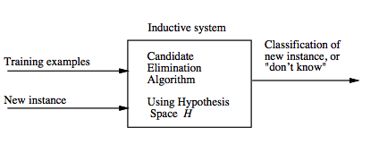
Inductive system
Notes:
63

Slide 64
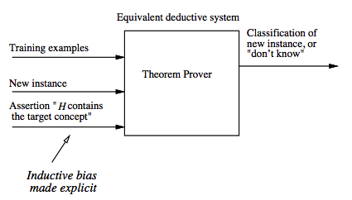
Equivalent deductive system
Notes:
64

Slide 65
One advantage of viewing inductive inference systems in terms of their inductive bias is that it provides a nonprocedural means of characterizing their policy for generalizing beyond the observed data.
A second advantage is that it allows comparison of different learners according to the strength of the inductive bias they employ

Slide 66
Each learner has an inductive bias
Three learner with three different inductive bias:
Rote learner: no inductive bias, just stores examples and is able to classify only previously observed examples
Candidate Elimination: the concept is a conjunction of constraints.
Find-S: the concept is in H (a conjunction of constraints) plus "all instances are negative unless seen as positive examples” (stronger bias)
The stronger the bias, greater the ability to generalize and classify new instances (greater inductive leaps).
Notes:
66

Slide 67
Bibliography
Machine Learning, Tom Mitchell, Mc Graw-Hill International Editions, 1997 (Cap 2).
Notes:
67

