Slide 1
Machine Learning: Lecture 1
Overview of Machine Learning
(Based on Chapter 1 of Mitchell T.., Machine Learning, 1997)
1
Notes:
1

Slide 2
What is Machine Learning
Machine learning is a subfield of computer science that is concerned with building algorithms that rely on a collection of examples of some phenomenon.
These examples can come from nature, be handcrafted by humans or generated by another algorithm.
It is defined as the process of solving a practical problem by
1) gathering a dataset,
2) algorithmically building a statistical model based on that dataset.
Machine Learning can be supervised, semi-supervised ,unsupervised and reinforcement.
2

Slide 3
What is Machine Learning
Supervised Learning: The goal of a supervised learning algorithm is to use the dataset to produce a model that takes a feature vector x as input and outputs information that allows deducing the label for this feature vector.
Ex: Based on a model we can find the probability that a person has a cancer
Unsupervised Learning:The goal of an unsupervised learning algorithm is to create a model that takes a feature vector x as input and either transforms it into another vector or into a value that can be used to solve a practical problem.
Ex: The model returns the id of the cluster for each feature vector in the dataset
3

Slide 4
Semi-Supervised Learning: The goal of a semi-supervised learning algorithm is the same as the goal of the supervised learning algorithm. The hope here is that using many unlabeled examples can help the learning algorithm to find a better model.
Reinforcement learning: The goal of a reinforcement learning algorithm is to learn a policy. A policy is a function f (similar to the model in supervised learning) that takes the feature vector of a state as input and outputs an optimal action to execute in that state.
Ex: game playing, robotics, resource management, or logistics.
4

Slide 5
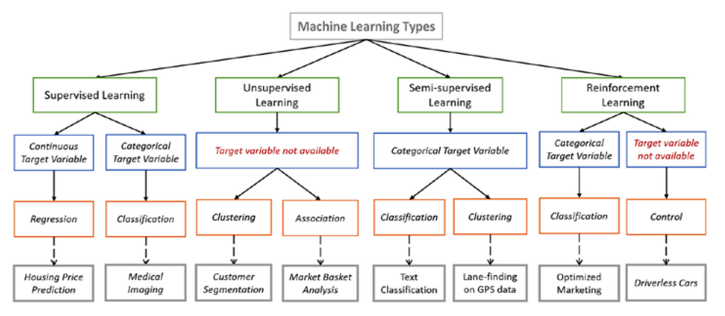

Slide 6
Data mining vs Machine Learning
Similarities
Both are analytics processes.
Both are good at pattern recognition.
Both are about learning from data so that we can improve decision making.
Both require large amount of data to be accurate.
6

Slide 7
Differences
 | Data Mining | Machine Learning
Meaning | Extracting knowledge from a large amount of data | Introduce a new algorithm from data as well as past experience
Responsibility | Data mining is used to get the rules from the existing data. | Machine learning teaches the computer to learn and understand the given rules.

Slide 8
Differences
Scope | Applied in the limited area | Can be used in a vast area.
Techniques Involved | Data mining is more of research using methods like machine learning | Self-learned and trains system to do the intelligent task.
Nature | Involves human interference more towards manual. | Automated, once design self-implemented, no human effort

Slide 9
Machine Learning: A Definition
Definition: A computer program is said to learn from experience E with respect to some class of tasks T and performance measure P, if its performance at tasks in T, as measured by P, improves with experience E.
9

Slide 10
Examples of Successful Applications of Machine Learning
Learning to recognize spoken words (Lee, 1989; Waibel, 1989).
Learning to drive an autonomous vehicle (Pomerleau, 1989).
Learning to classify new astronomical structures (Fayyad et al., 1995).
Learning to play world-class backgammon (Tesauro 1992, 1995).
10

Slide 11
Why is Machine Learning Important?
Some tasks cannot be defined well, except by examples (e.g., recognizing people).
Relationships and correlations can be hidden within large amounts of data. Machine Learning/Data Mining may be able to find these relationships.
Human designers often produce machines that do not work as well as desired in the environments in which they are used.
11

Slide 12
Why is Machine Learning Important (Cont’d)?
The amount of knowledge available about certain tasks might be too large for explicit encoding by humans (e.g., medical diagnostic).
Environments change over time.
New knowledge about tasks is constantly being discovered by humans. It may be difficult to continuously re-design systems “by hand”.
12

Slide 13
Machine Learning lifecycle:
The lifecycle of a machine learning project involves a series of steps that include:
Study the Problems: The first step is to study the problem. This step involves understanding the business problem and defining the objectives of the model.
Data Collection: When the problem is well-defined, we can collect the relevant data required for the model. The data could come from various sources such as databases, APIs, or web scraping.
Data Preparation: When our problem-related data is collected. then it is a good idea to check the data properly and make it in the desired format so that it can be used by the model to find the hidden patterns. This can be done in the following steps:
Data cleaning
Data Transformation
Explanatory Data Analysis and Feature Engineering
Split the dataset for training and testing.
Model Selection: The next step is to select the appropriate machine learning algorithm that is suitable for our problem. This step requires knowledge of the strengths and weaknesses of different algorithms. Sometimes we use multiple models and compare their results and select the best model as per our requirements.

Slide 14
Model building and Training: After selecting the algorithm, we have to build the model.
In the case of traditional machine learning building mode is easy it is just a few hyperparameter tunings.
In the case of deep learning, we have to define layer-wise architecture along with input and output size, number of nodes in each layer, loss function, gradient descent optimizer, etc.
After that model is trained using the preprocessed dataset.
Model Evaluation: Once the model is trained, it can be evaluated on the test dataset to determine its accuracy and performance using different techniques like classification report, F1 score, precision, recall, ROC Curve, Mean Square error, absolute error, etc.
Model Tuning: Based on the evaluation results, the model may need to be tuned or optimized to improve its performance. This involves tweaking the hyperparameters of the model.
Deployment: Once the model is trained and tuned, it can be deployed in a production environment to make predictions on new data. This step requires integrating the model into an existing software system or creating a new system for the model.
Monitoring and Maintenance: Finally, it is essential to monitor the model’s performance in the production environment and perform maintenance tasks as required. This involves monitoring for data drift, retraining the model as needed, and updating the model as new data becomes available.

Slide 15
Areas of Influence for Machine Learning
Statistics: How best to use samples drawn from unknown probability distributions to help decide from which distribution some new sample is drawn?
Brain Models: Non-linear elements with weighted inputs (Artificial Neural Networks) have been suggested as simple models of biological neurons.
Adaptive Control Theory: How to deal with controlling a process having unknown parameters that must be estimated during operation?
15

Slide 16
Areas of Influence for Machine Learning (Cont’d)
Psychology: How to model human performance on various learning tasks?
Artificial Intelligence: How to write algorithms to acquire the knowledge humans are able to acquire, at least, as well as humans?
Evolutionary Models: How to model certain aspects of biological evolution to improve the performance of computer programs?
16

Slide 17
In general, to have a well-defined learning problem, we must identity these three features:
the class of tasks,
the measure of performance to be improved, and
the source of experience.
Example:
A checkers learning problem:
Task T: playing checkers
Performance measure P: percent of games won against opponents
Training experience E: playing practice games against itself

Slide 18
Designing a Learning System: An Example
1. Problem Description
2. Choosing the Training Experience
3. Choosing the Target Function
4. Choosing a Representation for the Target Function
5. Choosing a Function Approximation Algorithm
6. Final Design
18

Slide 19
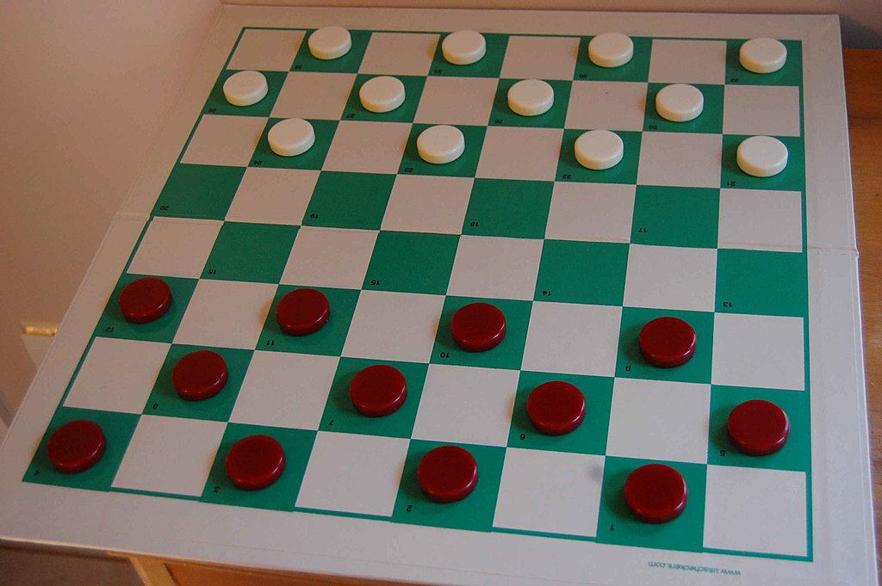

Slide 20
1. Problem Description: A Checker Learning Problem
Task T: Playing Checkers
Performance Measure P: Percent of games won against opponents
Training Experience E: To be selected ==> Games Played against itself
20

Slide 21
2.Choose the Training Experience
The type of training experience available can have a significant impact on success or failure of the learner.
One key attribute is whether the training experience provides direct or indirect feedback regarding the choices made by the performance system.
In this later case, information about the correctness of specific moves early in the game may be inferred indirectly from the fact
that the game was eventually won or lost.
Here the learner faces an additional problem of credit assignment
Credit assignment can be a particularly difficult problem because the game can be lost even when early moves are optimal
Hence, learning from direct training feedback is typically easier than learning from indirect feedback.

Slide 22
Choose the Training Experience
A second important attribute of the training experience is the degree to which the learner controls the sequence of training examples.
The learner might rely on the teacher to select informative board states and to provide the correct move for each.
Alternatively, the learner might itself propose board states that it finds particularly confusing and ask the teacher for the correct move
The learner may have complete control over both the board states and (indirect) training classifications, as it does when it learns by playing against itself

Slide 23
Choose the Training Experience
In this last case the learner may choose between experimenting with novel board states that it has not yet considered.
A third important attribute of the training experience is how well it represents the distribution of examples over which the final system performance P must be measured.
Learning is most reliable when the training examples follow
a distribution similar to that of future test examples.
Ex:The learner might never encounter certain crucial board states that are very likely to be played by the human checkers champion.

Slide 24
3. Choosing the Target Function
Given a set of legal moves, we want to learn how to choose the best move [since the best move is not necessarily known, this is an optimization problem]
ChooseMove: B --> M is called a Target Function [ChooseMove, however, is difficult to learn. An easier and related target function to learn is V: B --> R, which assigns a numerical score to each board. The better the board, the higher the score.]
We can define the target value V(b) for an arbitrary board state b in B, as follows:
1. if b is a final board state that is won, then V(b) = 100
2. if b is a final board state that is lost, then V(b) = -100
3. if b is a final board state that is drawn, then V(b) = 0
4.if b is a not a final state in the game, then V(b) = V(bl),
24

Slide 25
3.Choosing the Target Function
But this definition is not efficiently computable by our checkers playing program, we say that it is a non operational definition.
The goal of learning in this case is to discover an operational description of V
It may be very difficult in general to learn such an operational form of V perfectly.
In fact, we often expect learning algorithms to acquire only some approximation to the target function, and for this reason the process of learning the target function is often called function approximation.

Slide 26
4. Choosing a Representation for the Target Function
We must choose a representation that the learning program will use to describe the function V’ that it will learn.
Allow the program to represent V’ using a large table with a distinct entry specifying the value for each distinct board state.
Represent using a collection of rules that match against features of the board state, or a quadratic polynomial function of predefined board features, or an artificial neural network
We wish to pick a very expressive representation to allow
representing as close an approximation as possible to the ideal target function V.
But more training data will be required by the program in order to choose among the alternative hypotheses it can represent.
let us choose a simple representation:

Slide 27
4. Choosing a Representation for the Target Function
For any given board state, the function V^ will be calculated as a linear combination of the following board features:
xl: the number of black pieces on the board
x2: the number of red pieces on the board
x3: the number of black kings on the board
x4: the number of red kings on the board
x5: the number of black pieces threatened by red
X6: the number of red pieces threatened by black
our learning program will represent V’(b)
wo through W6 are numerical coefficients, or weights, to be chosen by the learning algorithm.

Slide 28
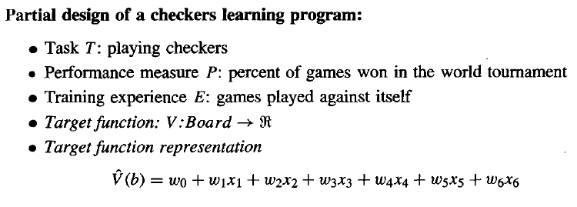

Slide 29
5. Choosing a Function Approximation Algorithm
In order to learn the target function V^ we require a set of training examples, each describing a specific board state b and the training value Vtrain(b) for b.
The following training example describes a board state b in which black has won the game and for which the target function value Vtrain(b)is therefore +100.
[e.g. <x1=3, x2=0, x3=1, x4=0, x5=0, x6=0, +100 (=blacks won)]
The procedure first derives such training examples from the indirect training experience available to the learner, then adjusts the weights to best fit these training examples.

Slide 30

5. Choosing a Function Approximation Algorithm
ESTIMATING TRAINING VALUES
Despite the ambiguity inherent in estimating training values for intermediate board states, one simple approach has been found to be surprisingly successful
Assign the training value of Vtrain(b) for any intermediate board state b to be V’(Successor(b)).

Slide 31

5. Choosing a Function Approximation Algorithm
ADJUSTING THE WEIGHTS
One common approach is to define the best hypothesis, or set of weights, as that which minimizes the square error E between the training values and the values predicted by the hypothesis V.
Several algorithms are known for finding weights of a linear function that minimize E defined in this way

Slide 32
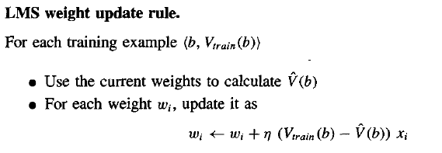
One such algorithm is called the least mean squares, or LMS training rule.
For each observed training example it adjusts the weights a small amount in the direction that reduces the error on this training example.

Slide 33
6. Final Design for Checkers Learning
The Performance Module: Takes as input a new board and outputs a trace of the game it played against itself.
The Critic: Takes as input the trace of a game and outputs a set of training examples of the target function
The Generalizer: Takes as input training examples and outputs a hypothesis which estimates the target function. Good generalization to new cases is crucial.
The Experiment Generator: Takes as input the current hypothesis (currently learned function) and outputs a new problem (an initial board state) for the performance system to explore
In this course, we are mostly concerned
with the generalizer
33

Slide 34
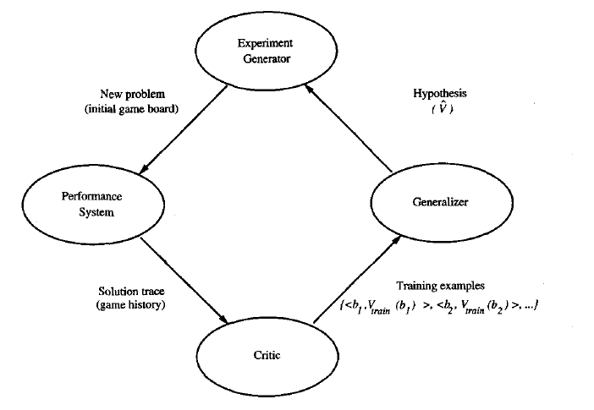

Slide 35
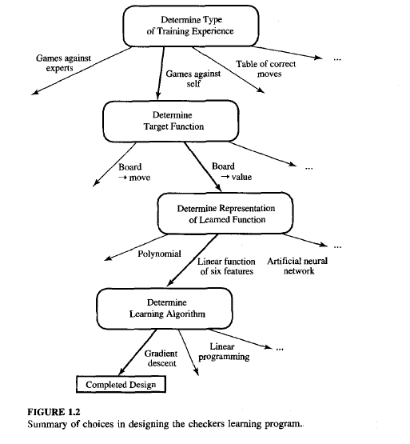

Slide 36
Issues in Machine Learning (i.e., Generalization)
What algorithms are available for learning a concept? How well do they perform?
How much training data is sufficient to learn a concept with high confidence?
When is it useful to use prior knowledge?
Are some training examples more useful than others?
What are best tasks for a system to learn?
What is the best way for a system to represent its knowledge?
36

