Slide 1
Brain Tumor Detection
MACHINE LEARNING (BATCH -03)
KATTA ANUSHA(Y20CS087)

Slide 2

CONTENTS
Abstraction
Introduction
Technologies used
Problem description
Implementation
result
conclusion

Slide 3
Abstract:
Tumor is the second leading cause for cancer-related deaths in men in age 20 to 39 and fifth leading cause cancer among women in same age group.
Brain tumors are painful and may result in various diseases if not cured properly. Diagnosis of tumor is a very important part in its treatment. Identification plays an important part in the diagnosis of begin and malignant tumors.
A prime reason behind an increase in the number of cancer patients worldwide is the ignorance towards treatment of a tumor in its early stages.

Slide 4
Plotting contour and c-label of the tumor and its boundary provides us with information related to the tumor that can help in a better visualization in diagnosing cases.
This process helps in identifying the size, shape and position of the tumor. It helps the medical staff as well as the patient to understand the seriousness of the tumor with the help of different color-labeling for different levels of elevation.

Slide 5
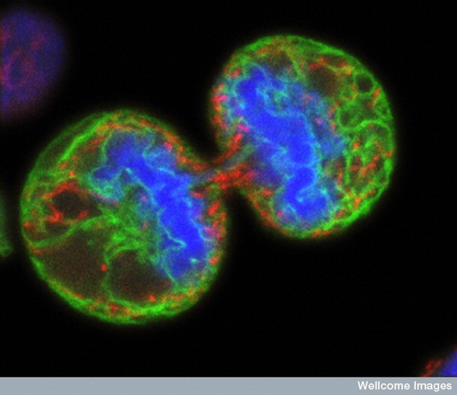
Introduction
A brain tumor is defined as abnormal growth of cells within the brain or central spinal canal. Some tumors can be cancerous thus they need to be detected and cured in time.
There are two types of brain tumor which is primary brain tumor and metastatic brain tumor. Primary brain tumor is the condition when the tumor is formed in the brain and tended to stay there while the metastatic brain tumor is the tumor that is formed elsewhere in the body and spread through the brain.

Slide 6
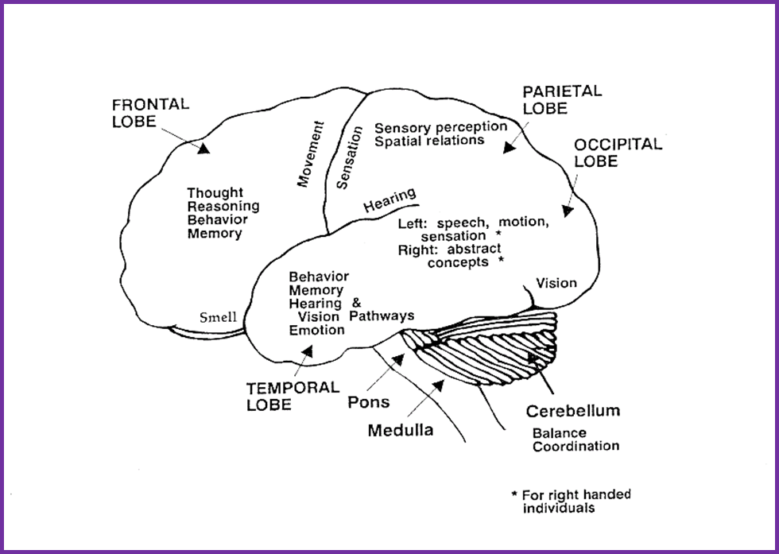
The exact cause of brain tumors is not clear and neither is exact set of symptoms defined, thus, people may be suffering from it without realizing the danger.
Primary brain tumors can be either malignant (contain cancer cells) or benign (do not contain cancer cells)

Slide 7
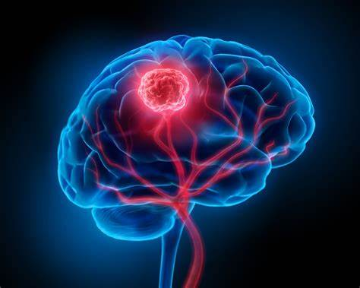
Brain tumor occurred when the cells were dividing and growing abnormally. It is appear to be a solid mass when it diagnosed with diagnostic medical imaging techniques.
The symptom having of brain tumor depends on the location, size and type of the tumor. It occurs when the tumor compressing the surrounding cells and gives out pressure.
The common symptoms are having headache, nausea and vomiting, and having problem in balancing and walking.

Slide 8
Some Symptoms of Brain Tumor:
unusual headaches
seizure
memory, personality, or behavior changes
inability to process incoming information correctly
visual changes: blurred vision, double vision
change in motor control

Slide 9
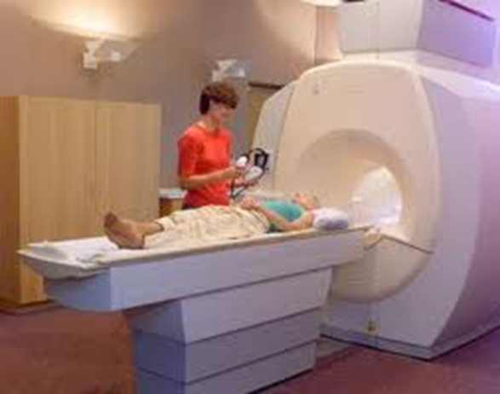
How brain tumors are diagnosed?
MRI scanning remains the gold standard
CT scan for emergencies, then MRI

Slide 10
TECHNOLOGY USED:
Convolutional Neural Network is a Deep Learning algorithm specially designed for working with Images and videos. It takes images as inputs, extracts and learns the features of the image, and classifies them based on the learned features.
Components of CNN
The CNN model works in two steps: feature extraction and Classification
Feature Extraction is a phase where various filters and layers are applied to the images to extract the information and features out of it and once it’s done it is passed on to the next phase i.e Classification where they are classified based on the target variable of the problem.
A typical CNN model looks like this:
Input layer
Convolution layer + Activation function
Pooling layer
Fully Connected Layer

Slide 11
CNNs are very effective in reducing the number of parameters without losing on the quality of models.
All the layers of a CNN have multiple convolutional filters working and scanning the complete feature matrix and carry out the dimensionality reduction. This enables CNN to be a very apt and fit network for image classifications and processing.
The number of parameters in a neural network grows rapidly with the increase in the number of layers. This can make training for a model computationally heavy (and sometimes not feasible).

Slide 12
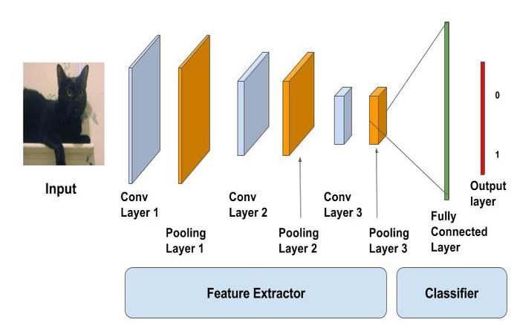

Slide 13
Problem description:
The aim is to provide an algorithm that guarantees the presence of a tumor by combining several procedures to provide a foolproof method of tumor detection in MR brain images.
The focus of this project is MR brain images tumor extraction and its representation in simpler form such that it is understandable by everyone.
The resultant image will be able to provide information like size, dimension and position of the tumor, and its boundary provides us with information related to the tumor that can prove useful for various cases, which will provide a better base for the staff to decide the curing procedure.

Slide 14
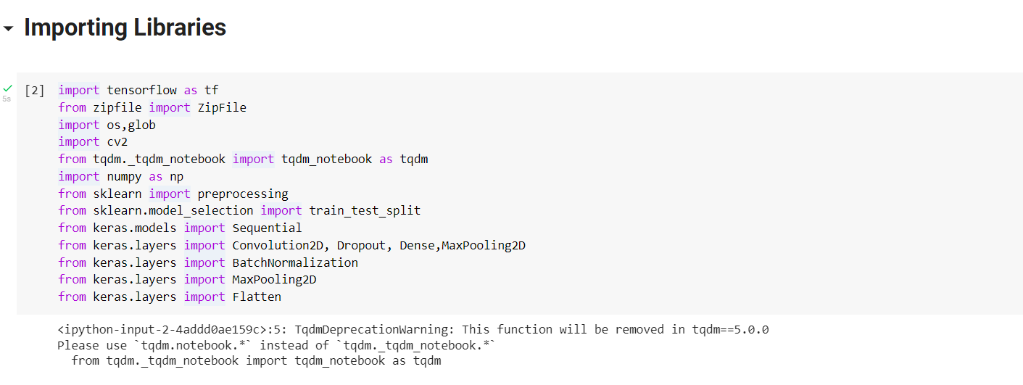
Implementation:

Slide 15
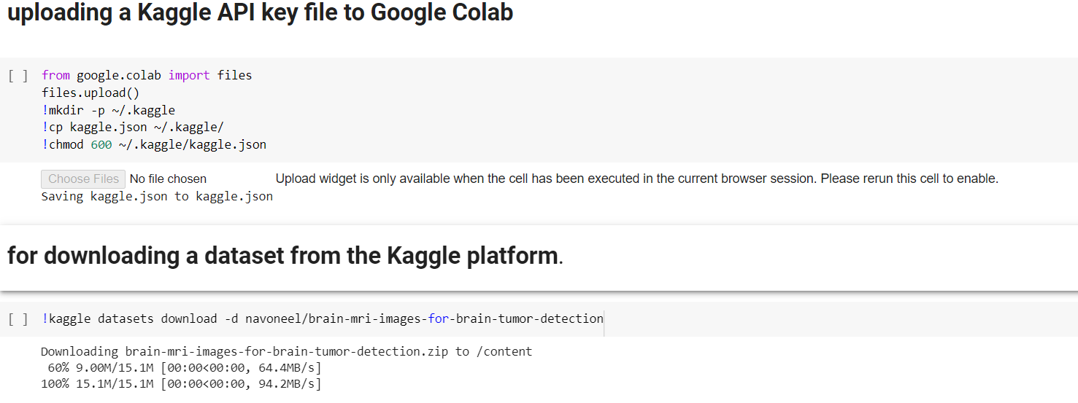
Loading Images:

Slide 16
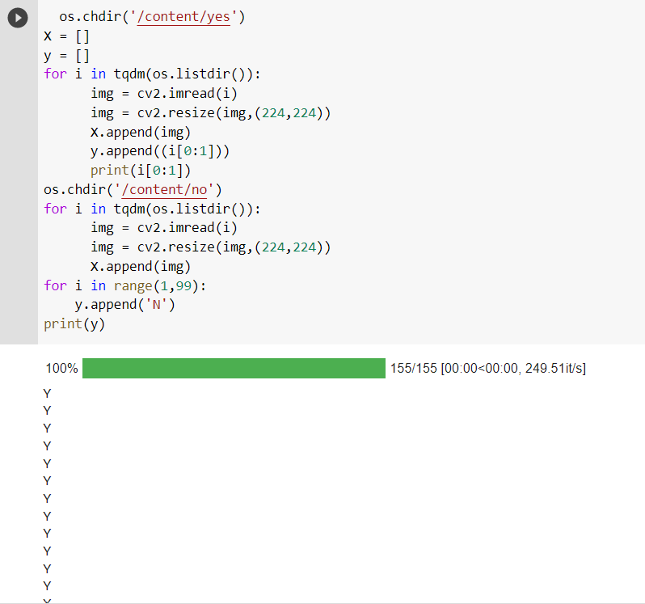

Slide 17
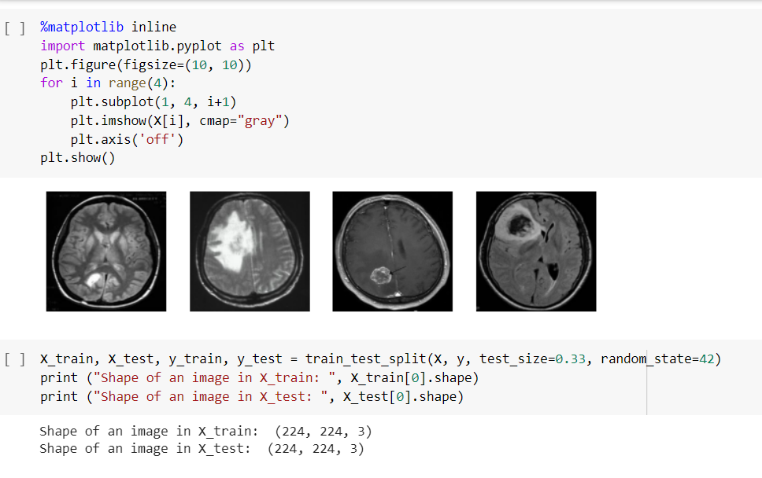

Slide 18
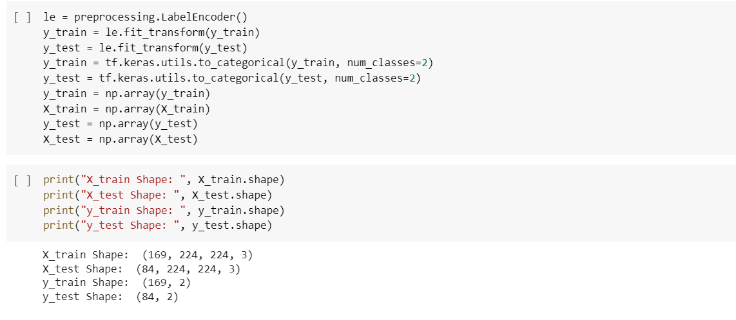

Slide 19
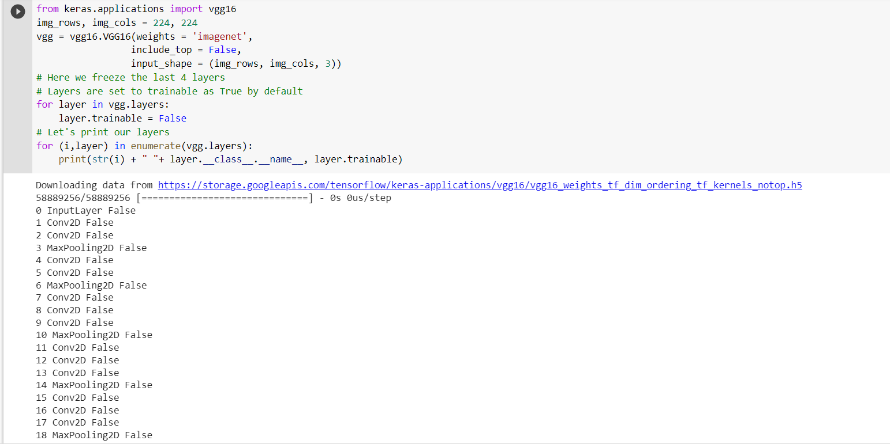

Slide 20
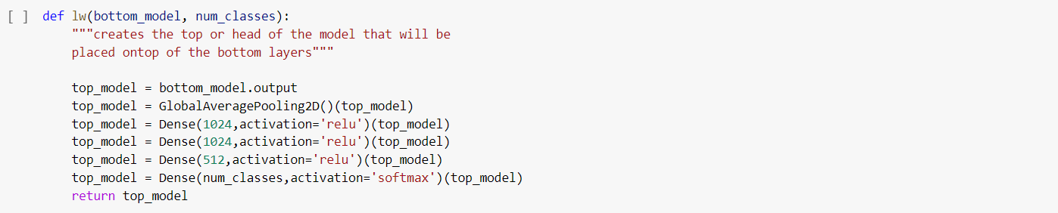
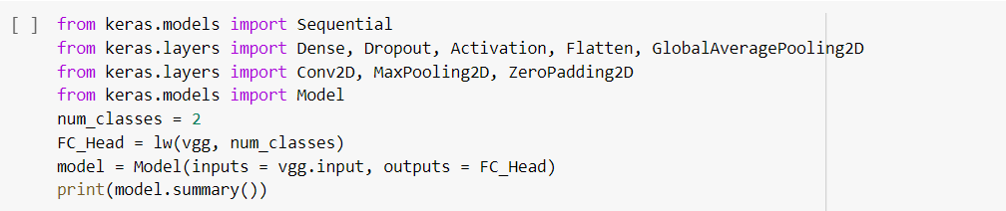

Slide 21
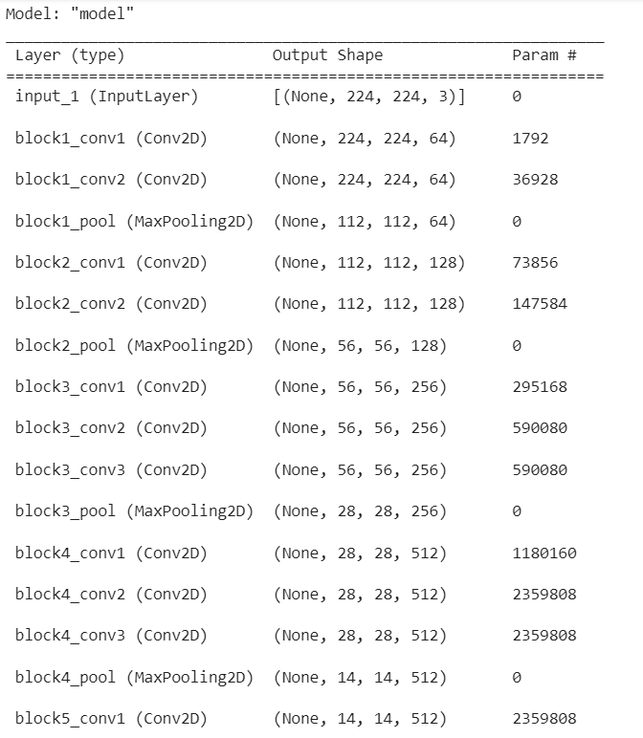

Slide 22
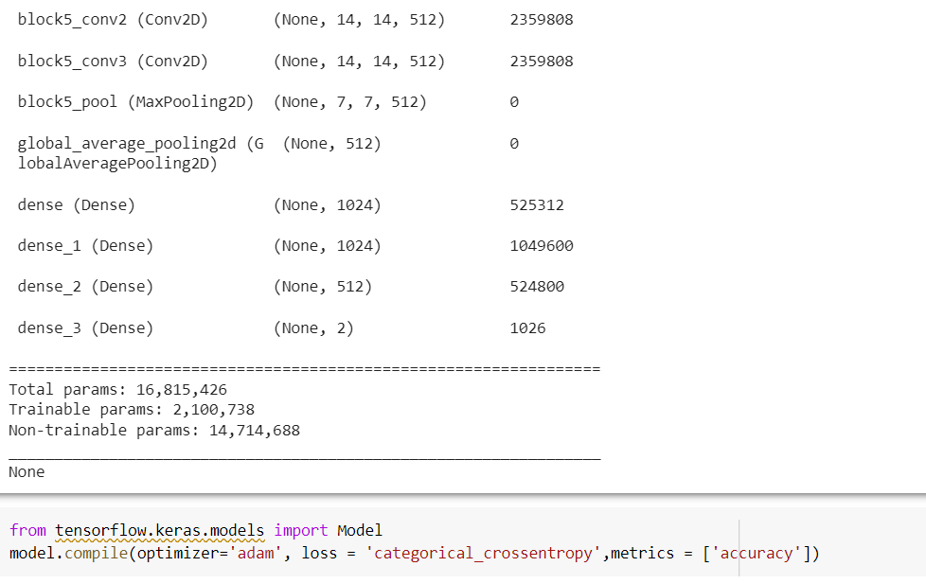

Slide 23
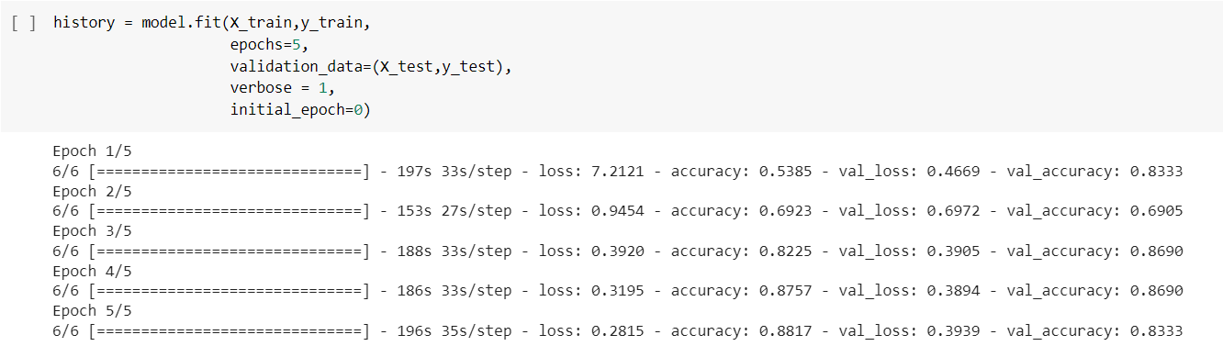

Slide 24
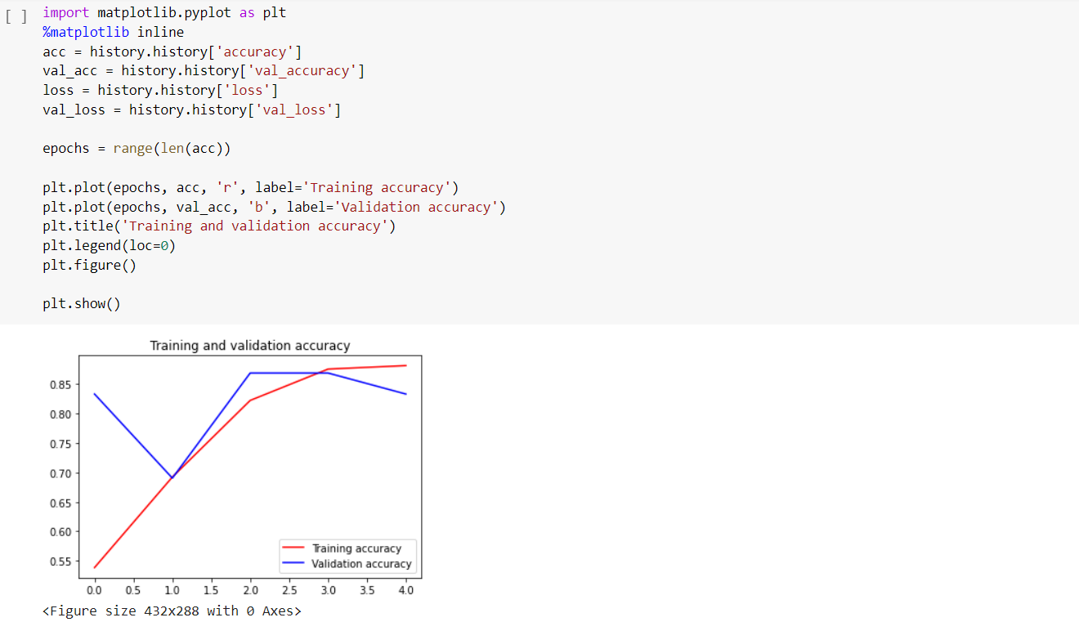

Slide 25
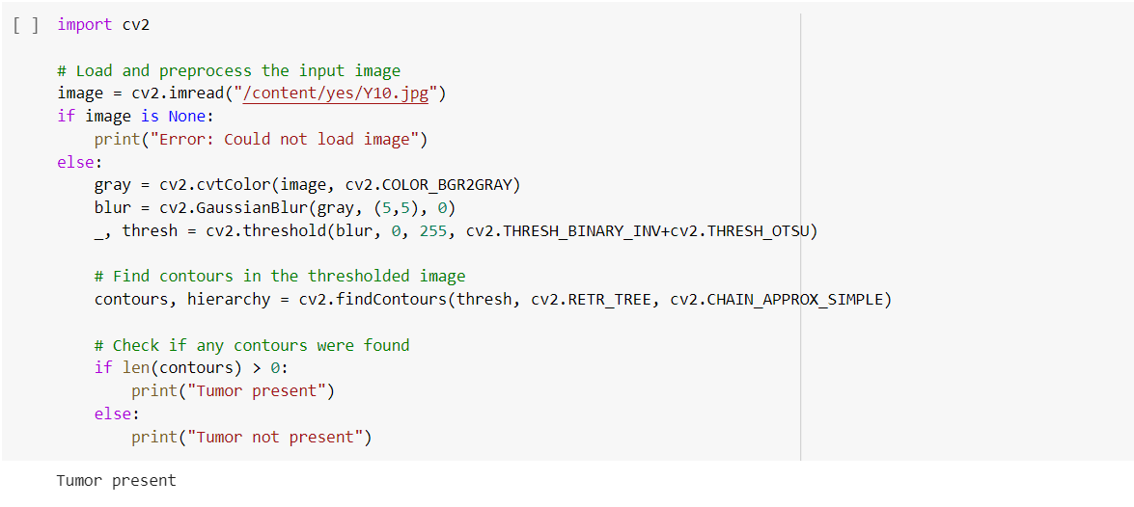
Result:

Slide 26
Conclusion:
We proposed a computerized method for the segmentation and identification of a brain tumor using the Convolution Neural Network.
The proposed model had obtained an accuracy of 94% and yields promising results without any errors and much less computational time.

Slide 27


