Slide 1



Intel® GenAI Hackathon
Team Name : mlwizards
Problem Statement :

Slide 2


Problem Statement
Develop an innovative platform for interactive storytelling that employs AI-driven tools, allowing users to actively shape the plot and characters through their input using use of Intel®️ oneAPI as the primary programming paradigm.
The aim is to craft captivating visual narratives using advanced AI techniques such as Stable Diffusion or Gen AI models. This involves gradually transforming a base image in accordance with a selected theme, effectively illustrating a progression or evolution. The end product could manifest as a collection of still images or a dynamic GIF, showcasing the transformative journey.
The interactive storytelling experience is designed to immerse users in a personalized and distinctive narrative, facilitated by generative AI technology, fostering engagement and creativity.

Slide 3
Unique Idea Brief (Solution)
We're harnessing the power of Language Model APIs (LLMs) and stable diffusion models to create captivating narratives depicted through a sequence of images. Users control the story's flow by providing prompts, guiding the narrative according to their preferences.
However, generating a cohesive image story with stable diffusion models poses a challenge: it tends to alter character traits from one image to the next, potentially visually disrupting storytelling. To address this, we've devised a method to initially fix the traits of main characters and maintain them throughout the story, while allowing secondary objects to change.
To preserve character traits, we’re defining some base images. The transformations to the actual of the story will be done by passing these base images to the model with the prompt which contains the scenario to be described in the image.

Slide 4
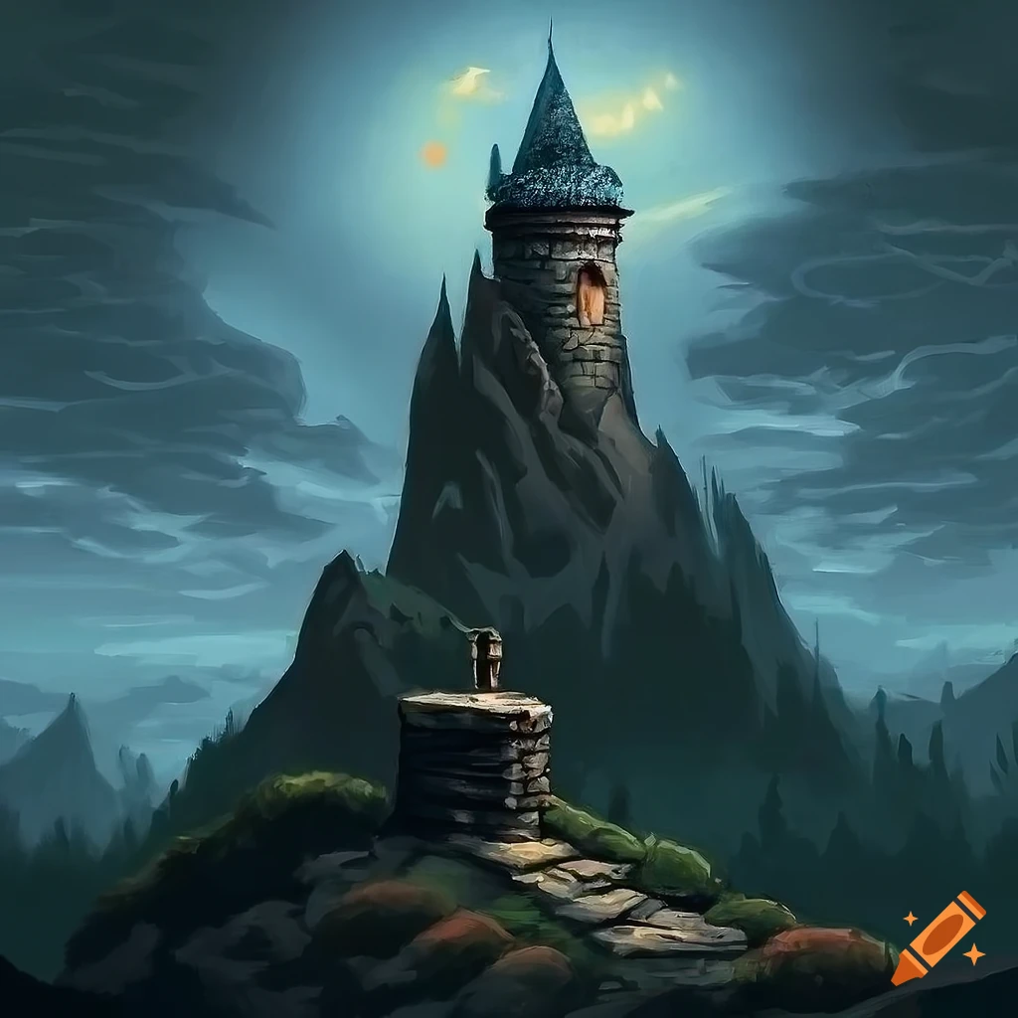
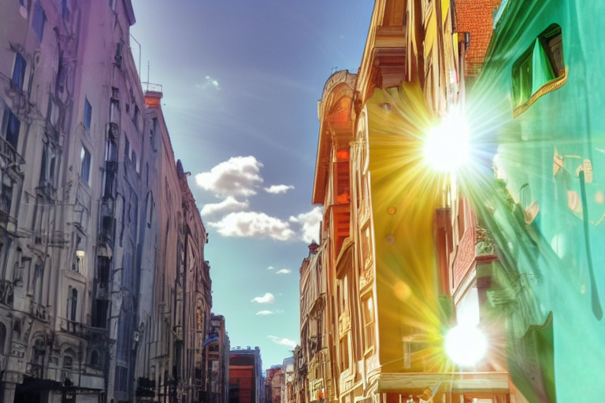
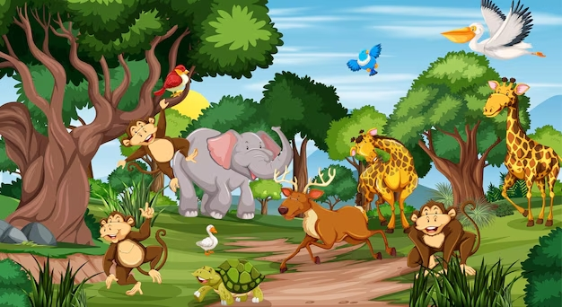
Image to Image transformation using stable diffusion with respect to a prompt
Feeding the left image to stable diffusion using prompt:
image of a city, buildings
The colors are maintained in the output image while the contents of the image are being changed according to the prompt

Slide 5
Features Offered
The story can be generated by simply entering a short description about the story plot.
The coherence of the image sequence is preserved to a good extent.
Ability to generate colorful images

Slide 6
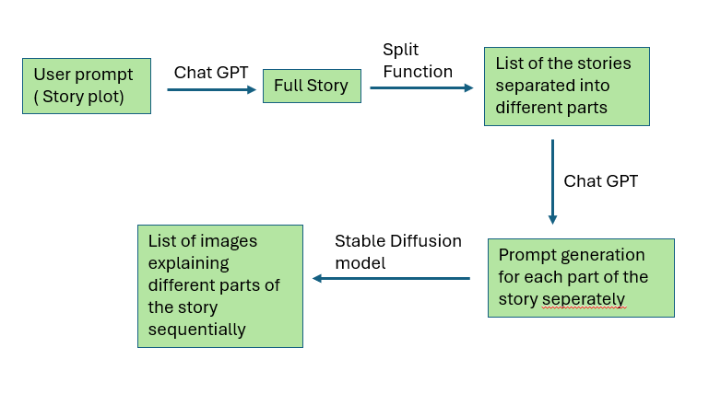
Process flow Diagram for complete story generation using brief story plot description

Slide 7
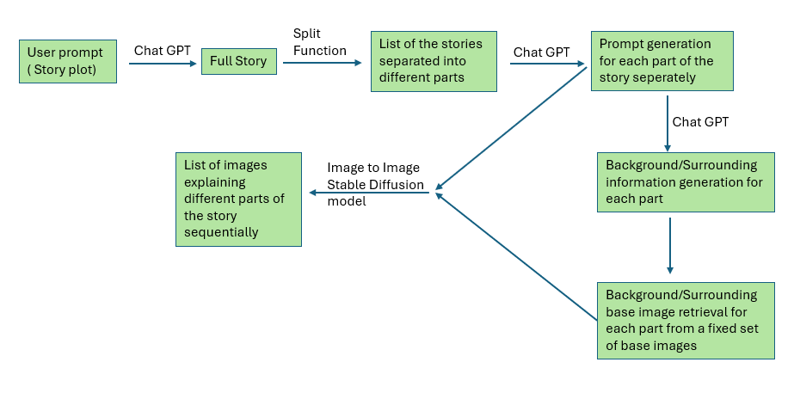
Process flow Diagram for generation of story with coherent images using image to image transformation on base images

Slide 8
Technologies used (Mark down oneAPI AI Analytics libraries used)
OpenAI LLM gpt-3.5-turbo
Stable diffusion Models
IDC for deployment

Slide 9
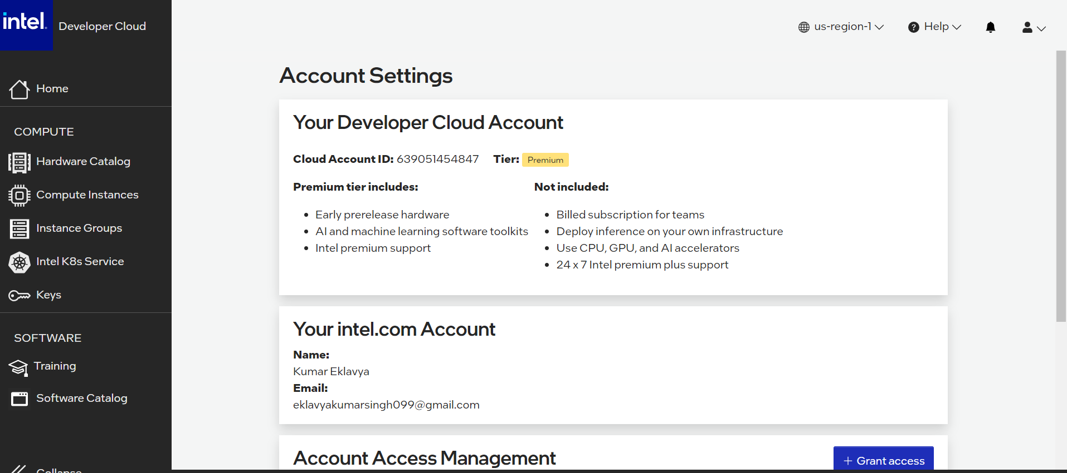
Intel® Developer Cloud Account (Screenshot)

Slide 10
Use case of Intel® Developer Cloud (IDC)
In the Intel Developer Cloud, we’ll be utilizing the high-performance computing resources and AI development tools like Intel AI DevCloud, OpenVINO Toolkit, and oneAPI Base Toolkit for optimized model development and deployment. We’ll enhance our performance with tools such as VTune Profiler, Intel Advisor, and Intel MKL. Utilize DL Boost for hardware-accelerated deep learning inference.

Slide 11
Thank you so much!

