Slide 1
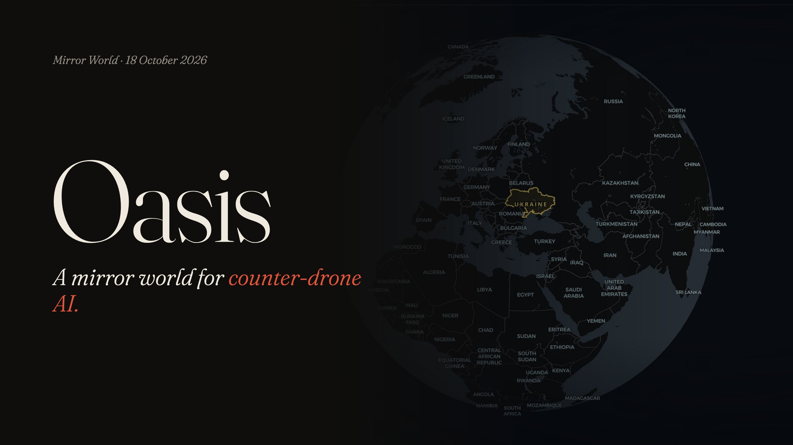
Notes:
[0:00–0:15] Every counter-drone system learns from data where someone knows the right answer. For drones over Ukraine, that data barely exists. We built OASIS to generate it.

Slide 2
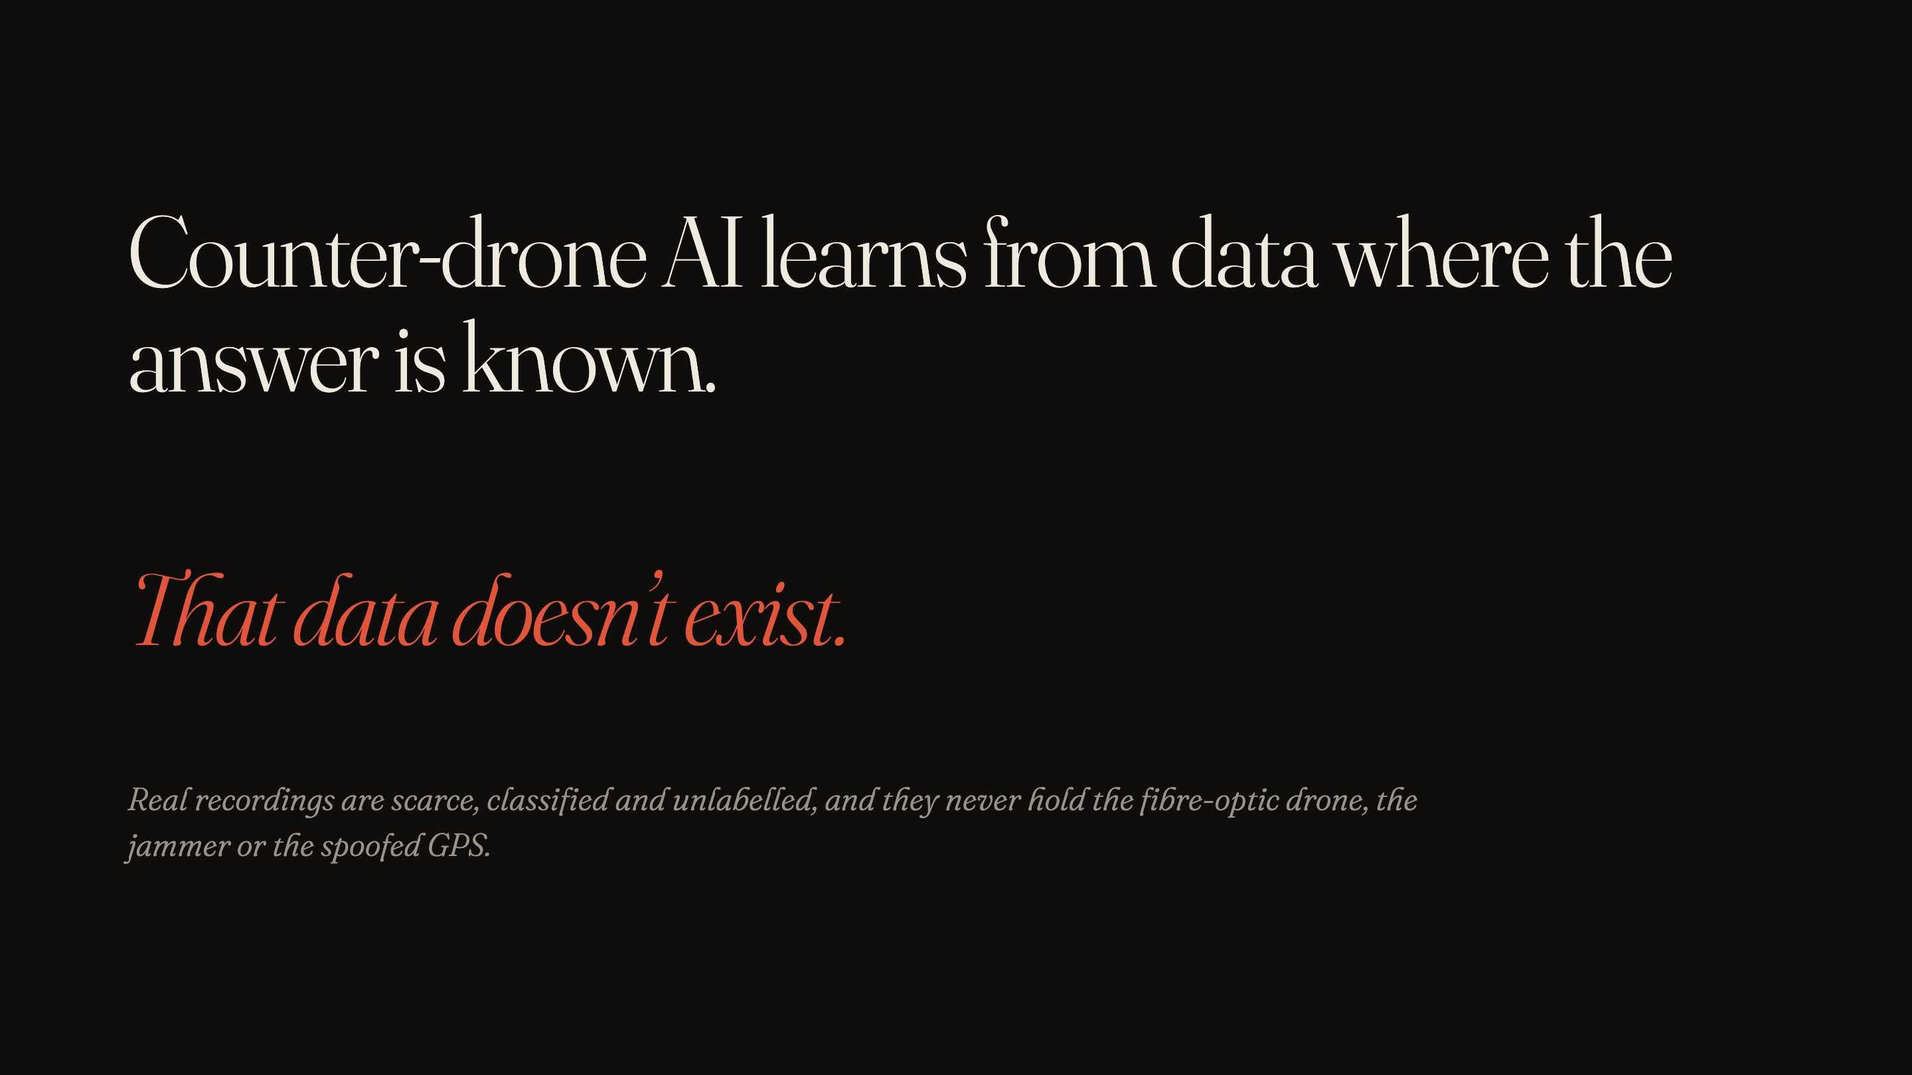
Notes:
[0:15–0:30] Real recordings are scarce, classified and unlabelled. Nobody can tell you which radio burst came from which drone. And they never contain the cases that matter most: a fibre-optic drone, a jammer, spoofed GPS.

Slide 3
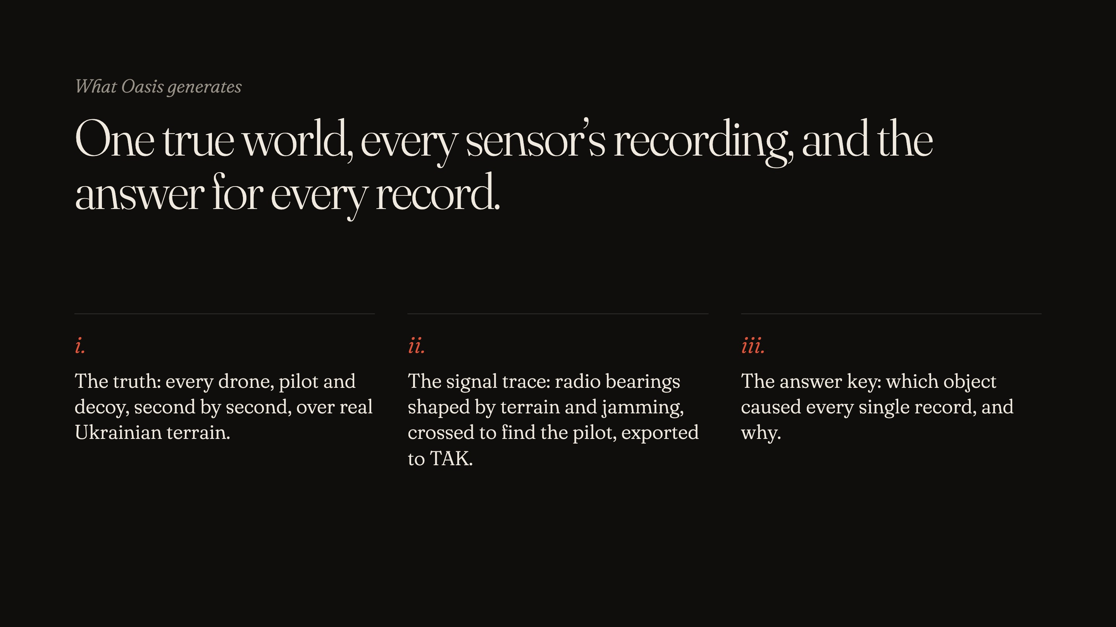
Notes:
[0:30–1:00] Oasis builds one true world over real terrain: every drone, pilot and decoy on one clock. Then it records what ten sensors would physically capture. At the core is the signal trace: radio bearings shaped by terrain and jamming. When a ridge hides the drone, the receiver goes silent. Crossed bearings locate the pilot, and everything exports to TAK. And every record comes with an answer key: which object caused it, and why.

Slide 4
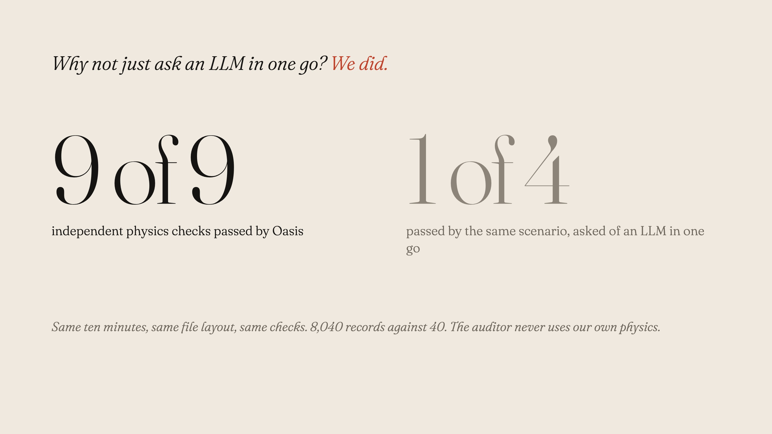
Notes:
[1:00–1:25] Why not just ask an LLM? We did: same scenario, same ten minutes, same ten independent checks. Its timestamps run backwards and its bearings are off by tens of degrees. It passes one of the four checks it can even be tested on. Oasis passes all nine that apply, with eight thousand records against forty. And the auditor never uses our physics, so it can’t simply agree with us.

Slide 5
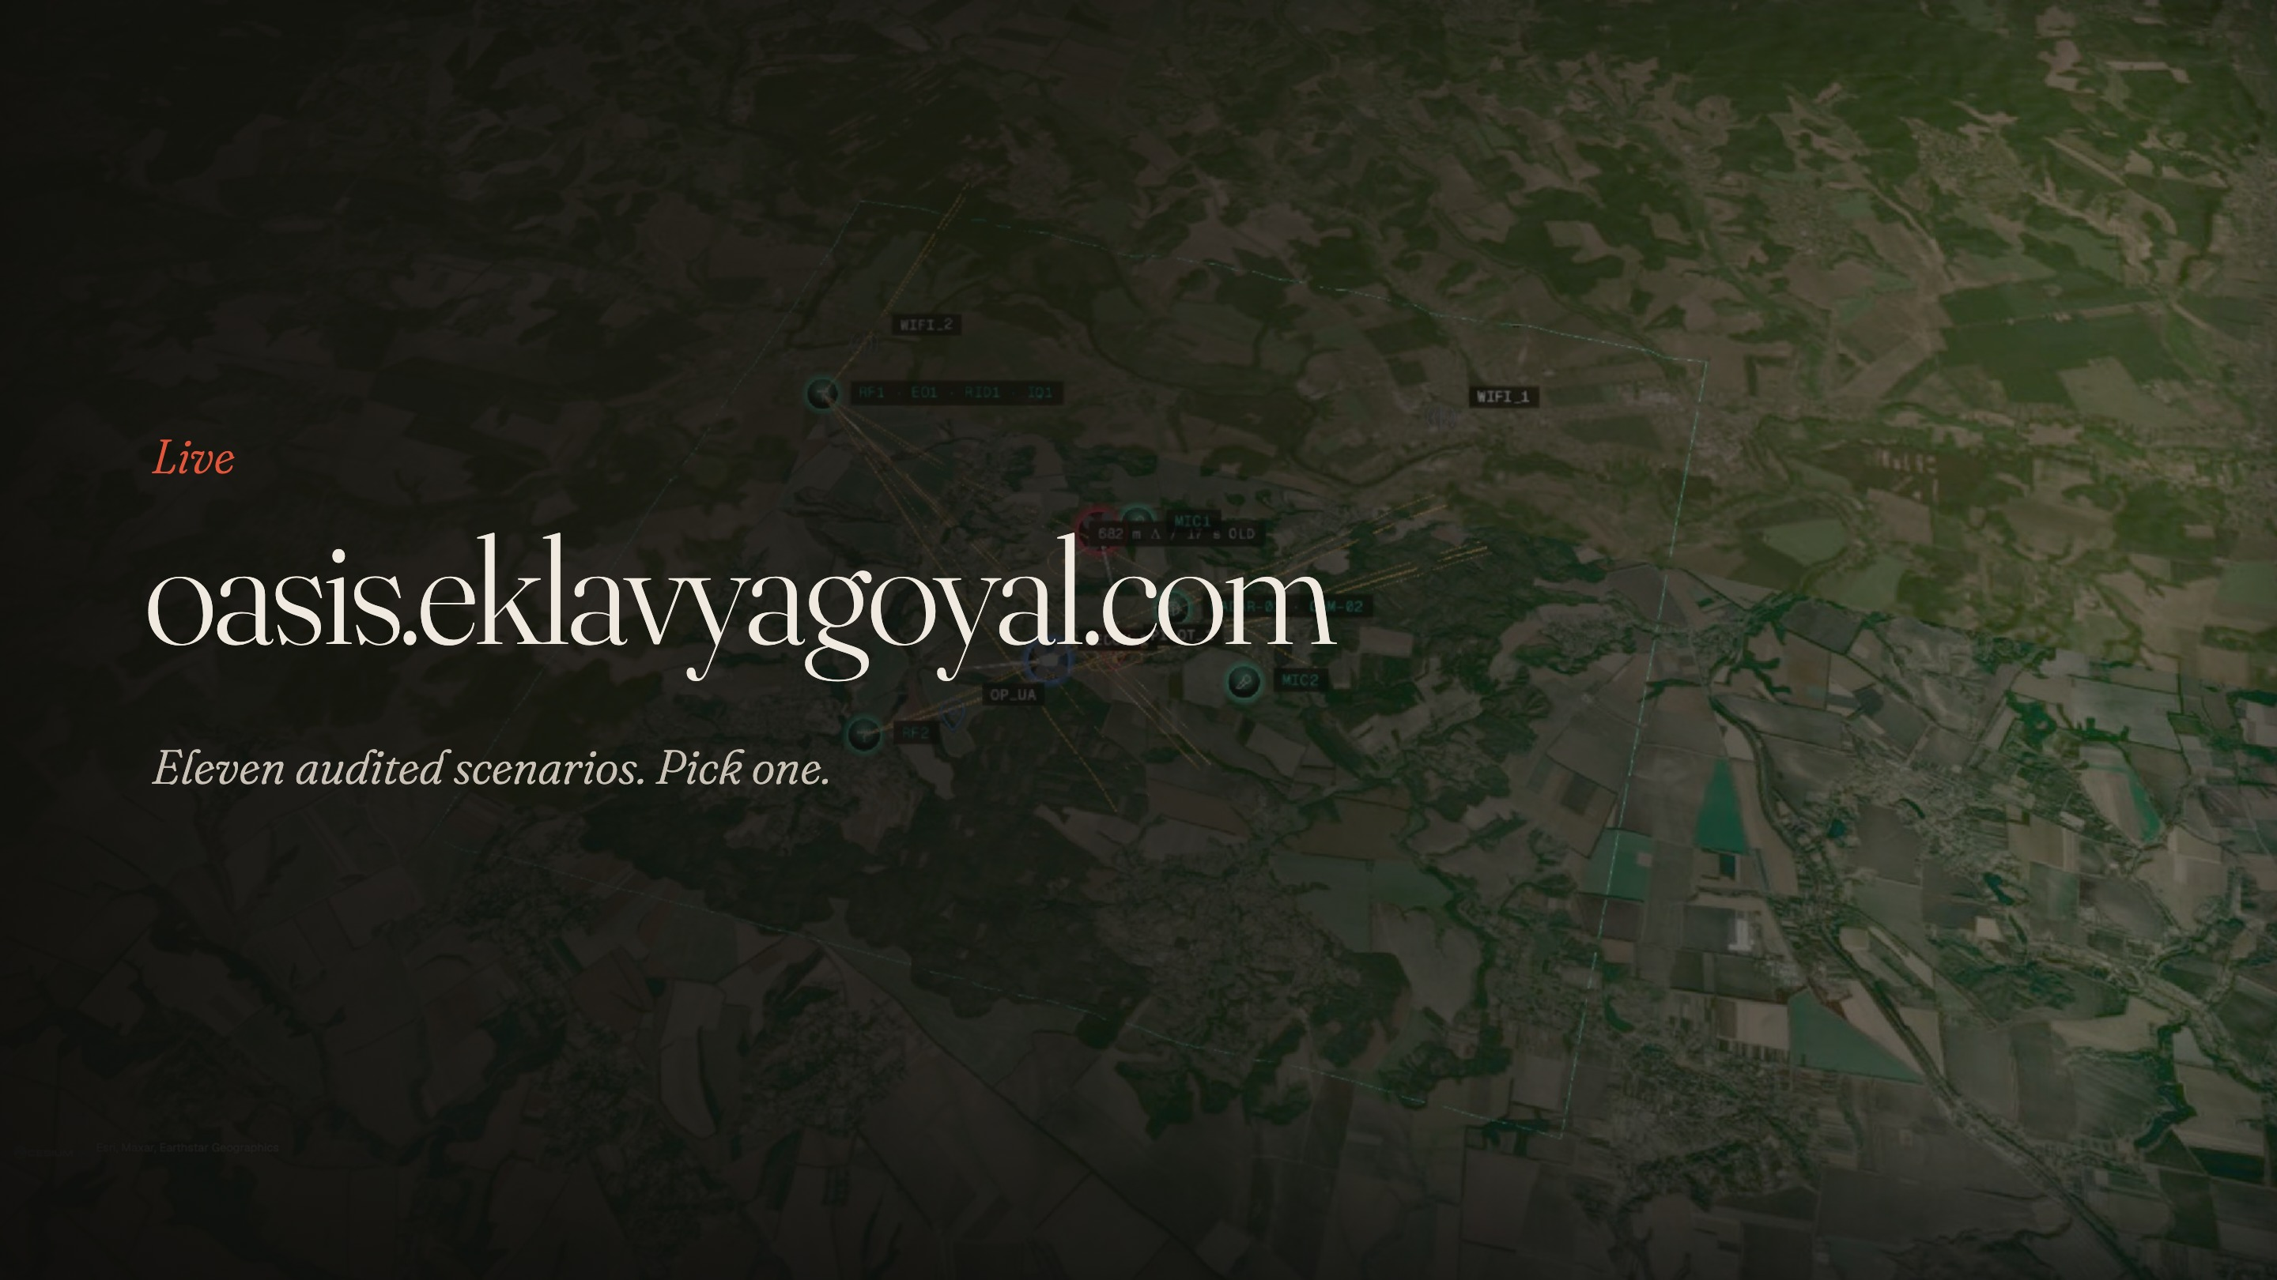
Notes:
[1:25–3:00] Click the link, then Enter simulation, then Hero day. “This is the live system: 49.37 north, 31.20 east, at dusk. At 14:02:07 this Mavic sits exactly on the brief’s example point. The amber lines are the bearings two masts actually recorded; where they cross is our fix, and this line is its error against the truth.” Switch to Operator: “this is all a defender sees.” Then God mode: “and this is what really happened.” Scrub to 14:10: “A fibre-optic drone launches. It has no radio link, so no electronic sensor records it; only civilians report it. That is the case real data never contains.” Back in the library: “Eleven scenarios, every one generated and audited the same way. The world stays fixed; the seed changes only what flies.” Close: “That’s Oasis. Every record has an answer. Thank you.”

