Slide 1
Sales Performance Analysis & Business Insights
Sales Performance Analysis & Business Insights

Slide 2

Name: Eklavya Kosre
B.Tech CSE
Satpura College of Polytechnic and Engineering

Slide 3
Project Objective
• Analyze sales data to understand revenue trends • Identify key customer segments • Evaluate city-wise performance • Support business decision making through data

Slide 4
Business KPIs
• Total Revenue: ₹27500 • Total Orders: 5 • Average Order Value: ₹5500.0

Slide 5
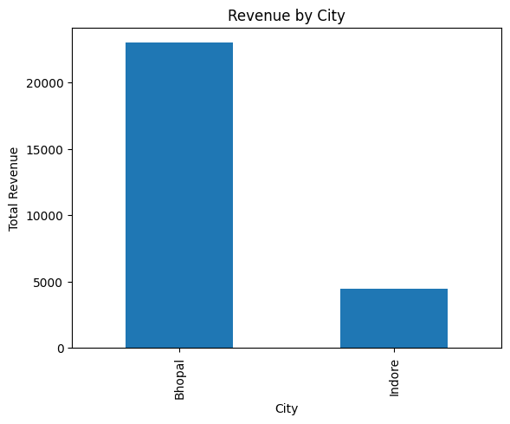
City-wise Revenue Analysis
The highest revenue generating city is :- Bhopal This indicates strong customer demand in that region.

Slide 6
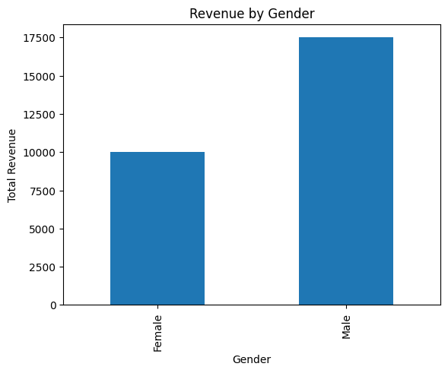
Gender-Based Revenue Analysis
Purchase_amount
Gender
Female | 10000
Male | 17500

Slide 7
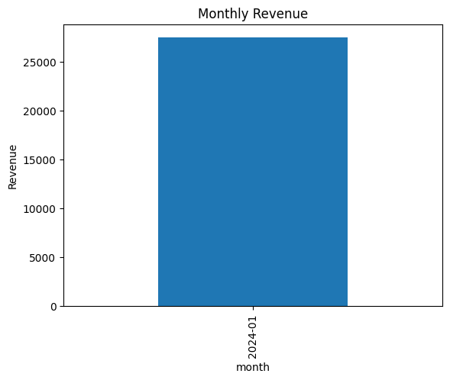
Revenue Growth Trend
Revenue peaked in 2024-01 month.
This may indicate seasonal or promotional impact.

Slide 8
Hypothesis Testing
H0: No significant difference in spending between Male and Female customers. H1: Significant difference exists.
P-value = 0.4043200610806625

Slide 9

Final Business Recommendations
• Focus marketing on top-performing city • Target high-spending age group • Improve engagement in low-revenue areas • Use seasonal campaigns to boost peak months
Thank You
Questions & Feedback Welcome

