Slide 1
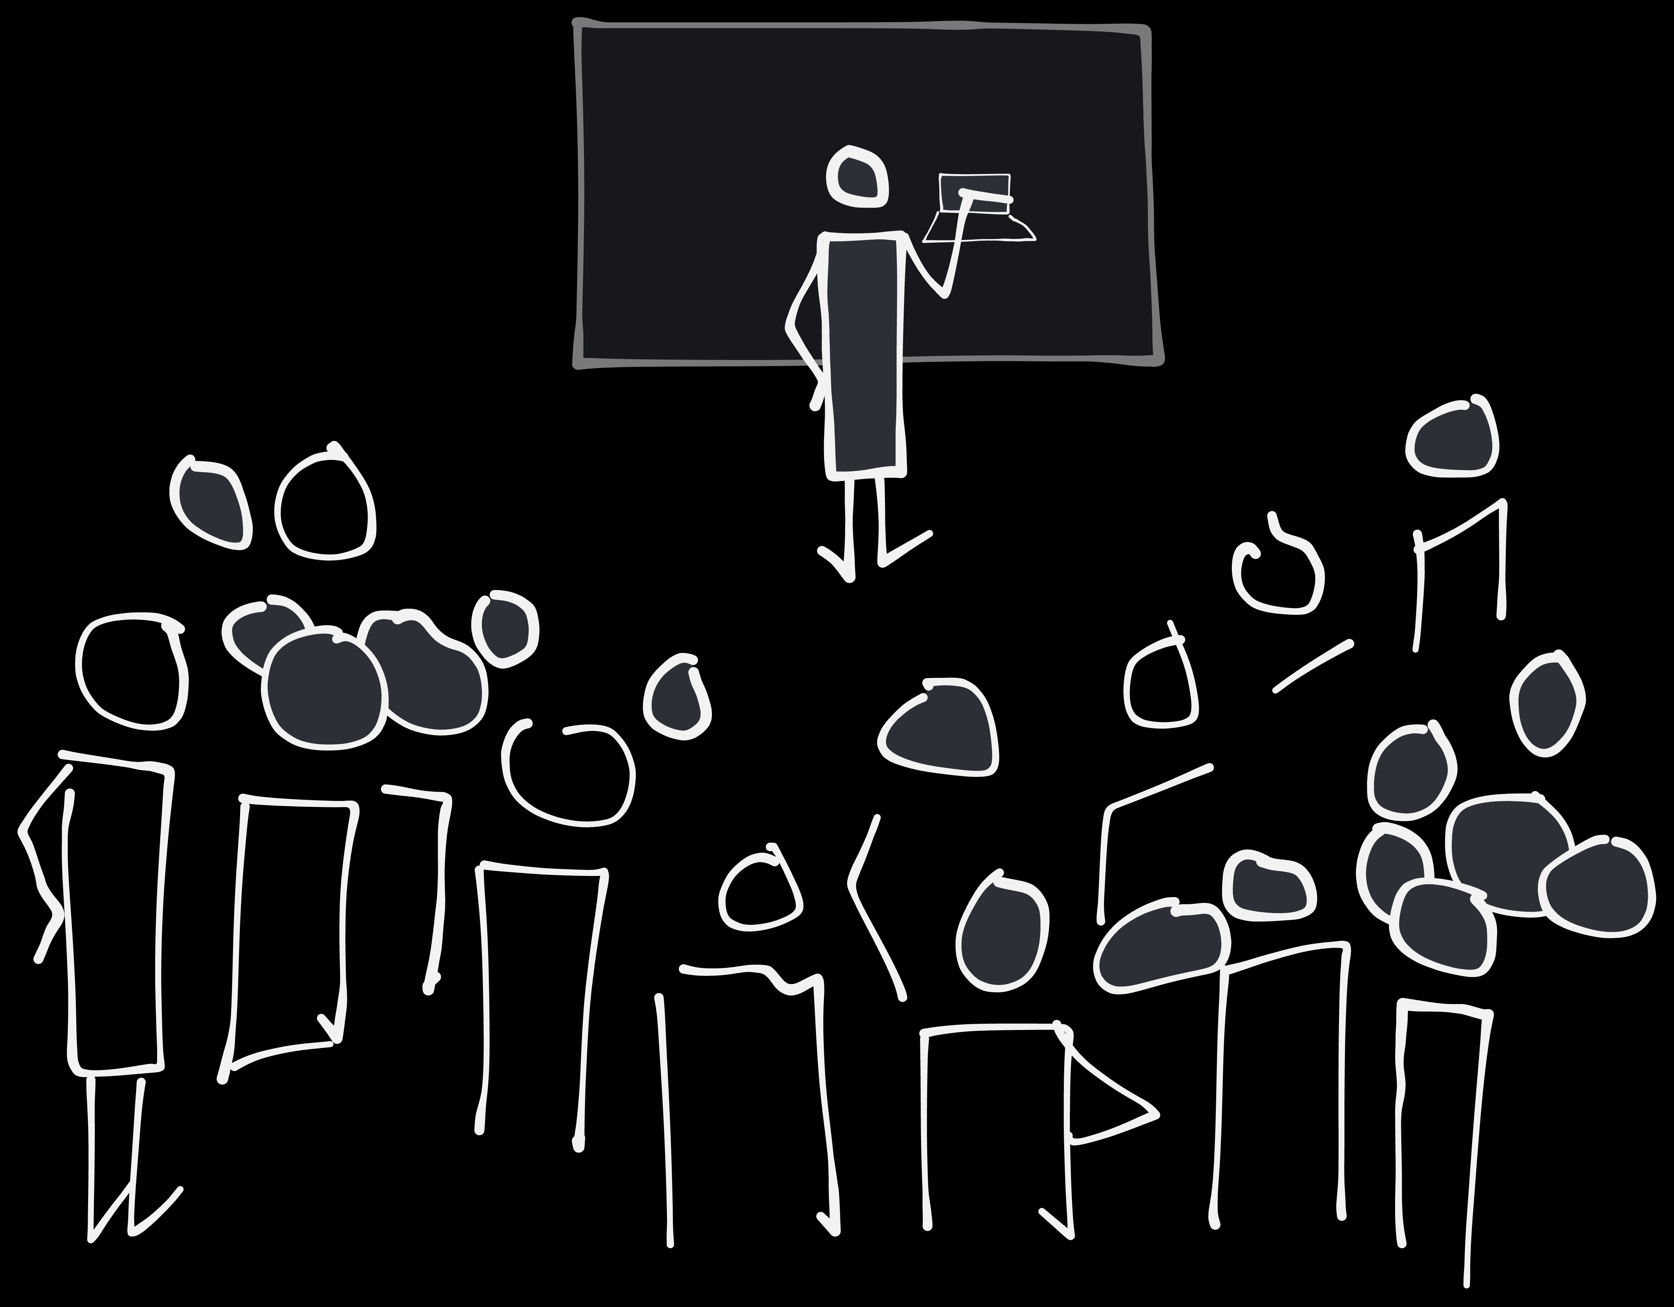
How to teach a million people to draw. Maybe...

Slide 2
The visual alphabet: What is it, and why

Slide 3
Why draw at work

Slide 4
Figuring I could teach others

Slide 5
First take on making it scale

Slide 6
Covid: Online workshops in Miro - Still doesn't scale

Slide 7
More useful in a work setting

Slide 8
What the future may hold - tldraw

