Slide 1
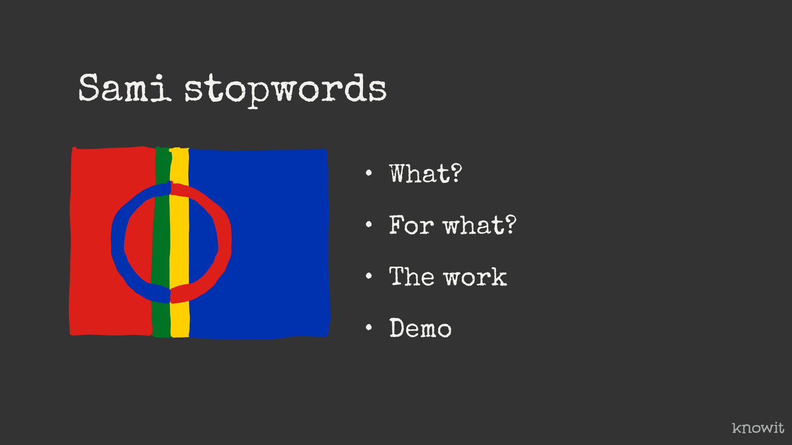
Notes:
What is it? For what? The work? Done and remaining. And a little about Wikipedia and NRK as text sources. Demo

Slide 2

Notes:
My name is Espen Klem. I work as an interaction designer and play around with JavaScript every now and then I’m not sami, and don’t know any of the Sami languages, but I thought it would be good with some simple language comprehension.
I have previously generated stopword lists forfor punjabi gurmukhi (Indian part of Punjabi) and Finish. And created some simple tools to do this work.

Slide 3
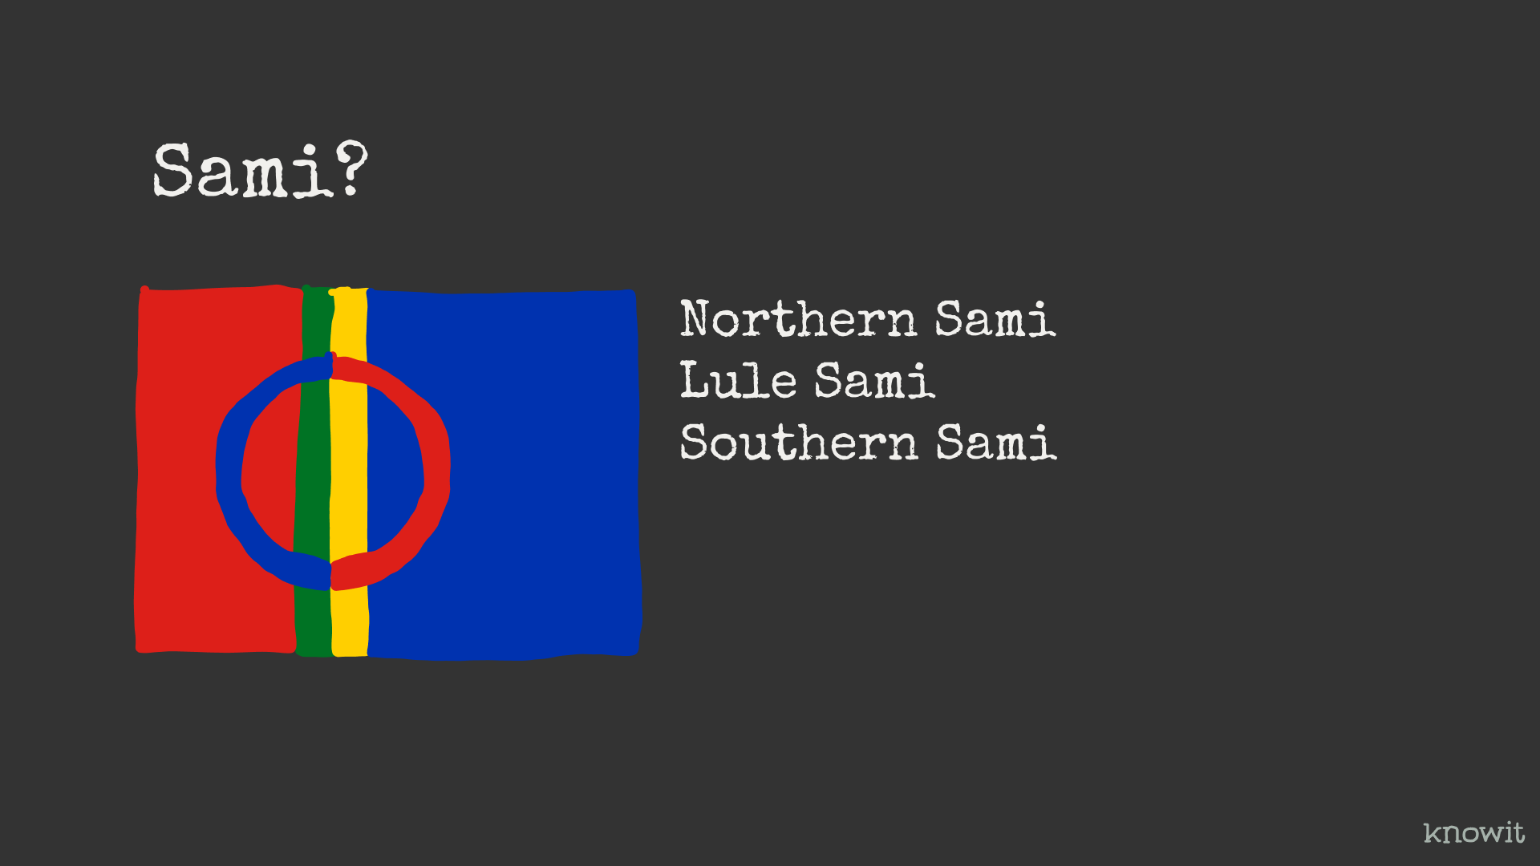
Notes:
Sami languages in Norway mainly consists of three languages. Northern Sami, Lule Sami and South Sami. The two first have some similarities, the last not. 3 different languages, and not dialects. Northern Sami is the largest by far and has 25000 users. 90% of the people that talk a Sami language daily uses Northern Sami. There are also a lot of other Sami languages, but these three are the official ones in Norway.
My motivation to do this work is to make it possible that they can function well in digital solutions.

Slide 4
What is it?

Slide 5
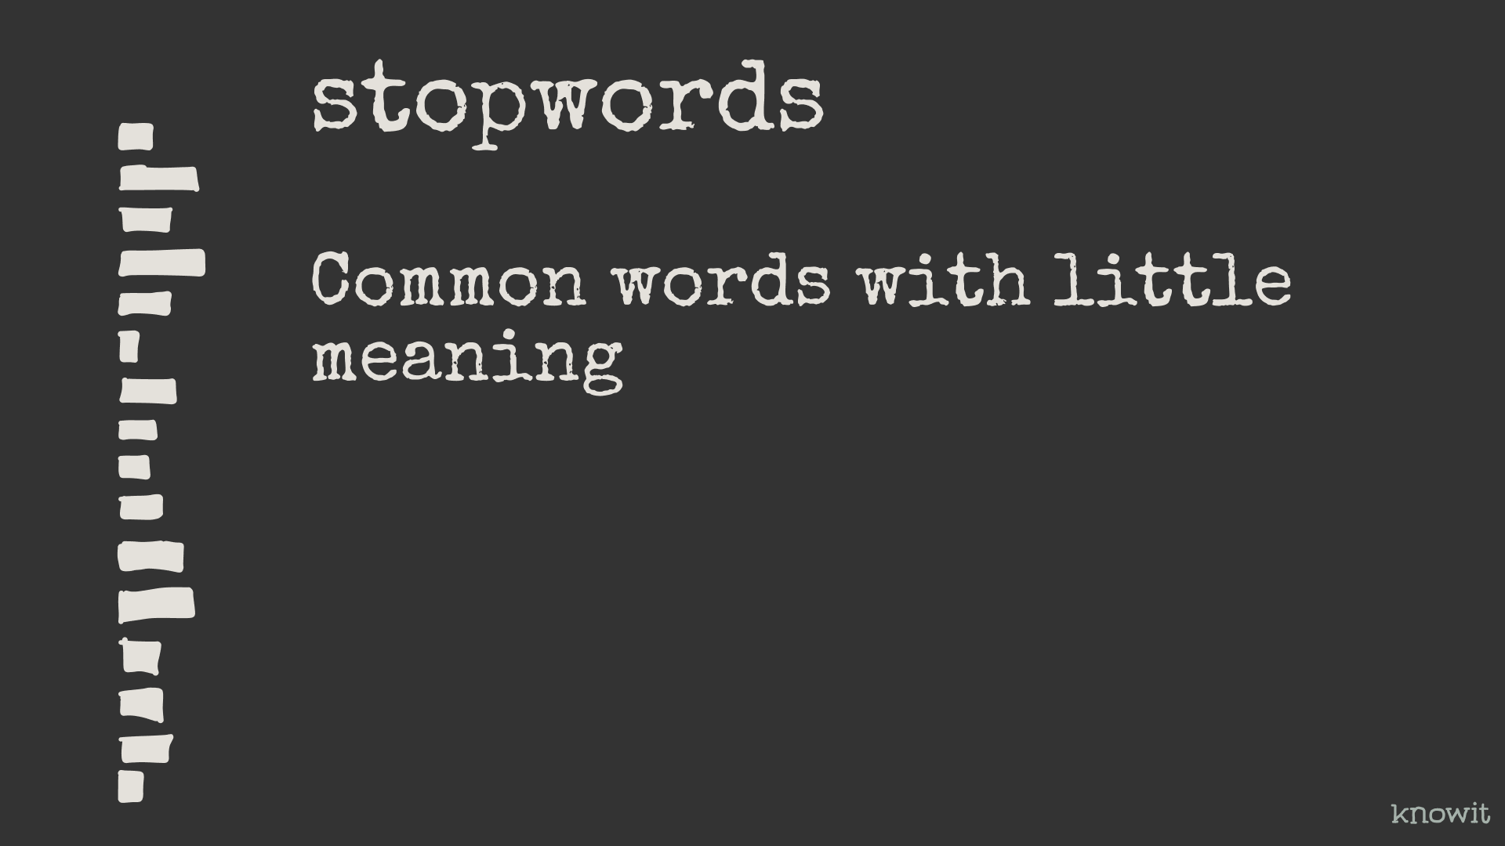
Notes:
So, what are stopwords? It’s all the common words with little to no meaning. Prepositions etc. But stopwords have no clear definition, so it’s some work to come up with a list.

Slide 6
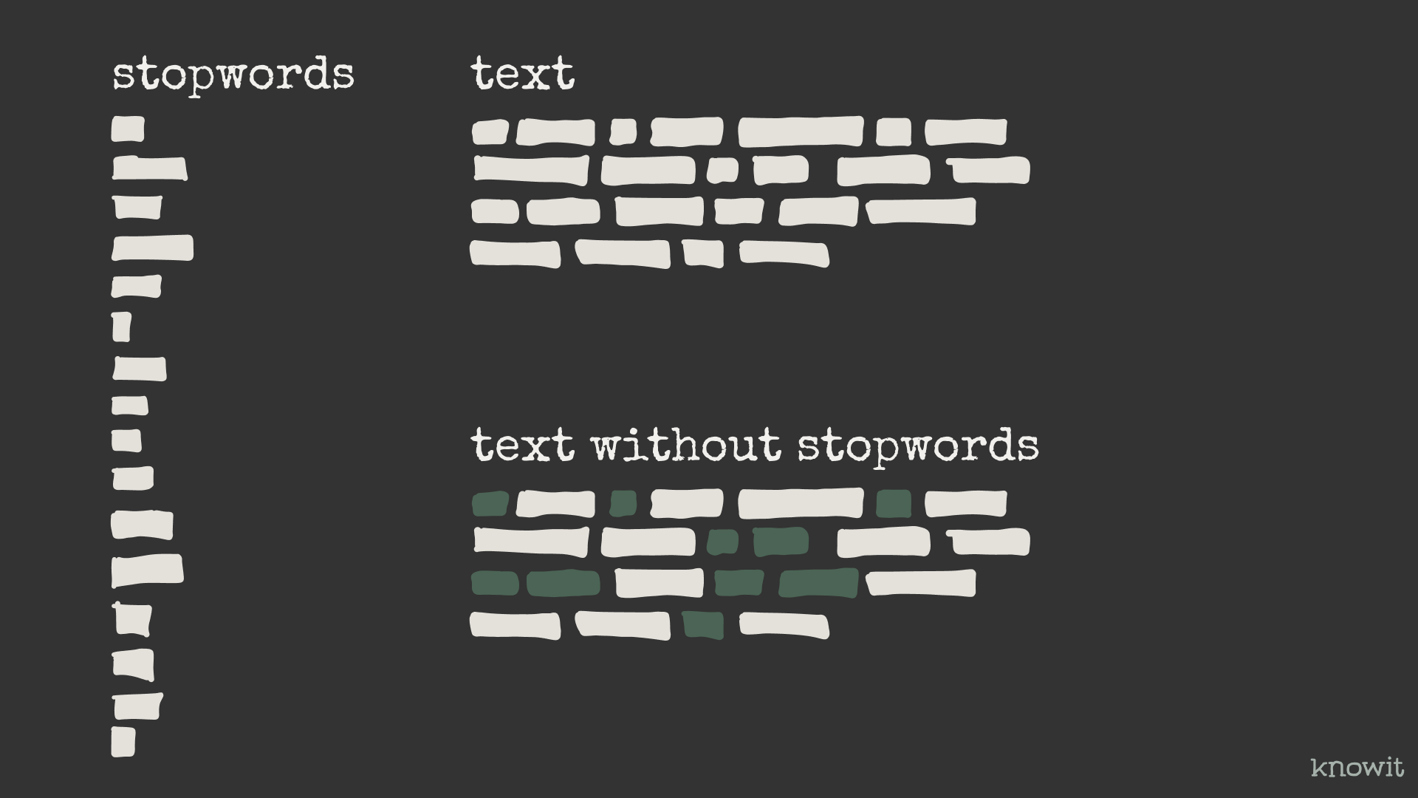
Notes:
The wat stopwords are used is mostly to remove them from text before further analysis.

Slide 7
What is it for?
Notes:
Then, what is it for, and where is it used?

Slide 8

Notes:
Search
Machinelearning
Email spam detection
Sentiment analysis
Plagiarism analysis
... from what I have seen. I know little about machine learning, but see that one of the module I maintain and develop is used for, among other things, machine learning.

Slide 9
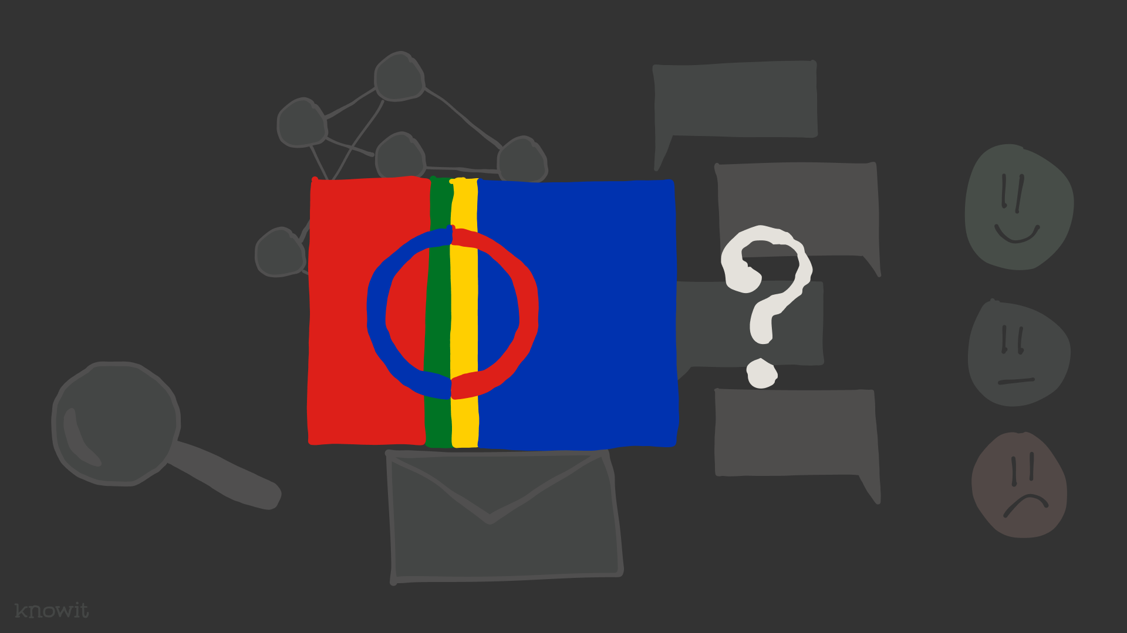
Notes:
Hopefully it will be easier to make good solutions like this when the project is finished and the stopword-sami reaches v1

Slide 10
The work we’re doing?
Notes:
What does the actual work consist of? How do you create a list of stopwords for a language?

Slide 11
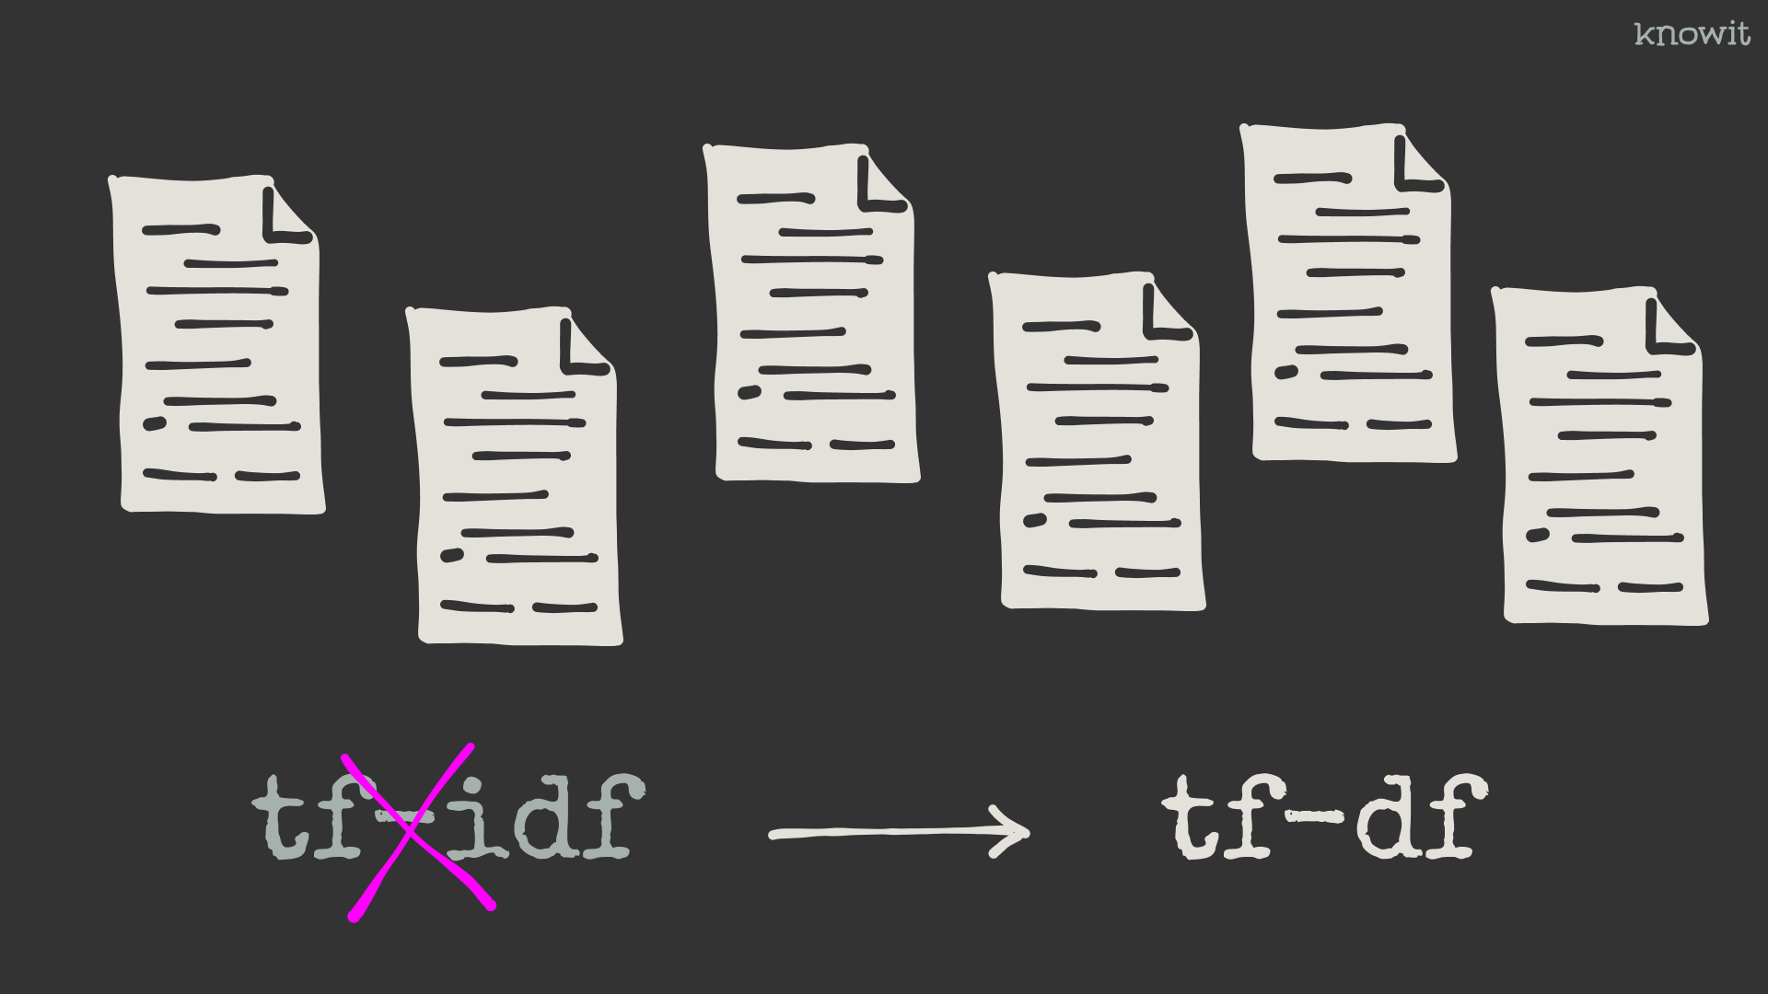
Notes:
The algorithm used is the oposite of what’s used to identifyt important words in a search text corpus. So, instead of “term-frequency-inverse-document-frequency” we use “term-frequency-document-frequency.” Words that are used most and over most documents gets the highest stopword score, or stopwordiness.

Slide 12

Notes:
And to do this analysis we need documents.

Slide 13
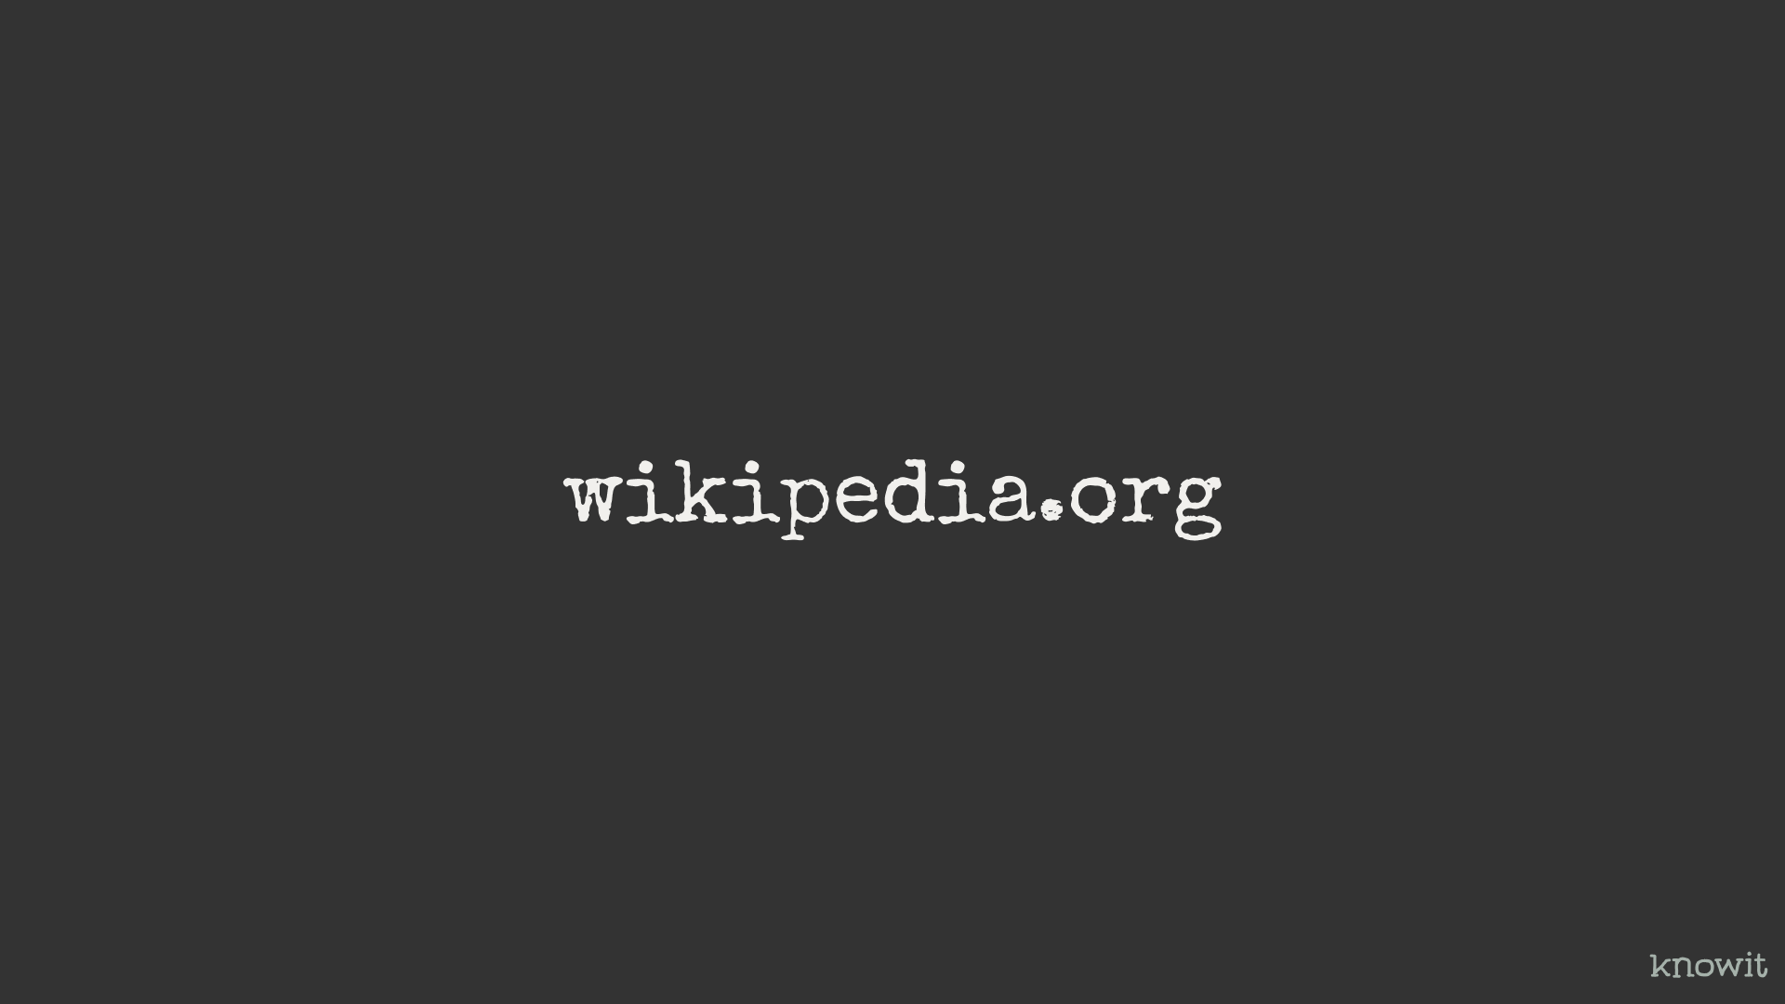
Notes:
I’ve used Wikipedia for Punjabi Gurmukhi and Finish before, and tested it on Norwegian.

Slide 14
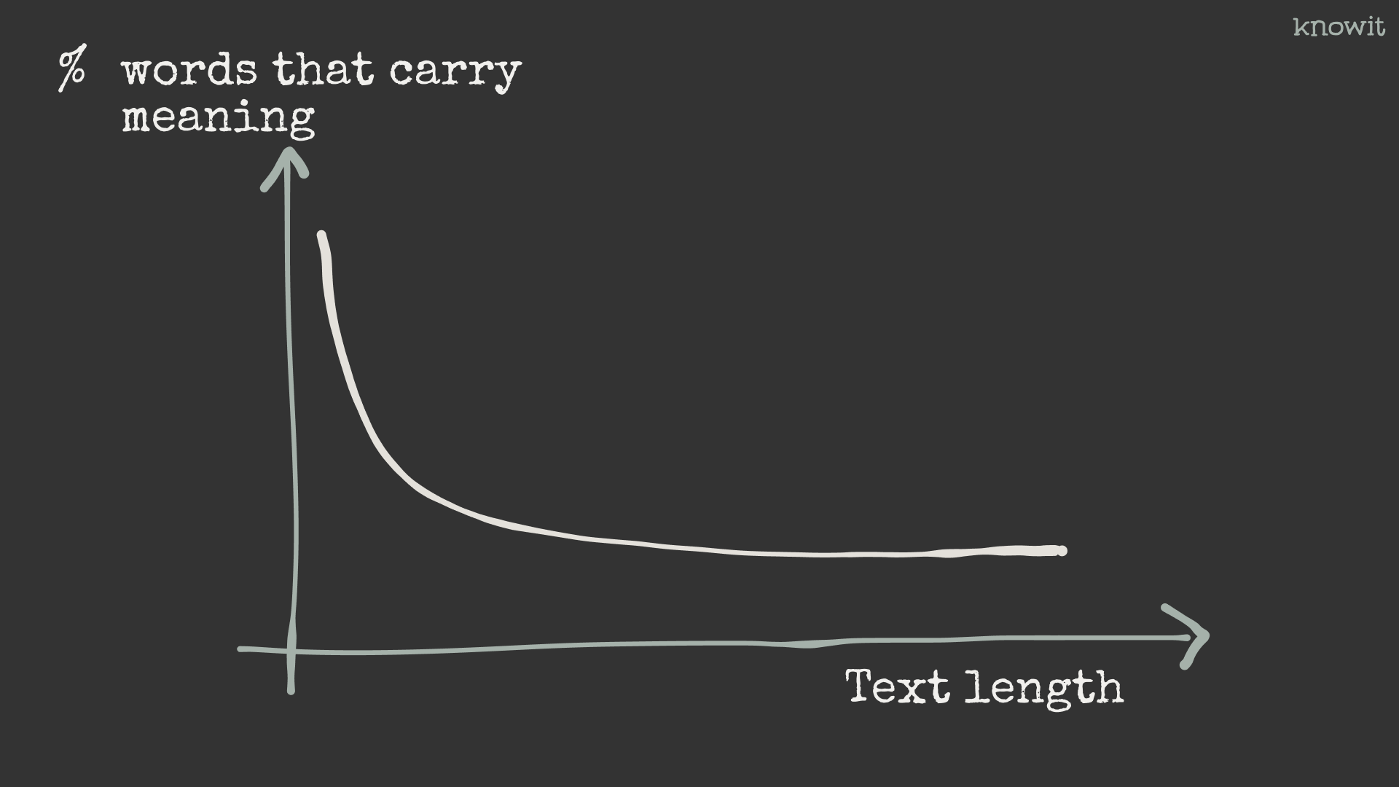
Notes:
One challenge has been that the percentage of words with a lot of meaning is high when the texts are short.
Also goes for Wikipedia, and especially for the smaller languages.
-> This gives us some challenges.

Slide 15
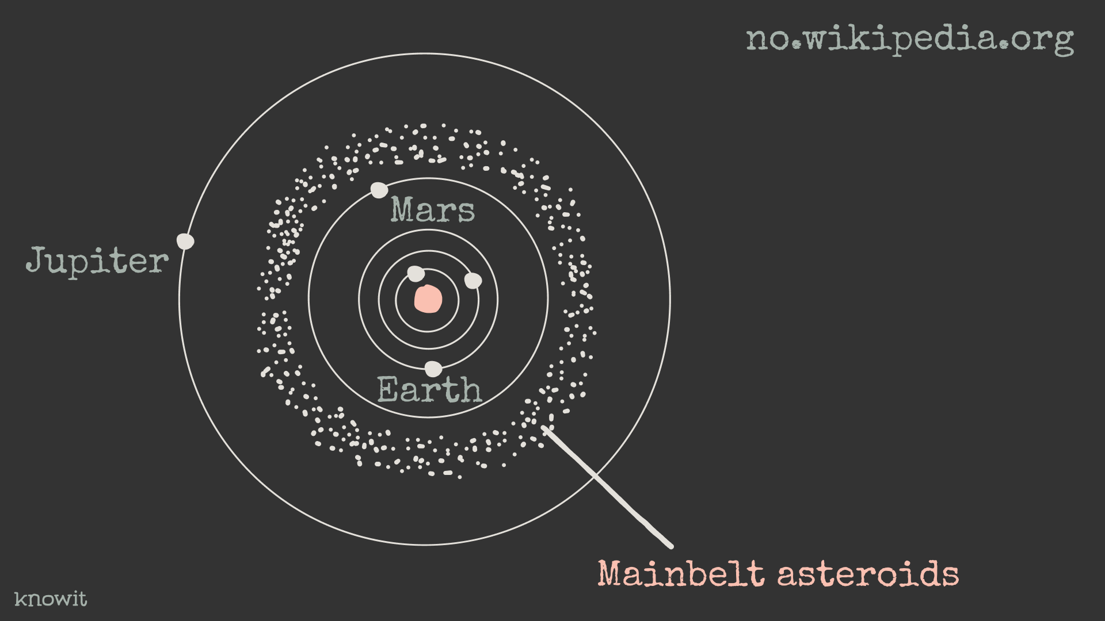
Notes:
Another more spesific Wikipedia-problem is that some words scores unreasonably high. I’ve done a short analysis and found that the word “mainbelt asteroid” was one of the top stopword suggestions. The reason is that there are a lot of these asteriods and probably some autogenerationg of articles for each of them. For the 10.000 first articles, the word was mentioned 1.800 times. The solution there was to skip all the articles that started with 0-9. So it could maybe work.

Slide 16
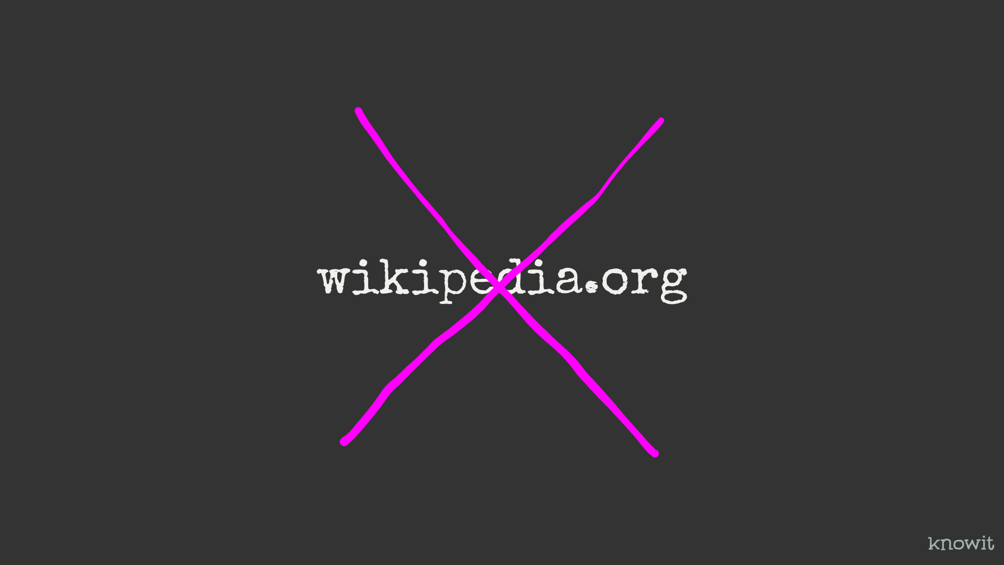
Notes:
But for Sami there is just one site, only covering Northern Sami. And it had really short articles. And it had way to much Norwegian text, so it wasn’t anything we could use.

Slide 17

Notes:
Therefore, the project was put on ice for a while. Until I found out that NRK has a subsite with article stubs in all three official Sami languages.

Slide 18
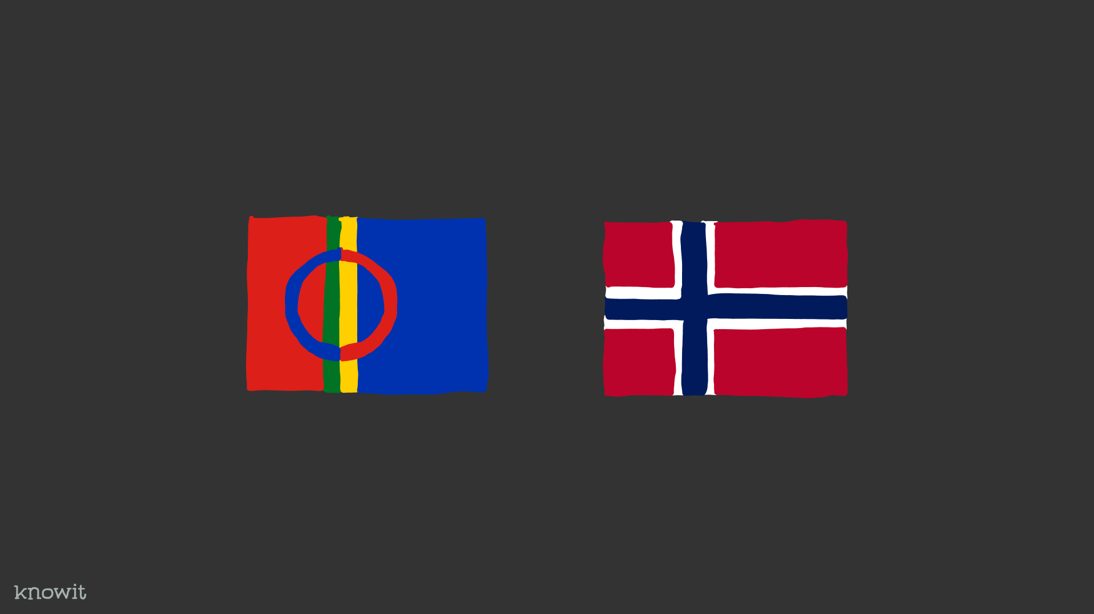
Notes:
There you have another challenge with a lot of words around Sami and Norwegian identity. But worth a try.

Slide 19
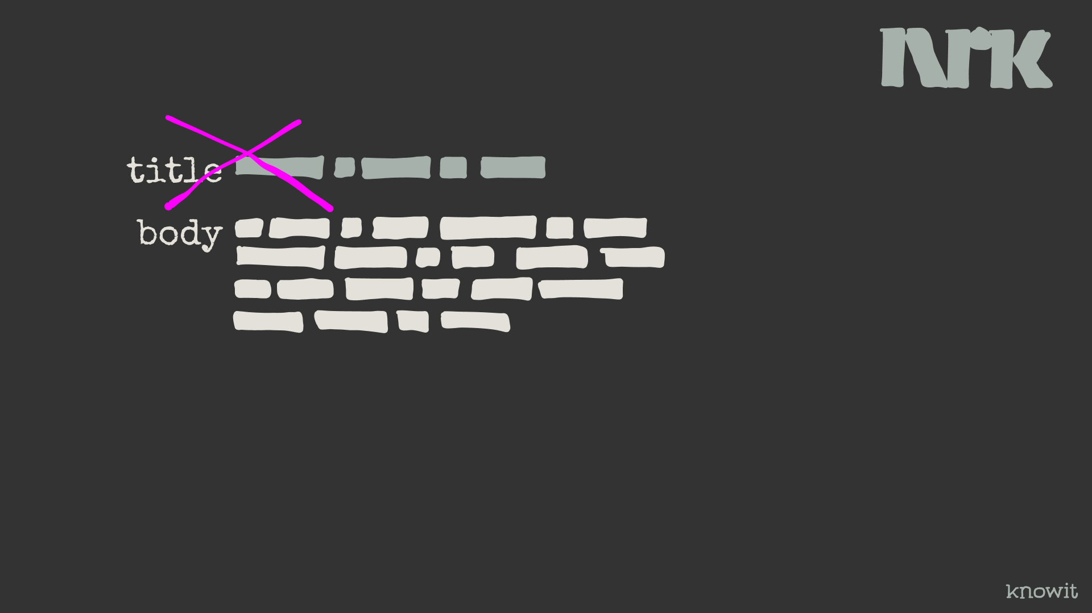
Notes:
Dropping the title in word counting helped.

Slide 20
Notes:
But still there were a problem that short texts seems to have. Too many words with meaning.

Slide 21
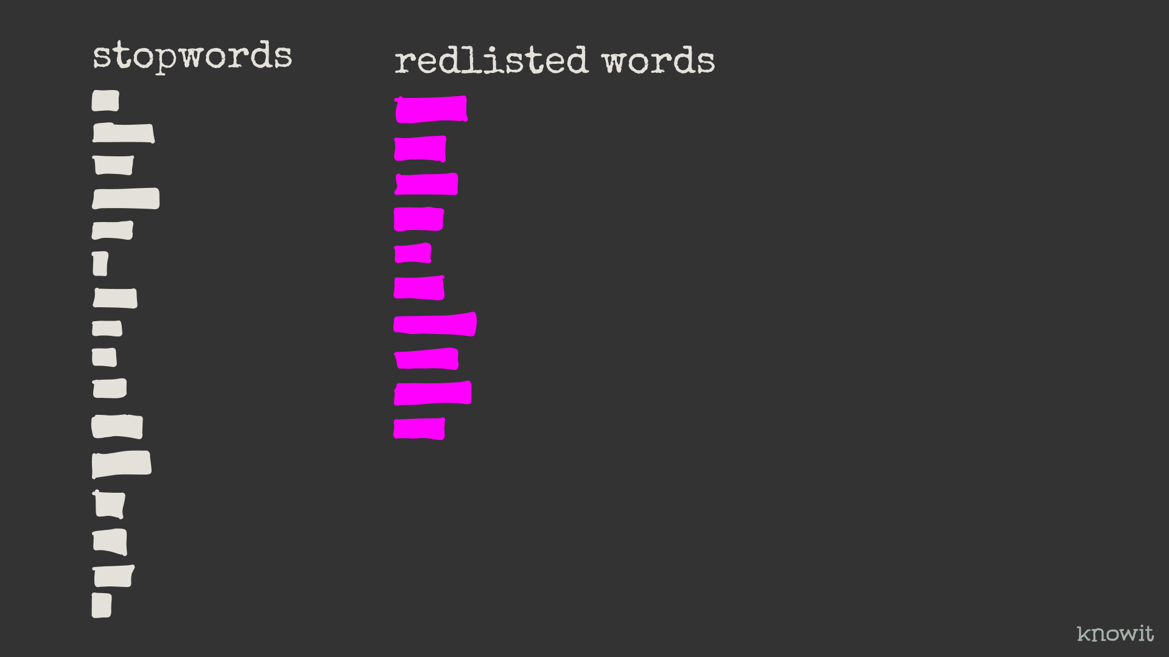
Notes:
To counter the problem, the stopword trainer can take a list of redlisted words. If a stopword list is blacklisting words, the redlist is the words you don’t blacklisted, or to ”go extinct”. Creating the list is manual work, but can then be used programatically.

Slide 22
Remaining work
Notes:
So, what’s the remaining work for the project?

Slide 23
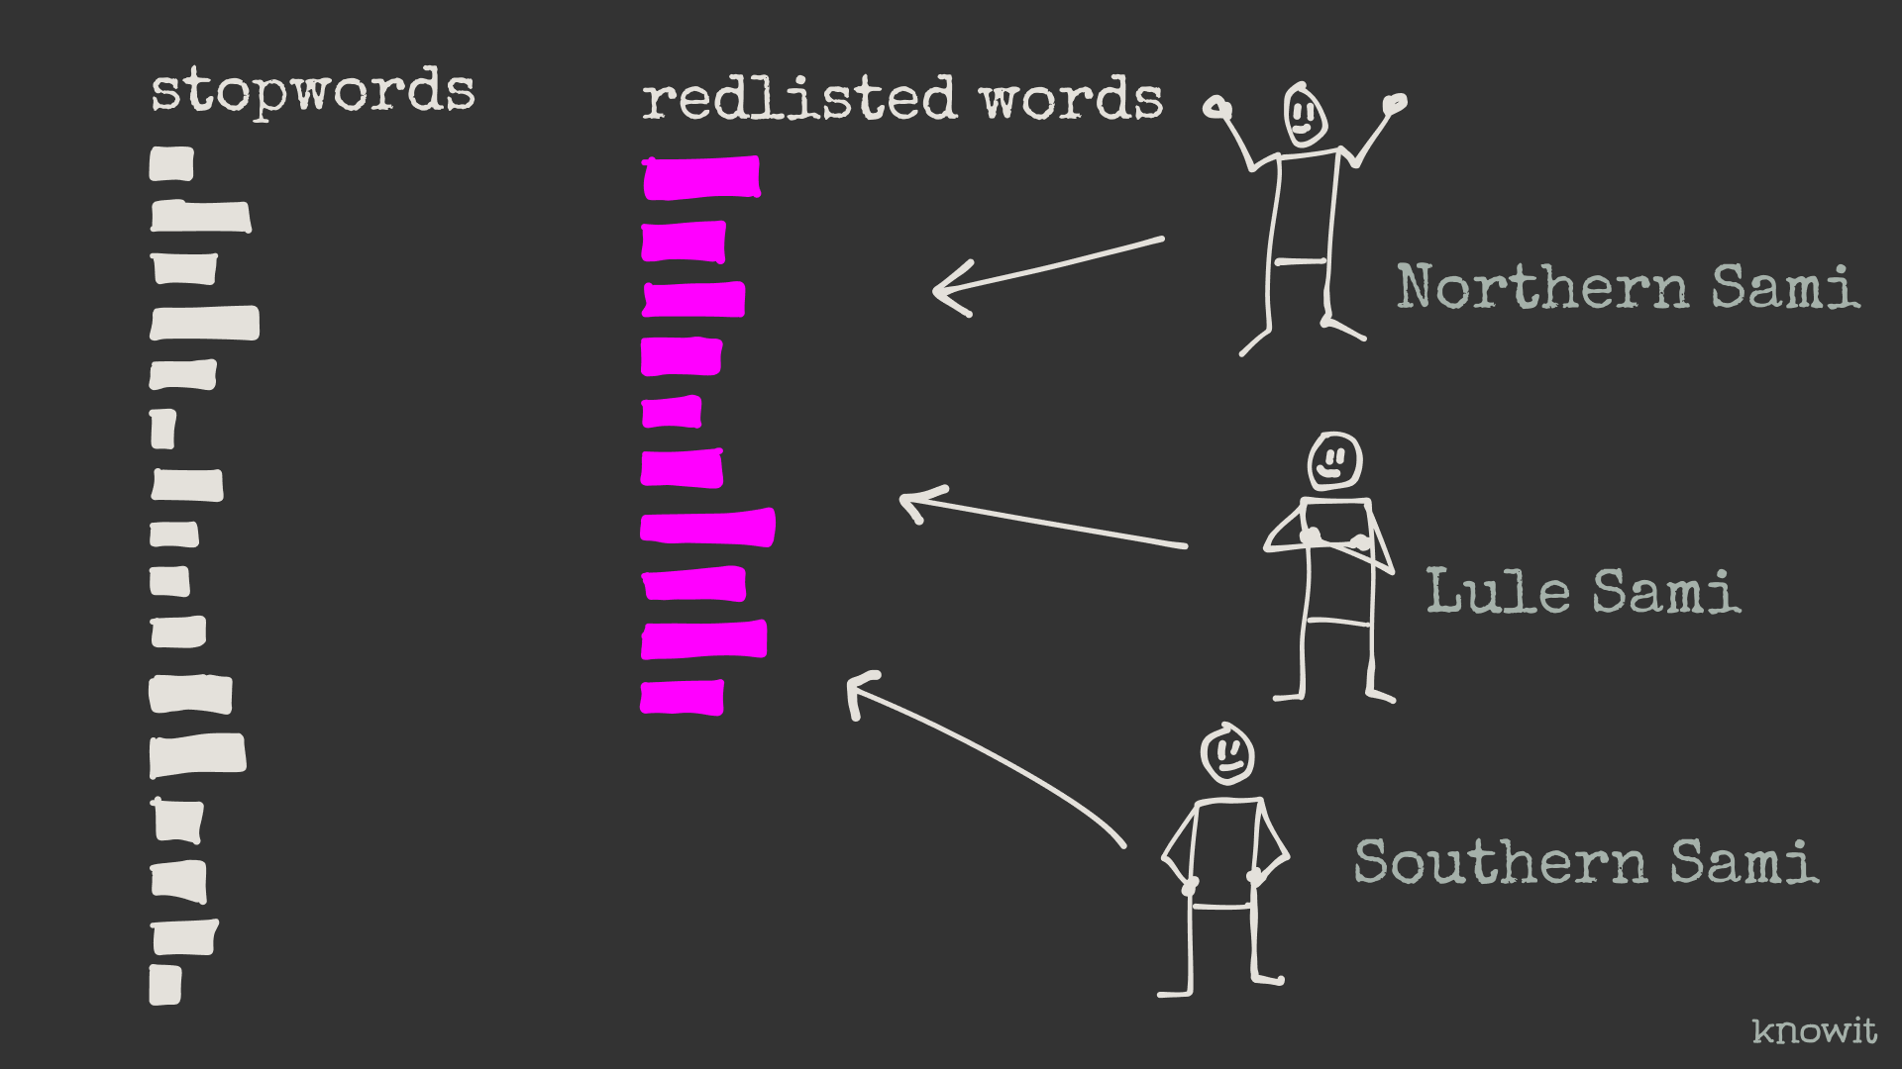
Notes:
We need three people, one for each Sami language, to go through the words with the highest stopwordiness and add the ones that shouldn’t be stopwords to th redlist. Maybe they need to go through th 2-3-4-500 first words.

Slide 24
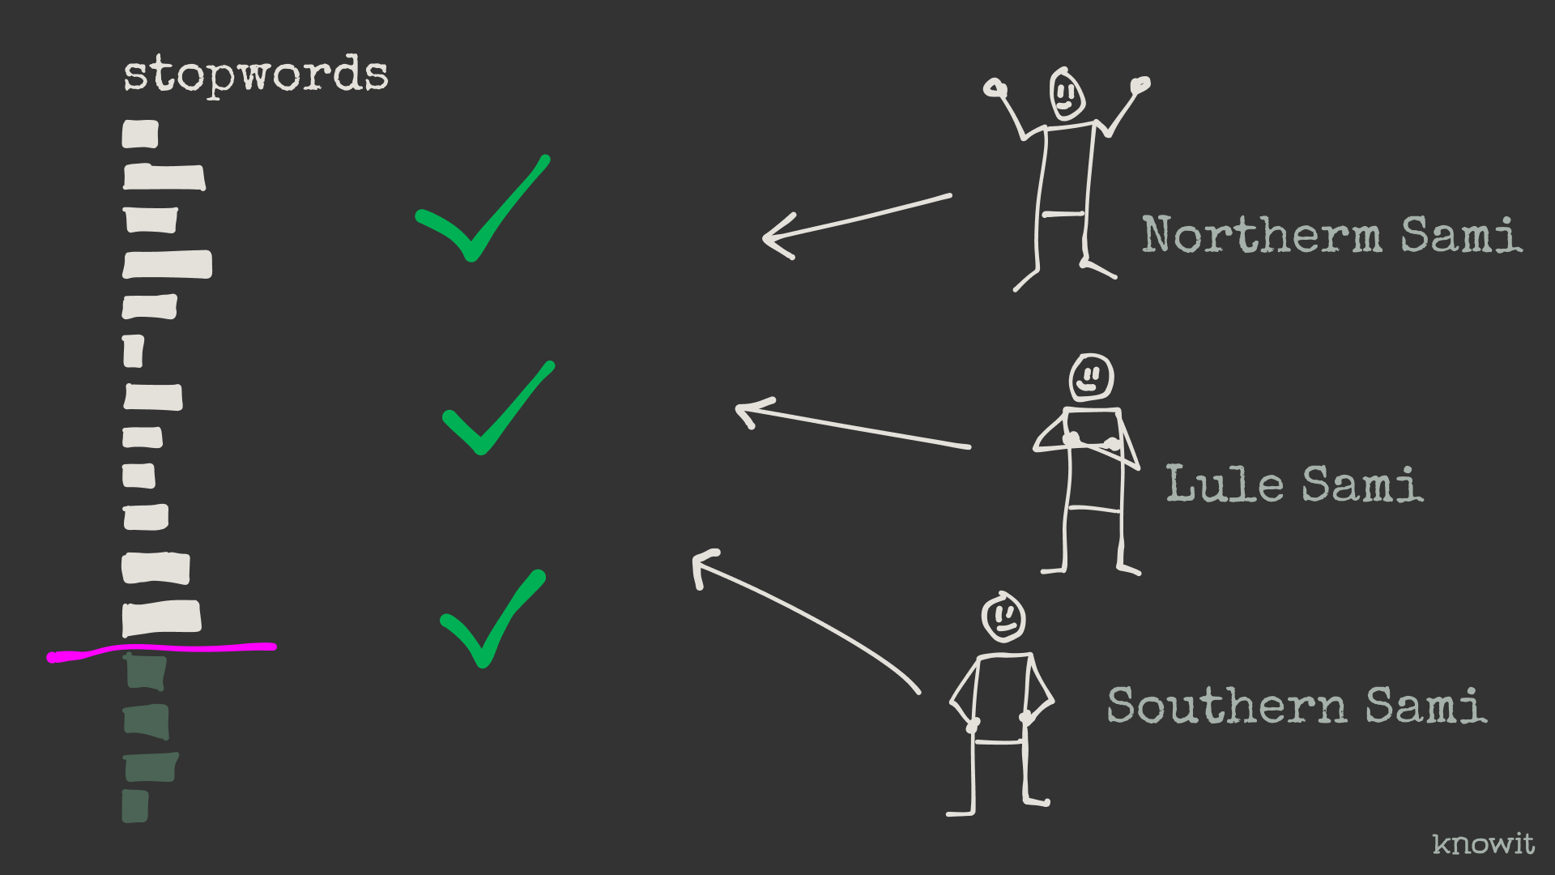
Notes:
In addition the end result needs to be verified and the cutoff of the length of each stopword list needs to be defined.

Slide 25
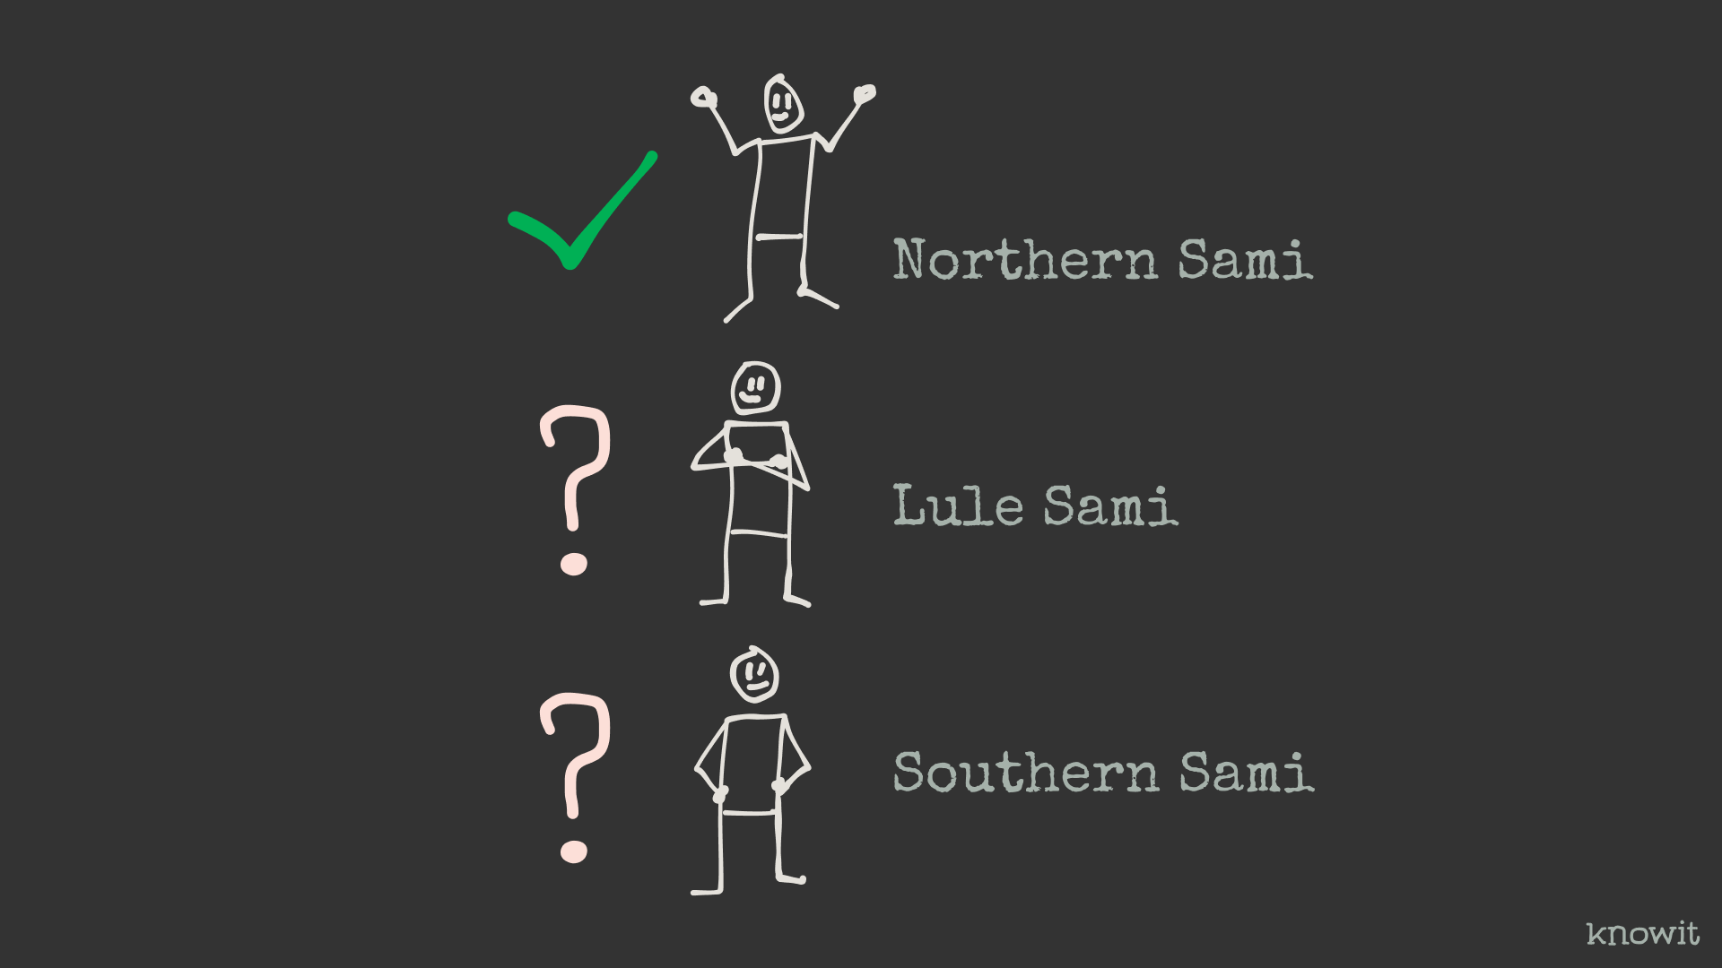
Notes:
To do this we need to find these people. Weve alreay found one. Levi Sørum at Knowit has said yes to help us with Norhtern Sami. So, two to go.

Slide 26
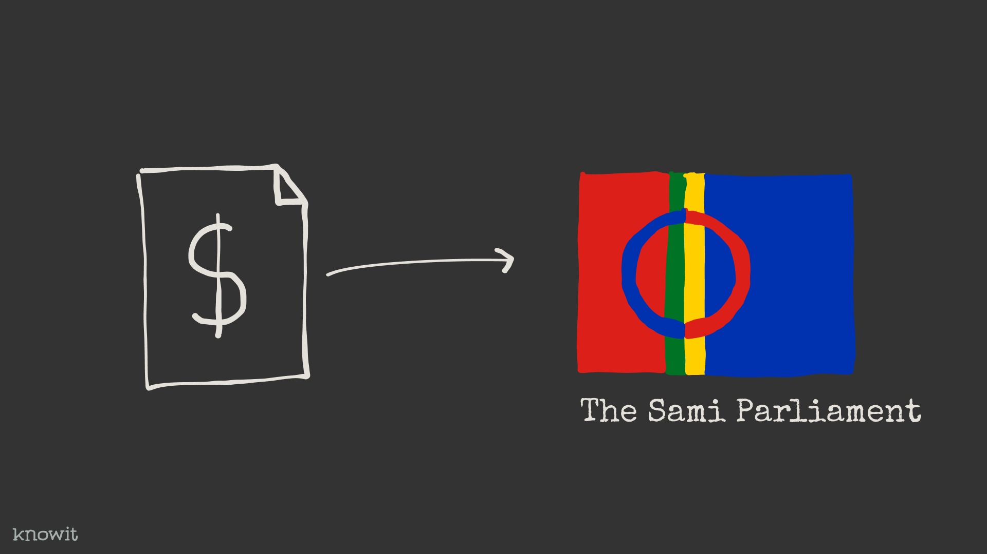
Notes:
Since we’re about to include other people in the project and there is some coordination and setup, I’ve applied the Sami Parliament for some money. I’m hoping for a reply in some weeks.

Slide 27
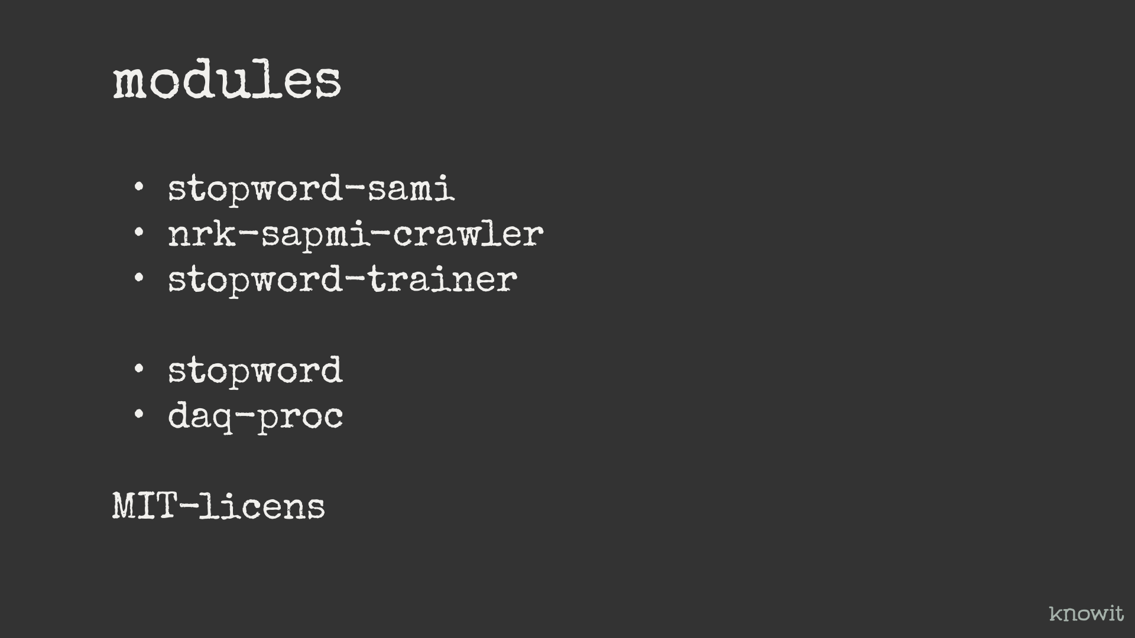
Notes:
The modules for the project is the following: Stopword-sami – which will contain the Sami stopwords and all that’s needed to create them.
Dependencies for this is:
Nrk-sapmi-crawler – Super simple crawler that gets a JSON of article IDs and then crawl these IDs. And then there is
Stopword-trainer – which is fed the body-text of the article stubs.
In addition we have
Stopword – Which is a code library to remove stopwords from text. It contains a little over 60 languages, and soon there will be three more.
Daq-proc – Small library for document and query processing library. Depends among other things, the stopword module. And also depends on an ngram and a keyword extractor.

Slide 28
Demo…
Notes:
So, then the only thing left is a little show and tell + demo.

Slide 29
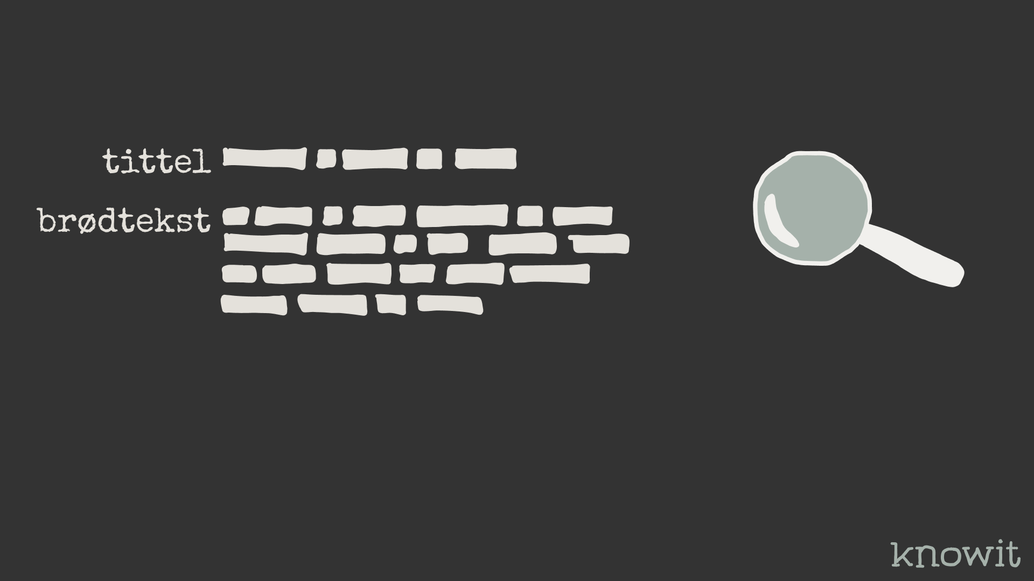
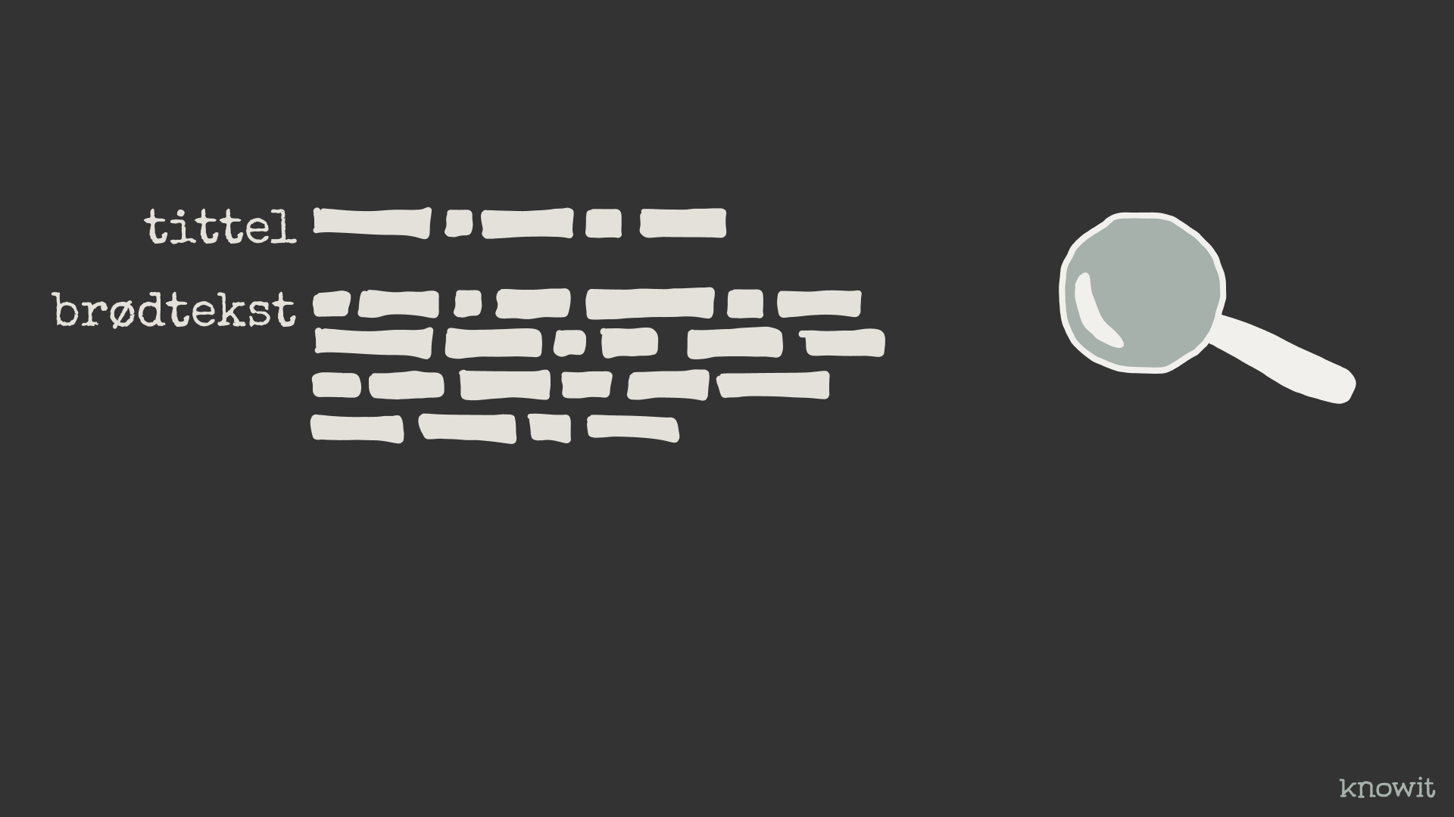

Slide 30
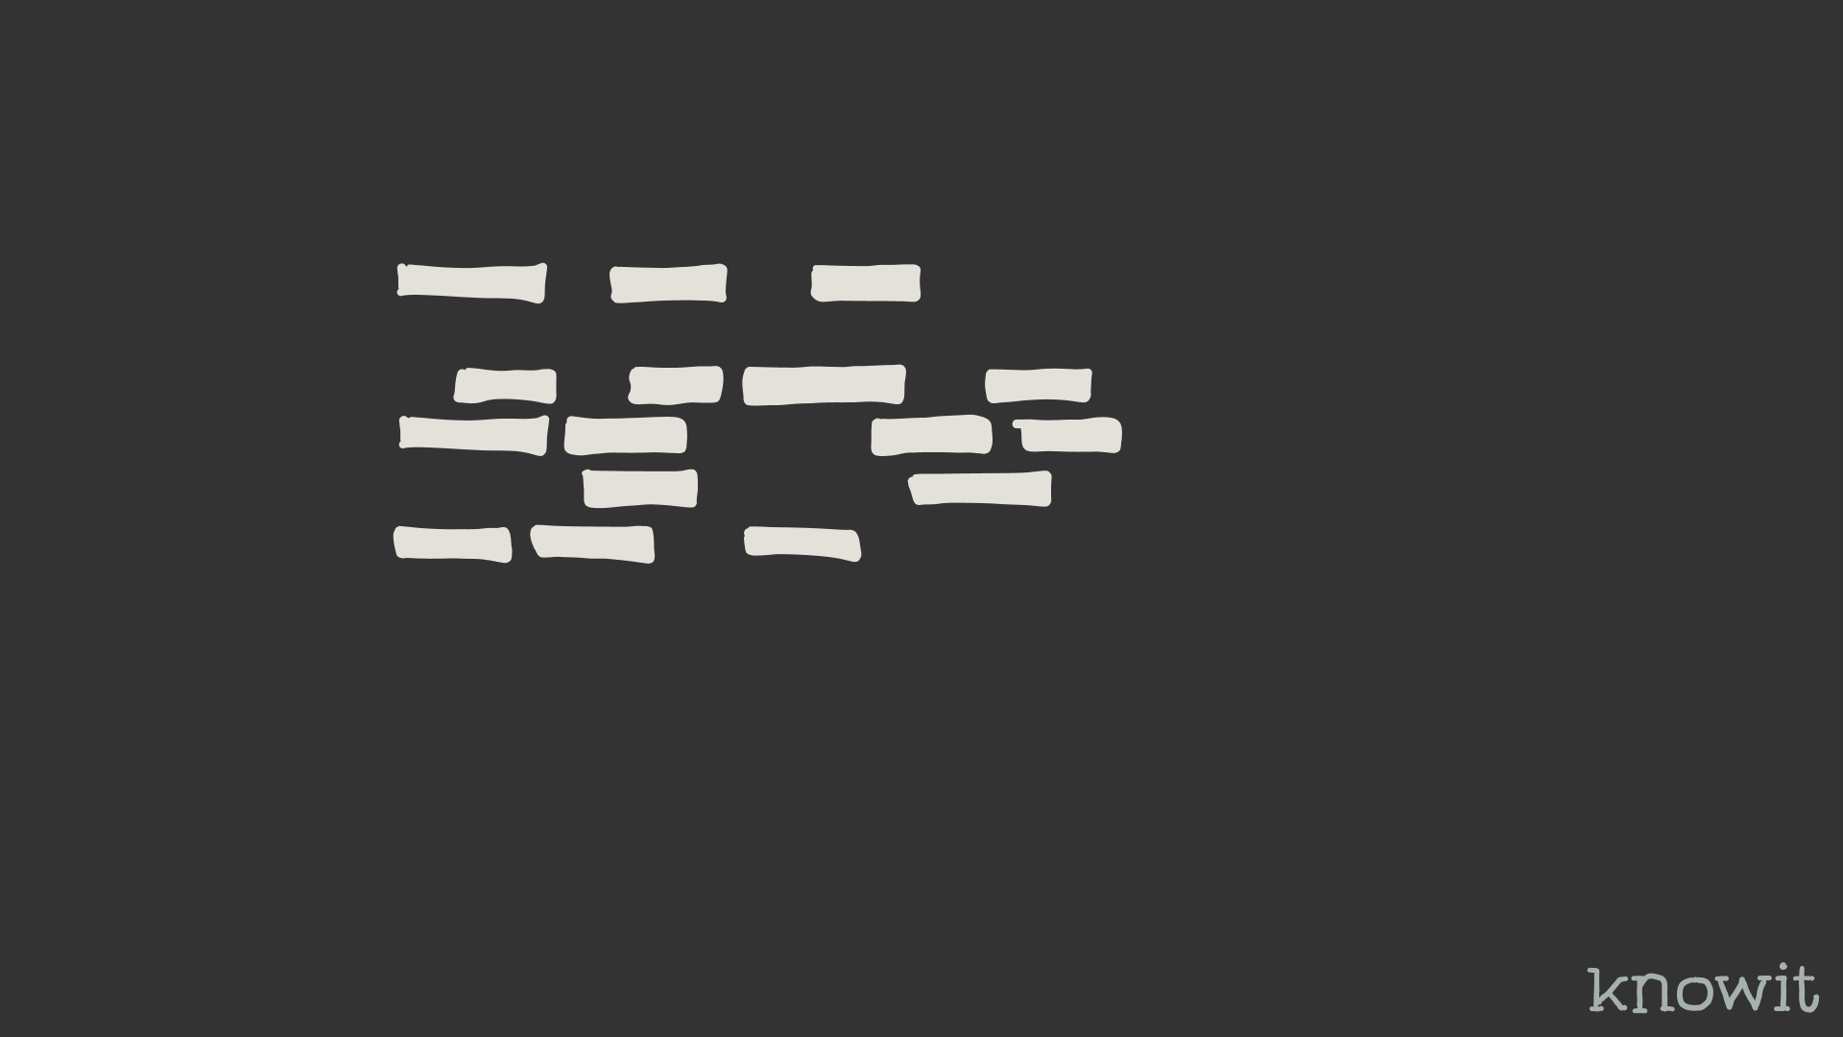
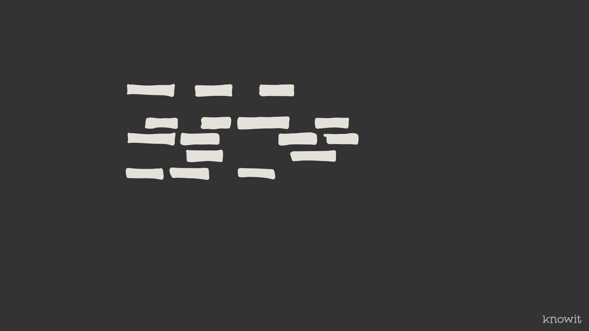

Slide 31
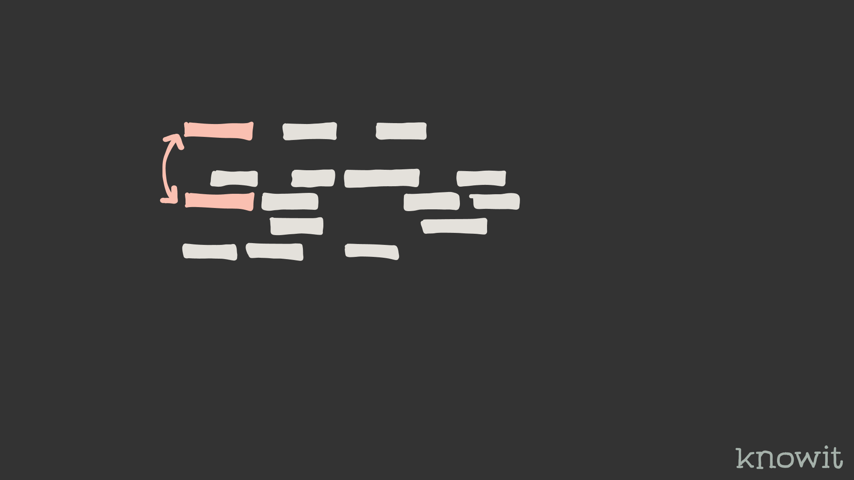
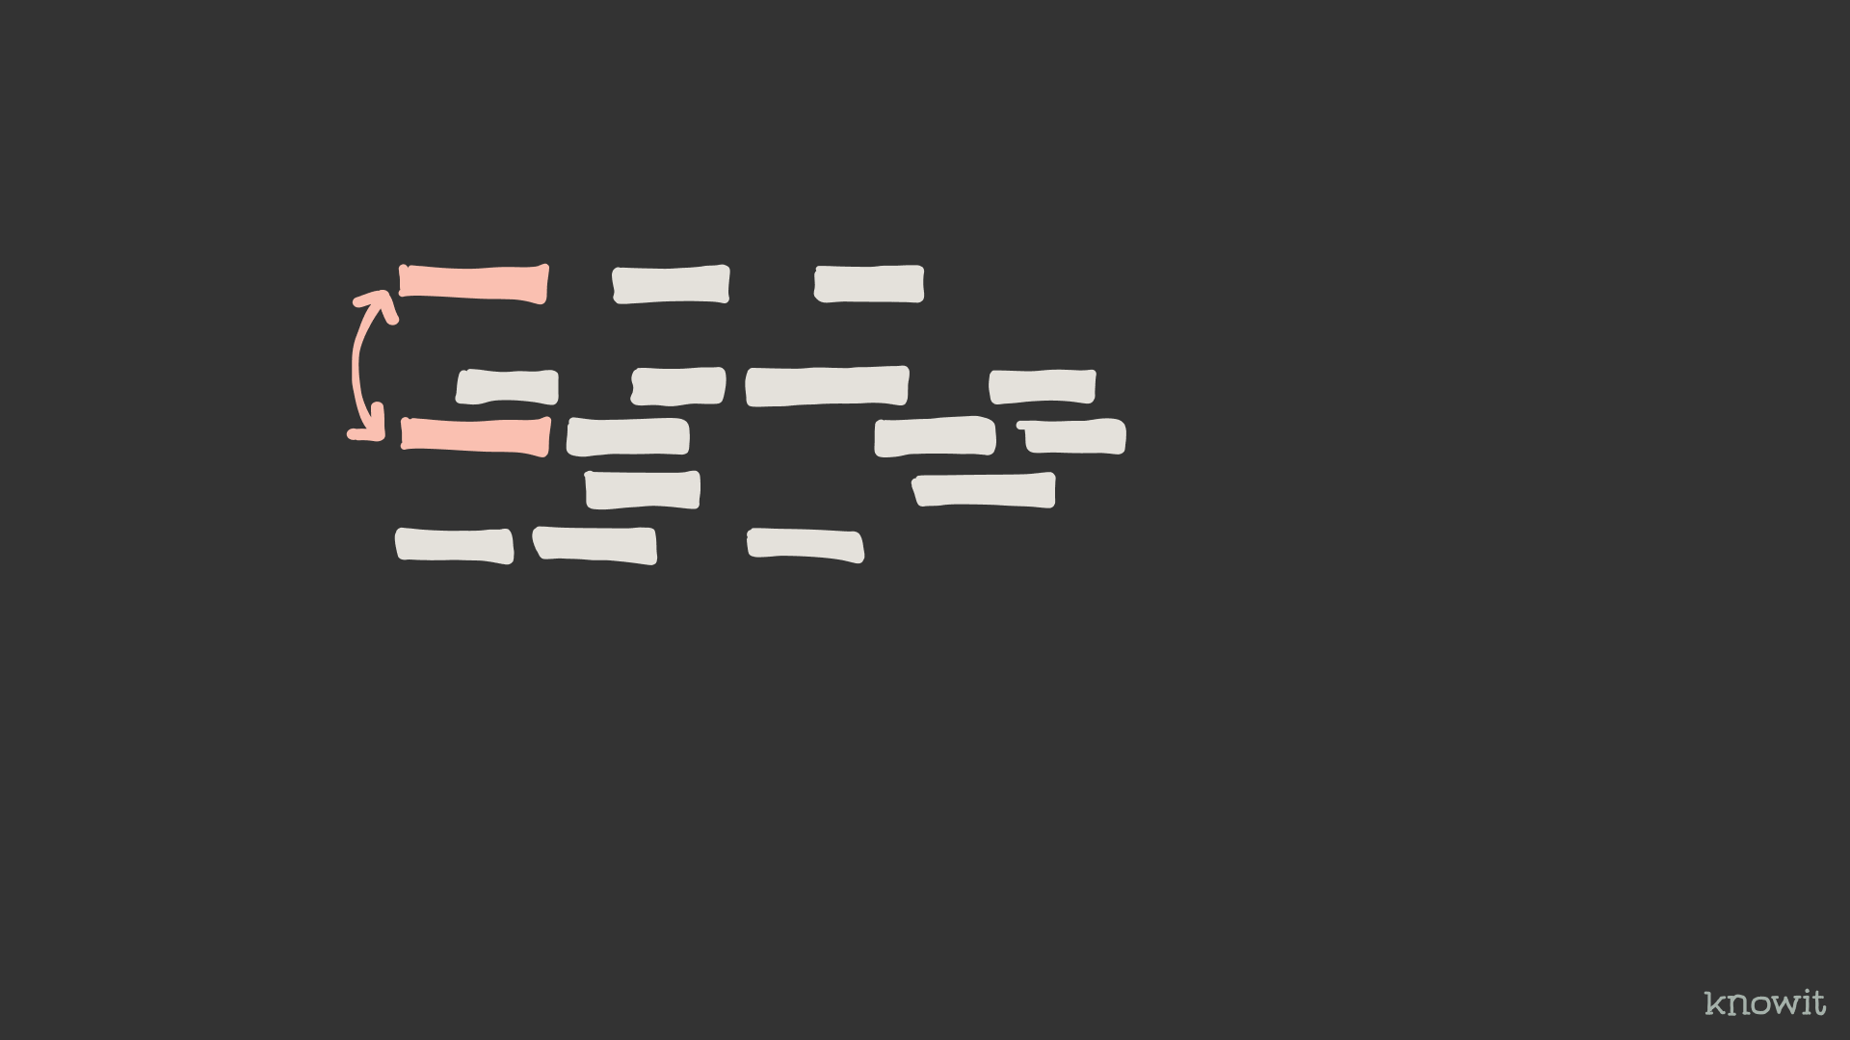

Slide 32
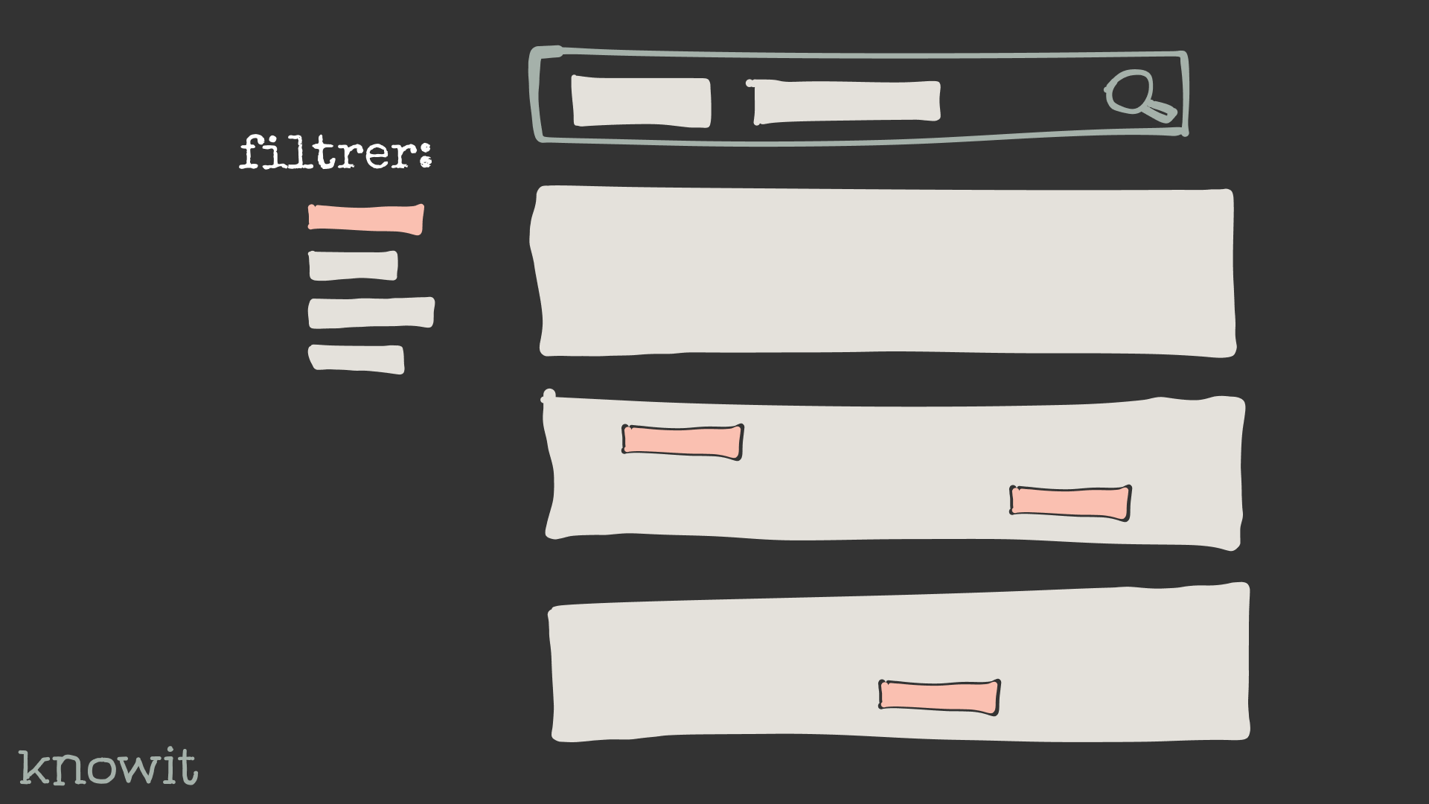
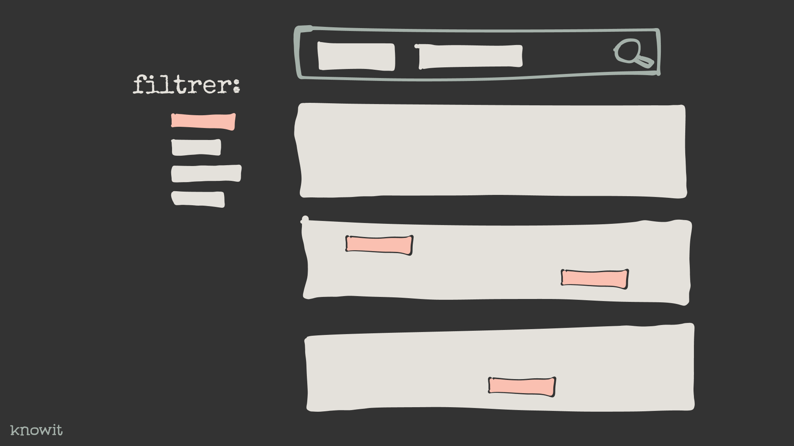

Slide 33

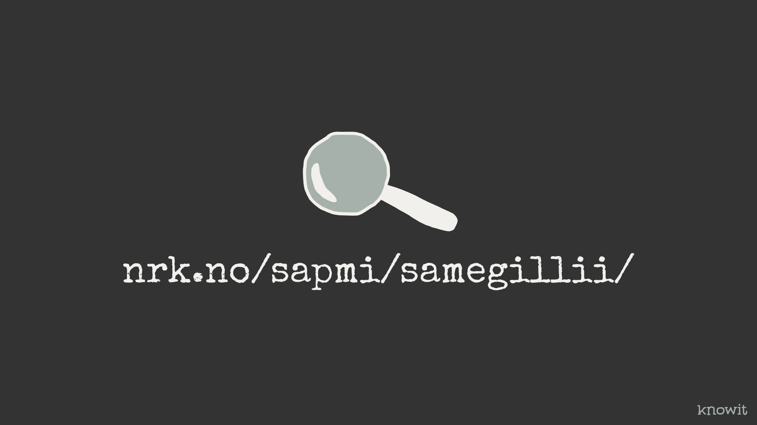
Notes:
What’s next? Create a demo-search from the data crawled. With filtering on language and keywords and maybe a typeahead.

Slide 34
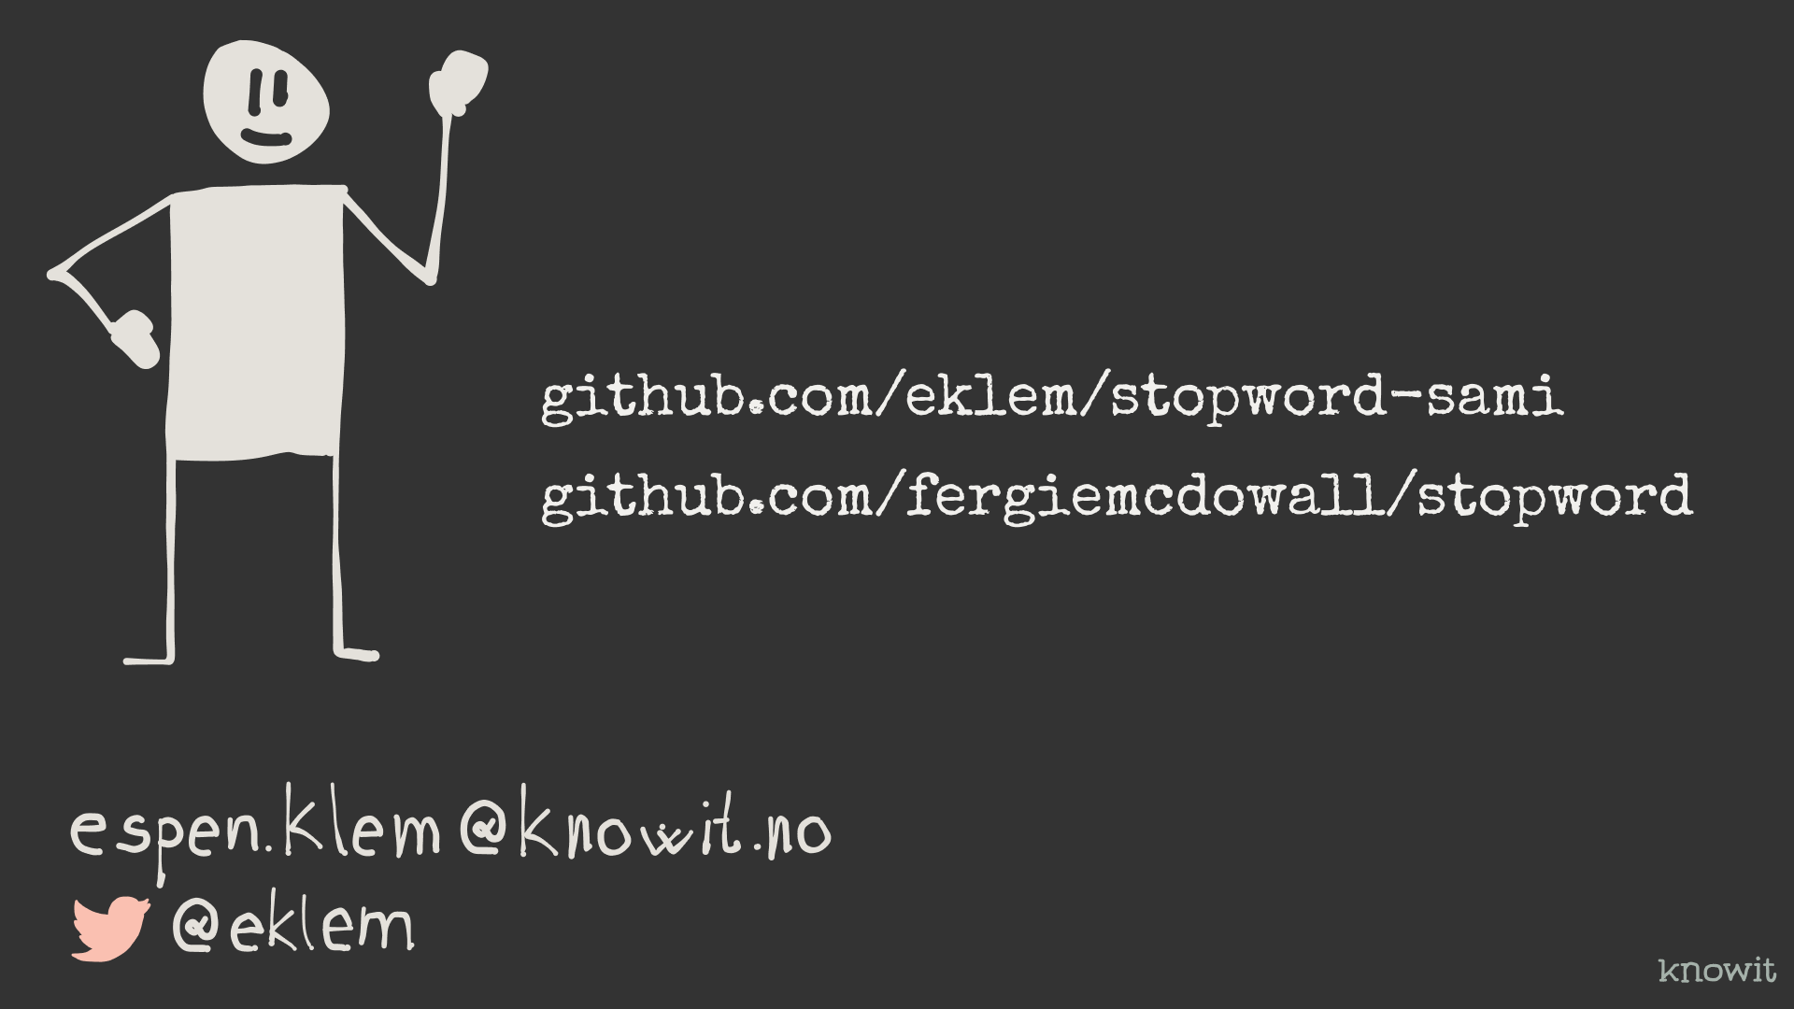
Notes:
Thanks a lot for your time! Hope you check out the library.

