Slide 1
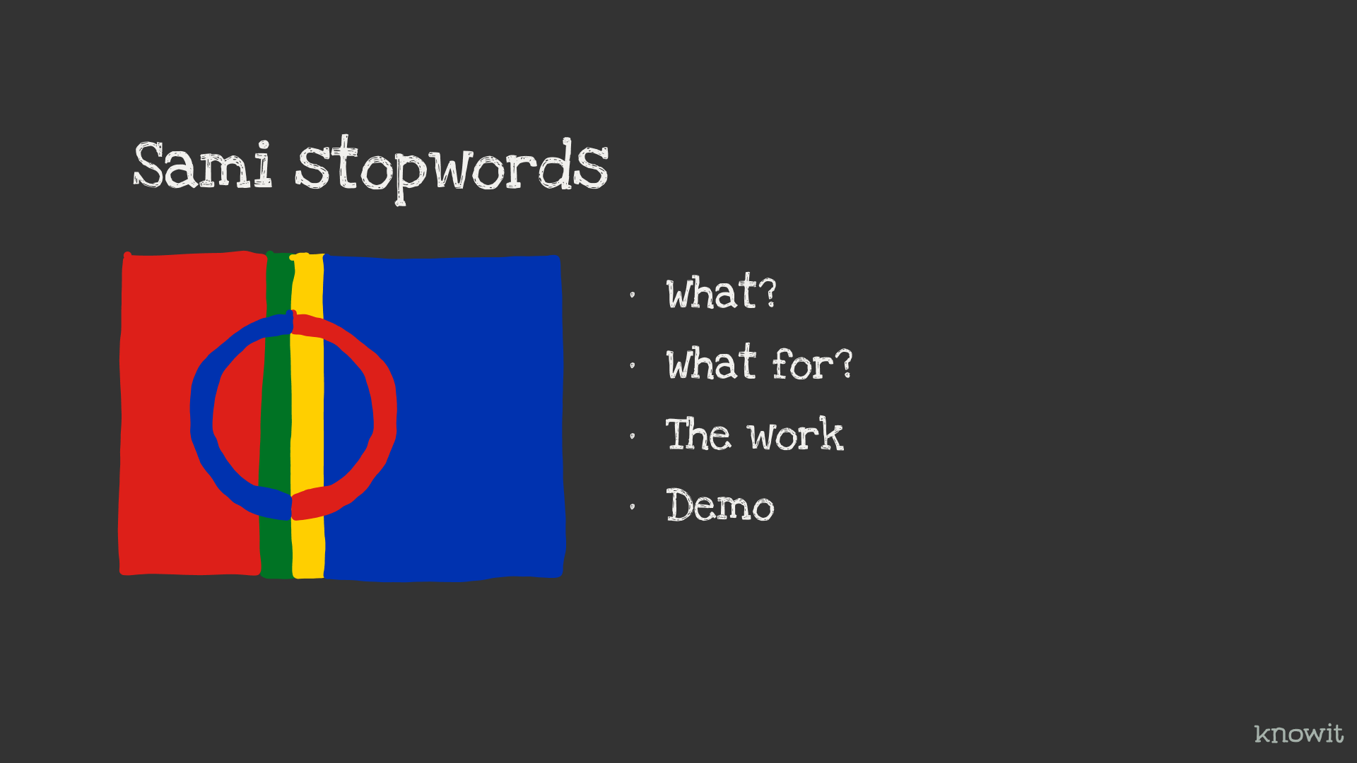
Notes:
I am going to talk about the Sami stopwords project.
What is it? What is it for? The work behind it. Both done and remaining.
And a little about the work with the text sources. Demo

Slide 2
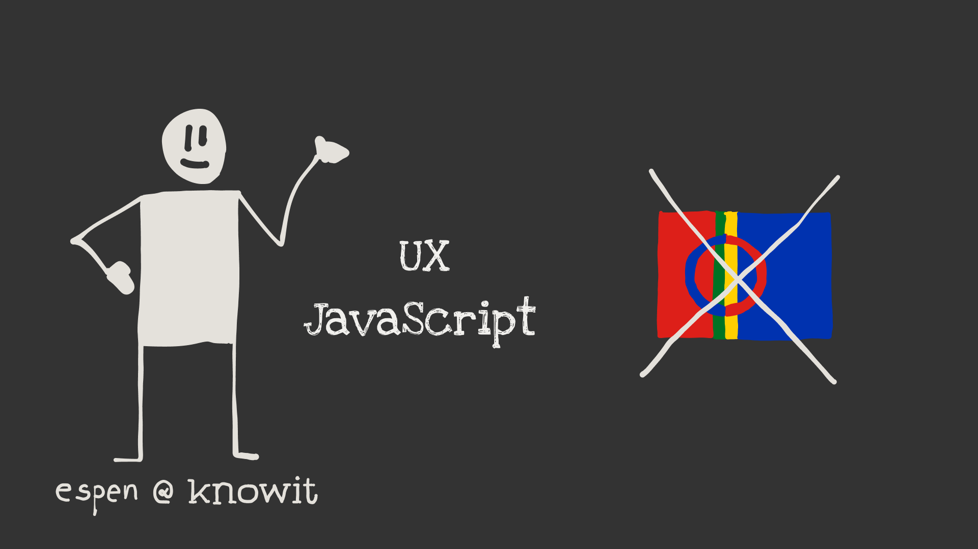
Notes:
My name is Espen Klem. I work as an Interaction Designer at Knowit and play around with JavaScript every now and then. I’m not sami, and don’t know any of the Sami languages.
I have previously generated stopword lists for Punjabi and Finish. And created some simple tools to actually do this work.

Slide 3
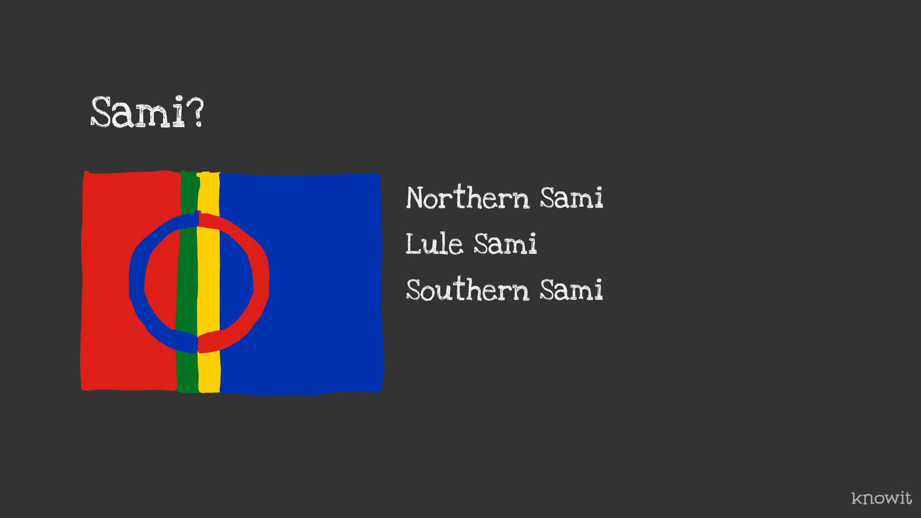
Notes:
Sami languages in Norway mainly consists of three different ones. Northern Sami, Lule Sami and Southern Sami. Northern Sami is the largest by far and has 25000 users.
My motivation to do this work is to make it possible to create better digital solutions in Sami.

Slide 4
What is it?
Notes:
What is it?

Slide 5
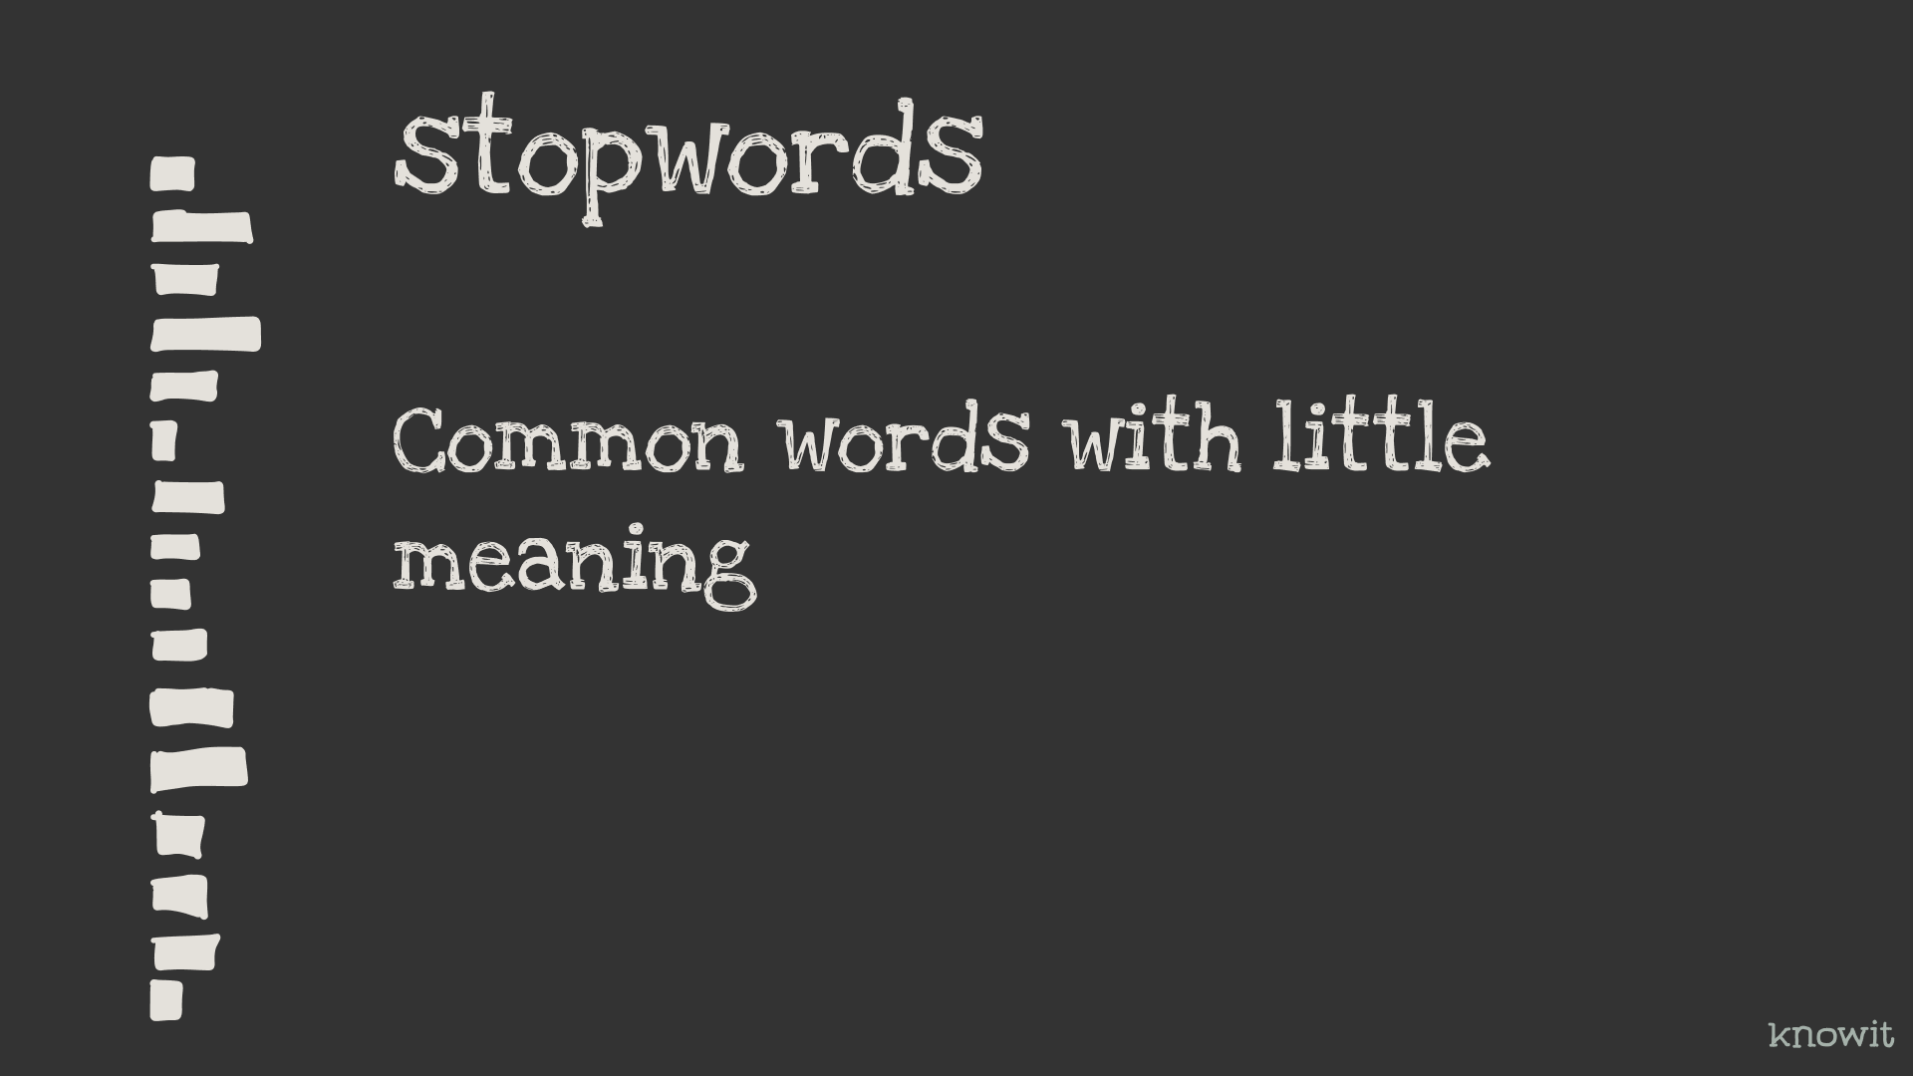
Notes:
What are stopwords? It’s all the often used words with little to no meaning. But stopwords have no clear definition, so it’s some work to generate an okay list.

Slide 6
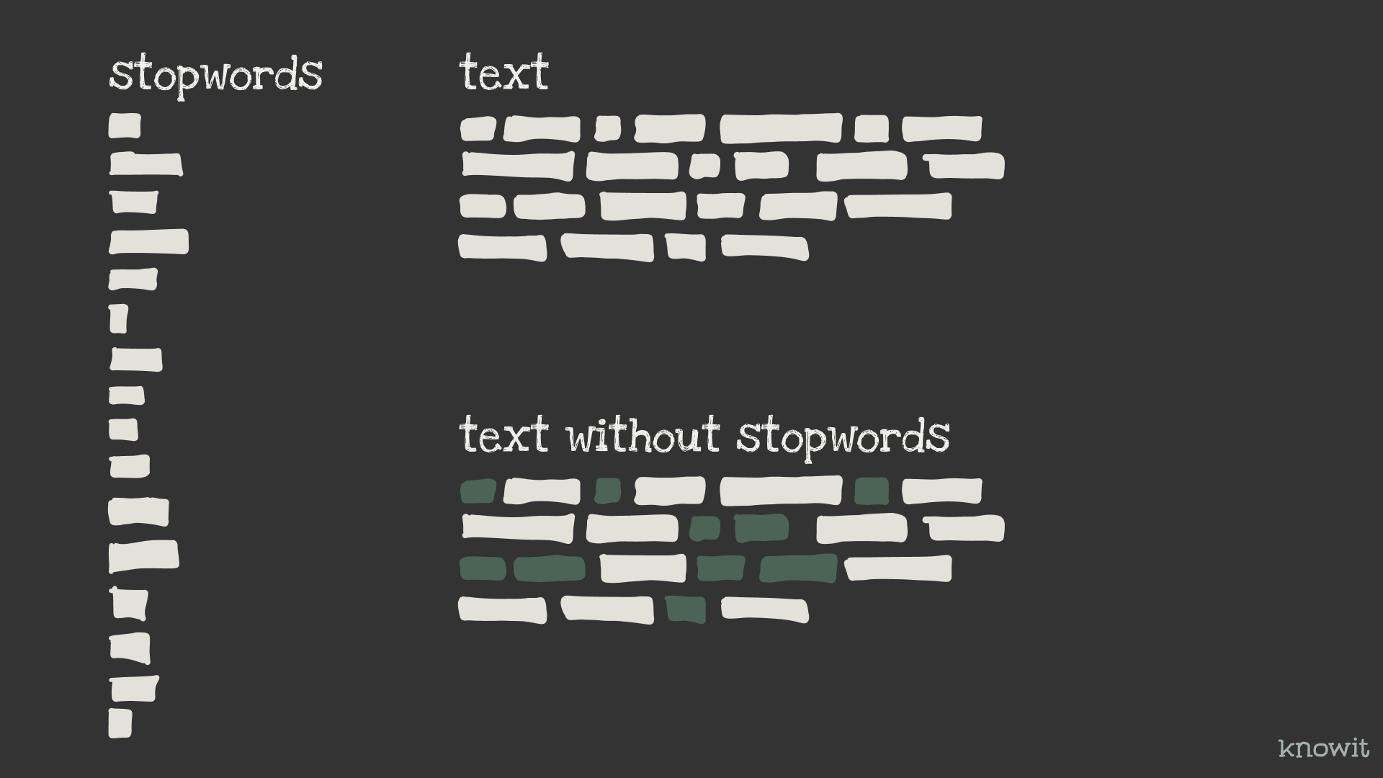
Notes:
The way stopwords are used is mostly to remove them from text before further, different text analysis.

Slide 7
What is it for?
Notes:
Then, what is it for, and where is it used?

Slide 8

Notes:
Search engines
Machinelearning
Email spam detection
Sentiment analysis
Plagiarism analysis
... This is from what I have seen.

Slide 9
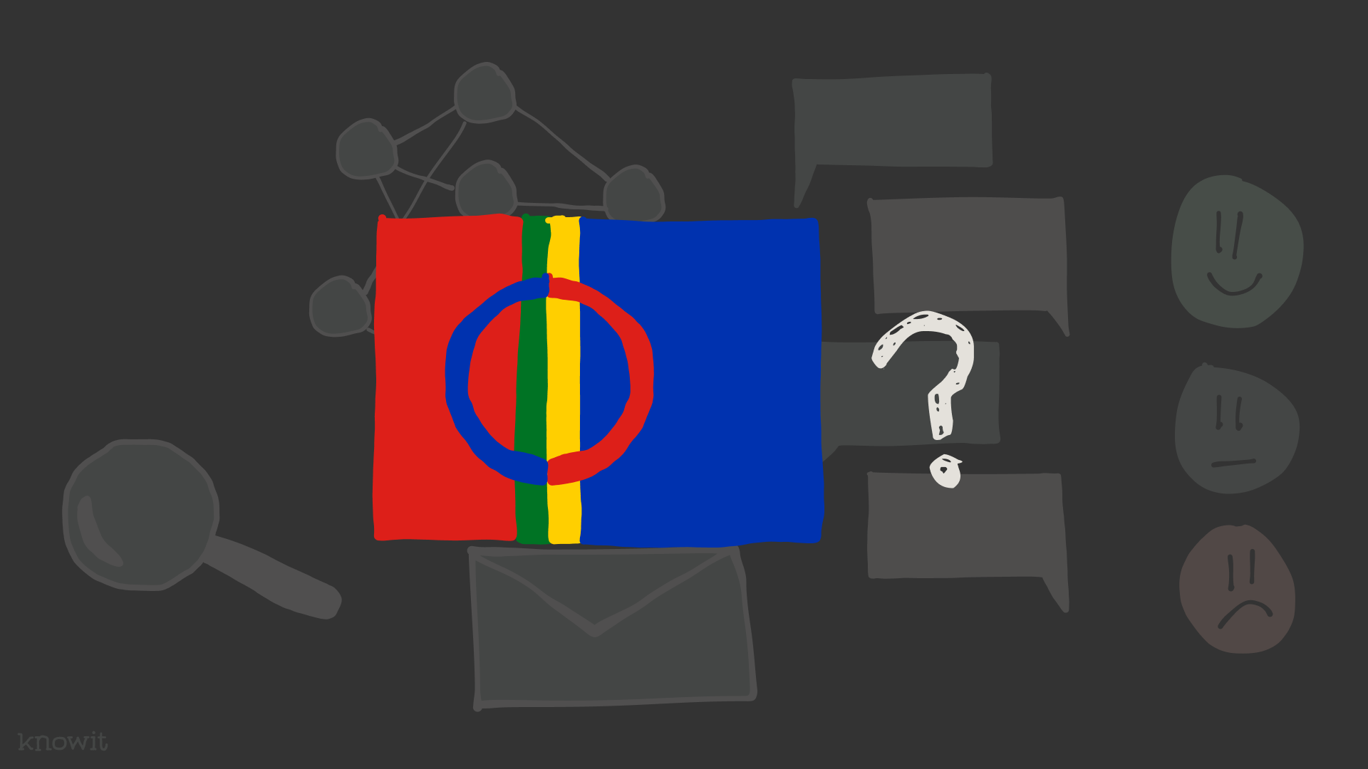
Notes:
Hopefully it will be easier to make good solutions like this in the sami languages when the project is finished and the stopword-sami library reaches v1

Slide 10
The work we’re doing?
Notes:
What does the actual work consist of? How do you create a list of stopwords for a language?

Slide 11
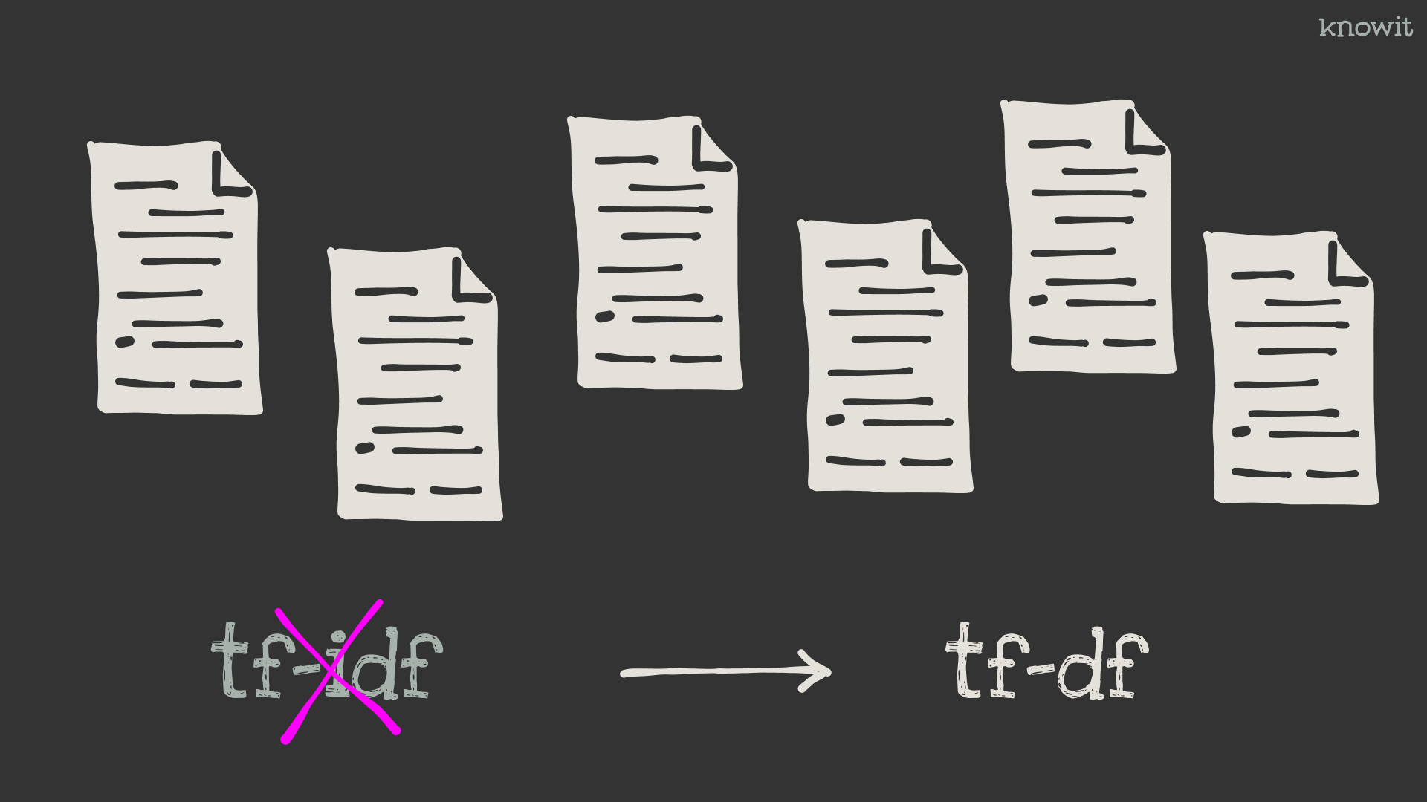
Notes:
The algorithm used is the oposite of what’s used to identifyt important words in a search text corpus. So, instead of “term-frequency-inverse-document-frequency” we use “term-frequency-document-frequency.” Words that are used most and in most documents gets the highest stopword score, or stopwordiness.

Slide 12

Notes:
And to do this analysis we need documents.

Slide 13
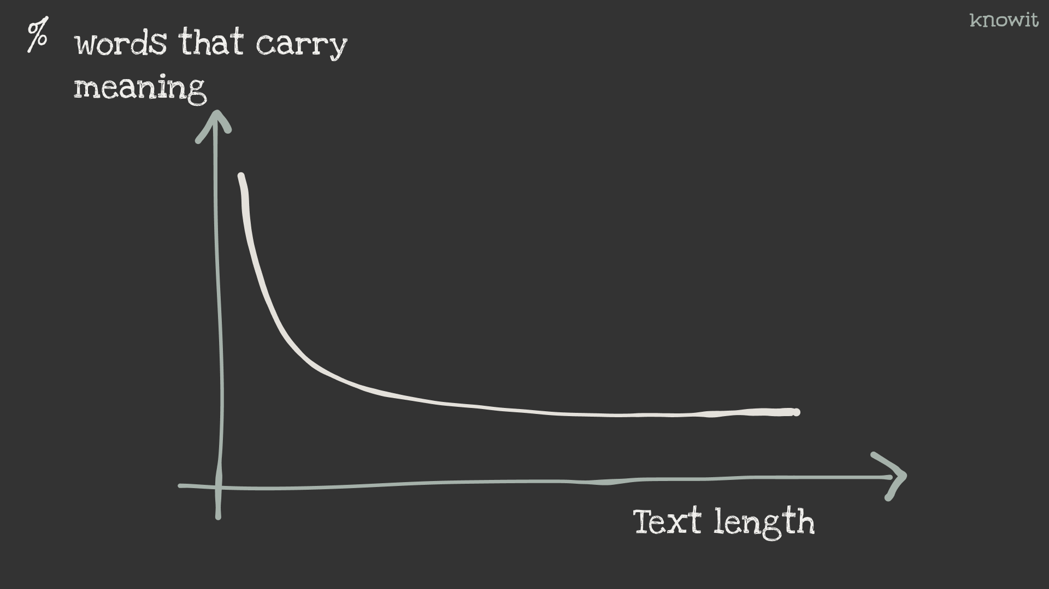
Notes:
One challenge has been that the percentage of words with a lot of meaning is high when the texts are short.

Slide 14
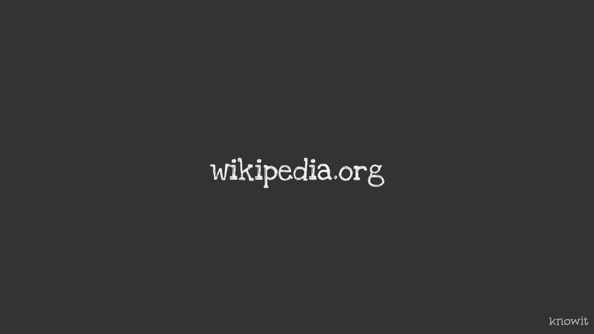
Notes:
I’ve used Wikipedia previosly for Punjabi and Finish, and tested it on Norwegian with good luck.

Slide 15
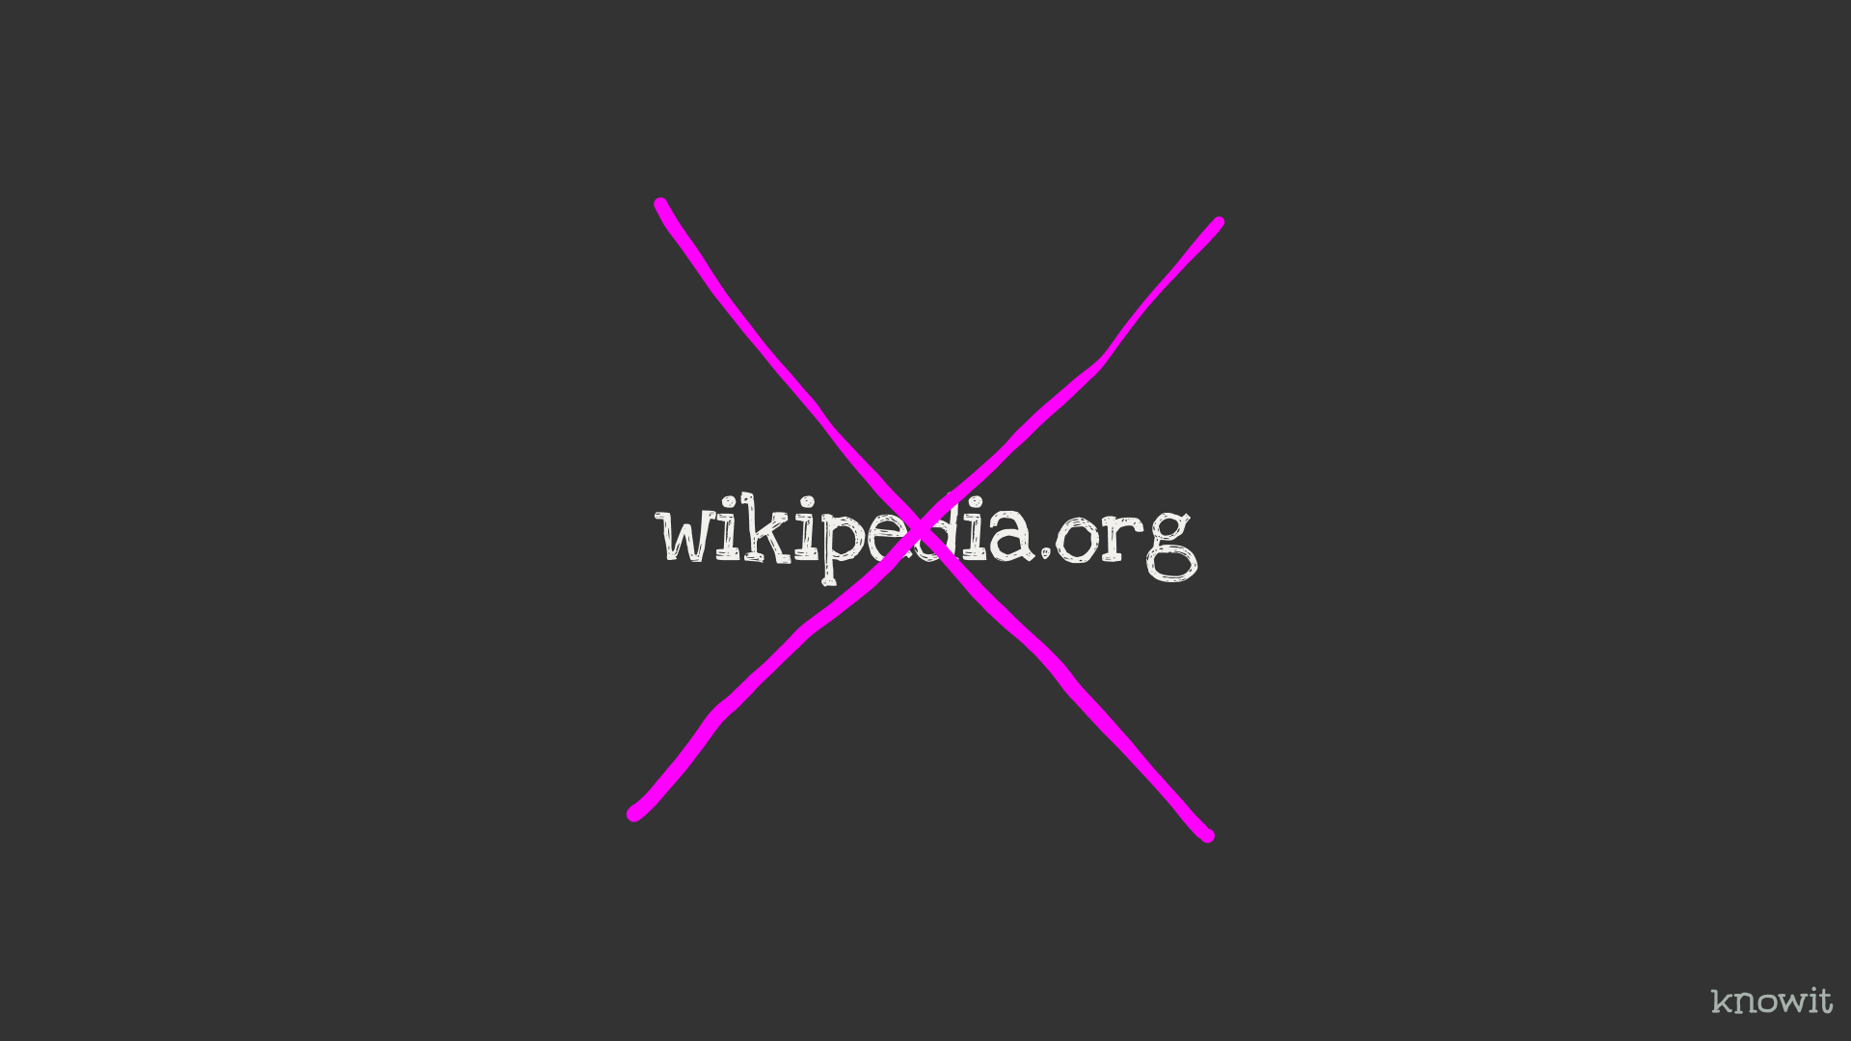
Notes:
But that doesn’t matter here. Because for Sami there is just one site, only covering Northern Sami. And it has really, really short articles. And it has way to much Norwegian text in it. So not usable.

Slide 16

Notes:
Therefore, the project was put on ice for a while. Until I found out that NRK has a subsite with article stubs in all three official Sami languages.

Slide 17
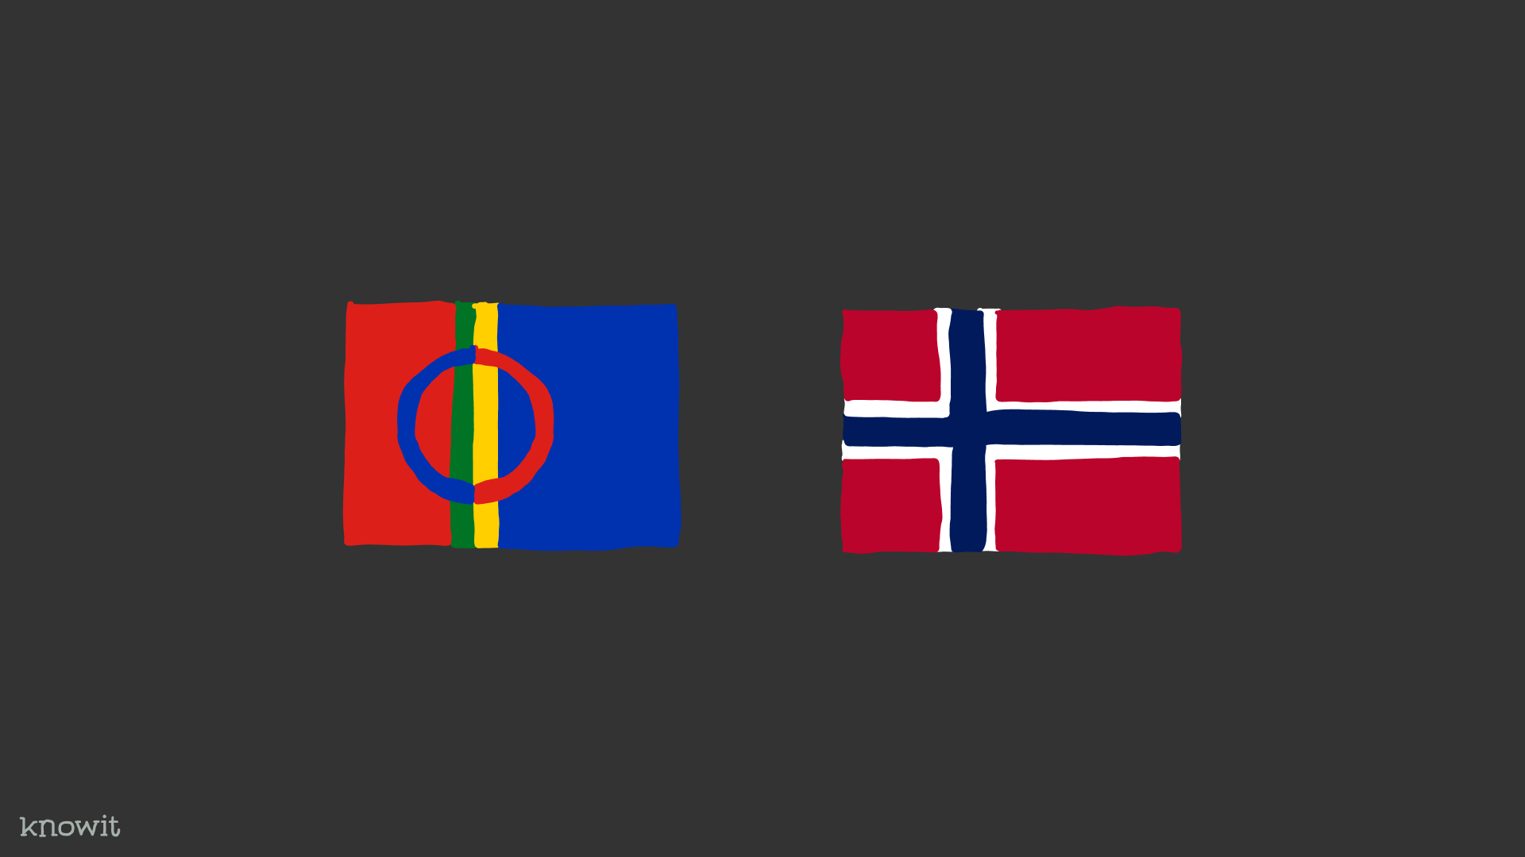
Notes:
There is a challenge with a lot of words around Sami and Norwegian cultural identity.

Slide 18

Notes:
And the titles are not good for this analysis. So, just dropping them, only using the body text.

Slide 19
Notes:
But still it has the problem of short texts: Too many words with too much meaning. You're bubbling up the wrong words every now and then.

Slide 20
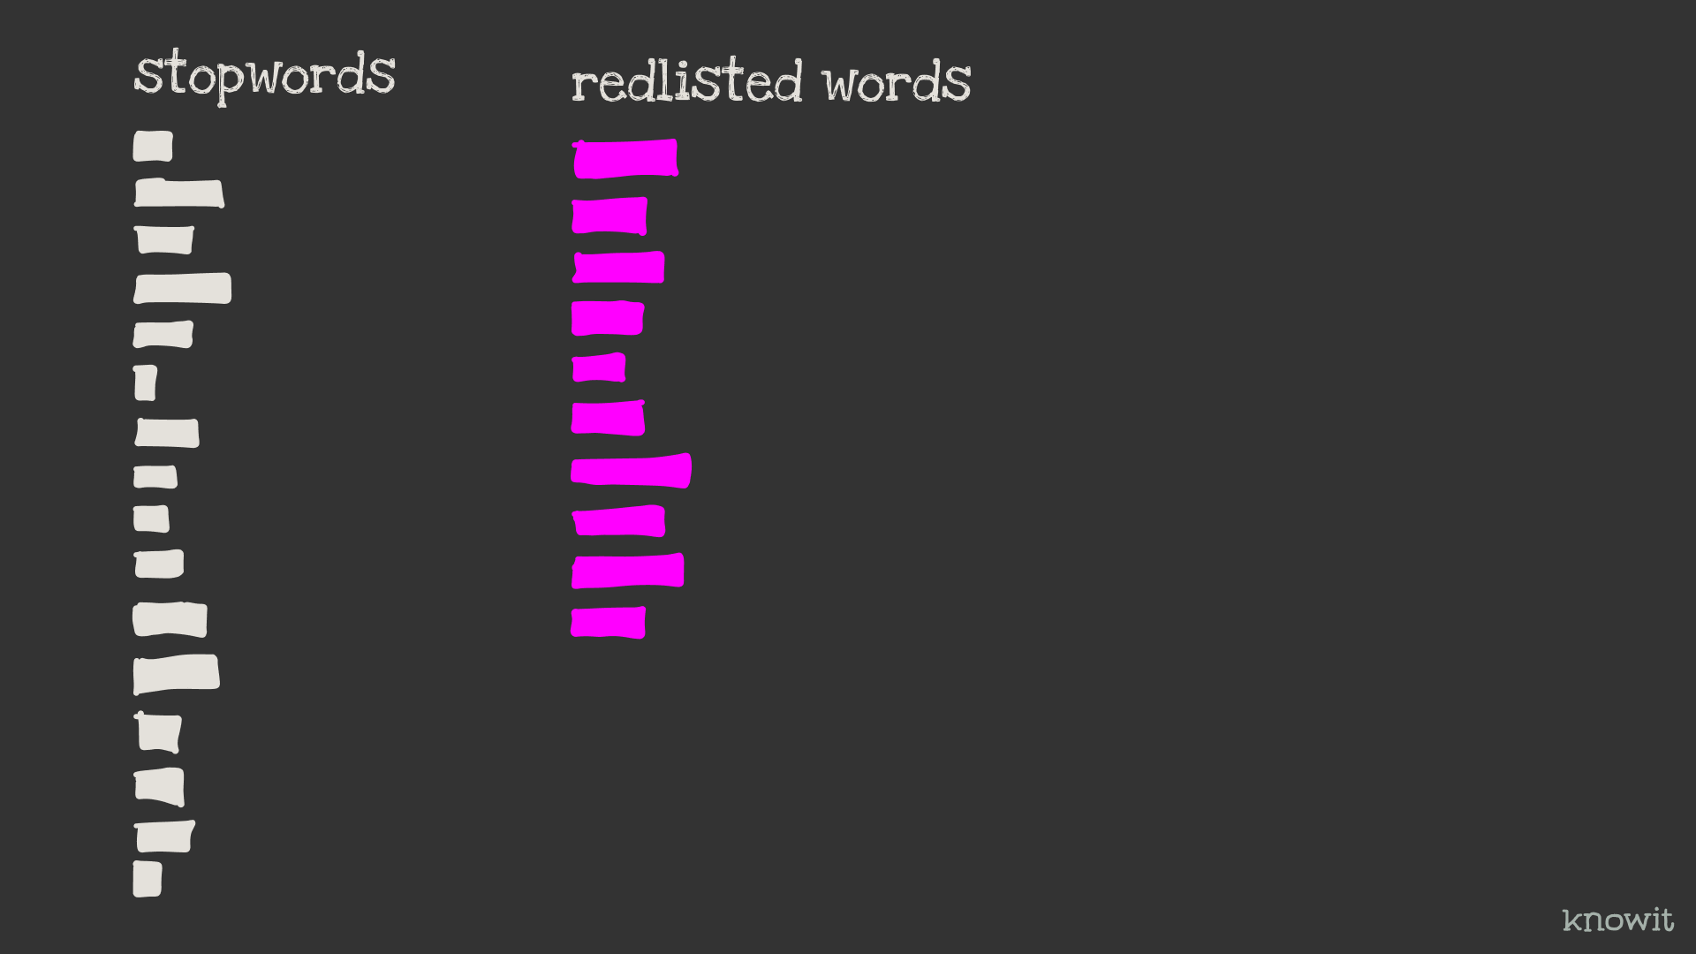
Notes:
To counter this, the stopword trainer can now take a list of redlisted words. If a stopword list is blacklisted words, the redlist is the words you don’t want blacklisted, or don’t want to ”go extinct”.
Creating the redlist is manual work,
but can then be used programatically.

Slide 21
Remaining work
Notes:
So, what’s the remaining work for the project?

Slide 22
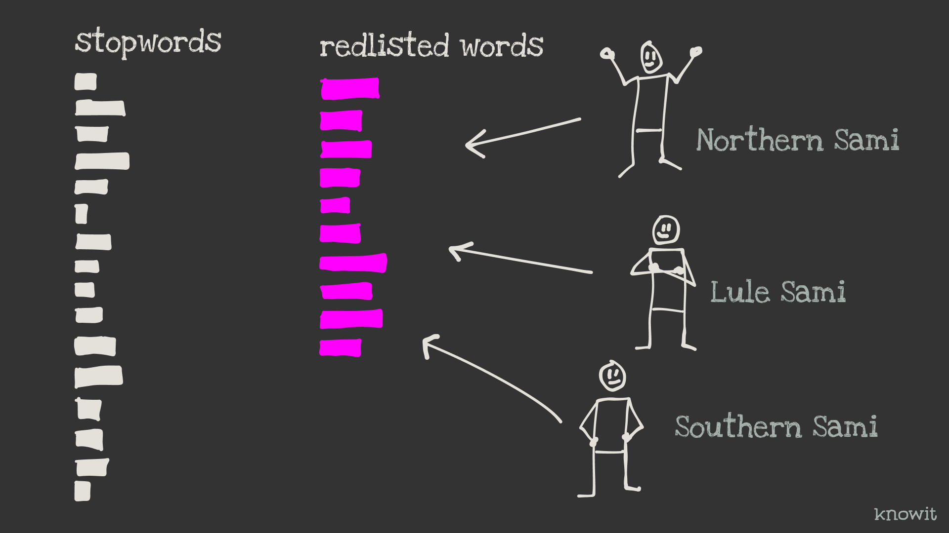
Notes:
We need three people, one for each Sami language, to go through the words with the highest stopwordiness and add the ones that shouldn’t be stopwords to the redlist. Maybe they need to go through the 2-3-4-500 first words.

Slide 23
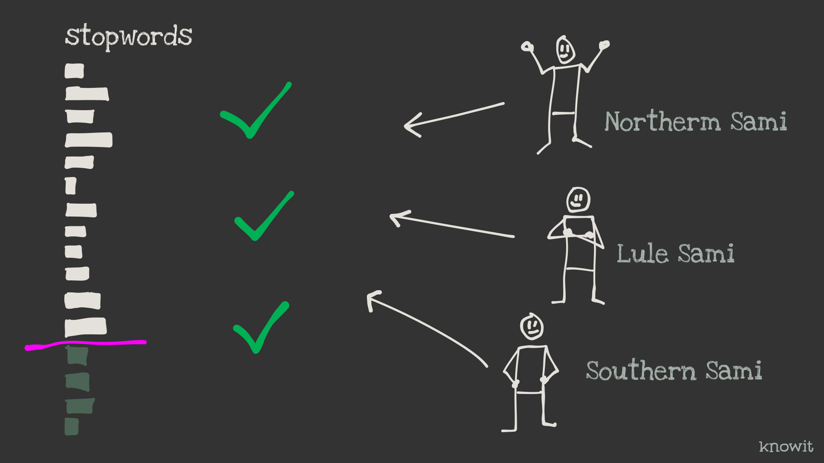
Notes:
In addition the end result needs to be verified and where to cutoff each stopword list needs to be defined.

Slide 24
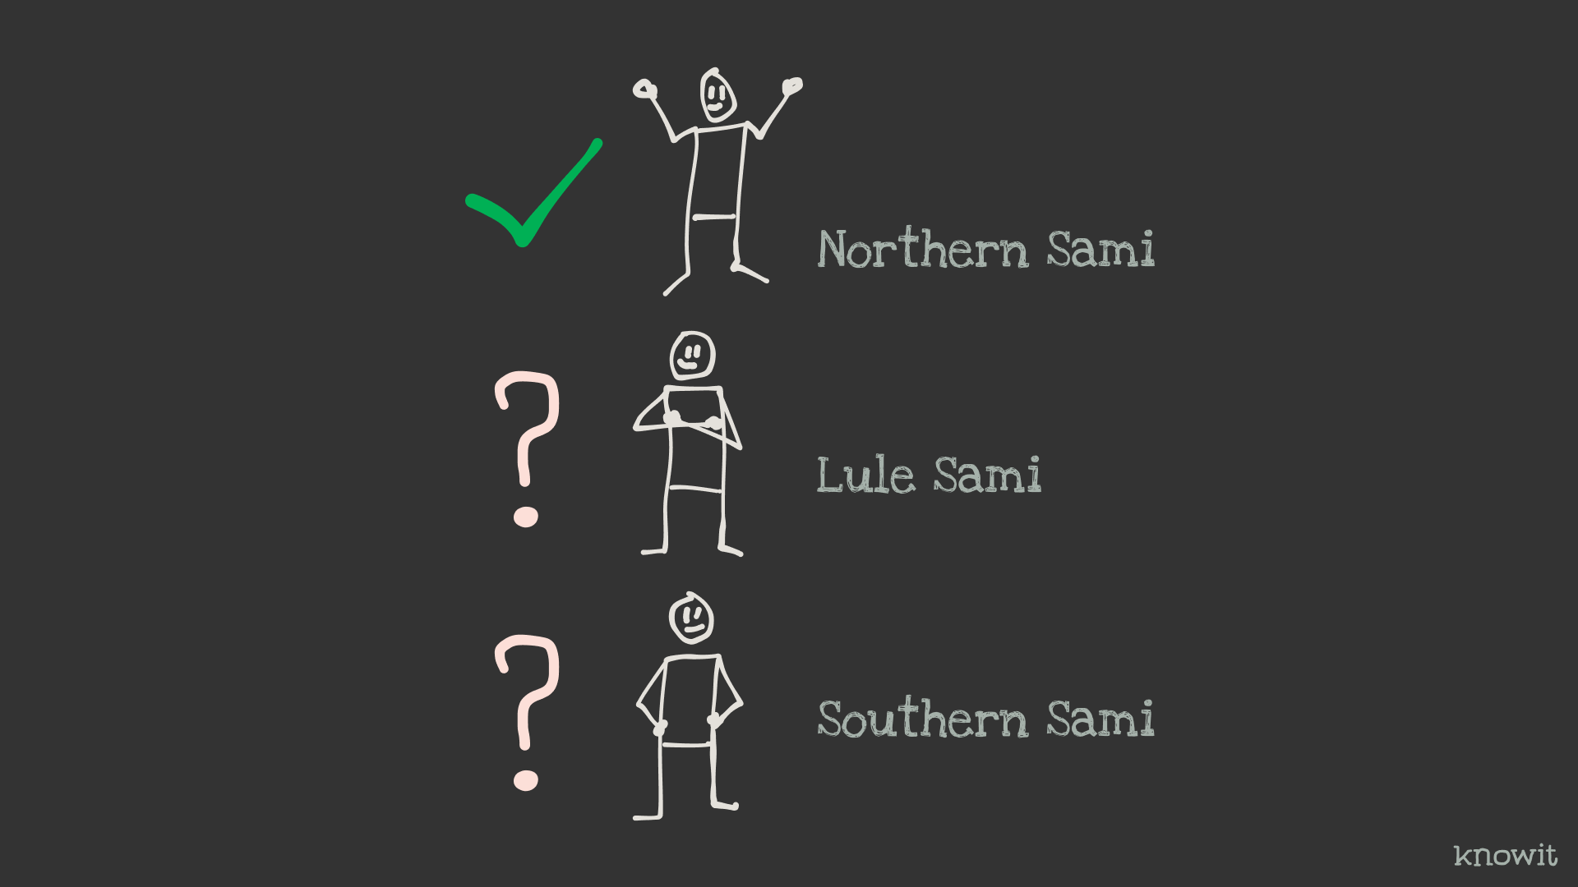
Notes:
To do this we need to find these people, since I don't know any of the Sami languages. We´ve alreay found one. A colleague of mine, Levi Sørum, has said yes to help us with Norhtern Sami. So, two to go.

Slide 25
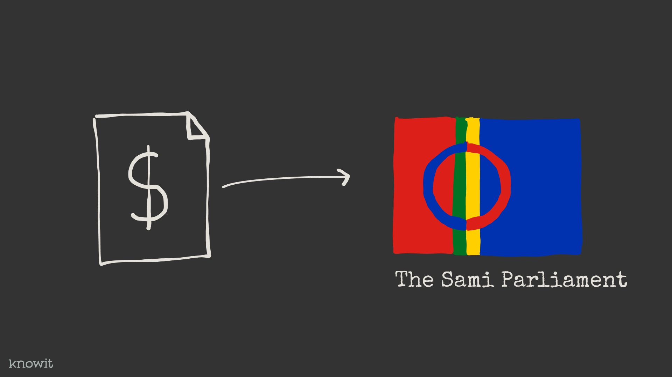
Notes:
Since the project has grown and I'm about to include other people in, and there is some coordination involved, I’ve applied the Sami Parliament for some money. I'll get a reply in a couple of weeks I think.

Slide 26
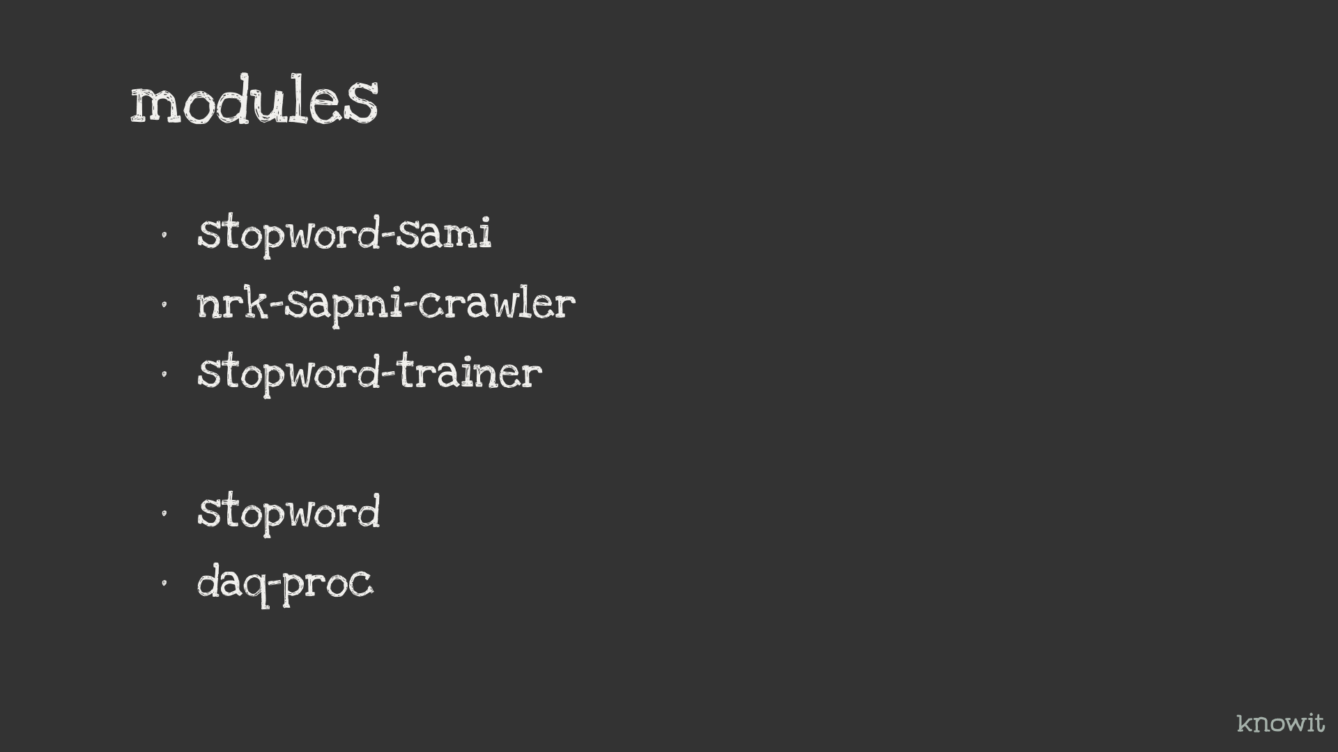
Notes:
The modules for the project is the following: Stopword-sami – which will contain the Sami stopwords and all that’s needed to create them. End format is JSON.
Dependencies for this is:
Nrk-sapmi-crawler – Super simple crawler that gets a JSON of article IDs and then crawl these IDs. And then there is
Stopword-trainer – which is fed the body-text of the article stubs.
In addition we have
Stopword – Which is a JavaScript code library to remove stopwords from text. It contains a little over 60 languages, and soon there will be three more.
Daq-proc – Small library for document and query processing. Depends among other things, on the stopword module. And also depends on an ngram and a keyword extractor.
They’re all under MIT license

Slide 27
Demo!
Notes:
Time for a quick demo.

Slide 28

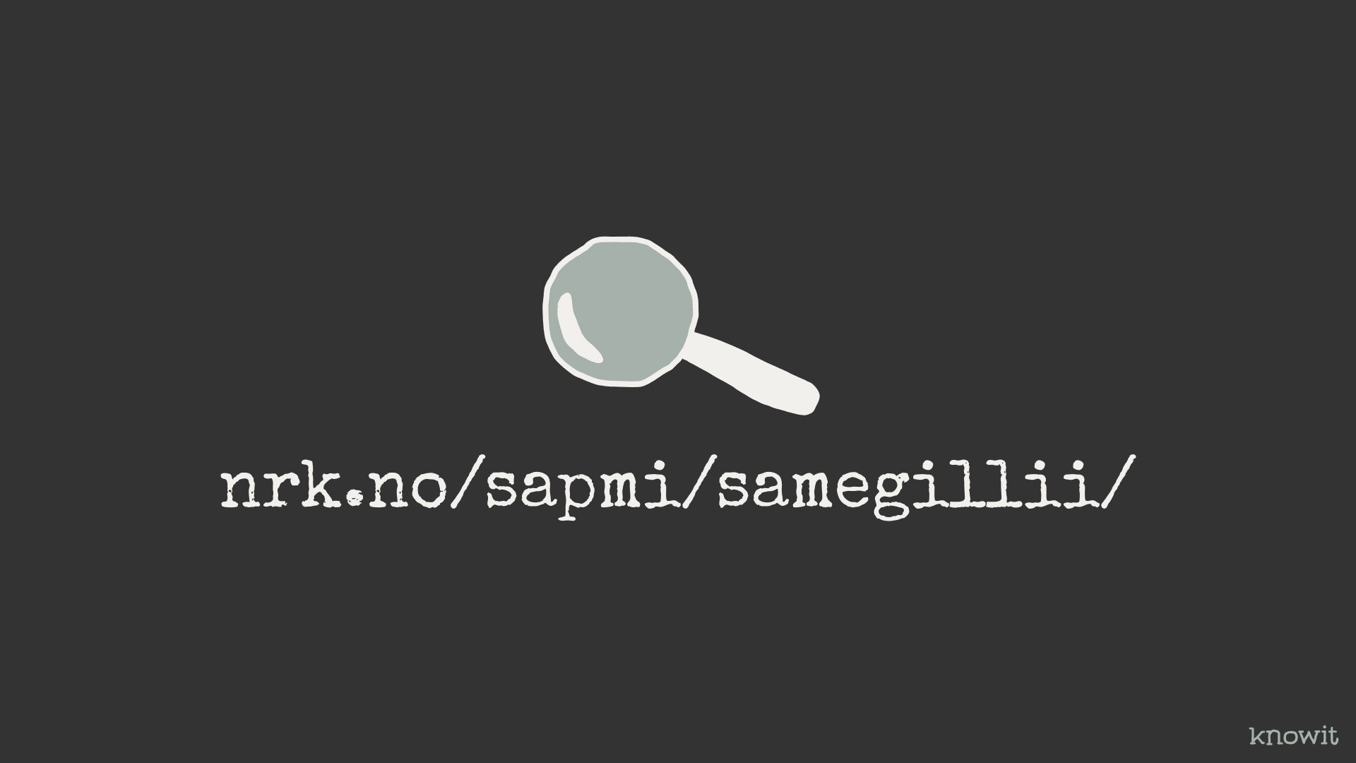
Notes:
What’s next? Create a demo-search from the data crawled. With filtering on language and keywords and maybe a typeahead.

Slide 29
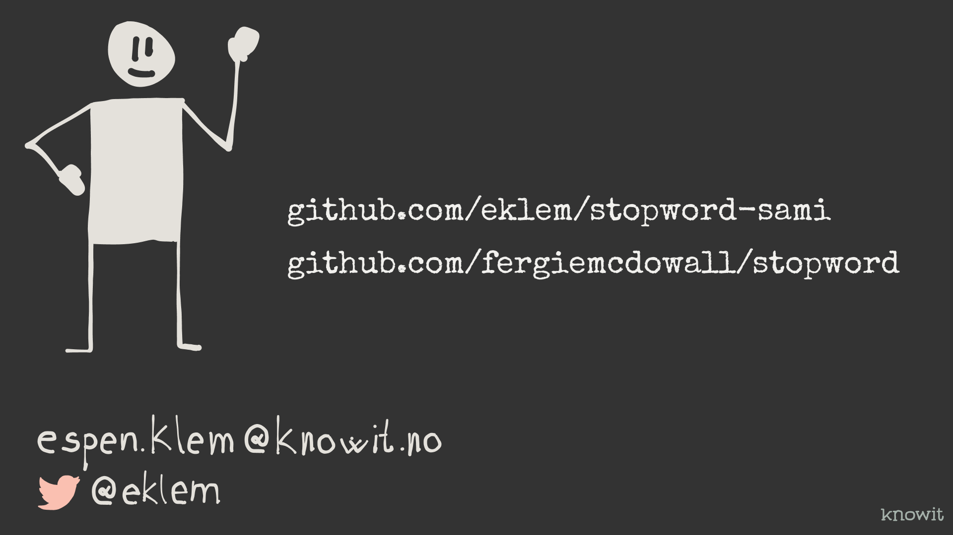
Notes:
Thanks a lot for your time! Hope you check out the library.

