Slide 1
Customs Taxpayer Risk Profiling Model
Progress review: features, evidence and decisions
Data Science Section, ITID | 15 October 2026
Notes:
Purpose: show how the agreed parameters became features, what the data told us, how the scorecard and bands work, how we measure success, both tracks, and how each decision was made.

Slide 2
The model in one slide
57,501
0.82
8%
45% vs 3%
IM4 and IM7 taxpayers scored, each with reasons
average AUC per check, 18 dates since 2017 (0.50 = chance)
of taxpayers (HIGH and above) carry half of all hits and 55% of top-up money
checks finding a top-up: VERY HIGH against VERY LOW
Where it stands
What it needs
Track A: built, tested over nine years, scoring the live list.
Track B: built, tested on 5 dates, one weakness to fix, blind review ready.
Risk Officers to confirm weights and thresholds.
Officers' verdicts on the blind review.
Data that is not in the view for 11 parameters.
Notes:
Track A scores compliance history. Track B looks at trading behaviour for taxpayers with no history. Track A is tested on 18 dates over nine years. Track B shows a signal but is not yet proven.

Slide 3
Agenda
1
Purpose
What the model is for and what officers receive
2
Data and EDA
What the data showed and the rules it forced
3
From columns to features
How each parameter was built, chosen and tested
4
The scorecard and the bands
How points become a score and a band
5
Does it work?
Success measures, nine years of tests, challengers
6
Track B
Risk for taxpayers with no record
7
Decisions and next steps
How decisions were made and what we need
8
Live demo
Score the live list and open the workbook
Notes:
About 90 minutes plus questions. Parts 2 to 4 are the core: data, features, scorecard.

Slide 4
1 Purpose
What the model is for and what officers receive

Slide 5
What the model is for
More revenue per check
Focus on the money
Facilitate the compliant
Checks on HIGH and above find a top-up about 40% of the time, against 9% for all checks.
The riskiest 8% of taxpayers carried 55% of top-up money in the 6 months after each date.
81% of taxpayers are VERY LOW. Checks on them find a top-up 3% of the time.
Same rules for everyone
Find what history misses
Every taxpayer scored the same way, with reasons in plain words, a model version and a settings code on every output.
Half of all hits come from taxpayers below HIGH. Track B looks for risk that has not yet shown up in a record.
Notes:
Checks cost officer time and delay compliant traders. Ranking the riskiest first means each check finds more and compliant traders are checked less.

Slide 6
What an officer receives: one workbook, one row per taxpayer
Column | What it says | Example (made up)
History Risk Score and Band | Track A, from the taxpayer's own record, 0 to 100 | 62, HIGH
Reason 1 to 3 | The three biggest contributors, in plain words | 18% of declarations needed a top-up
Risky Behaviour Flag | Track B: trading behaviour stands out against similar importers | Y or N
Overall Risk Band | The higher of the two tracks: what officers act on | HIGH
Notes | No points: limited history, unusual pattern | Limited history (under 10 declarations)
Entry evidence | Entries priced furthest below other importers | Entry number, item, % of peer price
Notes:
Officers act on the Overall Risk Band: the higher of the History Risk Band (Track A) and the Risky Behaviour Flag (Track B, capped at HIGH until proven).

Slide 7
2 Data and EDA
What the data showed, and the rules it forced on us

Slide 8
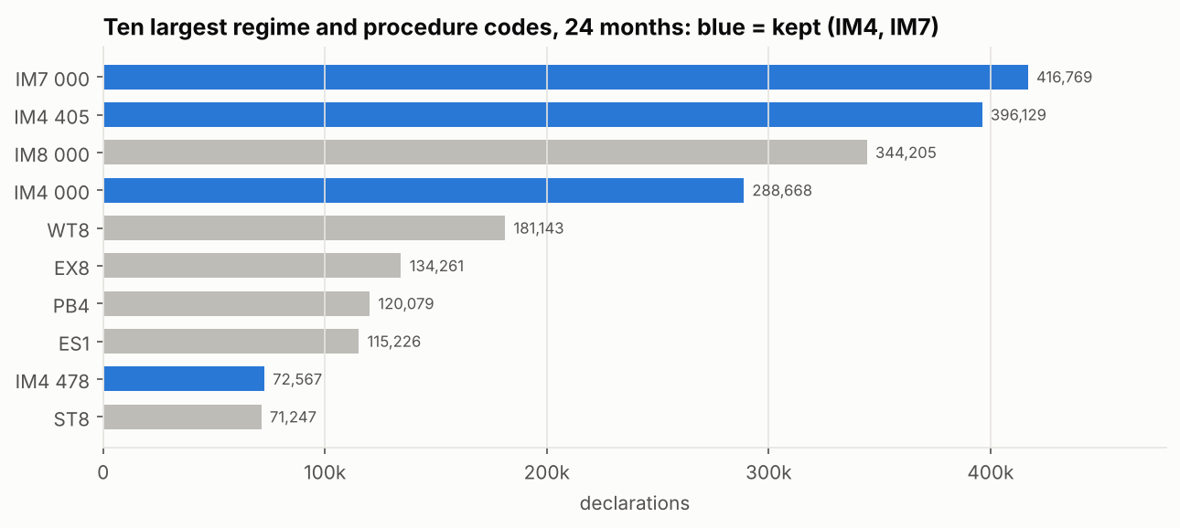
The data: one view, one row per declaration item
1.2M
IM4 and IM7 declarations in every 24 months
58,161
taxpayers with declarations in the 24 months to Mar 2026
24
columns used by the model, from Nov 2012 to Oct 2026 (stable from Sep 2014)
Notes:
Data Engineering built the view for this project. We score IM4 (home use) and IM7 (warehousing) only: other regimes carry guarantees, not duty paid. The model reads 24 of the view's columns.

Slide 9
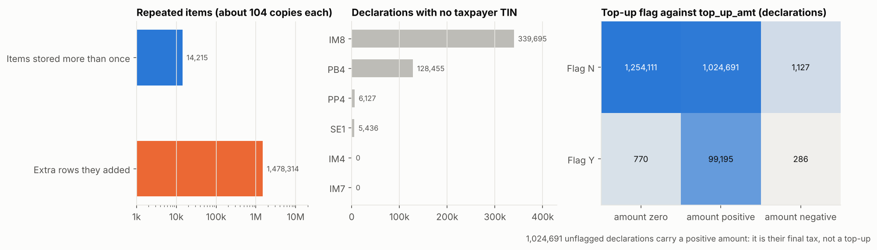
Problems in the data, and the rule for each
Found | Rule
Items repeated up to 522 times | Keep one row per item
top_up_amt holds the final tax, not the top-up | Top-up = flag Y and final tax above original
Original tax blank on 37% of unflagged declarations | Blank means unchanged: use the final tax
Tax repeated on every item of a declaration | Take tax once per declaration
14,065 cancelled declarations; consignee always the taxpayer | Cancelled removed; consignee not used
Notes:
Each rule came from an EDA query (decisions 1 to 18). Without the first two, every count and every top-up would have been wrong.

Slide 10
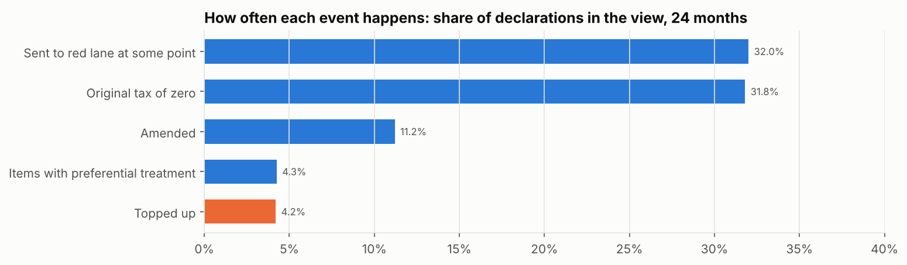
Top-ups are rare, so rates need many declarations
Share of declarations in the view with each event, 24 months.
Notes:
Only about 4% of declarations end in a top-up. A rate built on a handful of declarations is mostly chance.

Slide 11
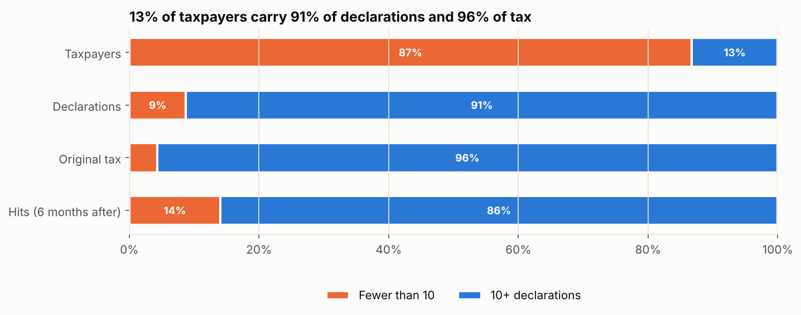
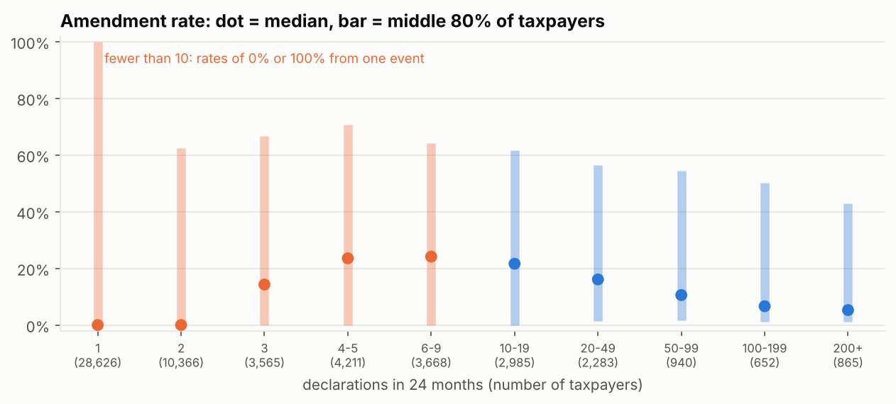
Most taxpayers have very little history
Notes:
87% of taxpayers have fewer than 10 declarations in 24 months. With 1 to 3 declarations, a rate is 0% or 100% from a single event.

Slide 12
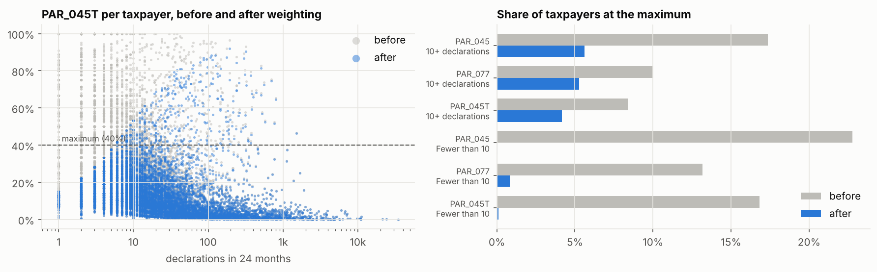
The fix: credibility weighting
How it works
Rate used = n / (n + 10) of own rate + the rest from the average, only when that lowers it.
2 declarations: 17% own rate.
40 declarations: 80% own rate.
Effect: small-history taxpayers in HIGH or above fell from 5,151 to 2,314, with the same results at the top. No weighting loses 46% of hits in the top 5%.
Notes:
A small-history rate is pulled towards the average, and only ever down, so clean small traders are not given risk they never showed.

Slide 13
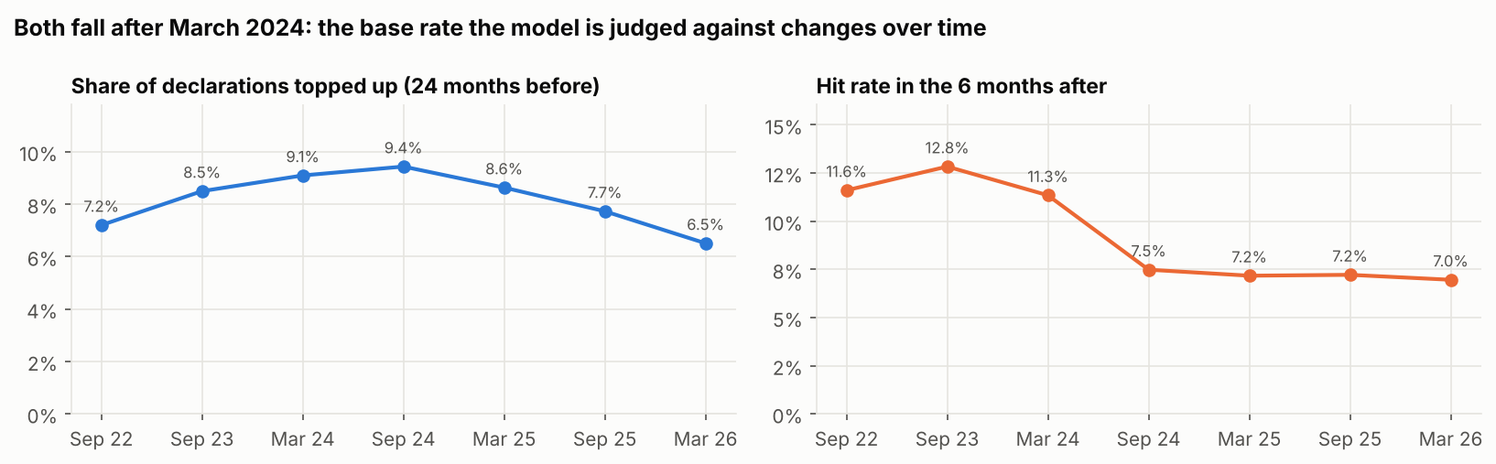
Checks found less after March 2024
Notes:
The share of checks that found a top-up fell from 11 to 13% to about 7% and stayed there. The model is judged against this changing base. Only the Risk Officers can say what changed.

Slide 14
3 From columns to features
How each parameter was built, chosen and tested

Slide 15
A column is not a feature
Columns in the view
Calculation we wrote
Feature
One row per item
taxpayer_tin
assessment_dt_wid
top_up_flg
original_tax_amt
final_amt
1. Remove duplicate items
2. Per declaration: topped up = flag Y and final tax above original
3. Per taxpayer: share of declarations topped up, last 3 years (1, 0.5, 0.25)
4. Small history pulled towards the average
One number per taxpayer
PAR_045T
Share of declarations topped up
Example: 18%
Every feature in this model is built this way: columns, then a calculation, then one value per taxpayer. Asking for a column is the start of a feature, not the feature.
Notes:
The view holds columns: raw values on each declaration item. A feature is a number per taxpayer that we calculate from several columns. None of the features exists as a column in the view.

Slide 16
The 20 agreed parameters: where each one stands
Status | Parameters
Scored: 7 parameters, 8 features | PAR_045 (amendments and PAR_045T top-up share), PAR_077, PAR_048, PAR_076, PAR_066, PAR_105, PAR_023
Built, waiting (2) | PAR_067 unit value reduced; PAR_053 tax forgone through exemptions
Need data not in the view (11) | PAR_012, 015, 016, 039, 040, 051, 054, 075, 096; PAR_078, 173 (agent)
Built beyond the 20: duty below HS peers, watch-list exemption codes, same-day splitting, new traders, price far from peers.
Notes:
None was dropped by choice. 11 need data that is not in the view. PAR_045 gives two features: amendments and the officers' top-up rule (PAR_045T).

Slide 17
11 agreed parameters need data that is not in the view
Parameter | What it needs | Not in the view because
PAR_012 Original vs final declaration | Earlier versions of each declaration | The view holds the final state only
PAR_016 Misclassification | HS changes between versions, or the misdeclaration flag | Neither is in the view
PAR_054 Procedure codes amended | Procedure code changes between versions | Final state only
PAR_096 HS changes that lowered duty | HS changes between versions | Final state only
PAR_051 Preferential declarations amended | Versions (use of preference is shown as information) | Final state only
PAR_015 Undervaluation risk | Box 45 adjustment rate | Box 45 not in the view
PAR_075 Customs vs statistical value | Box 46 statistical value | Box 46 not in the view
PAR_039, PAR_040 Penalties (number, value) | Penalty and seizure records | Separate system
PAR_078, PAR_173 Agent parameters | Agent TIN | Belongs to the Agent model
Notes:
These are blocked by data only. Each row is what we would ask Data Engineering for.

Slide 18
Track A features: columns used, how built, why
Feature | Columns used | How it is built (per taxpayer) | Why
PAR_045T Declarations topped up | top_up_flg, original_tax_amt, final_amt | Share of declarations with flag Y and final tax above original | Officers' rule; strongest alone
PAR_077 Severe top-ups | same | Share of declarations whose top-up is 30% or more of the final tax | Large top-ups, larger risk
PAR_045 Declarations amended | amendment_flg | Share of declarations amended | Strong alone
PAR_048 Top-ups as share of tax | original_tax_amt, final_amt | Total top-ups divided by total final tax | Size of the money
PAR_076 Value below benchmark | customs_value, net_weight, supplementary_qnty, hsc_cd, gds_org_cty | Shortfall against the median price other importers declare for the same HS code and origin, as a share of value | Undervaluation not yet caught
PAR_066 Tax reduced after assessment | original_tax_amt, final_amt | Share of declarations with final tax below original | Reductions need a look
PAR_105 Recent top-up | top_up_flg, assessment_dt_wid | A top-up in the last 180 days (yes or no) | Recent behaviour
PAR_023 Station movement | clearance_station_cd | Share of declarations away from the taxpayer's main station | Moving between stations
Notes:
All eight are agreed officer parameters. Each is a rate per taxpayer over the last 3 years, from IM4 and IM7 declarations.

Slide 19
Where the features are built in the code
Step | File | Where
Clean items; one row per declaration; top-up defined | src/ctrp/sql/features_outcomes.sql | raw, items, decl (lines 41 to 104)
Track A rates per taxpayer | src/ctrp/sql/features_outcomes.sql | tp (line 110); yearly counts yr (line 155)
PAR_076 price benchmark | src/ctrp/sql/features_outcomes.sql | bench, val (lines 226 to 299)
Own price, duty, exemptions, splitting, new traders | src/ctrp/sql/features_outcomes.sql | lines 300 to 424
Recency, PAR_048 over final tax, credibility weighting | src/ctrp/core.py | apply_recency, derive, _shrink_small_counts
Scorecard settings: thresholds, weights, bands | src/ctrp/core.py | PARAMS, RECENCY_WEIGHTS, SHRINK_K, BANDS
Points, score and band | src/ctrp/core.py | scale, layer2_scorecard, band_of
Track B feature list and peer comparison | src/ctrp/discovery.py | FEATURES, build_features, peer_percentiles
Notes:
Every feature is code we wrote. The SQL builds the per-taxpayer values from the view; Python applies recency, credibility weighting, points and bands.

Slide 20
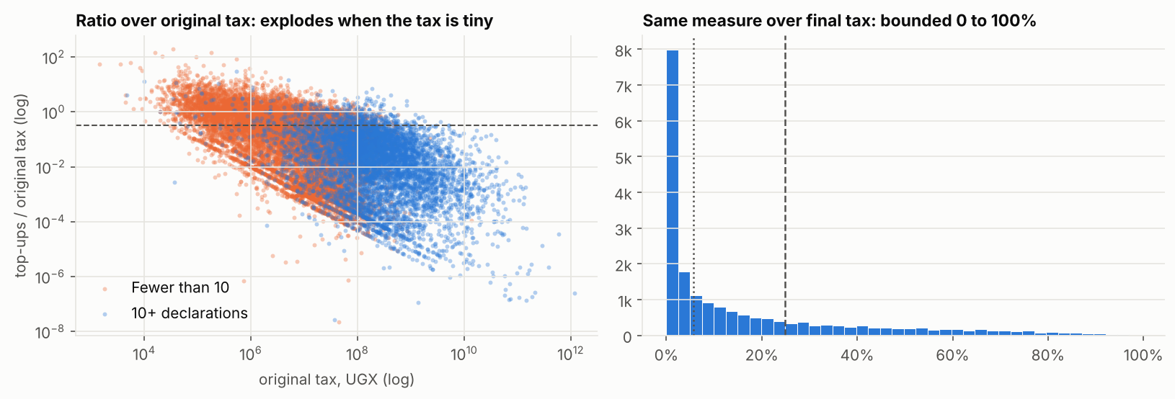
Choices the data forced
PAR_048 divided by final tax
Divided by original tax, a declaration taxed UGX 29 gave 4,399. Over final tax it stays between 0 and 100%.
PAR_045T maximum at 40%, not 10%
At 10%, 35% of regular traders got full points and the scale stopped ranking.
PAR_076 benchmark built by us
Median price per HS code and origin from 5 or more importers. Fuel left out.
Notes:
Three features had to be built differently from how the parameter was first written, because the data showed the first version would not rank taxpayers.

Slide 21
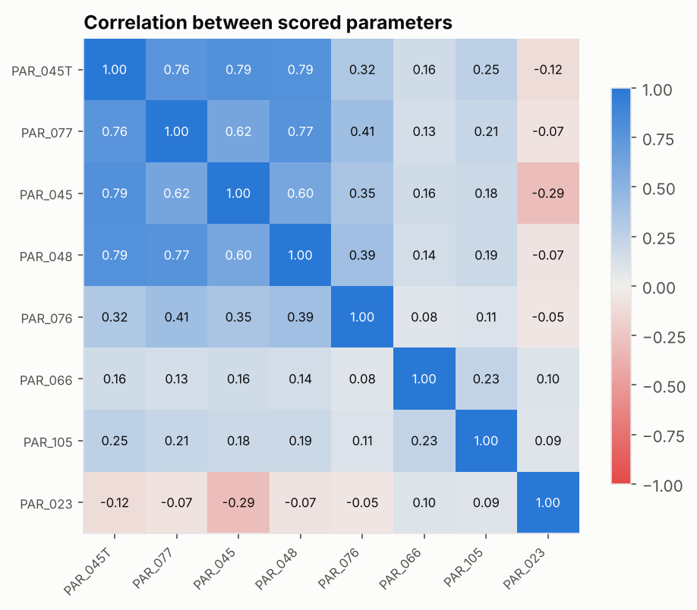
Some features measure the same thing
What moves together
PAR_045T, PAR_077, PAR_048 and PAR_045: all describe top-ups and amendments.
PAR_066, PAR_105, PAR_023 are close to independent.
What we did
PAR_045T and PAR_077 carry the weight. PAR_048 stays at 4% because PAR_077 already holds most of it.
Notes:
The top-up features move together (0.6 to 0.8). We kept all agreed parameters and set weights so the same behaviour is not counted twice at full strength.

Slide 22
How much each feature contributes
All eight together: 0.80. Three features carry 91% of the points that put taxpayers in HIGH and above.
Notes:
Left: how well each feature ranks checks on its own (0.50 = chance). Right: share of all points among taxpayers in HIGH and above.

Slide 23
Taking each feature out, one at a time
Feature | Alone | Change if removed | Reading
PAR_045T | 0.81 | -0.019 | The backbone of the score
PAR_077 | 0.68 | +0.003 | Overlaps the top-up share
PAR_045 | 0.80 | -0.004 | Strong alone, adds a little
PAR_048 | 0.73 | +0.001 | Overlaps PAR_077
PAR_076 | 0.59 | +0.000 | Aimed at risk top-ups cannot show
PAR_066 | 0.56 | -0.000 | Rare (4% of taxpayers)
PAR_105 | 0.45 | +0.005 | Slightly better without: question for officers
PAR_023 | 0.37 | +0.000 | Big traders use many stations
Decision: keep all eight now and take this evidence to the weights session with the Risk Officers.
Notes:
Remove one feature, rescore, measure again. Only the top-up share makes a real difference. The small five add little against top-ups but cover risks top-ups cannot show.

Slide 24
Recency: how much each year of history counts
1
0.5
0.25
Why halving
Every 3-year option ranks a little better than the old rule. Halving does best at the top of the list: more found per check in the top 5% on 15 of 18 dates.
Equal weights let old top-ups count too much. Steeper weights forget too fast.
5 years added nothing measurable.
Last 12 months
12 to 24 months ago
24 to 36 months ago
Example: topped up 2 of 10 (last year), 1 of 10, 0 of 10.
Rate = (2 + 0.5 x 1 + 0.25 x 0) / (10 + 5 + 2.5) = 14%
Option tested | AUC per check | Better ranking than old rule | More found per check, top 5%
Old rule: 2 years, equal | 0.813 | reference | reference
Last year only | 0.804 | 1 of 18 | 10 of 18
3 years, equal | 0.816 | 17 of 18 | 7 of 18
3 years, gentle | 0.817 | 18 of 18 | 10 of 18
3 years, halving: adopted | 0.817 | 18 of 18 | 15 of 18
3 years, steep | 0.816 | 18 of 18 | 14 of 18
Notes:
Each rate uses the last 3 years. The latest year counts fully, the year before half, the one before a quarter. Tested on all 18 dates since 2017.

Slide 25
4 The scorecard and the bands
How features become points, a score and a band

Slide 26
The scorecard
Feature | 0 points at or below | Full points at | Likelihood | Impact | Most points
PAR_045T Declarations topped up | 3% | 40% | 5 | 5 | 33
PAR_077 Severe top-ups | 2% | 20% | 4 | 5 | 26
PAR_045 Declarations amended | 10% | 50% | 4 | 4 | 21
PAR_048 Top-ups as share of tax | 5% | 25% | 3 | 1 | 4
PAR_076 Value below benchmark | 2% | 20% | 3 | 1 | 4
PAR_066 Tax reduced after assessment | 2% | 20% | 3 | 1 | 4
PAR_105 Recent top-up | no | yes | 3 | 1 | 4
PAR_023 Station movement | 30% | 70% | 3 | 1 | 4
Total |  |  |  |  | 100
Score = the sum of the eight. Bands: VERY LOW to 15, LOW to 35, MEDIUM to 50, HIGH to 80, VERY HIGH to 100.
Most points = likelihood x impact / 76 x 100, rounded.
Notes:
Each feature earns 0 points at or below its minimum risk level, full points at its maximum, and a straight line in between. Points add up to a score from 0 to 100. Weights are likelihood x impact, set by Data Science, to be confirmed by the Risk Officers.

Slide 27
How a score is calculated
1
2
3
4
5
Rate
Small history
Scale
Points
Band
Each feature over 3 years (1, 0.5, 0.25)
Pulled towards the average, only down
0 below the minimum, 1 at the maximum
Scale x most points; add them up
Score to band
Example (made up): 40 declarations, 15% topped up
PAR_045T scale = (15% - 3%) / (40% - 3%) = 0.32. Points = 0.32 x 33 = 10.7. Add the other seven the same way.
Reason 1 reads: "15% of declarations needed a top-up (minimum risk level 3%, maximum at 40%)".
Notes:
Five steps, in order. Every point can be traced to a feature and a reason sentence.

Slide 28
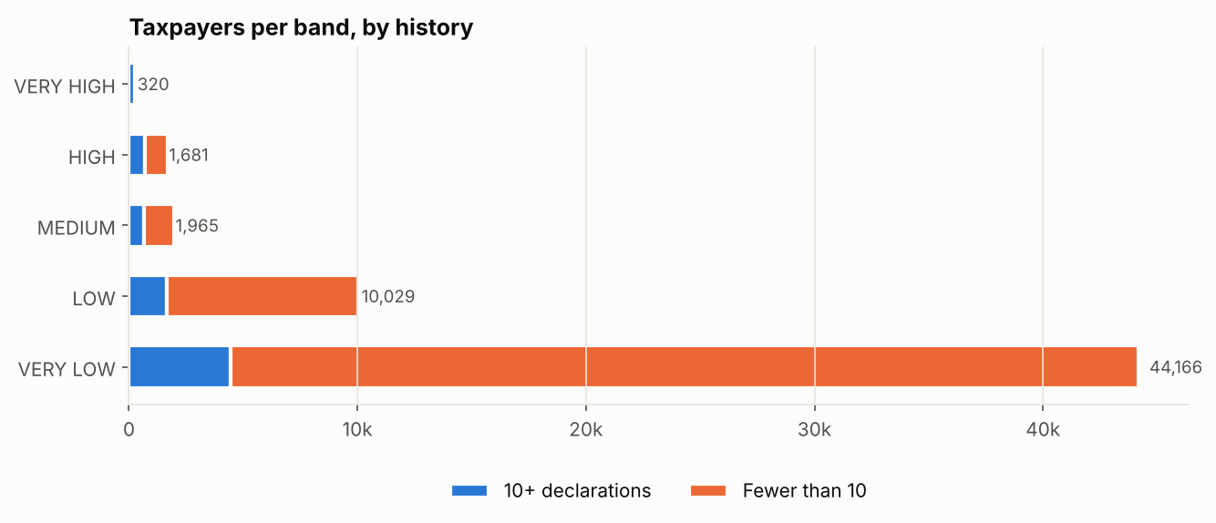
The bands
Band | Score | Taxpayers now (Sep 2026) | Checks that found a top-up | Share of top-up money
VERY HIGH | 80 to 100 | 204 | 45% | 37%
HIGH | 50 to 80 | 869 | 36% | 23%
MEDIUM | 35 to 50 | 1,326 | 20% | 9%
LOW | 15 to 35 | 8,264 | 10% | 13%
VERY LOW | 0 to 15 | 46,838 | 3% | 18%
Table: six test dates pooled, Sep 2023 to Mar 2026. Chart: taxpayers per band at Mar 2026; most of VERY LOW are small traders.
Notes:
The score is cut into five bands. Officers act on the band. Hit rate climbs at every step: VERY HIGH checks found a top-up 45% of the time, VERY LOW 3%.

Slide 29
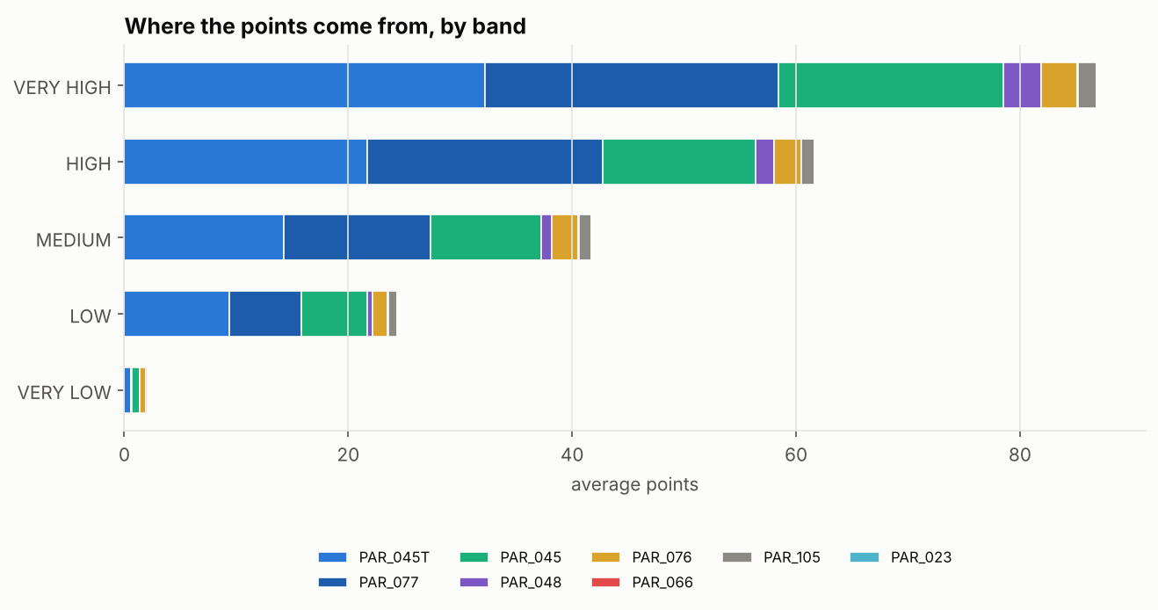
Where the points come from in each band
Notes:
The top-up share, severe top-ups and amendments make up most points in every band. The other five add a little at the top.

Slide 30
5 Does it work?
How we measure success, nine years of tests, and the alternatives

Slide 31
How we measure success
Measure | Question it answers | Use
AUC per check | Take a check that found a top-up and one that did not: how often does the model rank the first higher? 0.50 = chance, 1.00 = perfect | Main measure
Share of top-up money | What share of top-up money came from taxpayers above the line? | Revenue
Precision | Of checks above the line, how many found a top-up? | At HIGH and above
Recall | Of all checks that found a top-up, how many were above the line? | At HIGH and above
Accuracy | Share right overall | Not used
Every test is out of time: score at a date with history before it, judge on the 6 months after.
Notes:
Only about 9% of checks find a top-up, so a model that says "nothing found" is 91% accurate and useless. We measure ranking per check, with money beside it.

Slide 32
Where officers draw the line: precision, recall and money
Line | Taxpayers above | Precision | Recall | Share of top-up money
Top 1% | 1% | 43% | 15% | 26%
Top 5% | 5% | 40% | 42% | 47%
Top 10% | 10% | 37% | 55% | 59%
Top 20% | 20% | 31% | 64% | 69%
VERY HIGH | 2% | 43% | 22% | 33%
HIGH and above | 7.7% | 40% | 51% | 55%
MEDIUM and above | 14.3% | 35% | 59% | 63%
All taxpayers | 100% | 9% | 100% | 100%
Average of six dates, Sep 2023 to Mar 2026.
Notes:
HIGH and above: 8% of taxpayers, 40% of checks find a top-up, half of all hits, 55% of the money.

Slide 33
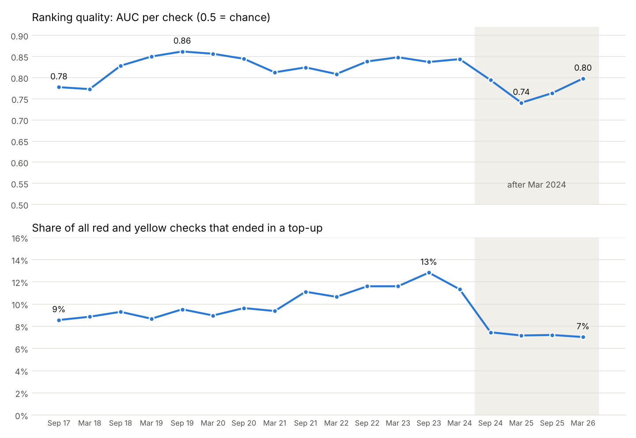
Nine years of tests: steady ranking
Notes:
Scored at 18 dates since Sep 2017, each judged on the next 6 months. AUC per check 0.74 to 0.86. The dip follows the March 2024 fall in what checks found.

Slide 34
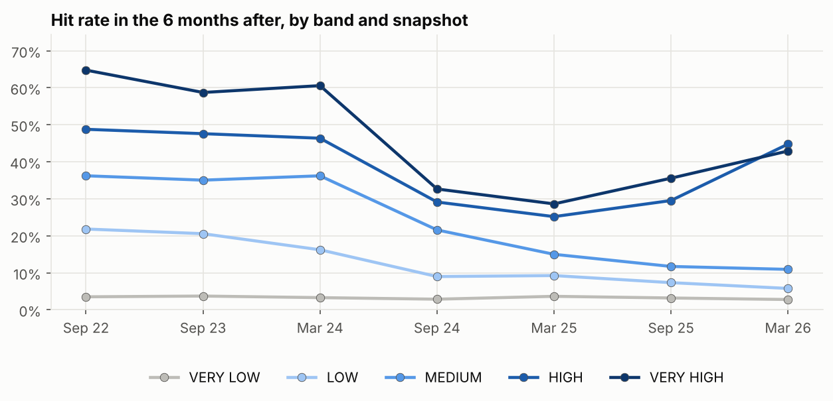
Higher bands find more on every test date
Notes:
On every date the bands keep their order from VERY LOW up to HIGH. VERY HIGH and HIGH sit close together at the latest date.

Slide 35
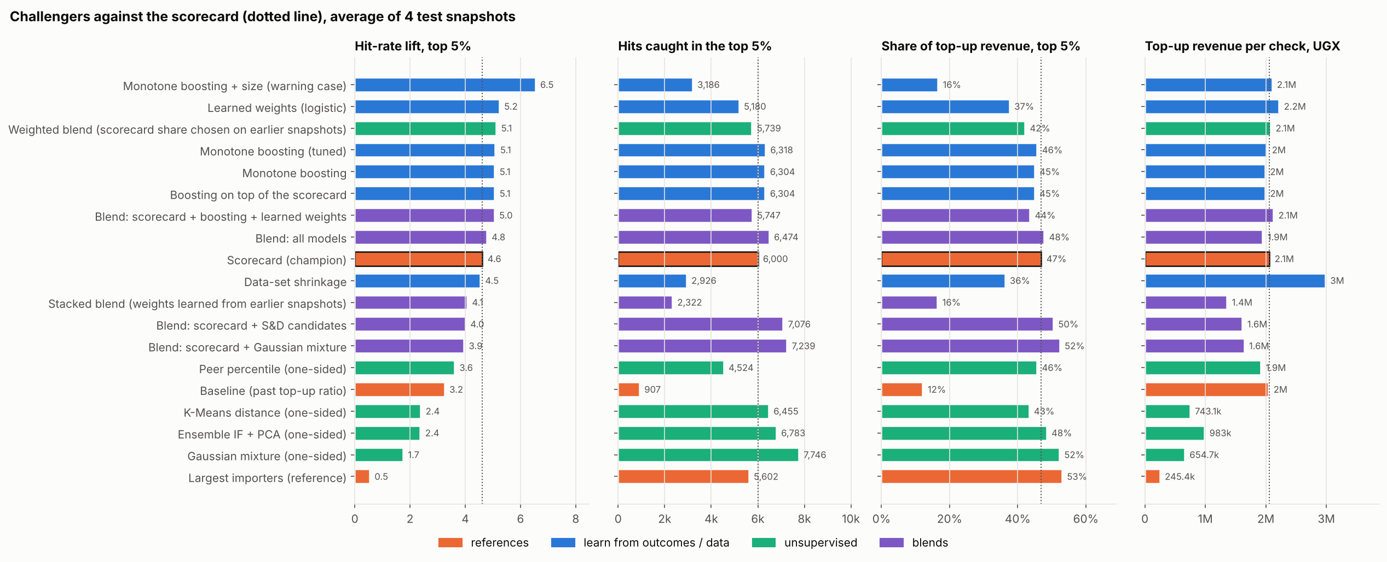
Challengers and ensembles: we tested the alternatives
Decision: keep the scorecard (orange). Its points can be explained line by line. Next: test a learned correction on top of it, running alongside.
Notes:
Each model trained only on earlier dates and tested on four. The scorecard finds 4.6 times the average hit rate in its top 5%, 6,000 hits and 47% of the money. Learned models reach about 5.1 to 5.2 but learn only from checks officers chose and are harder to explain. The warning case uses size and is not a fair comparison.

Slide 36
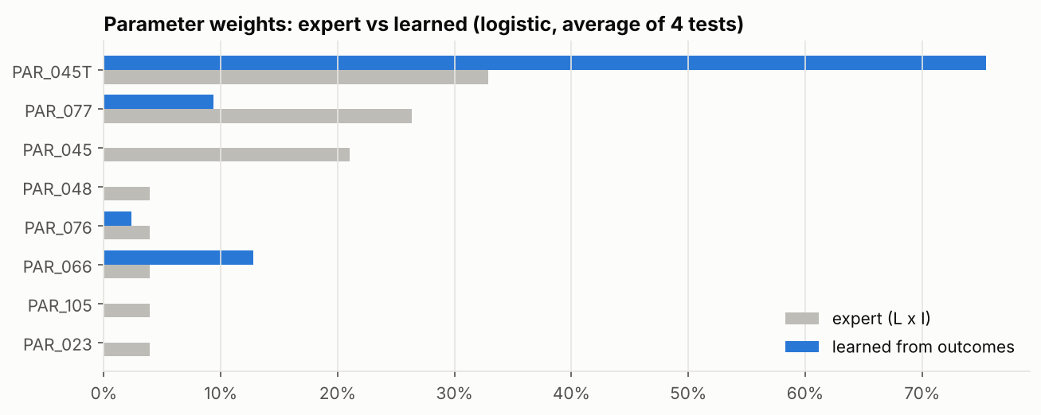
Officers' weights against weights learned from outcomes
Reading
Learned weights follow what checks already found.
Officers' weights cover risks checks may not have looked for.
The Risk Officers decide.
Notes:
A model that learns weights from past outcomes puts most weight on the top-up share and almost none on amendments. Evidence for the weights session, not a replacement.

Slide 37
An independent check: the model agrees with the AEO programme
1.7%
of checks on AEO members found a top-up, against 7.3% for others (Apr to Sep 2026)
8
AEO members to raise with officers: 1 HIGH, 3 with a behaviour flag, 4 MEDIUM
Notes:
The model is never told who is AEO. 298 current AEO members: 87% land in VERY LOW, none in VERY HIGH. A check only, not a score input.

Slide 38
6 Track B: risk without a record
Trading behaviour, for taxpayers with no top-up history

Slide 39
Why a second track
69%
About half
0
of taxpayers have no top-up history
of hits come from taxpayers below HIGH
Track A points for an undervaluer never caught
Rules for Track B
No customs actions as inputs (no top-ups, no lanes), so it does not repeat past selection.
Each feature compared within the peer group: same main goods, same size.
Flags: top 5% of regular traders and top 1% of small traders with no top-up history. A flag lifts the band to HIGH at most until proven.
Notes:
69% of taxpayers have no top-up history, so Track A gives them nothing to score. An importer who undervalues and has never been caught scores zero.

Slide 40
Track B features (1 of 2): declarations and valuation
Feature | Columns used | How it is built (per taxpayer)
Declarations amended | amendment_flg | Share of declarations amended
Tax left unpaid | pay_status | Share of declarations not paid
Prices that look like keying errors | customs_value, net_weight, hsc_cd | Share of items priced under 1% of the median for the HS code
Value below the HS benchmark | customs_value, net_weight, supplementary_qnty, hsc_cd, gds_org_cty | Shortfall against the median price of other importers, as a share of value (PAR_076)
Items priced below half the benchmark | same | Share of items under half the median price
Prices far from other importers (v2) | same | Typical distance from the median price, either way
Price dropped against own history (v2) | customs_value, net_weight, hsc_cd, assessment_dt_wid | Share of value where the taxpayer's own price for an HS code fell (PAR_067)
Notes:
Built from the same columns as Track A, but never from what customs did. "v2" = built and tested on one date; joins the model when older dates are pulled again.

Slide 41
Track B features (2 of 2): duty and trading pattern
Feature | Columns used | How it is built (per taxpayer)
Duty rate below HS peers (v2) | tax_assessed, customs_value, hsc_cd, cpc_cd | Share of value taxed under half the median rate for the HS code
Duty shortfall (v2) | same | Tax below the median rate, as a share of value
Exemption codes (v2) | cpc_cd, customs_value | Share of value under an exemption code (PAR_053)
Watch-list exemption codes (v2) | cpc_cd, customs_value | Share of value under the codes the AC-Trade memo marks for abuse (PAR_053)
Preferential treatment claimed | preferential_treatment_flag | Share of items claiming preference
Sudden rise in declarations | assessment_dt_wid | Last 90 days against the average quarter
Away from the main station | clearance_station_cd | Share of declarations away from the most used station
Many kinds of goods per declaration | hsc_cd, instance_id | HS headings used per declaration
Same-day splitting (v2) | hsc_cd, assessment_dt_wid, instance_id | Same goods, same day, separate declarations, above the norm for those goods
Recently started (v2) | assessment_dt_wid | Days since the first declaration
Notes:
Duty is compared only on items that claim no exemption. Cement and fuel are left out of splitting, because many trucks a day is normal for them.

Slide 42
Which behaviour features carry signal
Notes:
Each feature alone, taxpayers with no top-up history, 7 dates (0.50 = chance). Station movement, goods per declaration and price features carry the most. All signals are modest against top-ups.

Slide 43
Track B results: better than chance on every date
By date
Regular: 0.56 to 0.62.
Small: 0.54 to 0.62.
Limit
Undervaluation never caught never became a top-up, so top-ups show only part of what Track B is for.
Notes:
Five test dates, each trained only on earlier dates. Better than Track A on the same taxpayers in 9 of 10 tests.

Slide 44
What must be fixed: the flags lean on one feature
506 / 510
1
306
flags led by goods per declaration
declaration: the median flagged taxpayer
flags whose second reason is a price below half the benchmark
Fix before going live
1. Cap any one feature's share so no single feature can flag alone.
2. Require two independent signals for a flag.
3. Pull older dates again so the v2 features can be learned.
4. Use the blind review verdicts to confirm which signals officers act on.
Notes:
506 of 510 live flags have "many kinds of goods per declaration" as reason 1, and the median flagged taxpayer has 1 declaration.

Slide 45
Proving Track B: a blind review
Entry evidence
The review
For each flagged taxpayer: the entries priced furthest below other importers, with entry number. Median declared price: 19% of peers per kg.
Officers mark Act, Do not act or Not sure. Pack ready; the key is held by Data Science.
What counts as success
Clearly more "Act" verdicts for the flagged group than for the others. Blind, because officers who know who was flagged look harder at them.
Notes:
25 flagged and 25 unflagged taxpayers, mixed under codes R01 to R50. Officers judge without knowing which is which.

Slide 46
7 Decisions and next steps
How decisions were made, what we cannot yet claim, what we need

Slide 47
How decisions were made: one standard, every decision logged
1
Out of time
Set on the past, judged on the 6 months after
2
Against a baseline
Must beat "rank by past top-ups alone"
3
Per check and money
The officers' own measures: checks that find something, and revenue
4
Alternatives tested
Clustering, pattern points, 7 challengers, 5 combinations, 2 to 5 years
5
Logged
Model version and settings code on every output
Examples: clustering dropped (left 77% without a group); pattern points dropped (lowered results); PAR_045T maximum 40%; 3-year halving (18 of 18 dates).
Notes:
Every choice passed the same tests and is recorded with its evidence. 99 decisions so far.

Slide 48
Model progress
Stage | What was done | Outcome
1 EDA and cleaning | 18 rules from the data | Duplicates, top-up definition, regimes
2 Extracts | 6 dates, checked automatically | 49,699 to 58,161 taxpayers per window
3 Features | Distributions, overlaps, small history | Credibility weighting; PAR_048 over final tax
4 Scorecard | 8 features, weights from evidence | Beats ranking by past top-ups
5 Peers and pattern | Clustering against goods x size | Goods x size groups; pattern as a note
6 Challengers | 7 models, 5 combinations | Scorecard kept
7 Round 2 | Track B, AUC per check, nine years, recency, AEO check | Nine years tested; Track B signal; AEO agrees
Notes:
From the first query to nine years of evidence.

Slide 49
What we cannot yet claim
Outcomes only where customs looked
Settings are provisional
We see results only for checks selectivity chose. The blind review gives an outcome it did not choose.
Weights and thresholds stand until the Risk Officers confirm them.
Track B not yet proven
March 2024 unexplained
Modest signal, led by one feature. Fix and blind review first.
Checks found less from then on. Only the Risk Officers can say why.
11 parameters blocked
Pulls are manual
They need data that is not in the view.
Hue limits mean split queries. Zeppelin access would automate them.
Notes:
Each limit has a plan.

Slide 50
Next steps, and what we need
Data Science will
We need
1. Fix Track B's reliance on one feature; retest.
2. Pull older dates for Track B.
3. Score the blind review.
4. Test a learned correction on top of the scorecard.
5. Peer review of the results run (Herbert).
6. Scope and Design Architecture document.
7. Presentation to CITI.
1. A Risk Officers session: weights, thresholds, capacity, March 2024, random checks.
2. Officers' time for the blind review (50 codes).
3. Data Engineering: the data for the 11 blocked parameters.
4. Zeppelin permissions.
5. Your steer on the order.
Notes:
What Data Science will do, and what we need from others.

Slide 51
Live demo
Step | Action | What to show
1 | python main.py score data/live_2026-09-30.csv --evidence data/evidence/review_2026-09-30_v2.csv | Band counts; model version and settings code
2 | Open results/CTRP_scores_2026-09-30.xlsx | Scores and reasons; Overall Risk Band
3 | Risky behaviour flags and Entry evidence sheets | A flag and an entry priced below peers
4 | Open results/CTRP_performance_since_2017.xlsx | AUC per check by date; recency sheets
5 | Open docs/DECISIONS.md | Any decision with its evidence
Notes:
Run the scoring command live (about 2 minutes) and open the workbook. Outputs are pre-run as a fallback.

Slide 52
Backup slides
Detail for questions

Slide 53
Backup: getting nine years out of Hue
Split queries
The long run
Checked
Each date's query cut into 5 parts that finish inside Hue's limit and merge back exactly.
Counts per taxpayer per half-year, Oct 2014 to Sep 2026, in 12 pieces.
Against six dates pulled in full: 99.5 to 100% matching.
Notes:
Hue stops a query after about 30 minutes and cuts downloads at 100,000 rows.

Slide 54
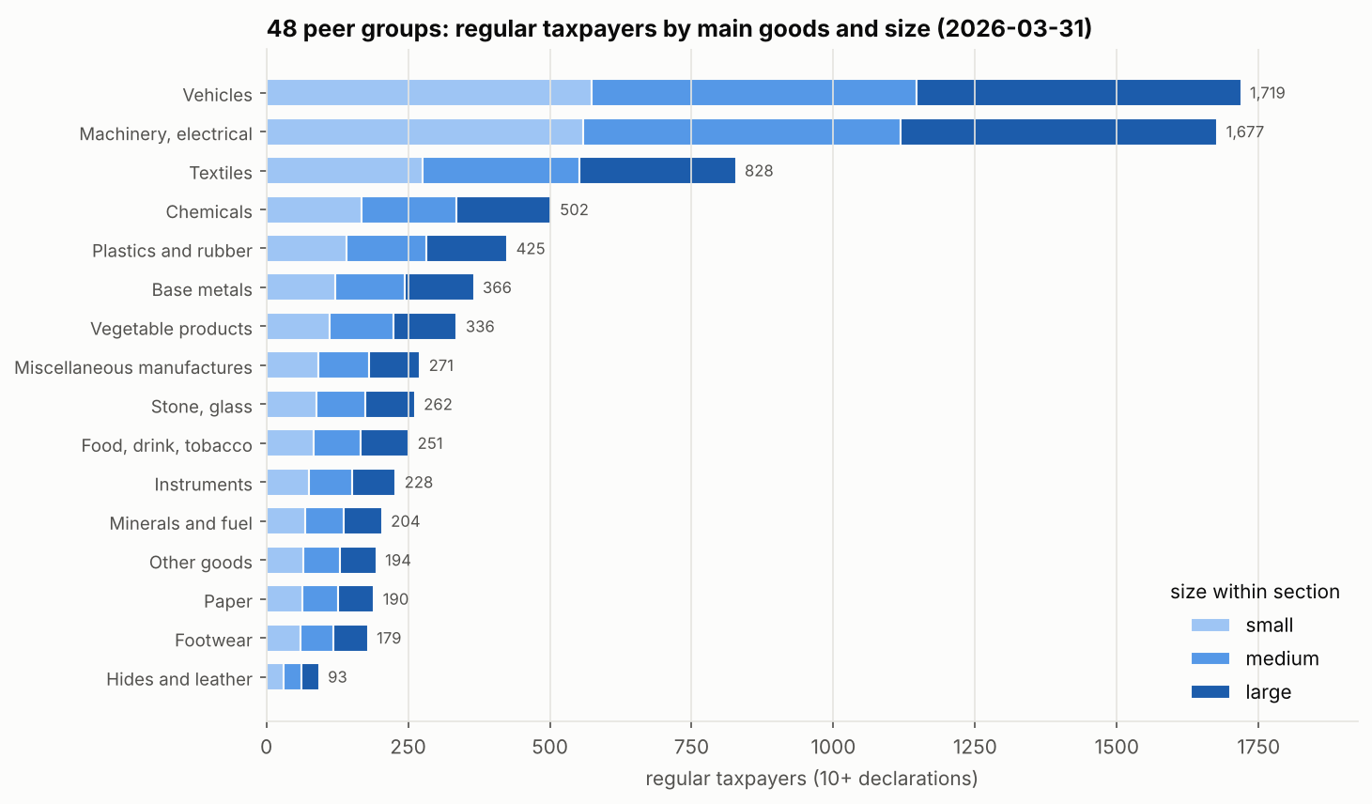
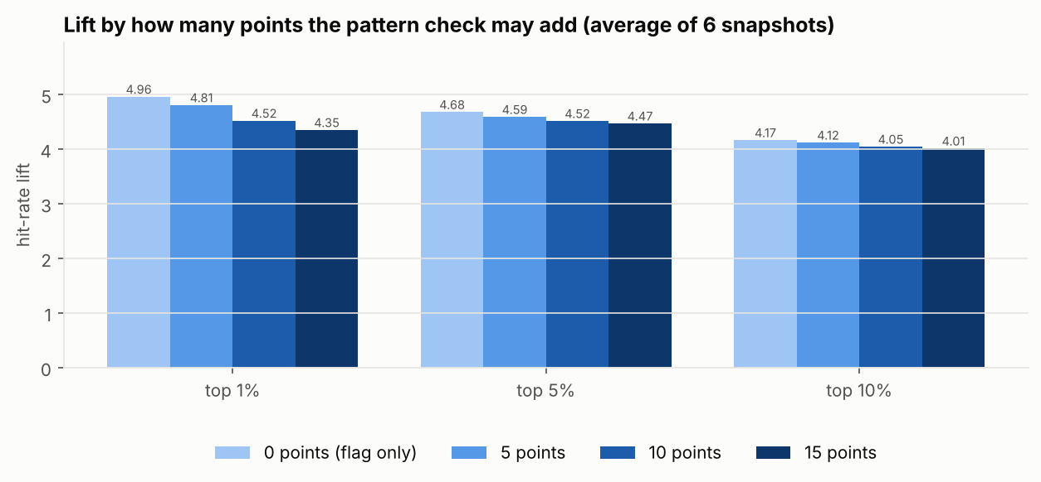
Backup: peer groups and the pattern check
Notes:
Clustering left 77% of regular traders without a group, so peer groups are main goods (HS section) x size: 48 groups. The pattern check lowered results when given points, so it is a note with no points.

Slide 55
Backup: settings in force (model 1.0.0-dev5)
Setting | Value | Meaning
RECENCY_WEIGHTS | 1, 0.5, 0.25 | How much each of the last 3 years counts
SHRINK_K | 10 | Credibility weighting n / (n + 10), only down
ADEQUATE_ENTRIES | 10 | Below this: limited history note
BANDS | 15 / 35 / 50 / 80 / 100 | Top score of each band
Track B flag shares | 5% regular, 1% small | Of taxpayers with no top-up history
SEED | 42 | Same input, same output
Notes:
All in src/ctrp/core.py; the settings code on every output changes when any of these change.

